Slide 1
PATENTSCOPE:
For Beginners
Cyber world
October
2020
Sandrine Ammann
Marketing & Communications Officer

Slide 2
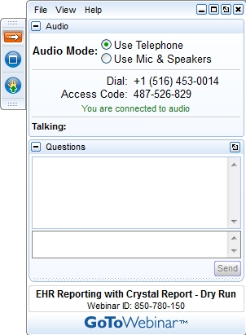
Raise your hand only if you can hear me otherwise please send me a message using the Questions box

Slide 3


Slide 4
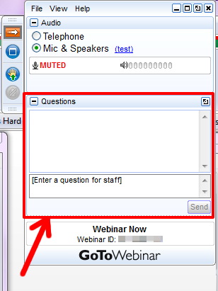

Slide 5
Questions/concerns
patentscope@wipo.int

Slide 6
Agenda
  Interfaces
  Quiz
  Webinars
  Q & A session

Slide 7
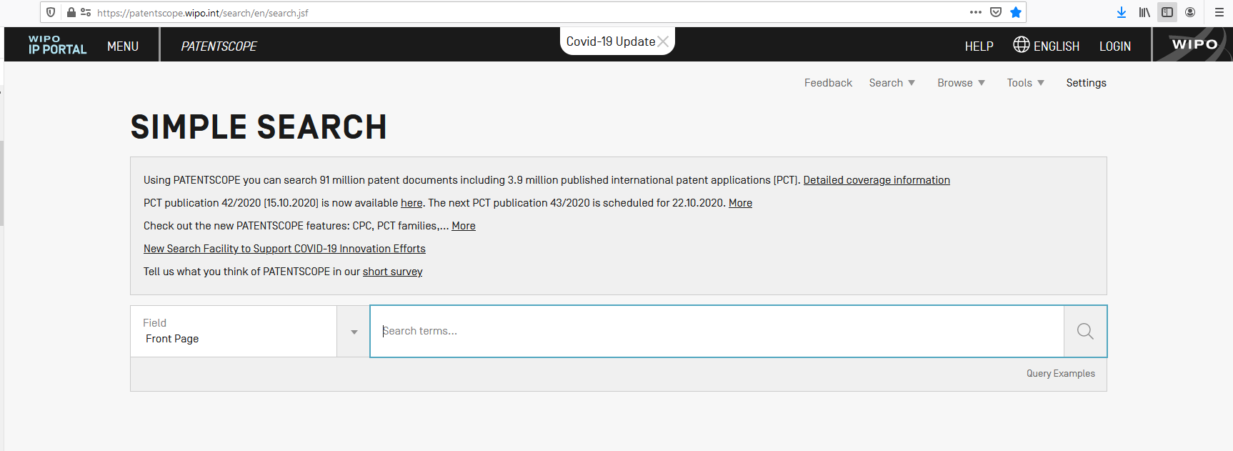
https://patentscope.wipo.int/search/en/search.jsf

Slide 8
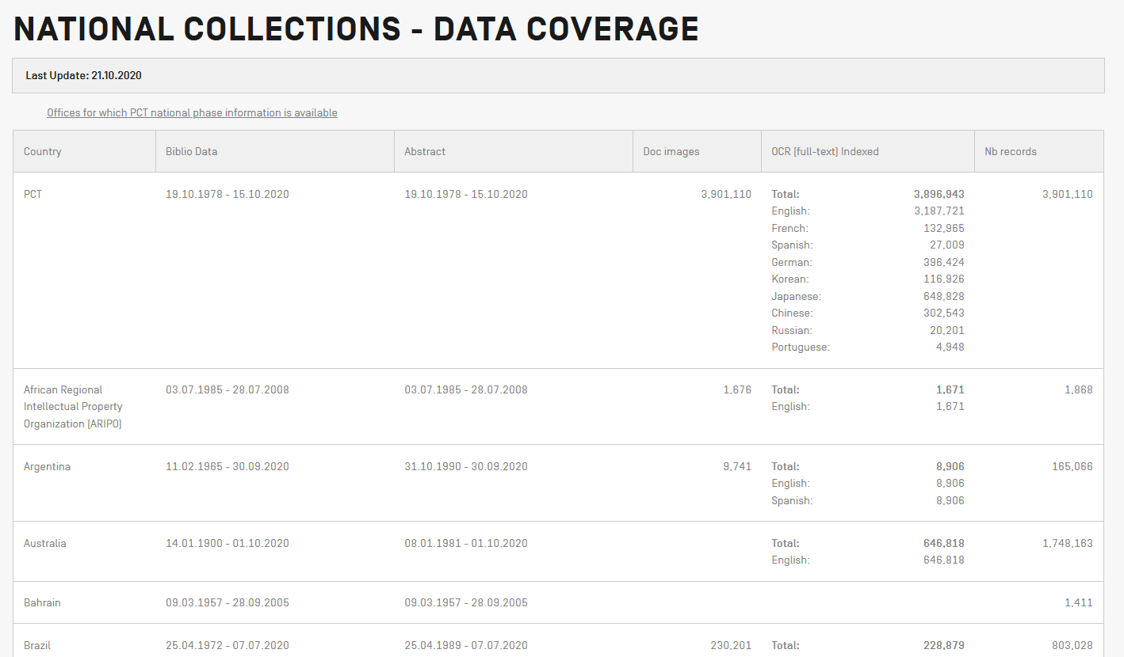
Data coverage

Slide 9
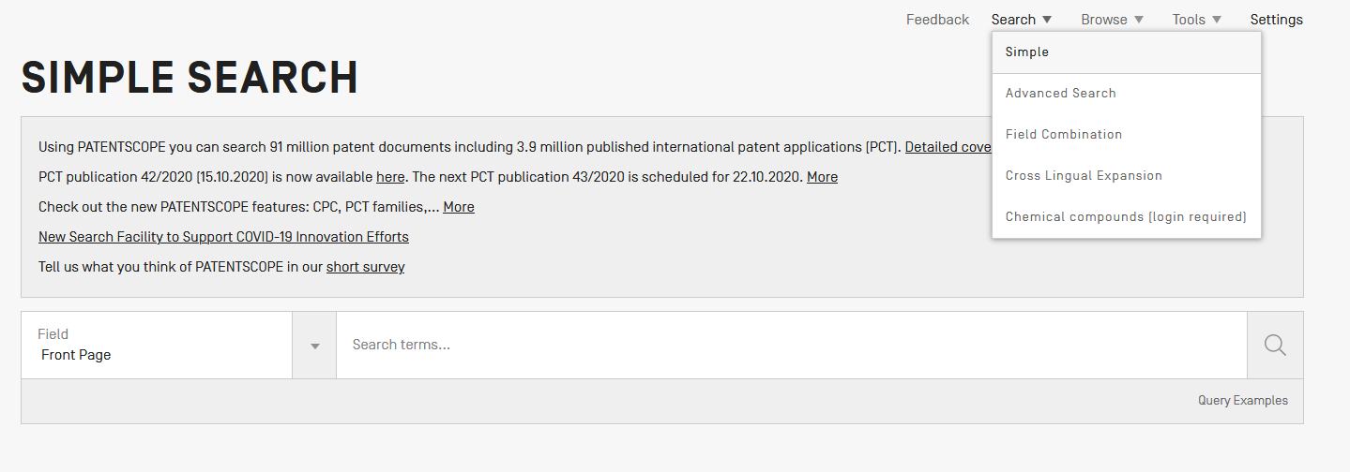
PATENTSCOPE: how to search

Slide 10

Which interface to use?

Slide 11

Simple search
  1 field
  Operators

Slide 12
Simple search
FP (front page) = title, abstract, numbers, names

Slide 13
Our example
Bicycle handelbars

Slide 14




Slide 15
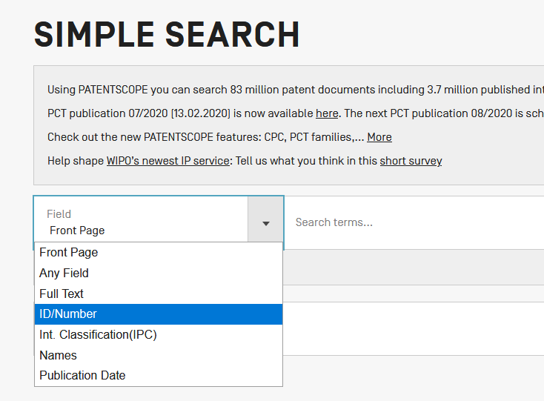
Number

Slide 16
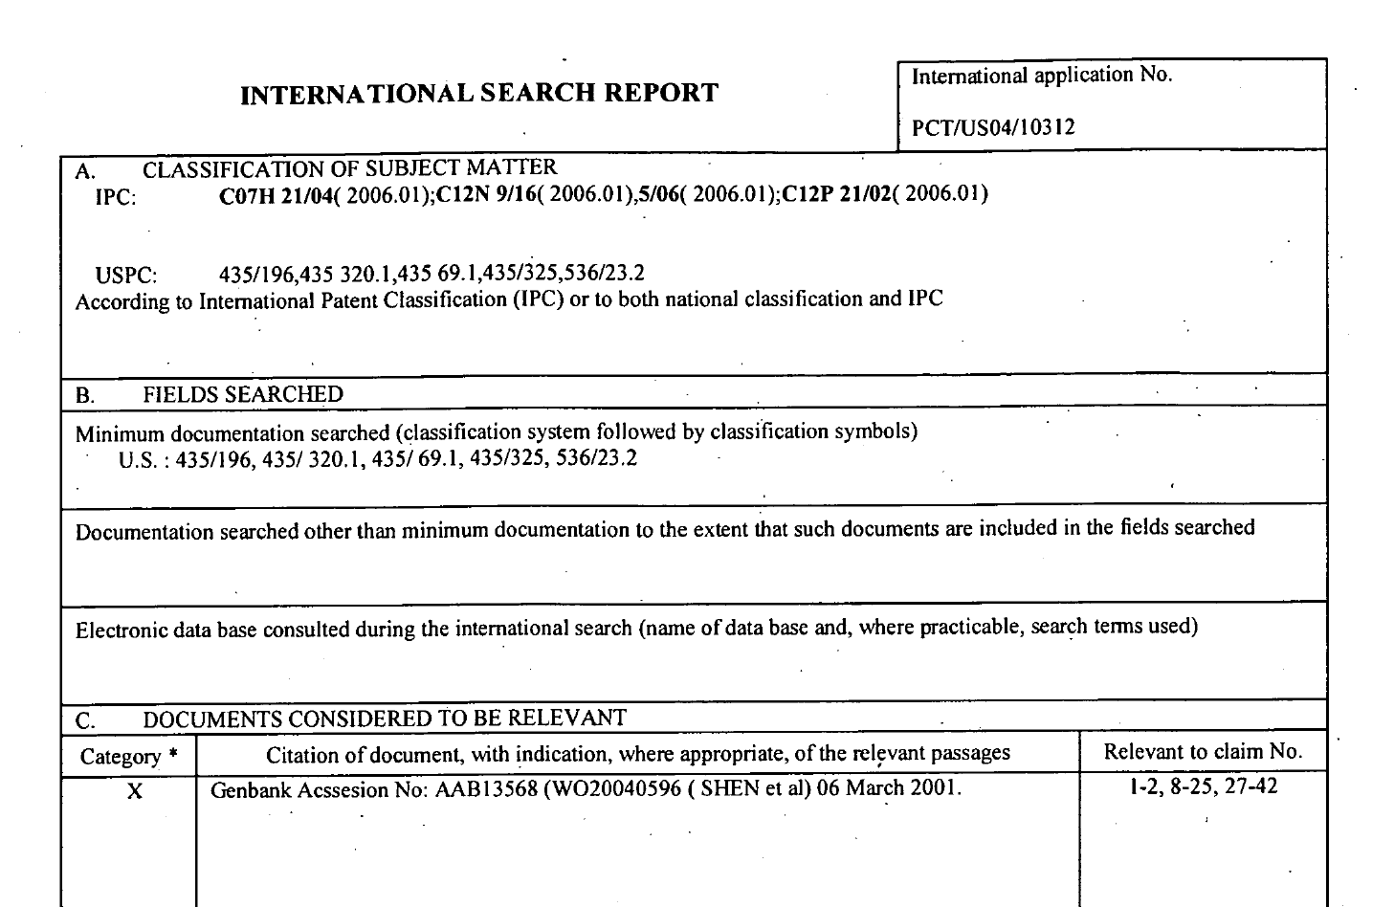

Slide 17
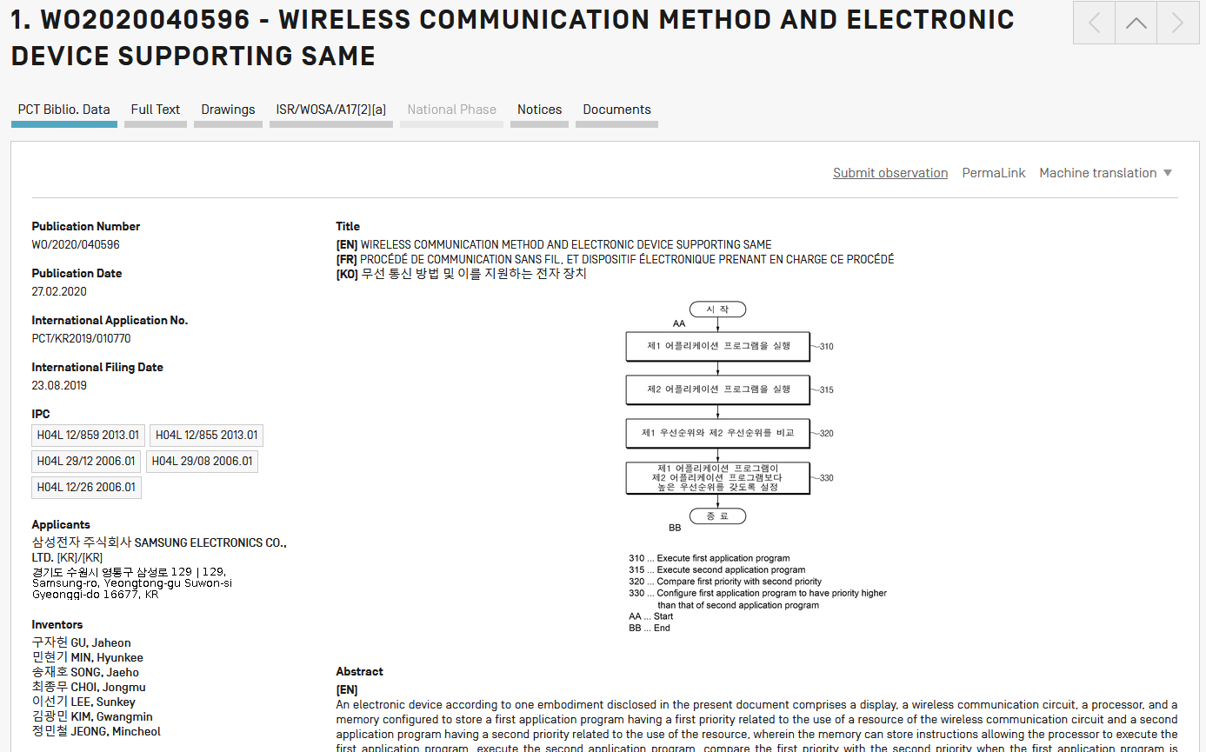
WO20040596
= WO2000040596

Slide 18
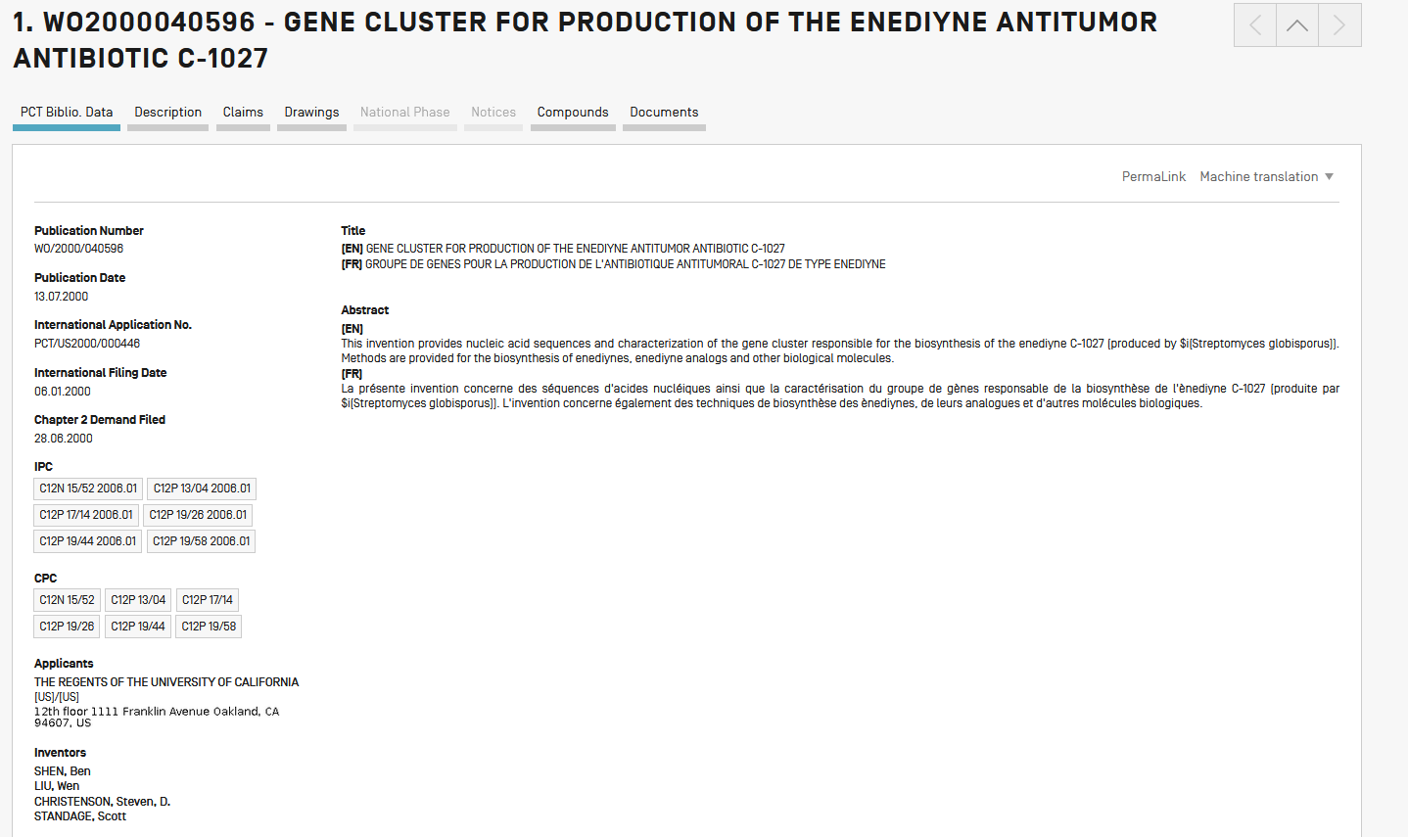

Slide 19
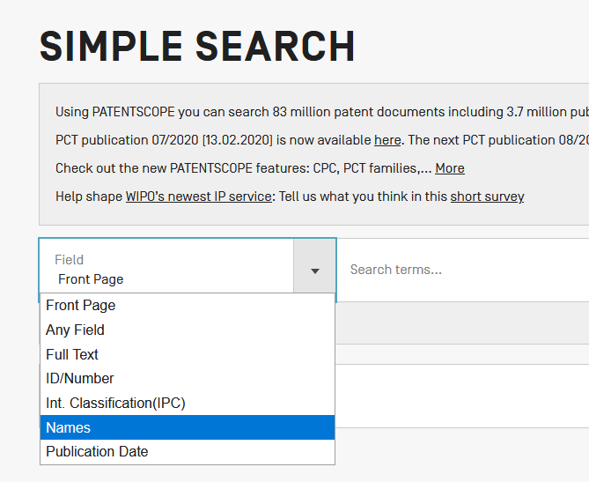
Names

Slide 20
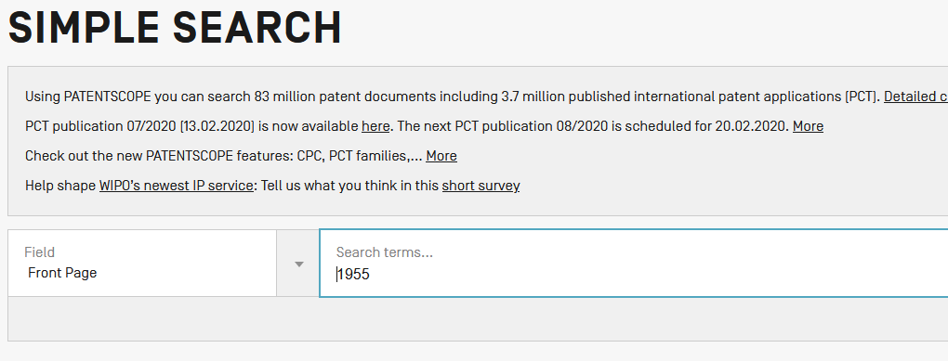

Slide 21
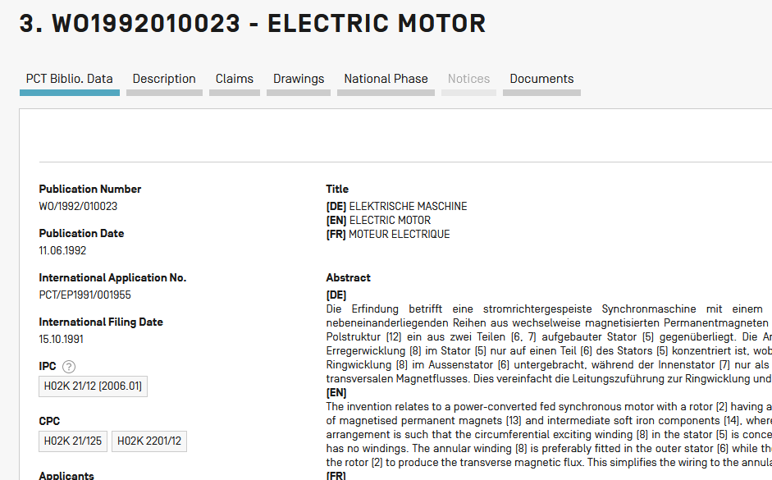

Slide 22
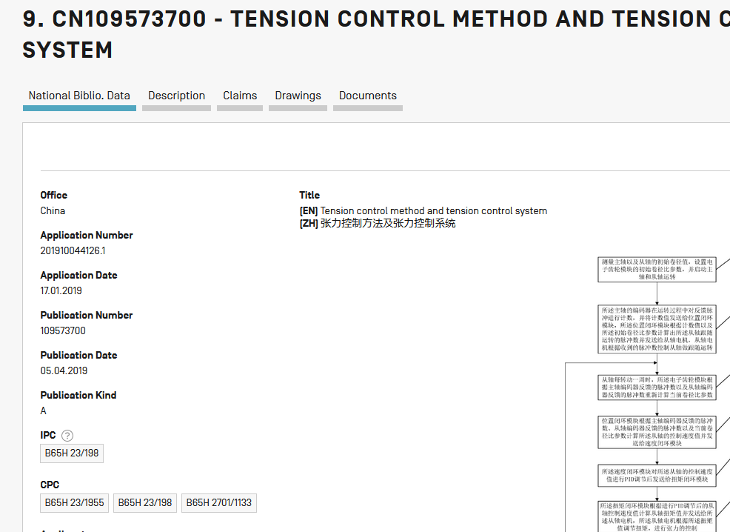

Slide 23
IPC
Include subgroups automatically – no wildcard needed
A61M16/10 A61M16/10...A61M16/18
A61M16/00 A61M16/00...A61M16/22

Slide 24
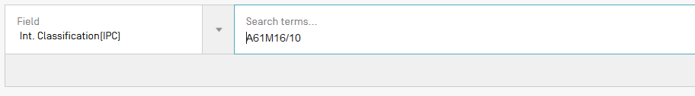
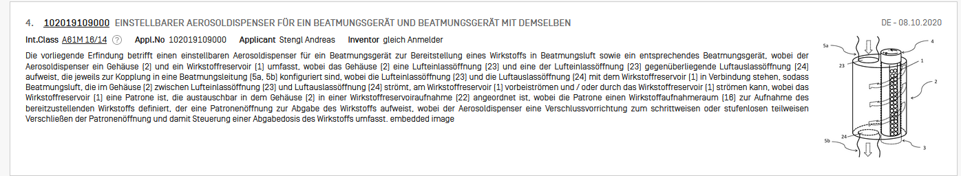
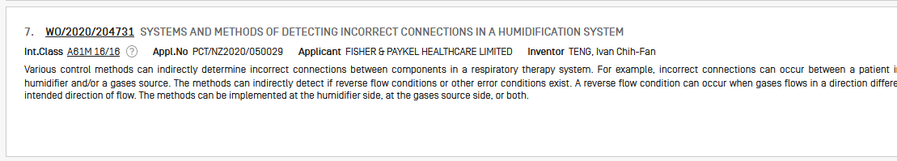

Slide 25
Simple search
1 field
Operators
Field has to be defined

Slide 26
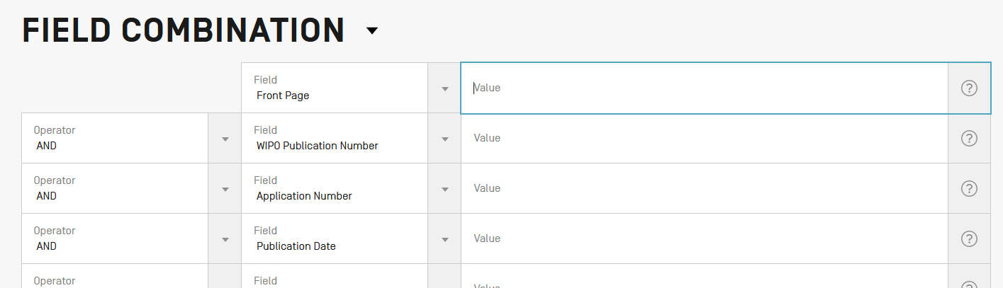
Field combination
2 or more fields
1 operator to combine the fields

Slide 27

Our example
Bicycle handlebars
2019

Slide 28
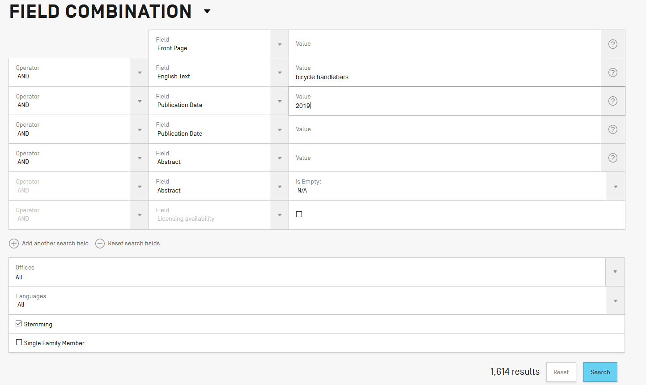

Slide 29
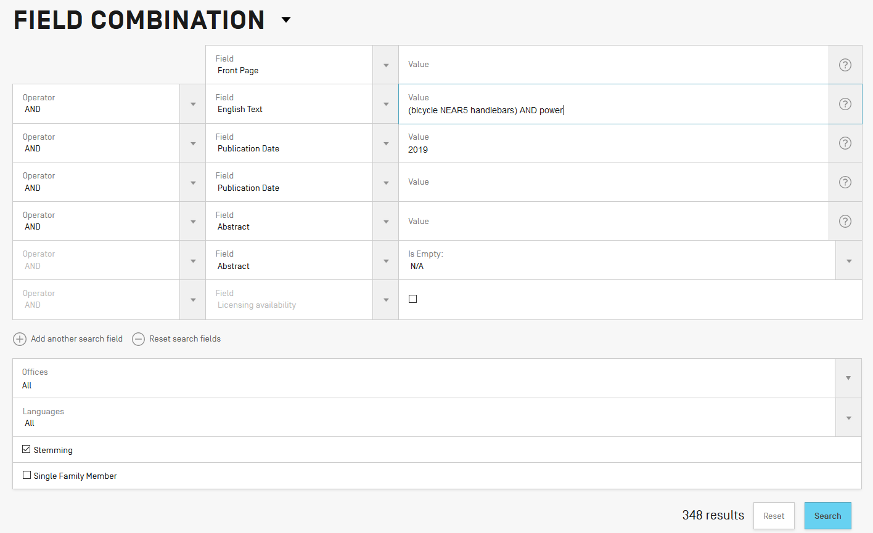

Slide 30
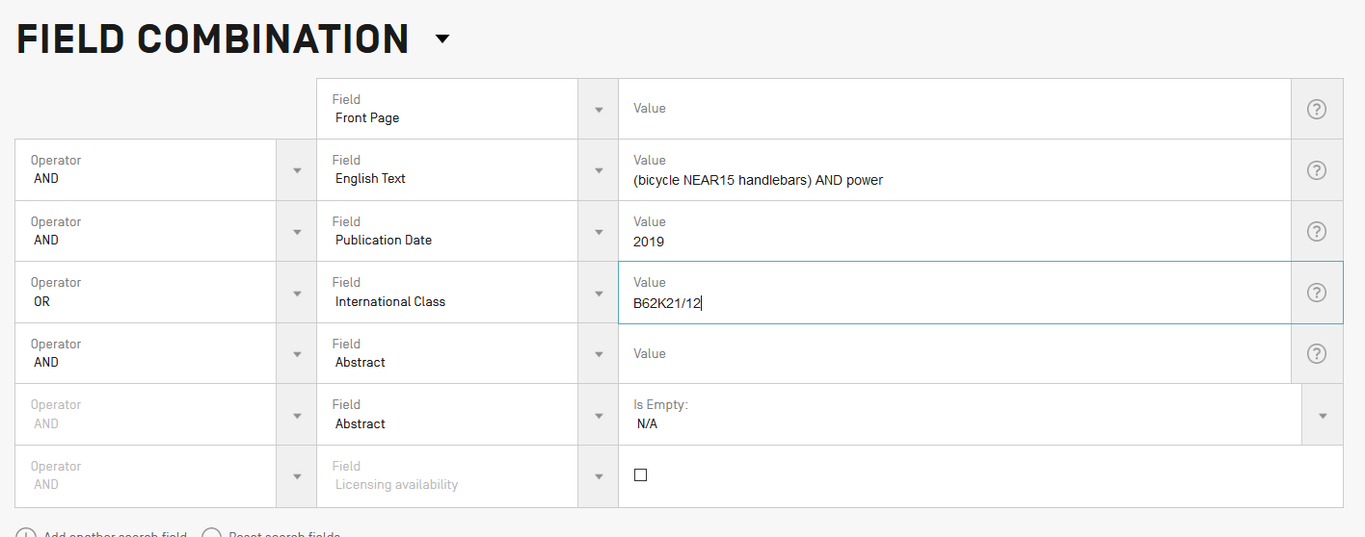

Slide 31
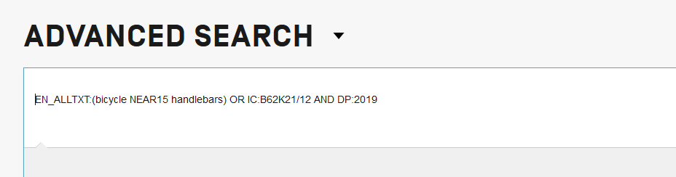

Slide 33
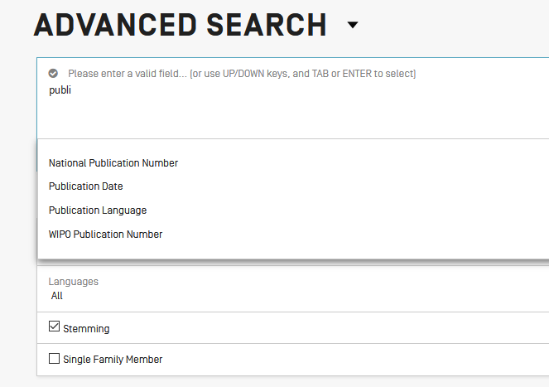

Slide 34
Instant help
Validates search query
Suggests terms
Provides:
  List of IPC codes
  List of countries

Slide 35
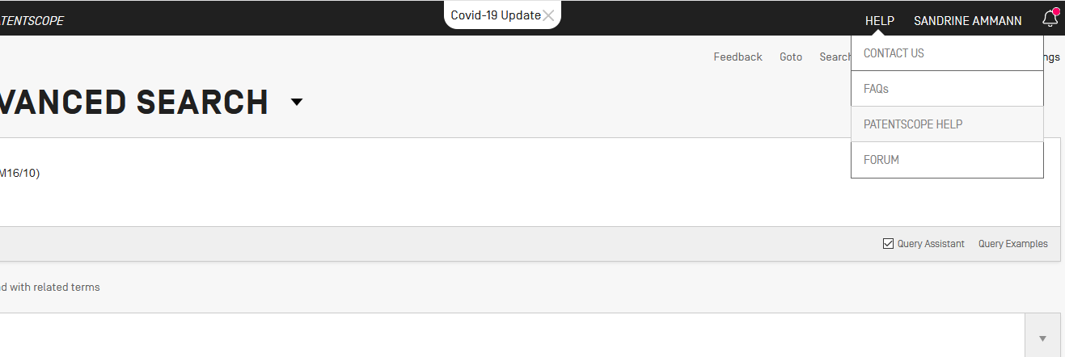
PATENTSCOPE Help

Slide 36
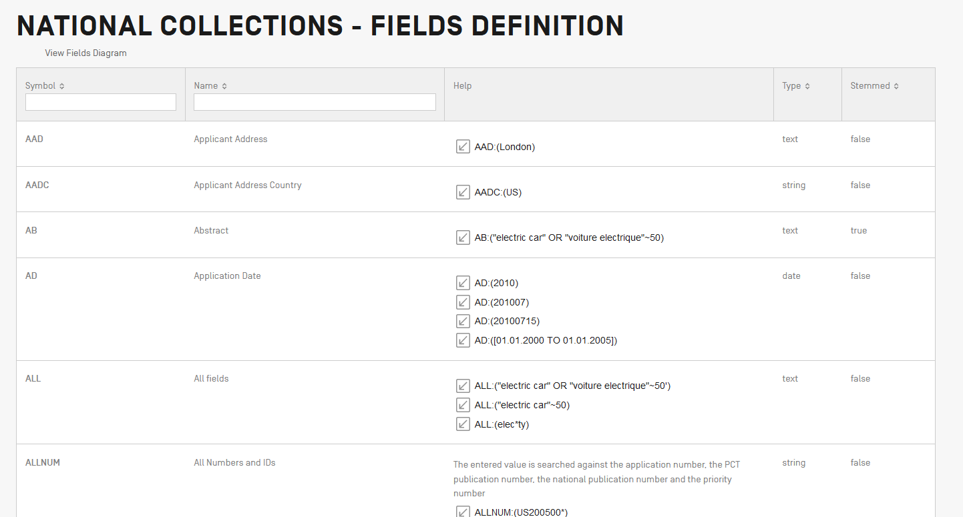

Slide 37
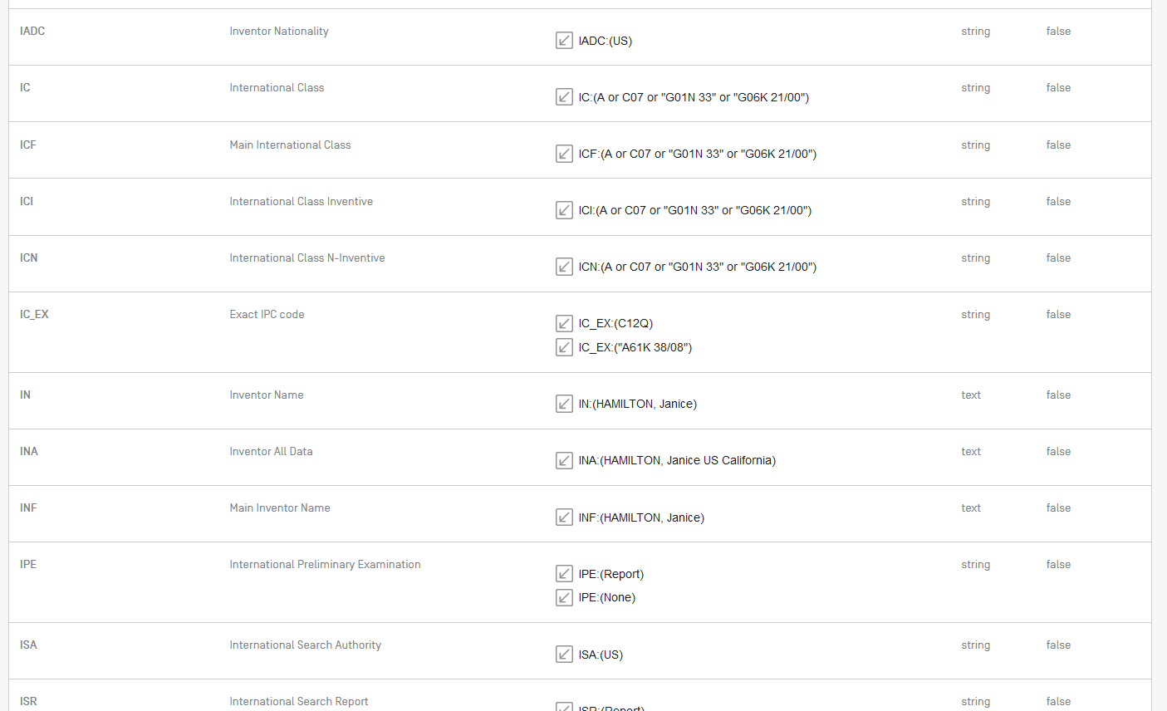

Slide 38
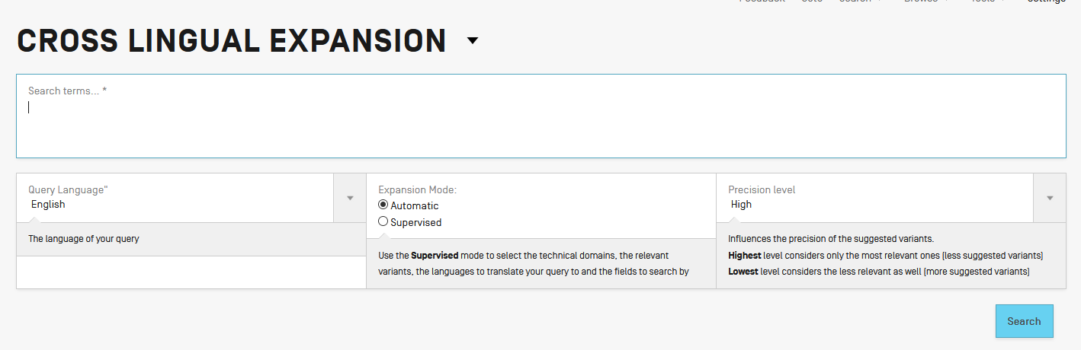
Cross-lingual expansion

Slide 39
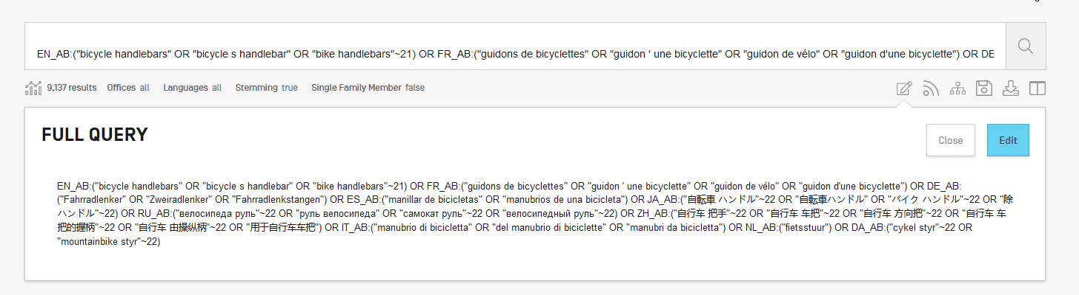

Slide 40
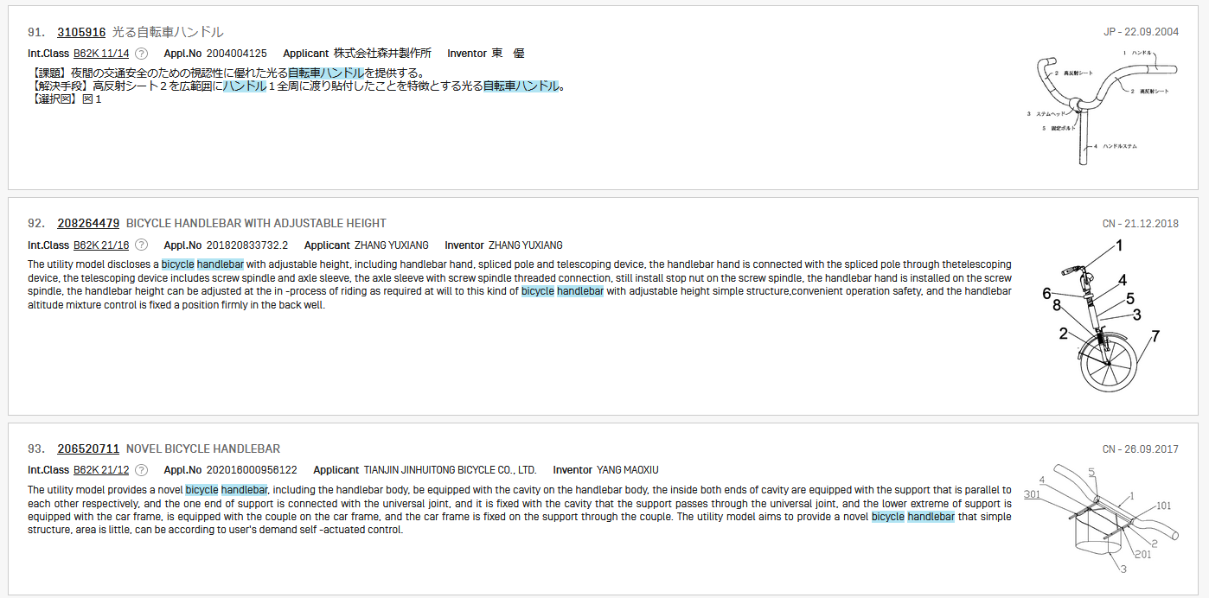

Slide 41
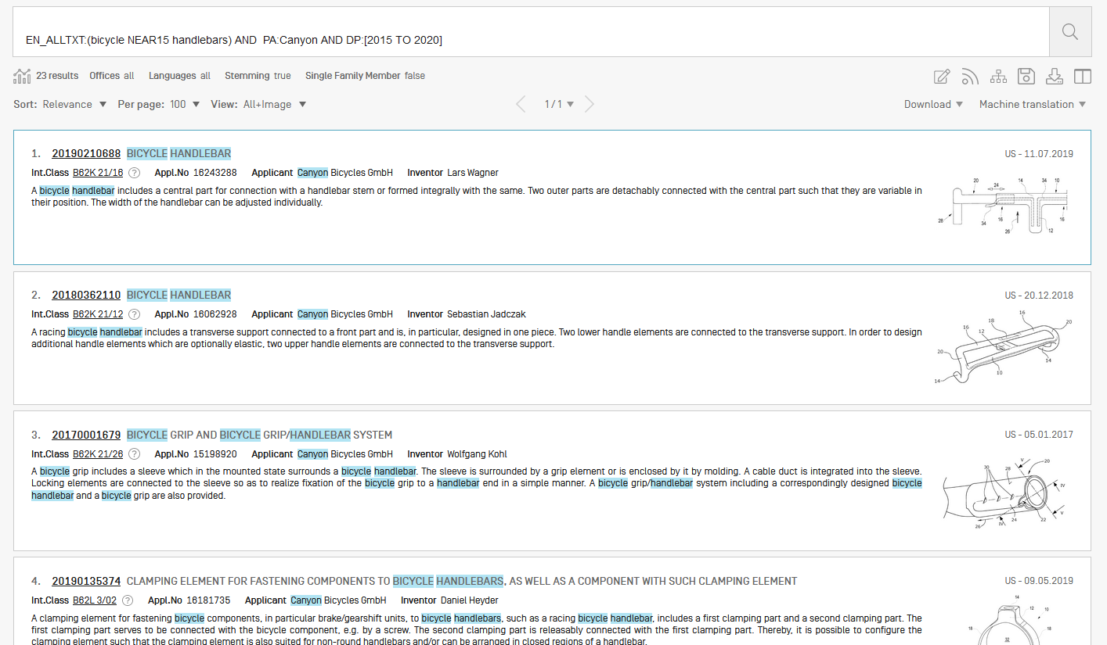
Result list

Slide 42
Document download

Slide 43
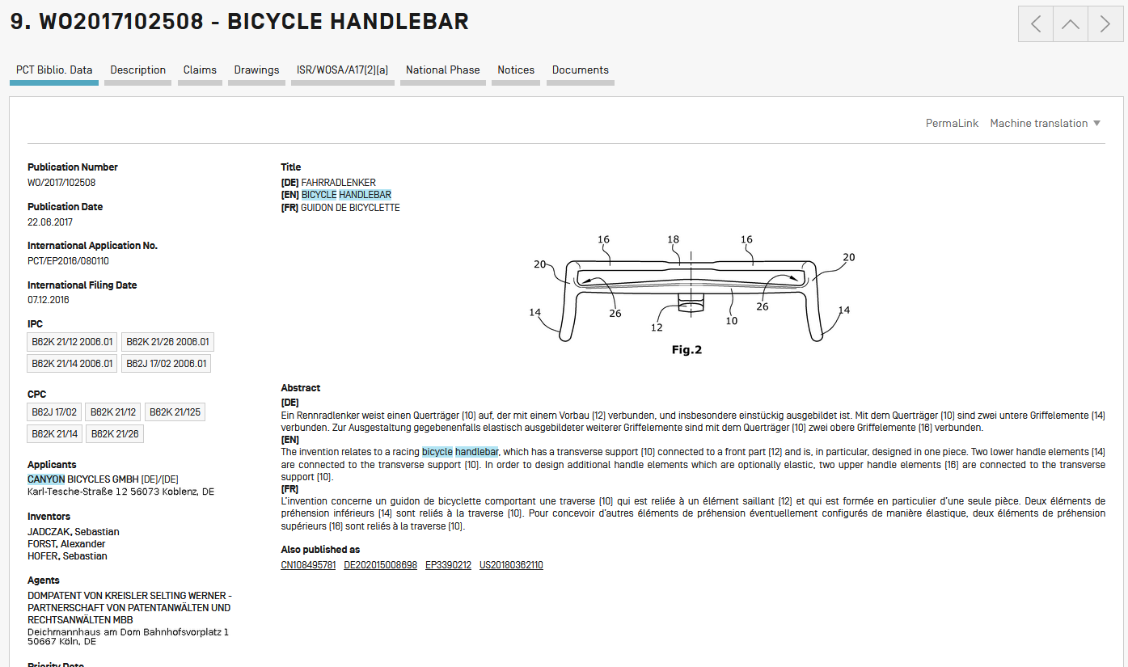

Slide 44
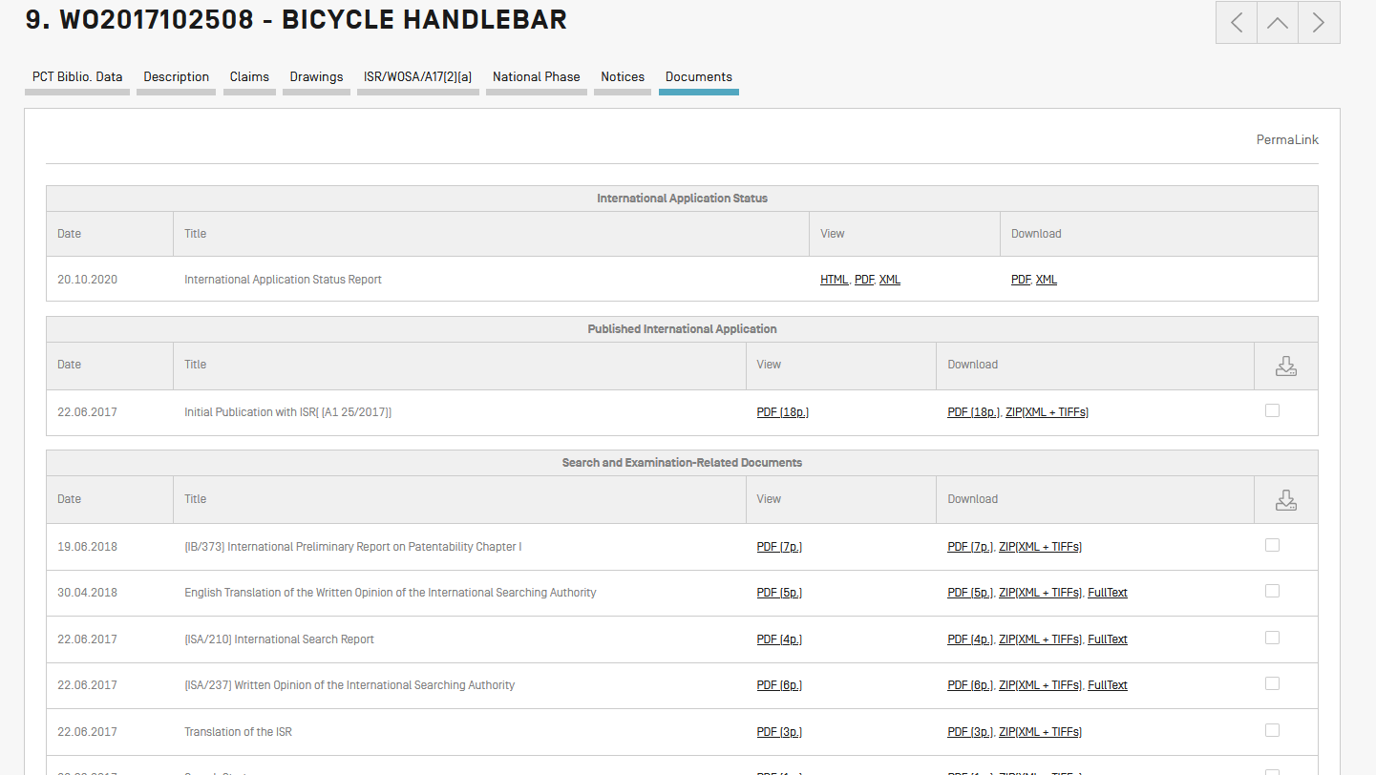

Slide 45
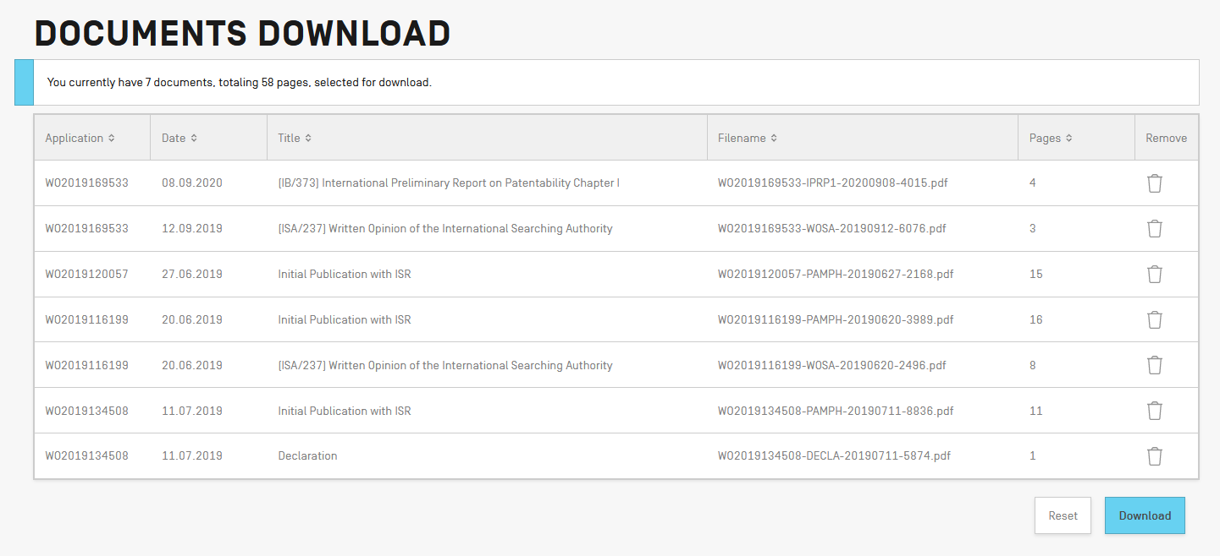

Slide 46
List download

Slide 47
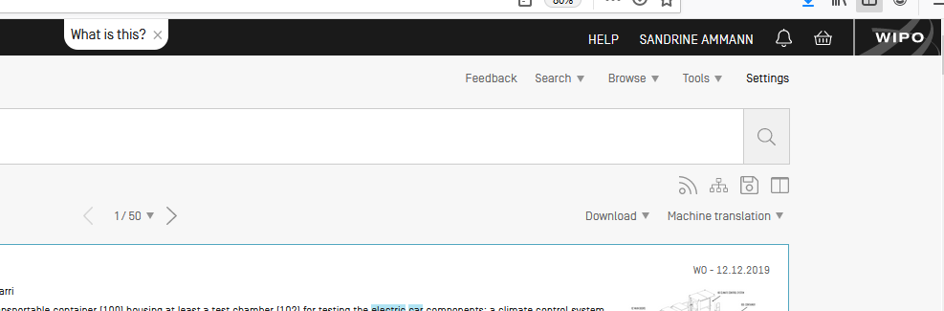
Logged-in

Slide 48
Save

Slide 49
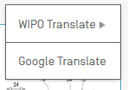
Translate

Slide 50
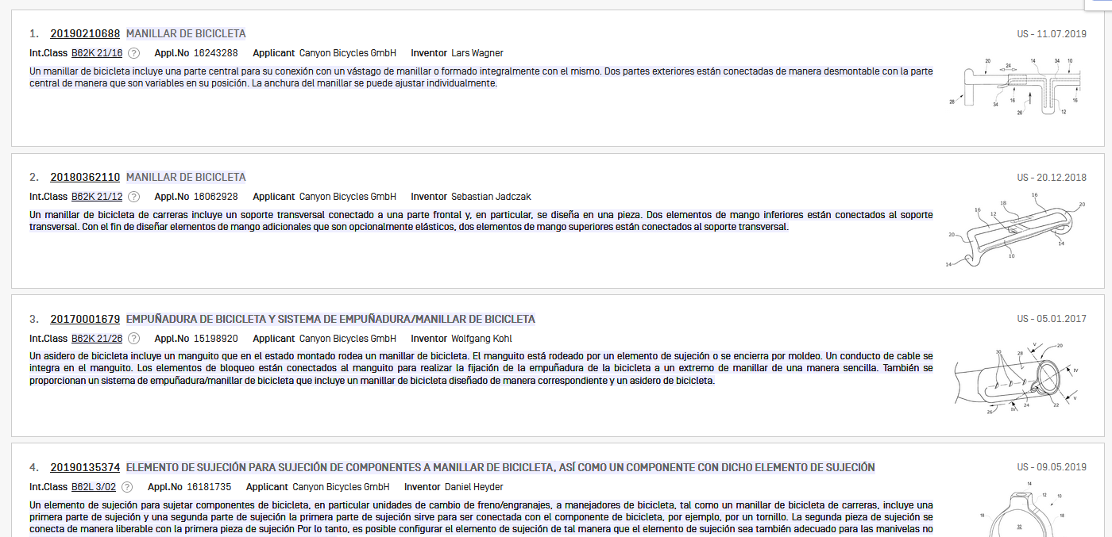

Slide 51
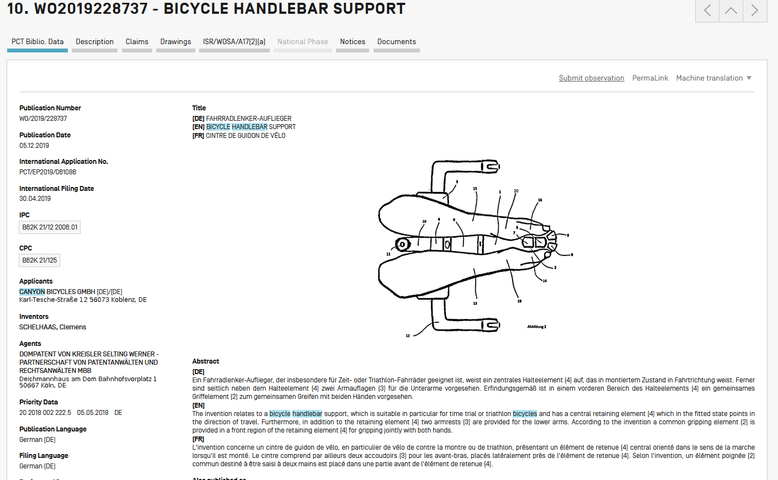

Slide 52
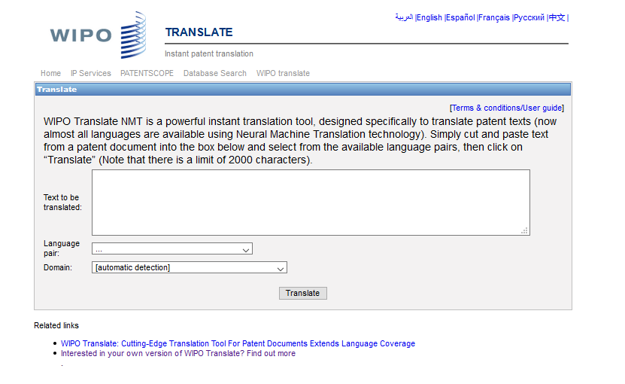
WIPO Translate

Slide 53
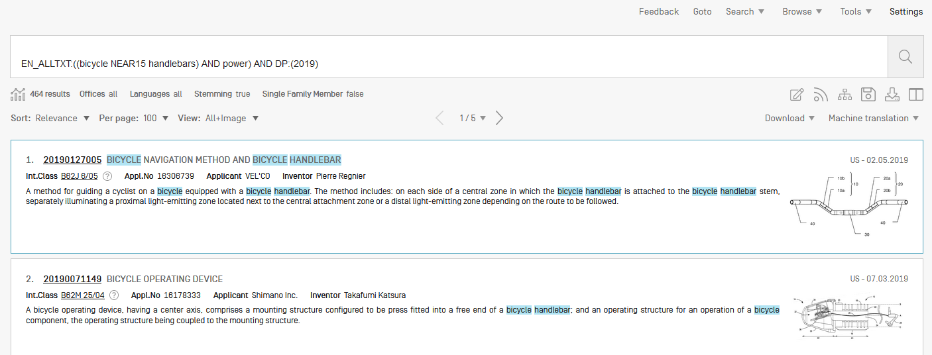

Slide 54
Sort/narrow down

Slide 55
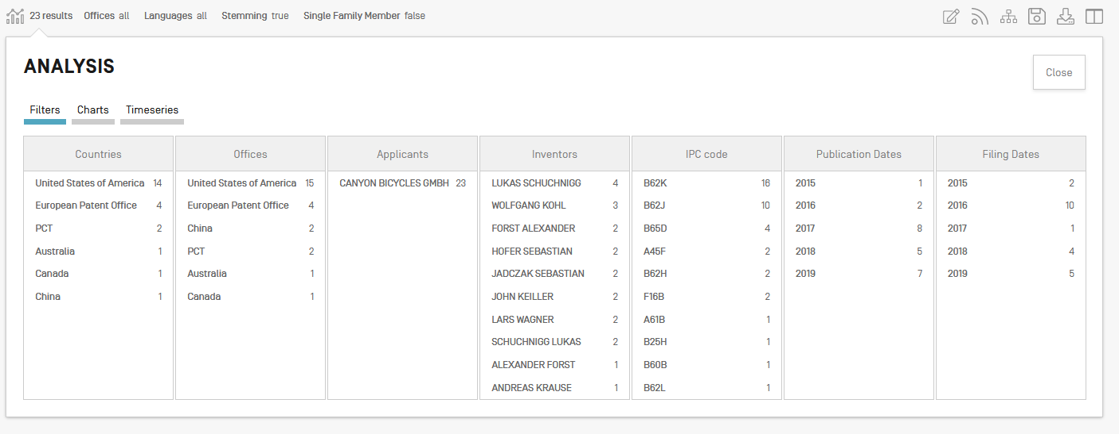

Slide 56
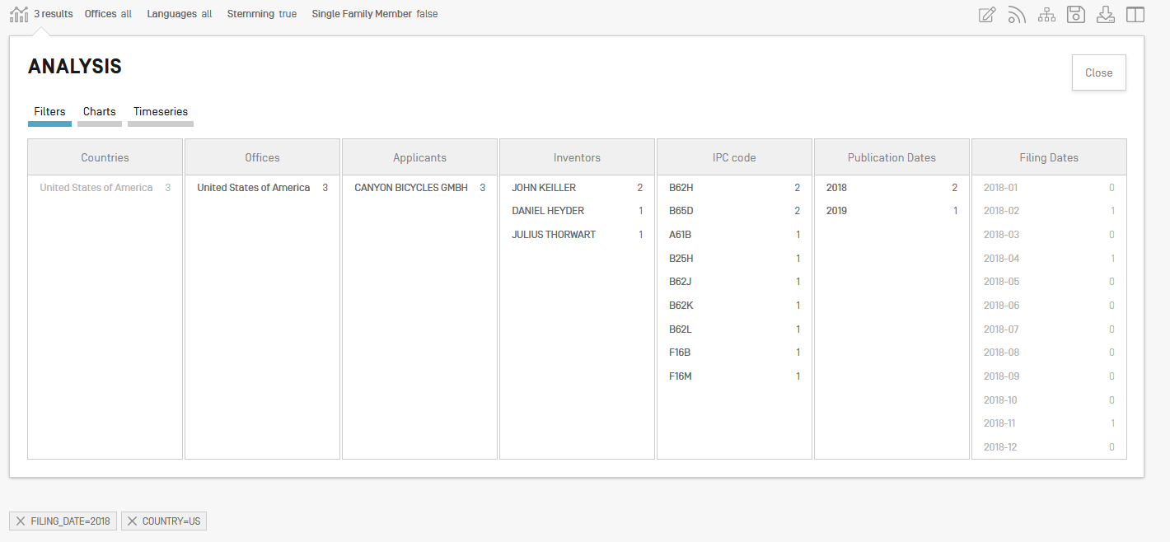

Slide 57
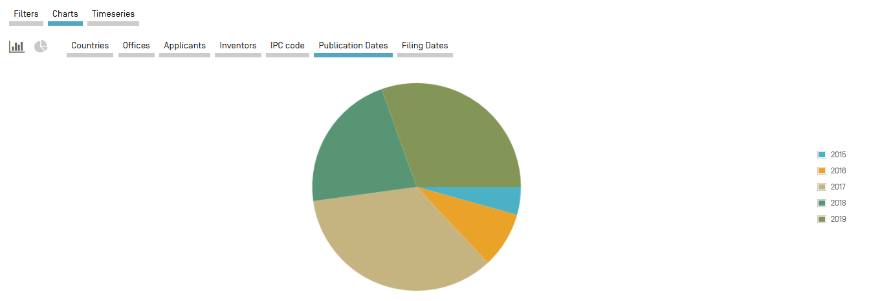

Slide 58
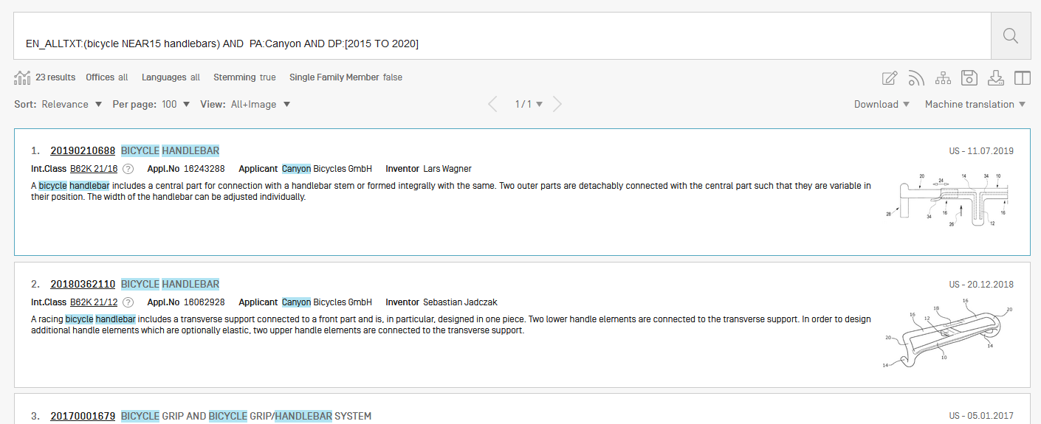
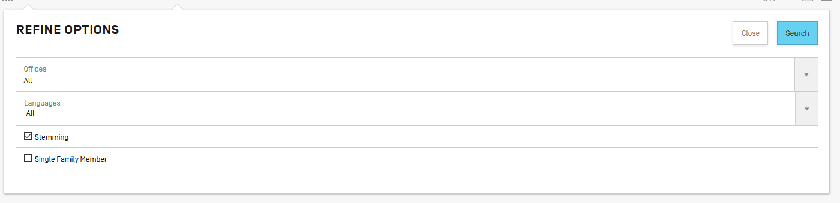
Collections

Slide 59
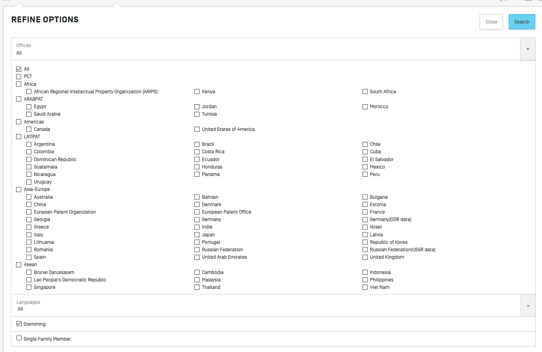

Slide 60


Slide 61
Q1: Using the PATENTSCOPE account, can you download the entire result list?
A
No
B
Yes

Slide 62

Q1: Using the PATENTSCOPE account, can you download the entire result list?
A
No
B
Yes

Slide 63
Q 2: if you would like to search in 4 fields combined by 2 operators which interface should you use?
A
Advanced search
B
Field combination

Slide 64
Q 2: if you would like to search in 4 fields combined by 2 operators which interface should you use?
A
Advanced search interface
B
Field combination

Slide 65
Q3: which data are you selecting here?
A
PCT national phase
B
National/regional collections

Slide 66
Q3: which data are you selecting here?
A
PCT national phase
B
National/regional collections

Slide 67

Survey

Slide 69
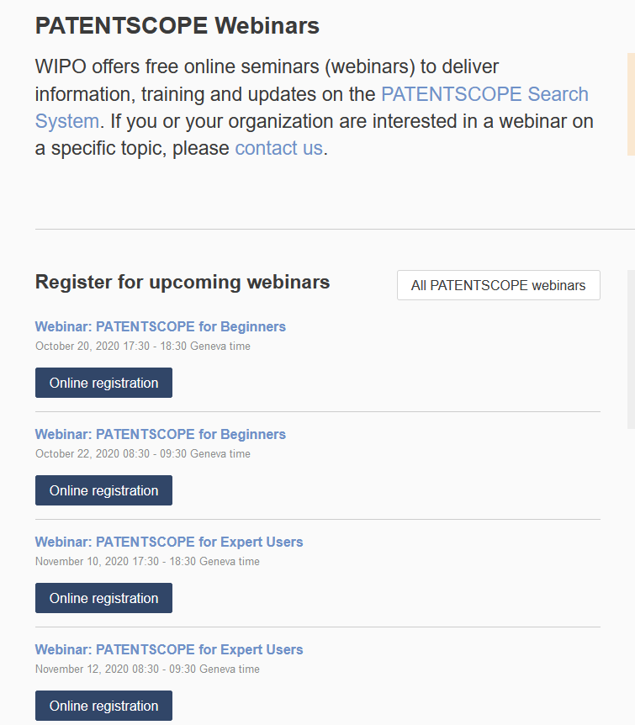
wipo.int/patentscope/en/webinar

Slide 70
Next webinar
PATENTSCOPE for experts
  November 10 at 5:30 pm or November 12 at 8:30 am
  https://www.wipo.int/patentscope/en/webinar/

Slide 71
Global Brand Database: webinar
How to search
  October 27 at 5:30pm CET
  https://www.wipo.int/reference/en/branddb/webinar

Slide 72
Global Design Database: webinar
How to read, save and share your results
  October 29 at 5:30pm CET
  https://www.wipo.int/reference/en/designdb/webinar

Slide 73


Slide 74

patentscope@wipo.int

