Slide 1
CPC & IPC in PATENTSCOPE
Online
July
2020
Patrick Fievet - IT Systems Head
Sandrine Ammann – Marketing & Communications Officer

Slide 2
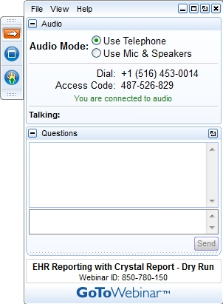
Raise your hand only if you can hear me otherwise please send me a message using the Questions box

Slide 3


Slide 4
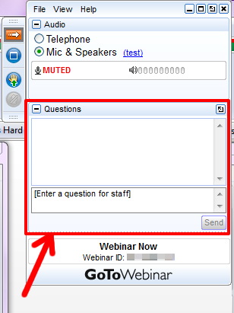

Slide 5

International Patent Classifications-based search in PATENTSCOPE
Geneva
July 2020
Patrick Fiévet
Head of IT Systems Section

Slide 6
Agenda
Why is patent classifications based search still relevant in patent databases?
IPC versus CPC
IPC based search strategies through the IPC publication platform (IPCPUB)

Slide 7
Challenge of textual information search in patent databases
Attempts of applicants to hide the actual substance of the invention while disclosing just enough to gain protection of the invention
Variations in information representation
Proliferation of documents more than 120 million
Patent information “noise” e.g. patent application never granted
Multi-facet aspects of inventions
Language barriers need for translation and evolution of the language over time

Slide 8
Why can patent classifications address these challenges?
Patent classification experts’ brain overcome information hiding attempts and variation in information representation
Large classification schemes reduce the number of documents
Language-independent classification codes
Multiple classification to address various aspects of the invention

Slide 9
IPC versus CPC
The cooperative patent classification (CPC) with more than 250 K symbols is an extension of the International Patent classification (IPC) system (75 K symbols).
The IPC is revised every year by Members of the IPC Union in its two authentic languages i.e EN and FR and is translated in several other languages.
The CPC is defined by the EPO and USPTO is in EN only and revised quarterly.
Both IPC and CPC symbols are present in PATENTSCOPE

Slide 10
Search strategies using IPC and CPC
A top-down approach logically starts with IPC search in user’s preferred language
On the basis of identified IPC symbols, the scope can be refined using CPC subdivisions of the IPC
Patent database e.g. PATENTSCOPE can be searched on the basis of the selected patent classification symbols

Slide 11
IPC publication platform (IPCPUB) features
https://www.wipo.int/classifications/ipc/ipcpub/
Text search in the IPC vocabulary
Statistic-based search in PATENTSCOPE (STATS): most frequently used IPCs for the query expression
Text Categorization in IPC (IPCCAT): Neural networks to classify a small text in the IPC
Bridge to patent databases & national versions of the IPC
IPC/CPC Parallel viewer

Slide 12
IPC publication platform (IPCPUB)
“Simple search”
Cascade of text searches combining:
  Search in the IPC Scheme,
  Search in the IPC Catchwords,
  Statistics on most frequently used IPC of patent documents found in PATENTSCOPE search results (STATS),
  Text Categorization (IPCCAT)
Search results ordered by guessed relevance

Slide 13
IPC publication platform (IPCPUB)
Text search in the IPC vocabulary
  Search in the IPC Scheme or in the IPC Catchwords
  Small variations of the query words
  “Path” search in the IPC tree structure
  If the term does not exist in the IPC vocabulary it cannot be found
  Can be conducted in more languages than EN only

Slide 14
IPC publication platform (IPCPUB)
STATS search in PATENTSCOPE
  PATENSCOPE search of the text
  Extraction of the most frequently used IPCs in these search results
  =>addresses terms that do not exist in the IPC vocabulary but exists in PATENTSCOPE patent documents

Slide 15
IPC publication platform (IPCPUB)
IPCCAT Automatic text categorization in the IPC
  ~8 000 neural networks trained with 50 millions of classified patent documents in English language
  Cross-lingual: accepts 10 languages
  Precision of predictions a IPC deepest level: 85%
  =>addresses terms that do not exist in the IPC vocabulary but exists in PATENTSCOPE patent documents

Slide 16
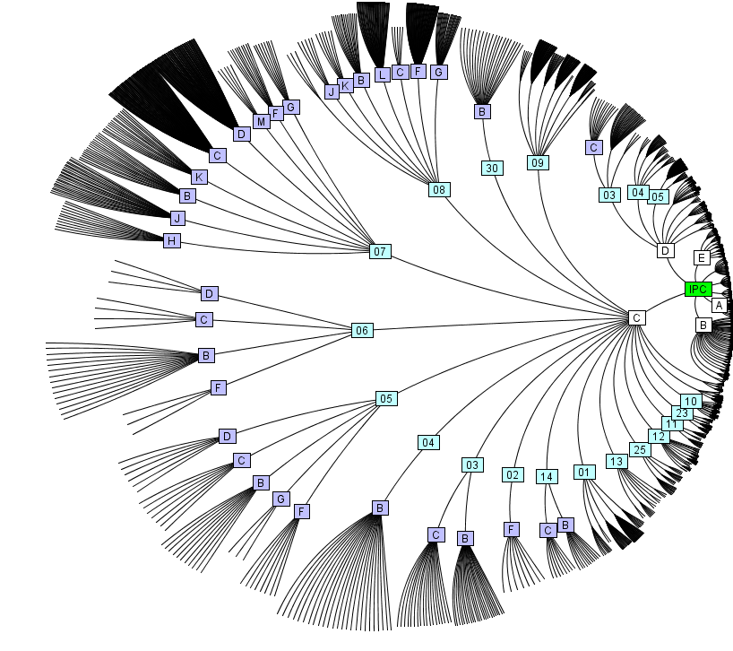

IPCCAT challenge: one choice among ~75,000 with a precision of 85%
Championing Innovation in Artificial Intelligence

Slide 17
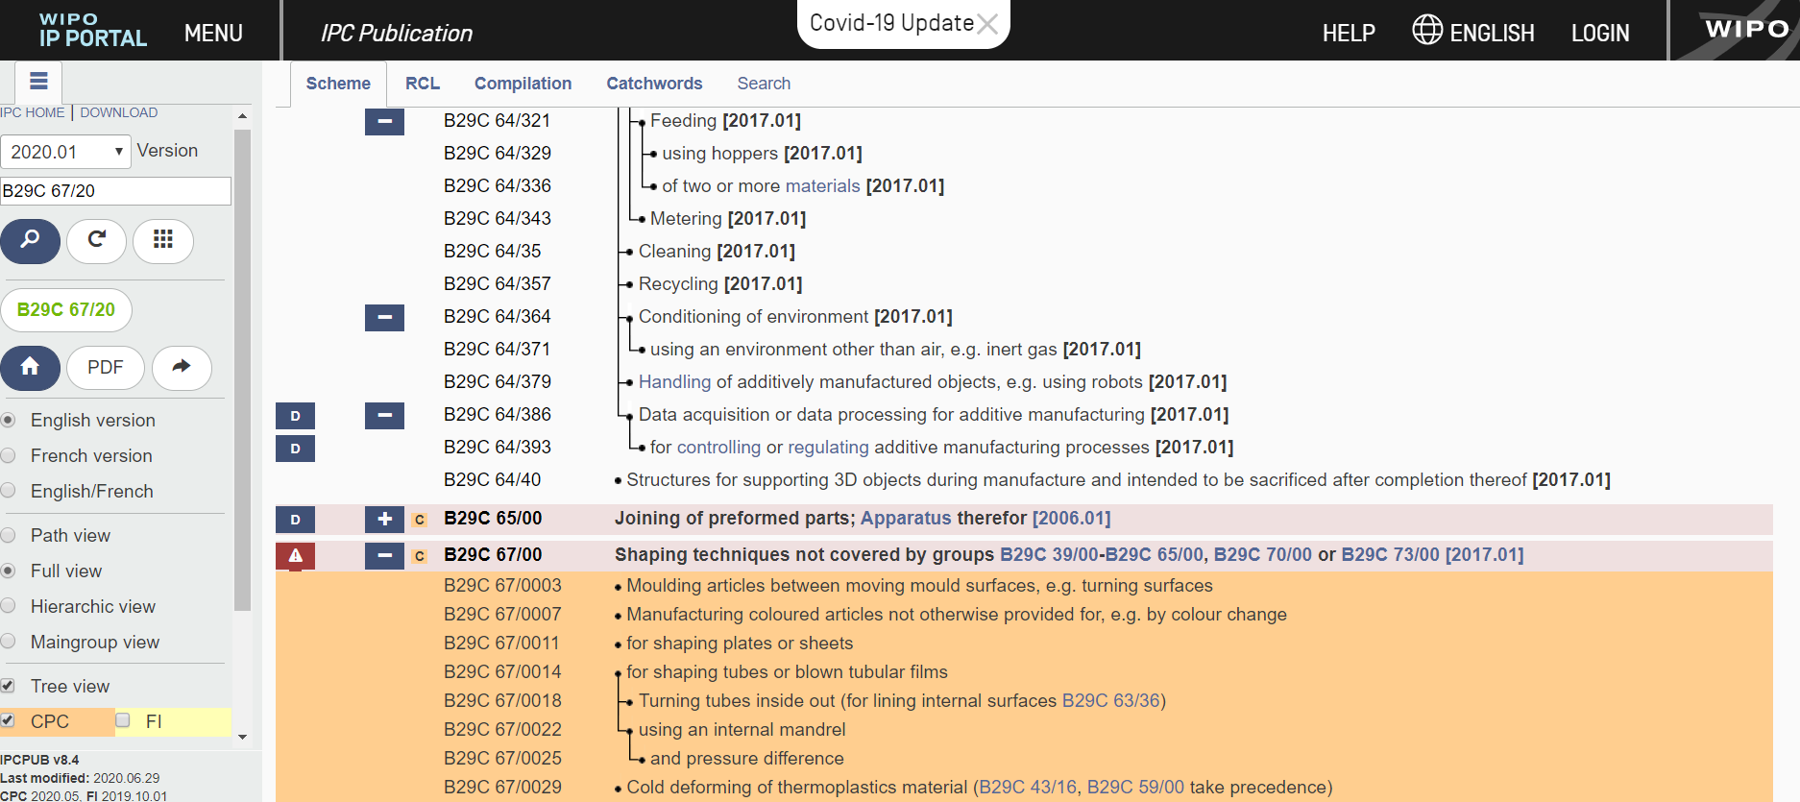
IPC/CPC parallel viewer in IPCPUB

Slide 18
IPCPUB-Smart Search
https://en.wikipedia.org/wiki/Honey_extraction
  IPCPUB Text search : A61K 35/644 (finds beewax propolis honey)
  IPCPUB STATS search: “ no result”
  IPCCAT search gives A01K 59/02, A61K 35/644 and A01K 59/04 (more relevant for honey extraction process )
  IPCPUB smart search: cascade of searches Term/STATS/IPCCAT (details under on-line help)

Slide 19
IPCPUB demonstration

Slide 20
IT support for the IPC
QUESTIONS?
contact WIPO at ipc.mail@wipo.int

Slide 21
International Patent Classification (IPC) in patentscope

Slide 22
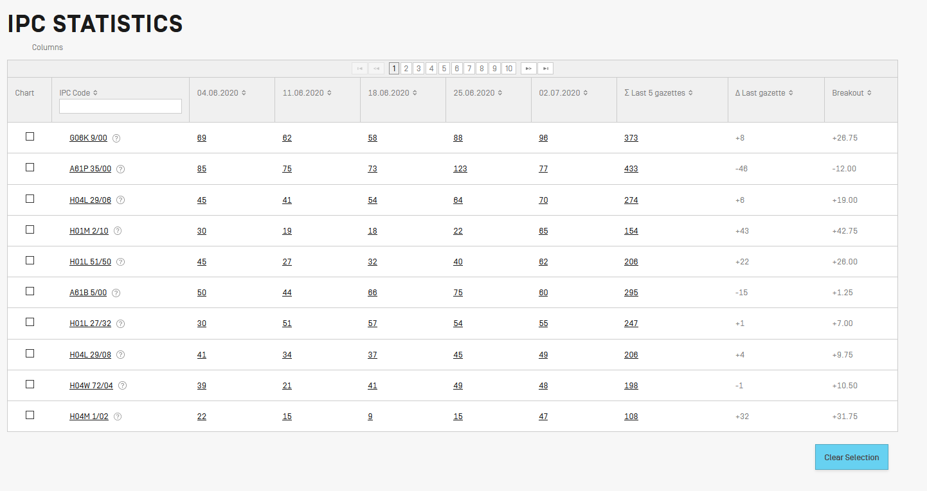
IPC Statistics

Slide 23
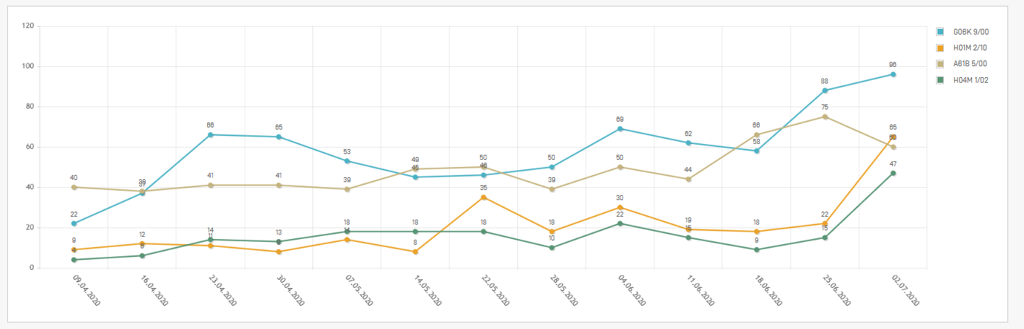

Slide 24
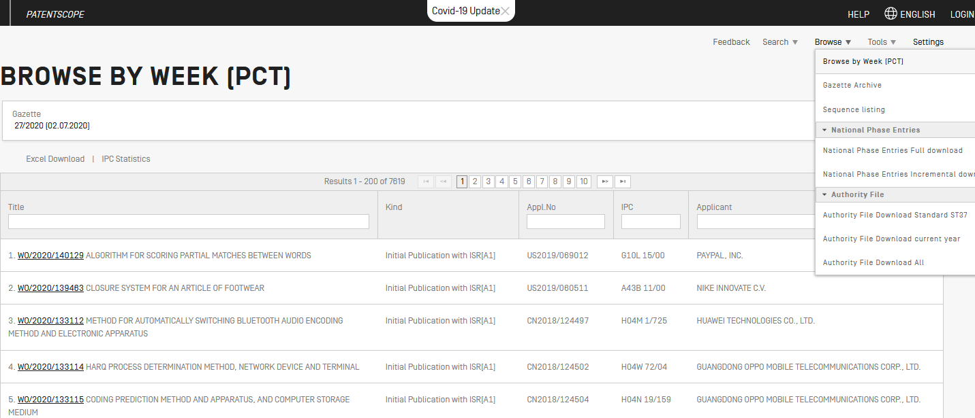

Slide 25

IPC searching in PATENTSCOPE

Slide 26
Advantages of the IPC
  Language independent
  Terminology / ”jargon” independent
  Standardized application to documents
  Available for (old) patent documents
  Concept search

Slide 27
Disadvantages of the IPC
Not available for all areas of technology
Not specific enough for particular searches
Not available for all documents
Complex

Slide 28
IC / ICI / ICN
IC = International Classification
ICI = International Classification Inventive
ICN = International Classification Non-inventive

Slide 29
IPC search in PATENTSCOPE
Searching and Grouping now by complete IPC codes:
D06F 1/06 will include by default
D06F 1/08
1/10
1/16
IC_EX ICI_EX ICN_EX = no subgroup

Slide 30
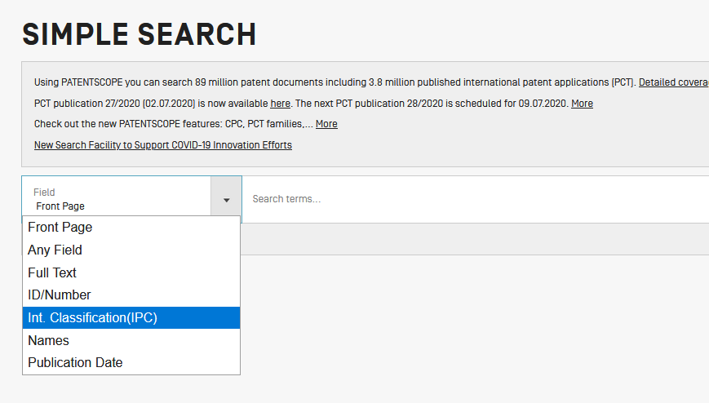
Search in Simple Search

Slide 31
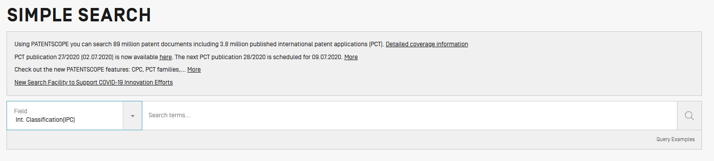


Slide 32
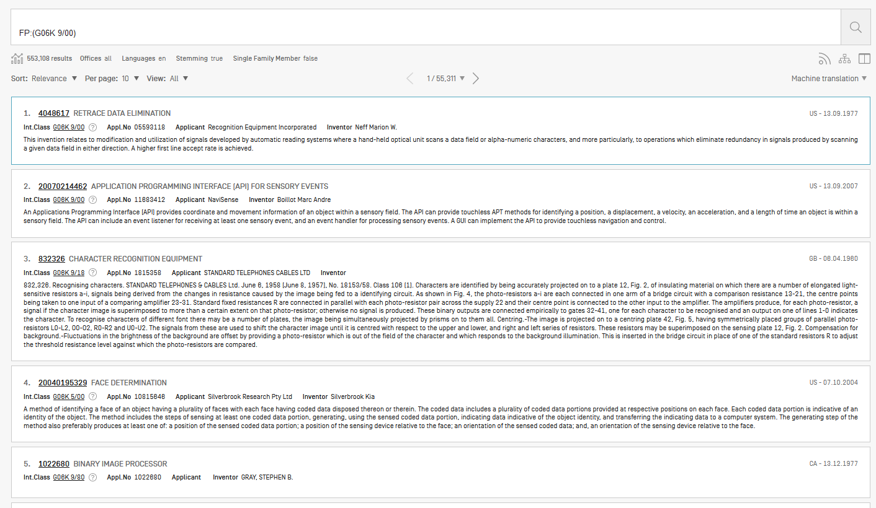

Slide 33
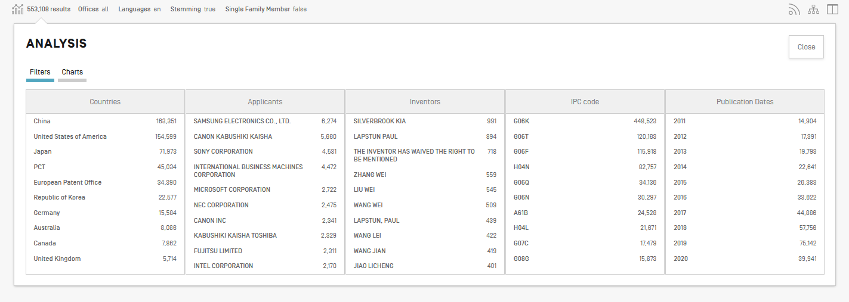

Slide 34
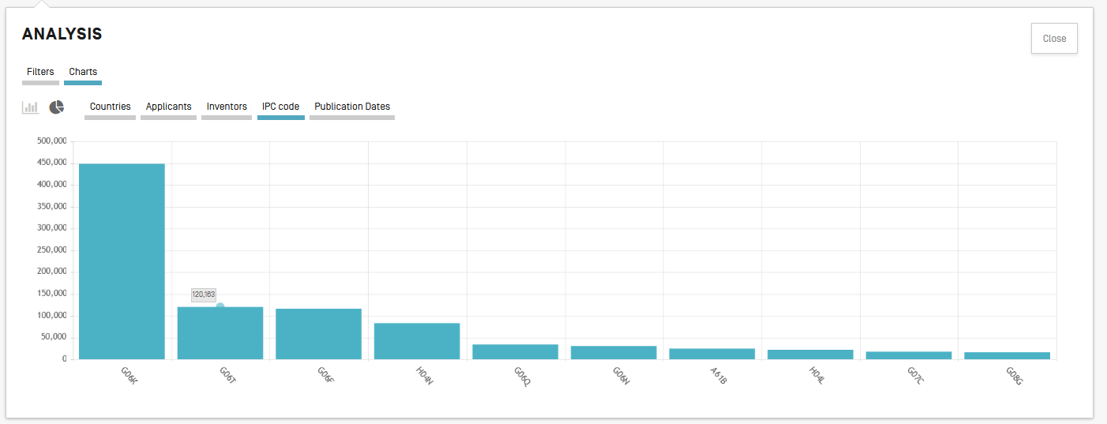

Slide 35
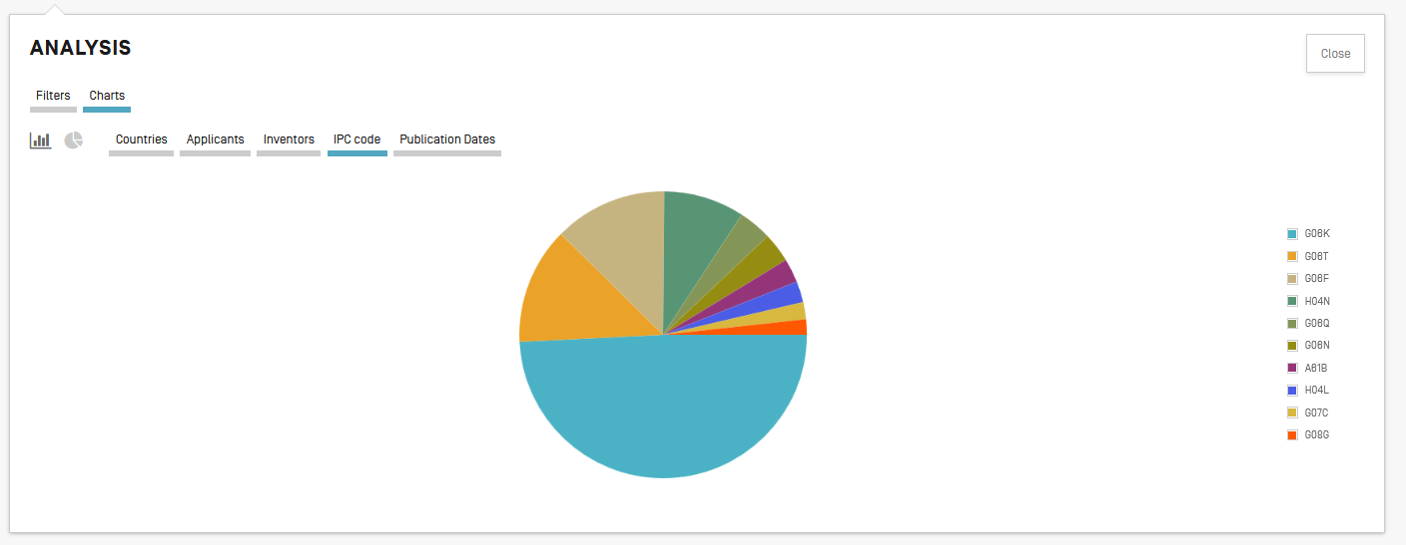

Slide 36
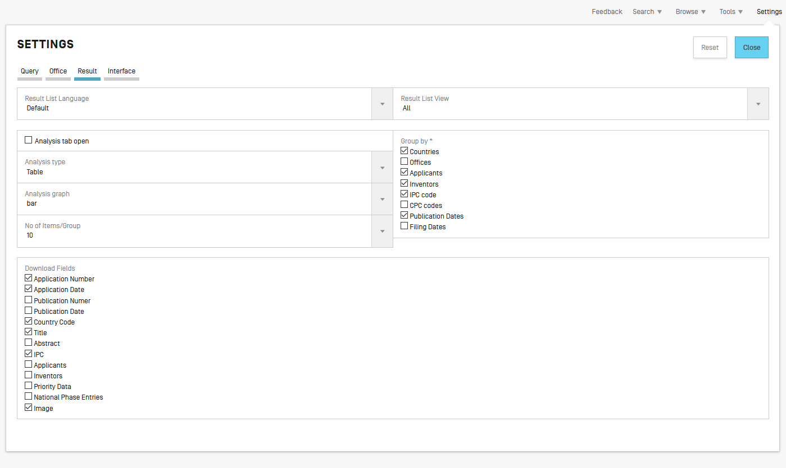


Slide 37
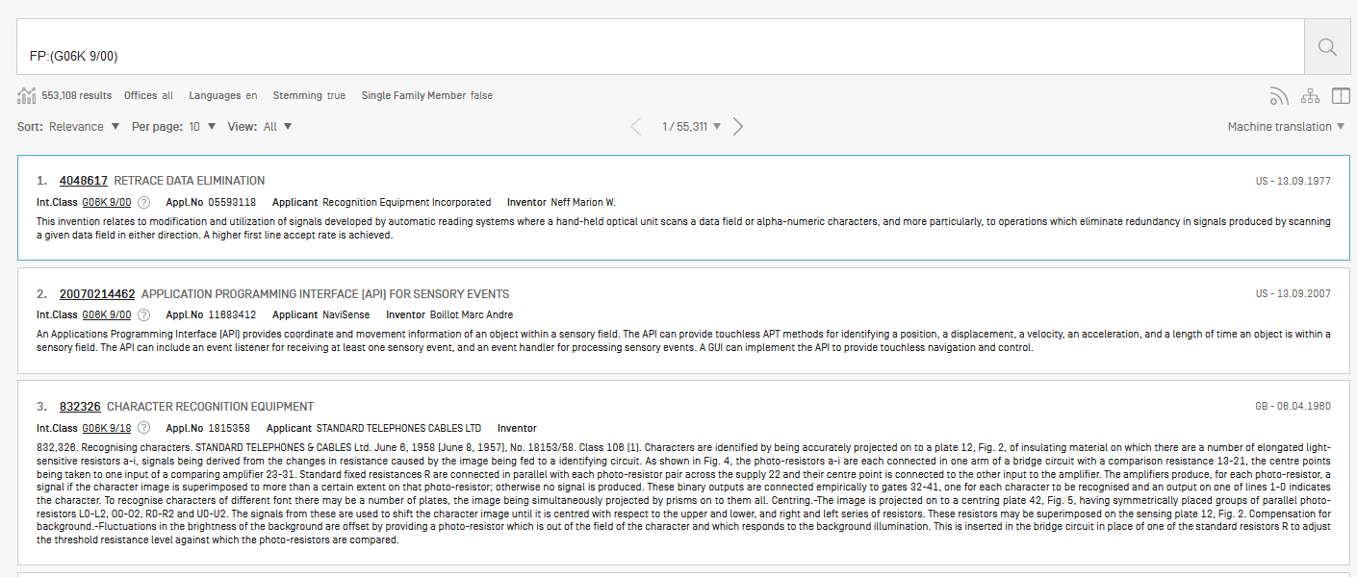
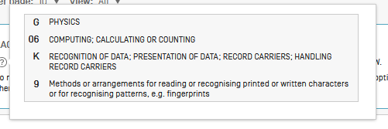

Slide 38
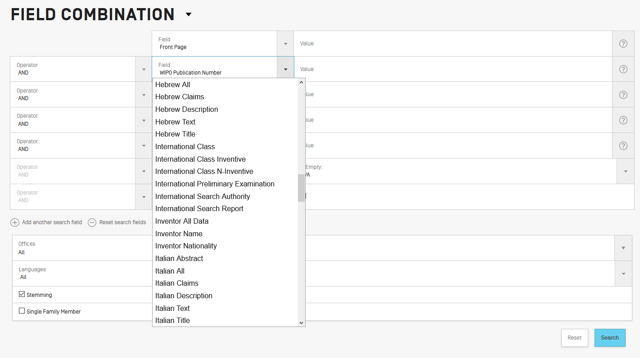
Search in Field Combination

Slide 39
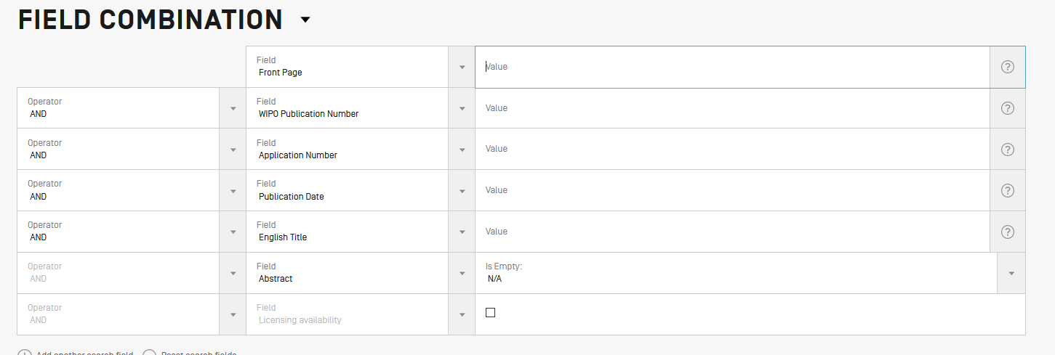

Slide 40
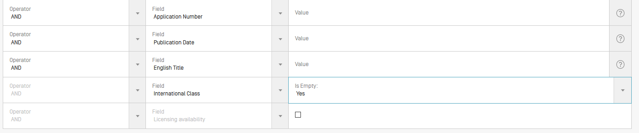
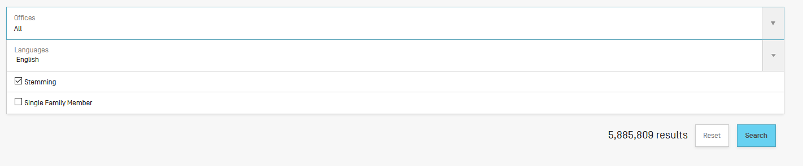

Slide 41
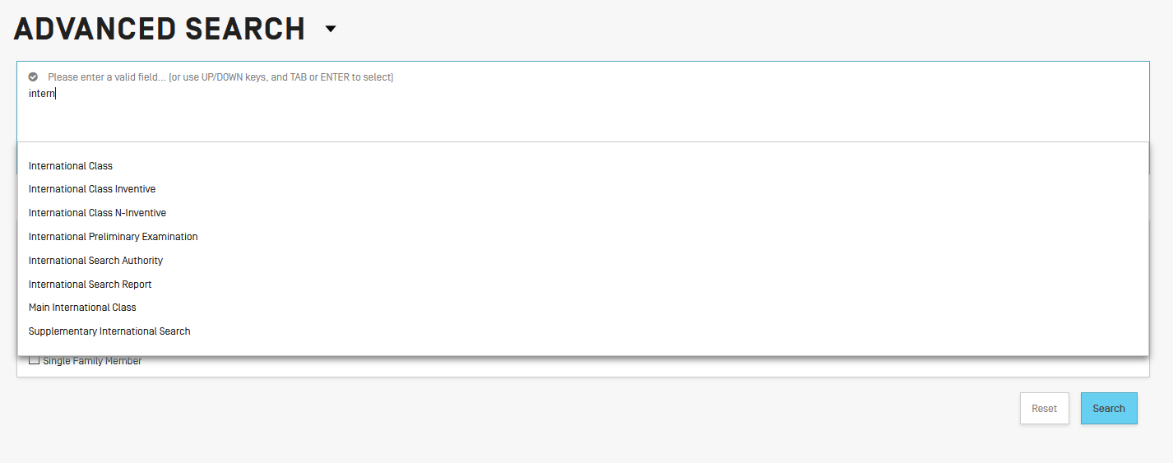
Search in Advanced

Slide 42
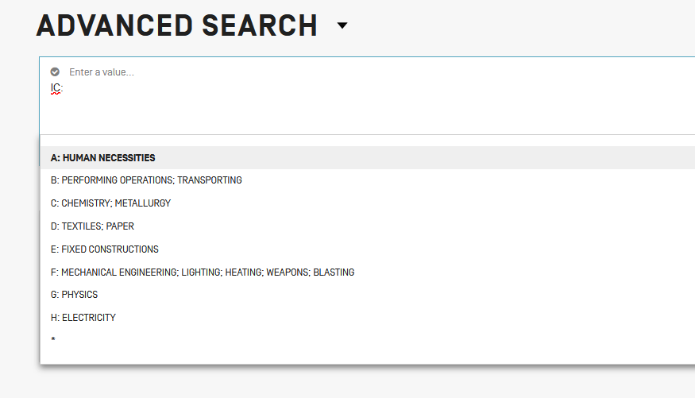

Slide 43
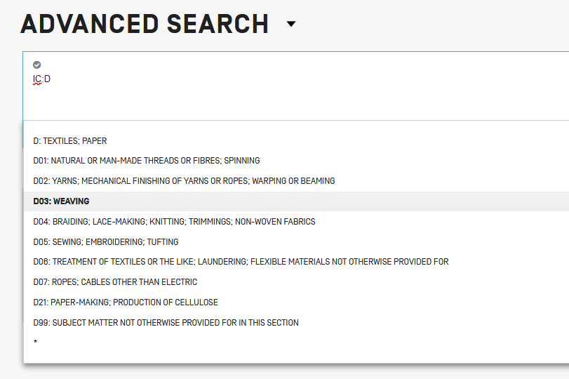

Slide 44
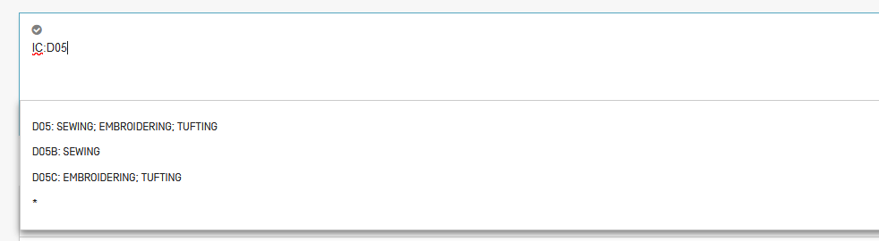

Slide 45

Combined search
Retrieve results that are specific “G06K 9/00“ and date range: first 6 months of 2020

Slide 46
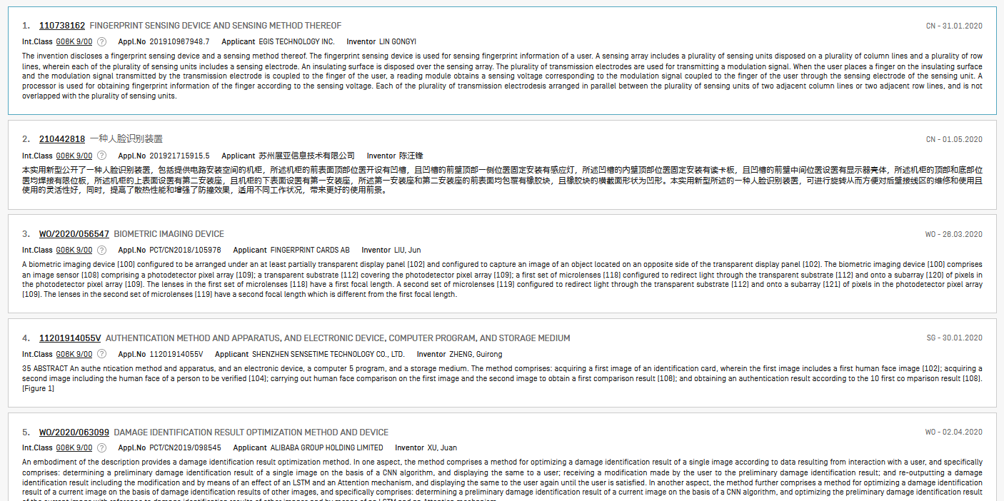

Slide 47
Caution
Use of (…) and […]
Use of " … "
(IC: A or B or C)
AD:([01.06.2012 TO 24.06.2016]) AND IC:("A23B 4/00")

Slide 48
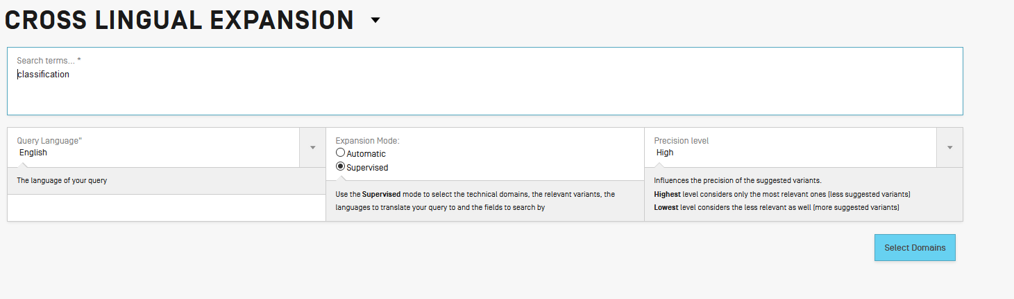

Slide 49
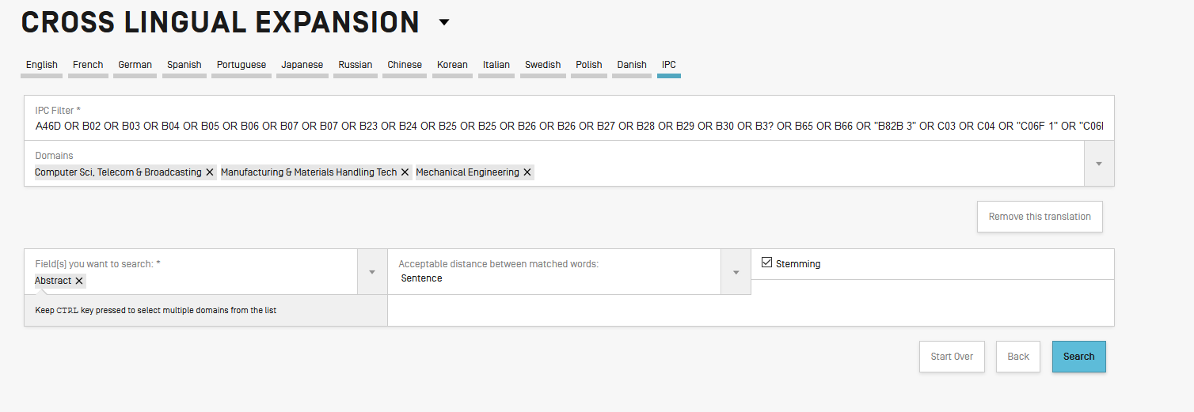

Slide 50
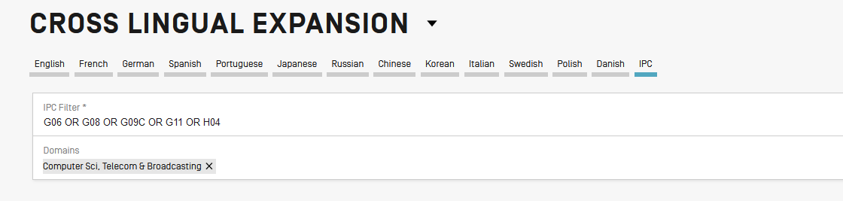

Slide 51
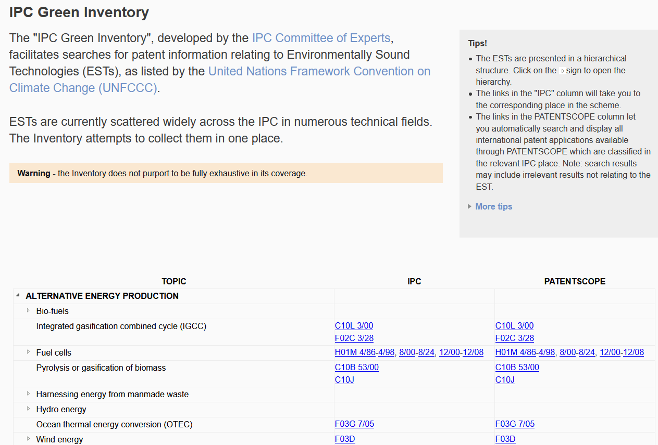
IPC Green Inventory

Slide 52
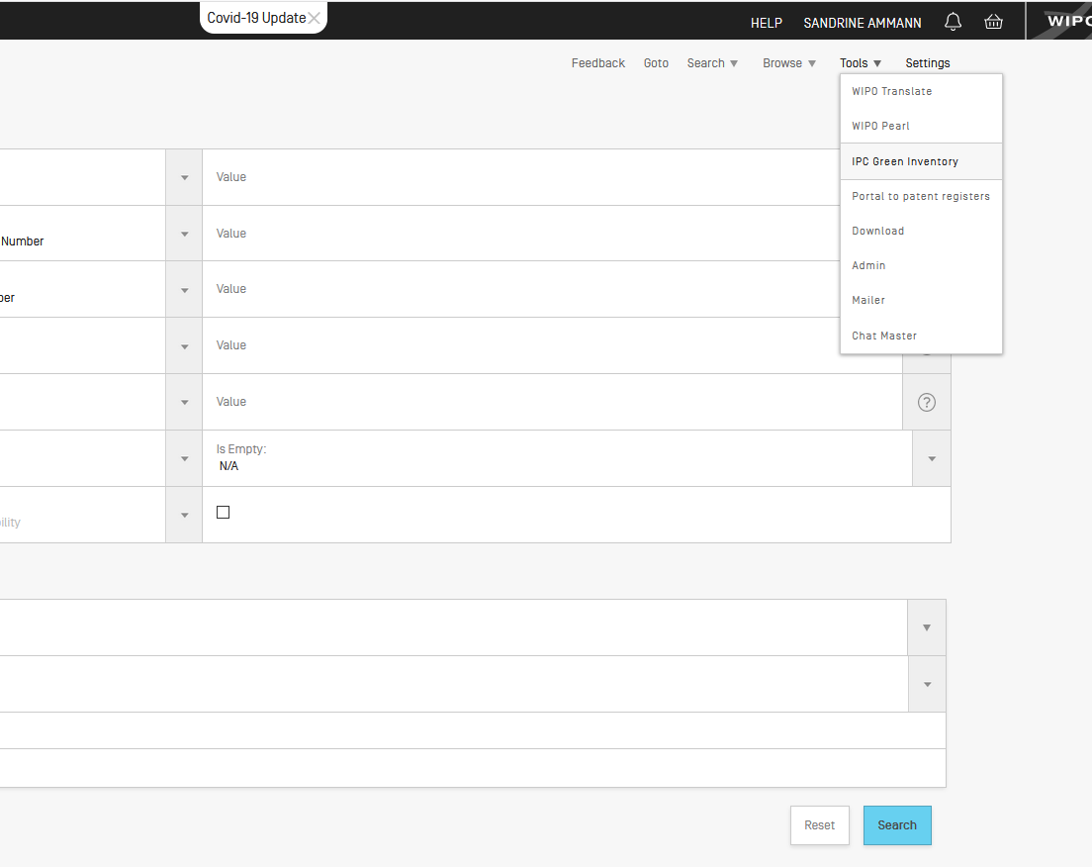

Slide 53
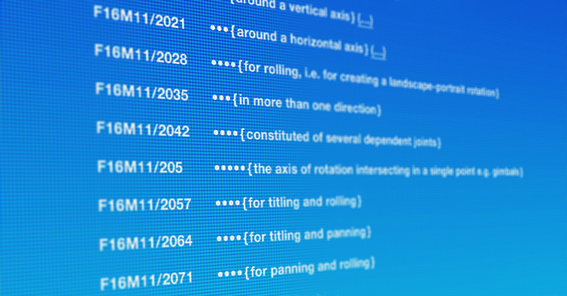
Source: https://www.cooperativepatentclassification.org/index

Slide 54
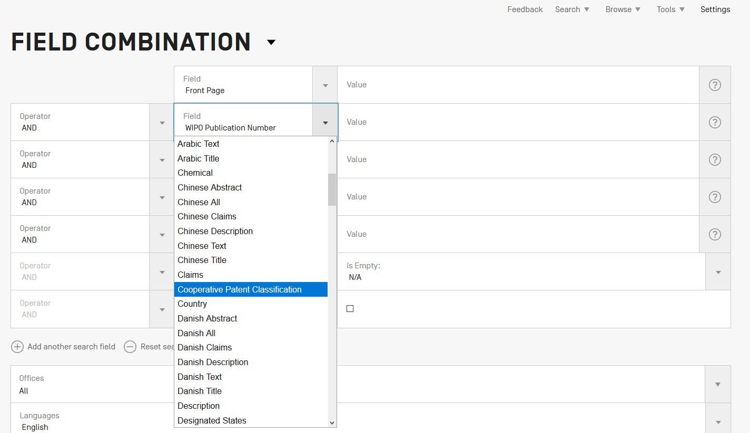

Slide 55
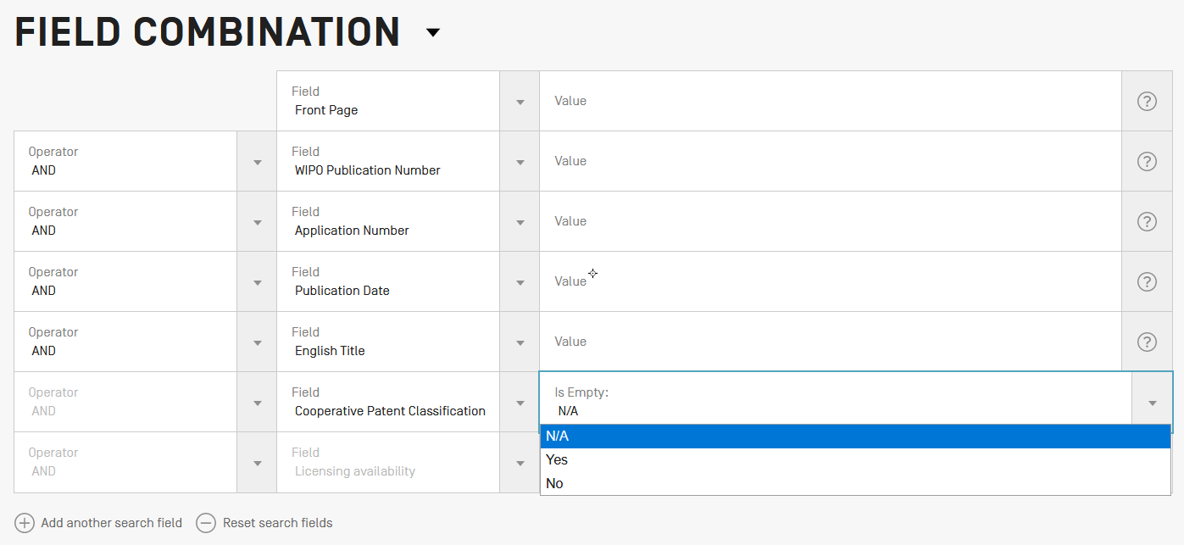

Slide 56
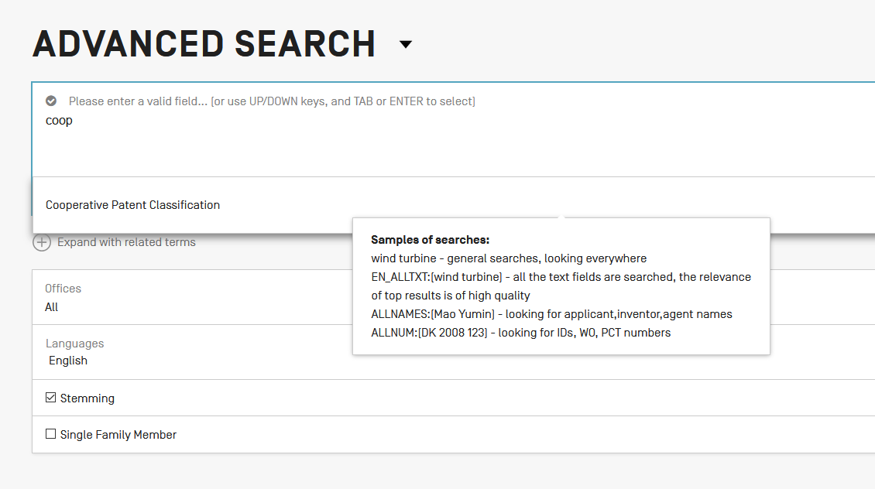

Slide 57
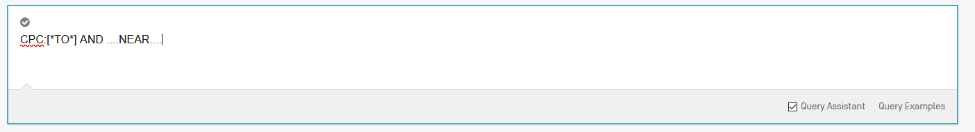

Slide 58
Collections - coverage
CPC imported from DocDB for PCT applications
52 national collections (IP5 + 47)

Slide 59


Slide 60
Field: classif
Union of CPC + IPC
  To cover old and new documents

Slide 61
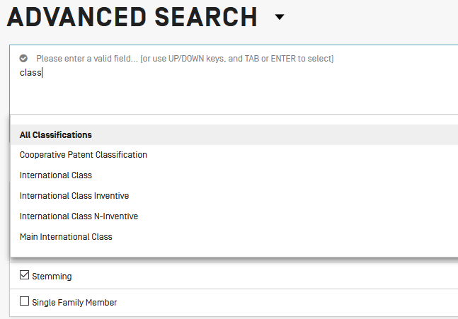

Slide 62
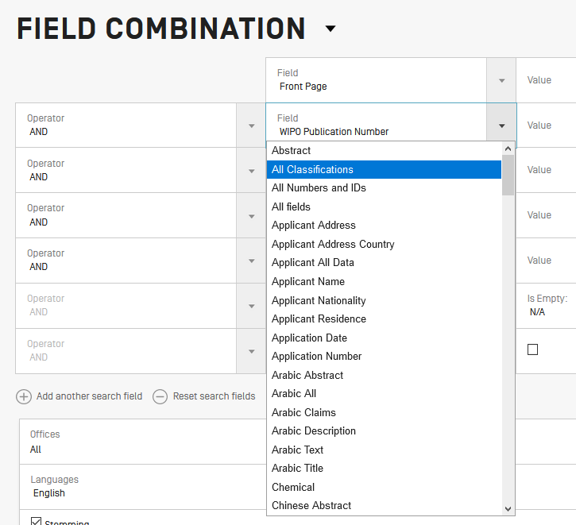

Slide 63
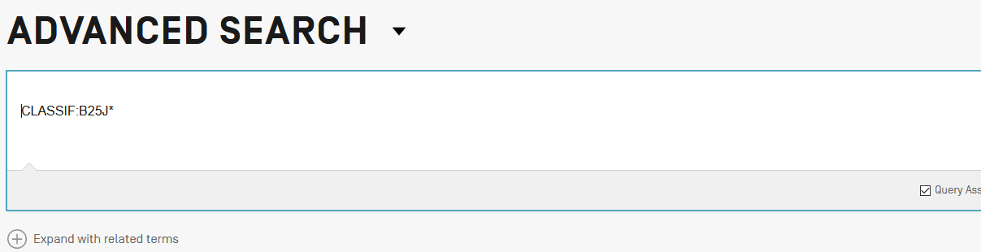

Slide 64
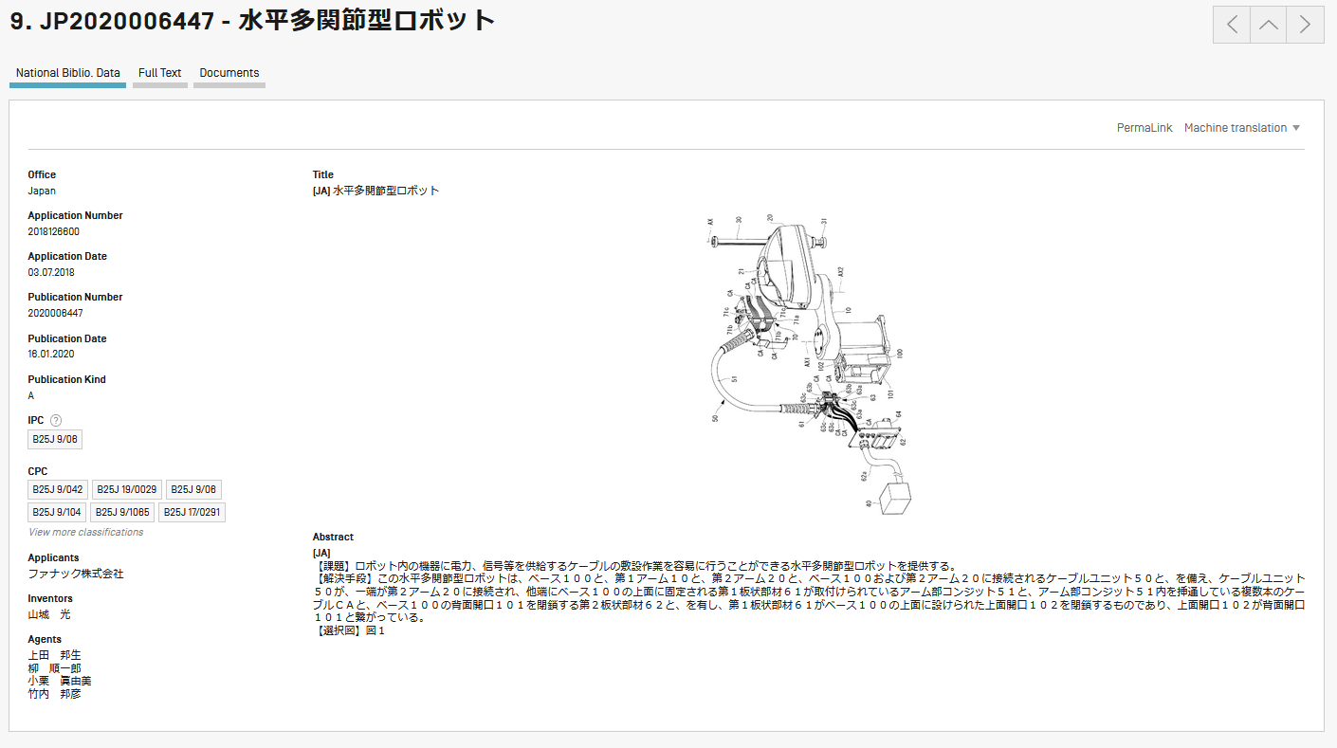

Slide 65
Next webinar
Overview of PATENTSCOPE
  August 25 or 27
To register: https://www.wipo.int/patentscope/en/webinar/

Slide 66
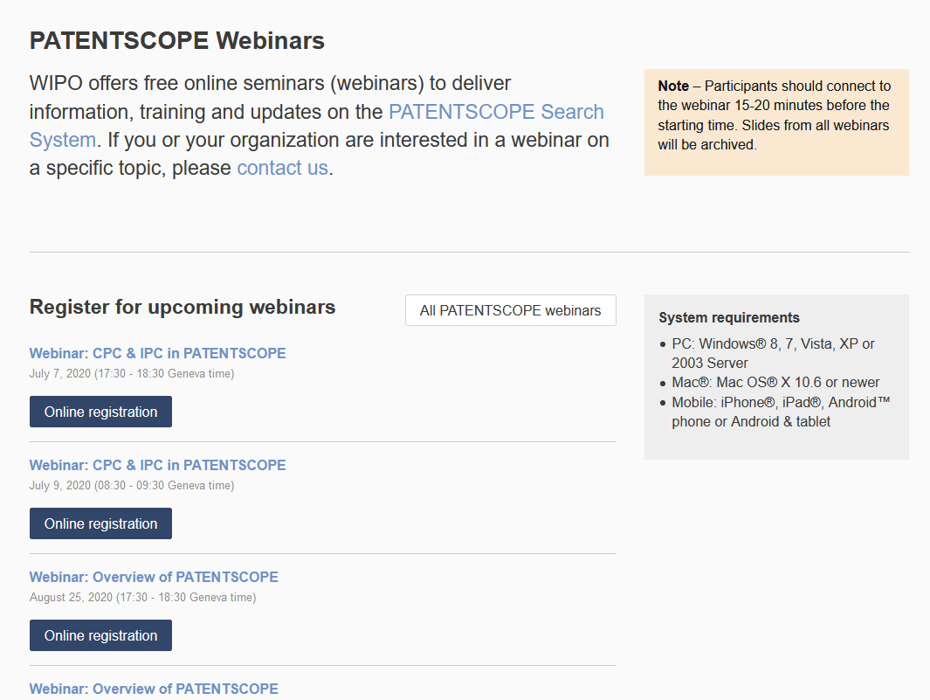
wipo.int/patentscope/en/webinar

Slide 67
Global Brand Database, Global Design Database
Webinars:
https://www.wipo.int/reference/en/branddb/webinar/index.html
https://www.wipo.int/reference/en/designdb/webinar/index.html

Slide 68


Slide 69
Are all of these search techniques and strategies (e.g., IPCCAT) available for free? Do the search techniques require logging in with an account? Yes all features are free and most of them are available without login. The IPCCAT interactive search feature in IPCPUB does not require a login but the direct call of IPCCAT webservice from another IT system requires a login. Please visit IPCPUB on-line help for more details.
Is there National or Regional Classification? Yes CPC NO (National Office) and FI/Fterm by the Japanese Patent Office is an example and in the past

Slide 70
What is the difference between inventive and non-inventive? The IPC requires all new and non-obvious technical information to be classified; however patent documents contain a lot of technical information and not all is directly linked to the invention but can explain the state of the are. Any additional information, that is not new but may be useful for search purposes, can also be classified. Therefore a separate “non-invention” classification for these documents was created so that these codes would not artificially inflate the IPC subgroups

Slide 71
Is it possible to get Indian patents in PATENTSCOPE? Yes, please check the data coverage here https://patentscope.wipo.int/search/en/help/data_coverage.jsf
Where is the search syntax available? In the Help menu in the black navigation bar, PATENTSCOPE help
Entering keywords what is the maximal amount and can i enter sentences? It is unlimited and yes sentences searching is supported
Is there a list of the wildcards used while searching? Yes in the User's Guide in the Help menu

Slide 72
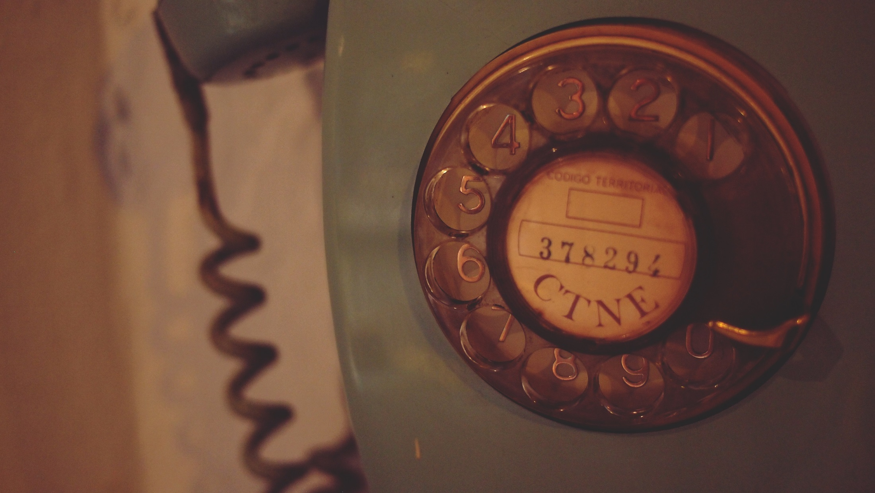
patentscope@wipo.int
ipc.mail@wipo.int

