Slide 1
First Name Last Name
Job Title

Slide 2
Click the Raise hand button if you hear me otherwise send me a message please!

Slide 5
Questions/concerns
patentscope@wipo.int

Slide 6
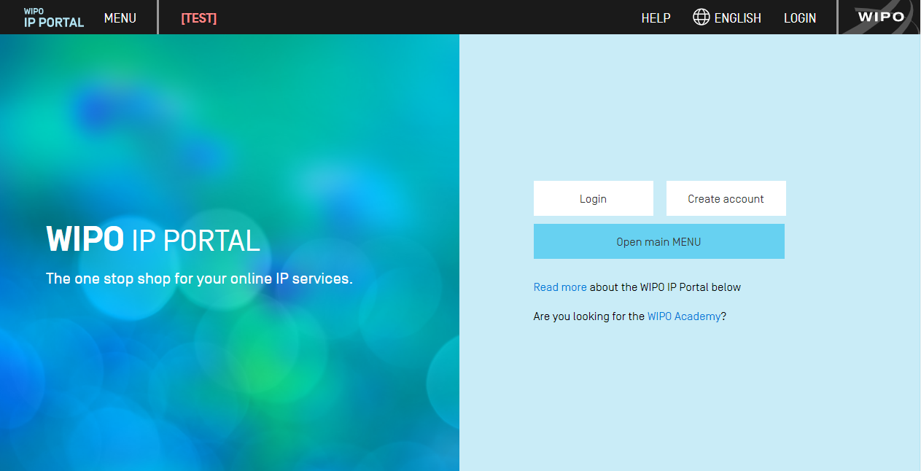
https://ipportal.wipo.int/

Slide 7
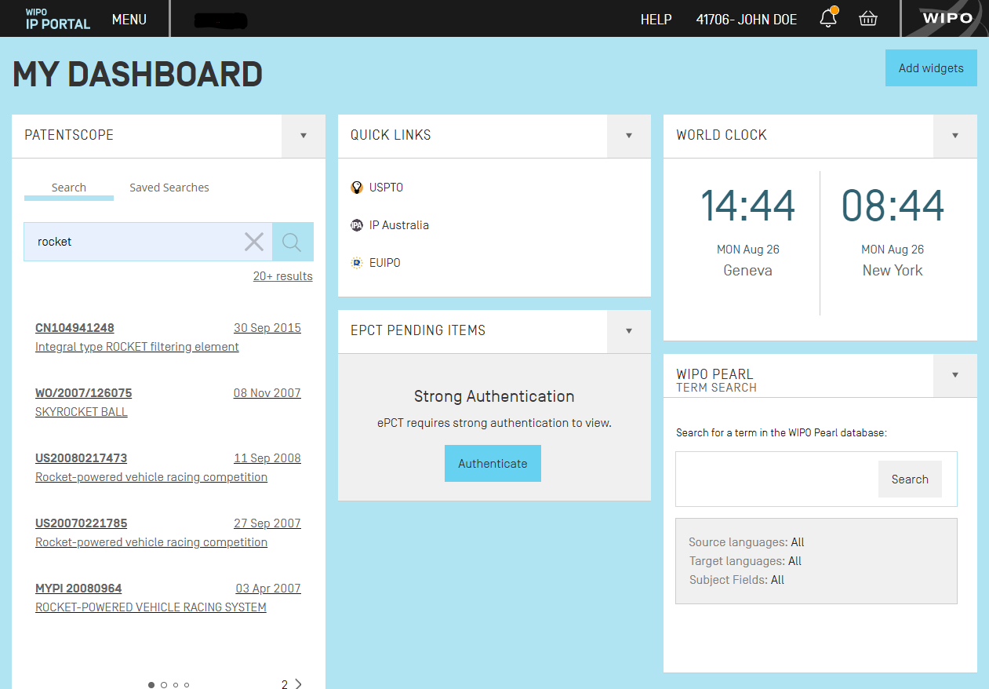

Slide 10
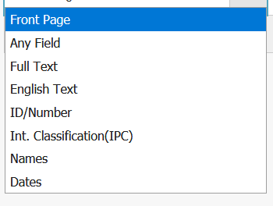
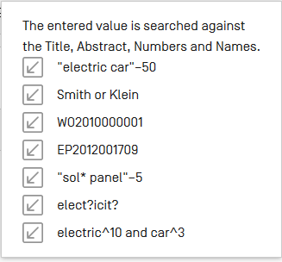

Slide 11
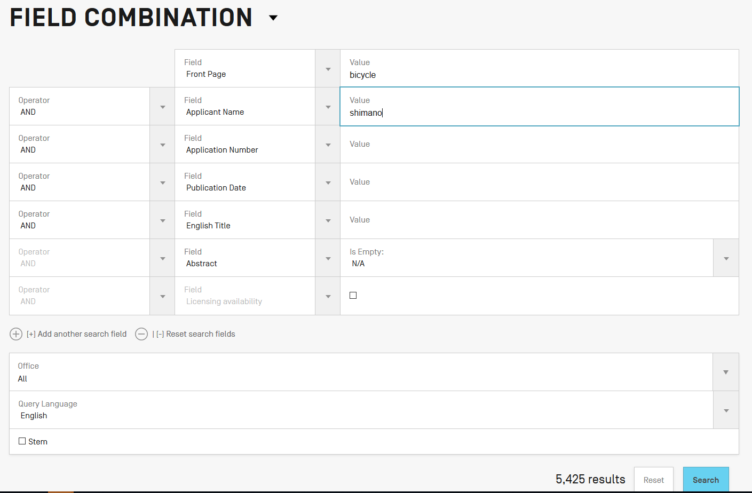

Slide 12
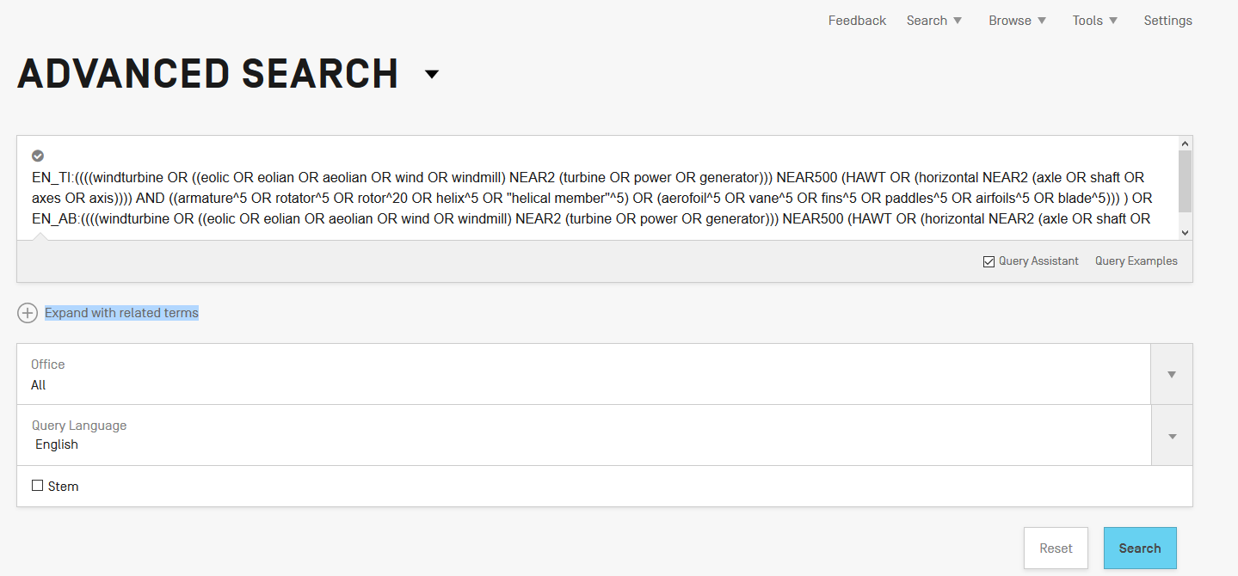

Slide 13
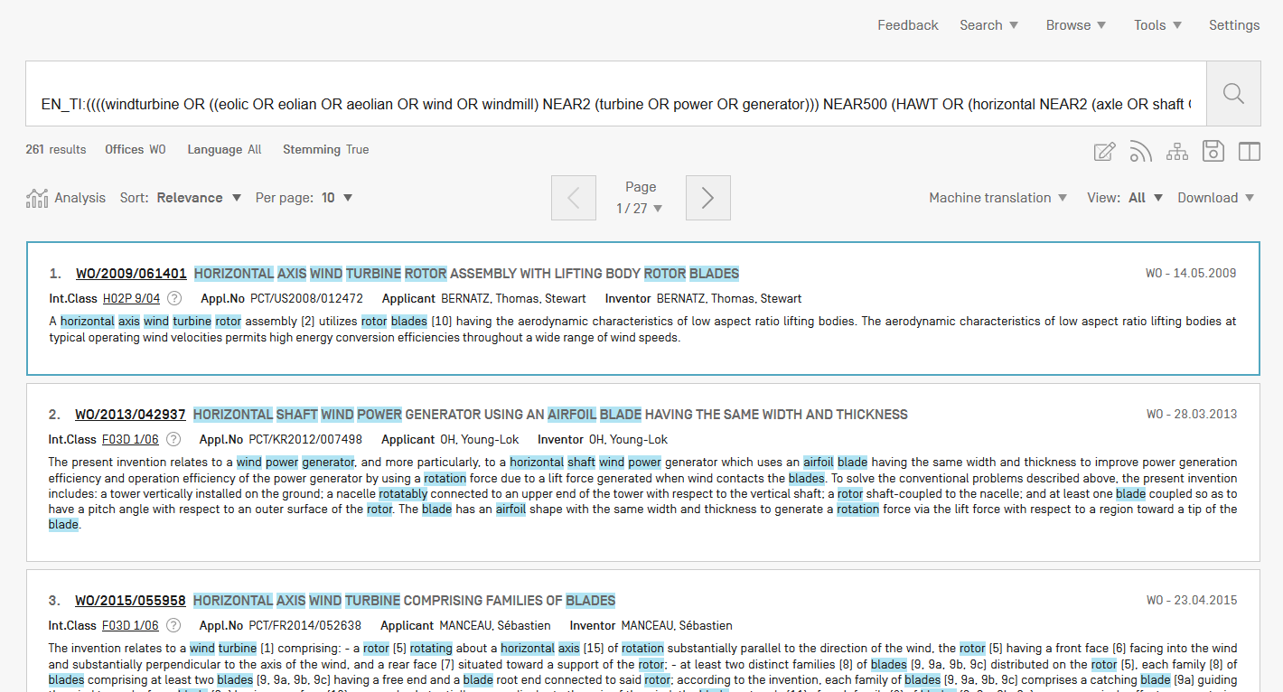

Slide 14
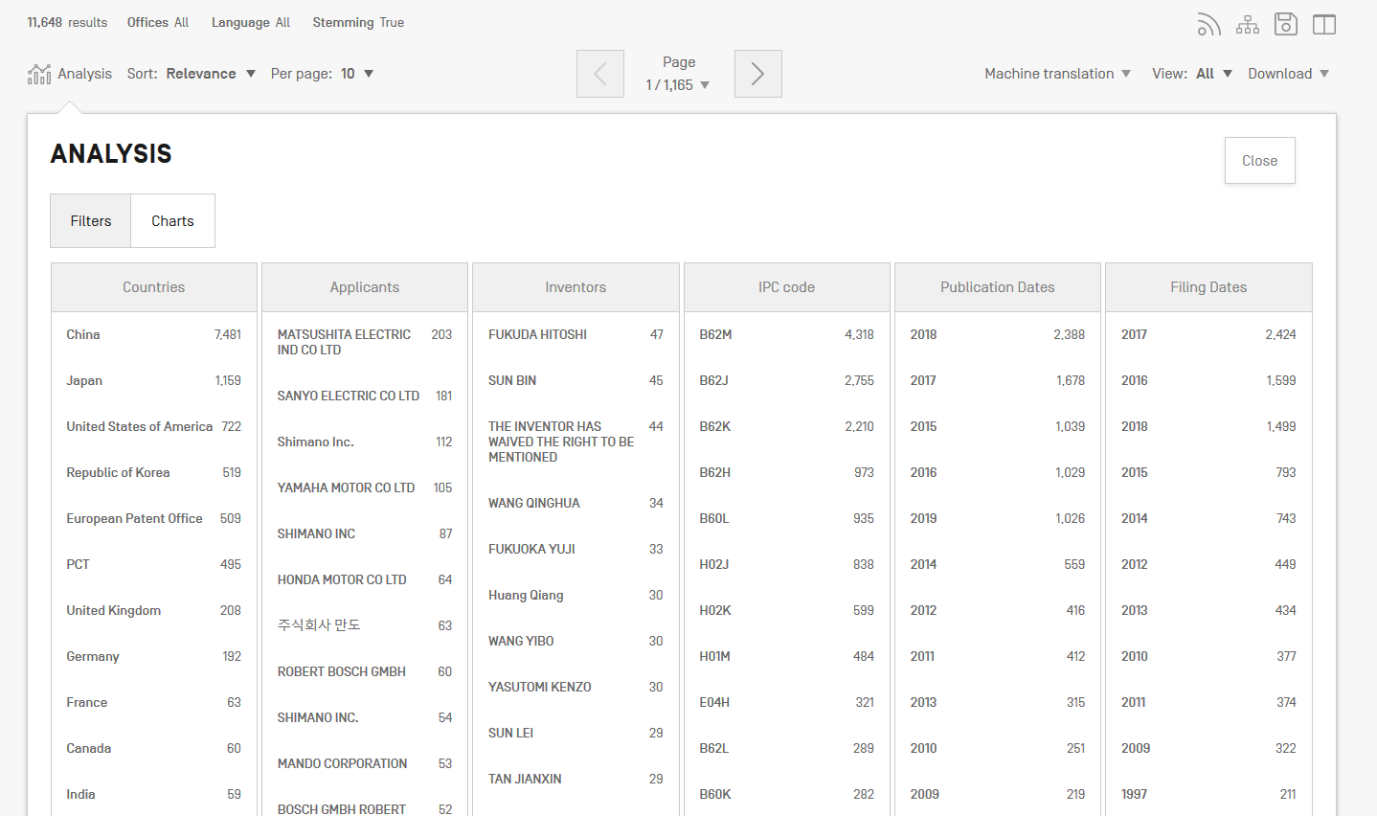

Slide 15
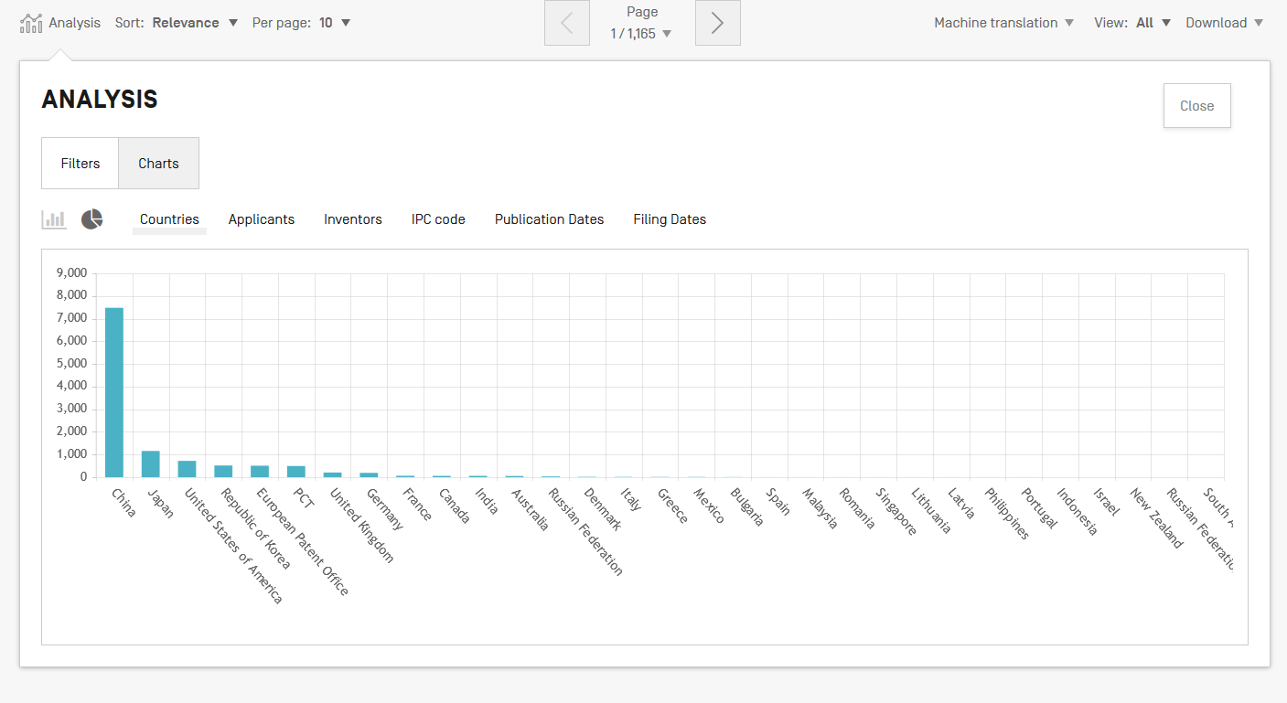

Slide 16
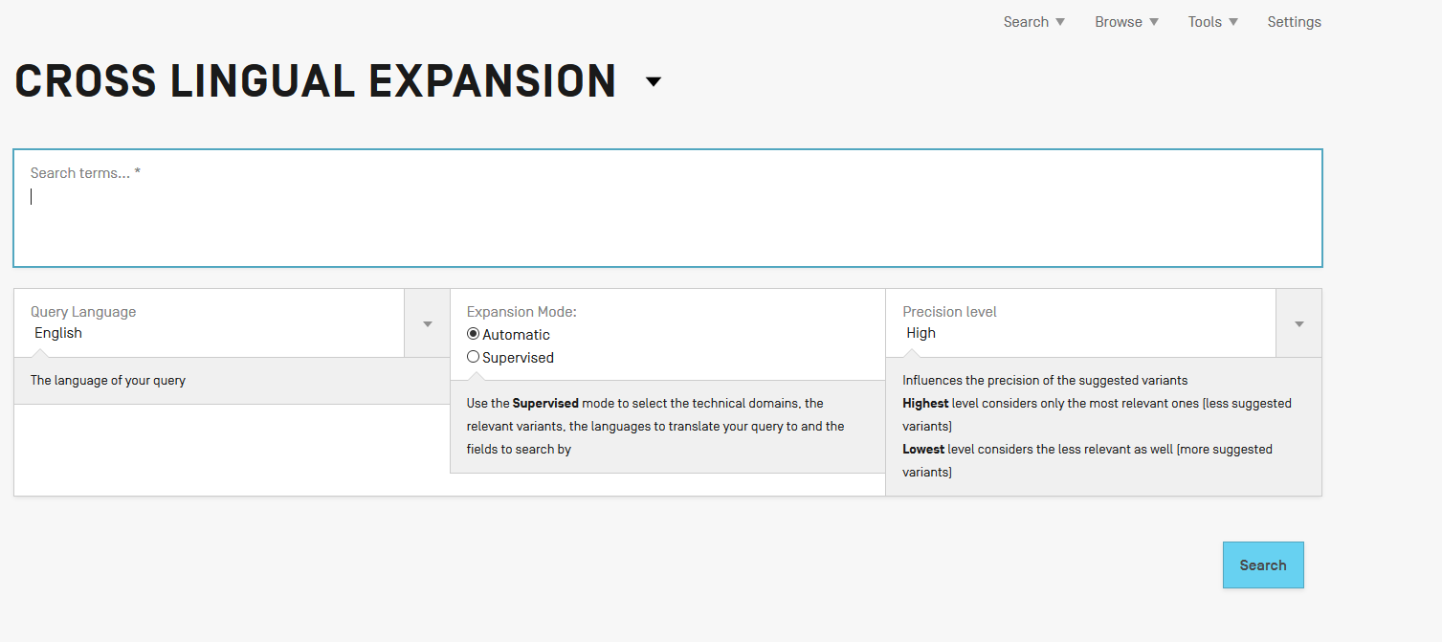

Slide 18
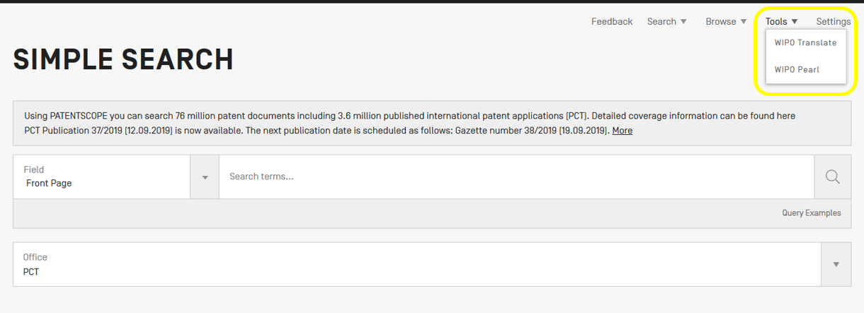

Slide 19
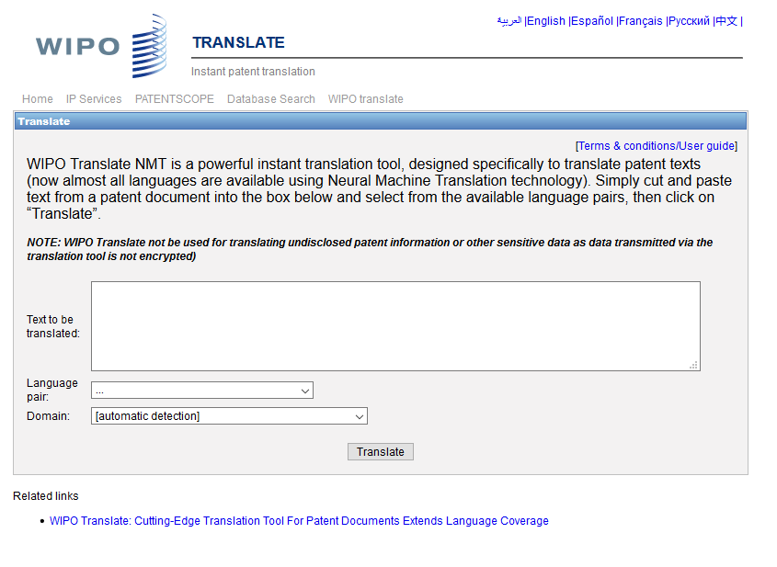

Slide 21
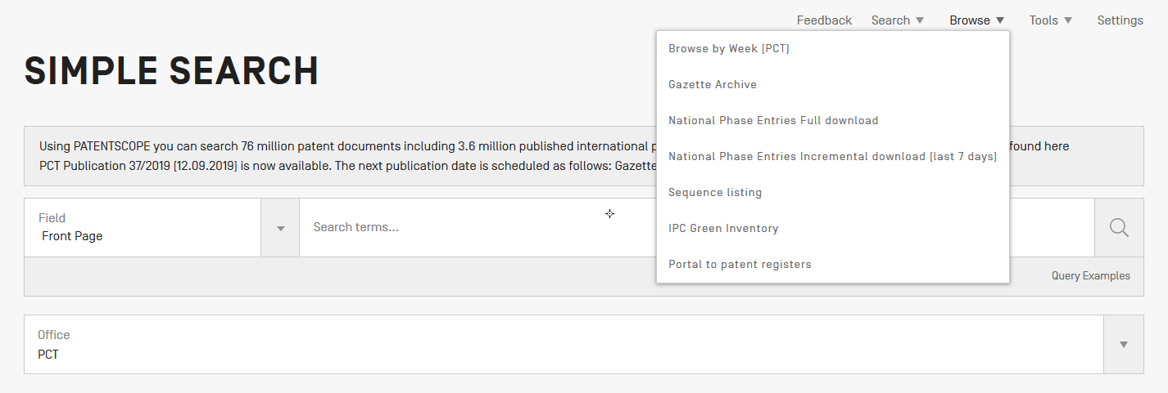

Slide 23
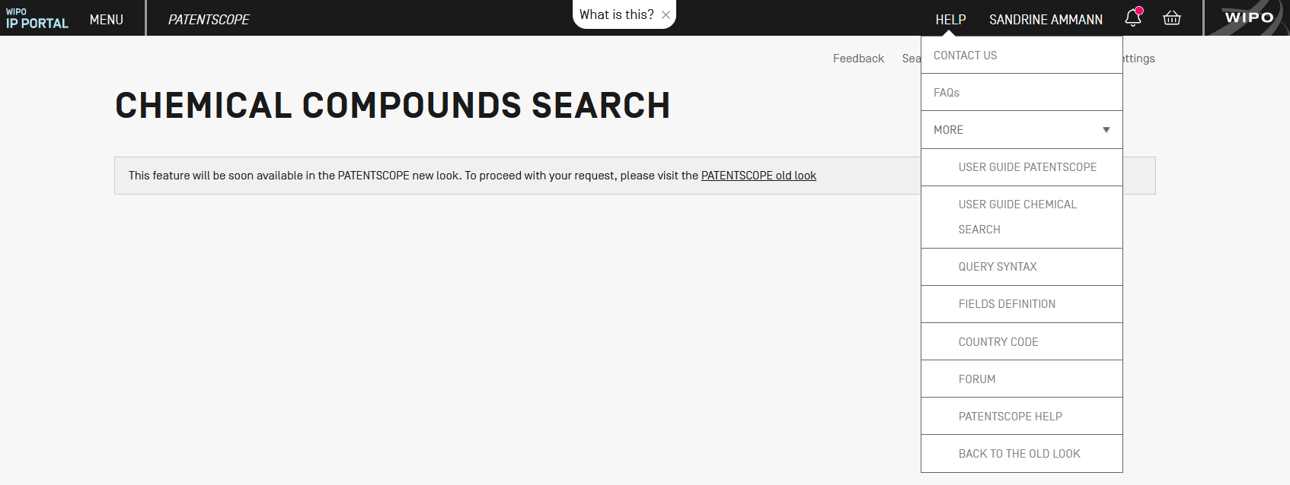

Slide 26
Next webinar
Overview of the PATENTSCOPE search system
September 24 @ 5:30 CEST
September 26 @ 8:30 CEST
https://attendee.gotowebinar.com/rt/5853500135647166467

Slide 27
Global Design Database
How to perform a search in the Global Design Database
September 27@ 5:30 CEST
https://attendee.gotowebinar.com/register/725050249276071426

Slide 28
Global Brand Database webinar
Overview of the Global Brand Database
October 23 @ 5:30 CEST
https://attendee.gotowebinar.com/register/6209538493436706818

Slide 30
Q: Until when is the old interface available? The next few months. Q: Do we need to log in to use the new interface? No. Q: Will the chemical compounds be highlighted again within the text in the new system ? Yes. Q: Will basic search capabilities change? No. Q: Are the data sources the same between the current and new interfaces? Are the results the same? Yes. Q: With the personal account is it possible to share some search with colleague ? Yes via RSS.

Slide 31
Q:Will you be sending out an email for these next webinars? If you have a WIPO account and have not unsubscribed to the Keep me informed feature, you will receive emails.
Q: What does "old look“ mean for the chemical compound search? It means that you will be redirected to the current version to perform your chemical searches.
Q: In your last slide, the purple line for “news” points to help, is that where news will appear now? Yes.
Q: The new black navigation bar has a bell icon and below that there is a messages window. Where do the messages go? Who answers any questions posted as a message? It is a notification system used by the different sectors to inform their users.

Slide 32
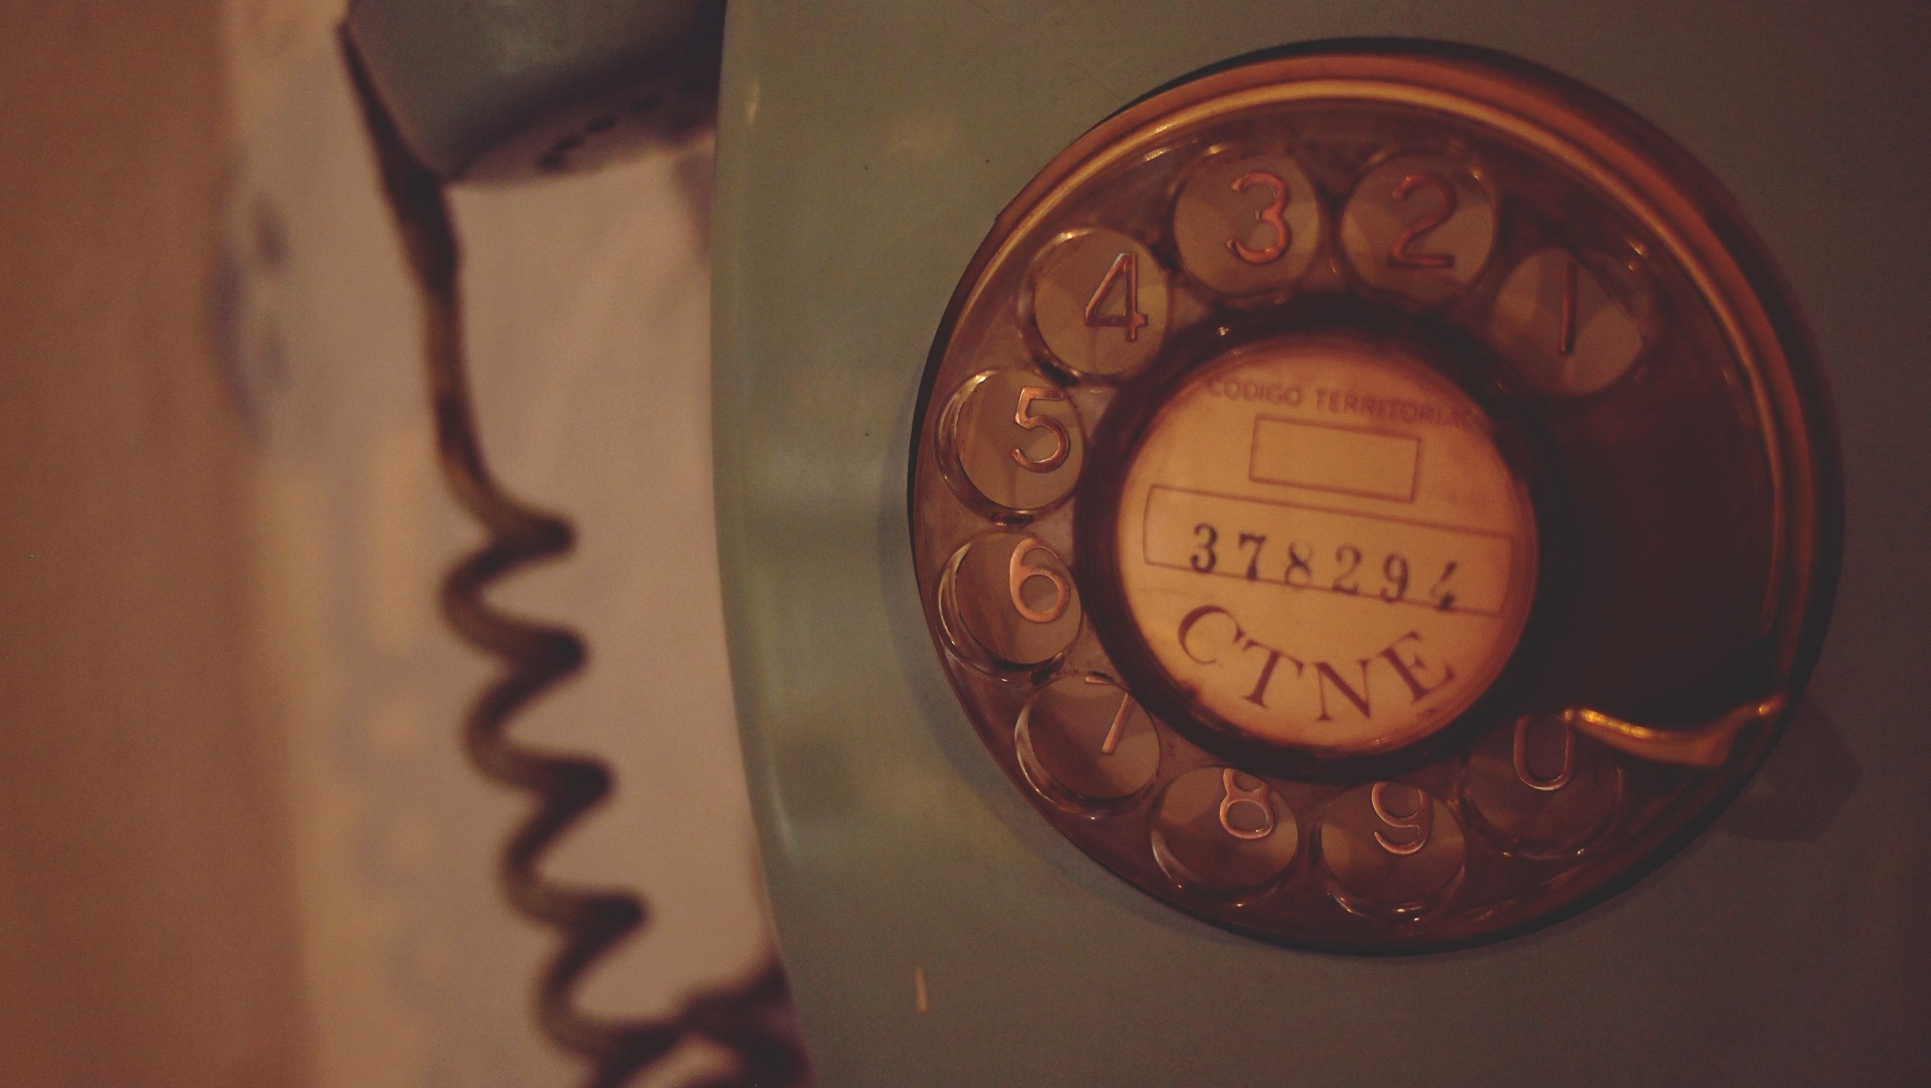
mulțumesc
mulțumesc
patentscope@wipo.int

