Slide 1
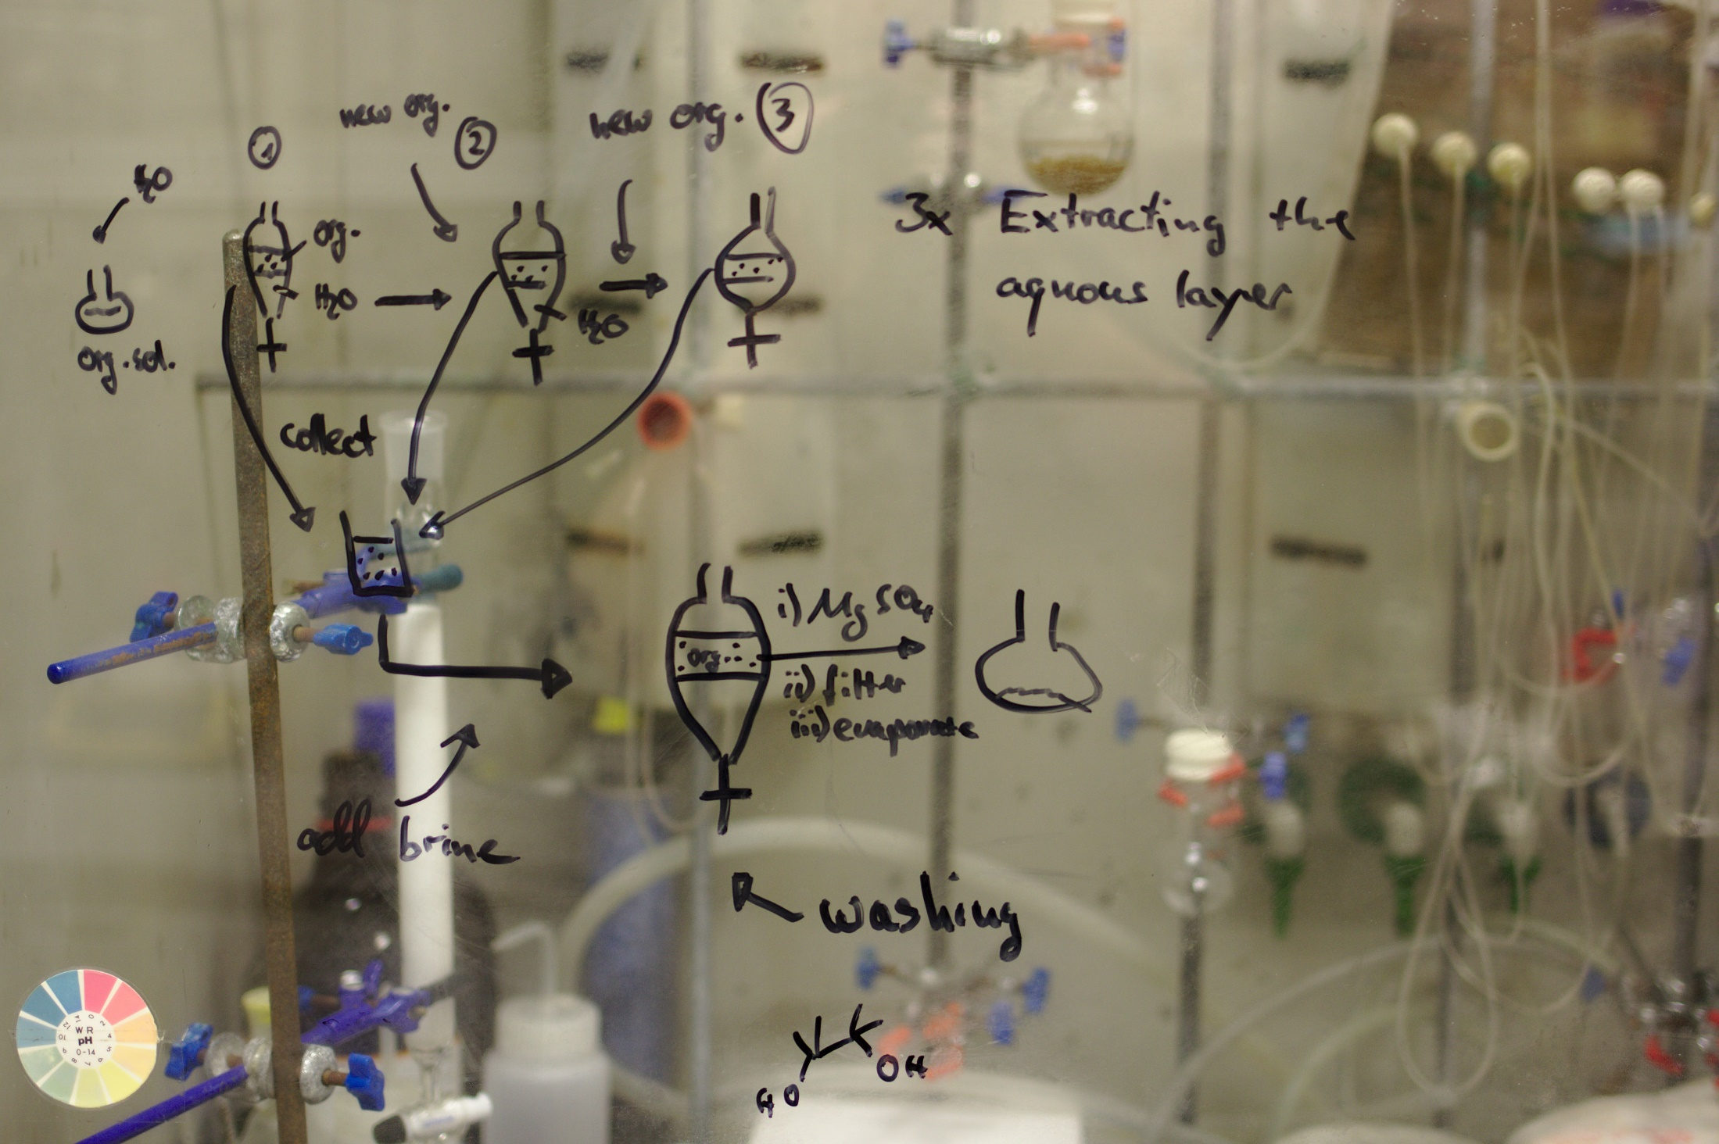

Slide 2
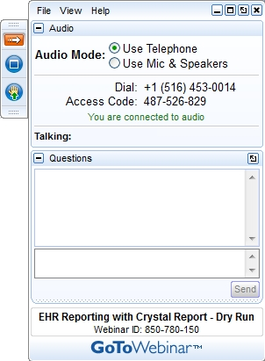
Click this button if you can hear my voice and see my screen

Slide 3


Slide 4
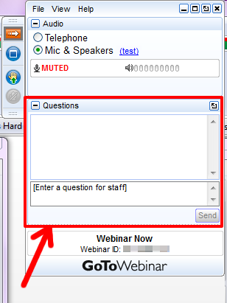

Slide 5
Questions/concerns
patentscope@wipo.int

Slide 6
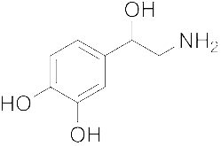
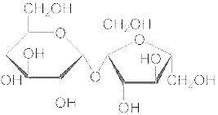
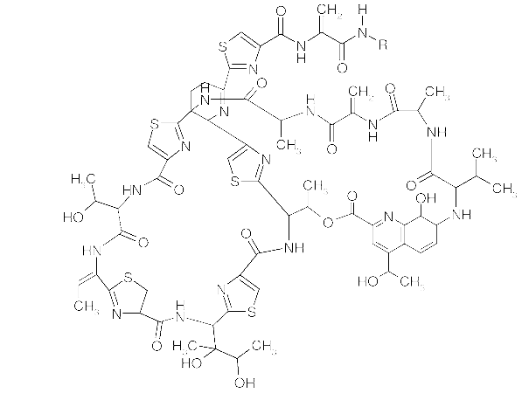
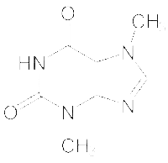
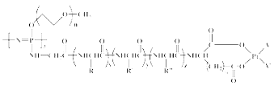
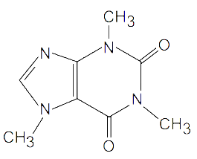
Agenda
Chemical structure search
Access
How does it work?
Q&A

Slide 7
Access
Available at https://patentscope.wipo.int
Access only with a WIPO account

Slide 8
Structure search - the concept
Recognize names and structures of chemical compounds in patent texts and embedded drawings
Standardize all the different representations of chemical structures into InchIkeys
InchIkeys can be used by non chemists

Slide 9
Inchikeys
Definition: a short, fixed-length character signature based on a hash code of the InChI string.
  Provide a precise & robust IUPAC* approved structure-derived tag for a chemical substance.
*International Union of Pure and Applied Chemistry

Slide 10
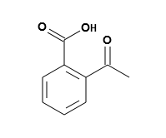
Example: InchI – InchIKey for aspirin
InChIKey = a fixed-length (27-character) condensed digital representation of an InChI
InChI = is a textual identifier developed to make it easy to perform web searches for chemical structures

Slide 11
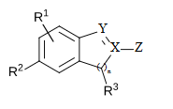
Scope
Works on developed exact formulas ≠ Markush structures (-R) that are chemical symbols used to indicate a collection of chemicals with similar structures.

Slide 12
Collections
- China [1996 -2019]
- European Patent Office [1978 -2019]
- Eurasian Patent Office [1998 -2018]
- Japan [1993 -2019]
- Republic of Korea [1980 -2019]
- PCT [1979 -2019]
- Russia [1995 -2019]
- United States [1979 -2019]

Slide 13
IPC codes
C08L
C09B
C09C
C09D
C09J
C09K
C10H
C10L
C10M
C10N
C11D
C12C
C12H
C12M
C12N
C12P
C12Q
C13B
C13K
C14C
C23C
C25B
C40B
H05B
G01N
G03C
A01N
A01P
A23J
A61K
A61L
A61P
A61Q
B01J
B01S
C01B
C01C
C01D
C01F
C01G
C06B
C07B
C07C
C07D
C07F
C07H
C07J
C07K
C08F
C08G
C08J
C08K

Slide 14
Fields
  Title
  Abstract
  Description
  Claim

Slide 15
Limitations
Long automated procedures, no supervision
Will not recognize 100%! Same drawbacks as the OCR
Depends on OCR quality for PCT applications
Does not work with simple formulas such H2O
Not all collections and related languages
Notes:
Simple formulae like H2O are not captured to avoid information overload (and they can be searched by keywords).

Slide 16
Why is it useful?
Terms such as “aspirin”, “paracetamol” not always used in patent documents
Many ways of representing formulas
Expansion of searches

Slide 17
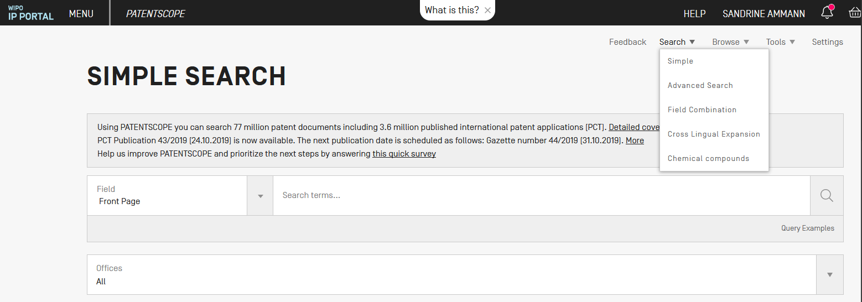
How does it work?

Slide 18
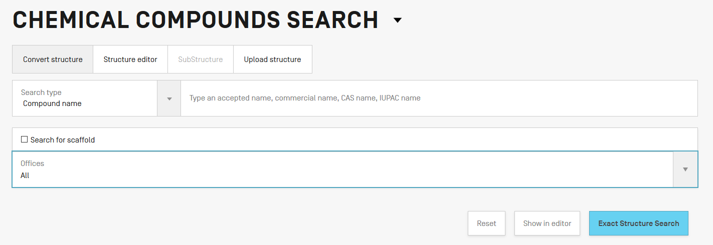
4 options

Slide 19
Scaffold
Basic skeleton of a molecule to which further groups and moieties are attached
Secondary information is ignored

Slide 20
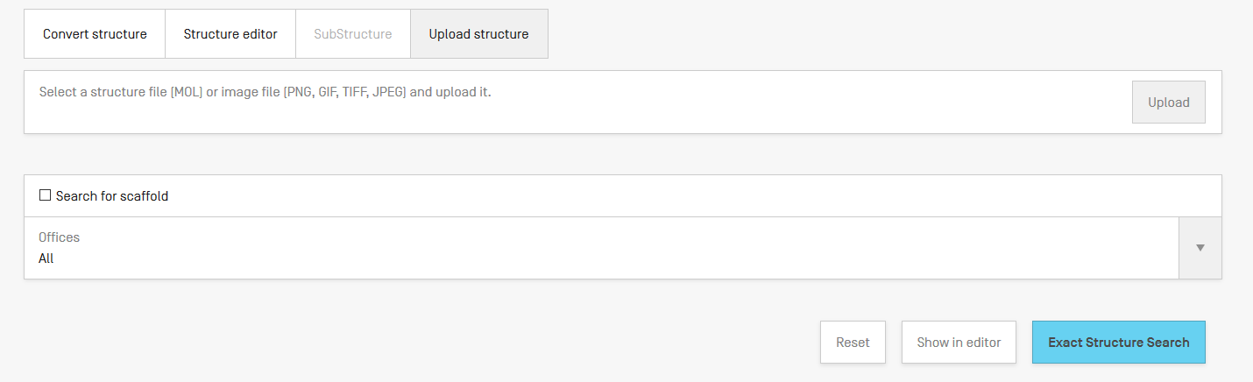
Upload a structure

Slide 21
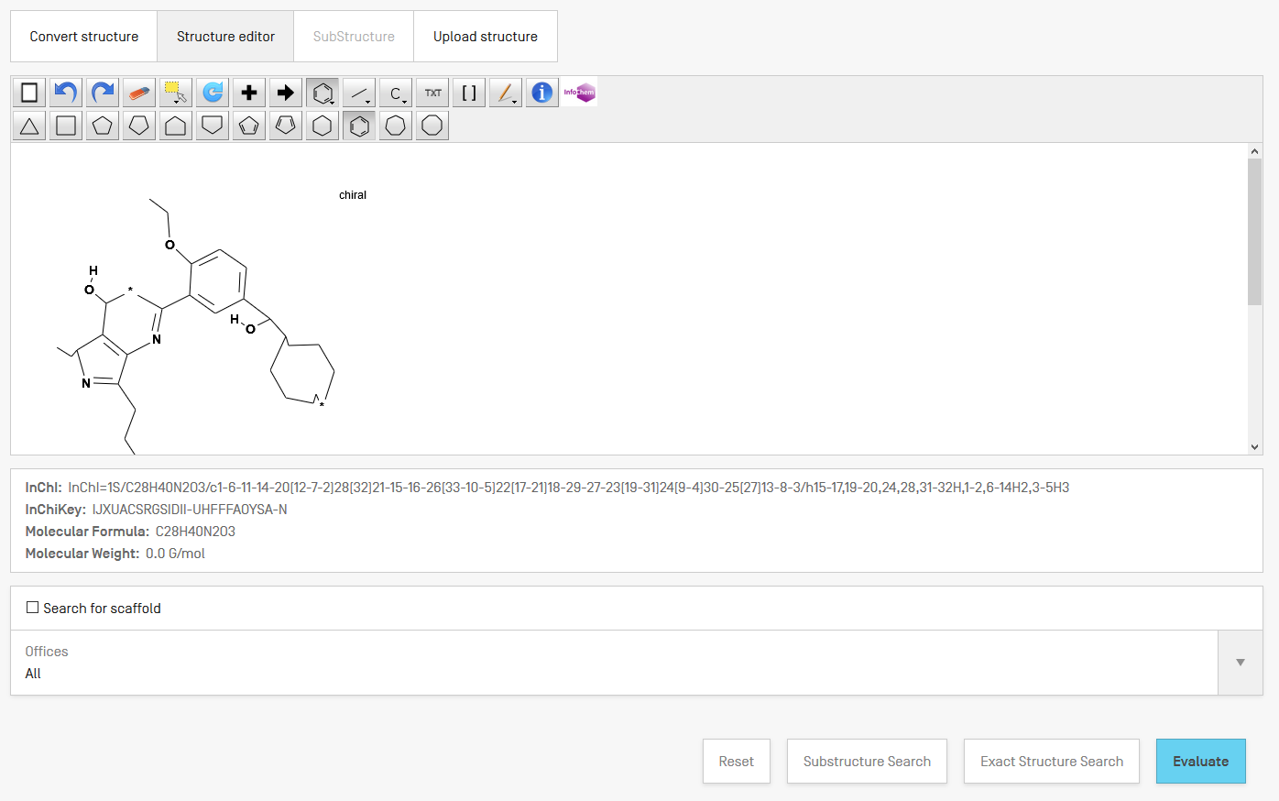
Example

Slide 22
Structure editor

Slide 23
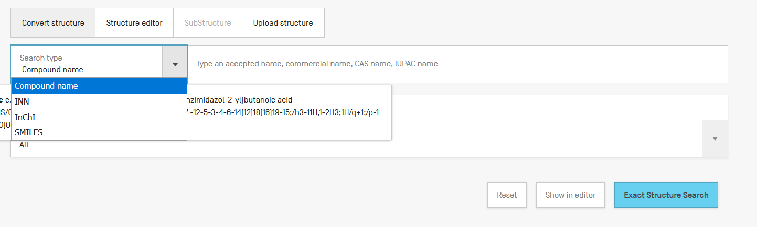
Convert a structure

Slide 24
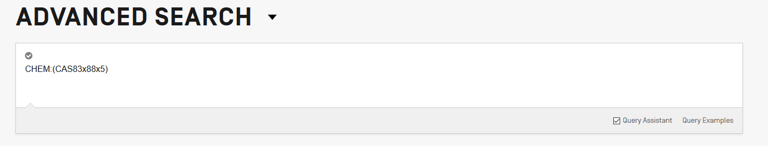
Search by CAS number
CAS83-88-5

Slide 25
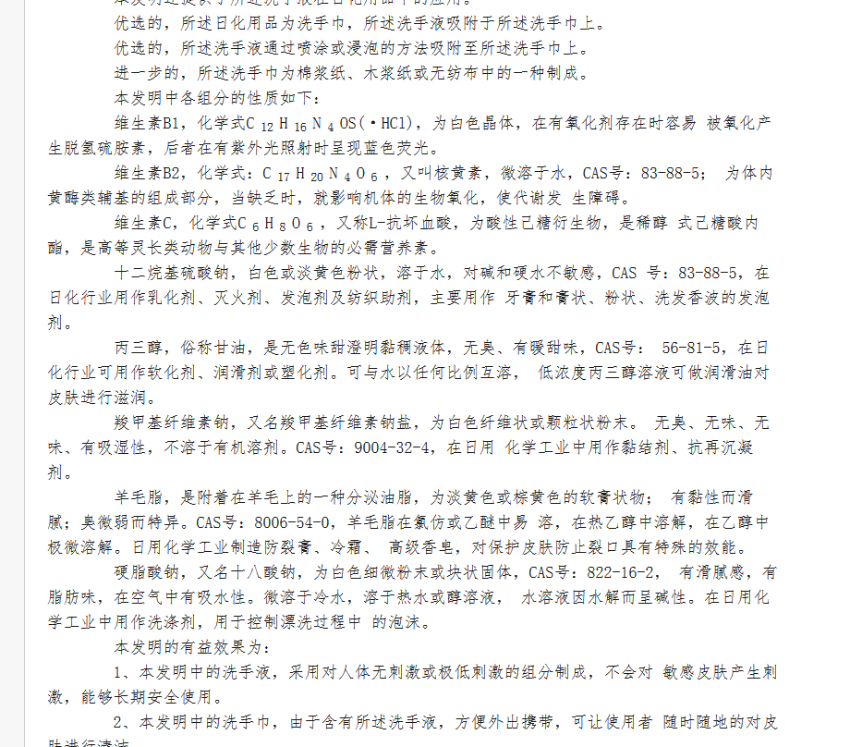

Slide 26
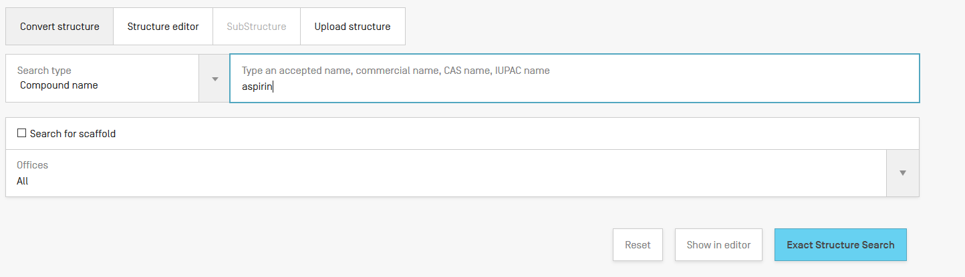
Convert structure: ex.: aspirin

Slide 27
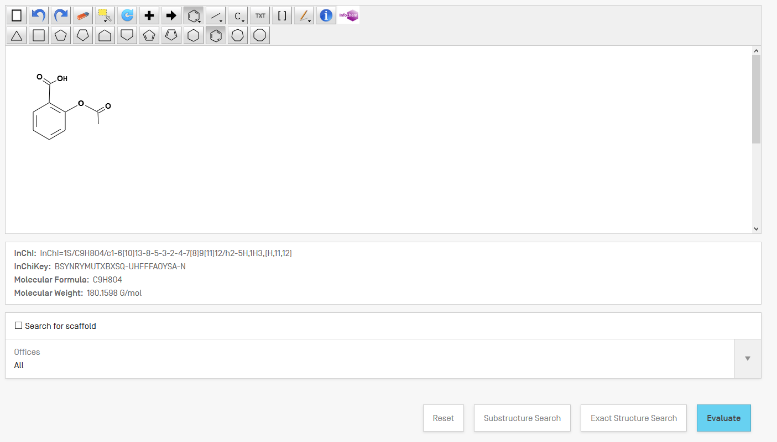

Slide 28
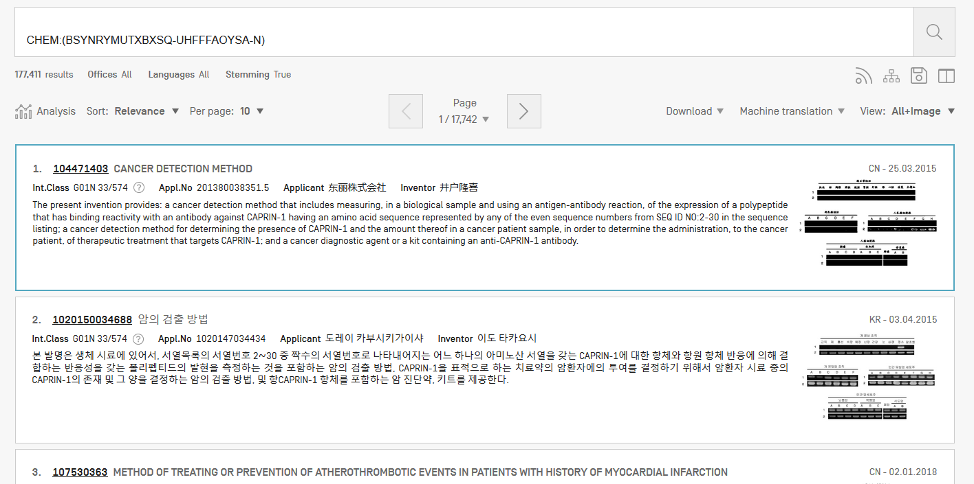
Results

Slide 29
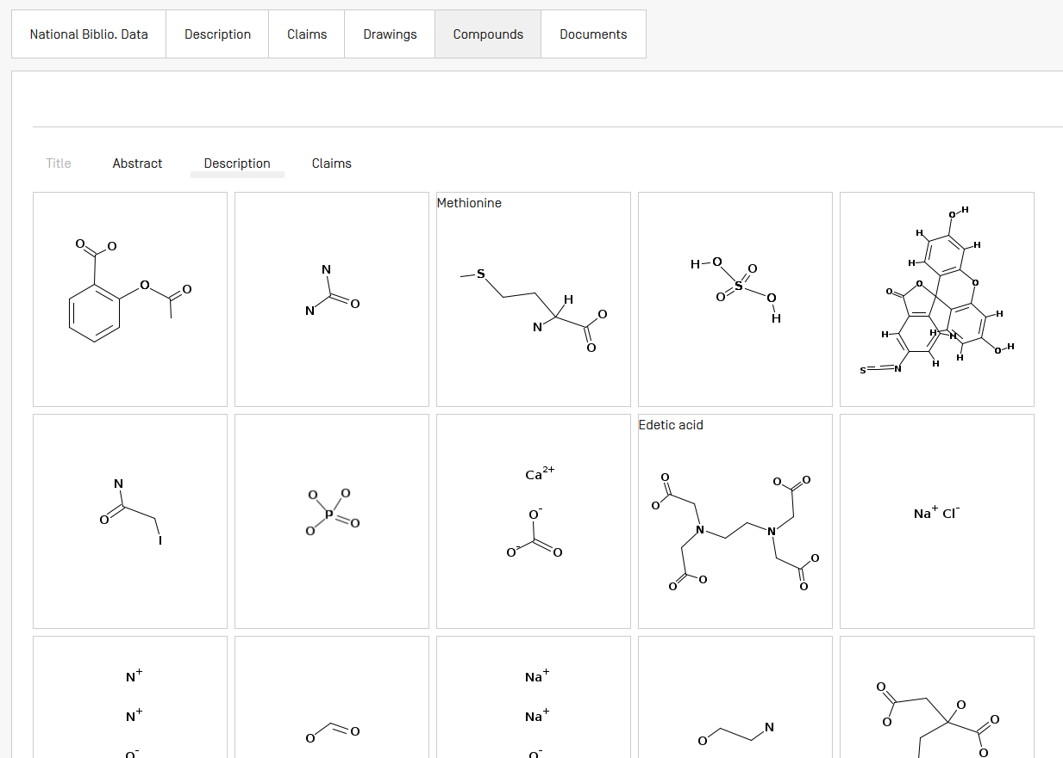

Slide 30
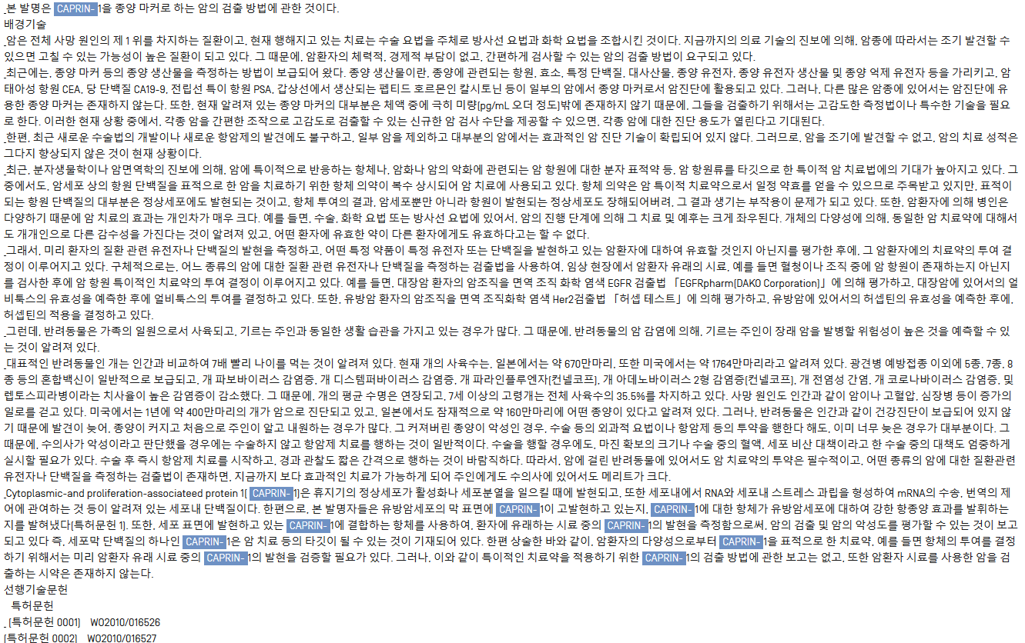

Slide 31
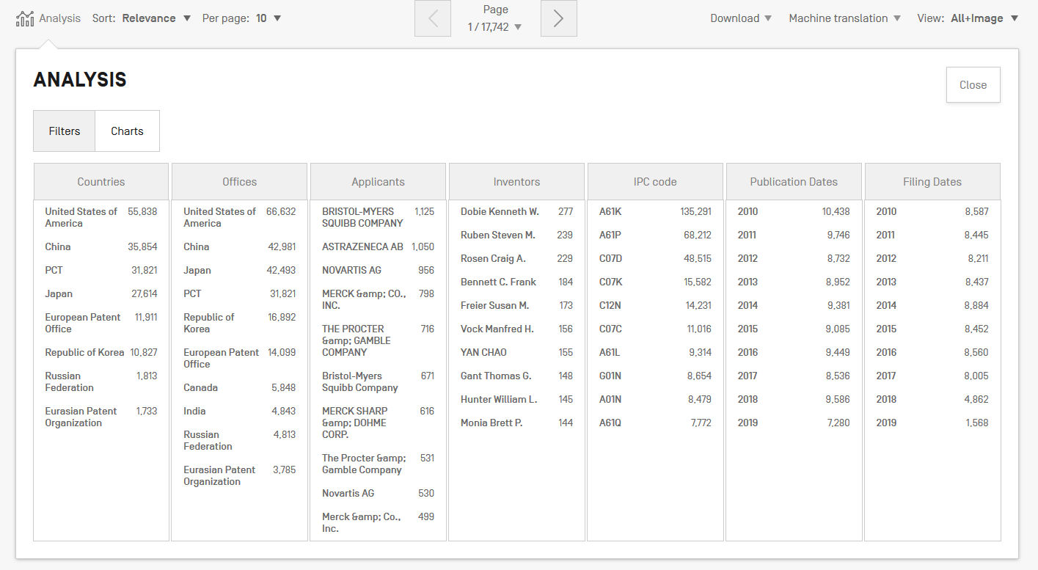
Analysis

Slide 32
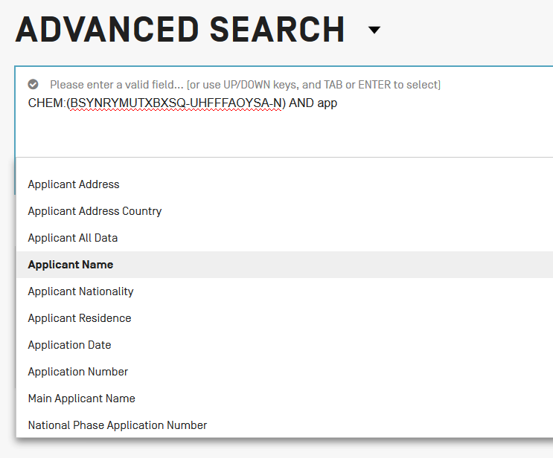
Combine with applicant

Slide 33
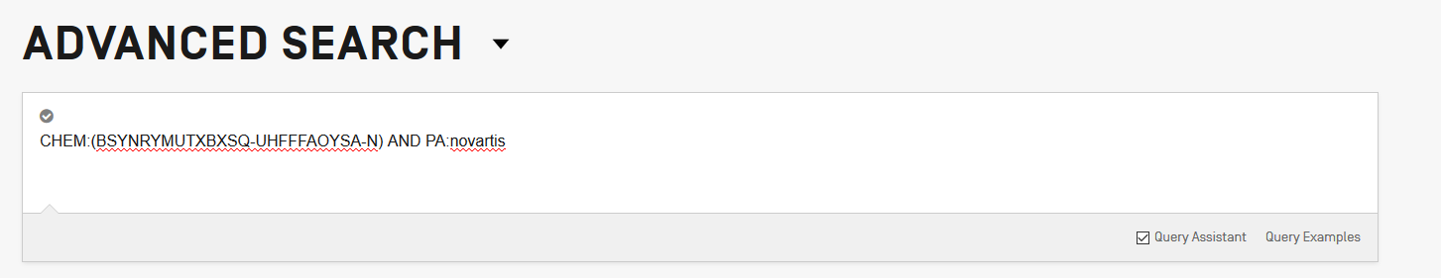

Slide 34
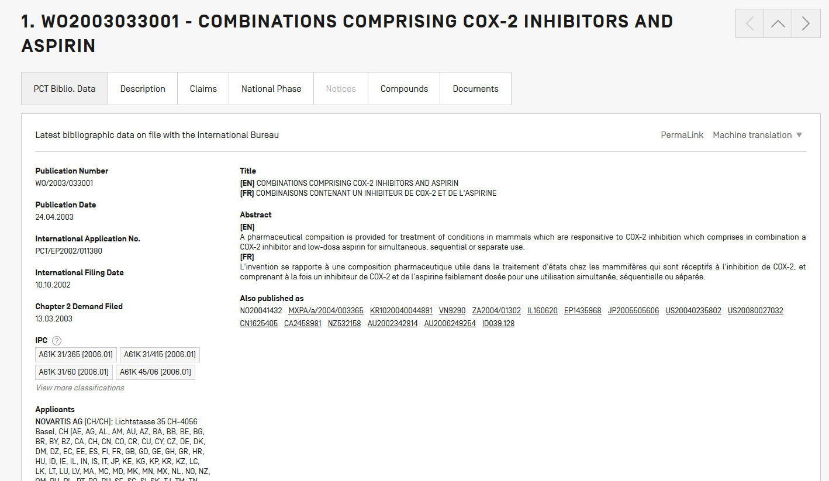

Slide 35
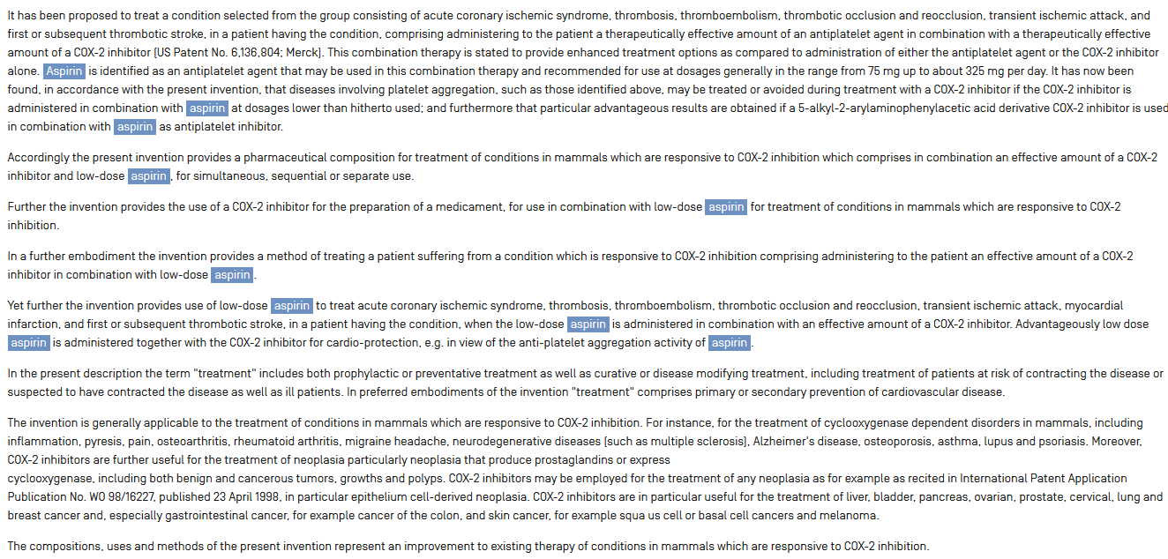

Slide 36
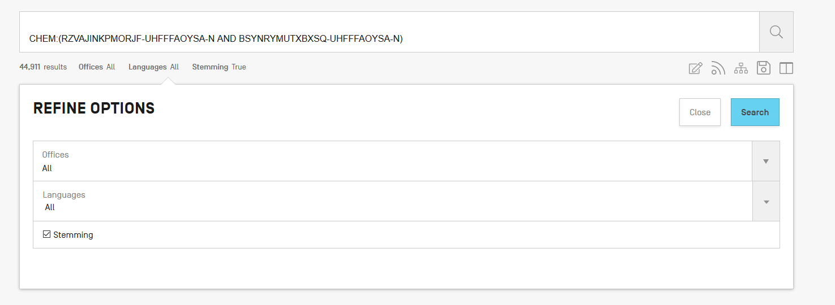
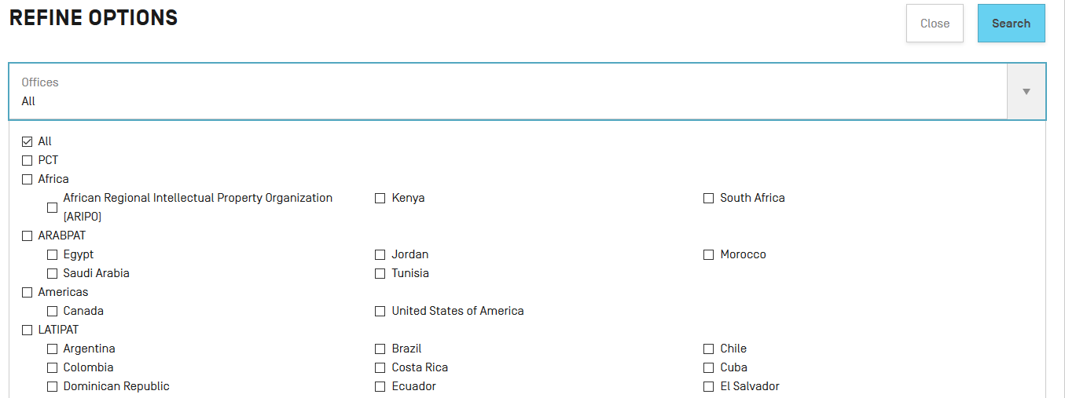
Combine with a country

Slide 37
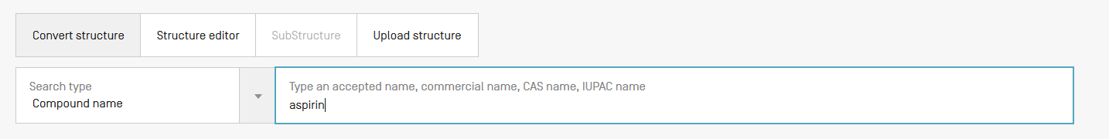
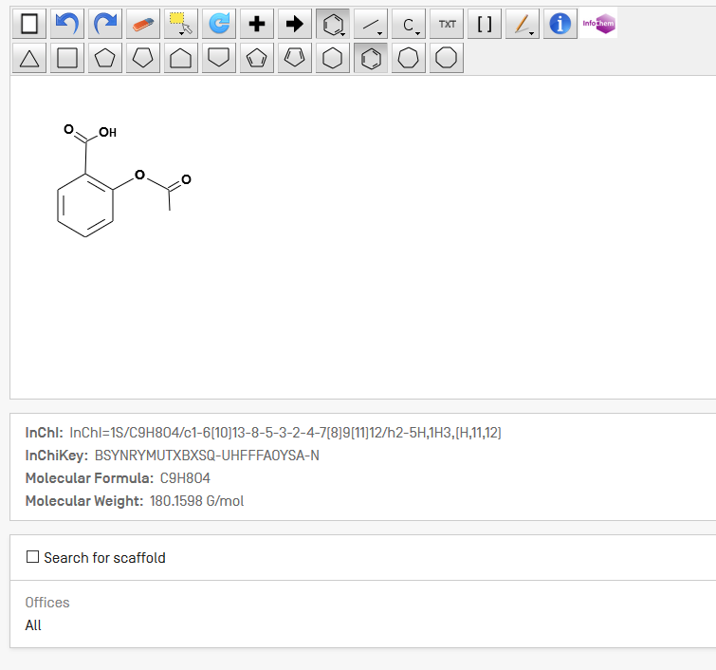
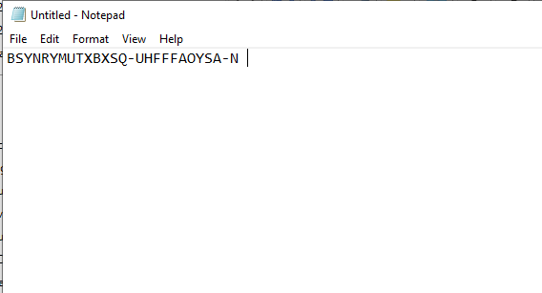
Combine 2 compounds
Notes:
I will now show you how to use the system with the example of theobromine.
The IUPAC name of theobromine is 3,7 dimethyl 1H purine 2,6 dione. It can be found in dark chocolate and is responsible for it’s bitter taste.
37

Slide 38
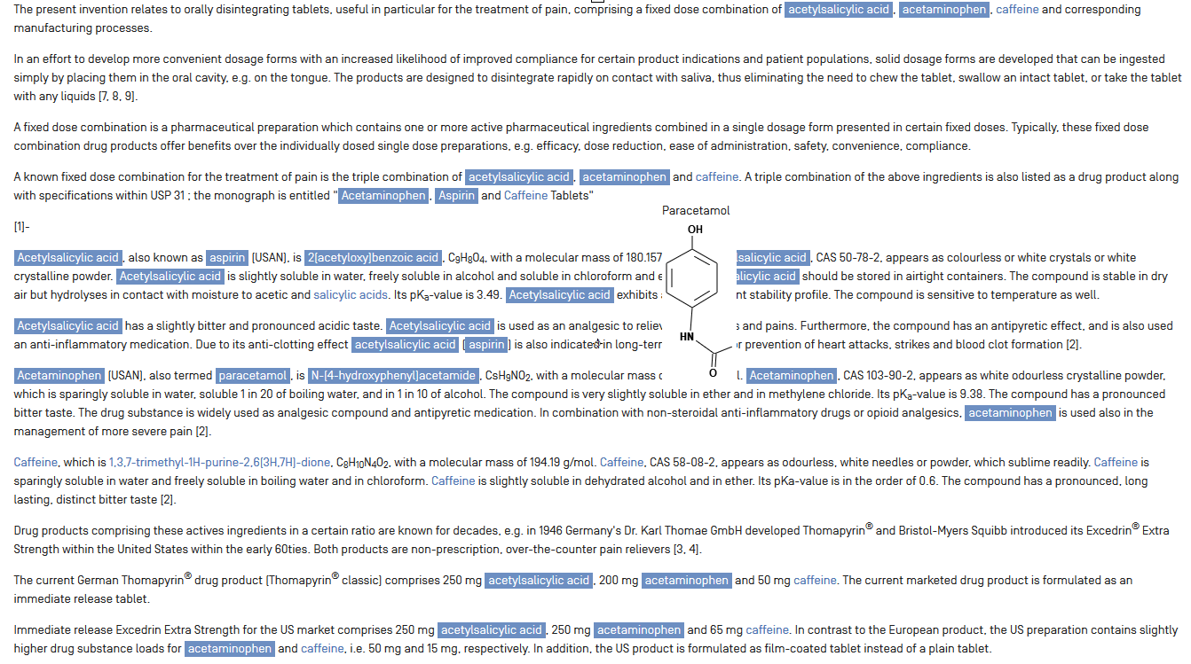
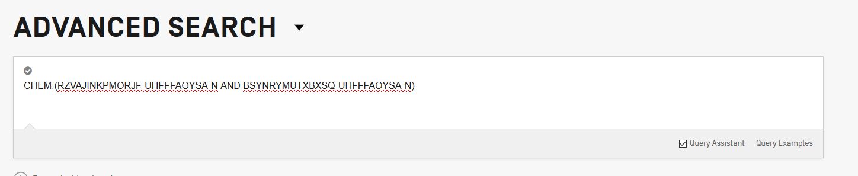

Slide 39
Example formula searching
4-(3-chloro-2-fluoroanilino)-7-methoxy-6-((1-(N-methylcarbamoylmethyl)piperidin-4-yl)oxy)quinazoline

Slide 40
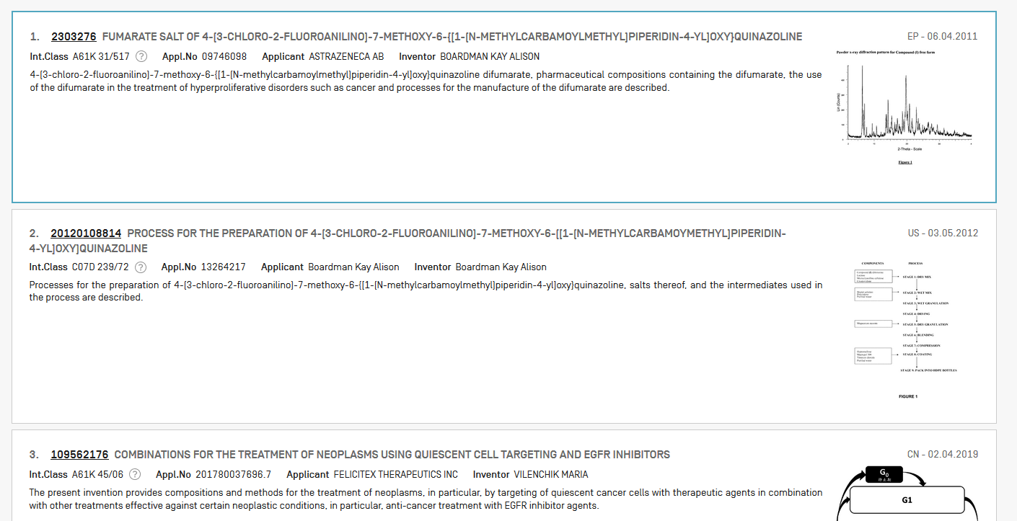

Slide 41
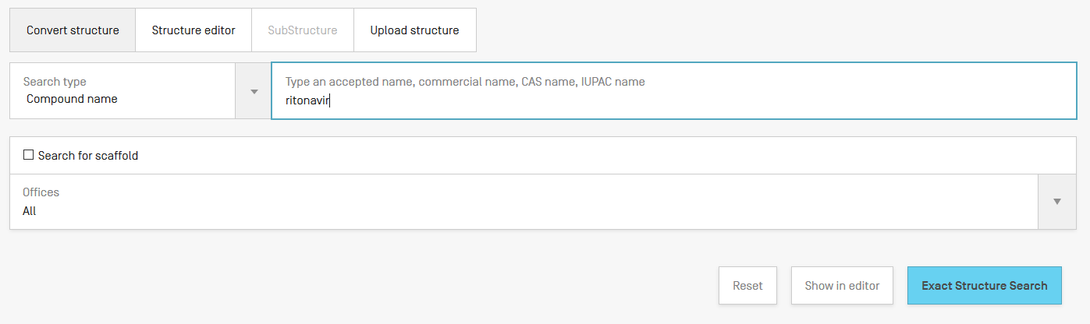
Example: Ritonavir

Slide 42
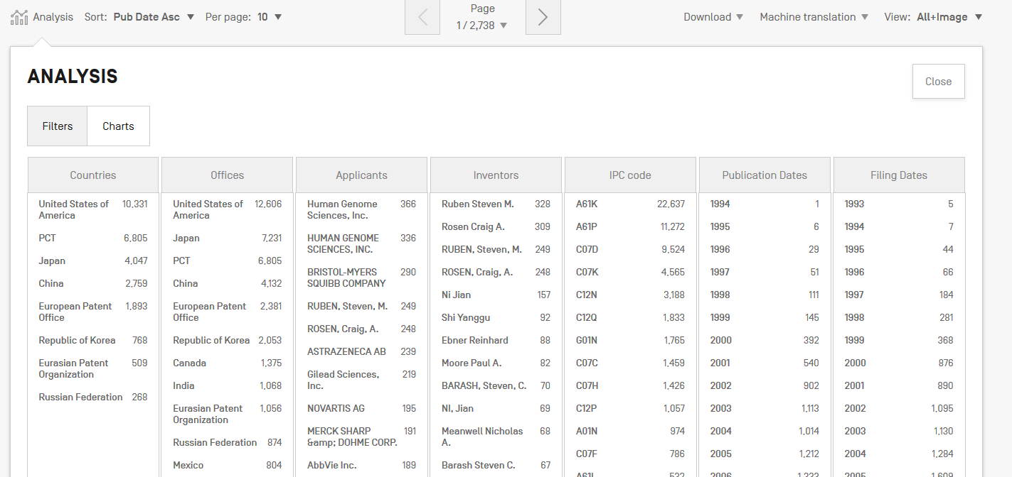

Slide 43
Patent landscape Report on Ritonavir-
Ritonavir is an antiretroviral drug from the protease inhibitor class used to treat HIV infection and AIDS. Ritonavir is included in the WHO Model List of Essential Medicines (EML)1.
The originator company is Abbott Laboratories, which markets Ritonavir under the brand name Norvir, or in combination with the protease inhibitor Lopinavir, as Kaletra or Aluvia. The U.S. Food and Drug Administration (FDA) approved the drug in March 1996 for oral solution and in June 1999 for capsules.
http://www.wipo.int/edocs/pubdocs/en/patents/946/wipo_pub_946.pdf

Slide 44
Sub-structure search – the concept
Identification of elements in larger structures
Notes:
Back in October 2016, we added the chemical search tool
It’s was developed on by InfoChem
You can draw the molecule or can search by compound name, INN, Inchi, SMILES or upload a MOL of images file
Chemical annotation of PATENTSCOPE full-text documents using InfoChem’s ICANNOTATOR

Slide 45
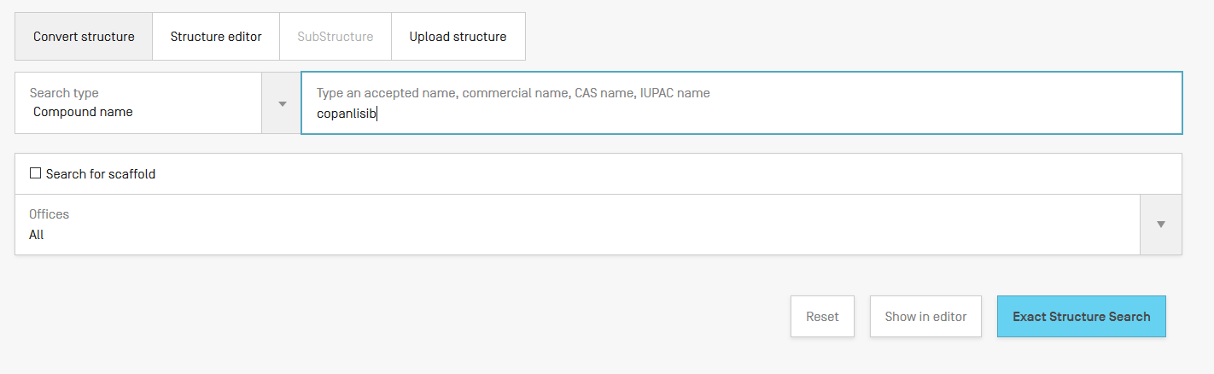
Substructure search

Slide 46
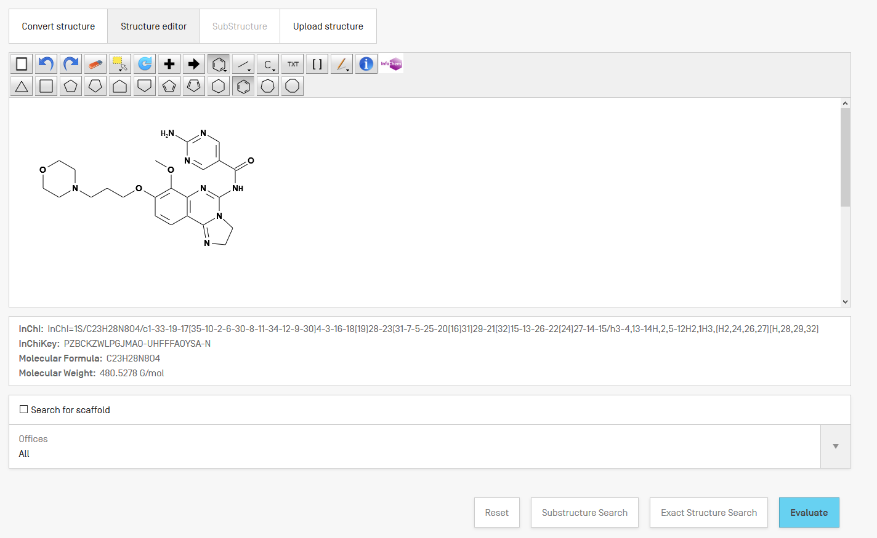

Slide 47
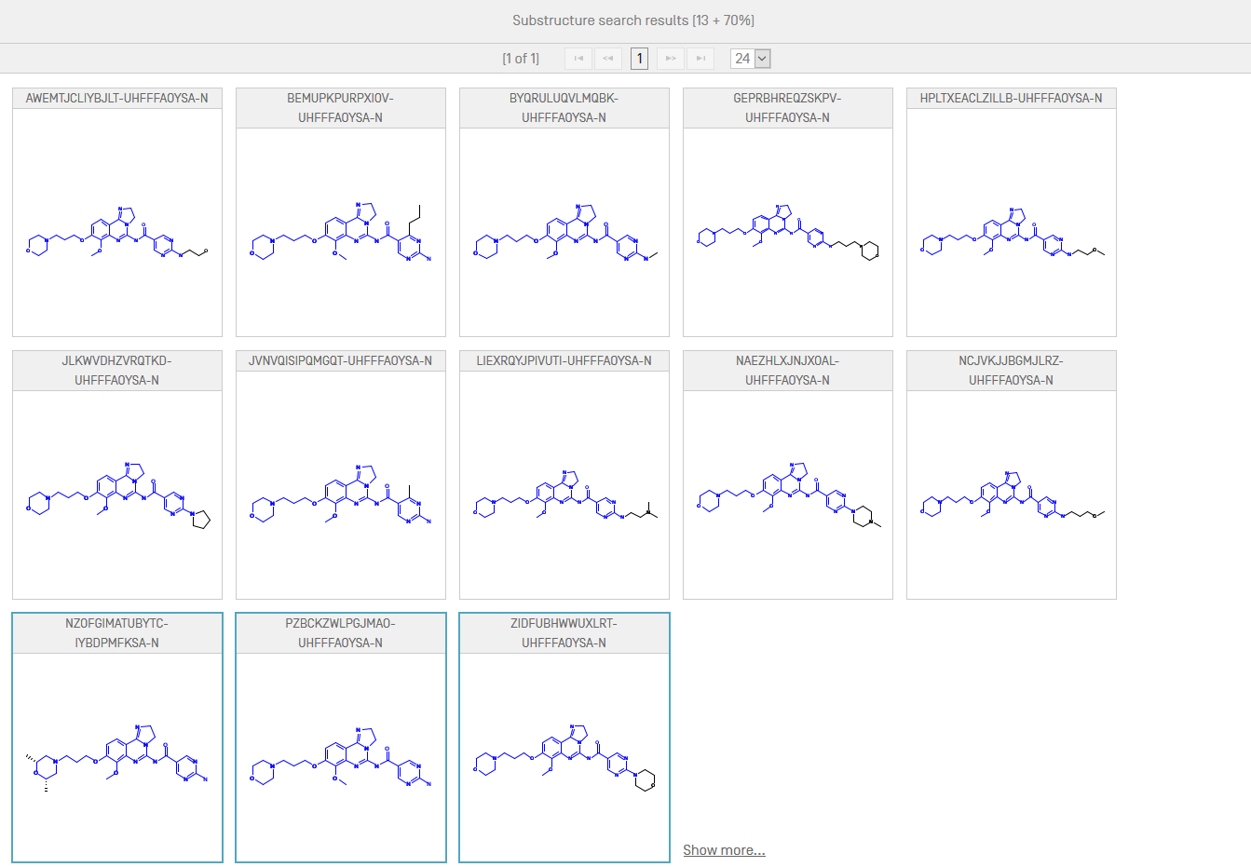
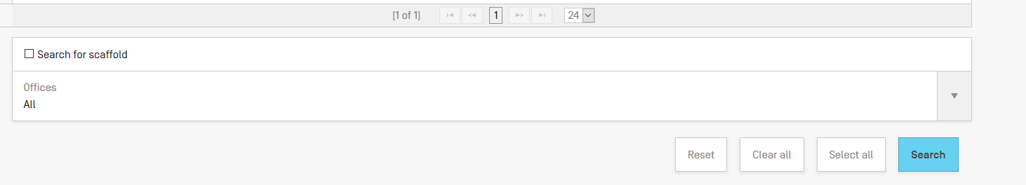

Slide 48
Restrict to the claims field
CHEM:( Inchikey BEFORE10000 description)

Slide 49
Can I search?
Stereoisomer
Monomer
Enantiomer
CAS name
Polymer, Poly(vinyl alcohol)
Inorganic cluster
Metal-organic framework
Transformable into InchI reactions
Reaction search
DNA sequence listing
Reaction search

Slide 50
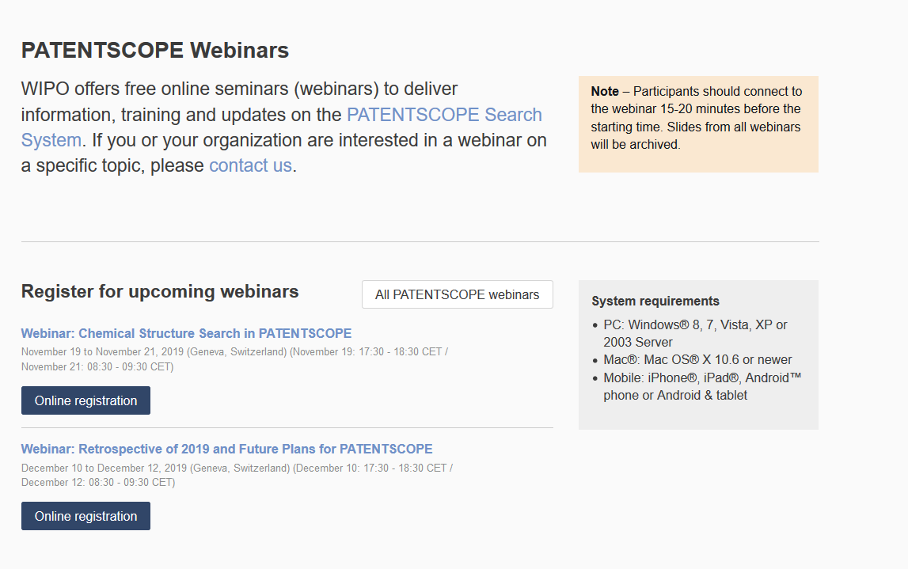
Future/past webinars:
wipo.int/patentscope/en/webinar

Slide 51
Next webinar
Retrospective of 2019 & plans for 2020
  December 10 5:00 pm
  https://attendee.gotowebinar.com/rt/3849374112211650563
  December 12 at 8:30 am
  https://attendee.gotowebinar.com/rt/3849374112211650563

Slide 52
INN searches
November 29 @ 5:30pm CET
https://attendee.gotowebinar.com/register/8341279340858653197

Slide 53
Global Brand Database: webinar
How to read, save and share your results in the Global Brand Database
  December 3 at 5:30 pm CET
  https://attendee.gotowebinar.com/register/5334242575331711234

Slide 54
Global Design Database: webinar
An introduction
  November 26 at 5:30 pm CET
  https://attendee.gotowebinar.com/register/569514433922545666

Slide 55


Slide 56
What are the document formats that can be uploaded to the "upload structure" search engine?
MOL, PNG, GIF, TIFF and JPEG
Is it possible to search for short aminoacid sequences?
No, unless you have the name such as in my example with Ritonavir
Is it possible to search on peptide sequences?
No
Is it possible to do a combination of more than one chemical structure apart from using InchI Key?
All chemical structure searches are done using InchIkeys

Slide 57
For new molecules are InchI keys provided by the software?
Following the general IPUC rules, our engine creates the InchIkeys.
Are these structure searches confidential ?
Yes
Does it search other than PCT
Yes, please see the list on slide 12
About the collection from other countries, I saw that Mexico is not included, but it can appear as a result from the search?
Not at the moment for chemical structure searches

Slide 58
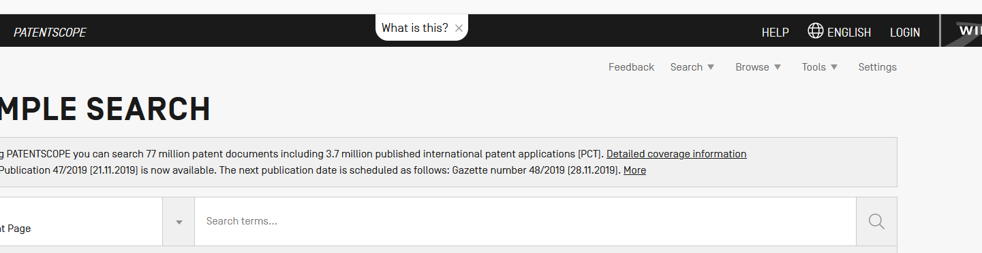
Does it search in the non-patent literature?
No
How to get a WIPO account?
Click the Login button to access the page to create the account
Is there an API option for the chemical search?
NO

Slide 59

patentscope@wipo.int

