Slide 1
PATENTSCOPE
Translation tools
May
2019
Sandrine Ammann
Marketing & Communications Officer

Slide 2
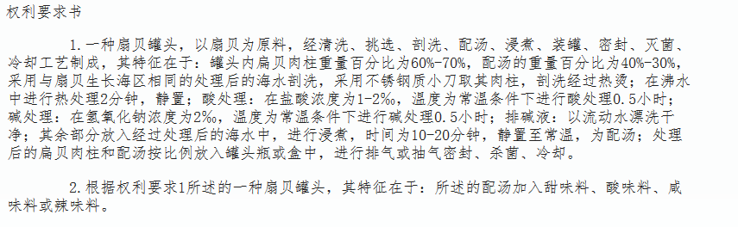


Slide 3
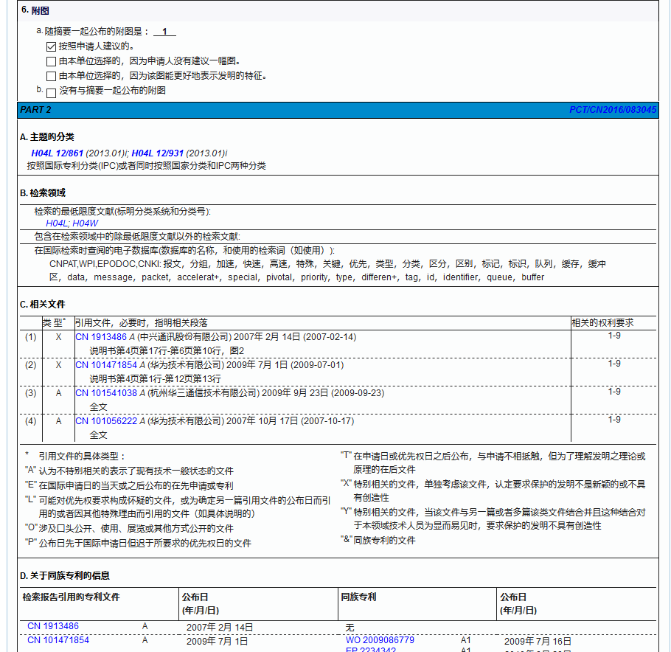

Slide 4
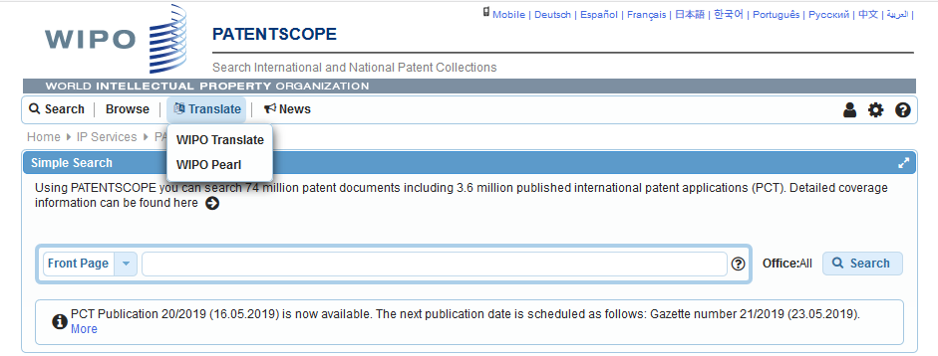
WIPO Translate

Slide 5
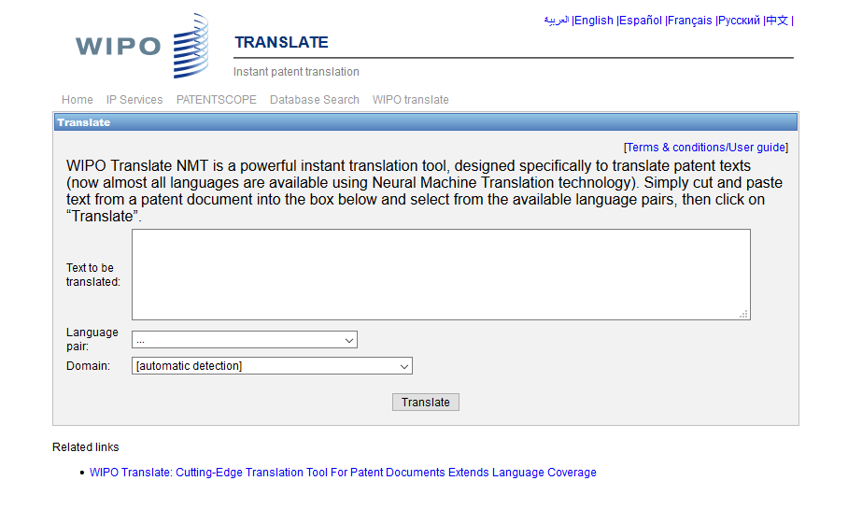

Slide 6
18 Language pairs
Arabic – English English-Arabic
Chinese – English English - Chinese
French – English English - French
German – English English - German
Japanese – English English - Japanese
Korean – English English - Korean
Portuguese – English English - Portuguese
Russian – English English - Russian
Spanish – English English - Spanish

Slide 7
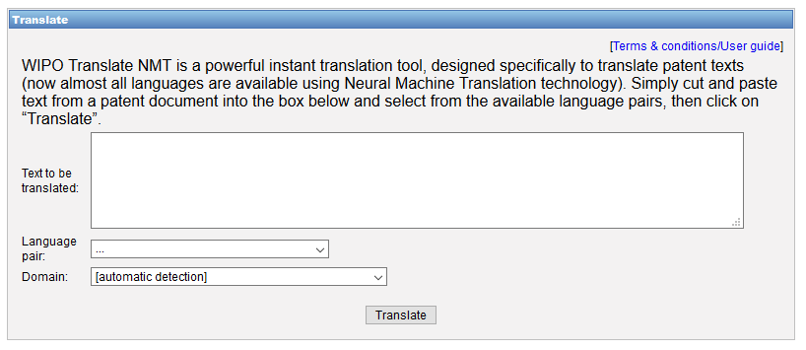
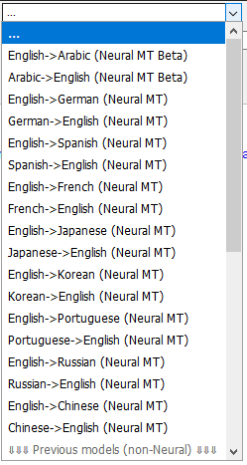

Slide 8
32 Technical domains from the IPC
[ADMN] Admin, Business, Management & Soc Sci
[AERO] Aeronautics & Aerospace Engineering
[AGRI] Agriculture, Fisheries & Forestry
[AUDV] Audio, Audiovisual, Image & Video Tech
[AUTO] Automotive & Road Vehicle Engineering
[BLDG] Civil Engineering & Building Construction
[CHEM] Chemical & Materials Technology
[DATA] Computer Sci, Telecom & Broadcasting
[ELEC] Electrical Engineering & Electronics
[ENGY] Energy, Fuels & Heat Transfer Eng
[ENVR] Environmental & Safety Engineering
[FOOD] Foods & Food Technology
[GENR] Generalities, Language, Media & Info Sci
[HOME] Home Contents & Household Maintenance
[HORO] Precision Mechanics, Jewelry & Horology
[MANU] Manufacturing & Materials Handling Tech
[MARI] Marine Engineering
[MEAS] Standards, Units, Metrology & Testing
[MECH] Mechanical Engineering
[MEDI] Medical Technology
[METL] Metallurgy
[MILI] Military Technology
[MINE] Mining, Oil & Gas Extraction & Minerals
[NANO] Nano Technology
[PACK] Packaging & Distribution of Goods
[PRNT] Printing & Paper
[RAIL] Railway Engineering
[SCIE] Optical Engineering
[SPRT] Sports, Leisure, Tourism & Hospitality
[TEXT] Textile & Clothing Industries
[TRAN] Transportation

Slide 9
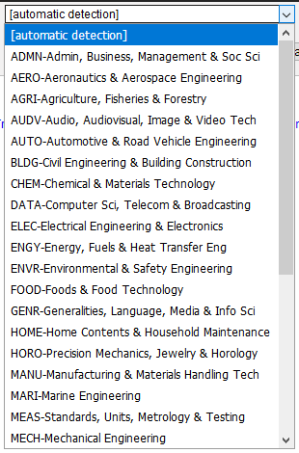

Slide 10
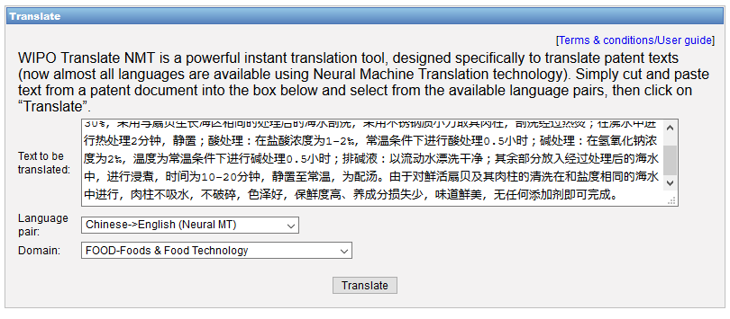
WIPO Translate: an example

Slide 11
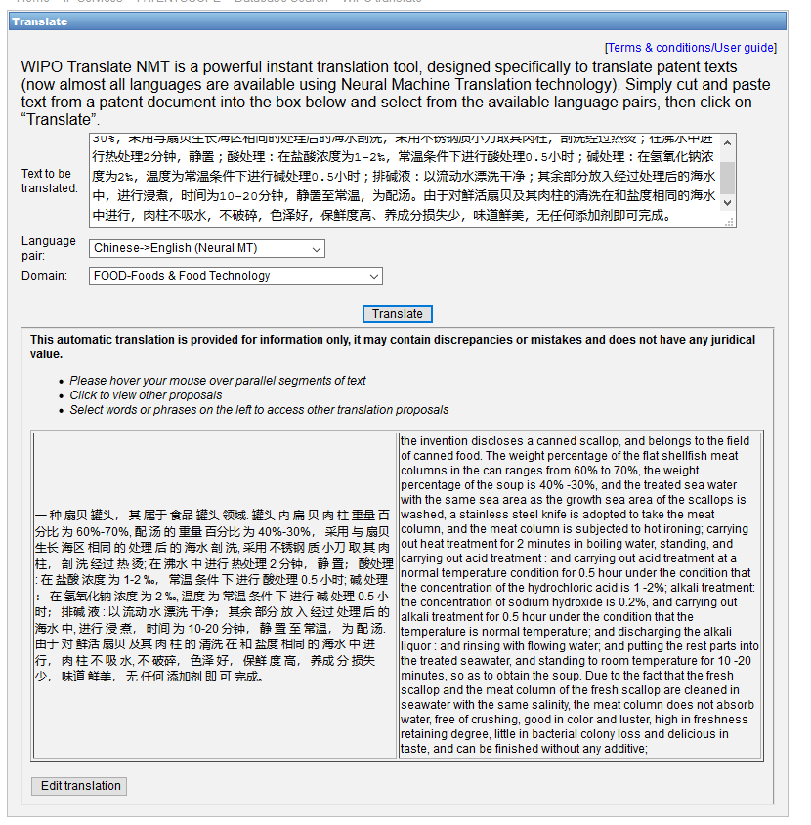

Slide 12
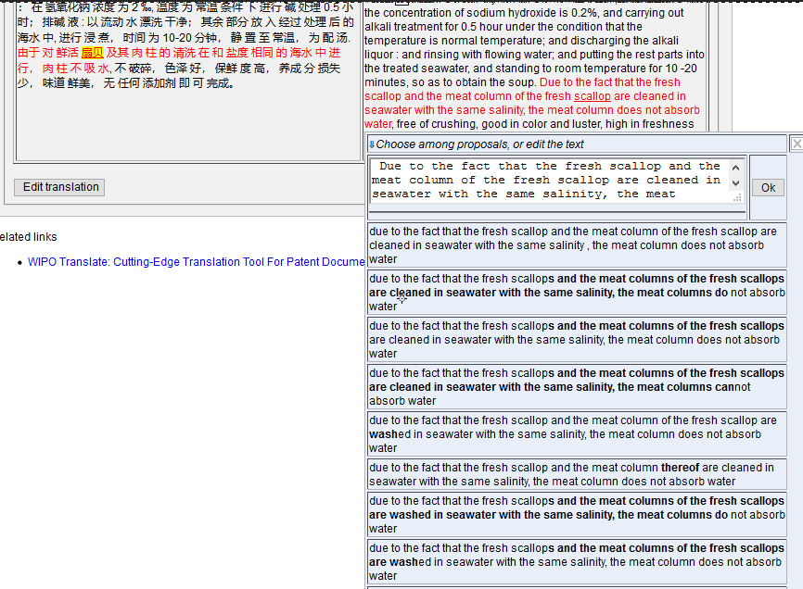

Slide 13
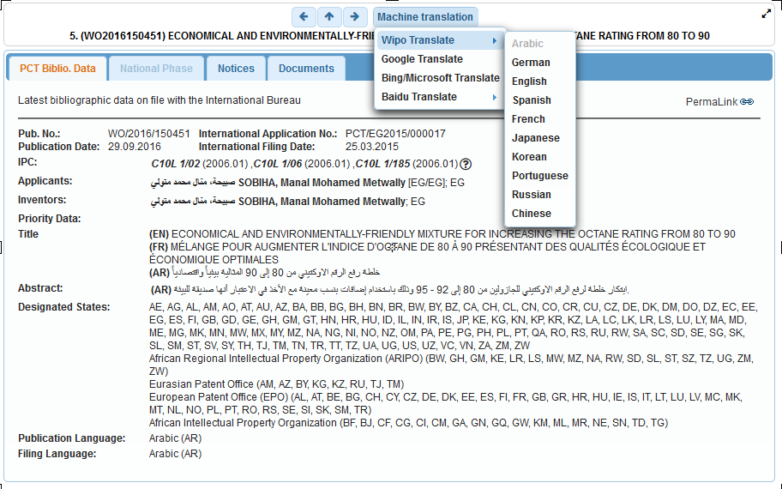
WIPO Translate: biblio data

Slide 14
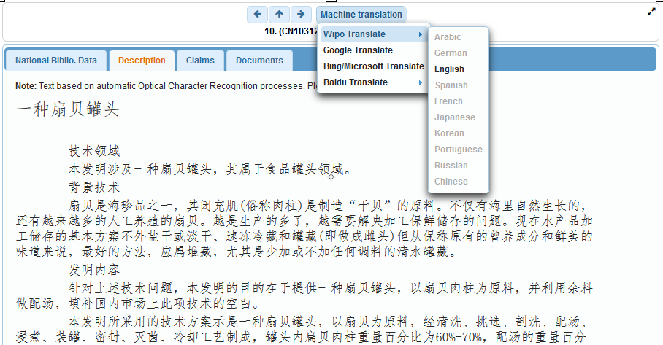
WIPO Translate: description/claims

Slide 15
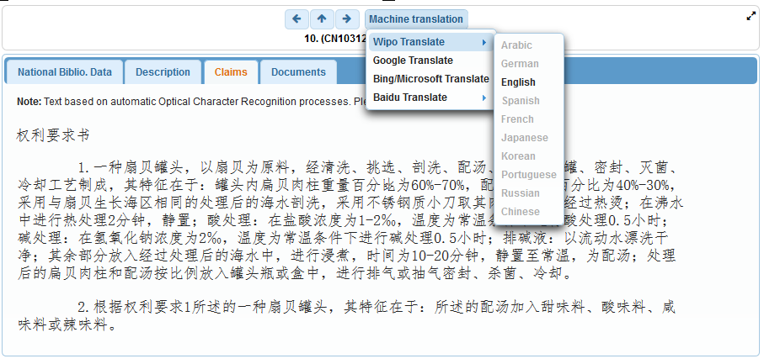

Slide 16
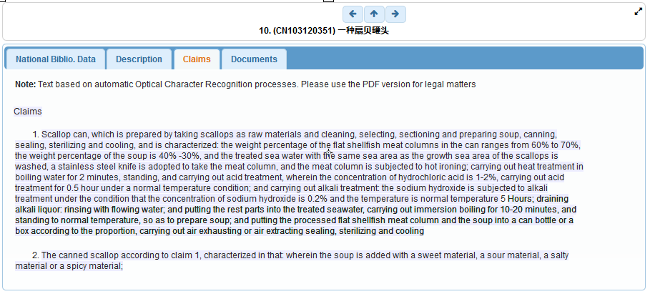

Slide 17
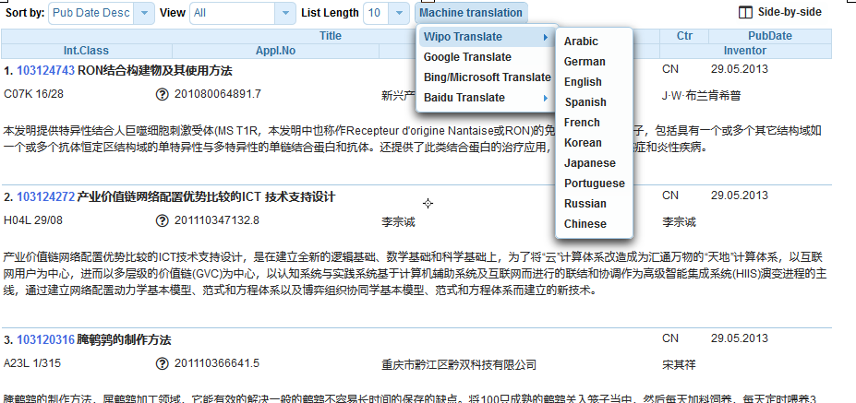
Result list

Slide 19
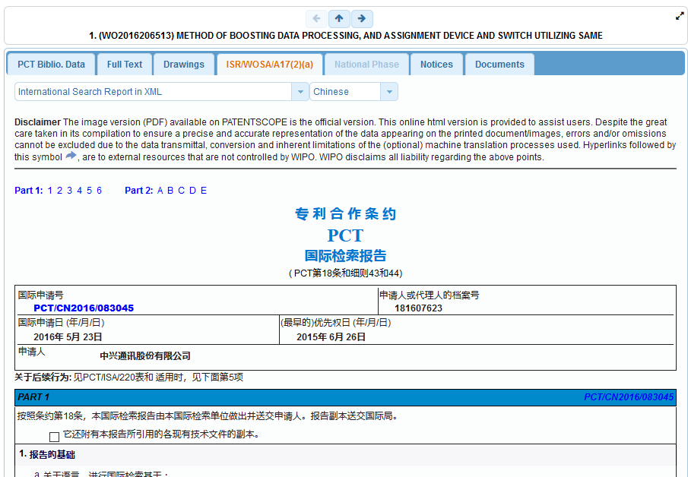

Slide 21

An example

Slide 22
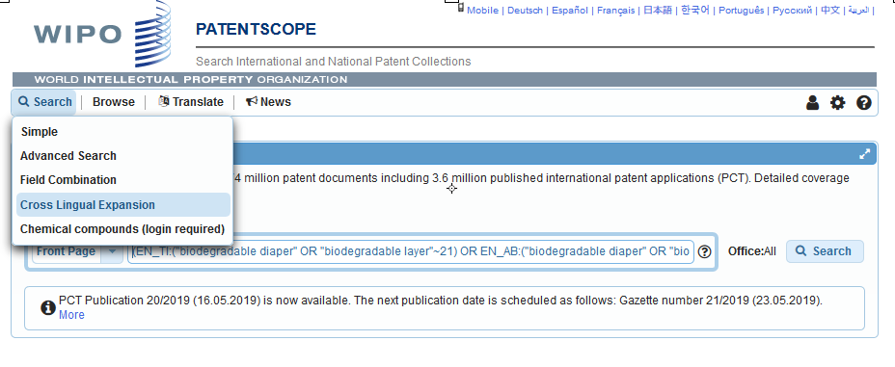
CLIR

Slide 23
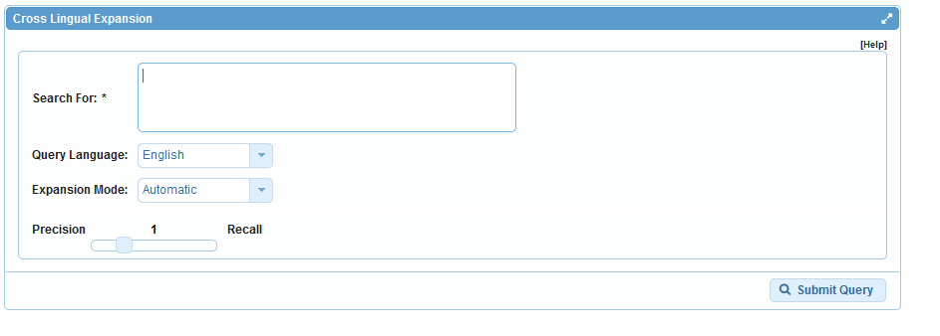
CLIR: interface

Slide 24
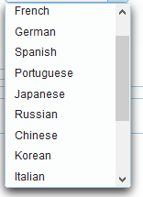
CLIR: query language

Slide 26
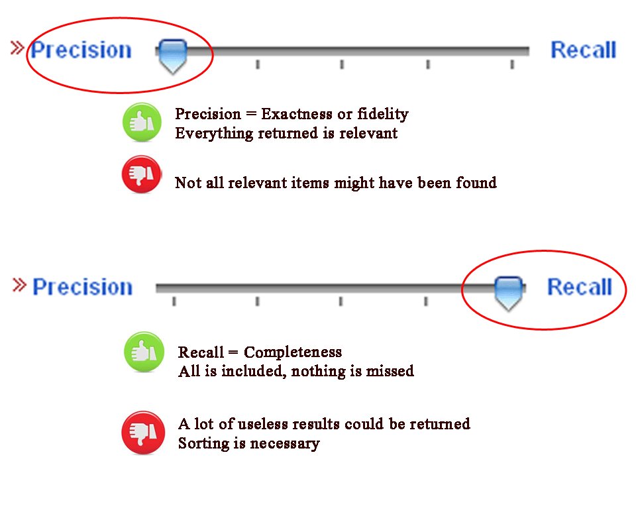
CLIR: precision vs recall

Slide 27
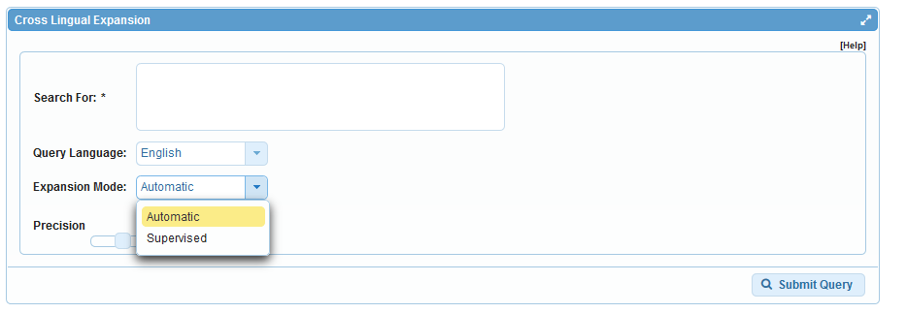
CLIR: expansion mode

Slide 28
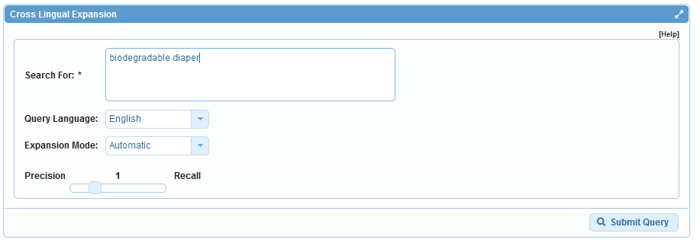
CLIR: an example

Slide 29
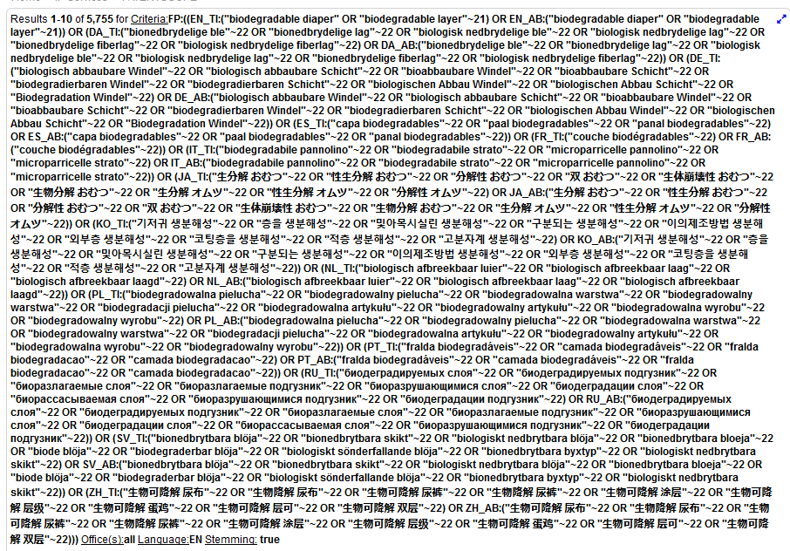
CLIR: an example

Slide 30
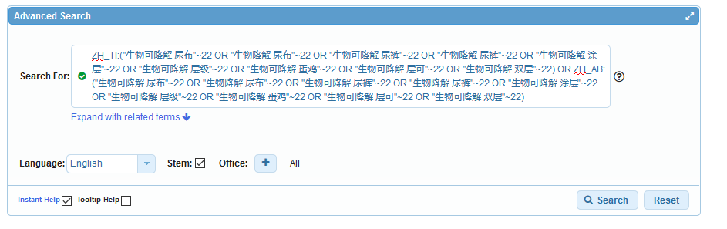
Advanced search

Slide 31
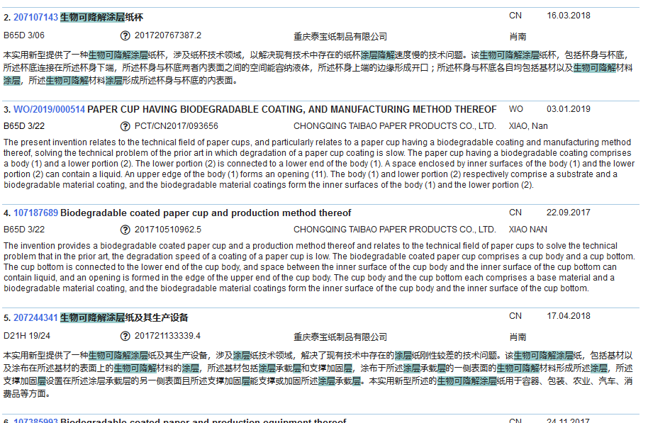

Slide 32
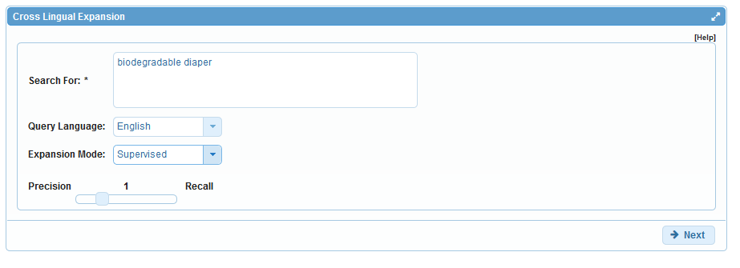
CLIR: supervised

Slide 33
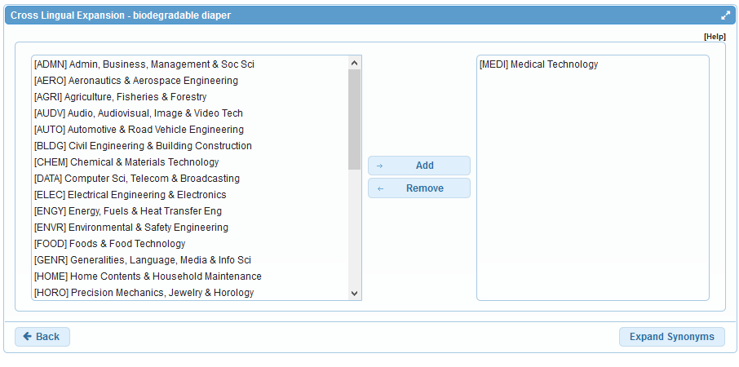
Domain selection

Slide 34
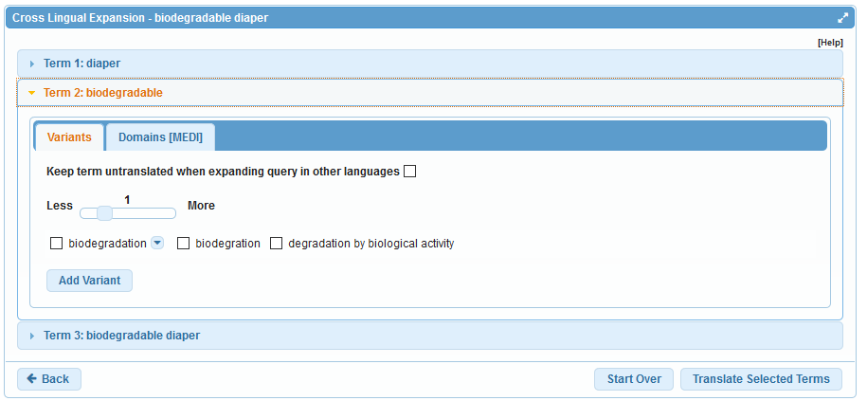
Variants selection

Slide 35
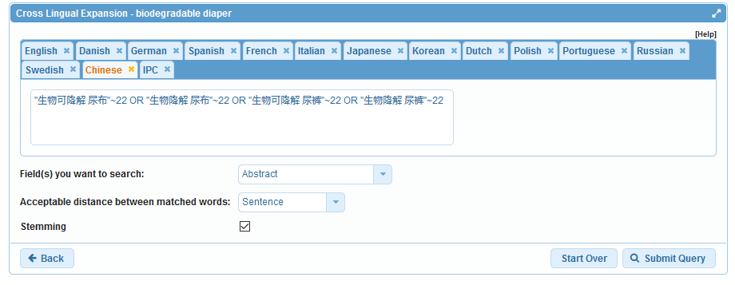
Summary of variants

Slide 36
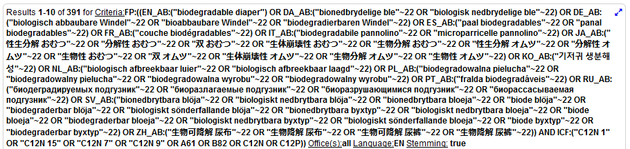
Results

Slide 37
WIPO Translate

Slide 38
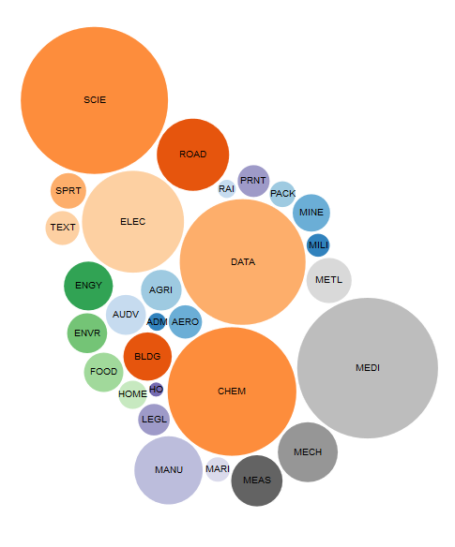
WIPO Pearl http://www.wipo.int/wipopearl/search/home.html

Slide 39

WIPO Pearl
WIPO’s online terminology database
17’000 concepts, 115’000 terms
10 languages
Contents validated by WIPO language experts and terminologists

Slide 40
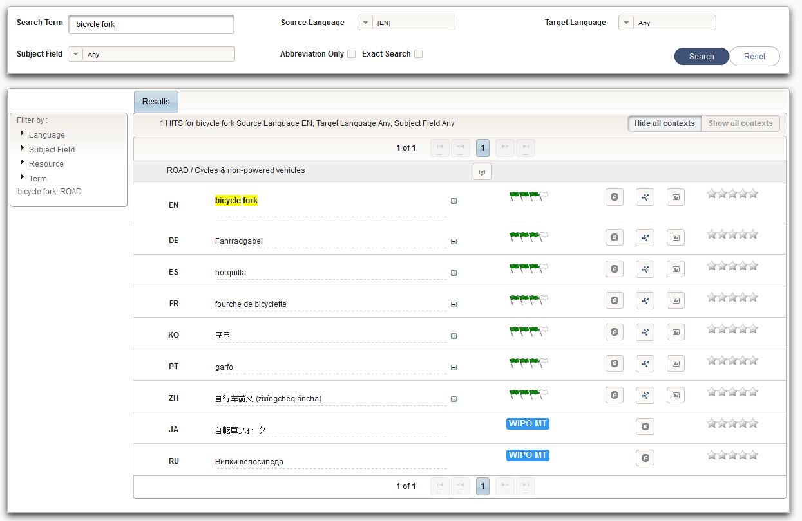
Example: bicycle fork

Slide 41
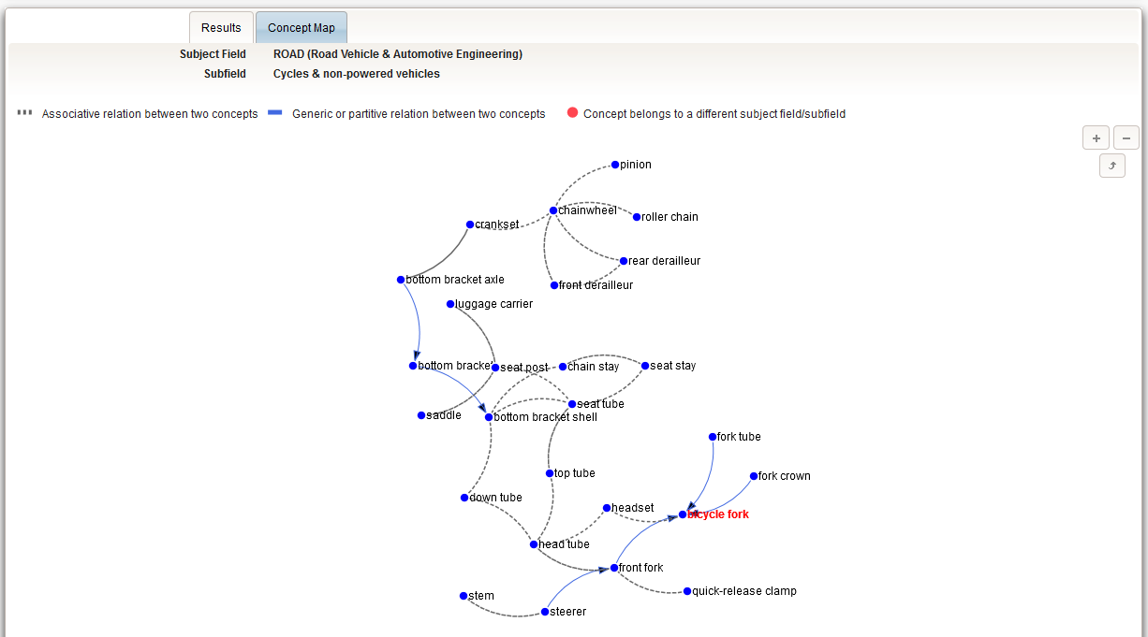

Slide 42


Slide 43
Q1: If in your result list, there a document in Greek, can you use WIPOTranslate to translate it?
A
No
B
Yes

Slide 44

Q1: If in your result list, there a document in Greek, can you use WIPOTranslate to translate it?
A
No
B
Yes

Slide 45
Q 2: if you would like to find synonyms and translation of your search which tool should you use?
A
CLIR
B
WIPO Translate

Slide 46
Q 2: if you would like to find synonyms and translation of your search which tool should you use?
A
CLIR
B
WIPOTranslate

Slide 47
Q3: In CLIR, which mode provides, in most cases, the longest queries?
A
supervised
B
automatic

Slide 48
Q3: In CLIR, which mode provides, in most cases, the longest queries?
A
supervised
B
automatic

Slide 49
Next webinar: June 18 or 20
Chemical structure search
To register:
https://attendee.gotowebinar.com/rt/1699217551444301571

Slide 50
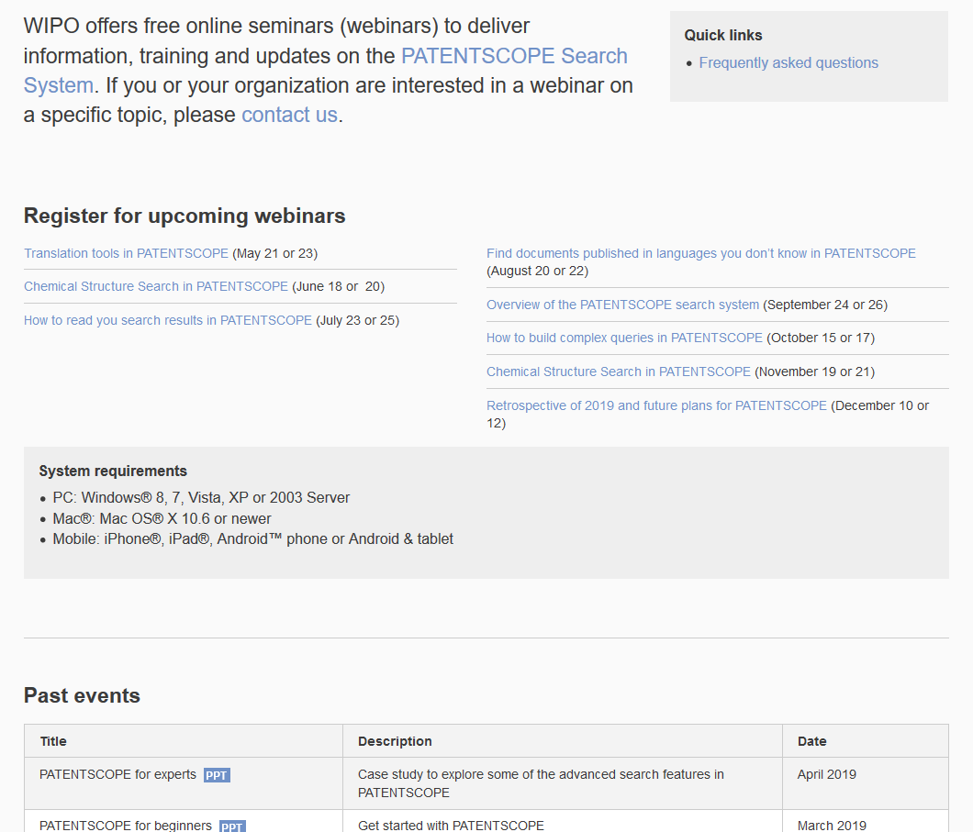
Future/past webinars:
wipo.int/patentscope/en/webinar

Slide 51
Global Design Database: webinar
Overview of the Global Design Database
  May 28 at 5:30pm CET
  https://attendee.gotowebinar.com/register/1422514455239388418

Slide 52
Global Brand Database: webinar
How to read, save & share your results in the Global Brand Database
  June 12 at 5:30pm CET
  https://attendee.gotowebinar.com/register/1483704476348386818

Slide 53


Slide 54
Questions
WIPO Translate
  Recommended length of a text to have better results?
  There is no recommendation in terms of text lengths. However, if you have one long sentence, fitting on 3 lines for example, we recommend that you cut it into different bits.
  Can you translate the entire document or does it have to be done in sections? Sections of 2000 characters
  Which browser do you recommend for Translate? Results are very similar with all browsers except IE

Slide 55
WIPO Translate
  Do you offer the translation only via Copy&Paste? No export option of translation?
That is correct no export option is available at the moment.
  All language pairs include English. Is there any way to use WIPO translate to translate from other pairs, such as French-Spanish? Yes using pivot translation by translating first French into English and then English into Spanish.
CLIR
  Does the CLIR tool search the entire patent specification, including the abstract? Using the supervised mode will allow you to define the field against which you would like to perform your search

Slide 56
Miscellaneous
  What kind of operators can we use on top of AND, OR and NOT? BEFORE, NEAR and ANDNOT are also supported
  What is stemming? It is an algorithm that remove common endings of words. When you enter support, in your results, you will also have supported, supporting, supports, etc.
  Do you have collaboration with Asian patent offices to increase quality of translations? Collaboration in terms of data exchange: the more data the better the system can be trained and the better the quality of translations.

Slide 57

patentscope@wipo.int

