Slide 1
CLIR
PATENTSCOPE search system
Cyberworld
September
2018
Sandrine Ammann
Marketing & Communications Officer

Slide 2
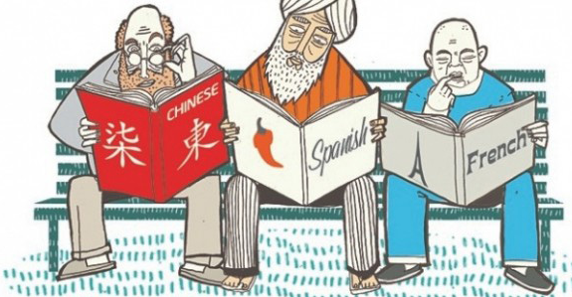
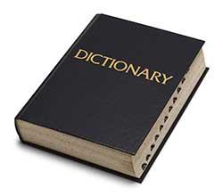
Patent keyword searches: challenges

Slide 3
CLIR
Cross-Lingual Information Retrieval

Slide 4
What is it?
1. Finds synonyms:
container receptacles/ reservoir/tank
2. Translates into 13 languages
container
emballage
conteneurs
contenants
Verpackung
Transportbehälter
Behältnisses
behaallare
viravattenbehållare
pappersmaskins
集装箱
容器
盒
Zbiorników
Pojemnika
kontenerowego
envase
contenedor
tanque
contentor
receptáculo
embalagem
용기
기
탱크
recipienti
serbatoio
riserva
Контейнера
Емкости
резервуара
toevoertank
watervat
opslagtank
コンテナ
タンク
貯槽
Fartøj
Påfyldningsindretning

Slide 5
Q:1 How many of you are already familiar with CLIR?
A
yes
B
no

Slide 6
CLIR – 14 languages available
NON-ASIAN
Danish
Dutch
English
French
German
Italian
Polish
Portuguese
Russian
Spanish
Swedish
ASIAN
Chinese
Japanese
Korean

Slide 7
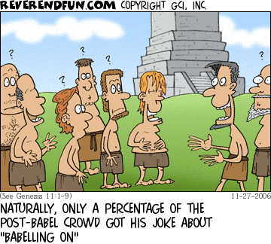
Historical background

Slide 8
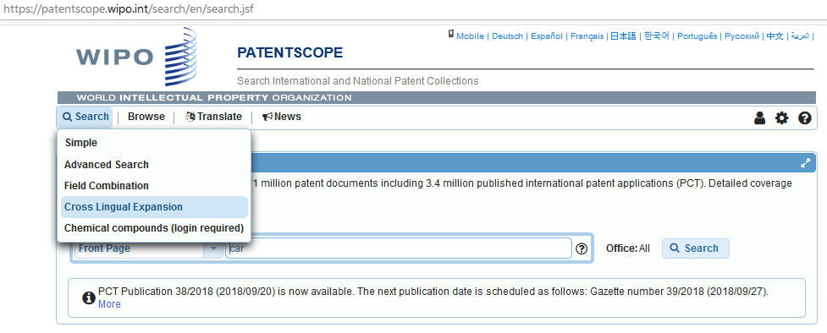
Where to find it?

Slide 9
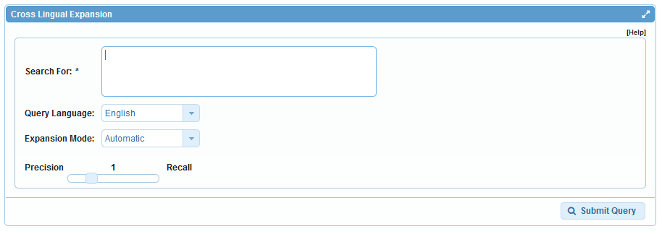
How to use it? Interface

Slide 10
Query language
Define the language of the query:

Slide 11
Expansion mode
2 modes:
  Automatic = 1 step
  Supervised = 4 steps

Slide 12
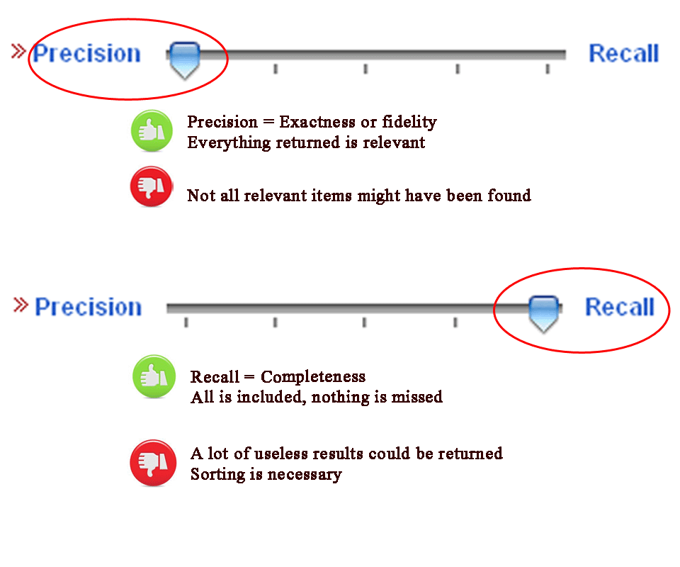
CLIR: precision vs recall

Slide 13
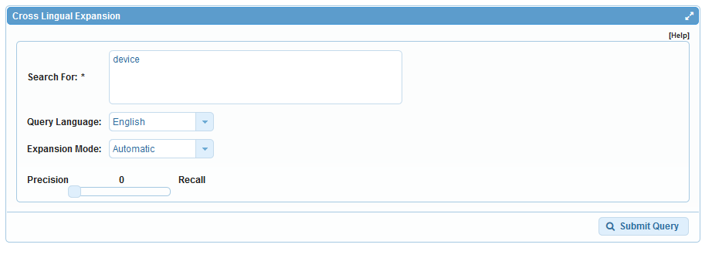
Example: precision

Slide 14
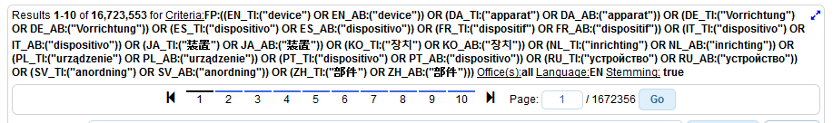
Results for «precision»

Slide 15
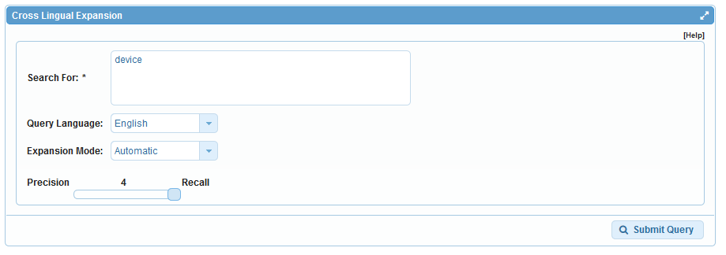
Example: recall

Slide 16
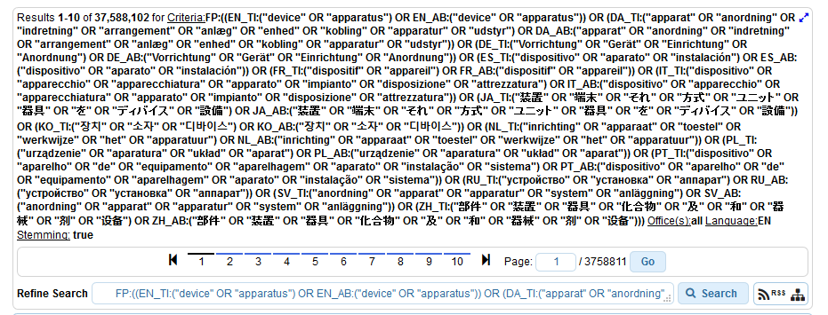
Results for «recall»

Slide 17

Example
Source:https://www.kickstarter.com/projects/igreenpod/biodegradable-coffee-pod-from-portland-oregon

Slide 18
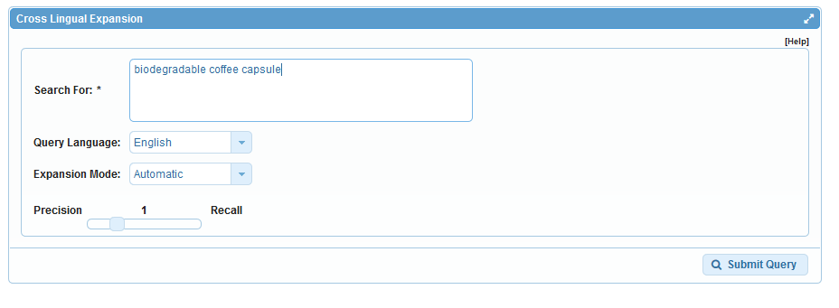
Automatic mode

Slide 19
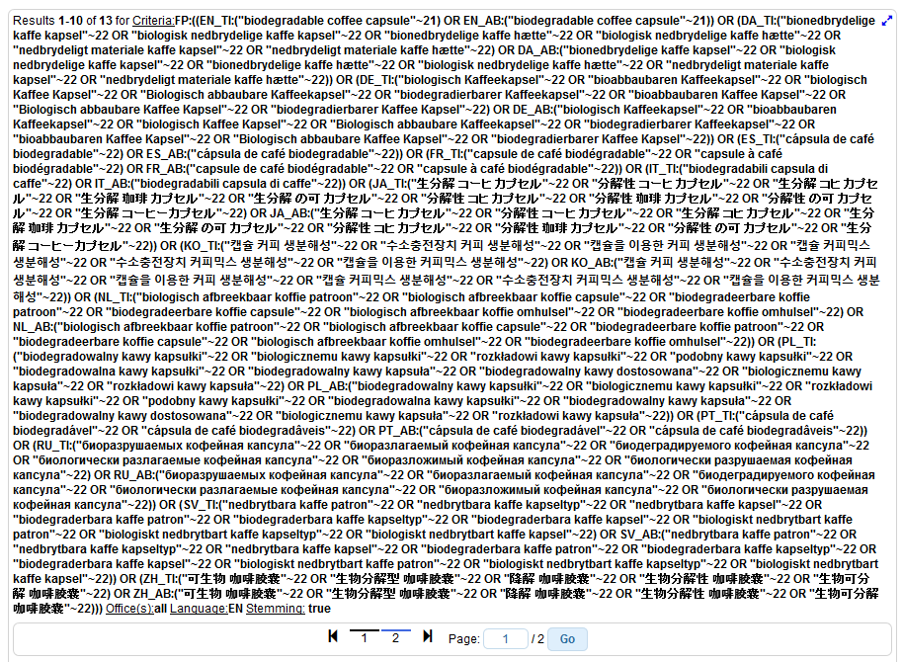

Slide 20
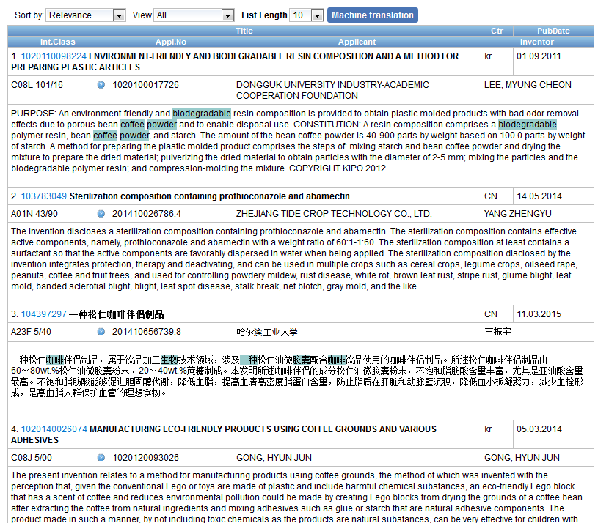
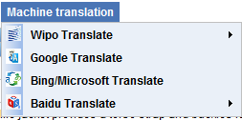
Result list

Slide 21
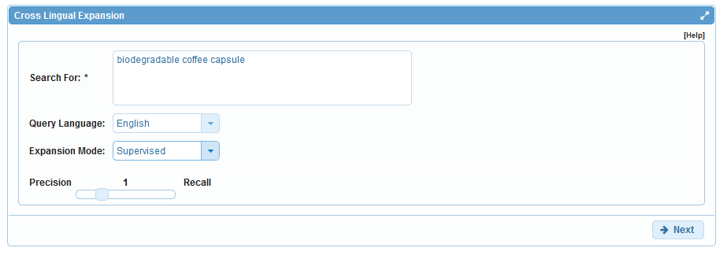
Supervised mode

Slide 22
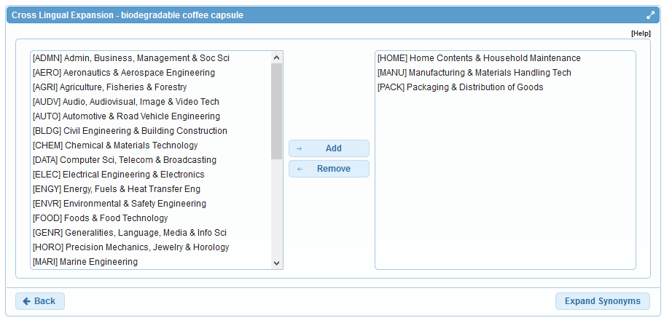
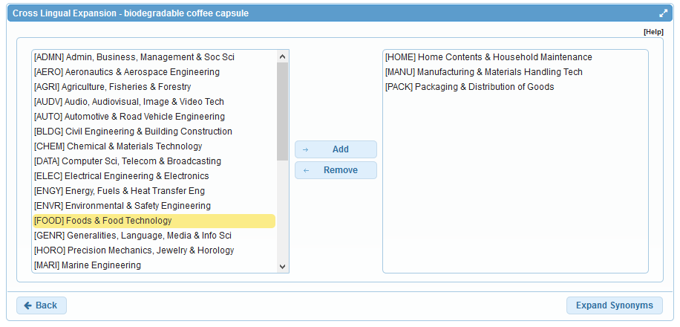
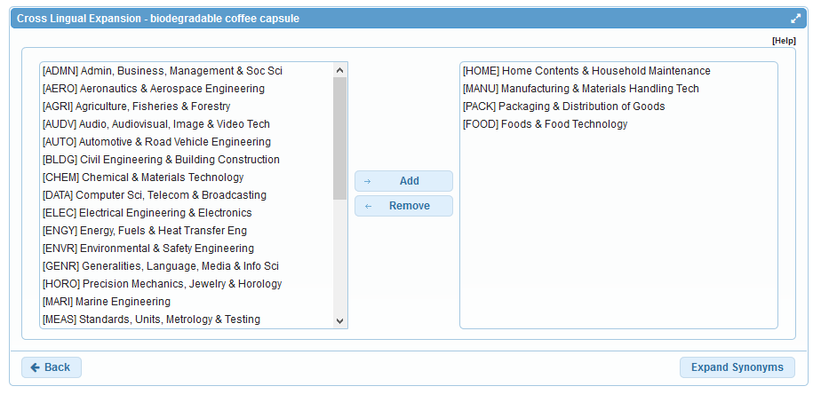
Step 1: technical field selection

Slide 23
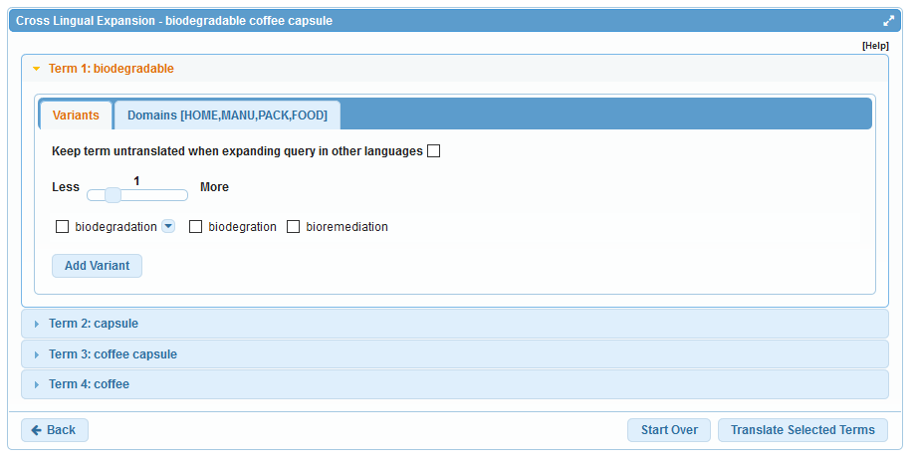
Step 2: synonym selection

Slide 24
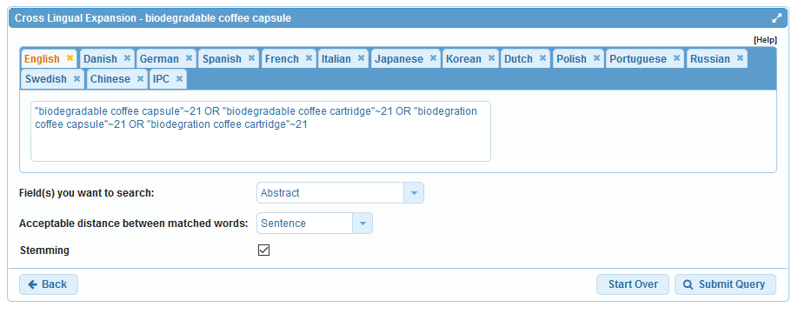
Step 3: translated term selection

Slide 25
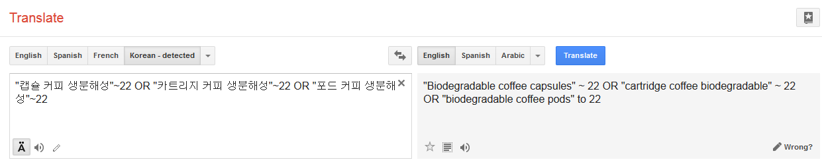
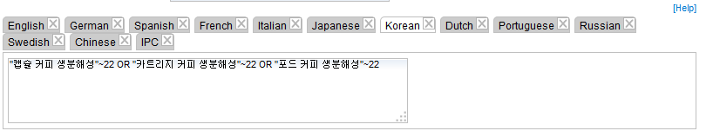
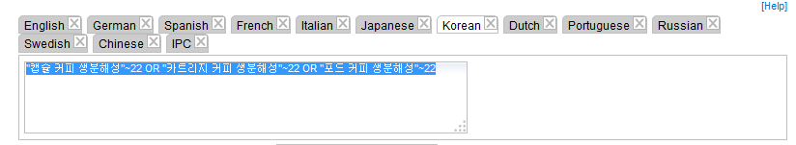
Relevance checking

Slide 26
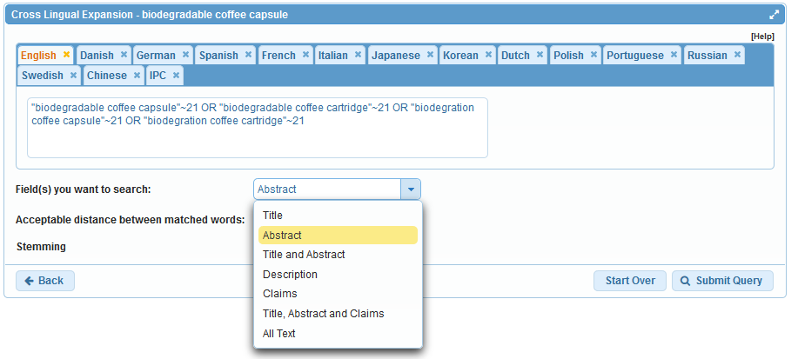
Fields

Slide 27
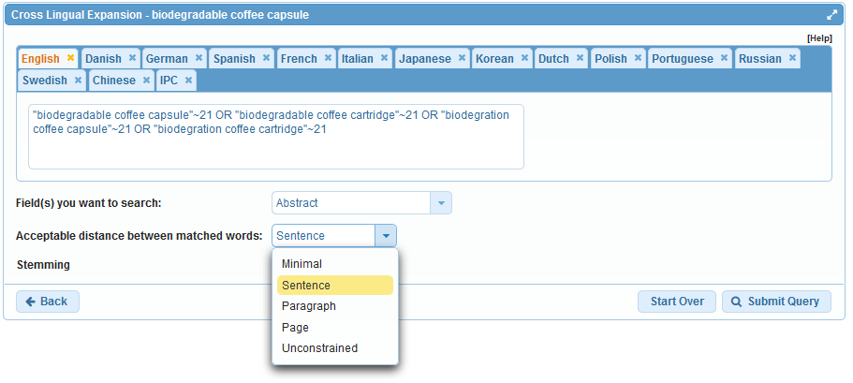
Acceptable distance

Slide 28
Stemming

Slide 29
Stemming
Use of the root form of a word
        displayed
        Display displaying
        displays

Slide 30
IPC checking

Slide 31
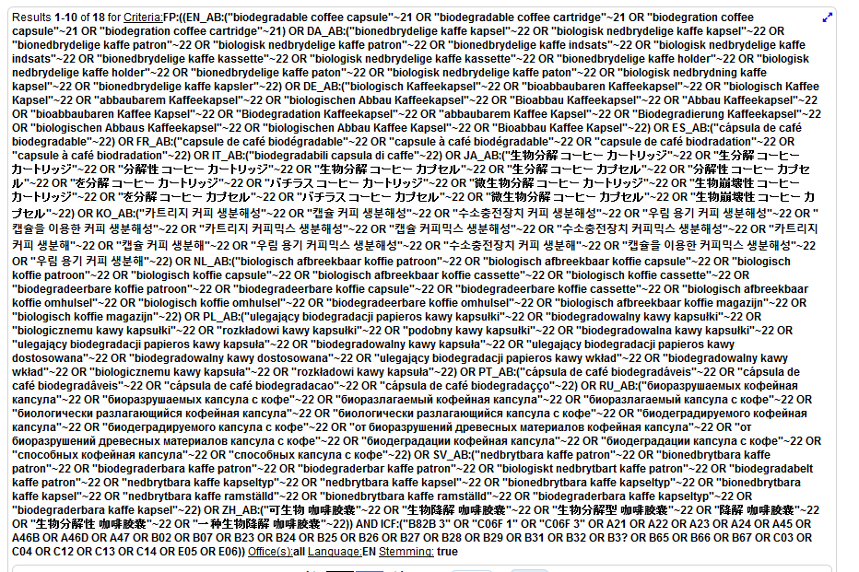

Slide 32
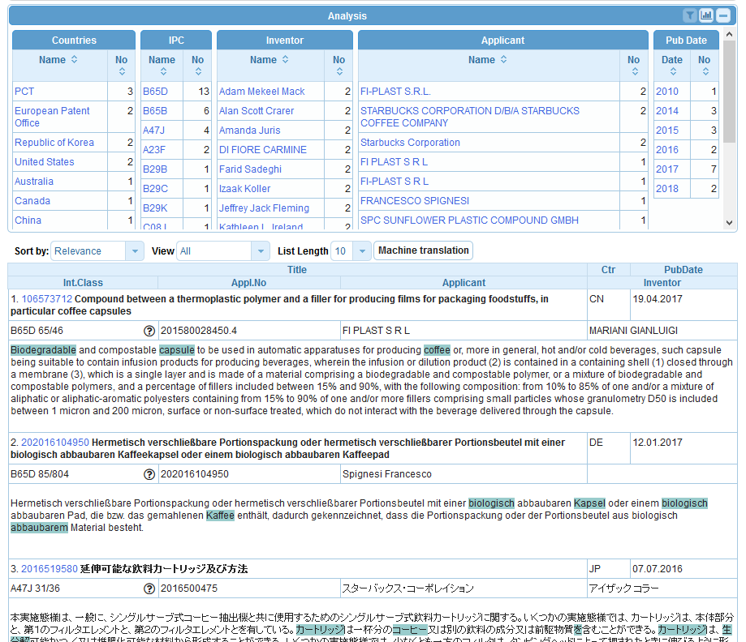

Slide 33
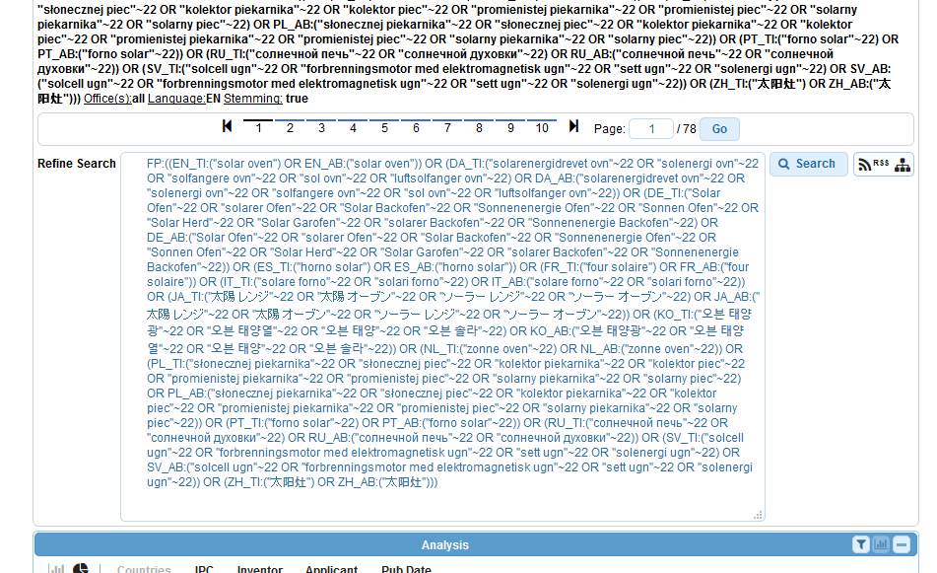
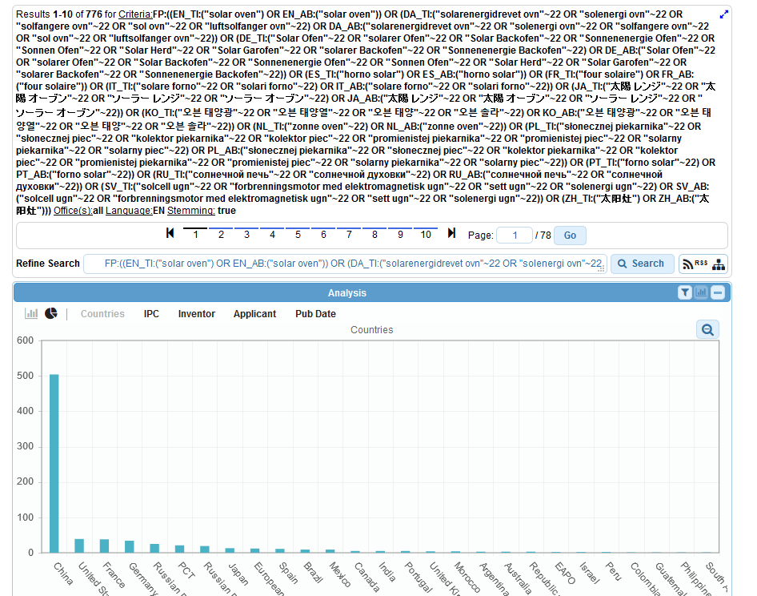
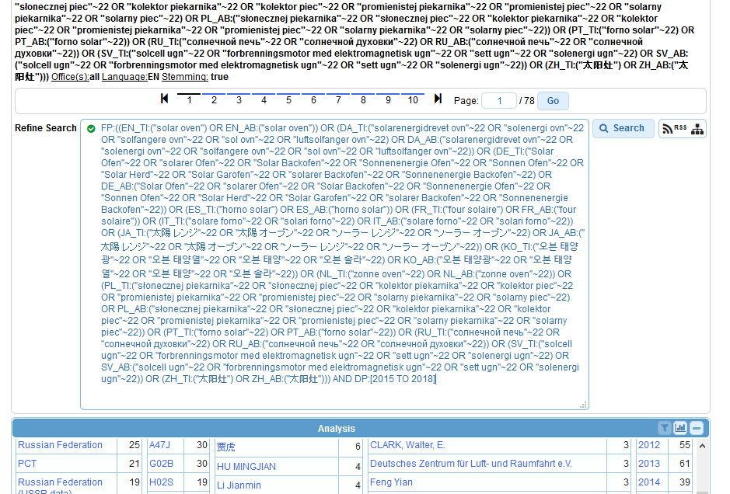
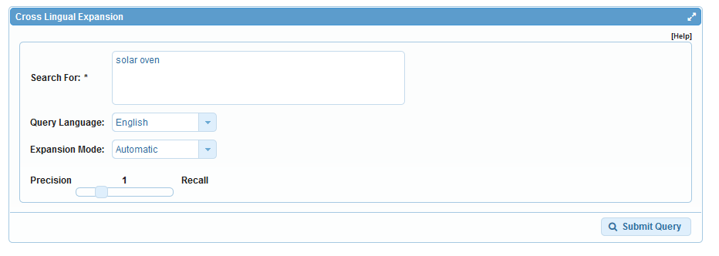
Query combination
solar oven + publication date

Slide 34
Why is CLIR useful?
Search full text collections simultaneously in many foreign languages
B) Improve significantly the number of relevant results without increasing significantly the number of irrelevant results
C) Have confidence in your searches:
No black box: users have access to the CLIR generated Boolean queries (albeit complex) and have the full control on them
D) Have a responsive system even for complex queries

Slide 35
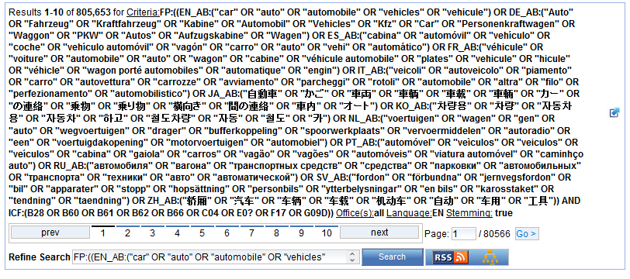

Slide 36
Q:3 which expansion mode was used to obtain this result list?
A
Automatic
B
Supervised

Slide 37

Q:3: which expansion mode was used to obtain this result list?
A
Automatic
C
Supervised

Slide 38
Q:2: which languages are supported by CLIR?
A
Chinese
B
Swedish
C
Korean
D
French

Slide 39
Q:2: which languages are supported by CLIR?
A
Chinese
B
Swedish
C
Korean
D
French
Spain

Slide 40
How to make the most of out CLIR?
Expansion modes:
  1meaning keyword = AUTOMATIC
  All other queries = SUPERVISED
Variants/synonyms
  words to be included in search results
  too many results delete generic variants

Slide 41
How to make the most of out CLIR?
Parameters:
  1. Title and abstract: unconstrained distance
  2. Claims: sentence/paragraph distance
  3. Description: sentence/paragraph distance
Stemming recommended

Slide 42
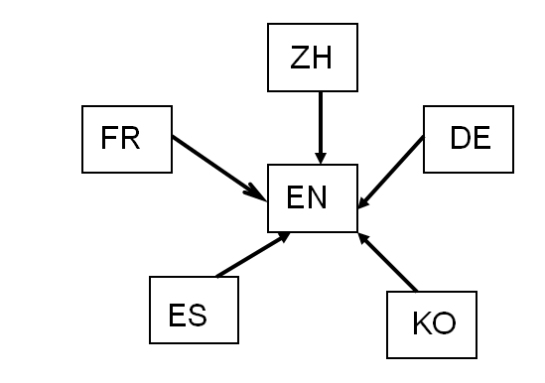
How was it developed?
Compilation of long lists of titles in language pairs
Creation of in-house extraction methodology
Tool learns statistical bilingual dictionaries of titles

Slide 43



Quality of dictionaries
  Chinese Korean Dutch
  English Portuguese Italian
  French Russian Swedish
  German Spanish Polish
  Japanese Danish

Slide 44
Disambiguation
Process of identifying the sense of a word in a sentence. http://en.wikipedia.org/wiki/Disambiguation_%28disambiguation%29
Applied to keywords:
  technical domains
  variants

Slide 45
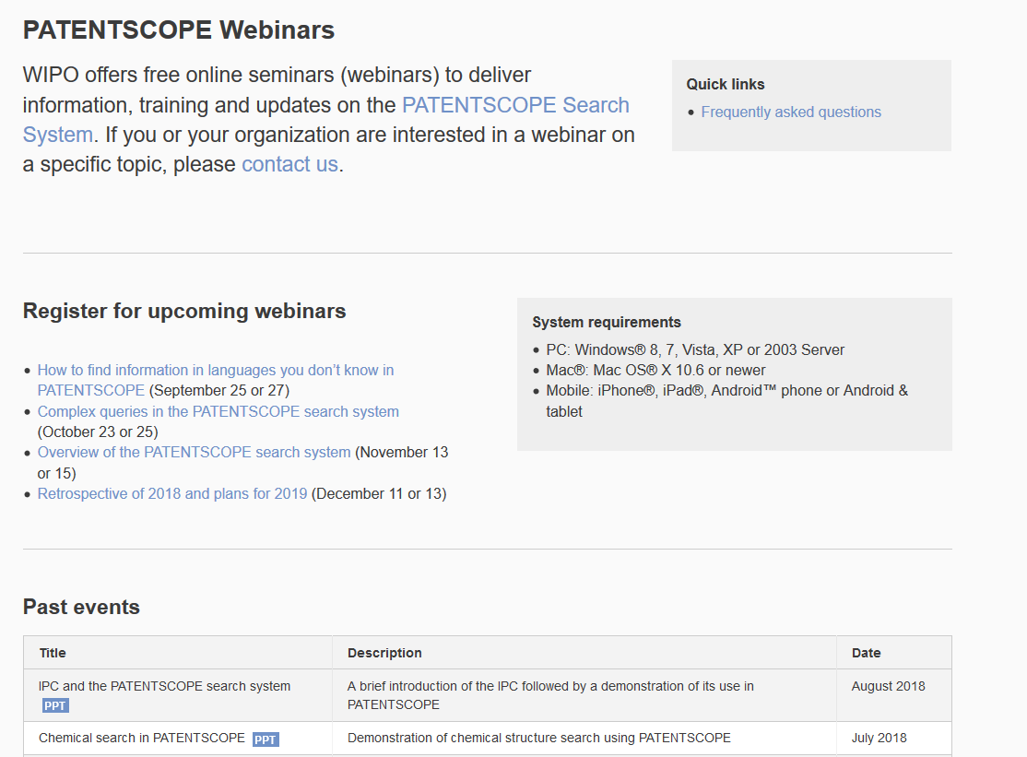
Future/past webinars:
wipo.int/patentscope/en/webinar

Slide 46
Global Design Database: webinar
How to perform a search in the Global Design Database
  October 16 at 5:30pm CET
  October 18 at 8:30 am CET
  https://attendee.gotowebinar.com/rt/2787233782654701825

Slide 47
Global Brand Database: webinar
How to read, save & share your results in the Global Brand Database
  October 23 at 3:00pm CET
  https://attendee.gotowebinar.com/register/5172829866925090051

Slide 48
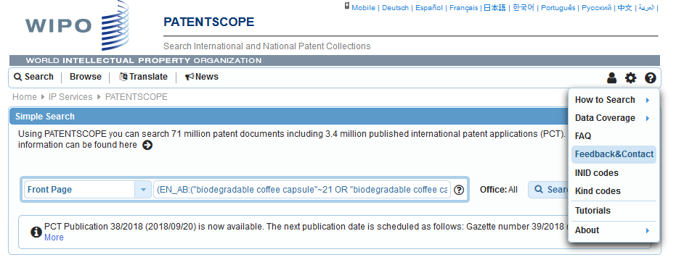
Forum

Slide 49
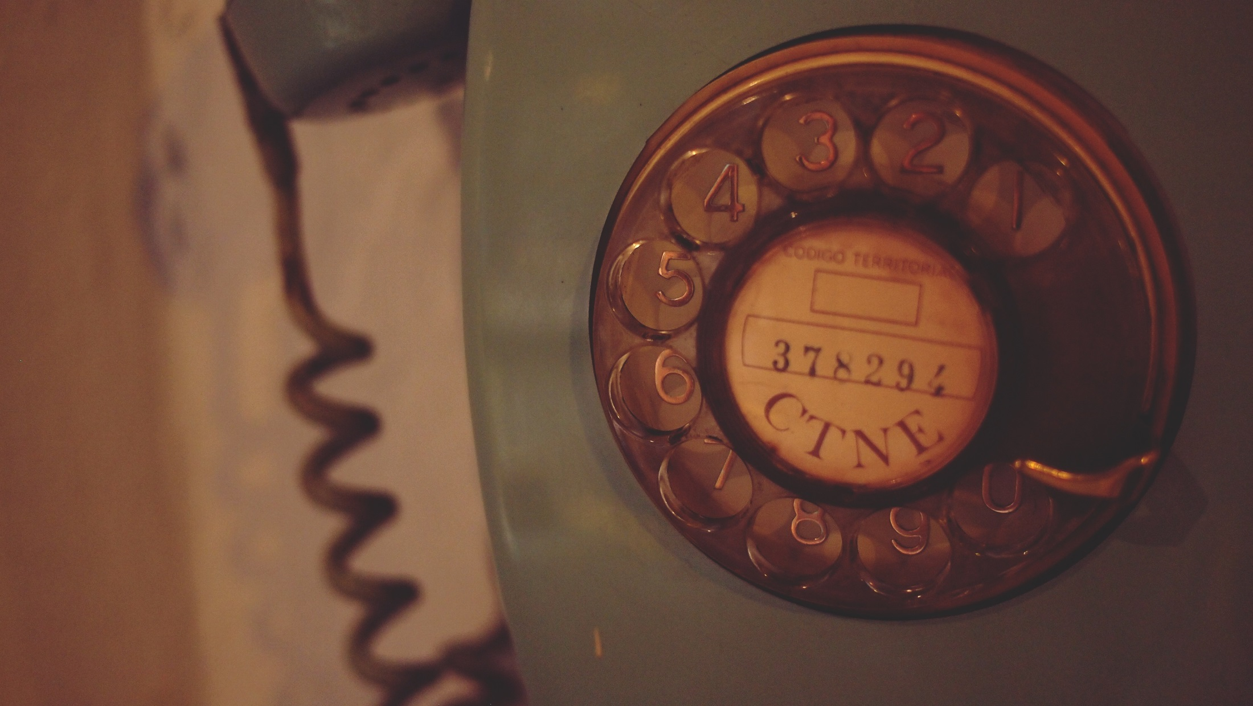
patentscope@wipo.int

