Slide 1
Questions/concerns
patentscope@wipo.int

Slide 2
Agenda
IPC brief introduction
IPC in PATENTSCOPE:
search
in the result list
in CLIR
statistics in the Browse menu
Quiz
Q & A session

Slide 3
What is IPC? International Patent Classification

Slide 4
What is classified?
► 2 types of information
► 1. Invention information:
Technical information worth granting a patent
► 2. Additional information:
Supplementary non-invention information
the classifier/examiner considers interesting
> obligatory classification
> discretionary classification
Notes:
Patent documents contain a lot of technical information and not all of it is directly linked to the invention but merely explains the state of the art. The rules of the IPC require all new and non-obvious technical information, i.e. the disclosed information that is eventually worth granting a patent must be classified.
Any additional information, that need not be new but may be useful for search purposes, can also be classified, at the discretion of the classifier.

Slide 5
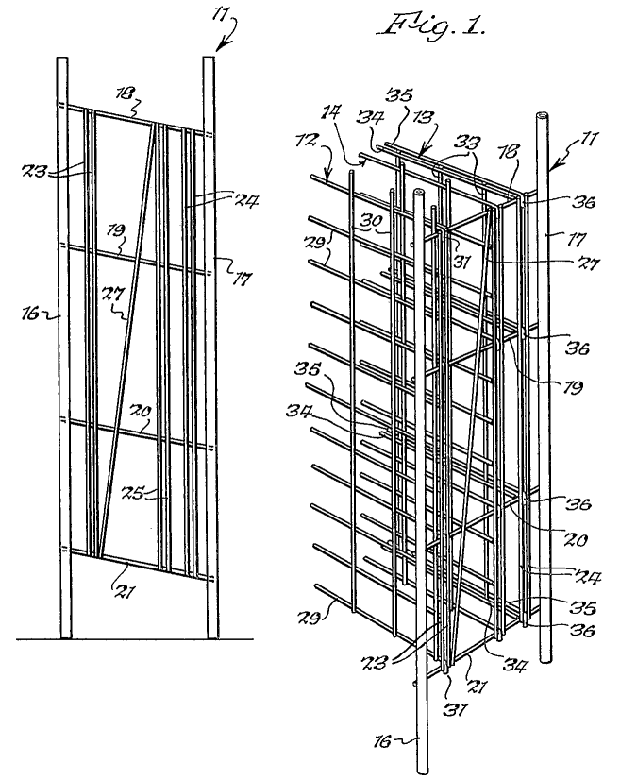
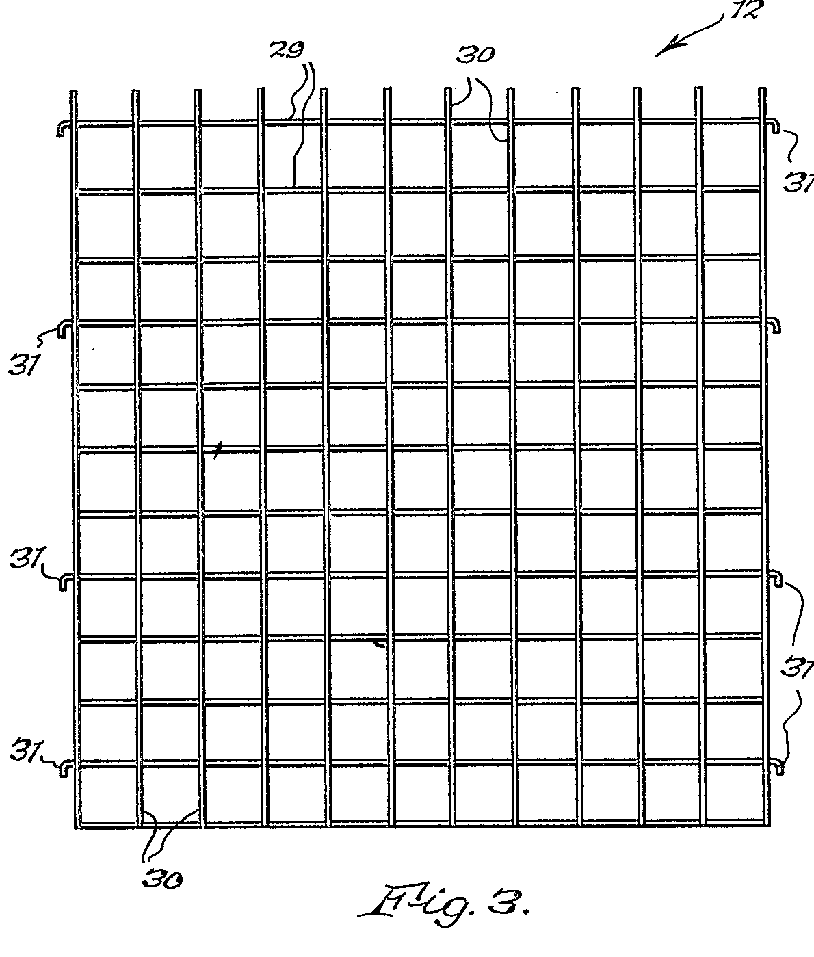
Example: A metal rod wine rack
1.Invention Information
A wine rack which is easily dismantled (claim)
2.Additional Information
A rigid wine rack made of “wire”
Int. Cl.
A47B 73/00 (2006.01)
A47B 47/02 (2006.01)
A47B 55/02 (2006.01)
Notes:
5

Slide 6
The IPC serves as a:
Tool for:
classifying patent documents
Basis for:
disseminating information
investigating the state of the art
preparing industrial property statistics

Slide 7
Tree type structure

Slide 8
Symbols and Titles
~ 70,000 entries
Symbol = succession of upper case letters and numbers
Title = phrase describing the technical content (scope) of the place
Notes:
Symbol is a succession of upper case letters and numbers.
Title is a phrase or succession of phrases

Slide 9
Sections
8
Classes
Classes
Classes
129
Subclasses
Subclasses
Subclasses
Subclasses
Subclasses
640
Groups
Groups
Groups
Groups
Groups
Groups
Groups
Groups
Groups
70,000

Slide 10
Example: A23G9/04
A..........................Section (A, B, ... H) Human Necessities
Foodstuffs; Tobacco
A23 ................. Class (any 2 digits) Foods or Foodstuffs; their treament, not covered by other classes
A23G ..................Subclass (any letter) Cocoa, coca products....
A23G 9/04 ......... Group Frozen sweet
Production of frozen sweets
Subgroup part
Main group part
Notes:
A23G 9/02 is a symbol representing an IPC group. Any group symbol consists of different components:
The first letter indicates the section of the IPC to which it belongs; there are 8 sections represented by the letters A, B,..H.
The section letter and the following two digits represent a class symbol.
Adding another letter to the class symbol generates the symbol of a subclass being part of the class.
After this subclass part of the symbol follows the group part which consist of two different elements separated by a stroke: the main group part and the subgroup part.
The formatting shown above with a space between the subclass part and the group parts and a slash between the two group parts is the offical format of IPC symbols that should be used for presenting IPC symbols. However, sometimes different presentations can be found or used for searching databases, e.g. no space after the subclass part, or a dash instead of a stroke.

Slide 11
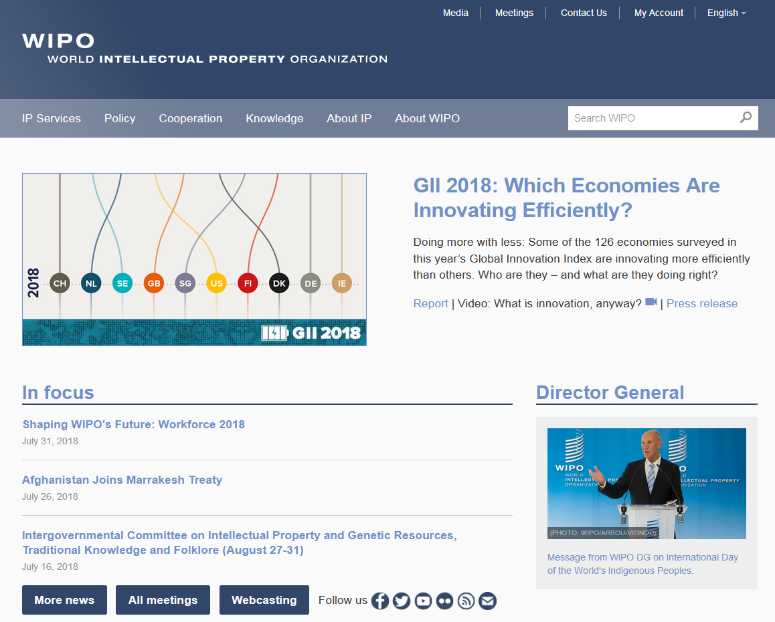

Slide 12
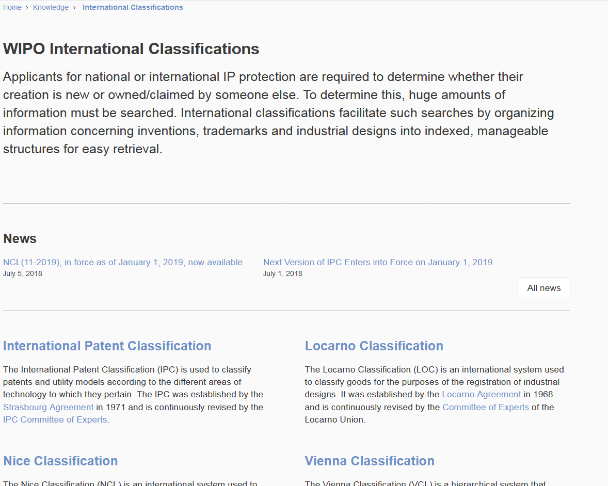

Slide 13
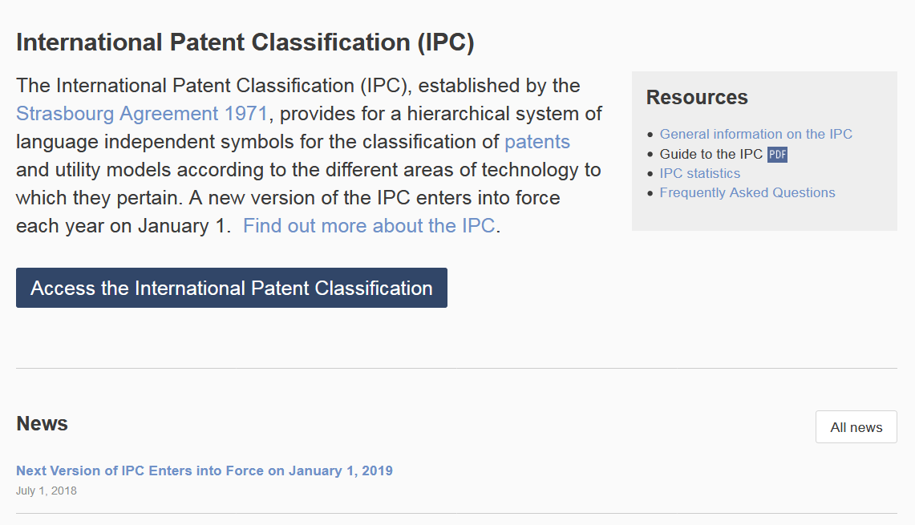

Slide 14
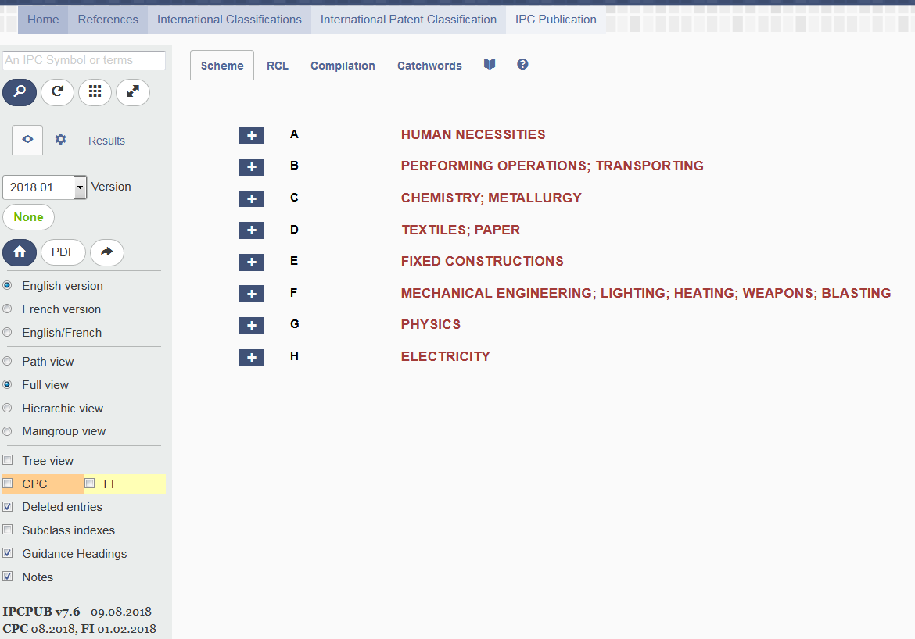
Help
IPC version and IPC symbol
View mode (path/full/hierarchic)
Display option (Subclass indexes, Guidance Headings, Notes, etc.)

Slide 15
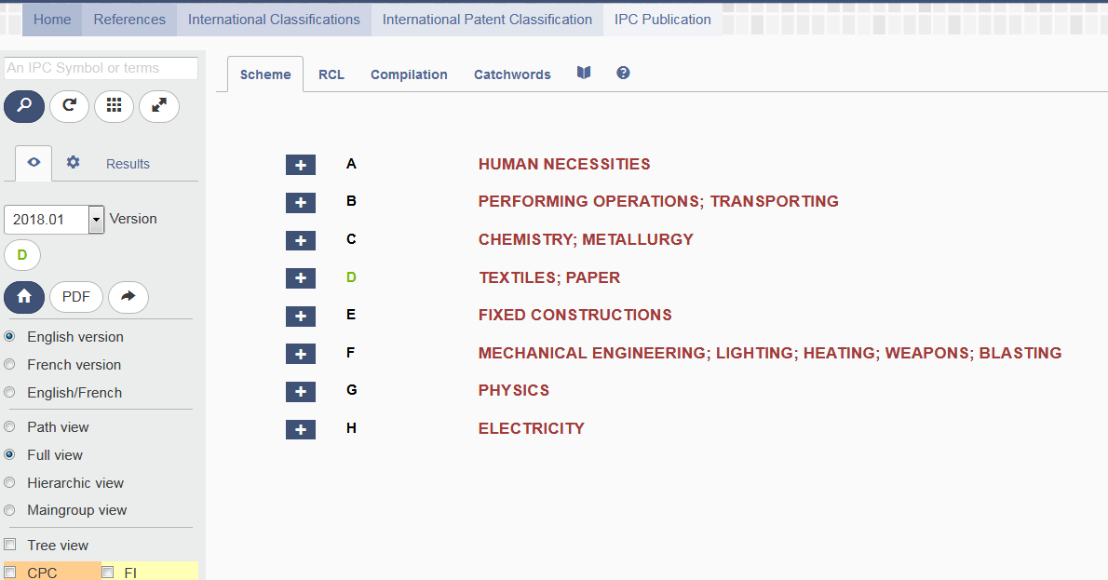
Scenario 1: definition of known code
Code G06T

Slide 16
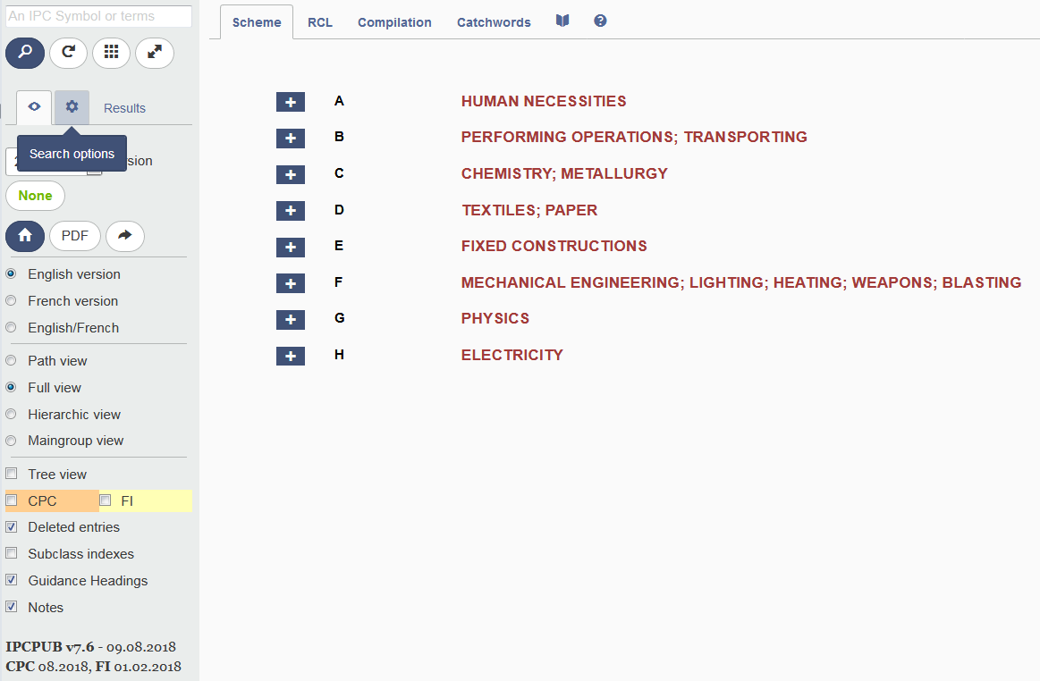
Scenario 2: specific topic

Slide 17
Terms/crossreference/stats/ipccat

Slide 18
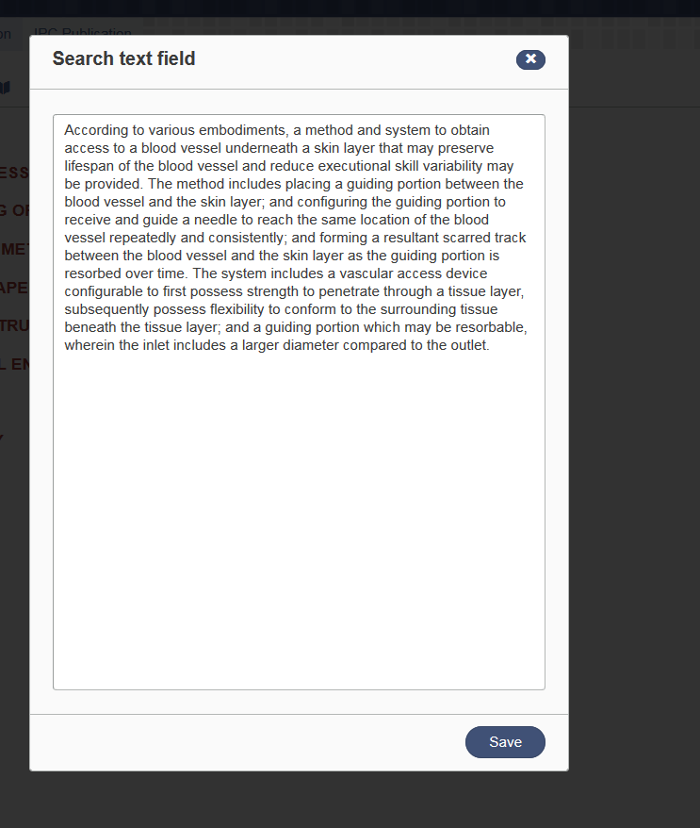
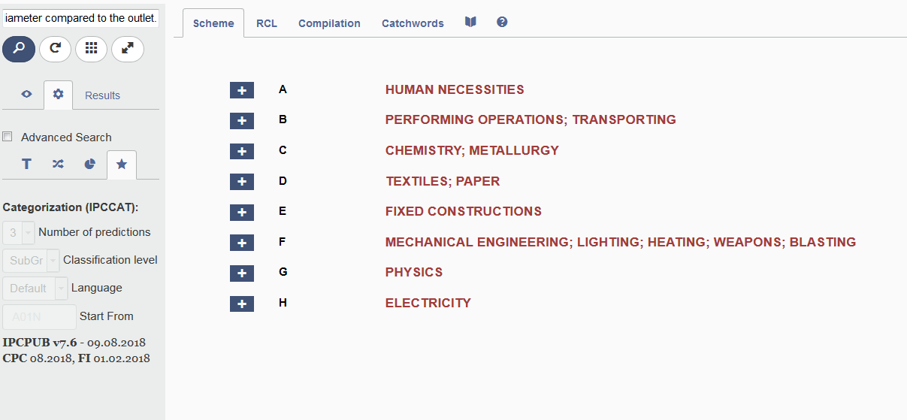
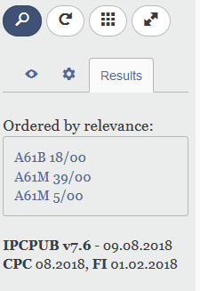
IPCCAT

Slide 19
Catchwords

Slide 20
Catchwords

Slide 21
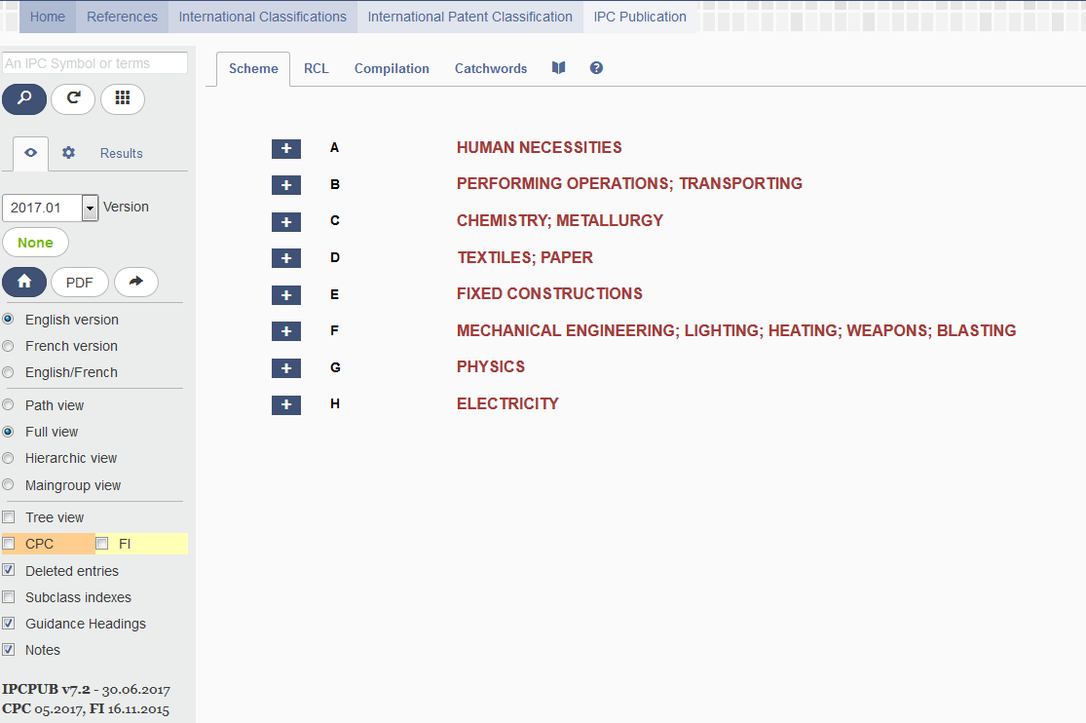
Index – pdf – bridge

Slide 22
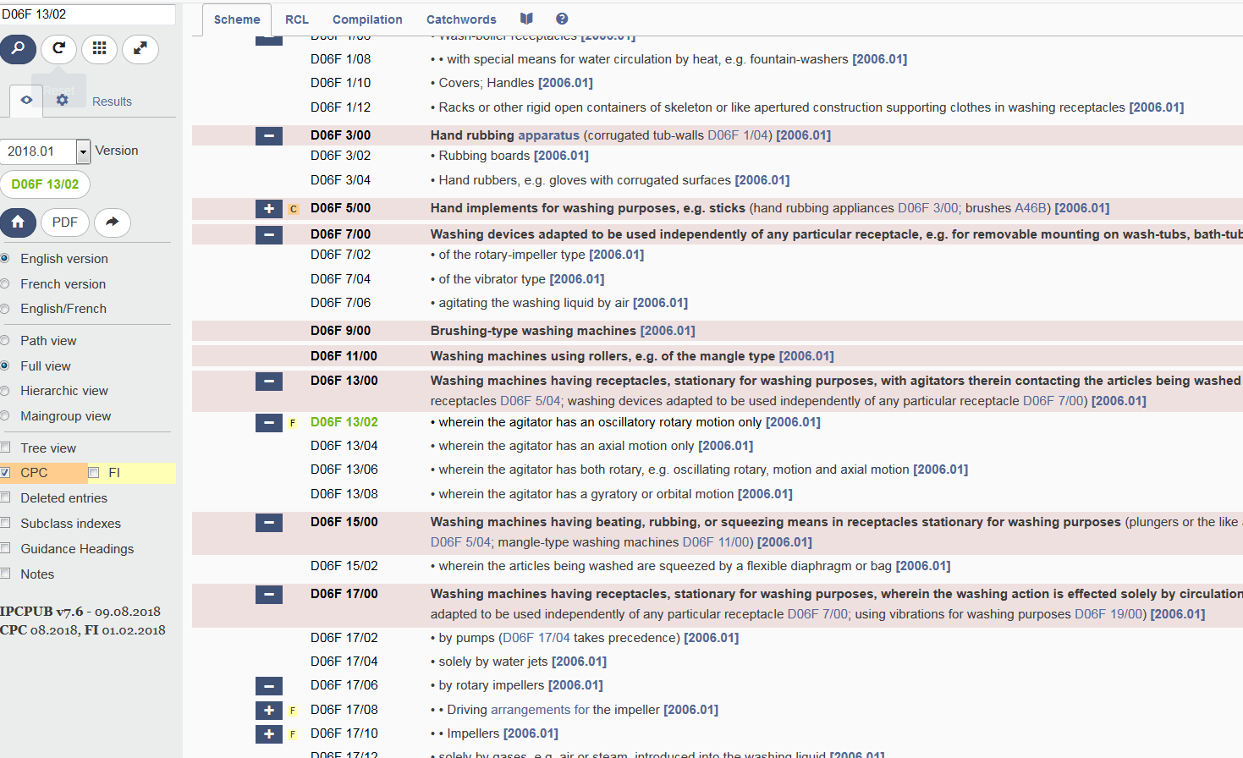
CPC/FI

Slide 23
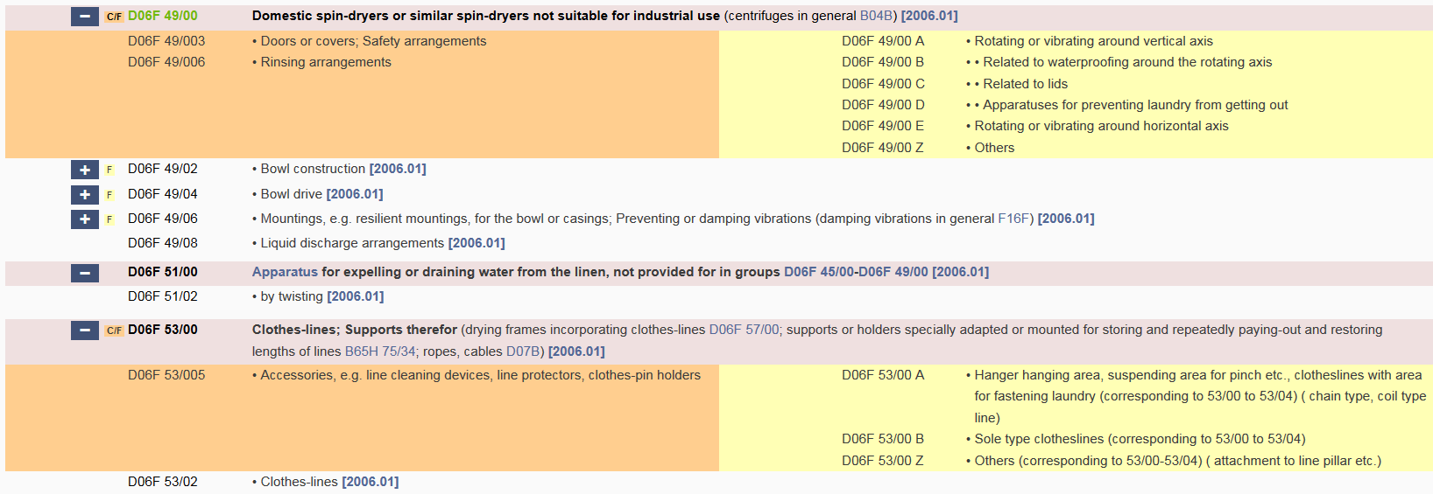
An example

Slide 24
Guide to the IPC
The official Guide to the IPC (version 2018) provides comprehensive information on the IPC. It is available for download on the WIPO website of the IPC at:
http://www.wipo.int/classifications/ipc/en/general/
Notes:
see the slide

Slide 25
Why is it useful?
Primary purpose:
effective search tool
classification of patent documents
Other purposes:
dissemination of information
investigation of the state of the art
industrial property statistics

Slide 26
Advantages of the IPC
Language independent
Terminology / ”jargon” independent
Standardized application to documents
Available for (old) patent documents
Concept search

Slide 27
Disadvantages of the IPC
Not available for all areas of technology
Not specific enough for particular searches
Not available for all documents
Complex

Slide 28
Any questions related to IPC/CPC
ipc.mail@wipo.int

Slide 29
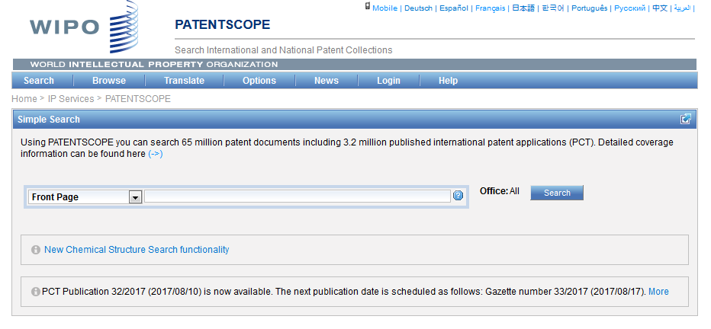
IPC in PATENTSCOPE
Statistics in the Browse by week option
Search IPC with Simple, Advanced, Field Combination
IPC in the result list
IPC in CLIR

Slide 30
Statistics in the Browse by week
Show global trends
Main/new actors

Slide 31
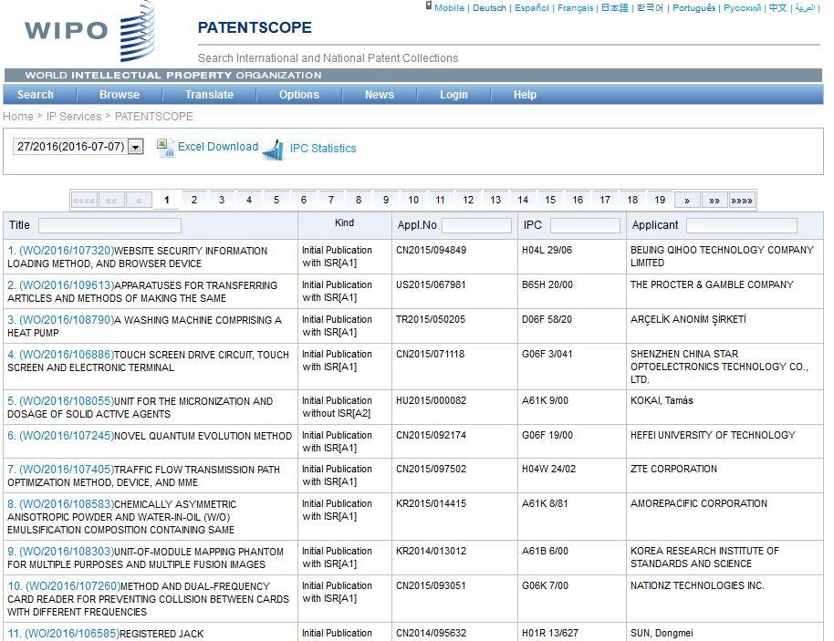
IPC statistics

Slide 32
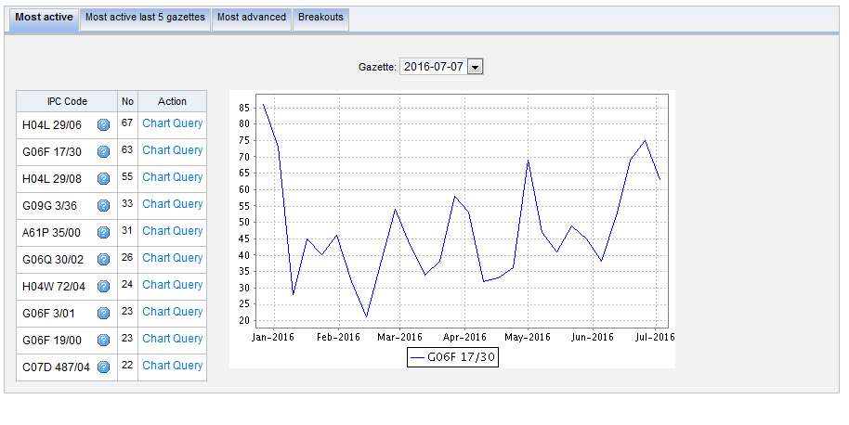
Most active

Slide 33
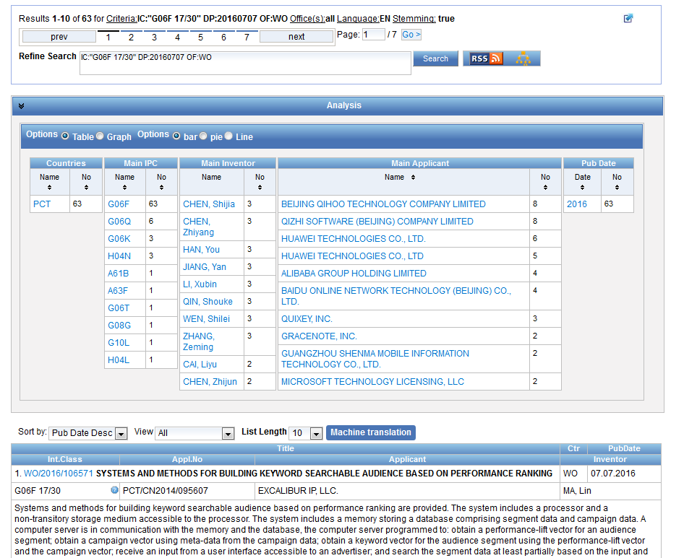

Slide 34
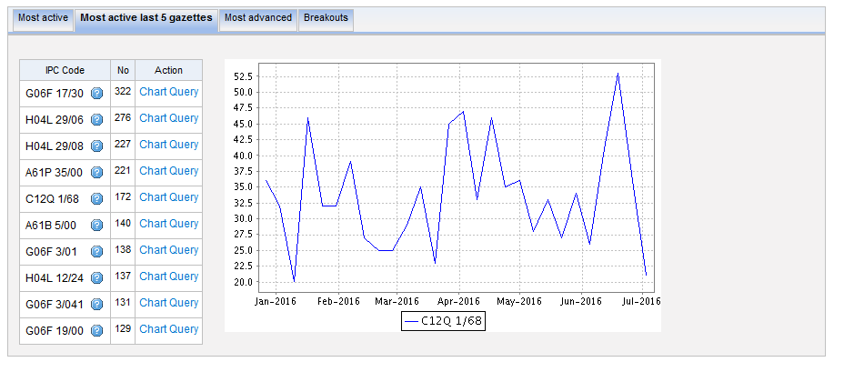
Most active last 5 gazettes

Slide 35
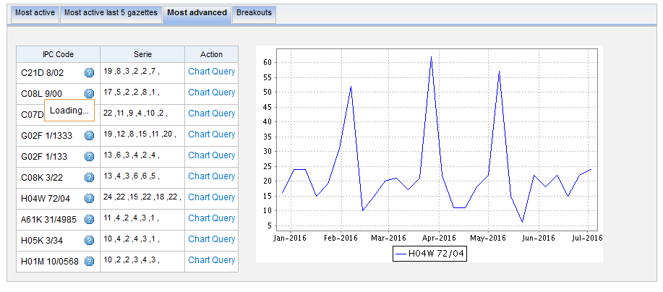
Most advanced

Slide 36
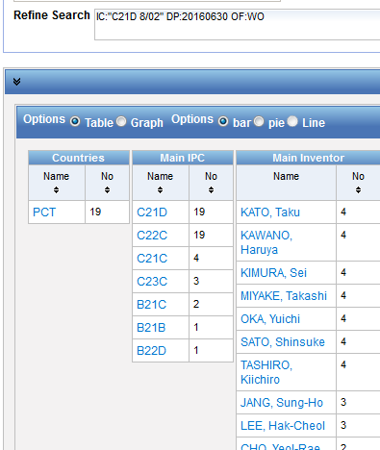
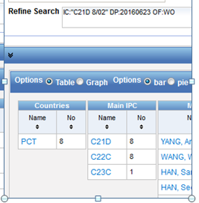
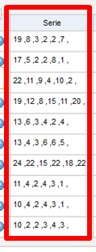
Serie column
6 last publications, nb of IPC per publication

Slide 37
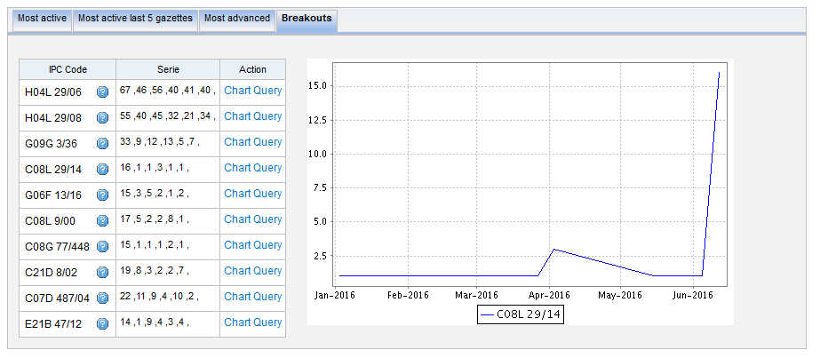
Breakouts

Slide 38
IPC searching in PATENTSCOPE

Slide 39
IPC search in PATENTSCOPE
Searching and Grouping now by complete IPC codes:
D06F 1/06 will include by default
D06F 1/08
1/10
1/16

Slide 40
IC / ICI / ICN
IC = International Classification
ICI = International Classification Inventive
ICN = International Classification Non-inventive
IC_EX ICI_EX ICN_EX = no subgroup

Slide 41
IPC search: Simple search

Slide 42
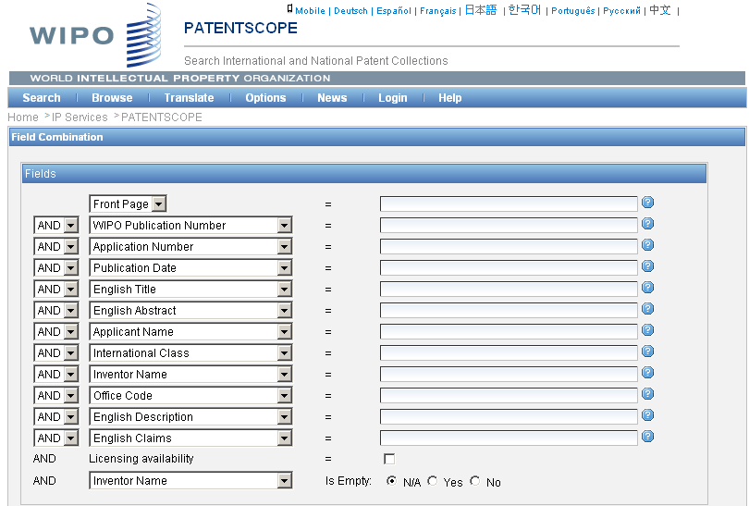
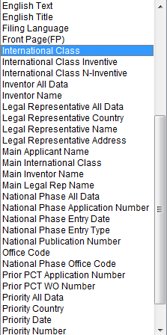
IPC search: Field combination

Slide 43
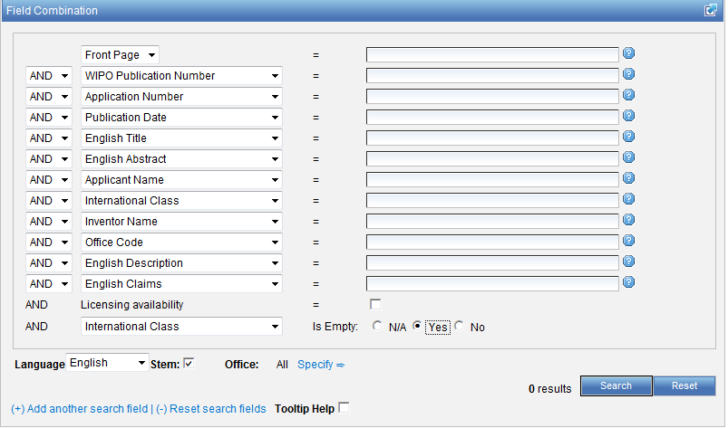

Slide 44
IPC search: Advanced search
http://patentscope.wipo.int/search/en/help/fieldsHelp.jsf

Slide 45
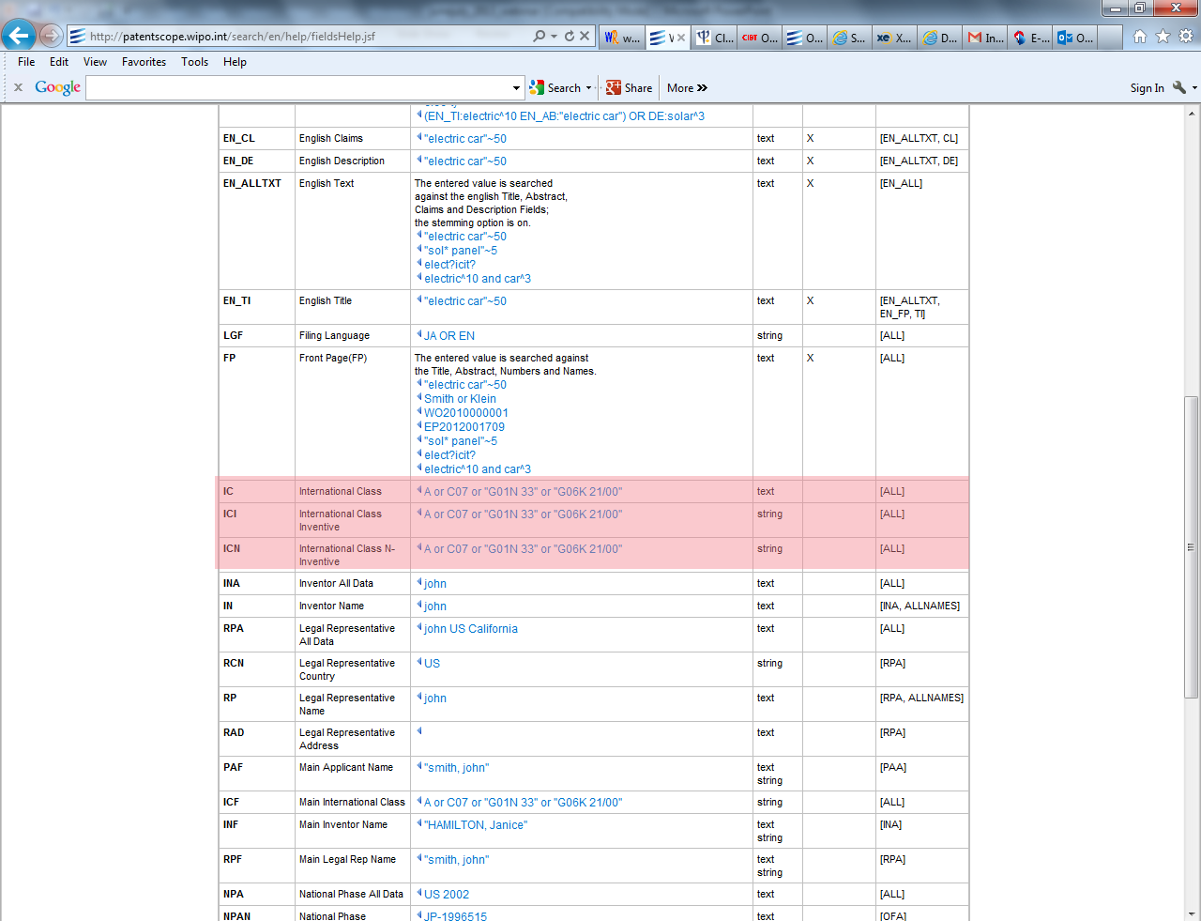

Slide 46
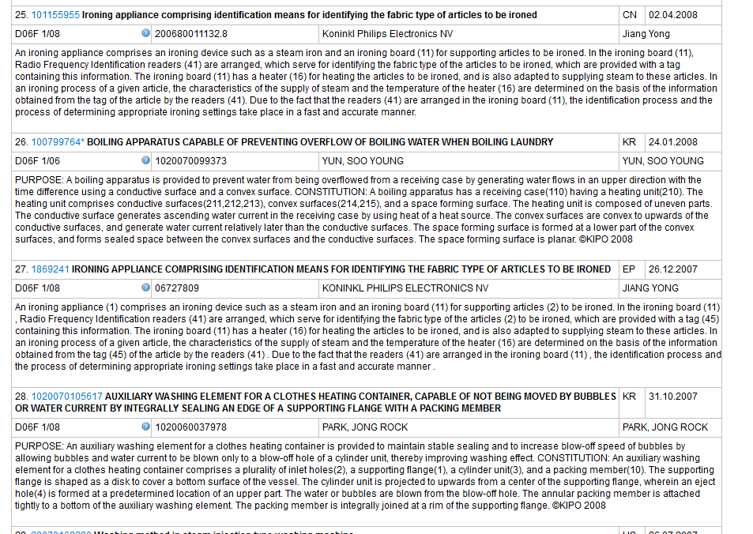
Example: D06F 1/06

Slide 47
Example: D06F 1/06

Slide 48
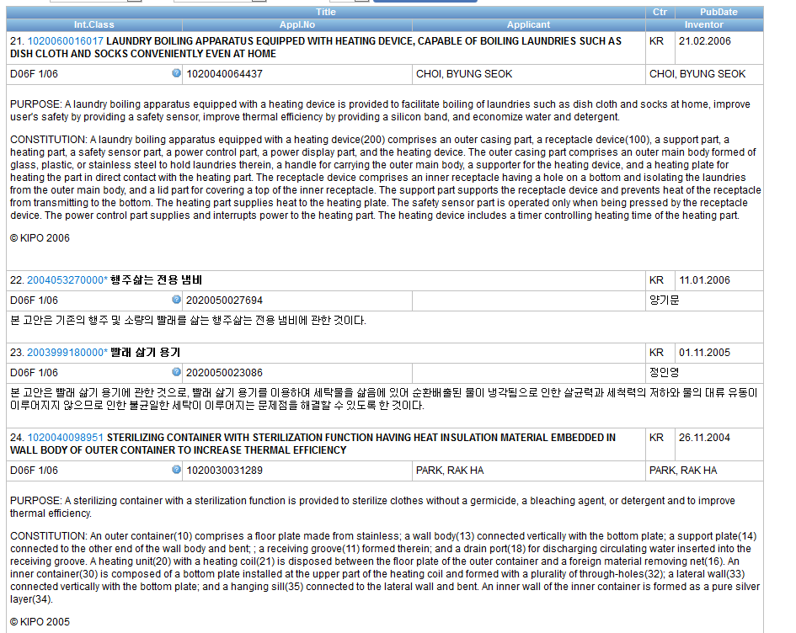

Slide 49
Combined search
Retrieve results that are specific "A23B 4/00“ and date range:
AD:[01.06.2012 TO 24.06.2016] AND IC_EX:("A23B 4/00")

Slide 50
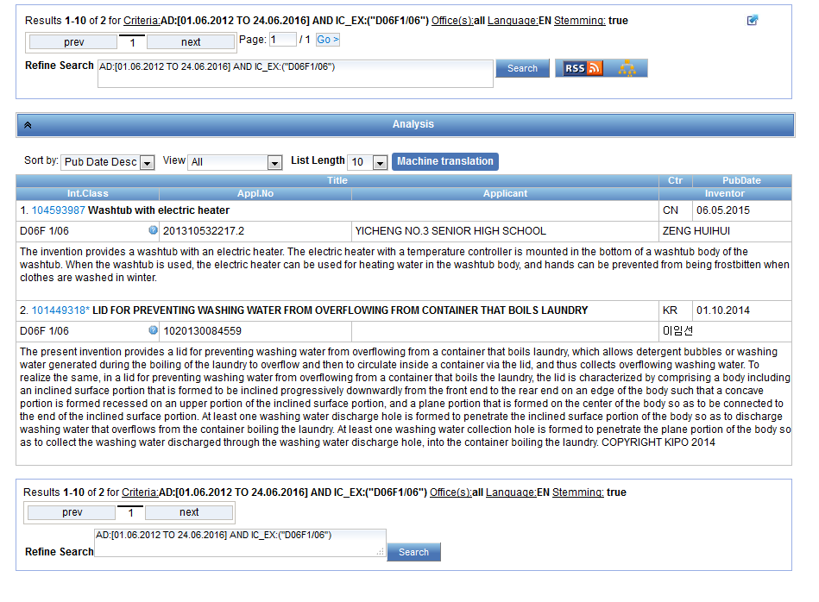

Slide 51
Caution
Use of (…) and […]
Use of " … "
(IC: A or B or C)
AD:([01.06.2012 TO 24.06.2016]) AND IC:("A23B 4/00")

Slide 52
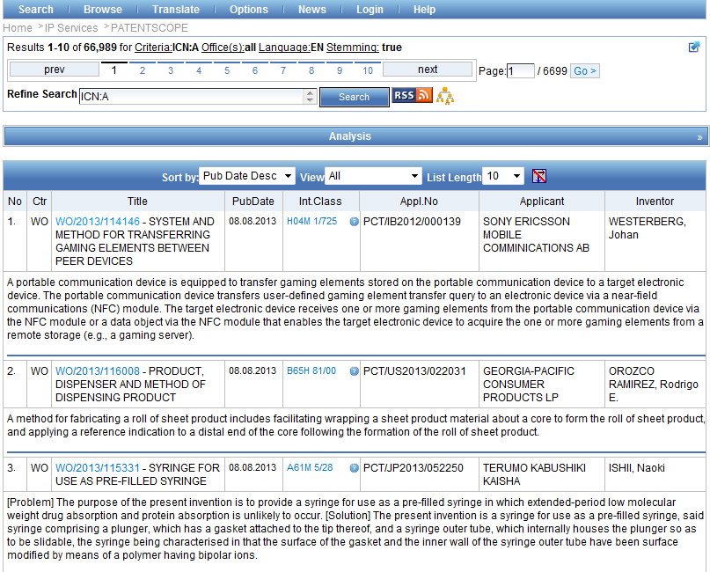

Slide 53
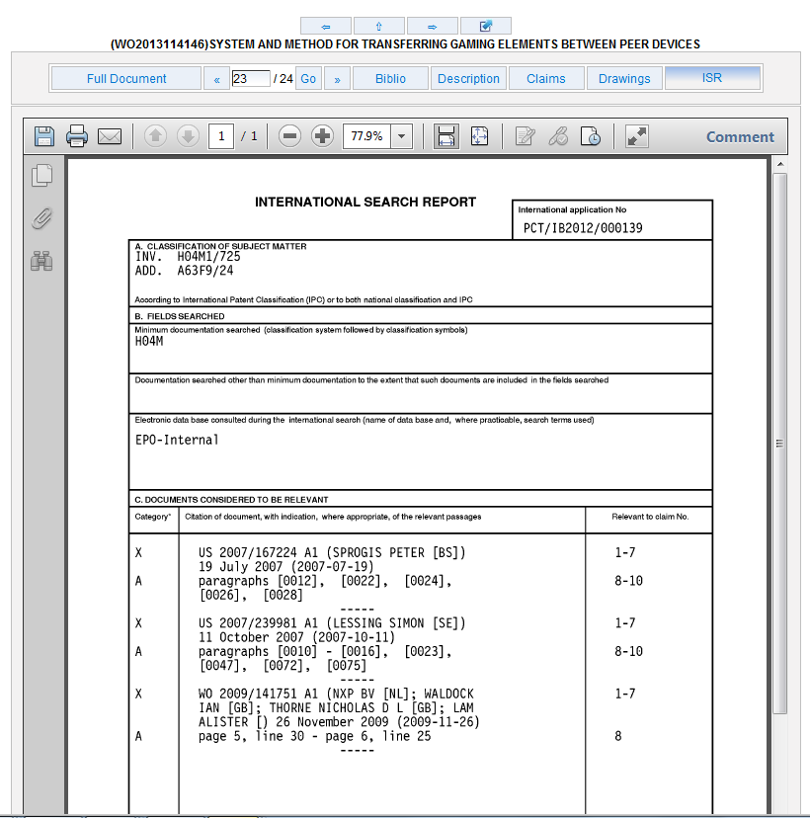

Slide 54
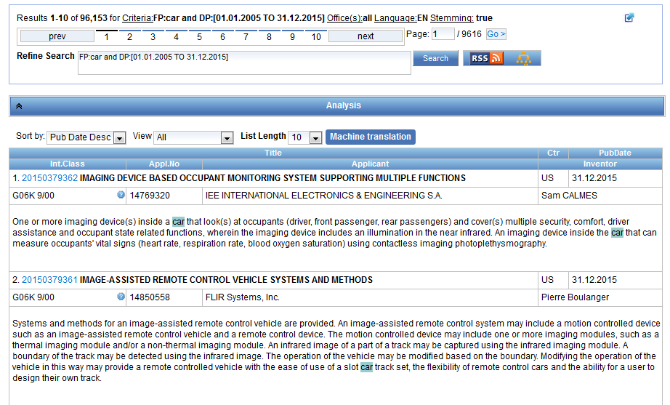
IPC in the result list

Slide 55
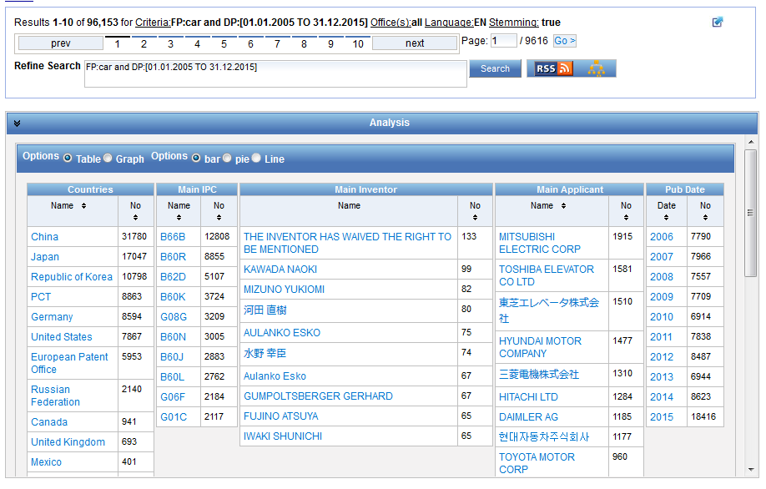

Slide 56
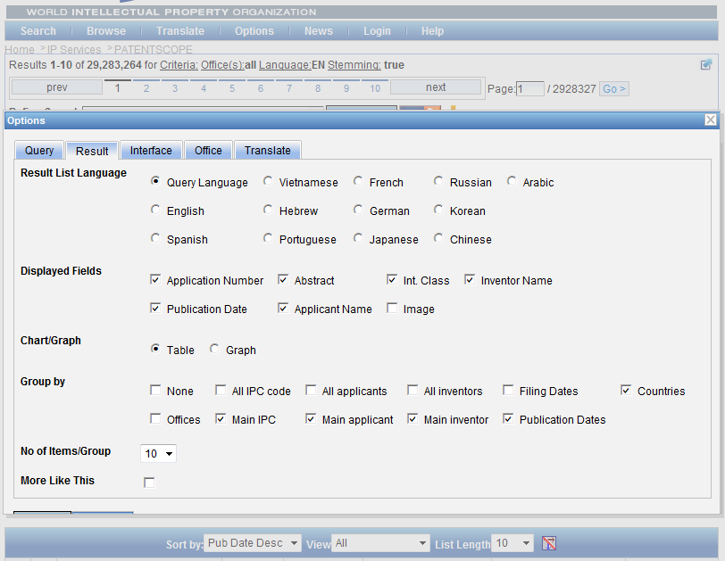

Slide 57
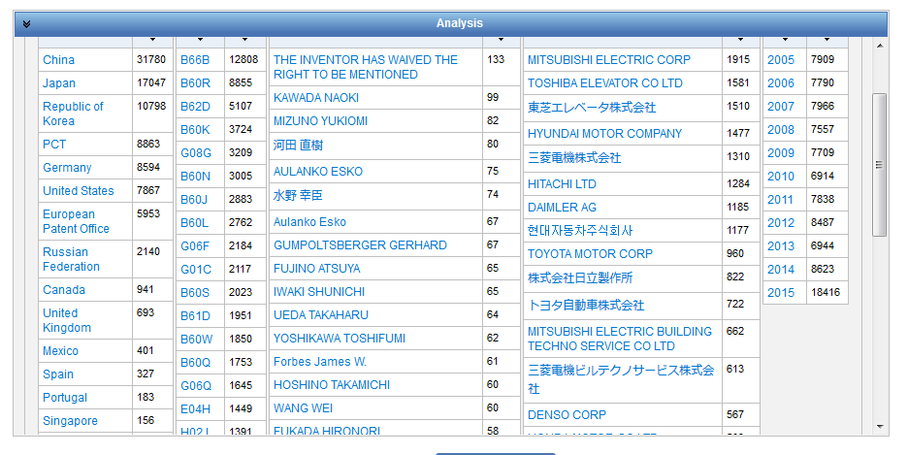

Slide 58
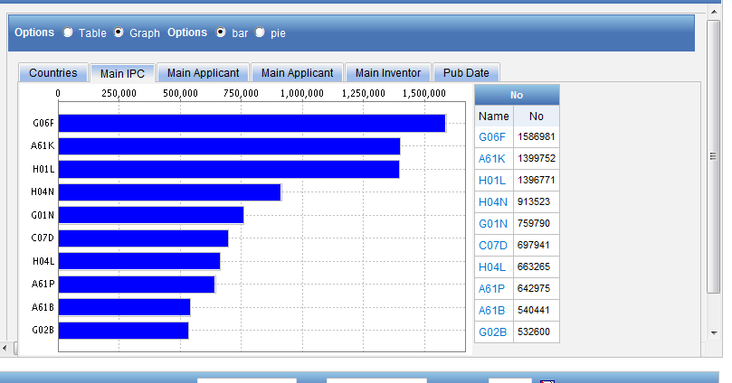
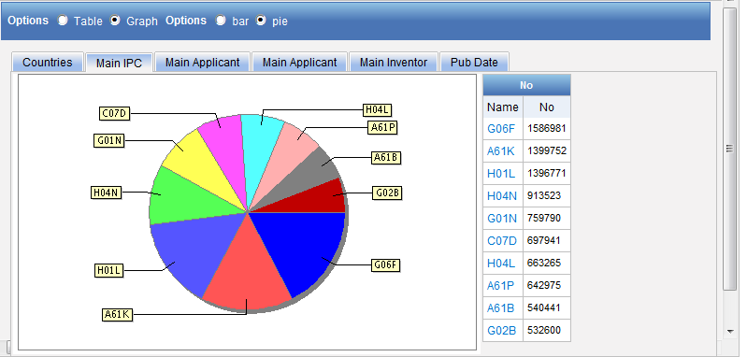
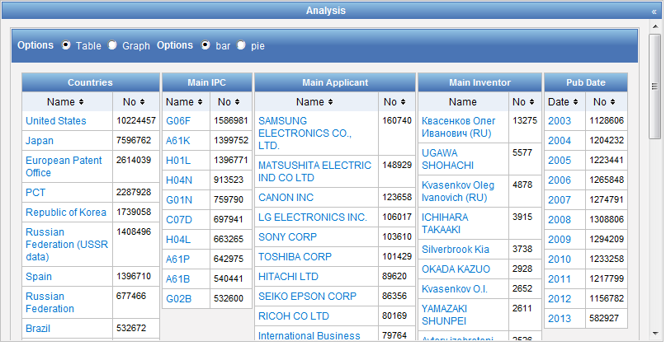

Slide 59
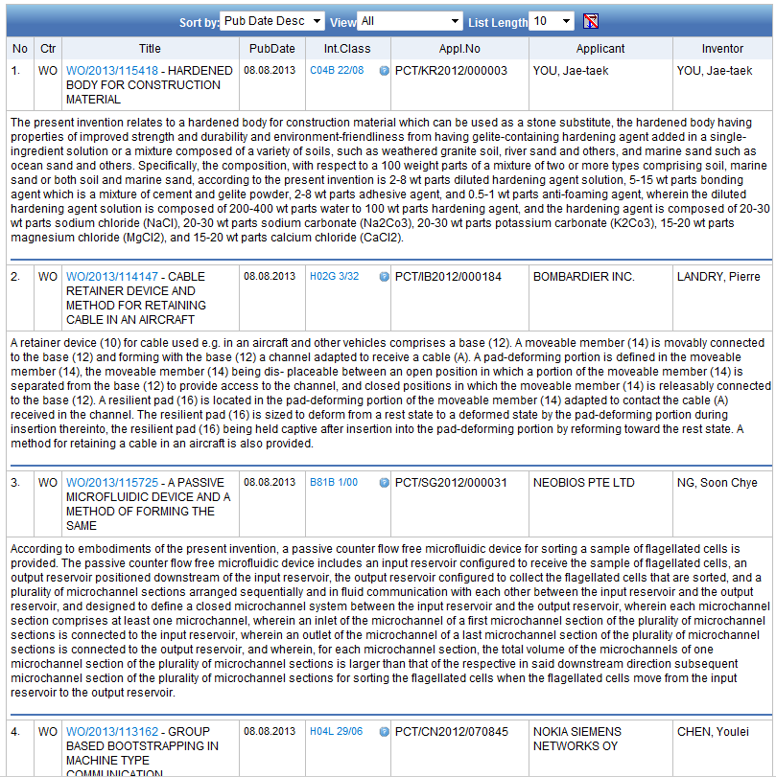
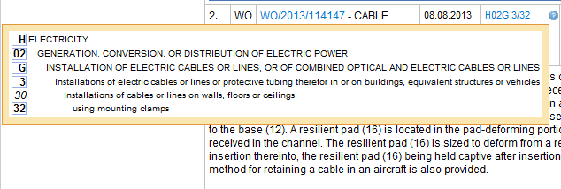

Slide 60
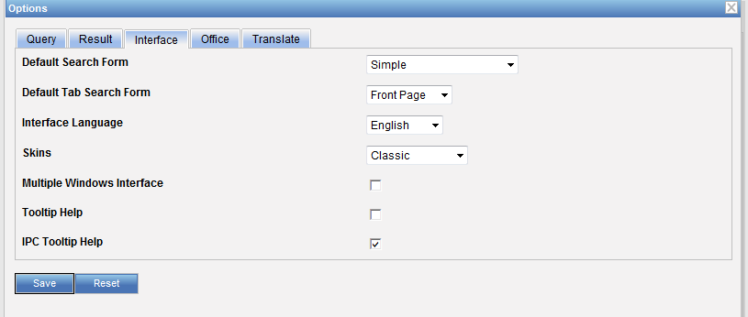

Slide 61
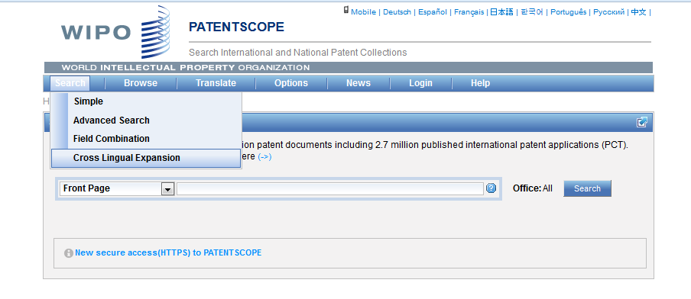
IPC CLIR

Slide 62
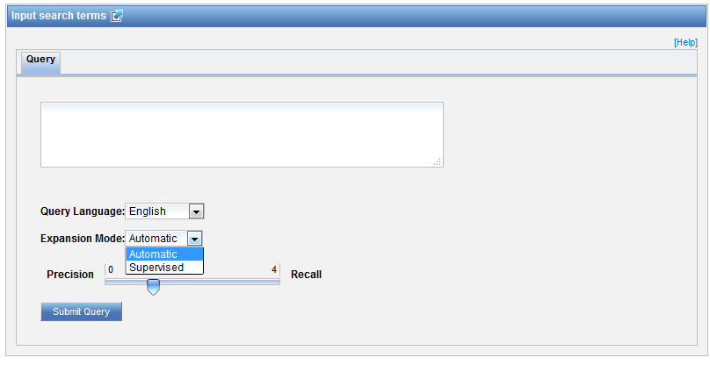
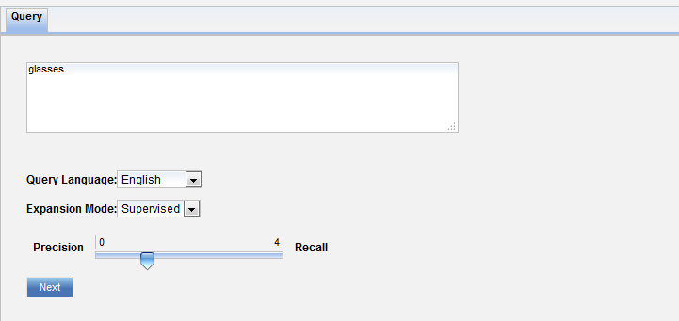
Supervised mode

Slide 63
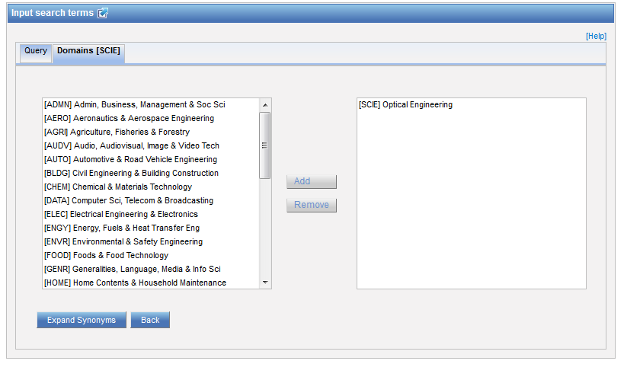
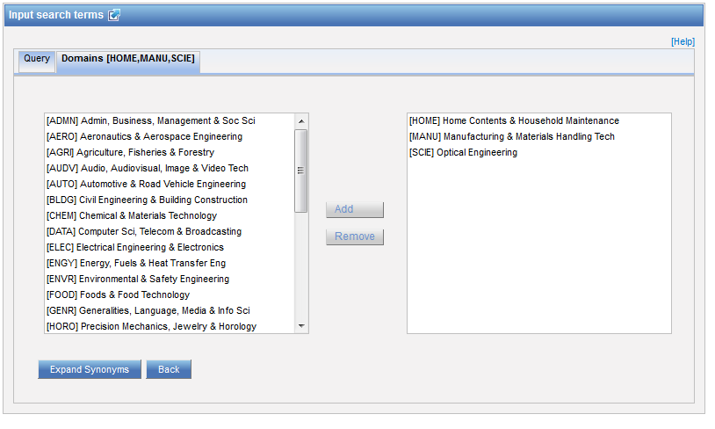
Technical domains

Slide 64
IPC

Slide 66
Q:1: IPC statistics are available in the
A
Search menu
B
Browse menu

Slide 67
Q: 1: IPC statistics are available in the
A
Search menu
B
Browse menu

Slide 68
Q:2: To find an IPC code, you can use
A
The IPC website
B
PATENTSCOPE CLIR
C
PATENTSCOPE Simple and Advanced
D
PATENTSCOPE Field Combination

Slide 69
Q:2: To find an IPC code, you can use
A
The IPC website
B
PATENTSCOPE CLIR
C
PATENTSCOPE Simple and Advanced
D
PATENTSCOPE Field Combination
Spain

Slide 70
Q:3 Why is the IPC so useful in patent searches?
A
Not standarized
B
Language-independent

Slide 71
Q:3: Why is the IPC so useful in patent searches?
A
Not standarized
C
Language-independent

Slide 73
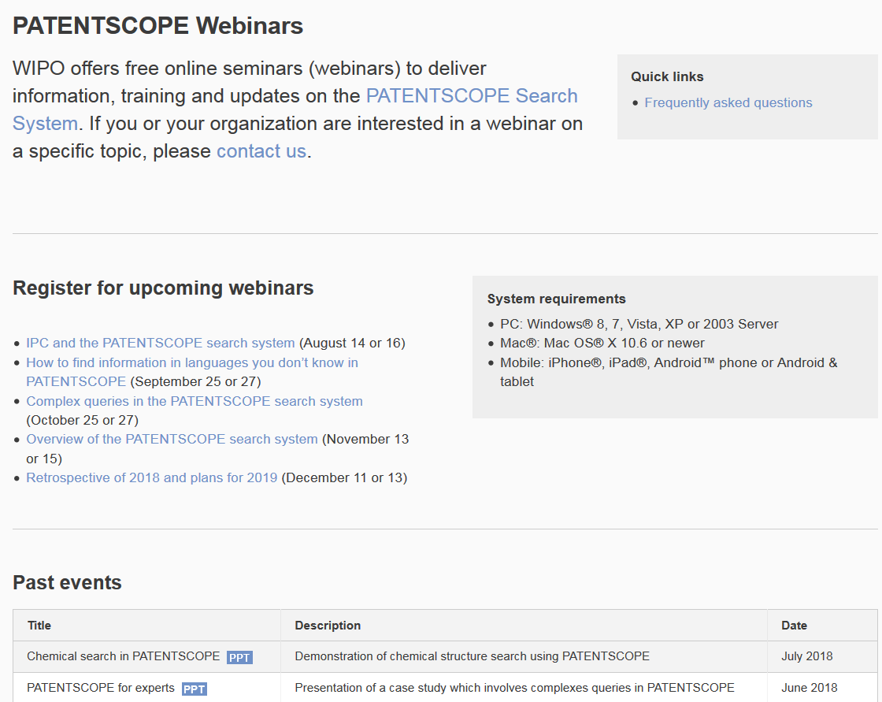
Future/past webinars:
wipo.int/patentscope/en/webinar

Slide 74
Next webinar
How to find information in languages you don’t know in PATENTSCOPE
September 25 at 5:30 pm
September 27 at 8:30 am
https://attendee.gotowebinar.com/rt/1978876131026604803

Slide 75
Global Brand Database: webinar
Image searching in the Global Brand Database
September 26 at 4:30pm CET
https://global.gotowebinar.com/manageWebinar.tmpl?webinar=1256669614973868035

Slide 76
Global Design Database: webinar
How to read, save and share your results in the Global Design Database
September 19 at 4:30pm CET
https://attendee.gotowebinar.com/register/3976121410613718786

Slide 77
Forum

Slide 78
patentscope@wipo.int

