Slide 1
PATENTSCOPE for experts
Cyber world
June
2018
Sandrine Ammann
Marketing & Communications Officer

Slide 2
Case study
cancer biomarkers
after 2010
JP national collection – without knowing 1 word of Japanese!
?
すみません、日本語がしゃべれません。

Slide 3
Search strategy
1. Open notepad
Notes:
CTR: abbreviation for country
In the advanced search start typing or go the [help]->[How to Search] -> [Fields definition]

Slide 4
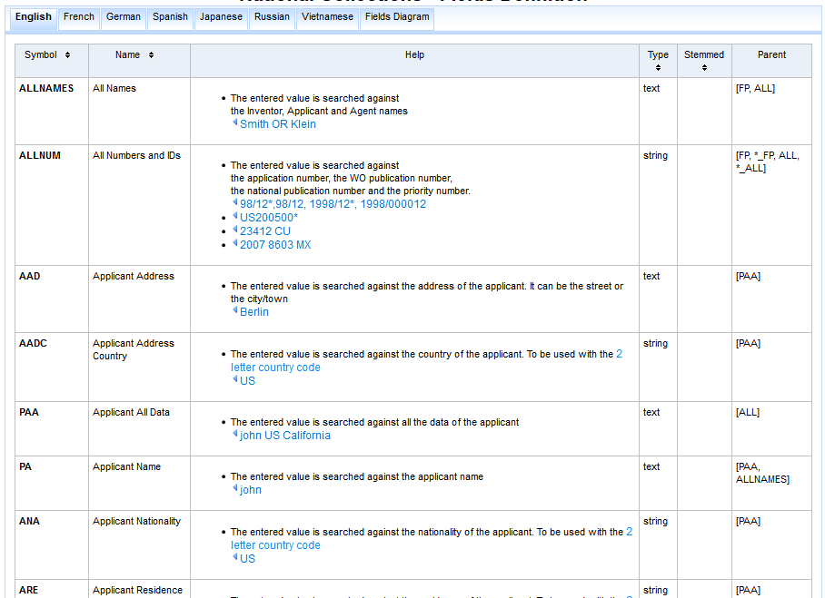
Search strategy
2. Select relevant fields

Slide 5
Search strategy
3. Select search syntax

Slide 6
Search strategy
Documents from the Japanese National Collection
CTR: JP
Documents published after 2010
DP: [2010 TO 2018]
Documents relating to biomarkers for cancer
JA_CL:( (biomarker) NEAR10 (cancer))
Notes:
DP: abbreviation for Publication Date
In the advanced search start typing or go the [help]->[How to Search] ->[Query syntax]

Slide 7
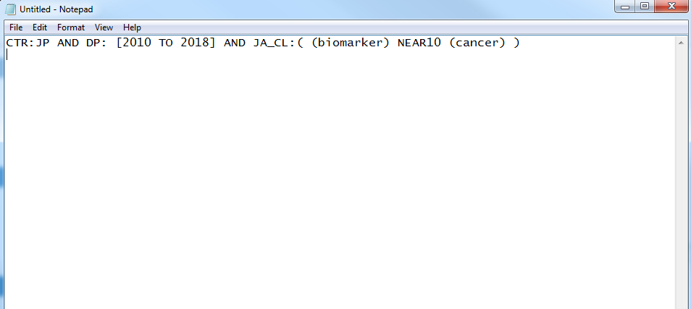
Search strategy
4. Write the search in the Notepad

Slide 8
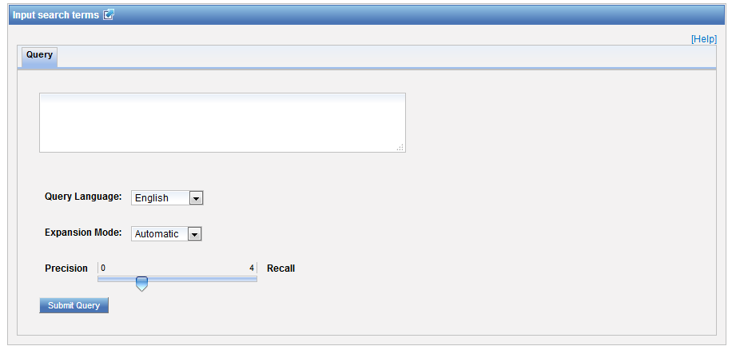
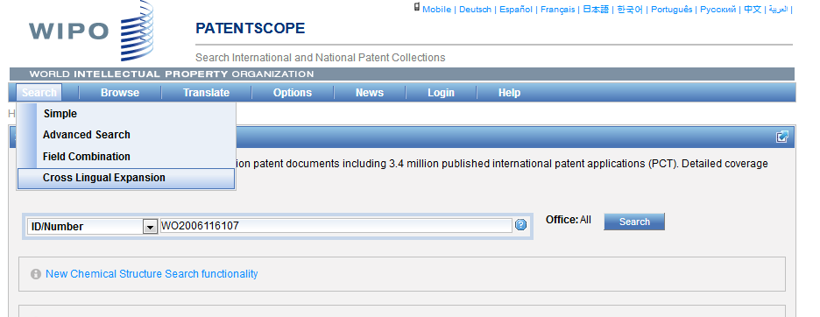
Search strategy
Open CLIR

Slide 9
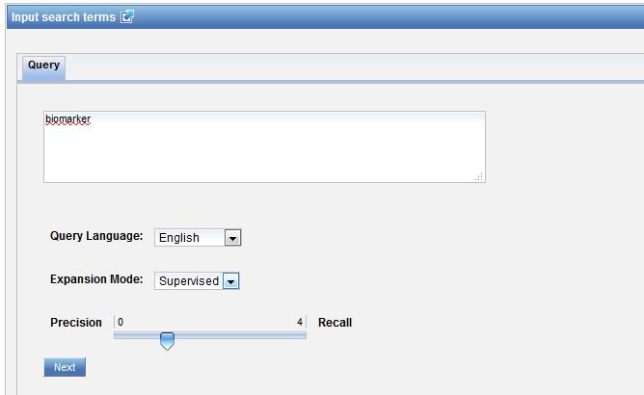
Search strategy
5a. Enter keywords
Notes:
Make sure you use the supervised mode

Slide 10
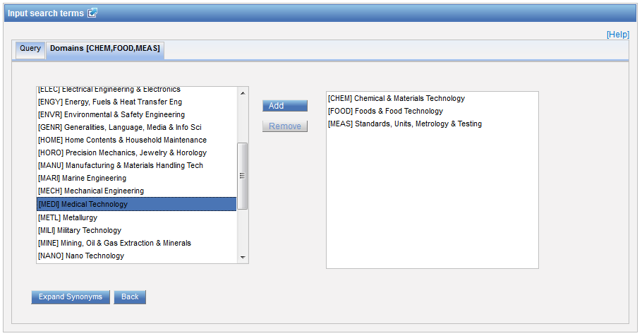
Search strategy
5b. Choose technical domains
Notes:
There are 30 technical domains that have been derived from the international patent classification
Gum:
Medical term is a flesh inside the mouth
Herbology or gardening: sticky substance that oozes out of some trees
it can also mean glue, or chewing substance

Slide 11
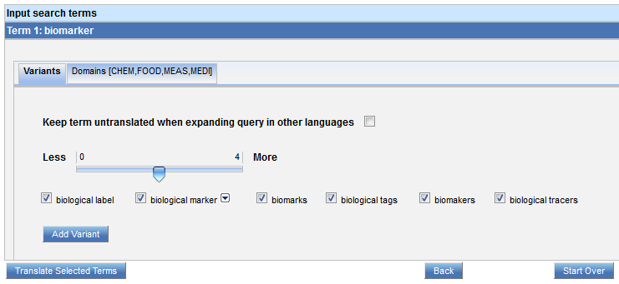
Search strategy
5c. Choose variants
Notes:
Use the slider to display less or more variants
Biomakers is a misspelling that was found in the patent corpus

Slide 12
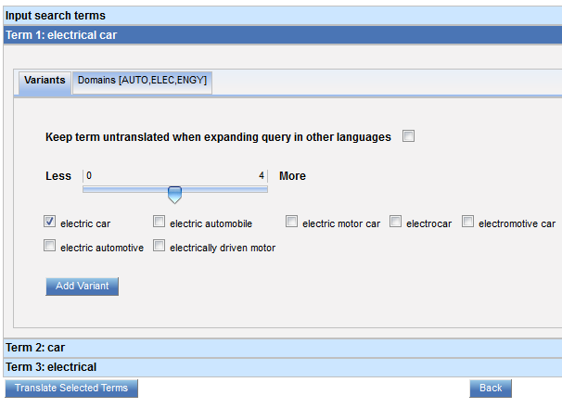
Search strategy
5c variants for each keyword
Notes:
On a side note, when the concept is express with multiple keywords, a tab for each word will be displayed

Slide 13
Search strategy
5d. Copy Japanese result
Notes:
The system shows you the selected terms in 13 different languages
Copy the Japanese translation and copy them in your strategy

Slide 14
Search strategy
6. Replace biomarker by Japanese characters
CTR:JP AND DP: [2010 TO 2018] AND JA_CL:( ("バイオマーカー" OR "生体指標" OR "の生物マーカー" OR "生物学的マーカー" OR "学的マーカー" OR "ための生物マーカー" OR "生体マーカー" OR "に関与する生物学的マーカー" OR "た生体物質標識剤") NEAR10 (cancer) )

Slide 15
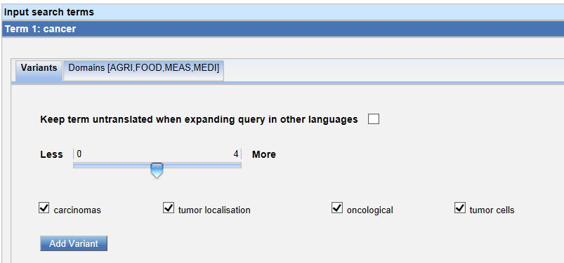
Search strategy
7. Repeat those steps for each keyword

Slide 16
Search strategy
8. Replace cancer by Japanese characters
CTR:JP AND DP: [2010 TO 2018] AND JA_CL:( ("バイオマーカー" OR "生体指標" OR "の生物マーカー" OR "生物学的マーカー" OR "学的マーカー" OR "ための生物マーカー" OR "生体マーカー" OR "に関与する生物学的マーカー" OR "た生体物質標識剤") NEAR10 ( "ガン" OR "腫瘍細胞" OR "癌腫" OR "癌およびそ") )

Slide 17
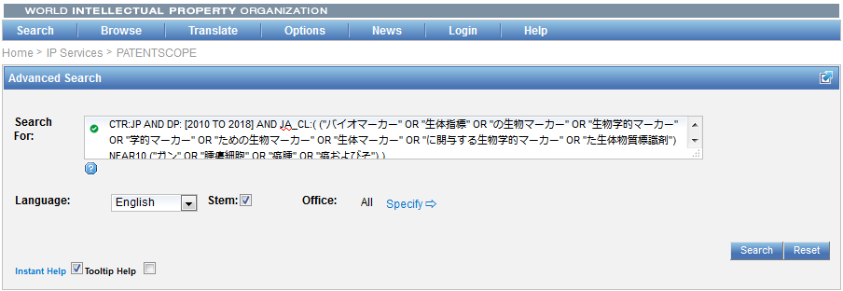
Search strategy
9. Ctrl C+ V and search

Slide 18
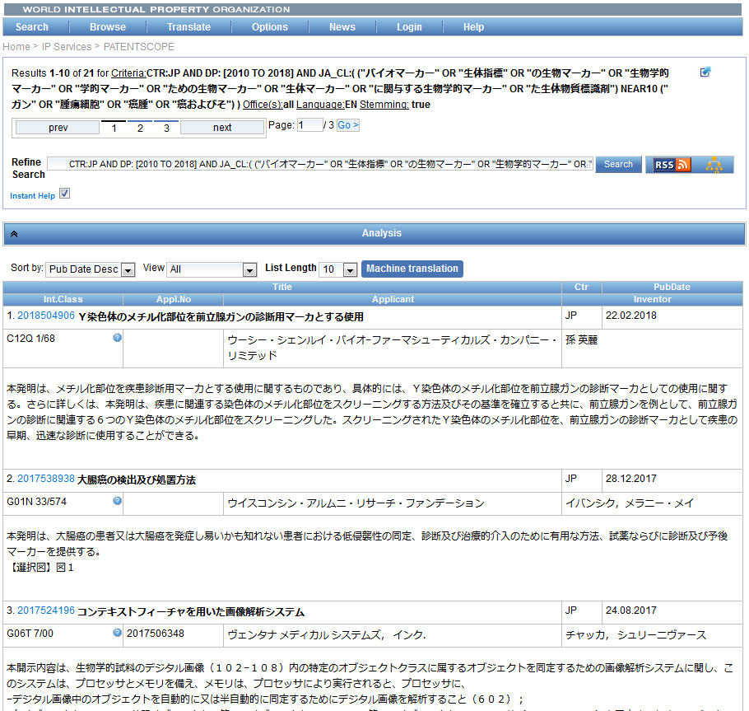
Search strategy
Notes:
You can sort the result by different criteria
The latest abstract in the results might not have been translated into English yet

Slide 19
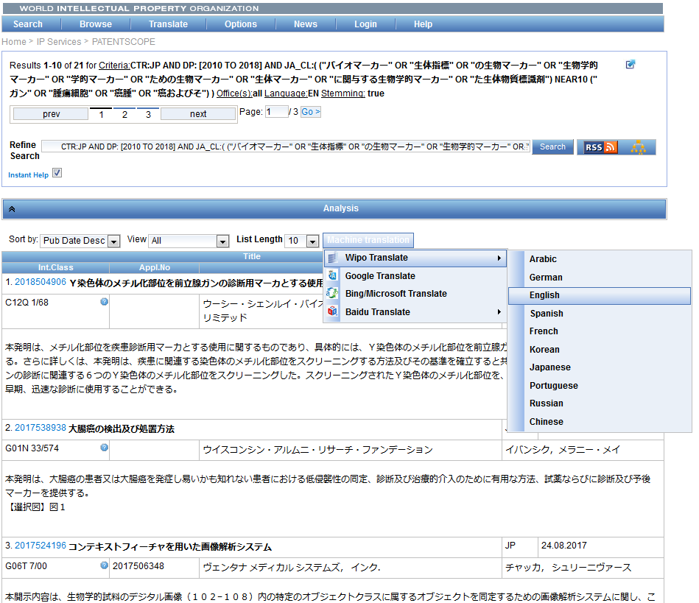
Search strategy
10. Result list translation

Slide 20
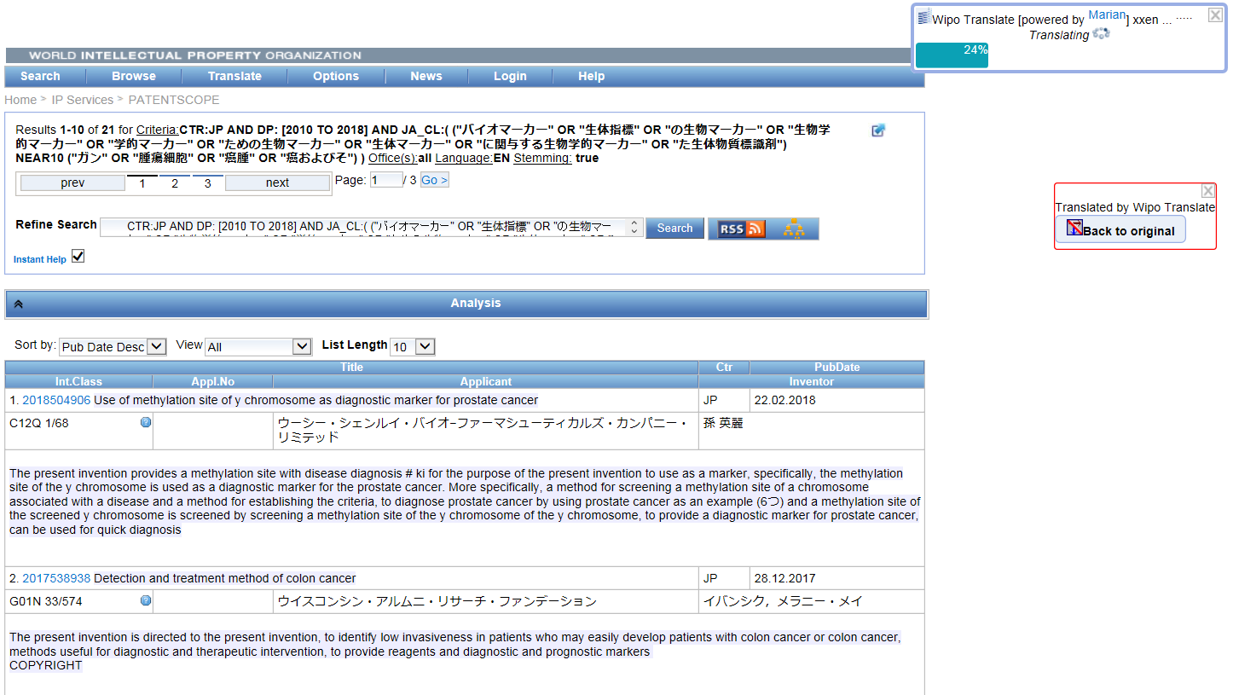
Search strategy

Slide 21
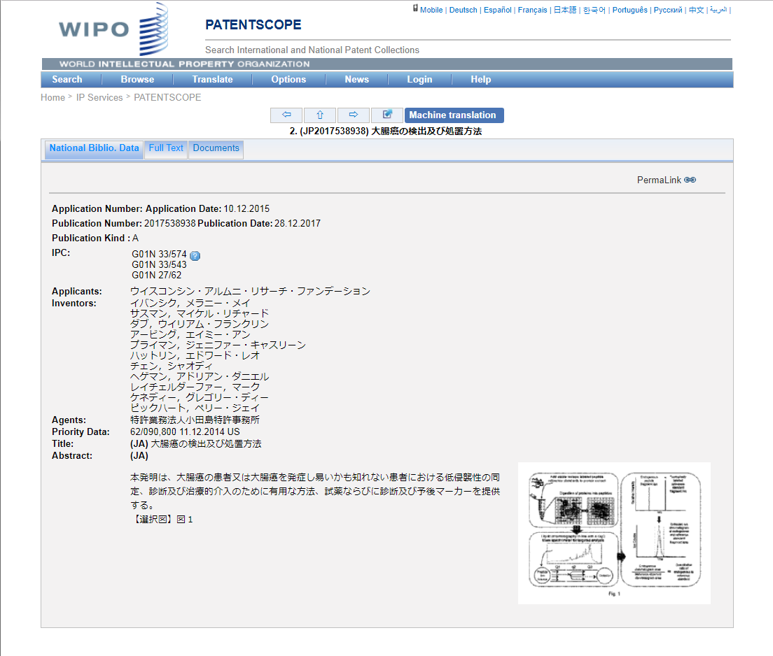
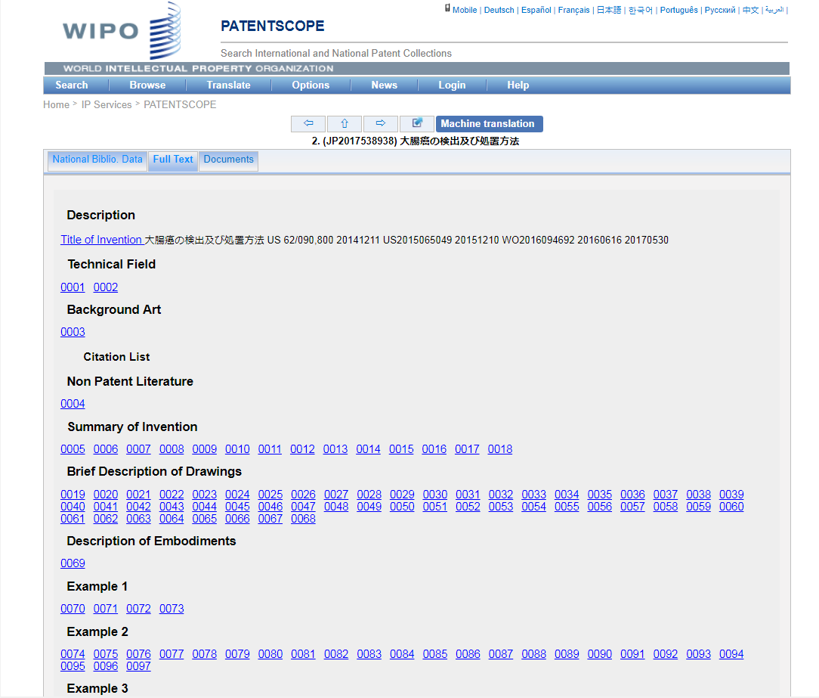
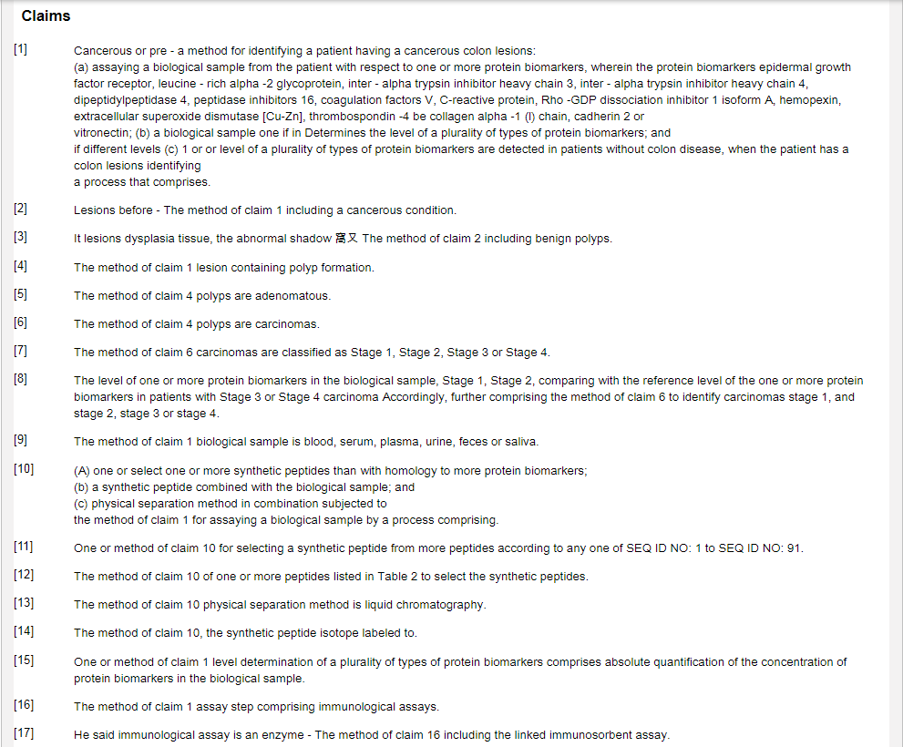
Search strategy

Slide 22
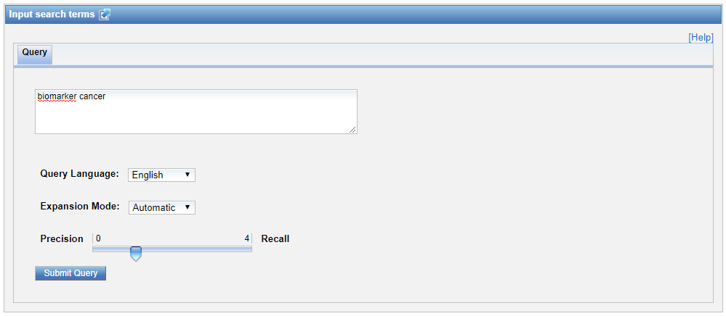
1 step alternative
enter all keywords
Notes:
Automatic means the system decides by itself the variant and the keywords as well as the translation in all languages

Slide 23
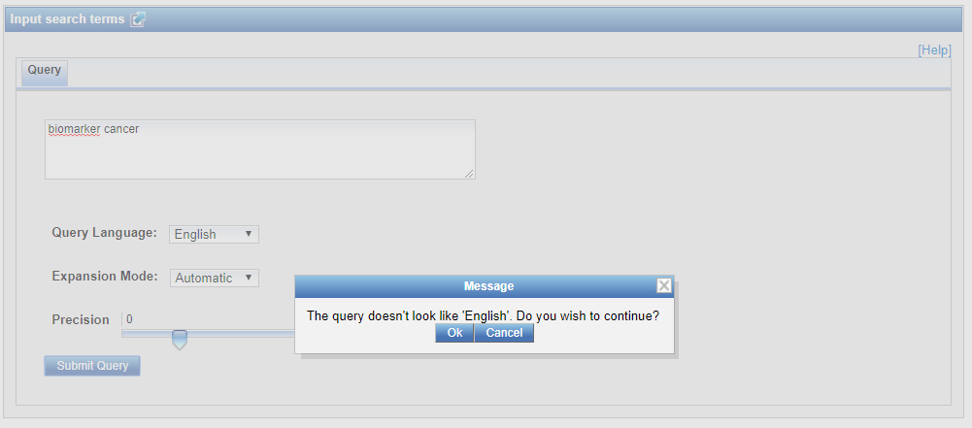
1 step alternative
Confirmer la langue
Notes:
Because the same keywords might be the same in different language

Slide 24
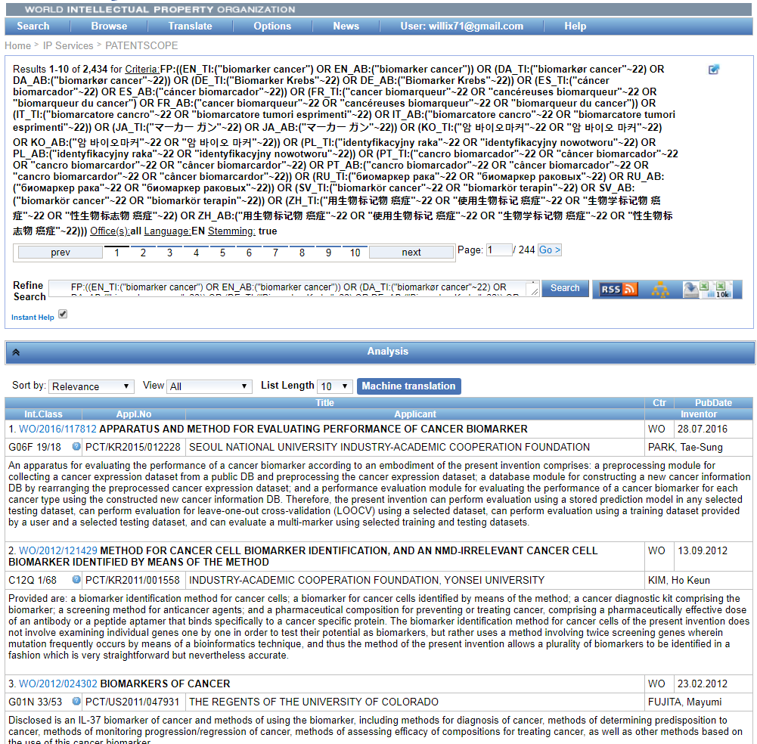
1 step alternative
Notes:
Query looking for the concepts in titles and abstract in 14 different languages

Slide 25
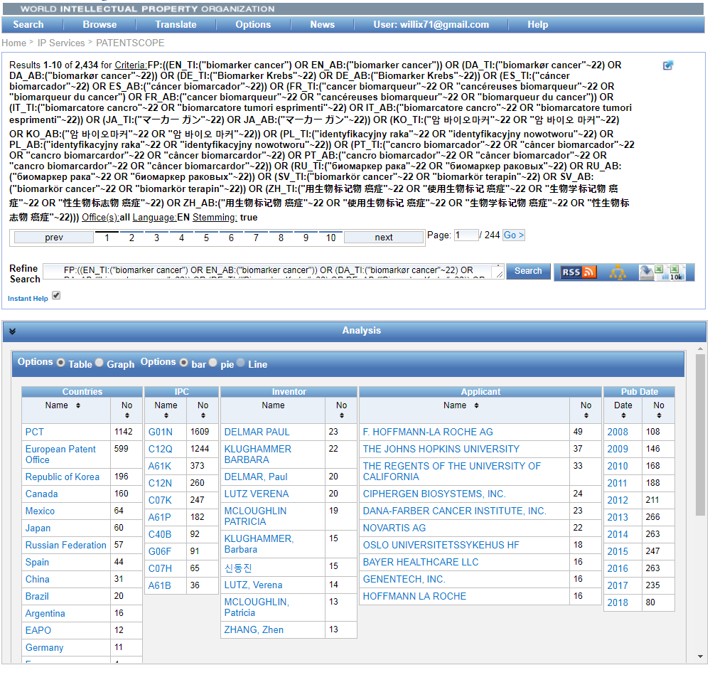
Results Analysis
Notes:
Top 10 patent collections
Distribution over the last 10 years
You can export the first 10’000 result to excel to be analyze by your favorite BI tool (if you are logged in)

Slide 26
News

Slide 27
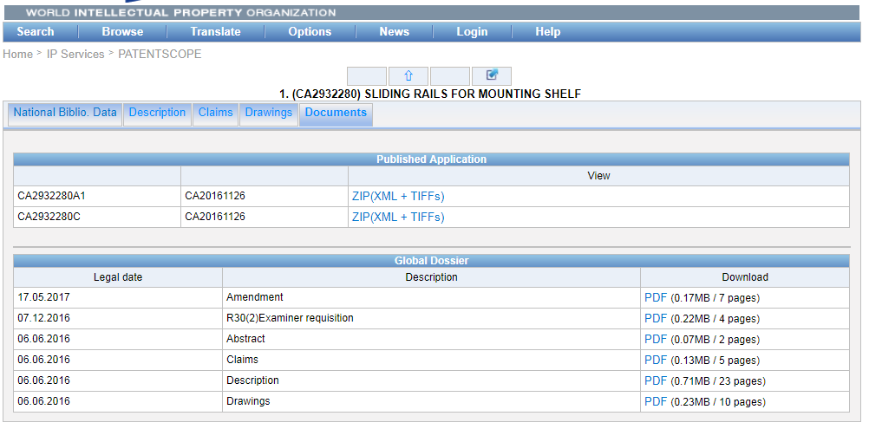
Wipocase Centralized Access to Search & Examination
CA,JP,EP,AU,US,KR,IN
Notes:
Centralized Access to Search & Examination The dossier content provides the most up-to-date information about a patent application’s progress through the examination process including
Search reports
Office actions
Correspondence between the applicant and the patent office

Slide 28
Wipocase coverage
Notes:
Application not found if no correspondence was found
Service unavailable if something else went wrong (quota)

Slide 29
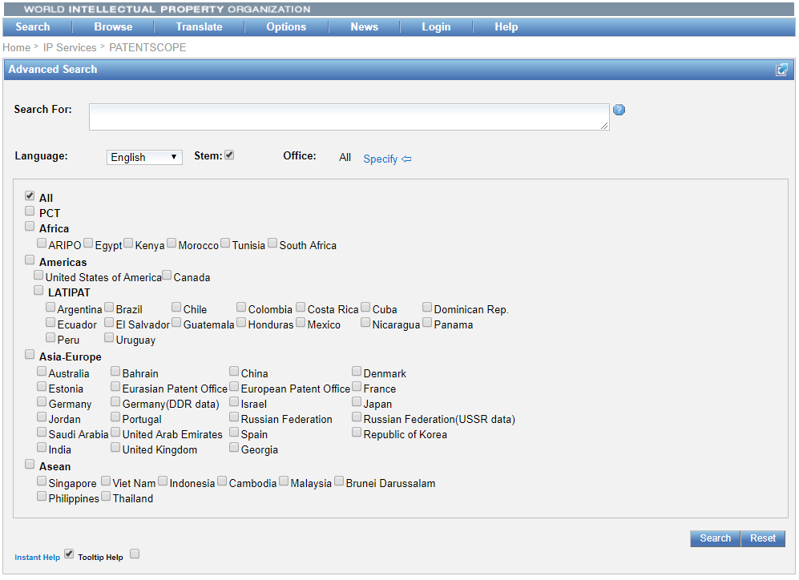
New national collections ASEAN+ India
Notes:
The national patent collections of Brunei Darussalam, Cambodia, Philippines, Indonesia, Malaysia and Thailand are now available in WIPO’s global patent search system PATENTSCOPE. Data from Viet Nam have been updated.
This brings to 51 the number of national/regional offices whose data is available in the PATENTSCOPE Search System and to over 65,000,000 the total number of records.

Slide 30
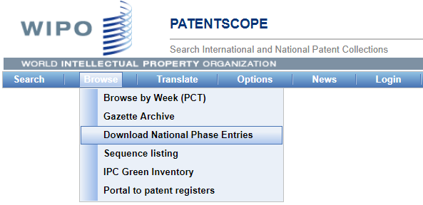
National phase entries
Notes:
Download a zip containing
a csv file per country
International Application Number
National Number
Entry Date
an index.csv summary file

Slide 31
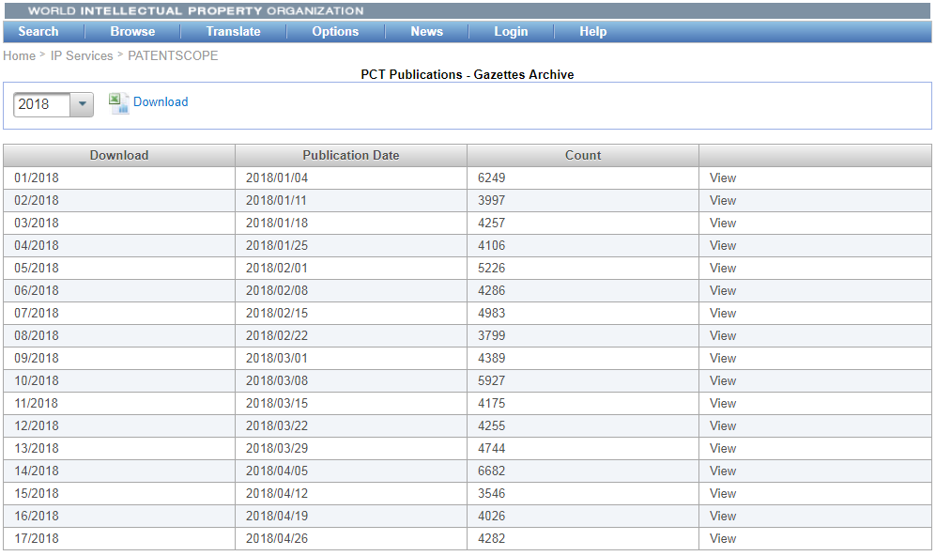
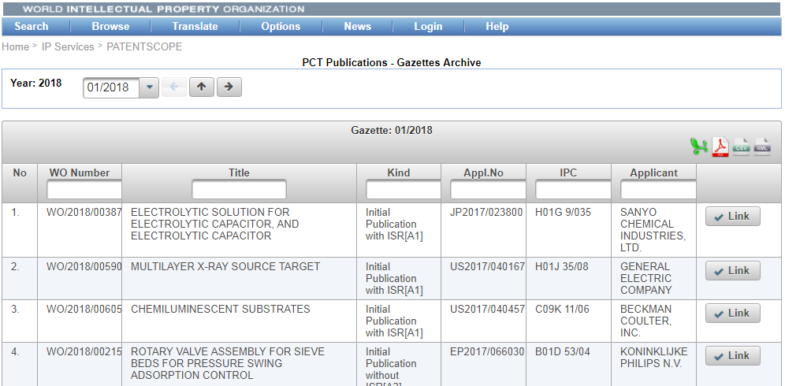
“Authority Files”
Notes:
Download Authority File
View the first 10’000 entries of a given week online
Takes a little time to load the first time
There is also an ALL selection

Slide 32
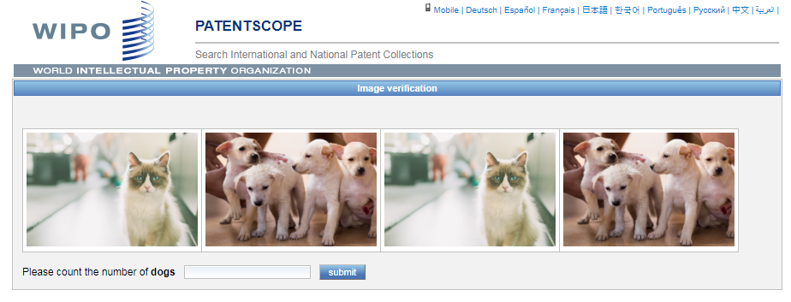
New captcha

Slide 33
WIPO Translate: Neural machine translation (NMT)
NMT remplaces SMT
Pilot system ZH⬄EN in October 2016
NMT: better translation quality and flow
Notes:
Gradually replaces
Pilot system in production in PATentscope in Oct 2016
meilleure qualité de traduction, meilleure fluidité, particulèrement pour les paires de langues distantes

Slide 34
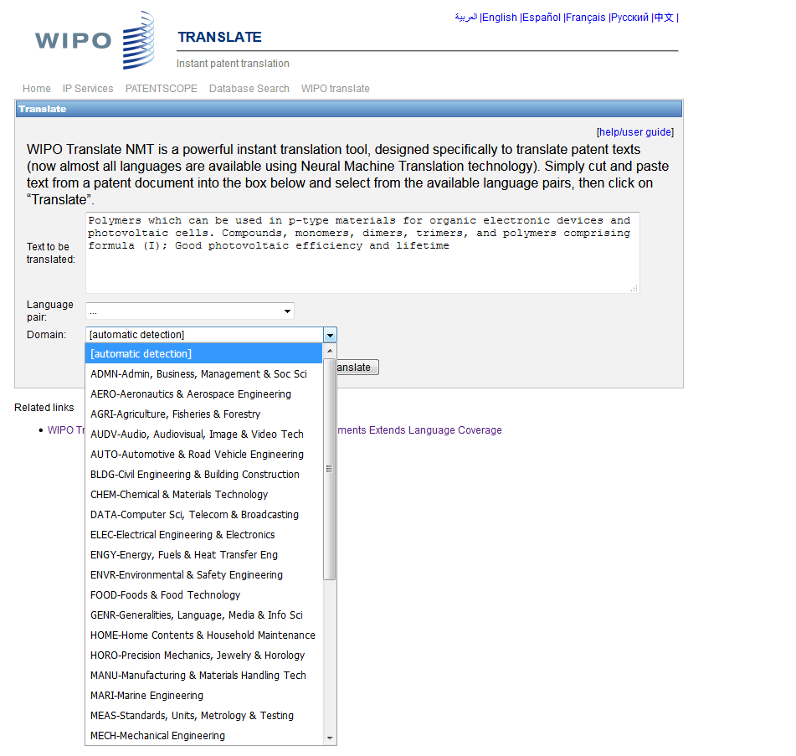

Slide 35
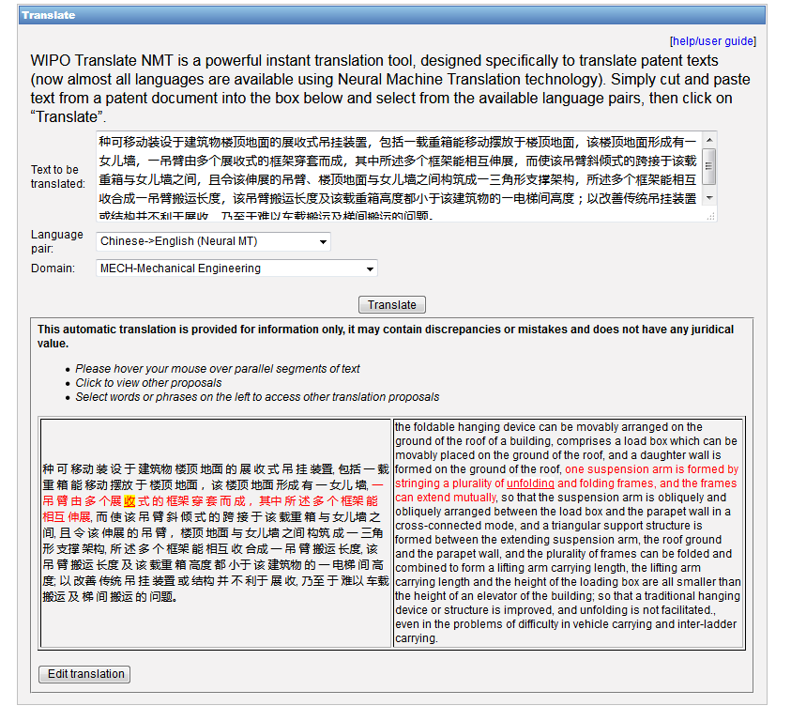
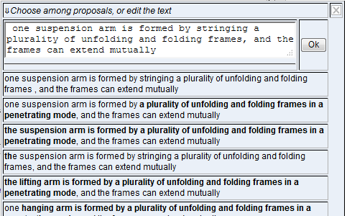

Slide 36
Language pairs
Notes:
Descriptions et revendications: EN⬄FR ,EN⬄JA, EN⬄RU, EN⬄AR, EN⬄DE, EN⬄ES, EN⬄KR, EN⬄PT et EN⬄ZH et vice versa

Slide 37
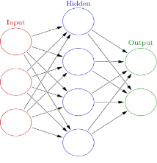
How different is NMT?
发明公布了一种通过在不同位置摆放现实物体来演奏音乐的娱乐装置
one kind of by-this-mean
by/for
of
发明公布
不同位置
摆放现实物体
演奏音乐
娱乐装置
invention discloses
different location
placing real object
play music
entertainment device
PBSMT (previous WIPO translate)
invention discloses
invention discloses a by placing a real object at a different location to play a music entertainment device
placing a real object
different location
play a music
entertainment device
发明公布
不同位置
摆放现实物体
演奏音乐
娱乐装置
invention discloses
different location
placing real object
play music
entertainment device
NMT (new WIPO translate)
placing real objects
the invention discloses an entertainment device for playing music by placing real objects at different positio
invention discloses
entertainment device
playing music
different position

Slide 38
WIPO*Translate /Google*Translate
Patent data
2016
WIPO PBSMT: Wipo translate using phrase-based SMT (Moses)
Notes:
Comparaison de la qualité de traduction de (scores BLEU)
Zh-en: t201635 PBSMT testset.tapta5m.en NMT: GoogleSmt: testset.en.google.tok GoogleNMT: testset.en.google.20161010.tok
Jp-en: t2016jul PBSMT testset.tapta5m.en
Ko-en t201642 PBSMT: testset.en.smt20161201.txt google: testset.en.google.tok GNMT: testset.en.google-nmt.tok
Fr-en: t201640 PBSMT nmt: testset.en.nmt.20161201.txt googleSMT: testset.en.google.tok

Slide 39
Advanced chemical search
Theobromine = C7H8N4O2 = 3,7-dimethyl-1H-purine-2,6-dione
PCTs including Theobromine and chocolate
Notes:
is found in the seeds of the plant Theobroma Cacao, which is the well-known source of chocolate and cocoa. It has a bitter flavor, which gives dark chocolate its typical bitter taste. Its chemical formula is C7H8N4O2 and IUPAC name: 3,7-dimethyl-1H-purine-2,6-dione ^{(source wikipedia)}
we would like to focus on the PCT patent applications where the invention cites Theobromine and is about chocolate

Slide 40
Step 1

Slide 41
Step 2

Slide 42
Step 3
Search strategy
CHEM:(YAPQBXQYLJRXSA-UHFFFAOYSA-N)
AND CTR:WO
AND EN_AB:chocolate

Slide 43
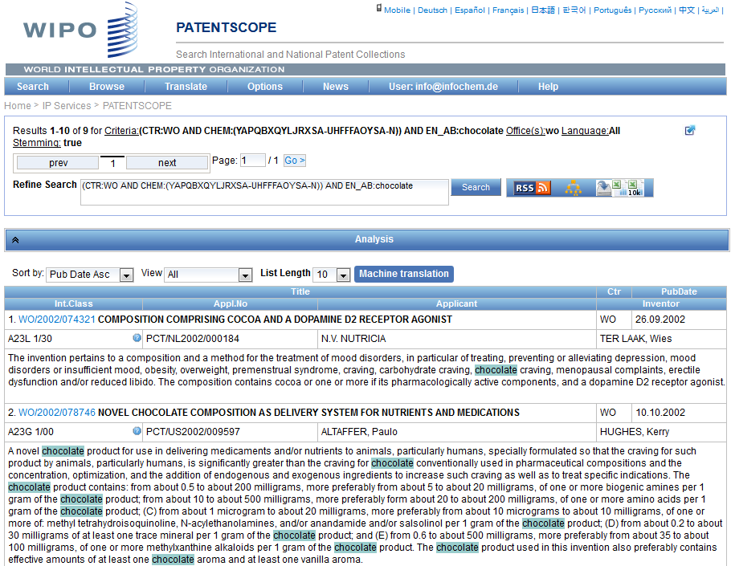
Step 4

Slide 44
Color documents

Slide 45
Future?

Slide 46
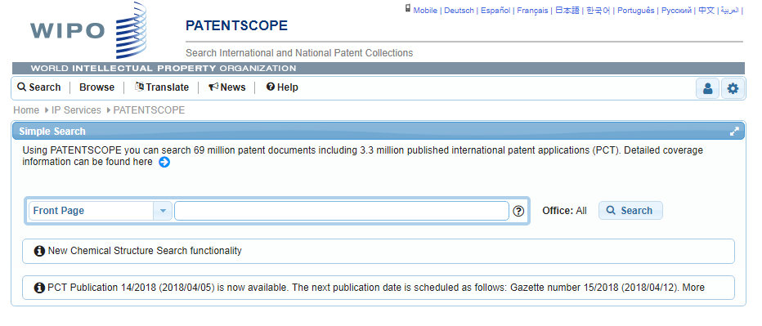
New Look & Feel
Notes:
Will enable us to improve the visual on small and large devices (Responsive web design)

Slide 47
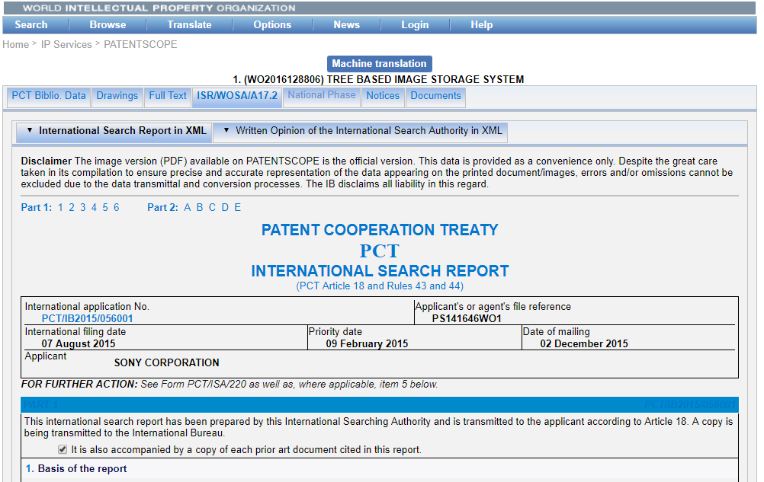
Search reports
Notes:
International Search Report
Written Opinion of the International Search Authority
Article 17.2

Slide 48
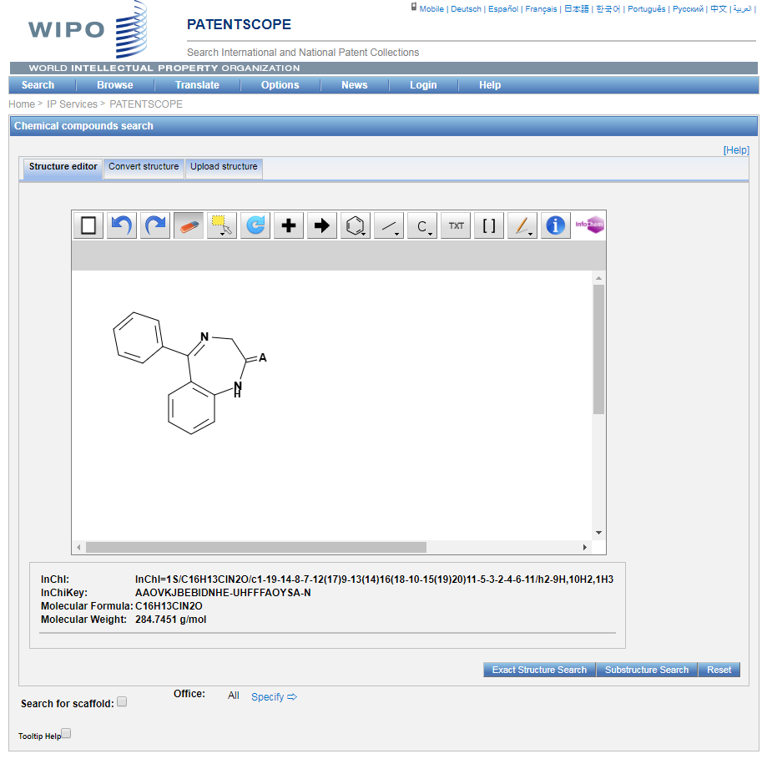
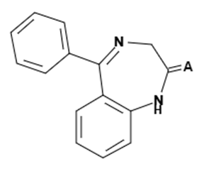
Sub-structure search
Notes:
Back in October 2016, we added the chemical search tool
It’s was developed on by InfoChem
You can draw the molecule or can search by compound name, INN, Inchi, SMILES or upload a MOL of images file
Chemical annotation of PATENTSCOPE full-text documents using InfoChem’s ICANNOTATOR

Slide 49
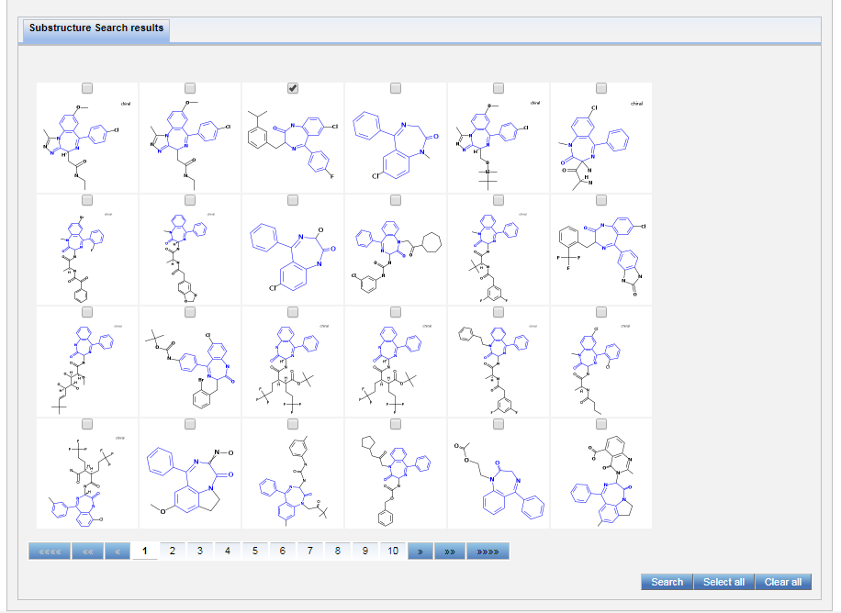
Sub-structure search

Slide 50
Sub-structure search
Notes:
Resultats

Slide 51
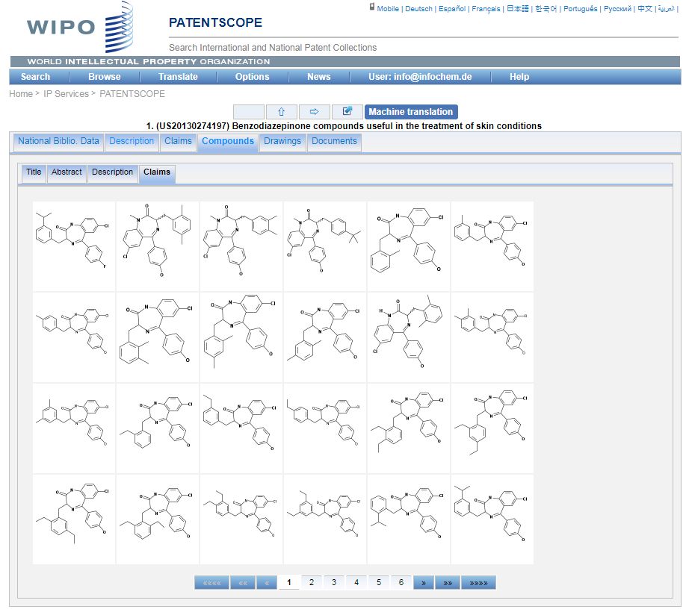
Sub-structure search
Notes:
Detail

Slide 52
Other
New search fields
CPC codes
Kind codes

Slide 53
Next webinar: July 17 or 19
Chemical Structure Search
To register:
https://attendee.gotowebinar.com/rt/3241594862538409217

Slide 54
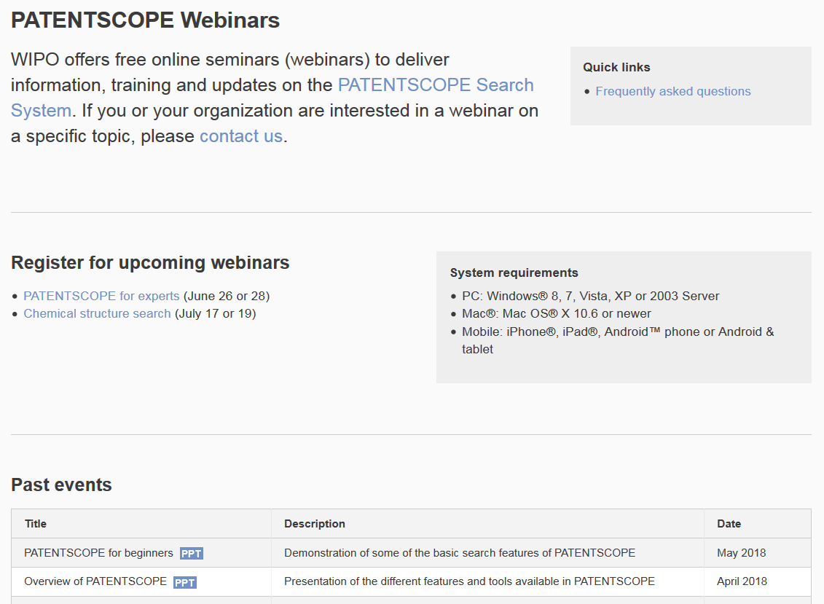
Future/past webinars:
wipo.int/patentscope/en/webinar

Slide 55
Global Design Database: webinar
How to perform a search in the Global Design Database
July 11 at 4:30pm CET
https://attendee.gotowebinar.com/register/2162408810209184771

Slide 56
Global Brand Database: webinar
Performing effective searches in the Global Brand Database
July 18 at 4:30pm CET
https://attendee.gotowebinar.com/rt/2978426757944878081

Slide 57
patentscope@wipo.int

Slide 58
patentscope@wipo.int

