Slide 1
PATENTSCOPE:
For Beginners
Cyber world
May
2018
Sandrine Ammann
Marketing & Communications Officer

Slide 2
Agenda
  Interfaces
    Simple interface
    Field Combination interface
    Advanced interface
  User account
  Quiz
  New features
  Webinars
  Q & A session

Slide 3
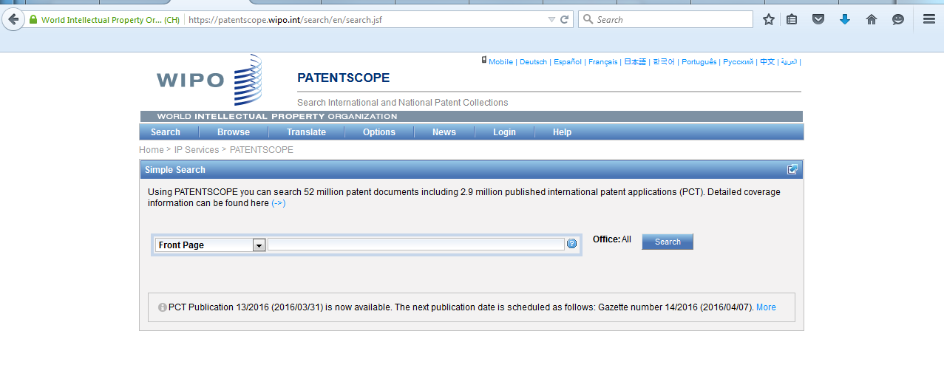
https://patentscope.wipo.int/search/en/search.jsf

Slide 4
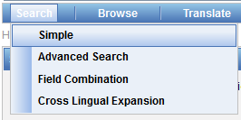
PATENTSCOPE: how to search
Search patent documents:
  Simple
  Field combination
  Advanced

Slide 5
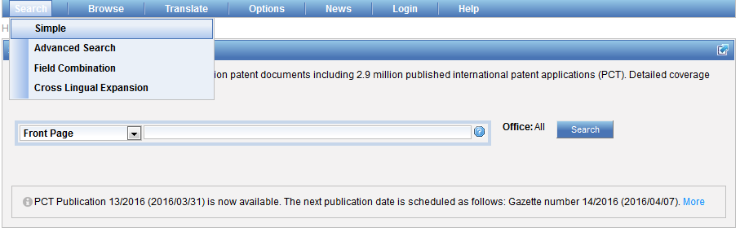
Interface : Simple

Slide 6
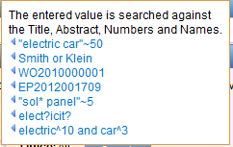
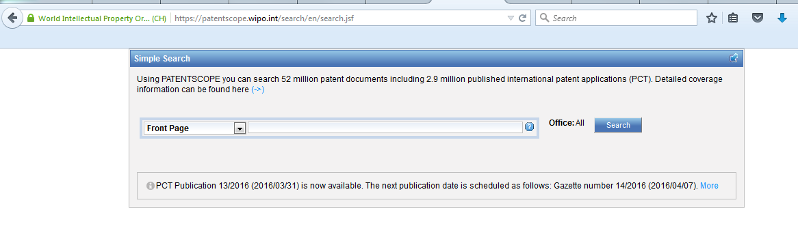
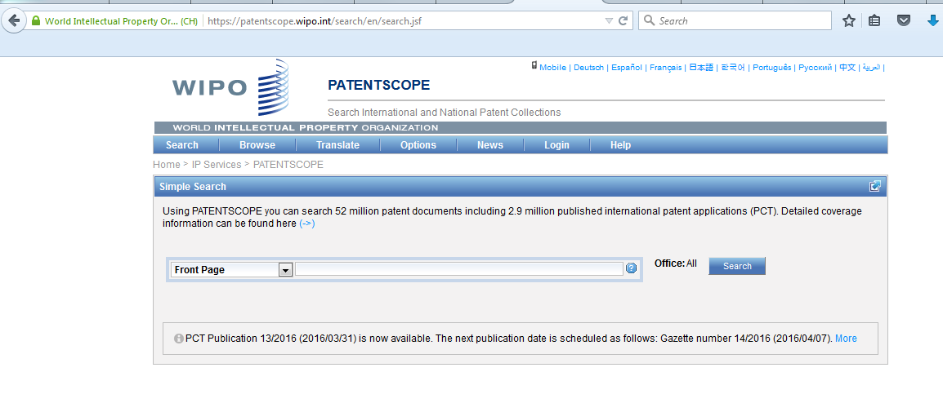
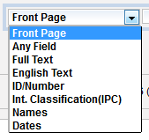
Interface

Slide 7
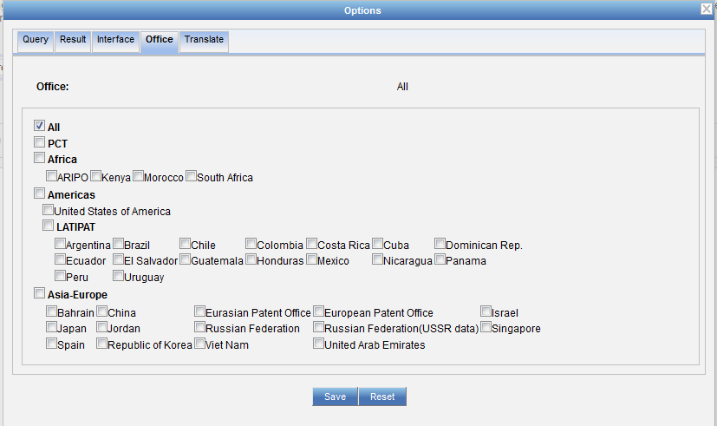
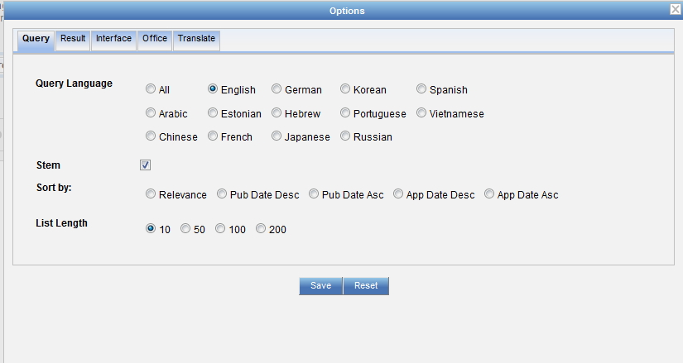
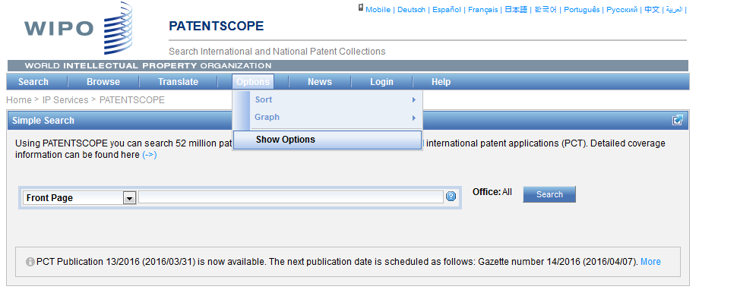
Collections selection

Slide 8
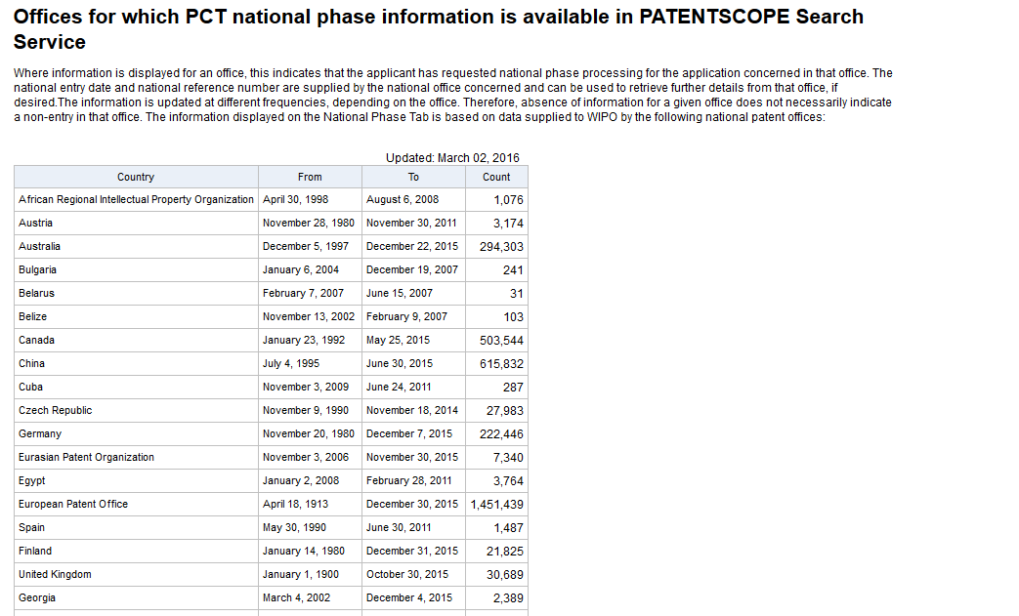
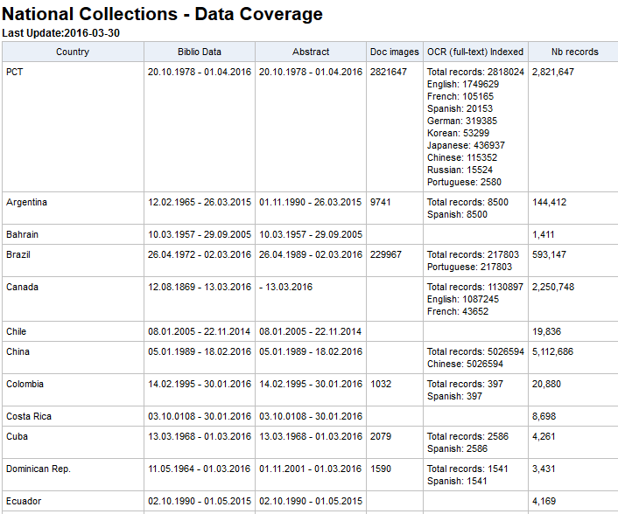
Coverage: collections-national phase
https://patentscope.wipo.int/search/en/help/data_coverage.jsf
https://patentscope.wipo.int/search/en/nationalphase.jsf

Slide 9
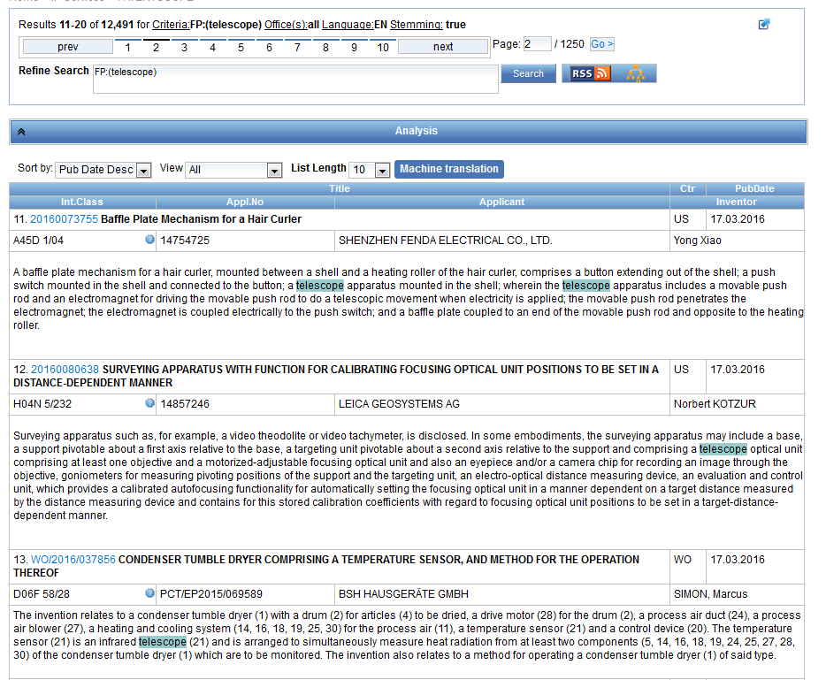
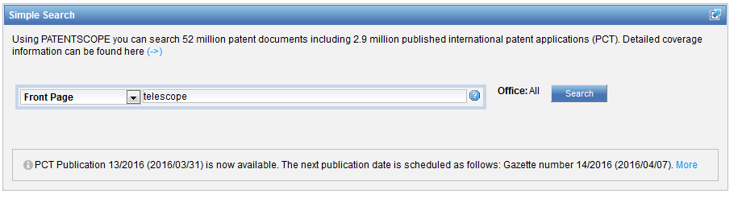
Interface simple - keywords

Slide 10
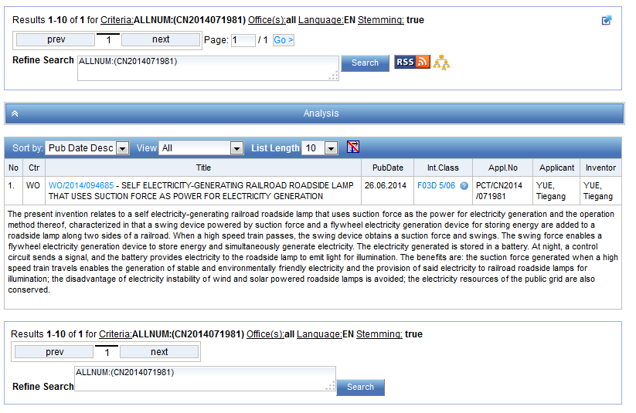
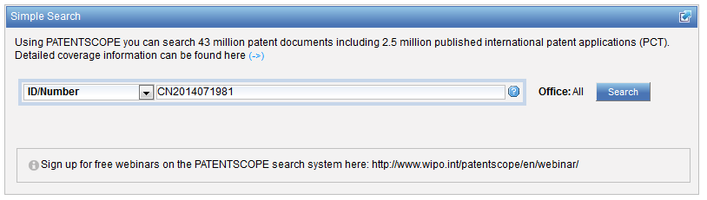
Simple interface - Numbers

Slide 11
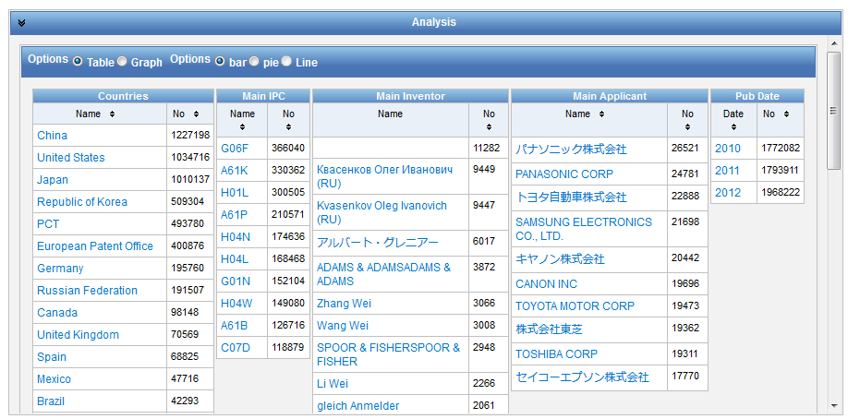
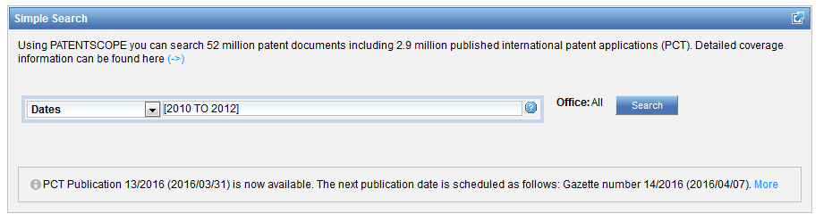
Date range using […TO…]

Slide 12
Interface: Field combination

Slide 13

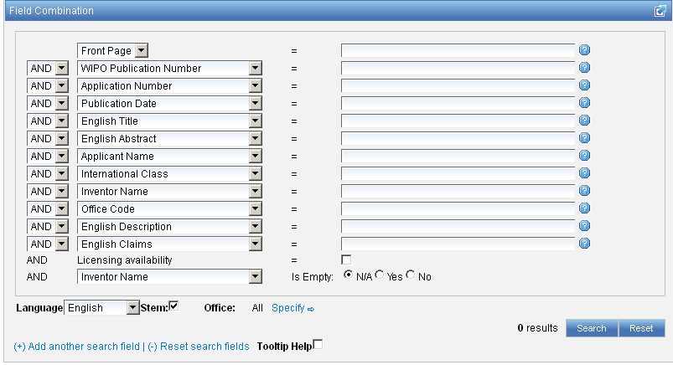
Interface : Field Combination - Structured

Slide 14
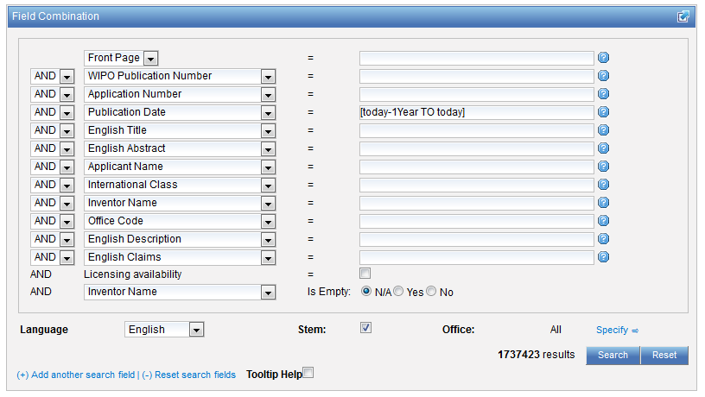
Stemming
Process that removes common ending from words by English Snowball algorithm
electric¦al = electric
electric¦ity = electric
electron¦ics = electron
More accurate results than wildcards:
elect* electoral, etc.

Slide 15
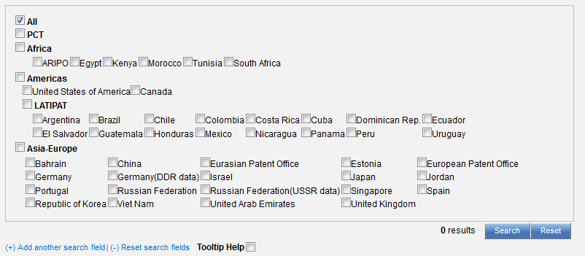

Interface : Field Combination - Structured

Slide 16
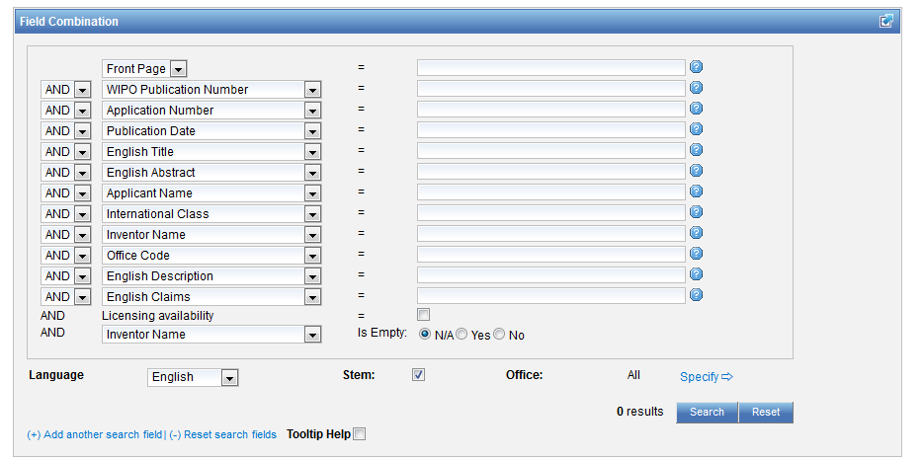

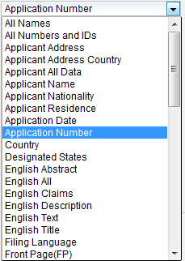
Field Combination

Slide 17
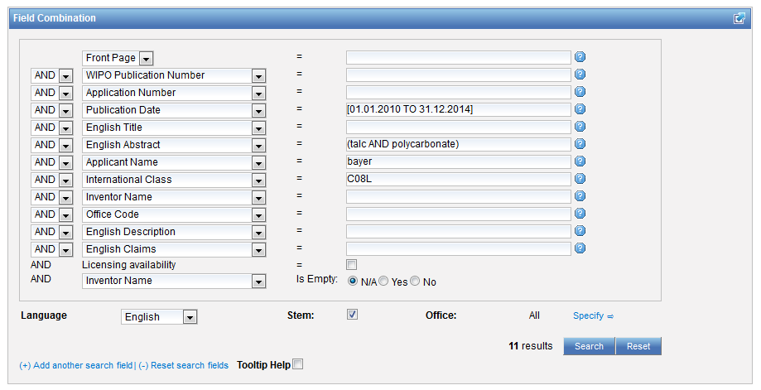
Interface Field Combination

Slide 18
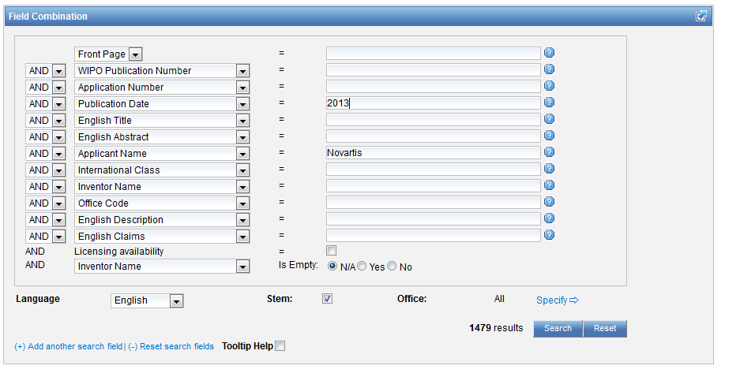
Search examples
Patent documents containing Novartis as inventor and published in 2010
Notes:
18

Slide 19
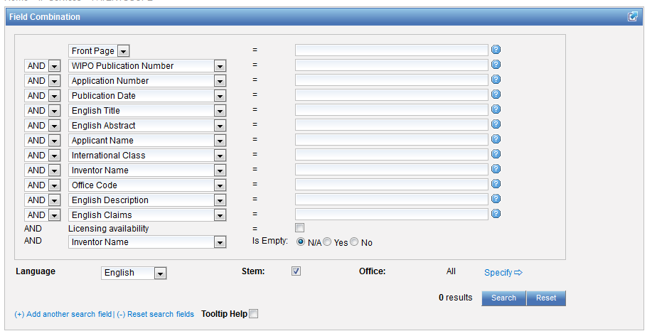
Empty fields

Slide 20
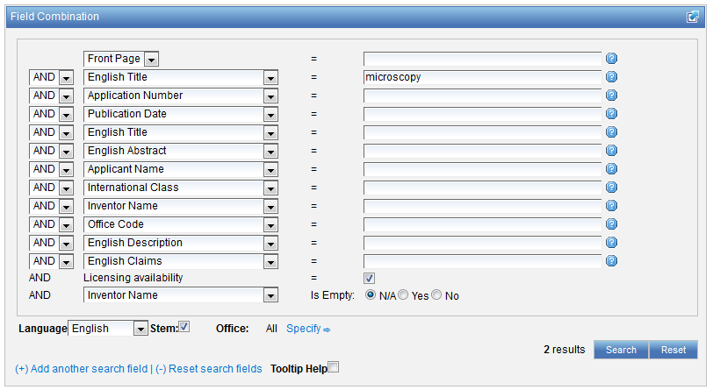
Search examples
Notes:
20

Slide 21
In the Publication Date field:
Examples
DP:today
DP:today-3days
DP:today-1Week
DP:today-2Years
Time ranges:
DP:[today-1Year TO today]
DP:[today-3Years TO today-1year]
Simplified time period ranges :
DP:Last3Days
DP:Last2Weeks
DP:Last1Year
Last Publications published :
DP:pct_lastpubdate
DP:pct_lastpubdate and PA:"University of Paris"

Slide 22
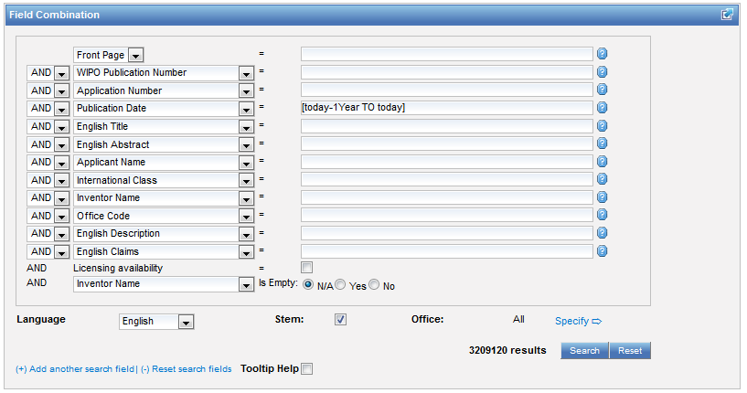

Slide 23
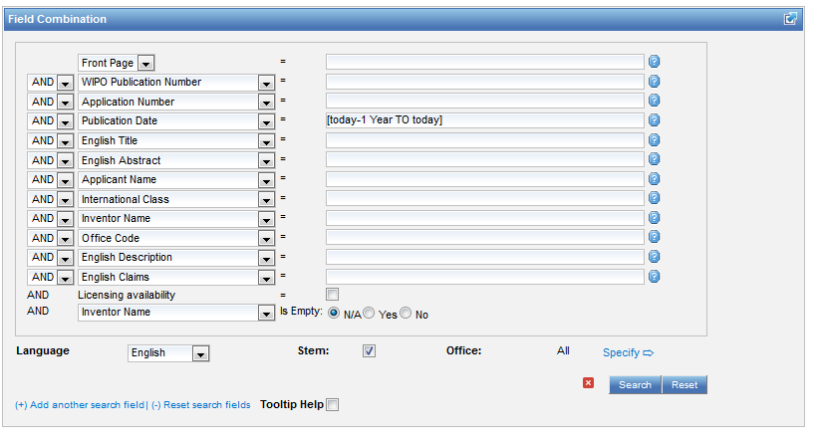
No space

Slide 24
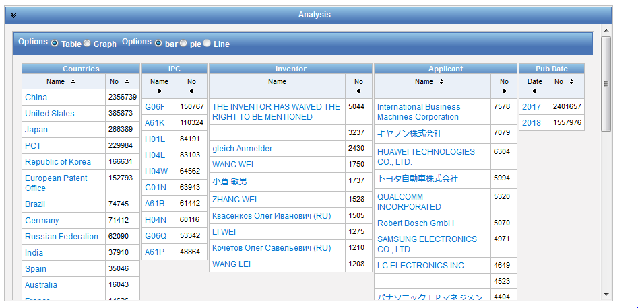

Slide 25
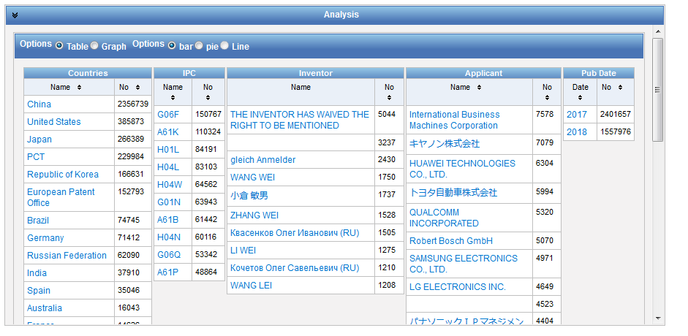
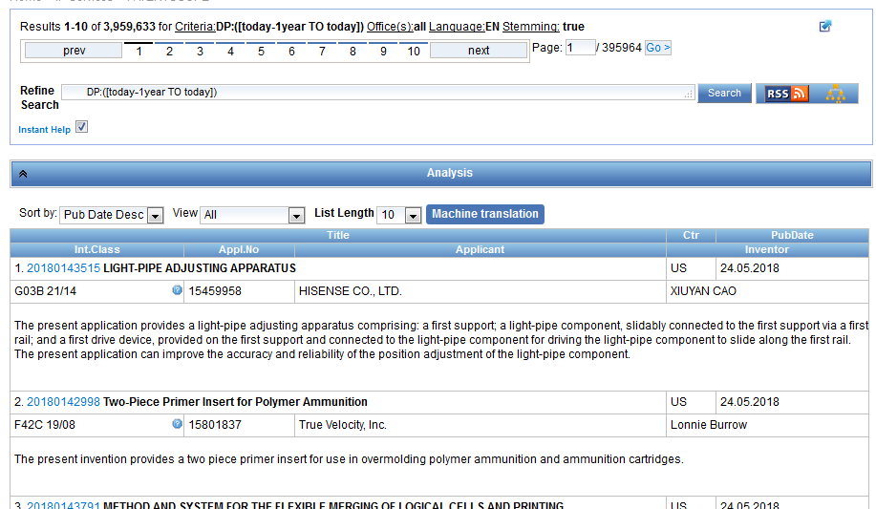
Analysis bar

Slide 26
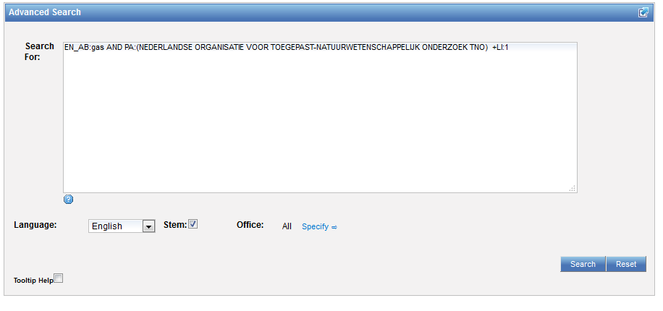
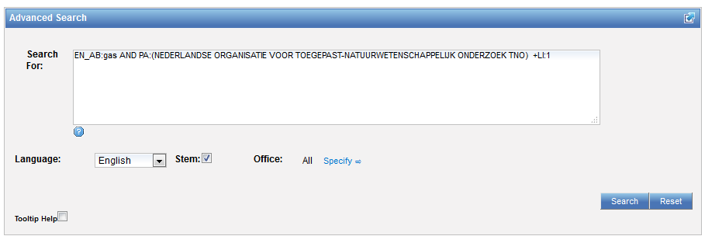
Interface: Advanced search

Slide 27
Instant help
Validates search query
Suggests terms
Provides:
  List of IPC codes
  List of countries

Slide 28
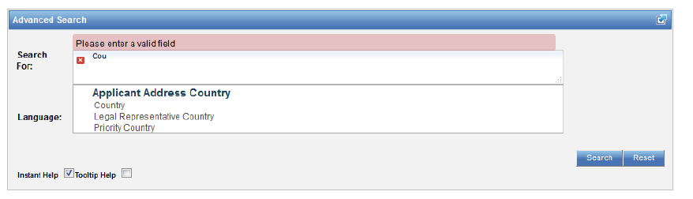
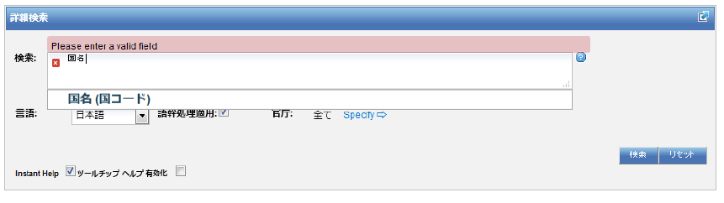

Slide 29
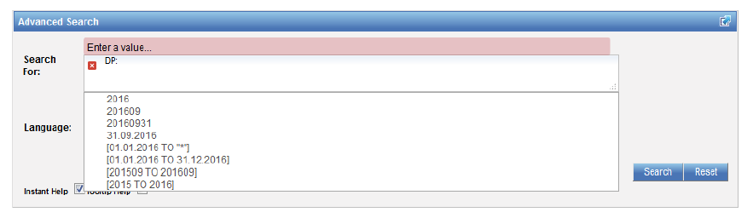
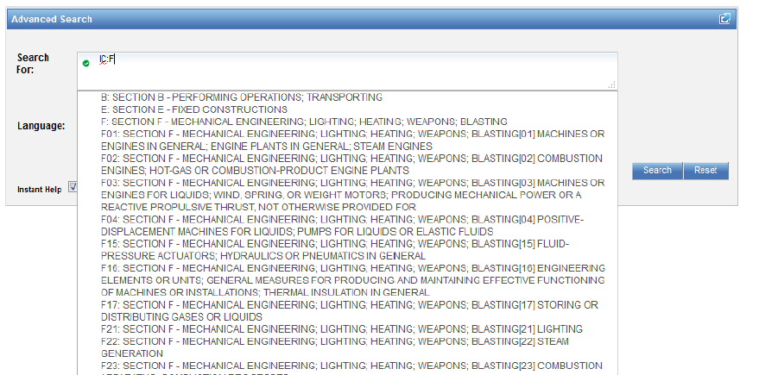

Slide 30
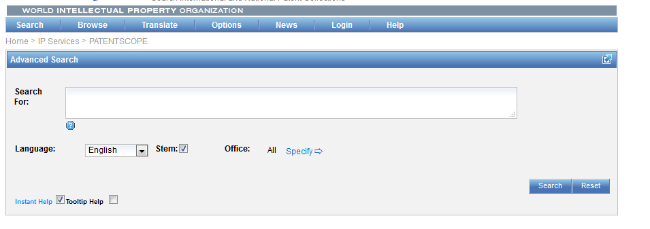

Help

Slide 31
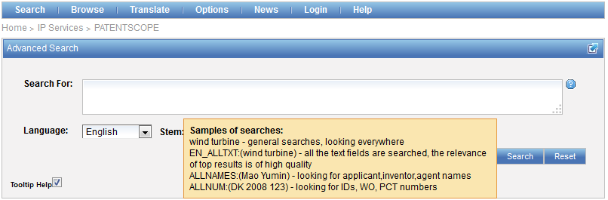
Tooltip help

Slide 32
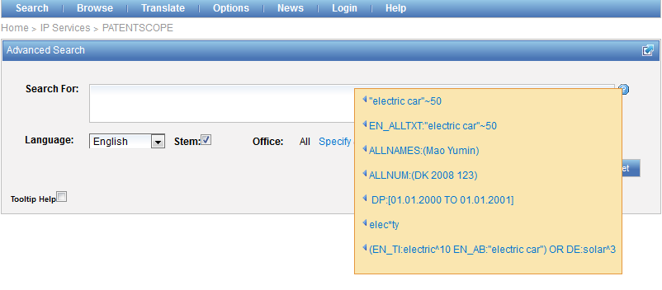
Question mark help

Slide 33
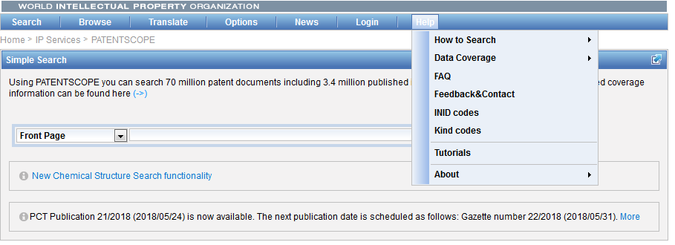
Help menu

Slide 34
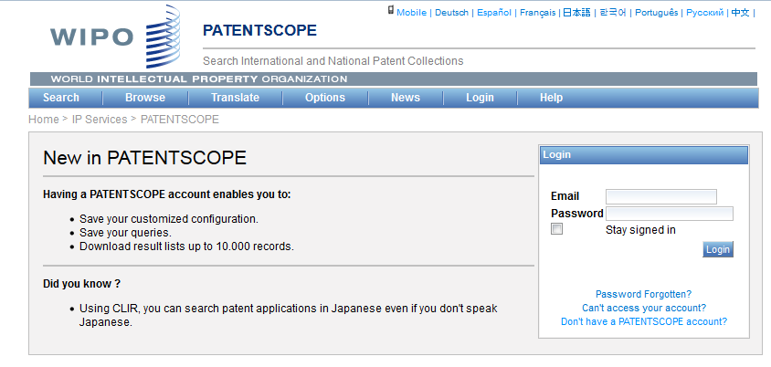
PATENTSCOPE account

Slide 35
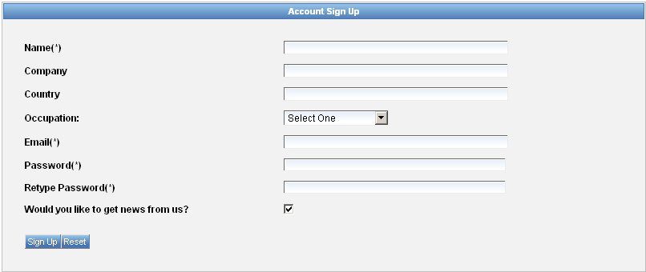
Signing up

Slide 36
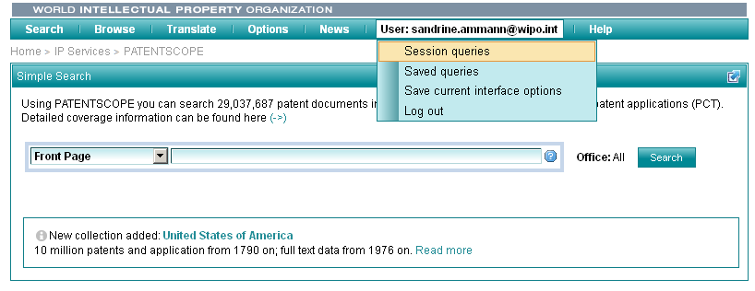
Once logged-in

Slide 37
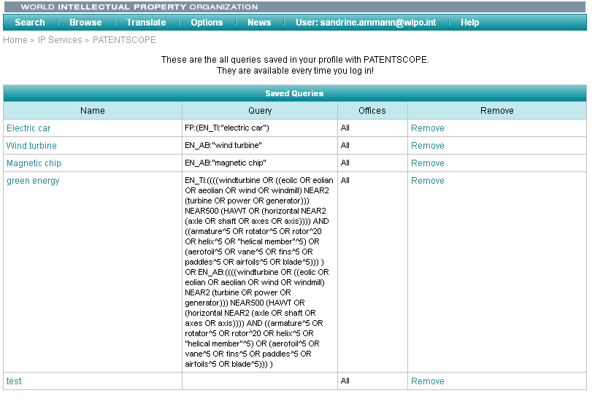
Saved queries

Slide 38
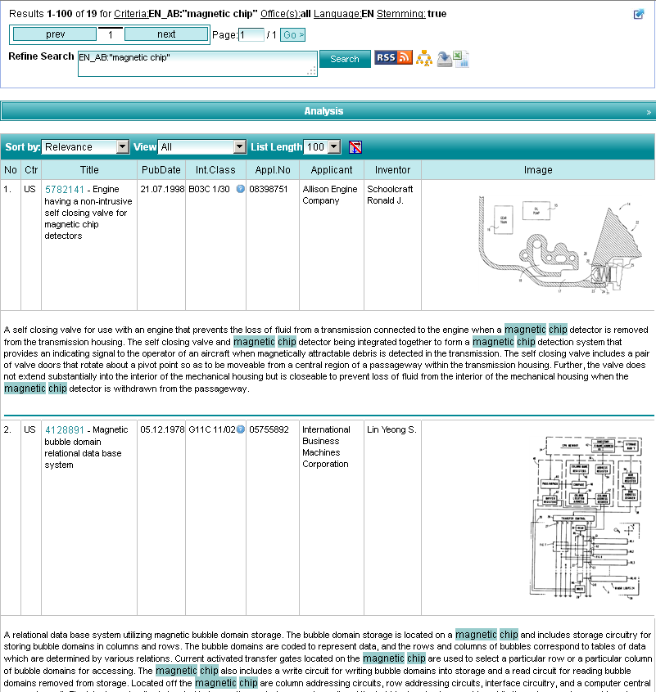
Downloading the results

Slide 39
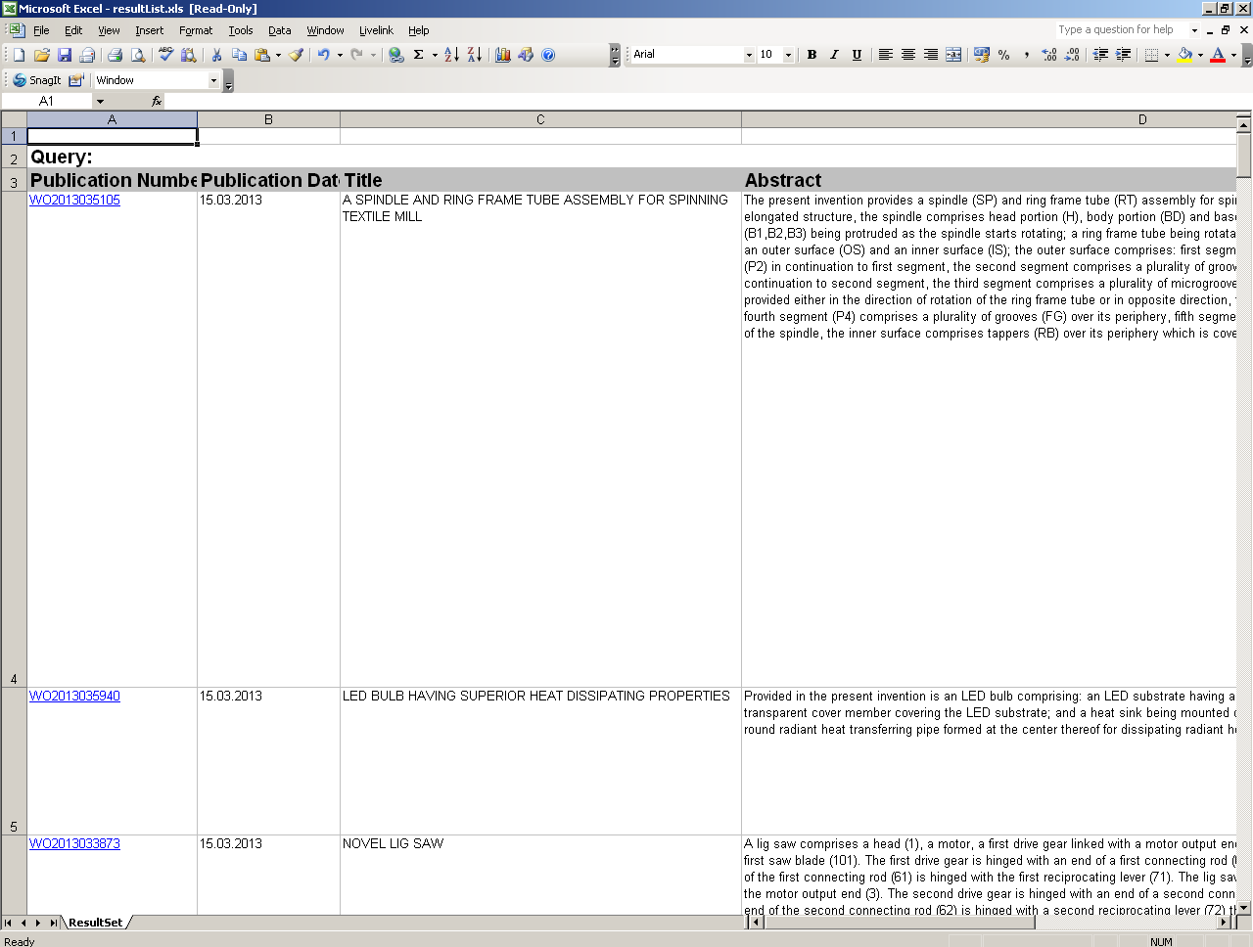
Downloaded results

Slide 40
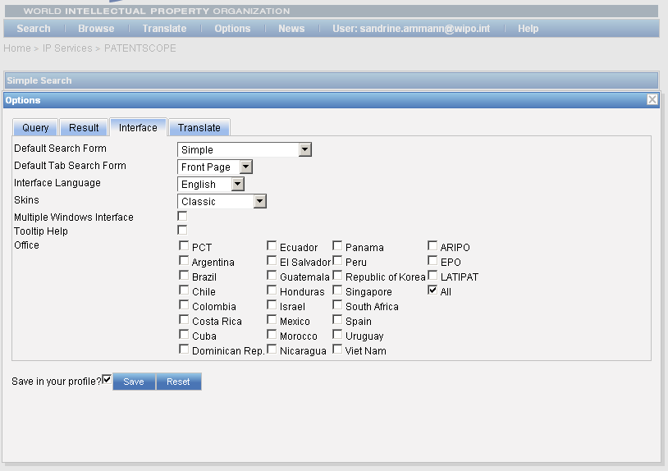
Account customization

Slide 41


Slide 42

Q.1: which fields are not pre-defined fields in the Simple search interface?
A
Applicant nationality
B
Filing language
C
National phase data
D
Front page

Slide 43
Q.1: which fields are not pre-defined fields in the Simple search interface?
A
Applicant nationality
B
Filing language
C
National phase data
D
Front page

Slide 44
Q.2: when you select a collection, you are selecting:
A
PCT national phase entry
B
Collection from a national/regional office

Slide 45
Q 2: when you select a collection, you are selecting:
A
PCT national phase entry
B
Collection from a national/regional office

Slide 46
Q:3: Using the PATENTSCOPE account, can you download the entire result list?
A
No
B
Yes

Slide 47
Q.3: Using the PATENTSCOPE account, can you download the entire result list?
A
No
B
Yes

Slide 48
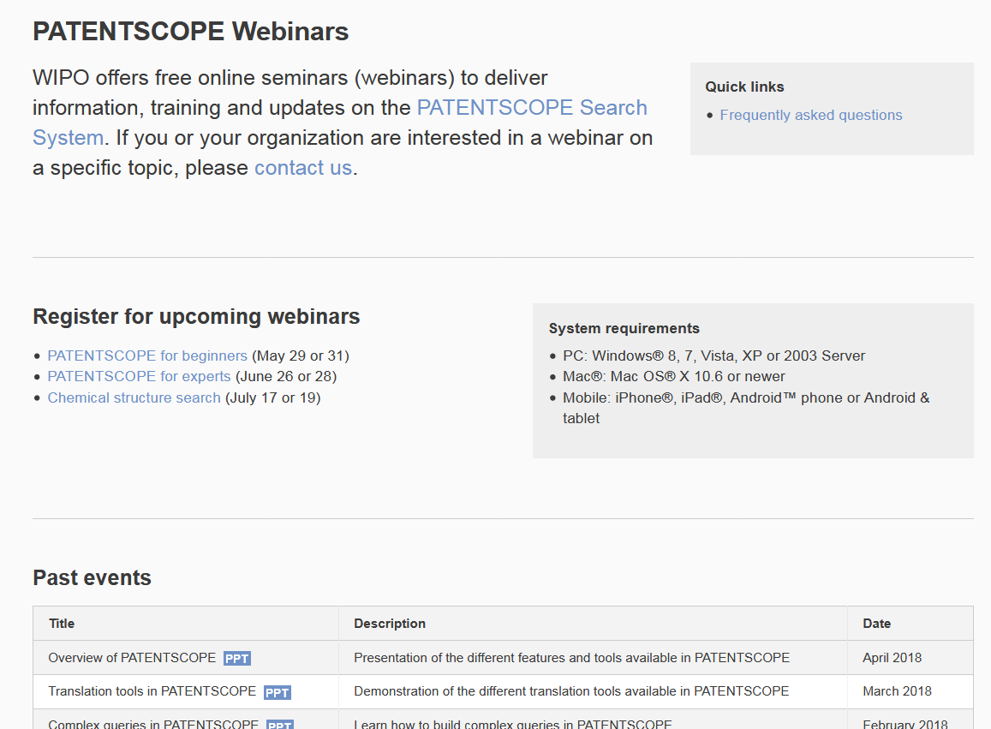
Future/past webinars:
wipo.int/patentscope/en/webinar

Slide 49


Slide 50

Browse

Slide 51

Gazette Archive

Slide 52


Download national phase entries

Slide 53

Next webinar
PATENTSCOPE for experts
  June 26 at 8:30 am
  https://attendee.gotowebinar.com/rt/2544881623016771329
  June 28 at 5:30 pm
  https://attendee.gotowebinar.com/rt/2544881623016771329

Slide 54
Global Design Database: webinar
The result list in the Global Design Database
  June 19 at 5:30pm CET
  https://global.gotowebinar.com/manageWebinar.tmpl?webinar=5030889511120021250

Slide 55
Global Brand Database: webinar
Image searching in The Global Brand Database
  June 20 at 4:30pm CET
  https://global.gotowebinar.com/manageWebinar.tmpl?webinar=1953427932748107265

Slide 56

Forum

Slide 57

patentscope@wipo.int

