Slide 1
Complex queries in the PATENTSCOPE search system
Online
February
2018
Sandrine Ammann
Marketing & Communications Officer

Slide 2
Agenda
Interfaces
Search fields
Syntax
Examples
Combination of interfaces
Q&A

Slide 3

Complexity
“Complexity” of queries depends on:

Slide 4
Q:Would consider yourself as a
A
Beginner seacher
B
Expert searcher

Slide 5
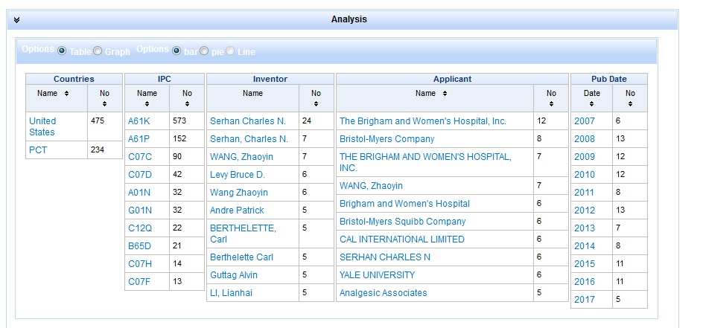
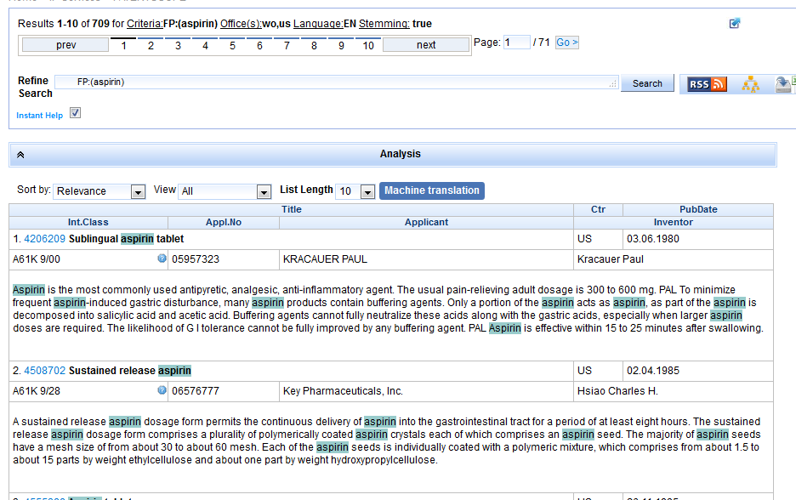
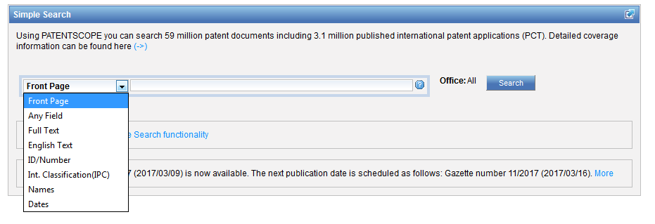
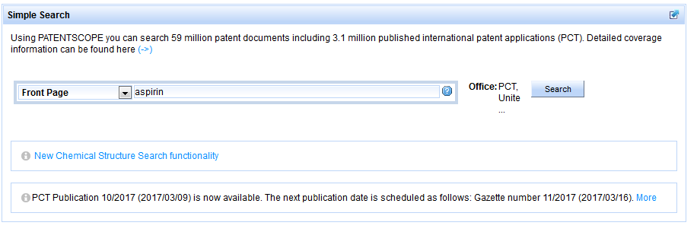
Complexity in this webinar

Slide 6
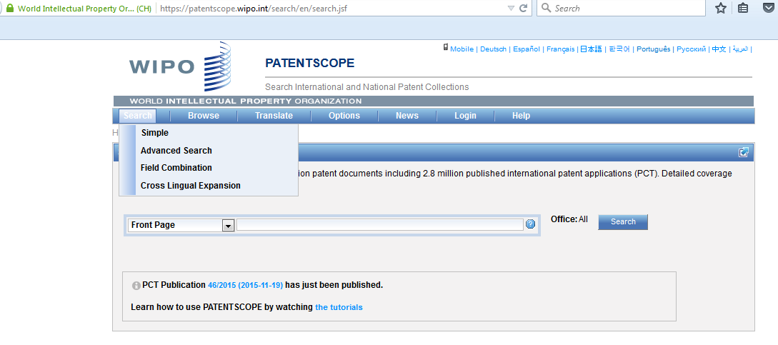
2 interfaces

Slide 7
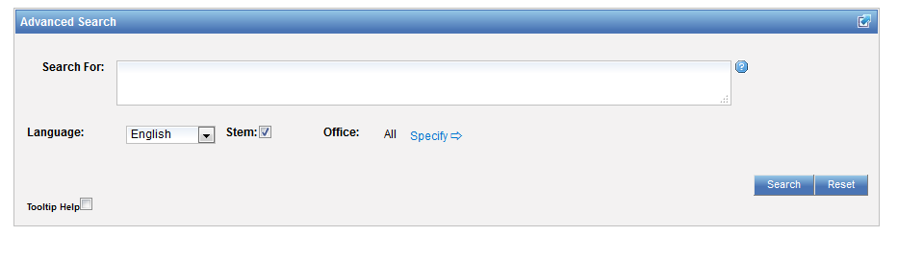
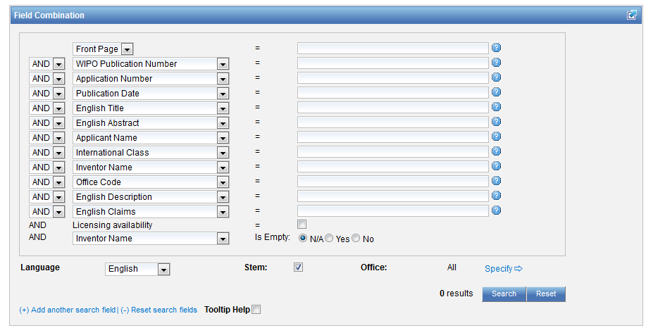
Advanced or Field Combination

Slide 8
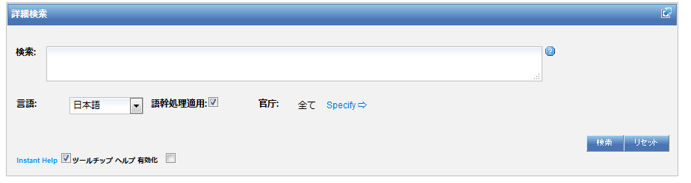
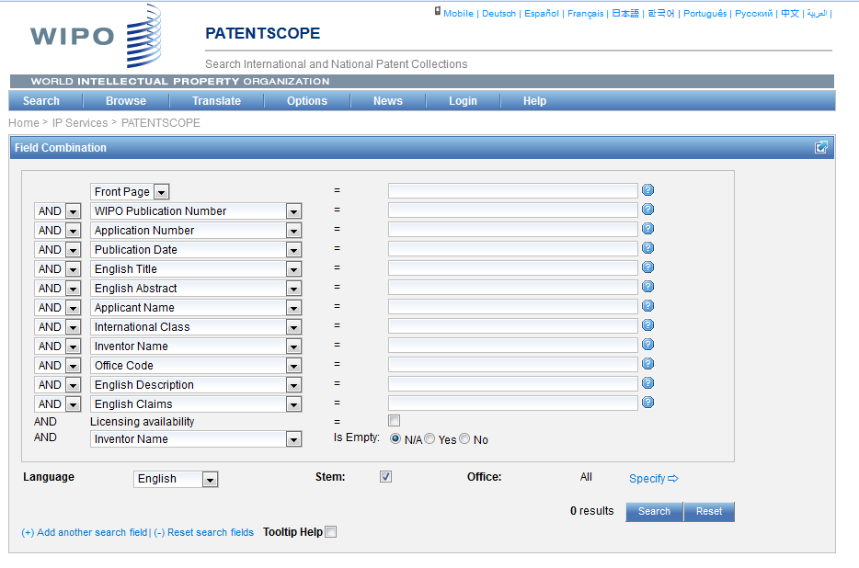
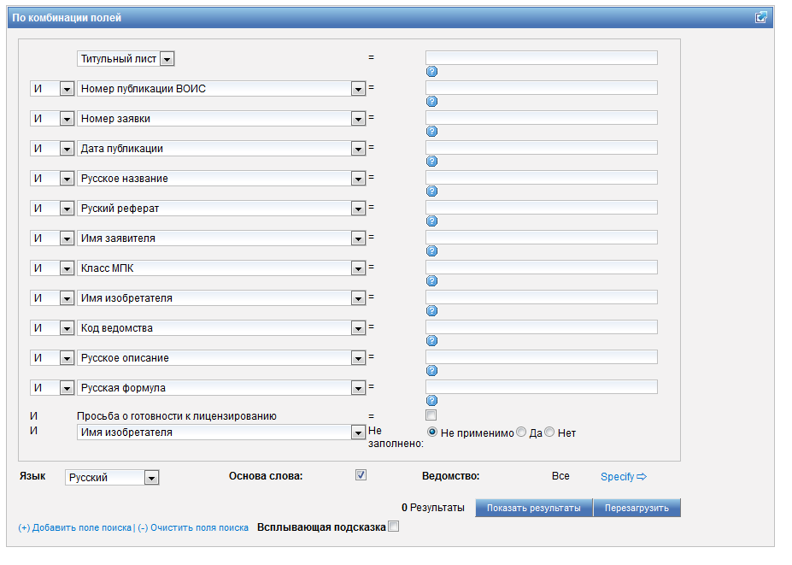
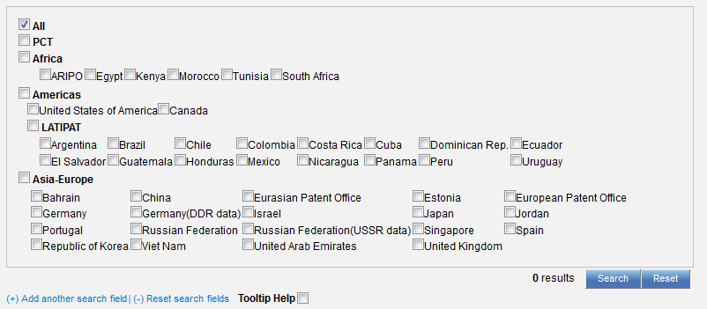

Slide 9
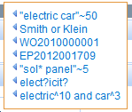

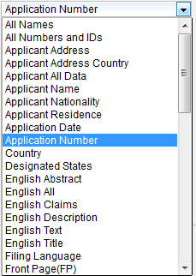
Field Combination

Slide 10
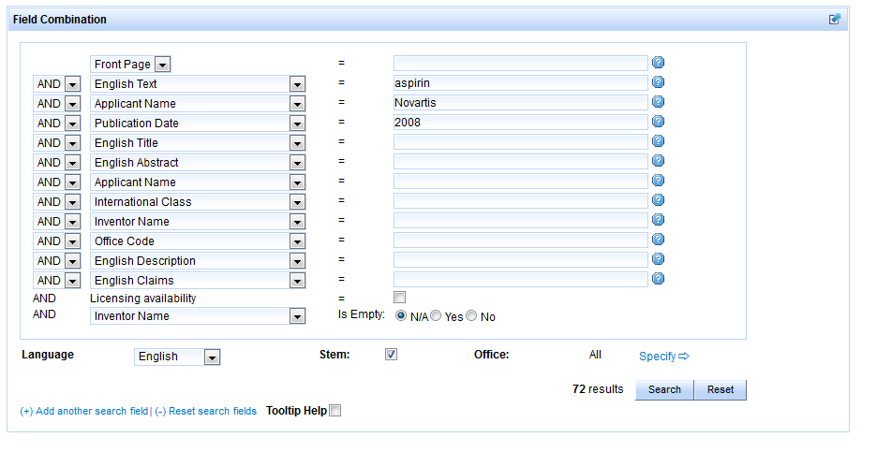
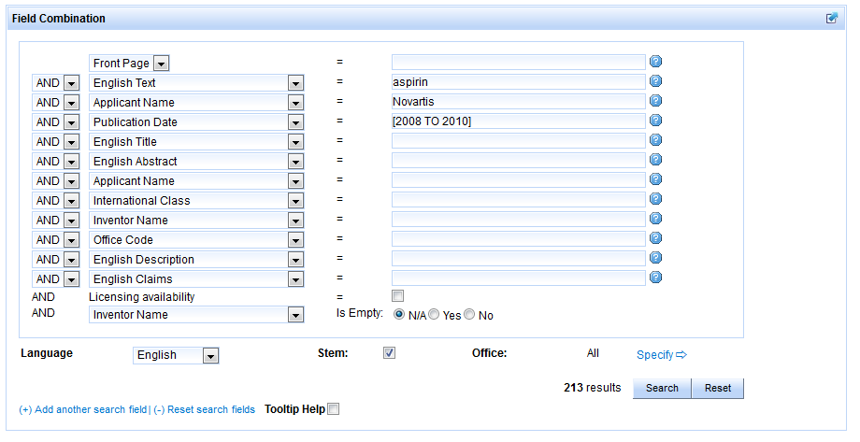

Slide 11
Field Combination - pros
Predefined fields
Immediate results on the same page

Slide 12
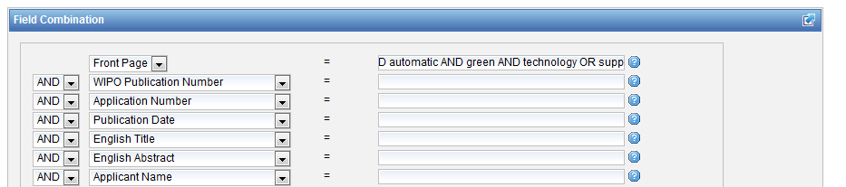
Field combination - cons

Slide 13
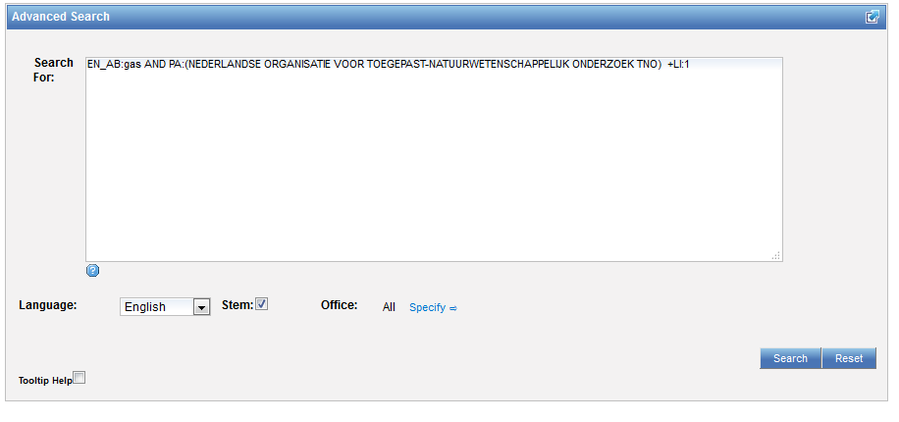
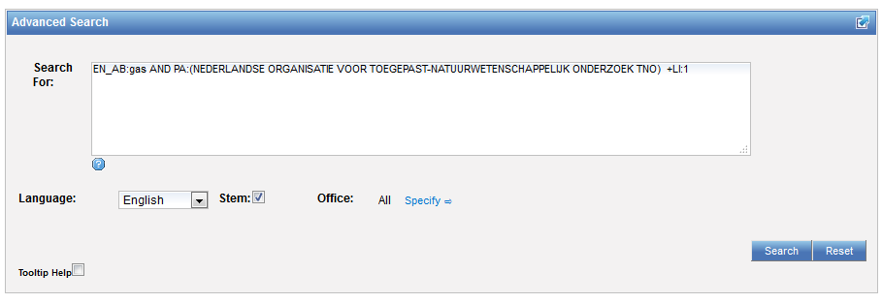
Interface: Advanced search

Slide 14
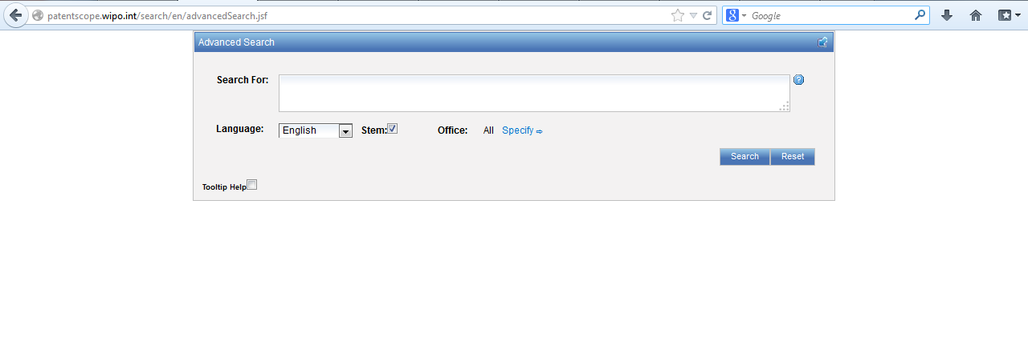
Advanced search interface

Slide 15
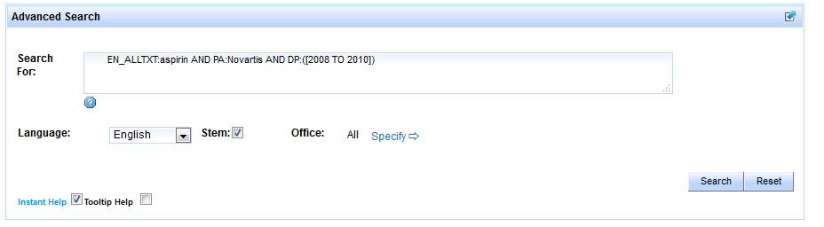
EN_ALLTXT; PA; DP = fields
AND = operator

Slide 16

Fields: where to search
Source: http://spicewallpaper.blogspot.ch/2012/08/green-fields-with-blue-sky.html

Slide 17
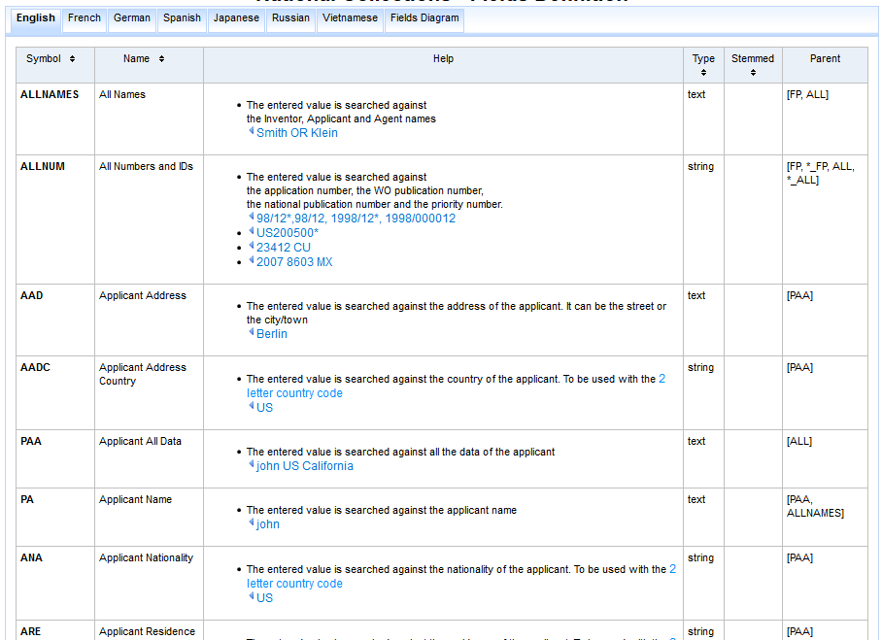
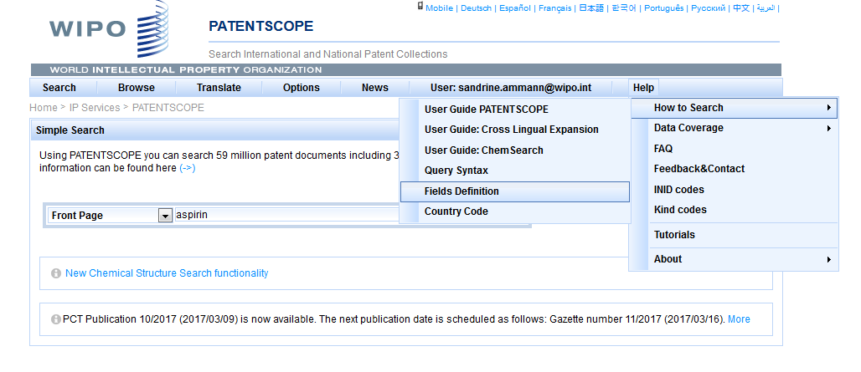

Slide 18
Examples
FP = front page
ALL = all fields
ALL_NAMES = all names
IC = IPC
DP = publication date
CTR = country either WO or country from nat collection
NPCC= national phase entry
AN = origin of PCT

Slide 19
Date search
Simple:
  DP:01.02.2000
  DP:20000201
  DP:02.2000
  DP:200002
  DP:2000

Slide 20
Example: IPC
IC = International Classification
  IC :A
  IC :A47
  IC :A47L
  IC :A47L1
  IC:A47L11
  IC:A47L11/03

Slide 21
D06F 1/06 will include by default
D06F 1/08
1/10
1/16
To exclude subgroup: IC_EX
ICI = International Classification Inventive
ICN = International Classification Non-inventive
ICI_EX ICN_EX = no subgroup

Slide 22
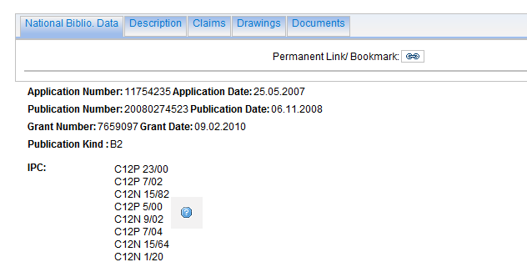
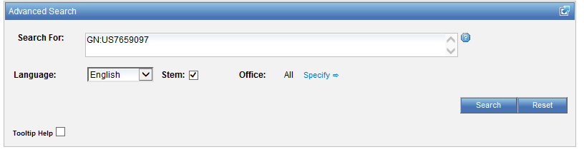
Example: grant

Slide 23
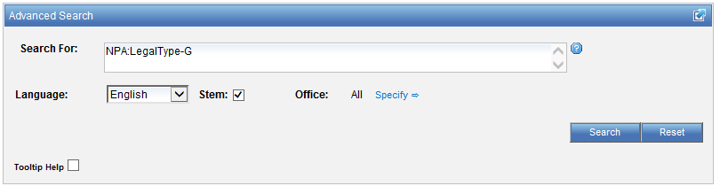
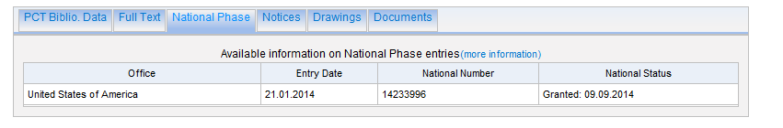
Example: grant

Slide 24
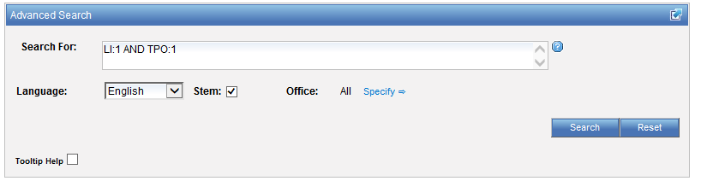
Example: licensing + 3rd party observation

Slide 25
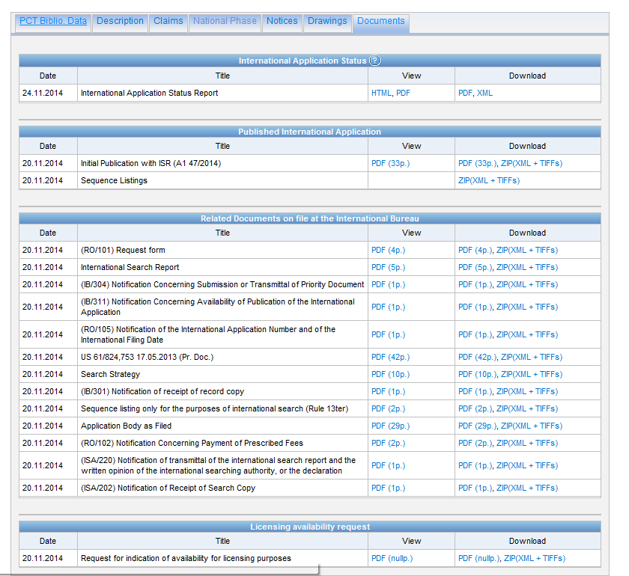

Slide 26
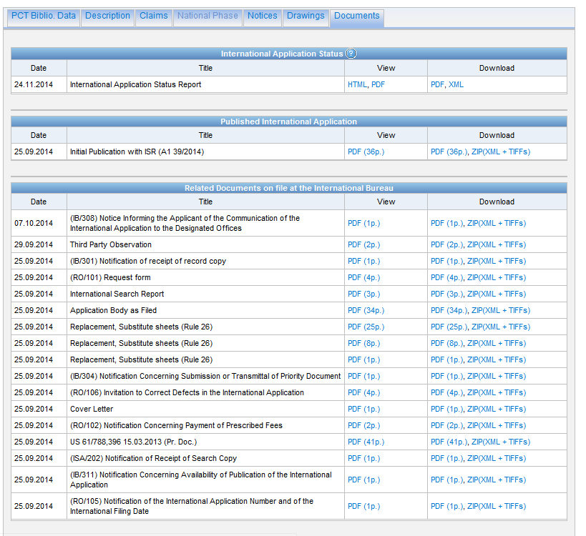

Slide 27
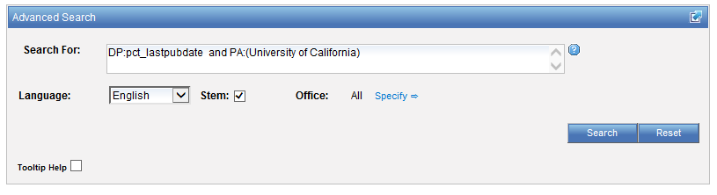
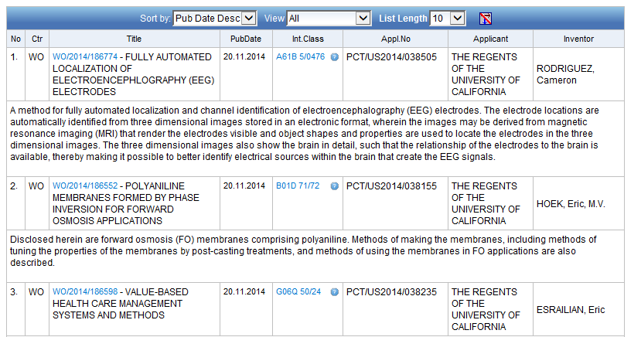
Example: last pub + applicant

Slide 28
New Fields
ISA
ST.3 Office code of the patent authority that performed the preliminary search report
ISA:US and OF:WO
ISR
For an ISR document in status filed (ISR): Report ; if there is an Article 17(2)(a) declaration in status filed (A172A): Declaration
ISR:declaration and OF:WO
SIS
If any Supplementary International Search Report has been received, show status “report”;If no SIS Reports or Declarations are on file, show status “None” SIS:report and OF:WO
IPE
If there is an IPER in status filed (IPER or IPRP2) and the time limit for making the report visible to Patentscope has passed: Report
IPE:report and OF:WO

Slide 29
Fields rules
Basic fields: elements of a patent document
Derived fields
2 letter code = individual field
EN_TI FR_AB ES_DE_S
Convention: language specified by 2 letters
if not specified all languages
S = stemmed
: to separate term without any space

Slide 30
Intuitive queries
PCTHavingThirdPartyObservations
PCTPublishedLastWeek
PCTHavingApplicantFromUS
DP:Last1Year
DP:[Today-1Week TO Today]

Slide 31
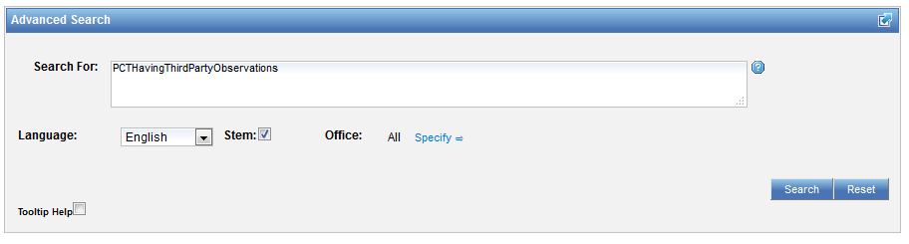
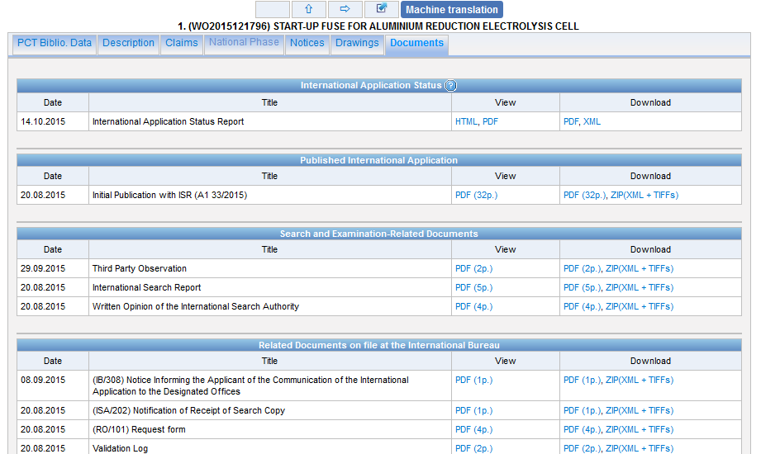
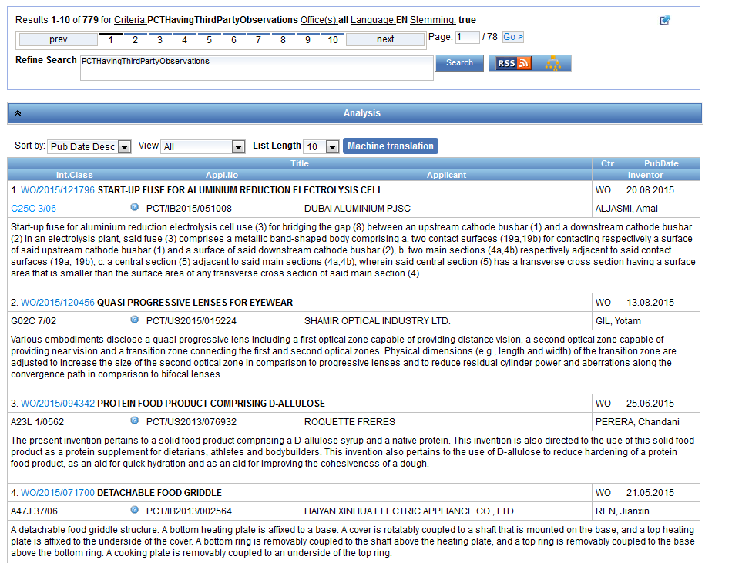

Slide 32
Fields: golden rules
EN_ALL = default field field indicator not required
Field name followed by : ":" or "/"
The field is only valid for the term that it directly precedes, so the query:
EN_TI:("wind turbine" AND electric) solar
"wind turbine" AND electric in the title field "solar" in the default field (EN_ALL ).

Slide 33
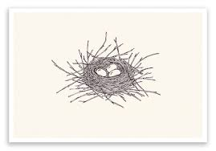
Grouping- nesting

Slide 34
Grouping/nesting
Solar OR (wind AND turbine)
(solar OR wind) AND turbine
EN_TI: electric car
electric will be searched in English title but car in all fields
EN_TI: (electric car)
Both electric and car will be searched in the English title

Slide 35
Range search
Range:
  DP:[01.01.2000 TO 01.01.2001]
  Can also be used to search non-date fields
    IN: {Smith to Terence}

Slide 36
EN_ALLTXT; PA; DP = fields
AND = operator

Slide 37
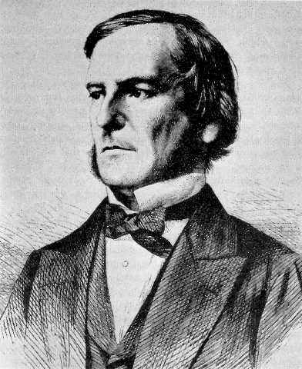
Boolean operators
AND
OR
NOT
ANDNOT

Slide 38
ANDNOT - NOT
Use ANDNOT when searching A excluding B
  Ex: bicycle ANDNOT boat
  Use NOT when searching all documents except A
    Ex:NOT(car AND bicycle AND boat)

Slide 39
Proximity operator NEAR
Finds words that are next to each other
NEAR3 3 = the max nb of word gaps between 2 search terms

Slide 40
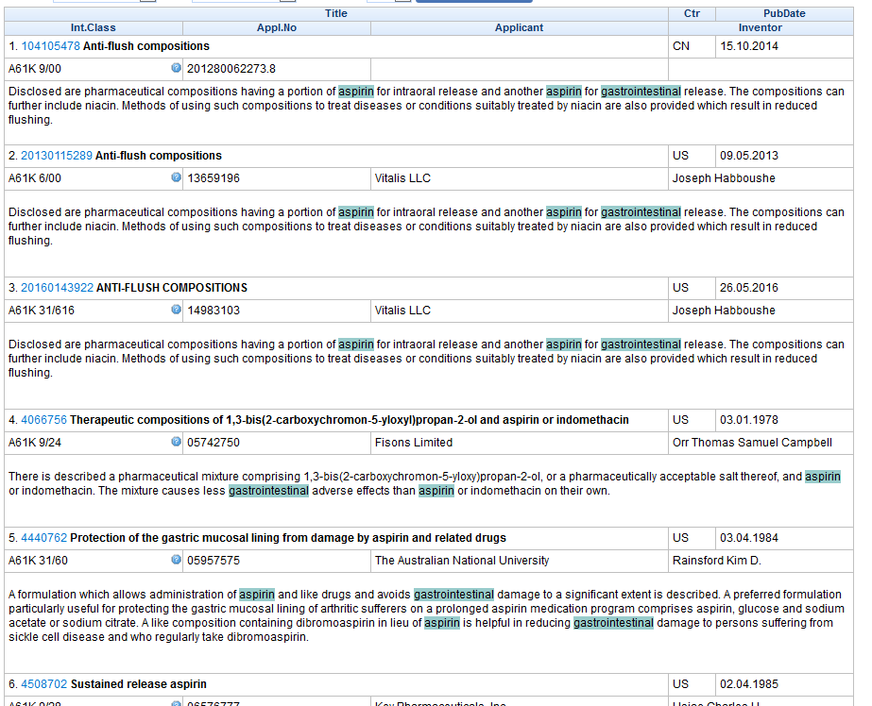
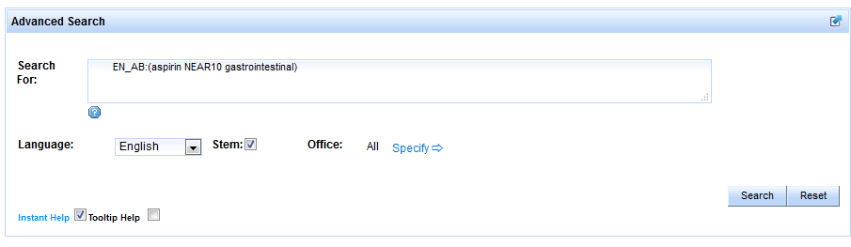
Example

Slide 41
Proximity search: BEFORE
the order of terms is significant.
trunk BEFORE cutting

Slide 42
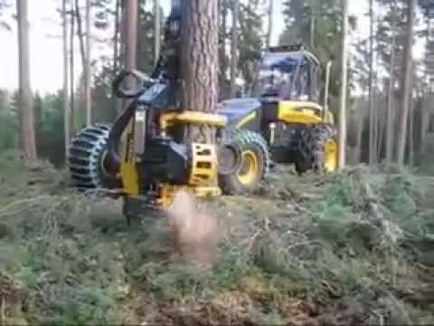
An example

Slide 43
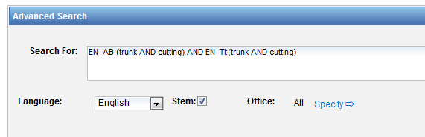
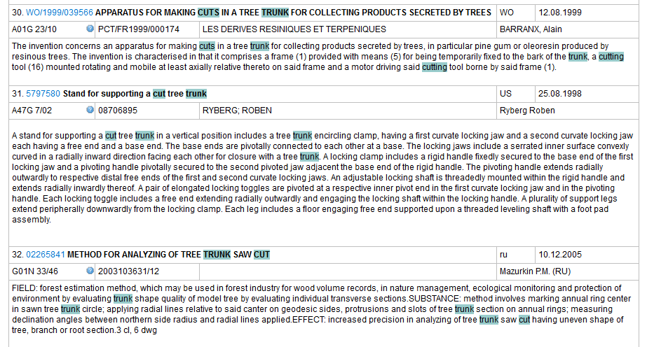

Slide 44
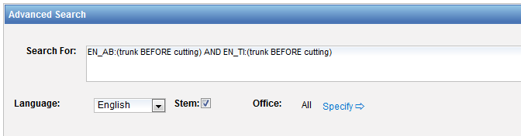
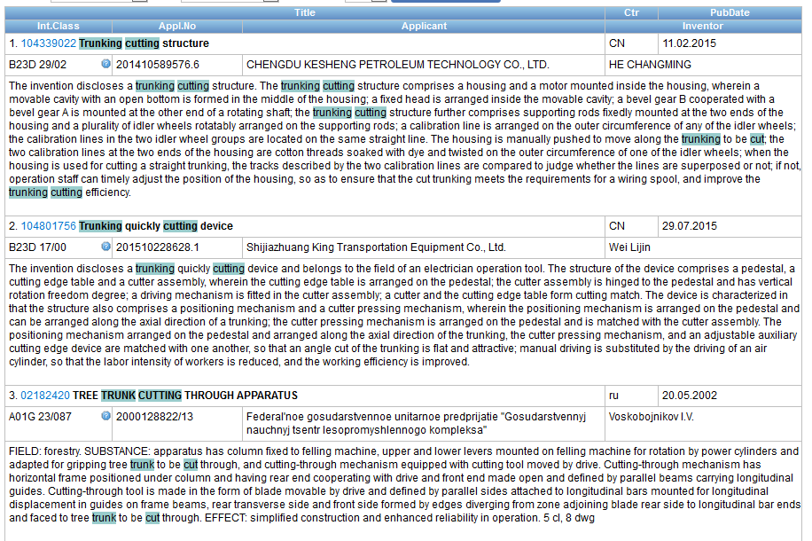

Slide 45



Slide 46
Keywords
Stemming
Wildcard
Truncation
Fuzzy

Slide 47
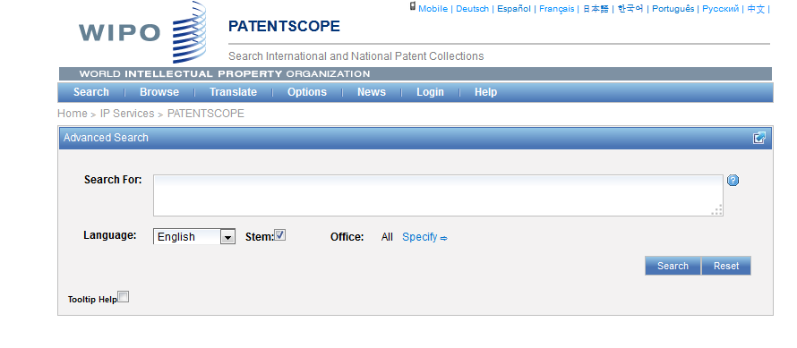
Stemming

Slide 48
Stemming
Stem = stemming
Process that removes common endings from words.
critical
critically
criticism each word is reduced to ‘critic’
criticisms
critics

Slide 49
Stemming
no dictionary includes the necessary technical terms to express patent concepts
Porter Stemming Algorithm finds words that contain common roots
Save time and effort

Slide 50
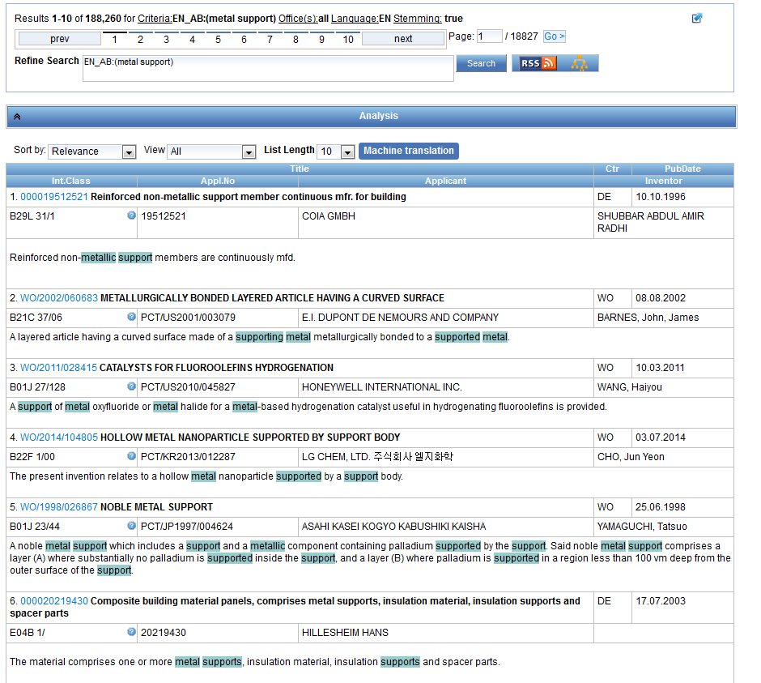
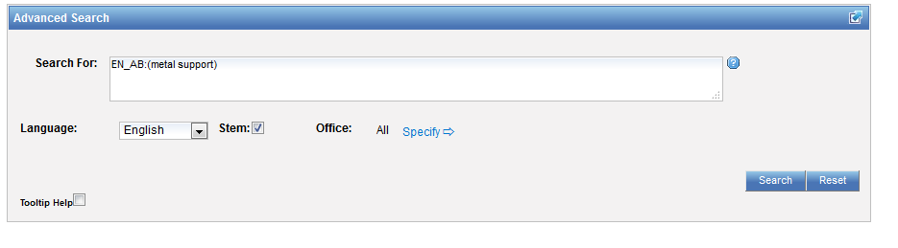
Stemming - example

Slide 51
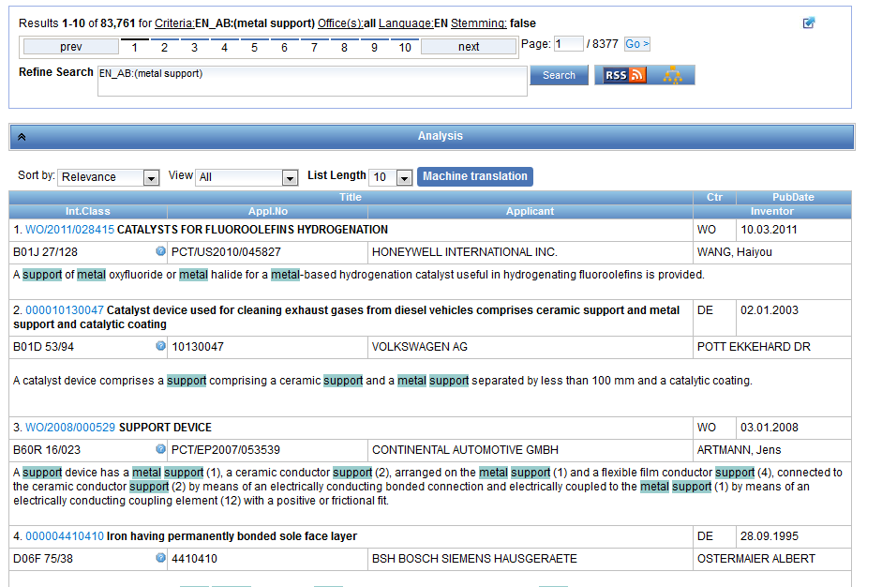
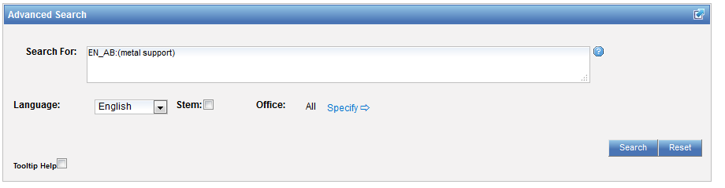
Same search without stemming

Slide 52
Wildcards/truncation : ? *
* stands for 0 or more characters
? stands single character
te?t = test or text
electric* = electrical; electricity
behavi*r = behaviour or behavior
micro?p* = microspeaker, microsporidial

Slide 53
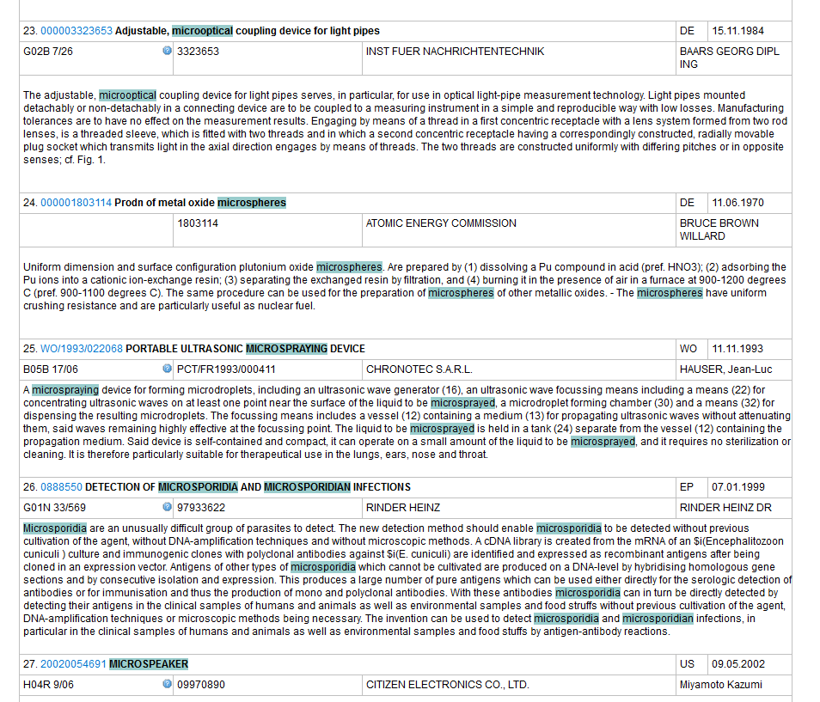
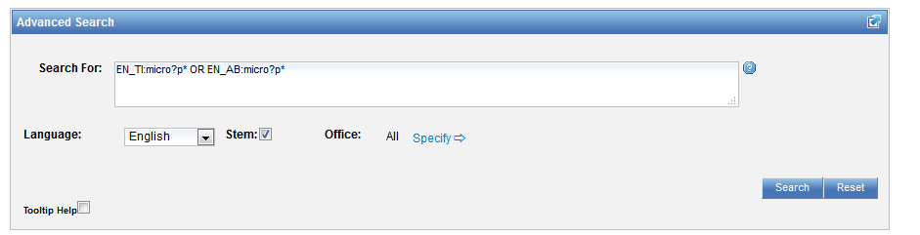
An example

Slide 54
Use of wildcards
Spelling uncertainty (plural, tenses, foreign words):
  tyre vs. tire t*re
  University vs Universität Universit* Stuttgart
Multiple spelling variants are known:
  color vs. colour col*
Preferred option over stemming:
electric vs. electricity electri*

Slide 55
Wildcard vs stemming
Logic results:
  navy, navies or naval if nav* = navigating, navigation,
  electricity or electric if elect* = electoral

Slide 56

Fuzzy searches
Use of the tilde: ~
Examples:
roam~ foam / roams
Roam~0.8
Useful to find misstpyed, misspelt or mis-OCRed words
Notes:
Smilar in spelling

Slide 57
Q: when you use wildcard, …
A
The results retrieved are all relevant
B
Stemming is turned off

Slide 58

Q: when you use wildcards, …
A
The results retrieved are all relevant
B
Stemming is turned off

Slide 59
^ caret = weighting factor
Same result but ranking will be different
touch^3 AND polarize

Slide 60



Slide 61



Slide 62



Slide 63

Example: national phase entry
All applications that entered national phase in China in 2012

Slide 64

Example: nb of patent applications from France seeking protection in USA

Slide 65



Slide 66

Advanced search interface
Search syntax
Search fields

Slide 67


Help

Slide 68

Tooltip help

Slide 69
Instant help
Validates search query
Suggests terms
Provides list of:
  IPC codes
  countries

Slide 70



Slide 71



Slide 72

Question mark help

Slide 73


Slide 74
Result combination
Combine search with chemical structure search
Combine search with CLIR

Slide 75


For queries with compounds

Slide 76


Slide 77




Slide 78



Combining with CLIR

Slide 79



Slide 80



Slide 81
Most common errors
(….) "…"
" not “
Field name
No space
Wildcard at the beginning of a word

Slide 82
Q: how to build a query in order to obtain patents by the company Huawei with at least one innovator from Germany?
A
Huawei AND Germany
B
IN:Huawei AND INA: Germany
C
IADC:DE AND PA:Huawei
D
CTR: Germany AND IN: Huawei

Slide 83
Q: how to build a query in order to obtain patents by the company Huawei with at least one innovator from Germany?
A
Huawei AND Germany
B
IN:Huawei AND INA: Germany
C
IADC:DE AND PA:Huawei
D
CTR: Germany AND IN: Huawei

Slide 84



IADC = inventor nationality
PA: applicant name

Slide 85





Slide 86

IN = Inventor Name
INA = Inventor all data

Slide 87



Slide 88
Next webinar: March 20 or 22
Translation tools in PATENTSCOPE
To register: http://www.wipo.int/patentscope/en/webinar/

Slide 89


Future/past webinars:
wipo.int/patentscope/en/webinar

Slide 90
Global Design Database: webinar
The Global Design Database: an introduction
  March 15 at 5:30pm CET
  https://attendee.gotowebinar.com/register/6135778847881454338

Slide 91
Global Brand Database: webinar
The Global Brand Database: an introduction
  March 8 at 5:30pm CET
  https://attendee.gotowebinar.com/register/8130148904643851778

Slide 92


patentscope@wipo.int

Slide 93


Slide 94

patentscope@wipo.int

