Slide 1
PATENTSCOPE for experts
Cyber world
November
2017
Sandrine Ammann
Marketing & Communications Officer

Slide 2



To the PATENTSCOPE search system webinar
Complex queries

Slide 3
Patenting activity
Biomarkers for cancer
Japanese applications and grants
Published after 2010
Without knowing a word of Japanese

Slide 4
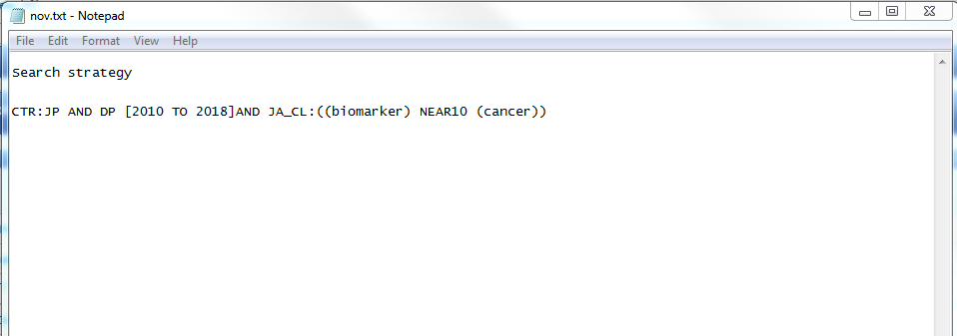
Search strategy

Slide 5
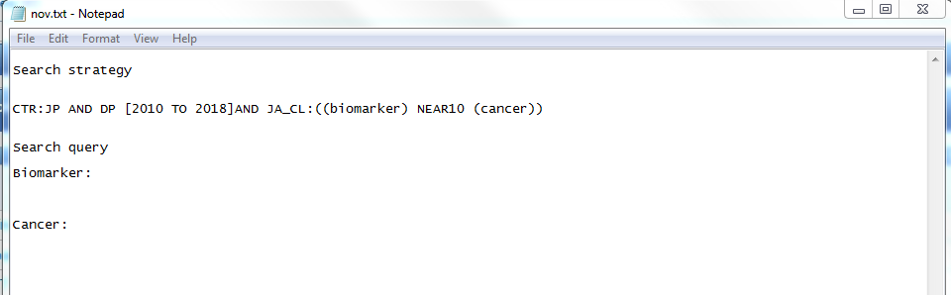
Search Query

Slide 6
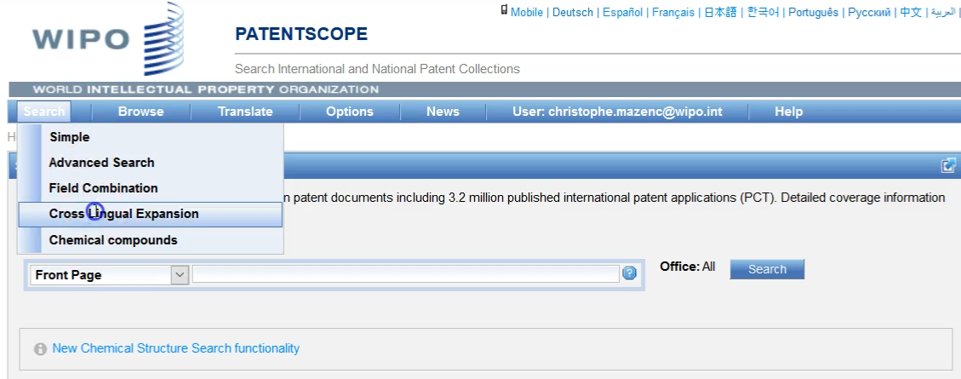
CLIR

Slide 7
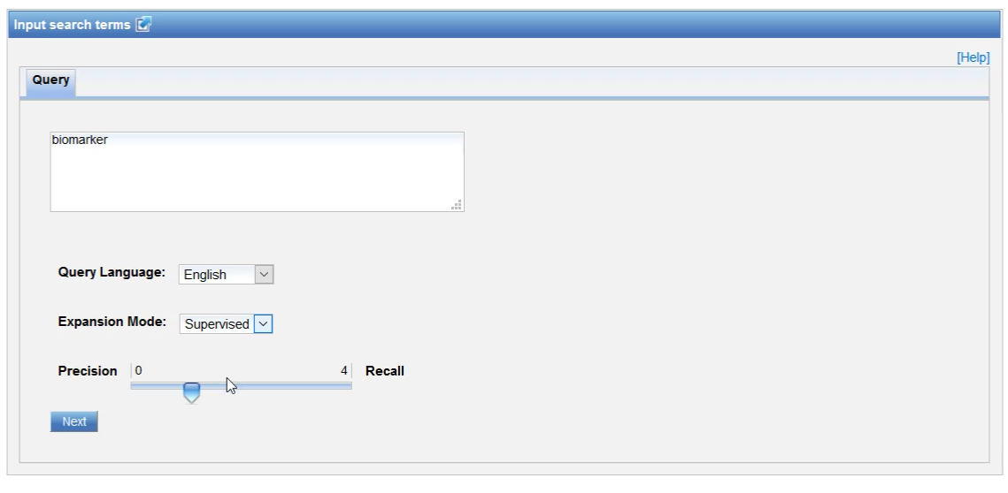

Slide 8
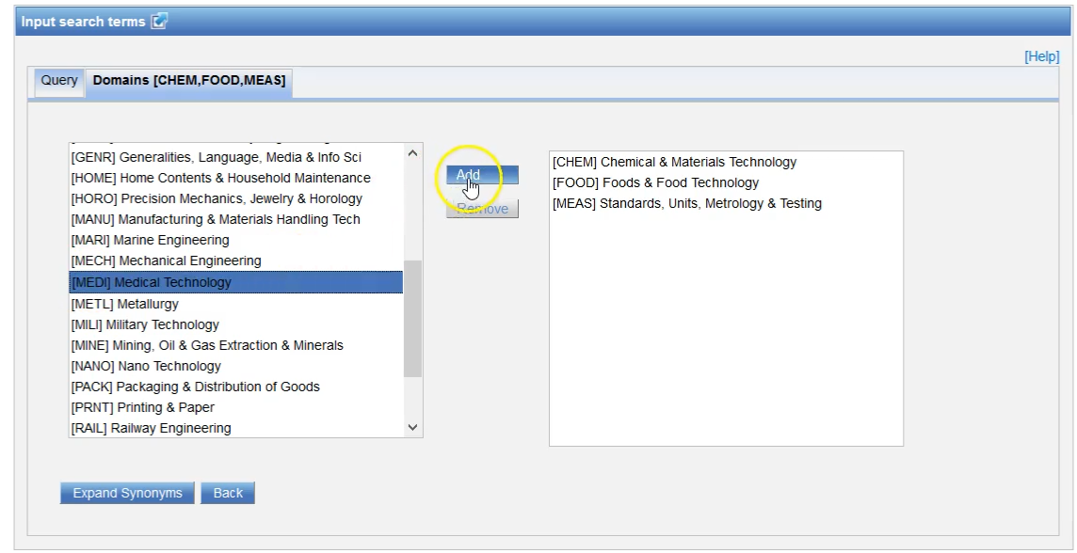

Slide 9
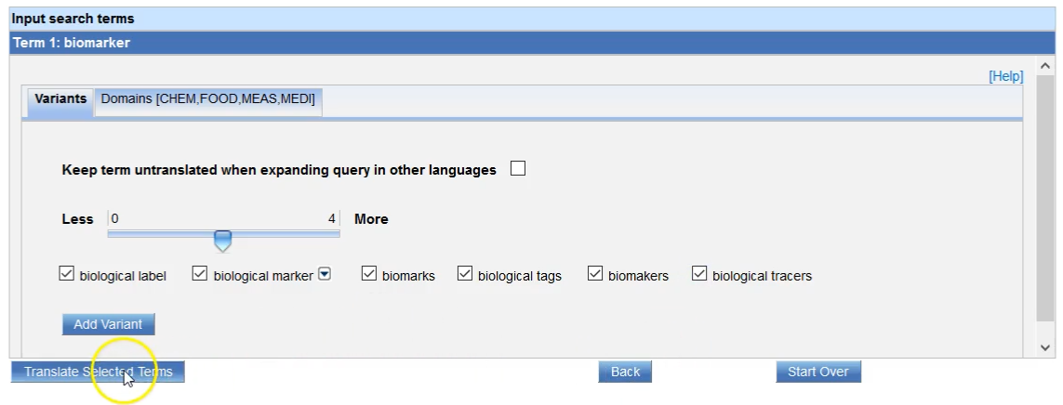

Slide 10
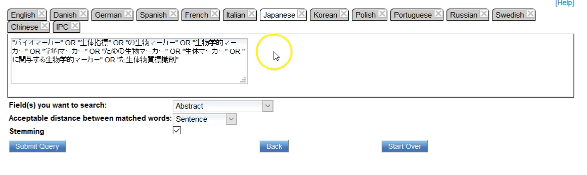

Slide 11
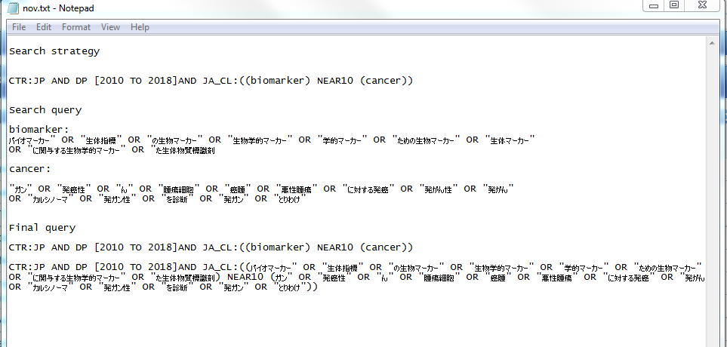

Slide 13
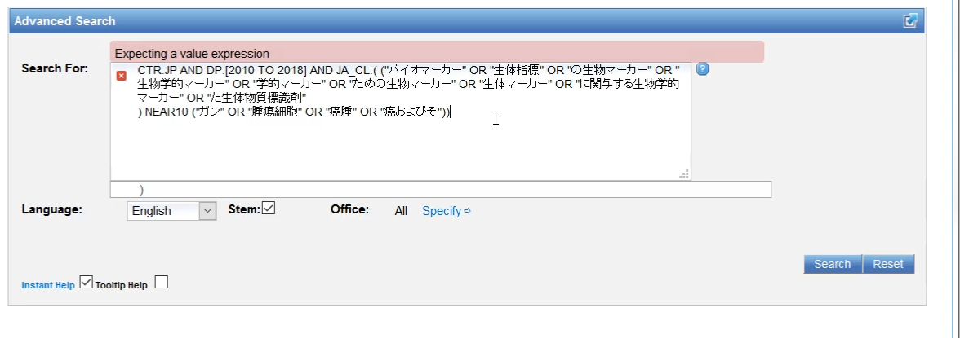
Advanced search

Slide 14
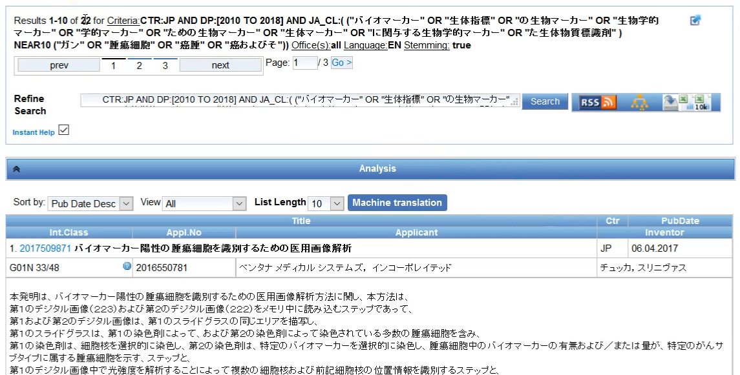
Result

Slide 15
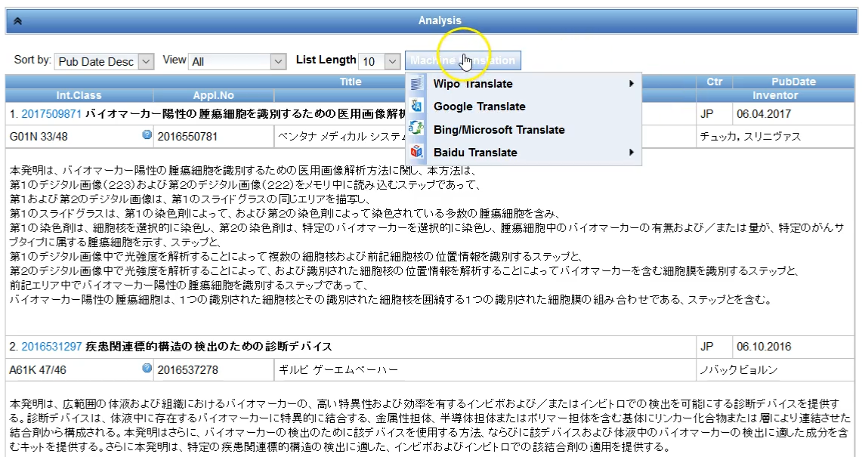

Slide 16
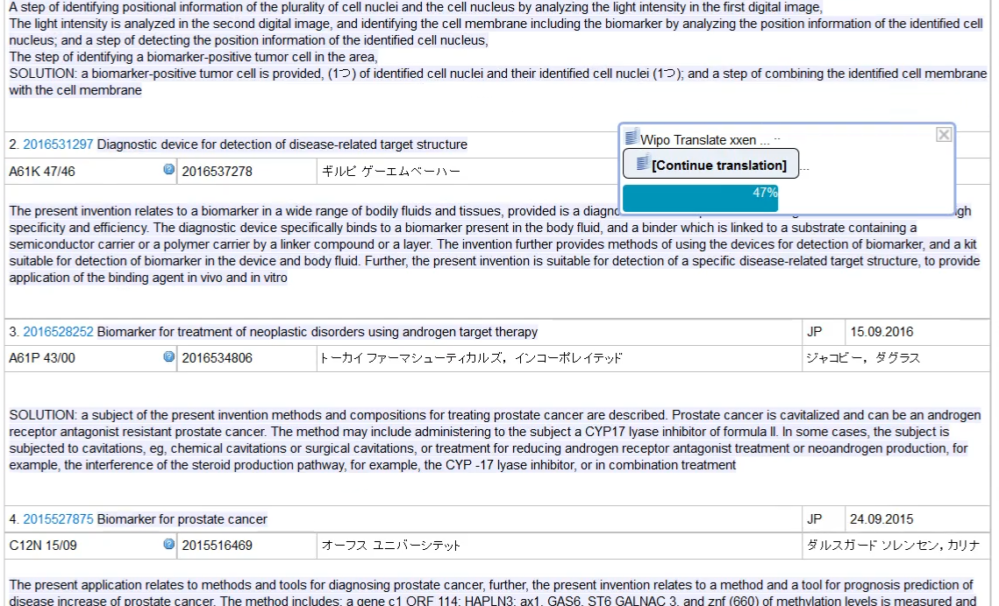

Slide 17
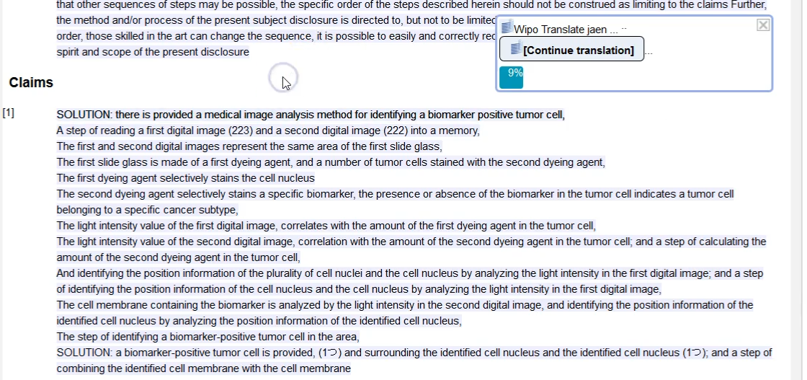
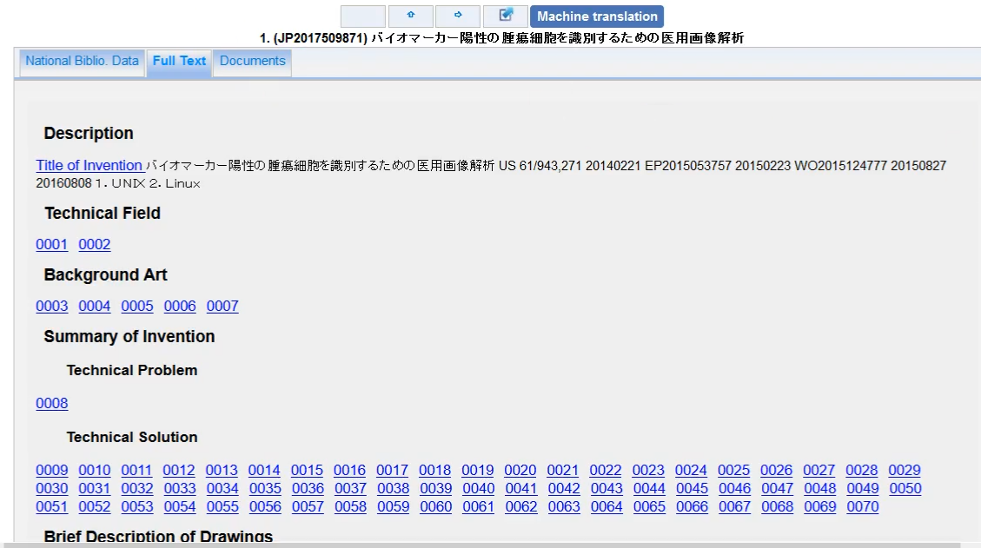
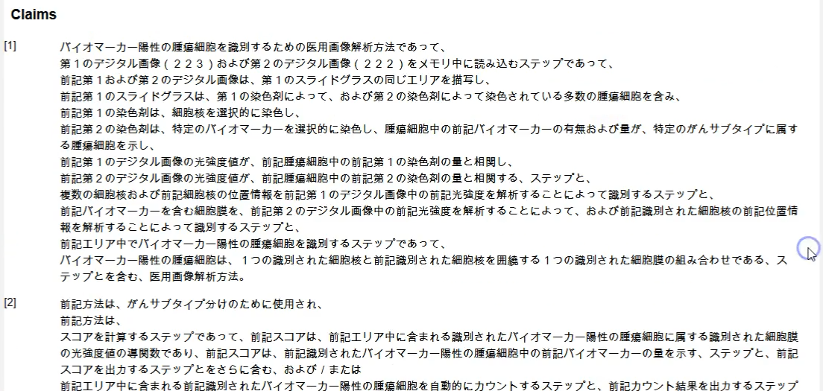

Slide 18
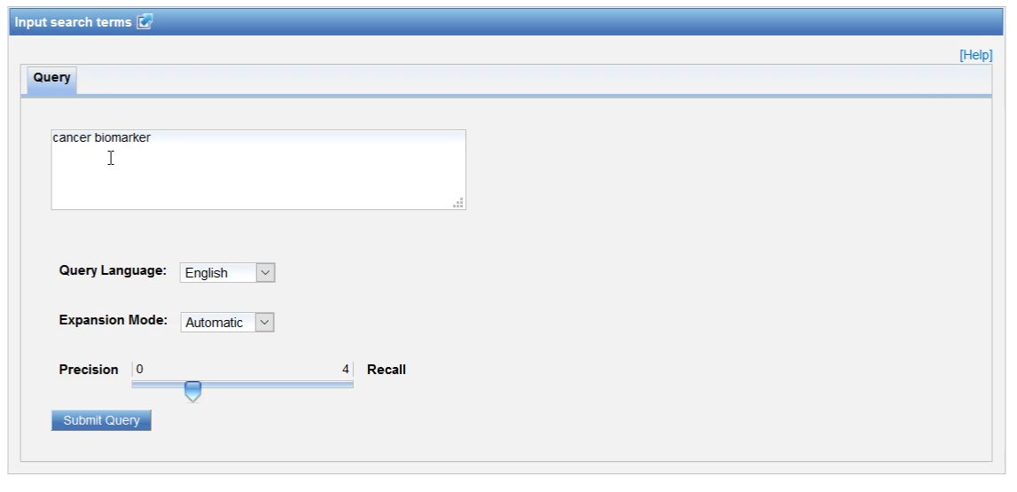

Slide 19
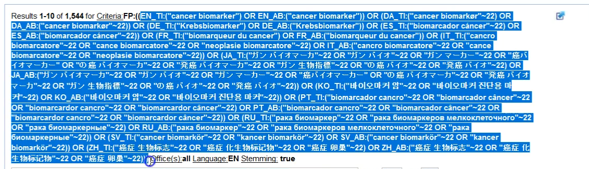

Slide 20
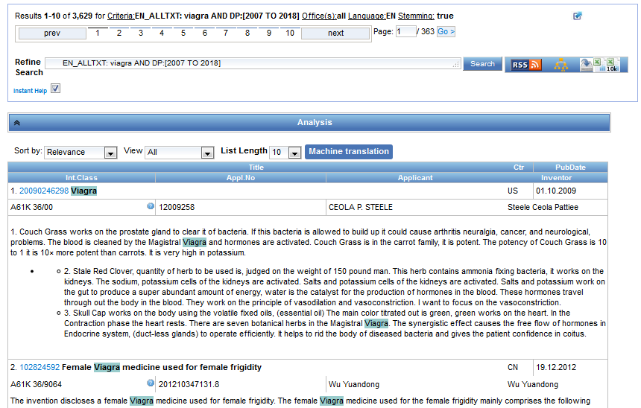
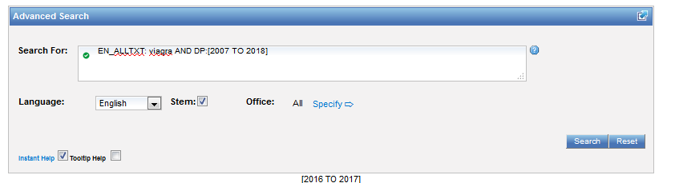
With chemical compounds

Slide 21
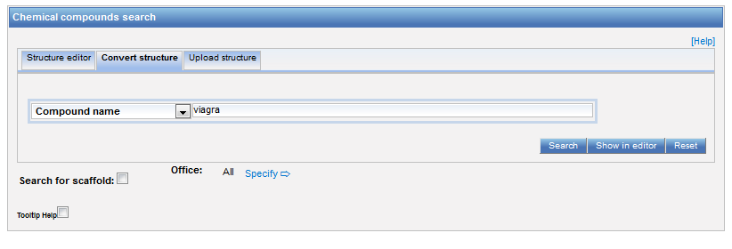
Chemical compound search

Slide 22
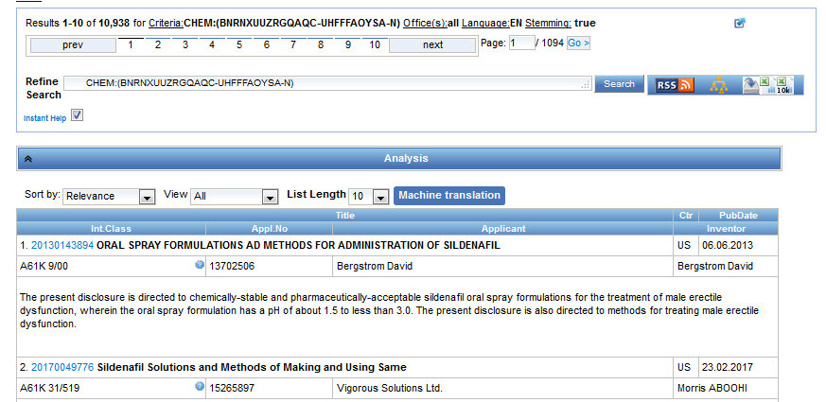
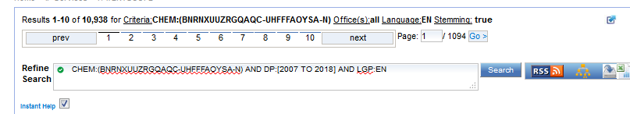

Slide 23
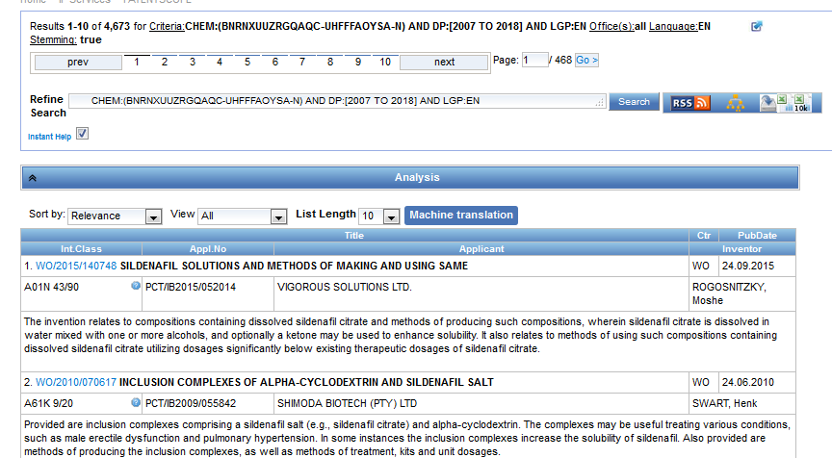

Slide 24
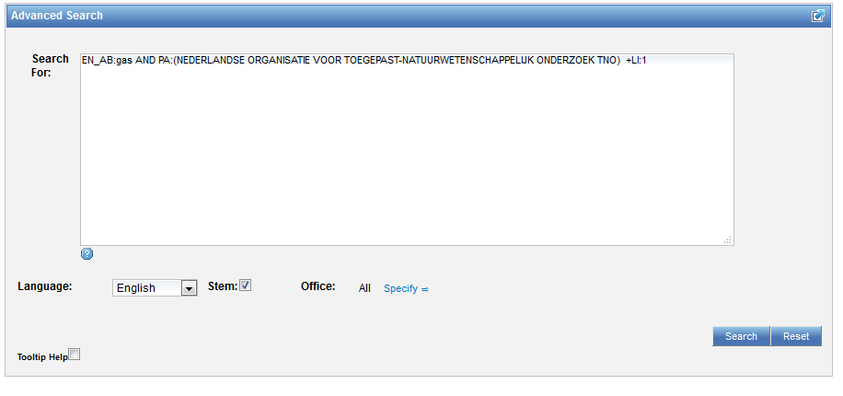
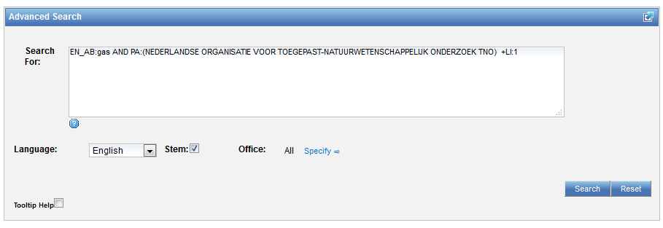
Interface: Advanced search

Slide 25
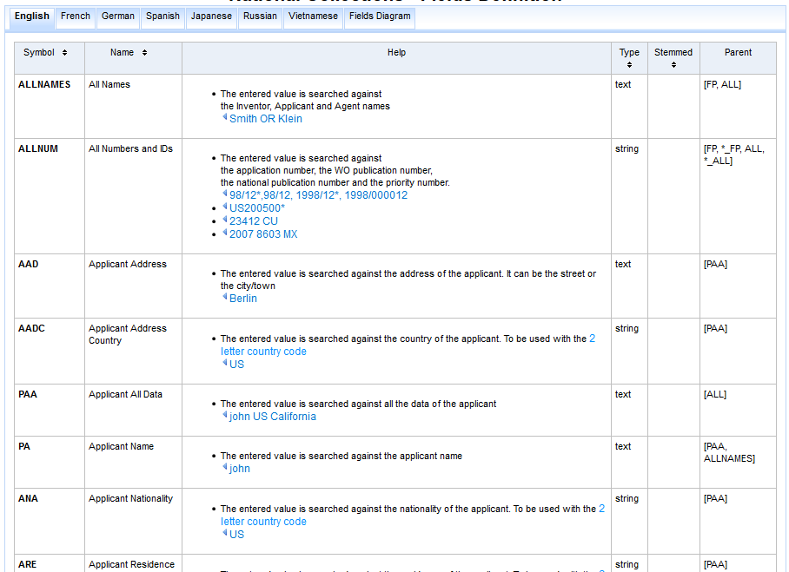
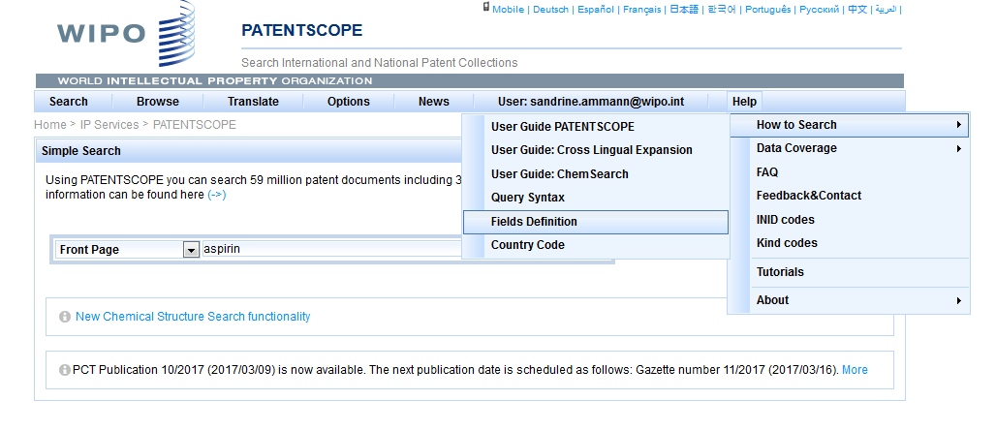

Slide 26
Examples
FP = front page
ALL = all fields
ALL_NAMES = all names
IC = IPC
DP = publication date
CTR = country
NPCC= national phase entry
AN = origin of PCT

Slide 27
Date search
Simple:
  DP:01.02.2000
  DP:20000201
  DP:02.2000
  DP:200002
  DP:2000

Slide 28
Example: IPC
IC = International Classification
  IC :A
  IC :A47
  IC :A47L
  IC :A47L1
  IC:A47L11
  IC:A47L11/03

Slide 29
D06F 1/06 will include by default
D06F 1/08
1/10
1/16
To exclude subgroup: IC_EX
ICI = International Classification Inventive
ICN = International Classification Non-inventive
ICI_EX ICN_EX = no subgroup

Slide 30
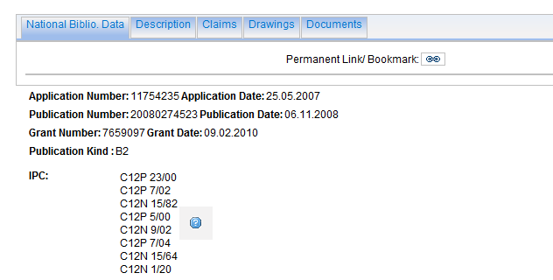
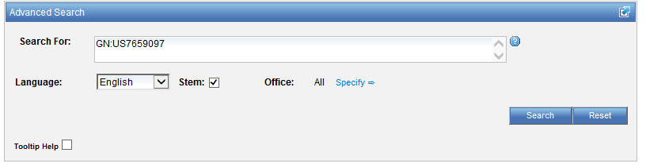
Example: grant

Slide 31
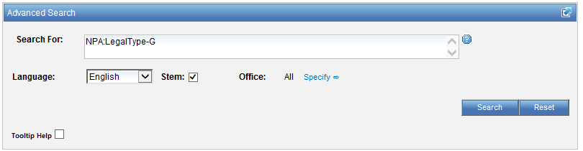
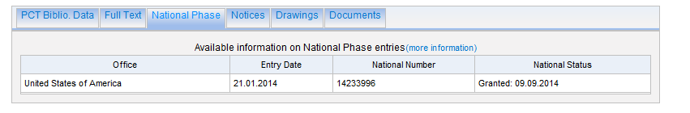
Example: grant

Slide 32
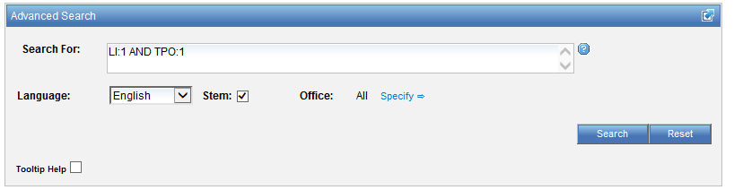
Example: licensing + 3rd party observation

Slide 33
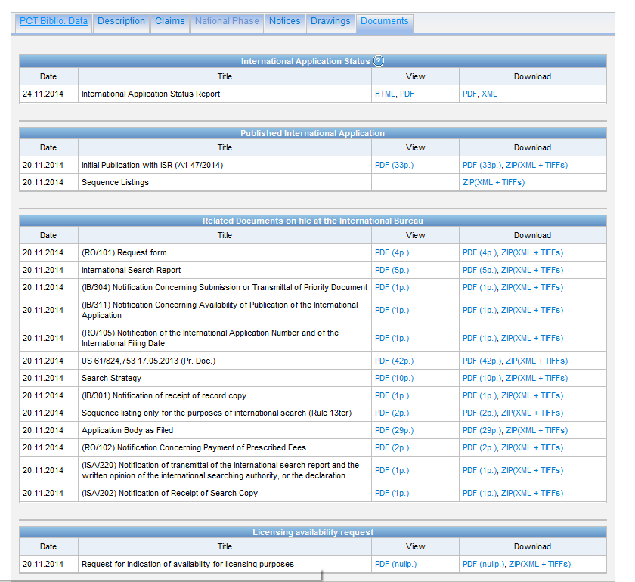

Slide 34
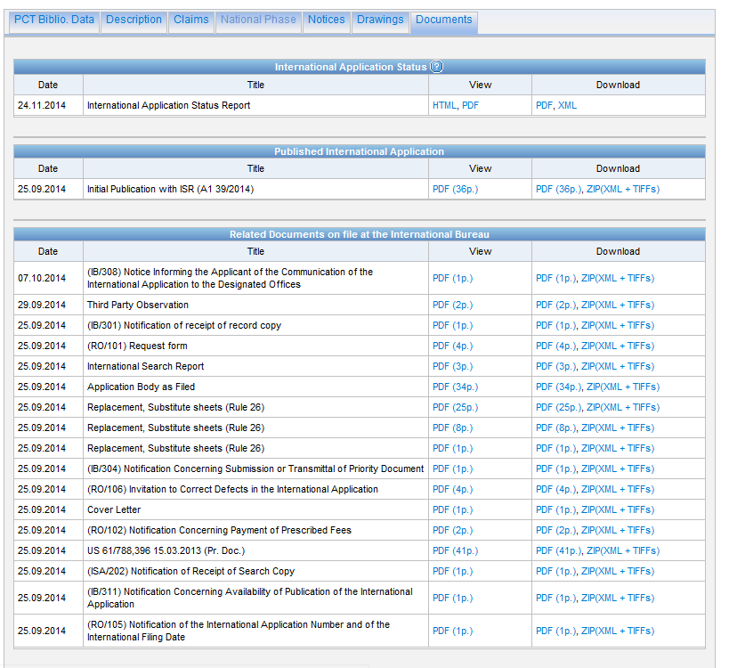

Slide 35
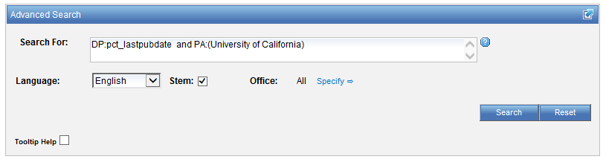
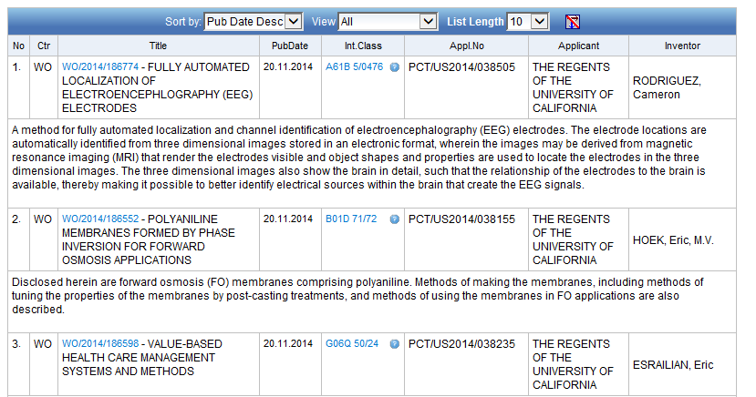
Example: last pub + applicant

Slide 36
Fields rules
Basic fields: elements of a patent document
Derived fields
2 letter code = individual field
EN_TI FR_AB ES_DE_S
Convention: language specified by 2 letters
if not specified all languages
S = stemmed
: to separate term without any space

Slide 37
Intuitive queries
PCTHavingThirdPartyObservations
PCTPublishedLastWeek
PCTHavingApplicantFromUS
DP:Last1Year
DP:[Today-1Week TO Today]

Slide 38
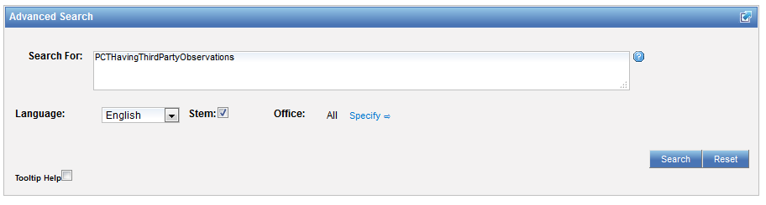
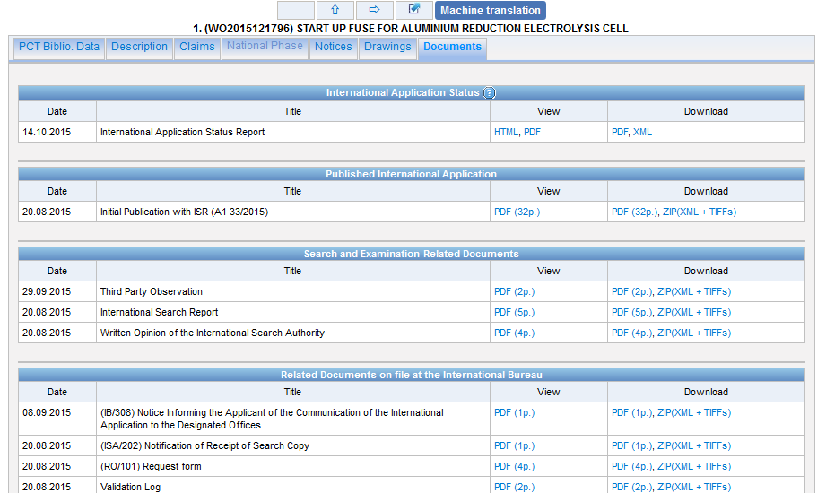
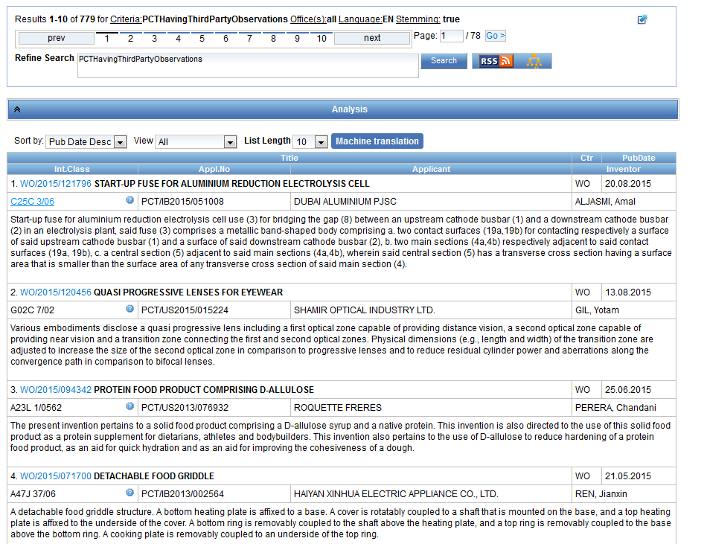

Slide 39
Fields: golden rules
EN_ALL = default field field indicator not required
Field name followed by : ":" or "/"
The field is only valid for the term that it directly precedes, so the query:
EN_TI:("wind turbine" AND electric) solar
"wind turbine" AND electric in the title field "solar" in the default field (EN_ALL ).

Slide 40
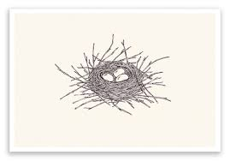
Grouping- nesting

Slide 41
Grouping/nesting
Solar OR (wind AND turbine)
(solar OR wind) AND turbine
EN_TI: electric car
electric will be searched in English title but car in all fields
EN_TI: (electric car)
Both electric and car will be searched in the English title

Slide 42
Range search
Range:
  DP:[01.01.2000 TO 01.01.2001]
  Can also be used to search non-date fields
    IN: {Smith to Terence}

Slide 43
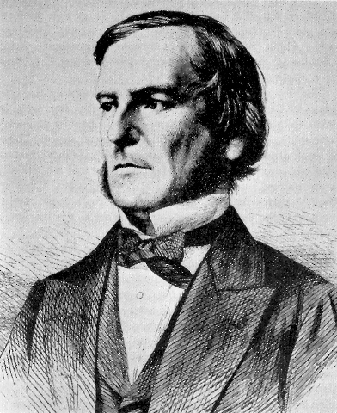
Boolean operators
AND
OR
NOT
ANDNOT

Slide 44
ANDNOT - NOT
Use ANDNOT when searching A excluding B
  Ex: bicycle ANDNOT boat
  Use NOT when searching all documents except A
    Ex:NOT(car AND bicycle AND boat)

Slide 45
Proximity operator NEAR
Finds words that are next to each other
NEAR3 3 = the max nb of word gaps between 2 search terms

Slide 46
Proximity search: BEFORE
the order of terms is significant.
trunk BEFORE cutting

Slide 47
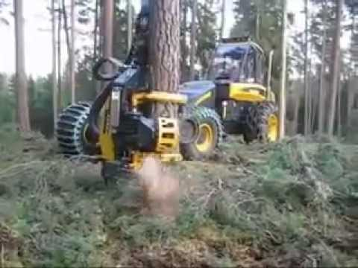
An example

Slide 48
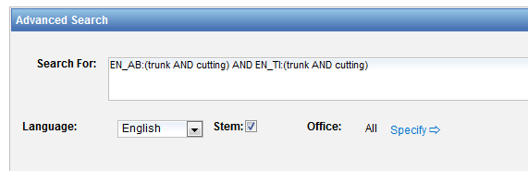
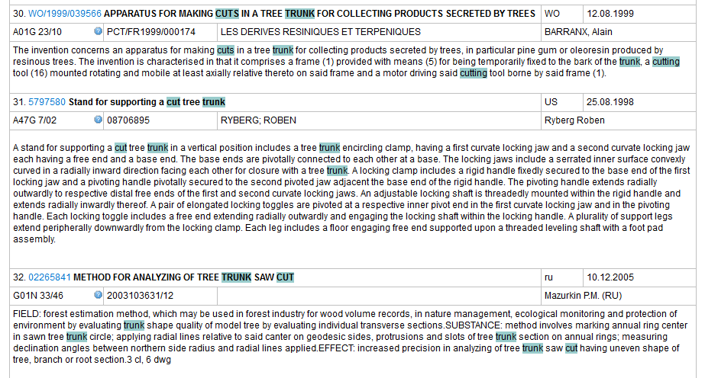

Slide 49
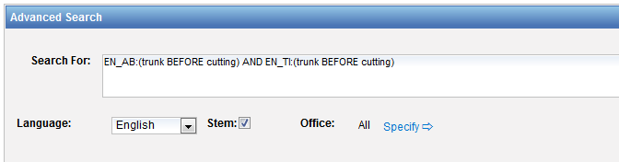
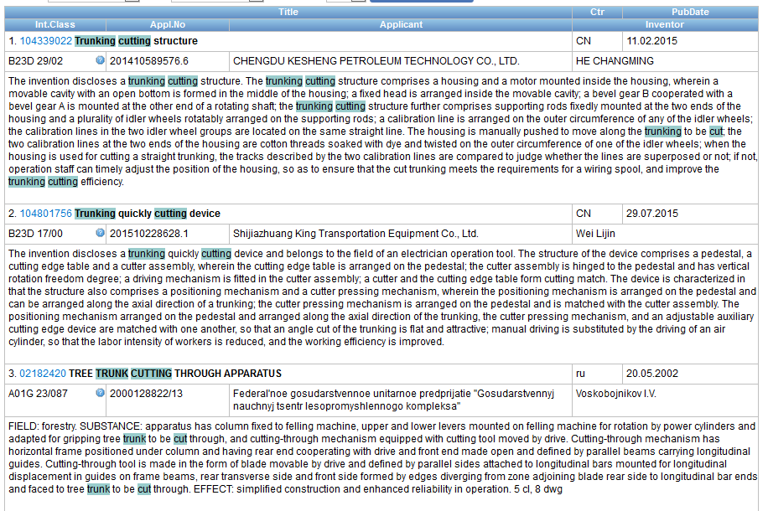

Slide 50
Keywords
Stemming
Wildcard
Truncation
Fuzzy

Slide 51
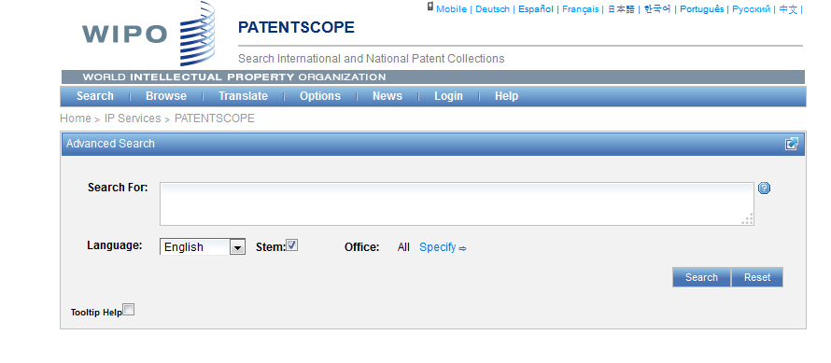
Stemming

Slide 52
Stemming
Stem = stemming
Process that removes common endings from words.
critical
critically
criticism each word is reduced to ‘critic’
criticisms
critics

Slide 53
Stemming
no dictionary includes the necessary technical terms to express patent concepts
Porter Stemming Algorithm finds words that contain common roots
Save time and effort

Slide 54
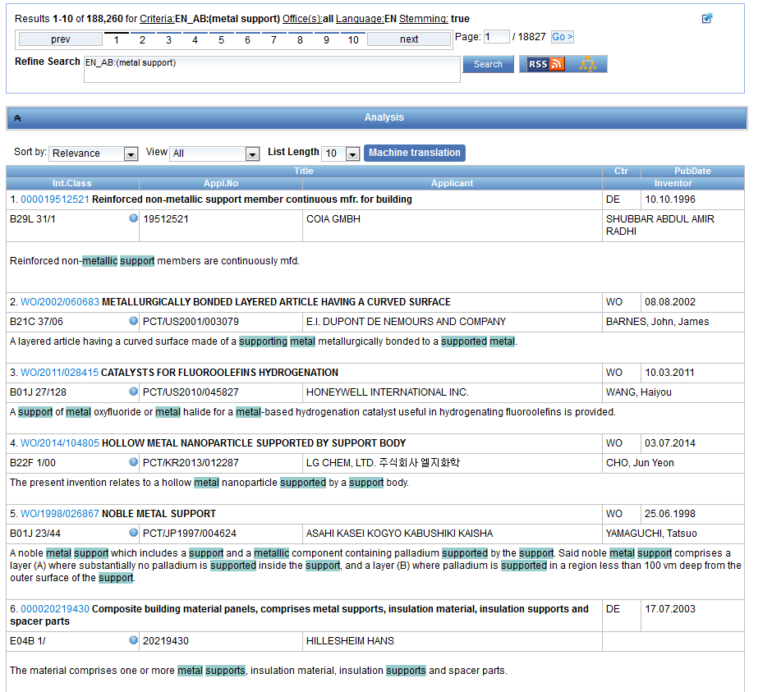
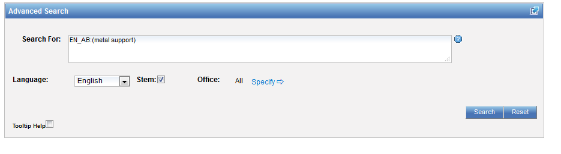
Stemming - example

Slide 55
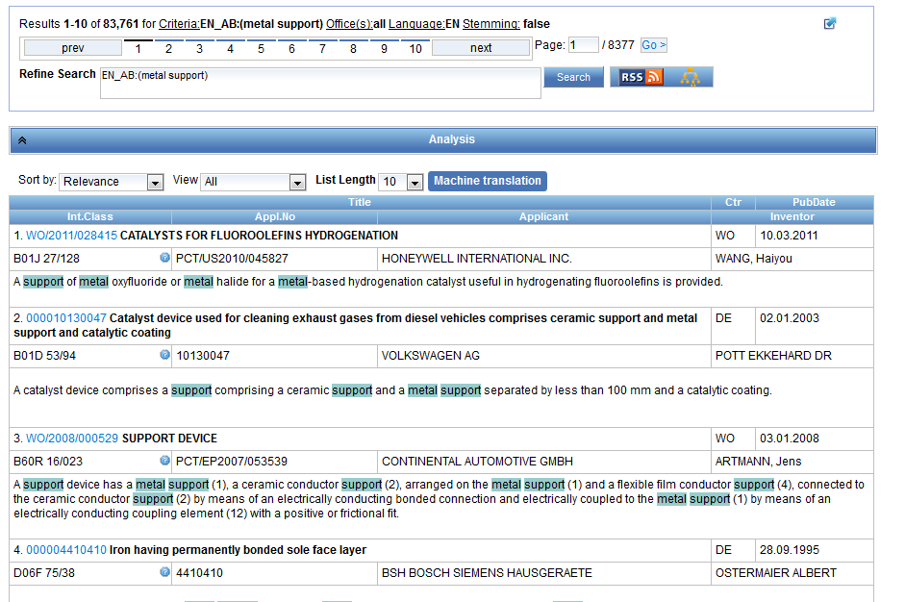

Same search without stemming

Slide 56
Wildcards/truncation : ? *
* stands for 0 or more characters
? stands single character
te?t = test or text
electric* = electrical; electricity
behavi*r = behaviour or behavior
micro?p* = microspeaker, microsporidial

Slide 57


An example

Slide 58
Use of wildcards
Spelling uncertainty (plural, tenses, foreign words):
  tyre vs. tire t*re
  University vs Universität Universit* Stuttgart
Multiple spelling variants are known:
  color vs. colour col*
Preferred option over stemming:
electric vs. electricity electri*

Slide 59
Wildcard vs stemming
Logic results:
  navy, navies or naval if nav* = navigating, navigation,
  electricity or electric if elect* = electoral

Slide 60

Fuzzy searches
Use of the tilde: ~
Examples:
roam~ foam / roams
Roam~0.8
Useful to find misstpyed, misspelt or mis-OCRed words
Notes:
Smilar in spelling

Slide 61
Q: when you use wildcard, …
A
The results retrieved are all relevant
B
Stemming is turned off

Slide 62

Q: when you use wildcards, …
A
The results retrieved are all relevant
B
Stemming is turned off

Slide 63
^ caret = weighting factor
Same result but ranking will be different
touch^3 AND polarize

Slide 64



Slide 65



Slide 66



Slide 67

Example: national phase entry
All applications that entered national phase in China in 2012

Slide 68

Example: nb of patent applications from France seeking protection in USA

Slide 69



Slide 70

Advanced search interface
Search syntax
Search fields

Slide 71


Help

Slide 72

Tooltip help

Slide 73
Instant help
Validates search query
Suggests terms
Provides list of:
  IPC codes
  countries

Slide 74



Slide 75



Slide 76

Question mark help

Slide 77
Most common errors
(….) "…"
" not “
Field name
No space
Wildcard at the beginning of a word

Slide 78
Q: how to build a query in order to obtain patents by the company Huawei with at least one innovator from Germany?
A
Huawei AND Germany
B
IN:Huawei AND INA: Germany
C
IADC:DE AND PA:Huawei
D
CTR: Germany AND IN: Huawei

Slide 79
Q: how to build a query in order to obtain patents by the company Huawei with at least one innovator from Germany?
A
Huawei AND Germany
B
IN:Huawei AND INA: Germany
C
IADC:DE AND PA:Huawei
D
CTR: Germany AND IN: Huawei

Slide 80



IADC = inventor nationality
PA: applicant name

Slide 81





Slide 82

IN = Inventor Name
INA = Inventor all data

Slide 83



Slide 84
Next webinar: December 5 or 7
Retrospective of 2017 & plans for 2018
To register:
https://attendee.gotowebinar.com/rt/1219605069484395010

Slide 85

Future/past webinars:
wipo.int/patentscope/en/webinar

Slide 86
Global Design Database: webinar
The Global Design Database: an introduction
  December 12 at 5:30pm CET
  https://attendee.gotowebinar.com/rt/2386170415254530818

Slide 87
Global Brand Database: webinar
The Global Brand Database: how to perform effective searches
  November 28 at 5:30pm CET
  https://attendee.gotowebinar.com/rt/8193445586516212994
  November 30 at 8:30 am CET
  https://attendee.gotowebinar.com/rt/8193445586516212994

Slide 88


patentscope@wipo.int

Slide 89

patentscope@wipo.int

