Slide 1
PATENTSCOPE:
For beginners
Cyber world
October
2017
Sandrine Ammann
Marketing & Communications Officer

Slide 2


Slide 3
Agenda
  Simple interface
  Field Combination interface
  Advanced interface
  User account
  Quiz
  Q & A session

Slide 4
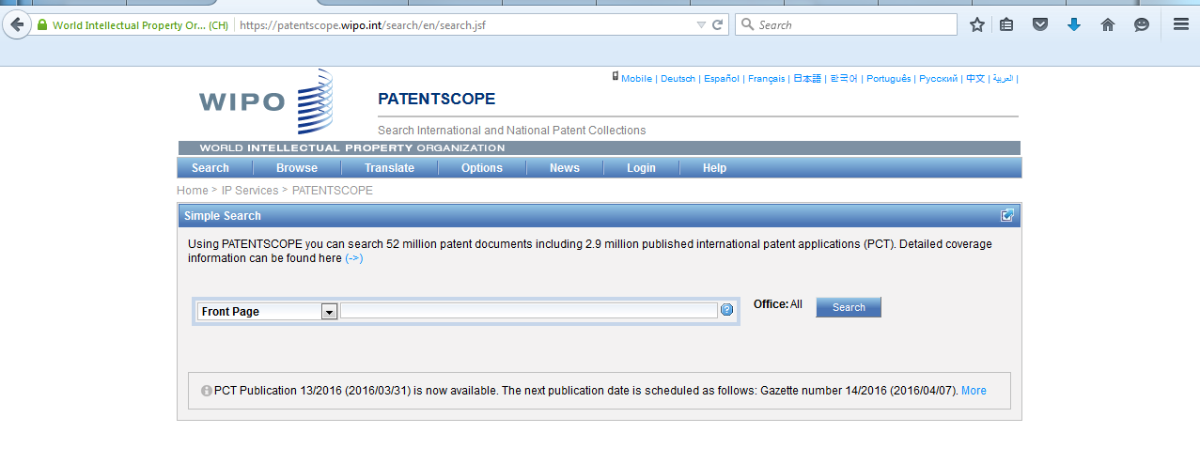
https://patentscope.wipo.int/search/en/search.jsf

Slide 5
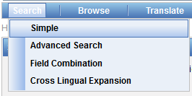
PATENTSCOPE: how to search
Search patent documents:
  Simple
  Field combination
  Advanced

Slide 6
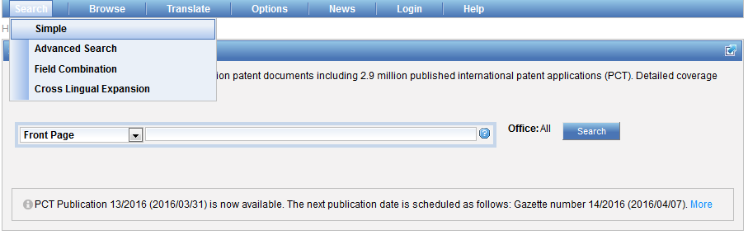
Interface : Simple

Slide 7
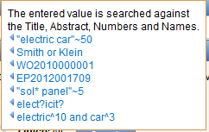
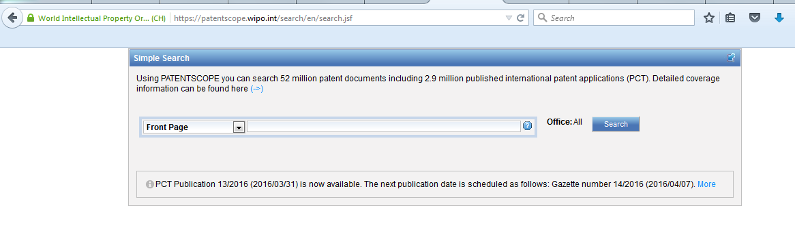
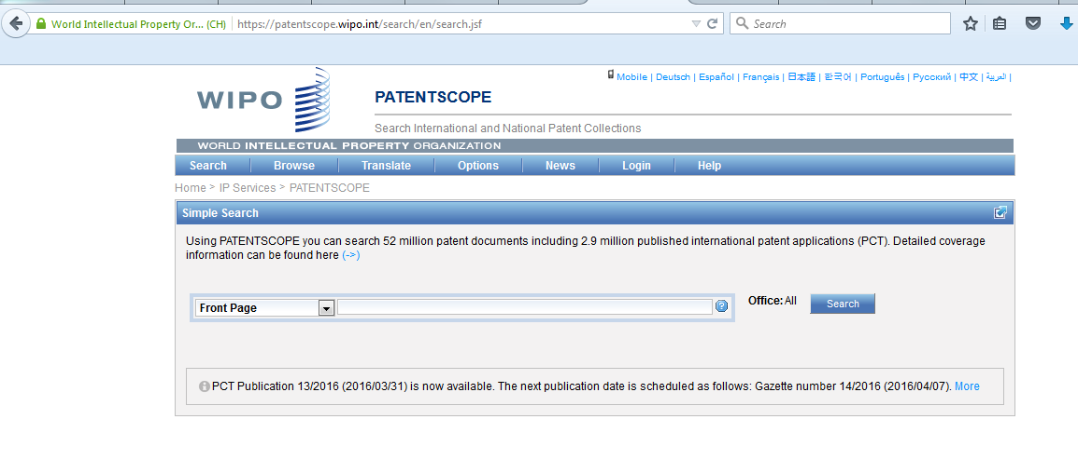
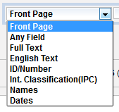
Interface

Slide 8
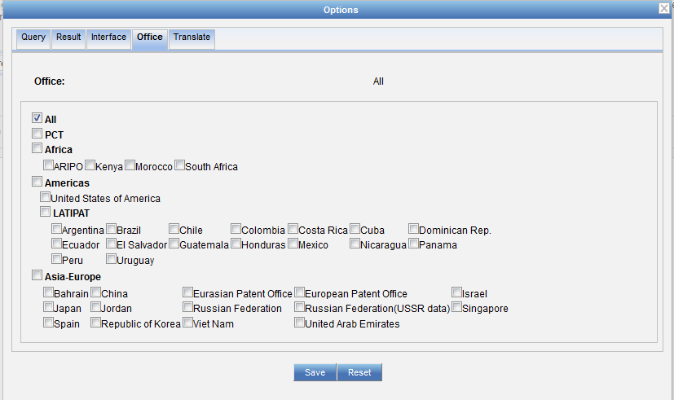
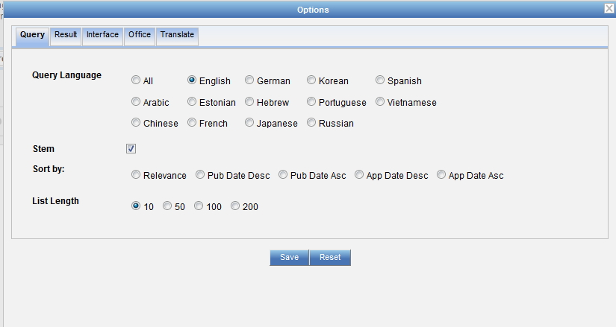
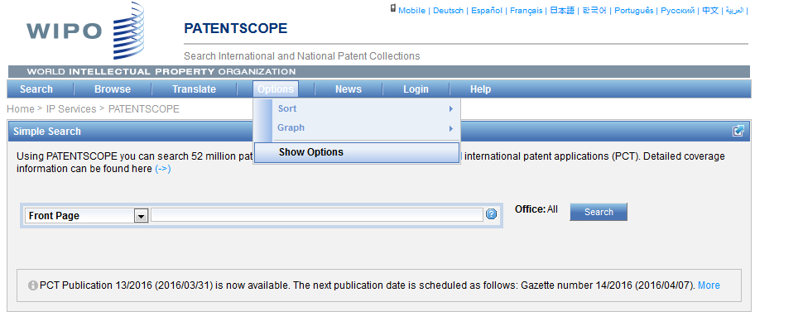
Collections selection

Slide 9
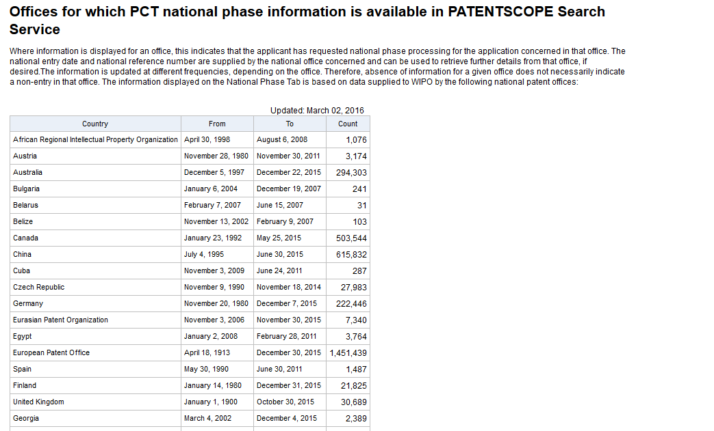
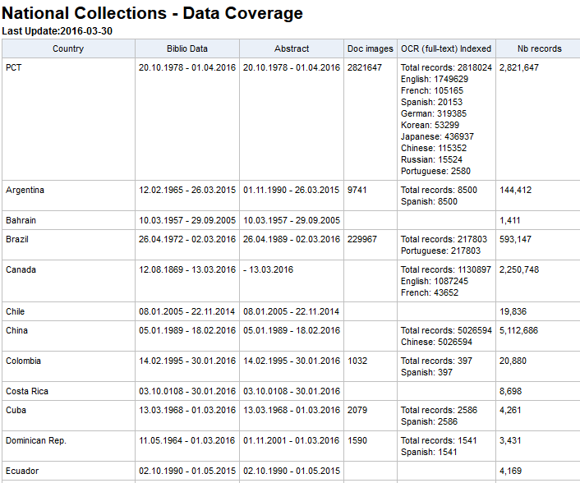
Coverage: collections-national phase
https://patentscope.wipo.int/search/en/help/data_coverage.jsf
https://patentscope.wipo.int/search/en/nationalphase.jsf

Slide 10
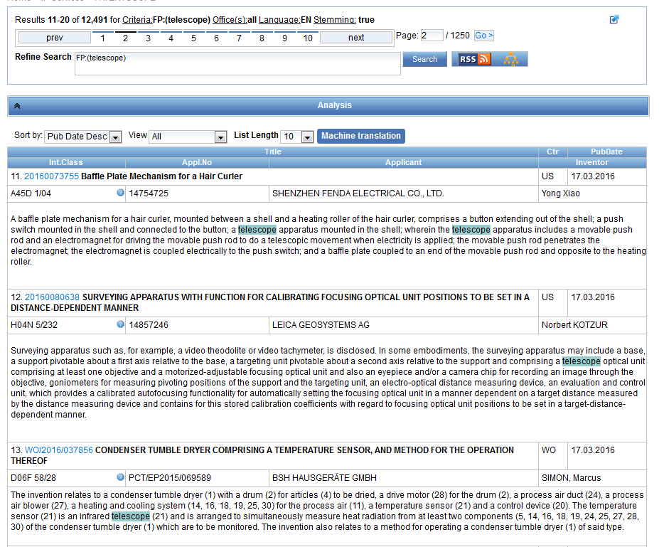
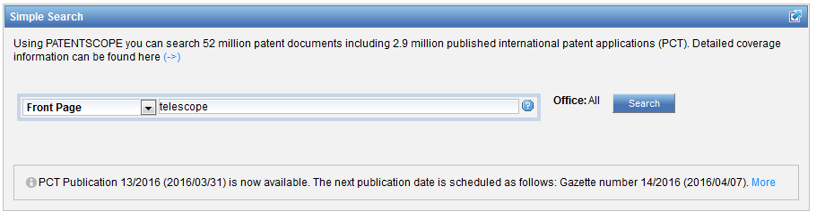
Interface simple - keywords

Slide 11
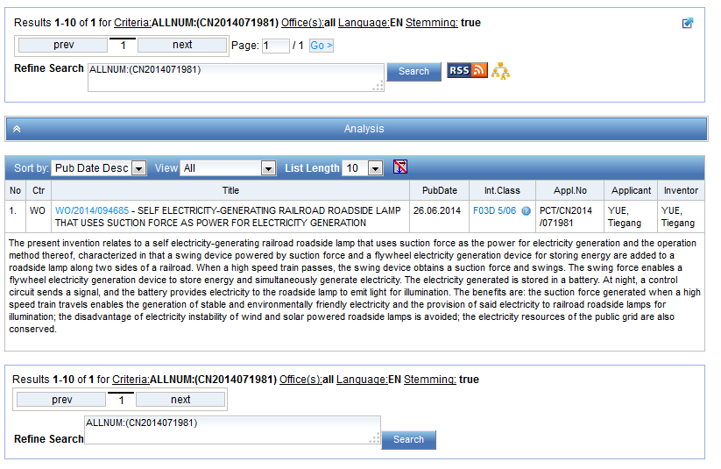
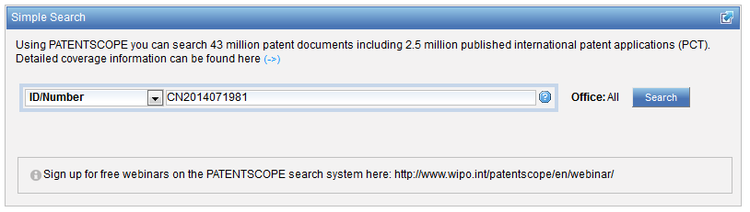
Simple interface - Numbers

Slide 12
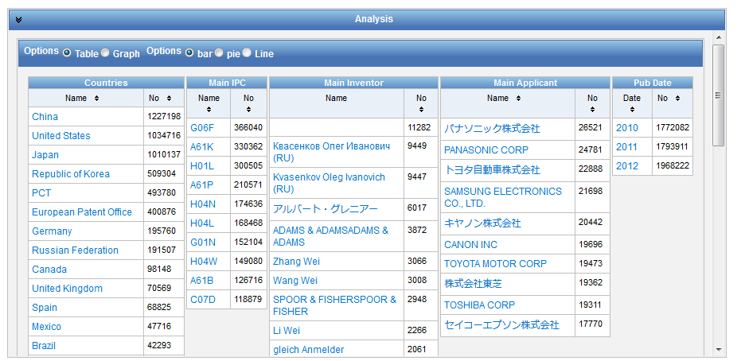
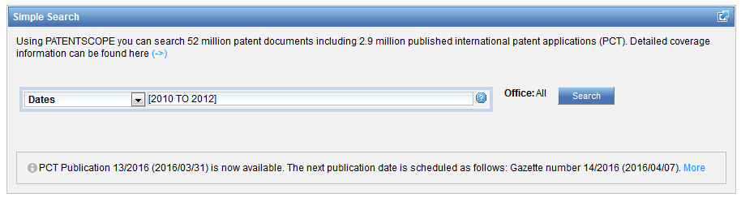
Date range using […TO…]

Slide 13
Interface: Field combination

Slide 14

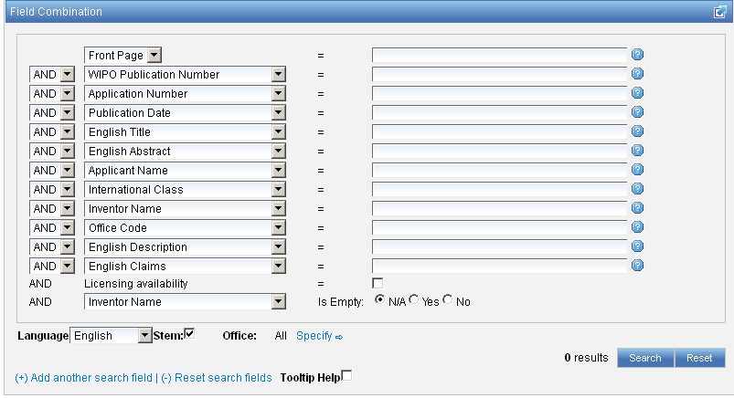
Interface : Field Combination - Structured

Slide 15
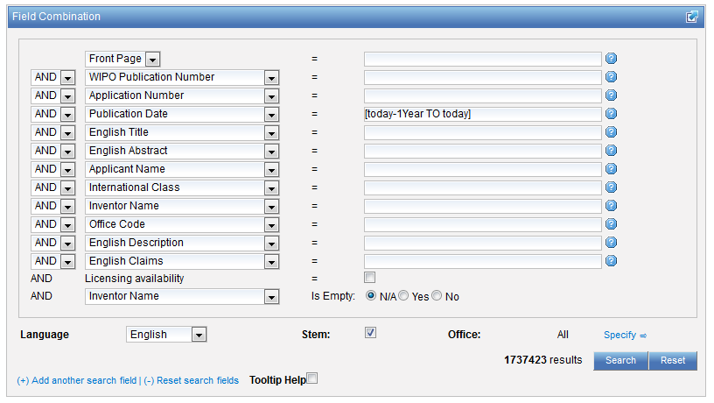
Stemming
Process that removes common ending from words by English Snowball algorithm
electric¦al = electric
electric¦ity = electric
electron¦ics = electron
More accurate results than wildcards:
elect* electoral, etc.

Slide 16
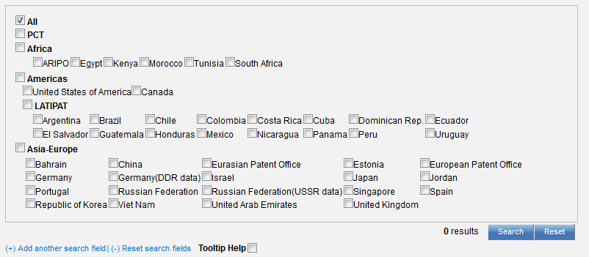

Interface : Field Combination - Structured

Slide 17
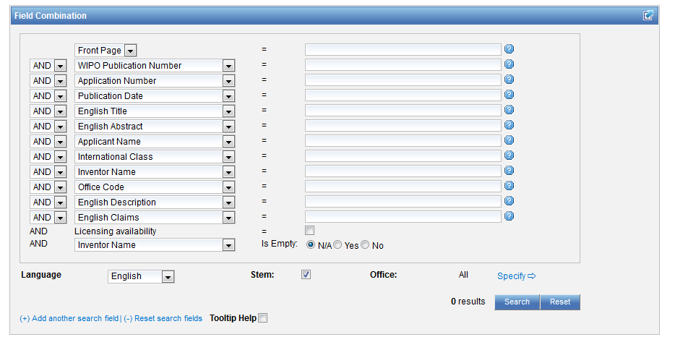

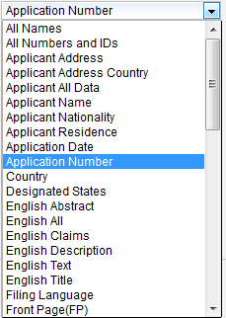
Field Combination

Slide 18
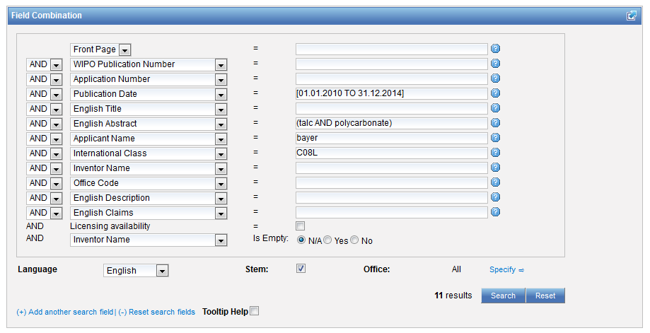
Interface Field Combination

Slide 19
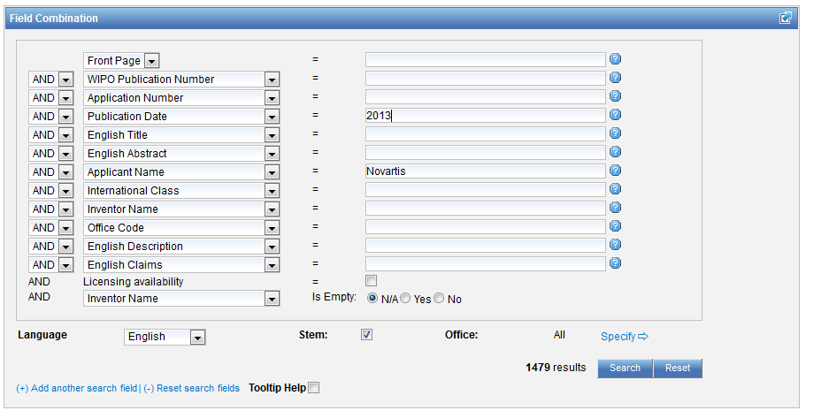
Search examples
Patent documents containing Novartis as inventor and published in 2010
Notes:
19

Slide 20
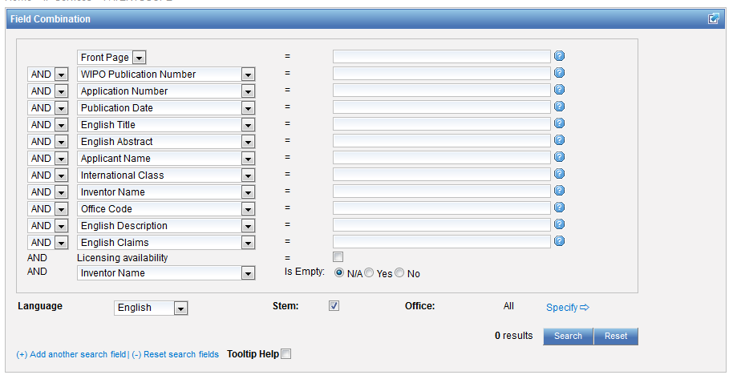
Empty fields

Slide 21
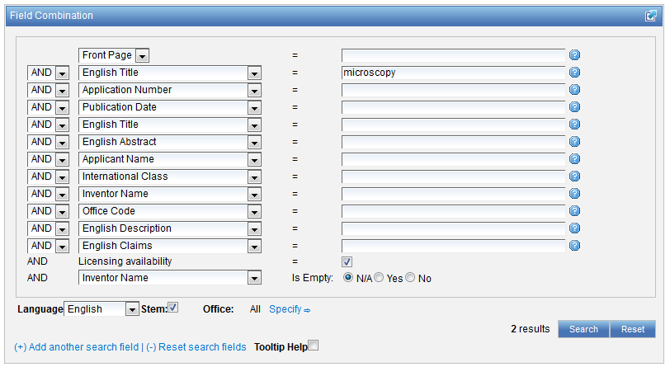
Search examples
Notes:
21

Slide 22
In the Publication Date field:
Examples
DP:today
DP:today-3days
DP:today-1Week
DP:today-2Years
Time ranges:
DP:[today-1Year TO today]
DP:[today-3Years TO today-1year]
Simplified time period ranges :
DP:Last3Days
DP:Last2Weeks
DP:Last1Year
Last Publications published :
DP:pct_lastpubdate
DP:pct_lastpubdate and PA:"University of Paris"

Slide 23
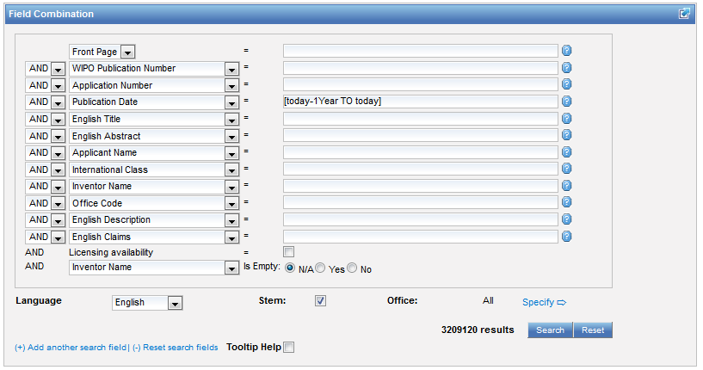

Slide 24
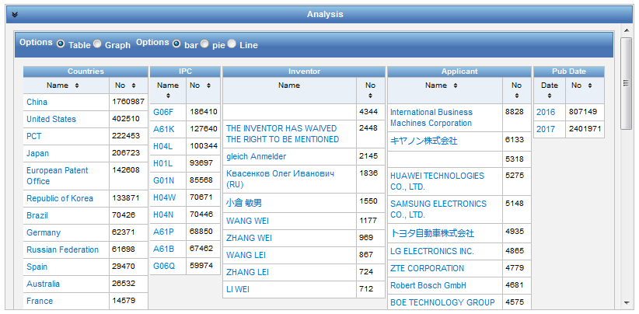

Slide 25
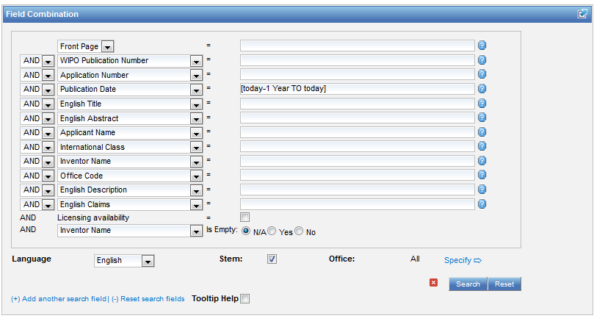
No space

Slide 26
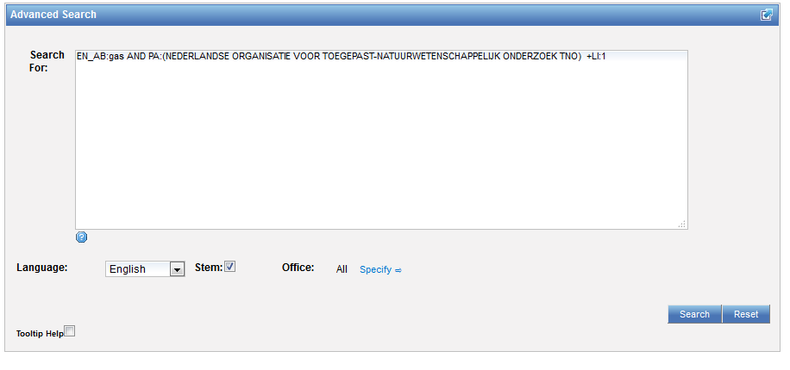
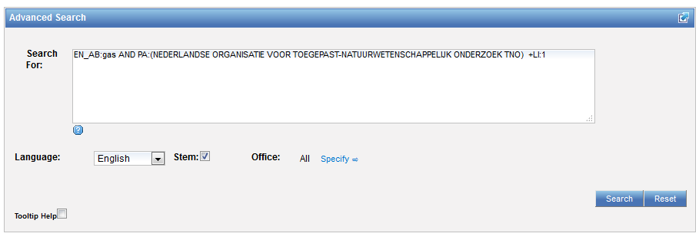
Interface: Advanced search

Slide 27
Instant help
Validates search query
Suggests terms
Provides:
  List of IPC codes
  List of countries

Slide 28
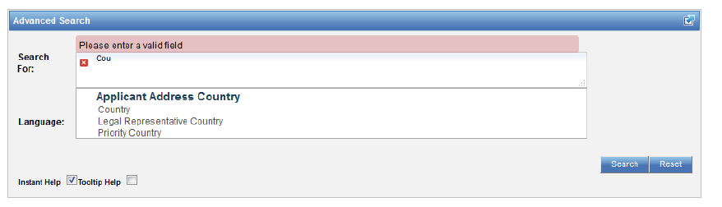
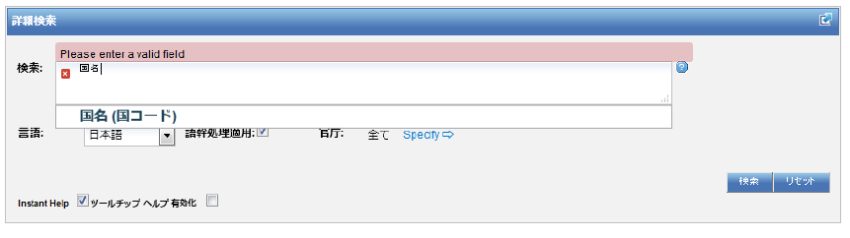

Slide 29
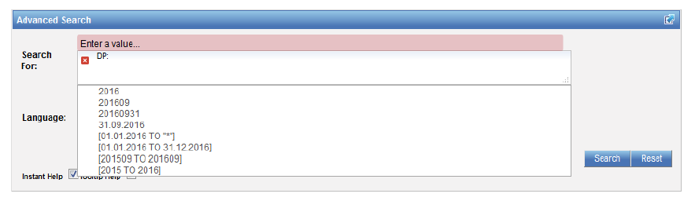
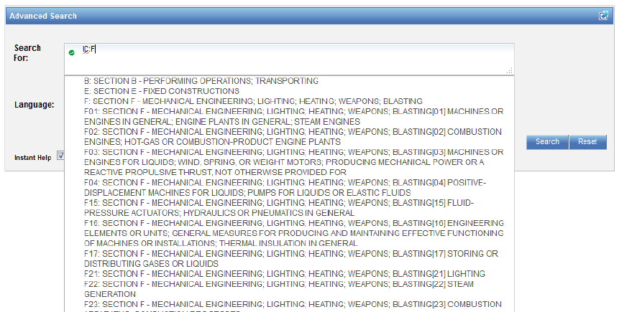

Slide 30
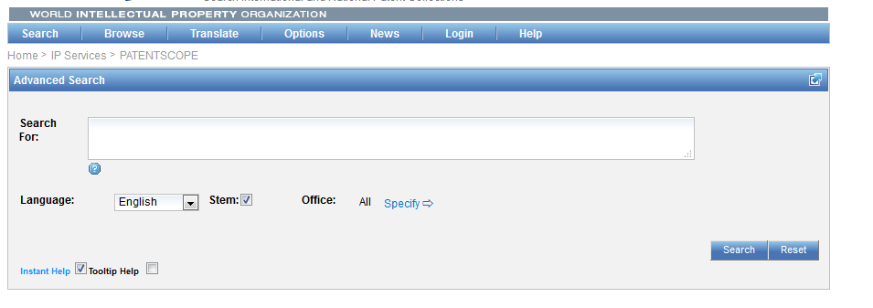

Help

Slide 31
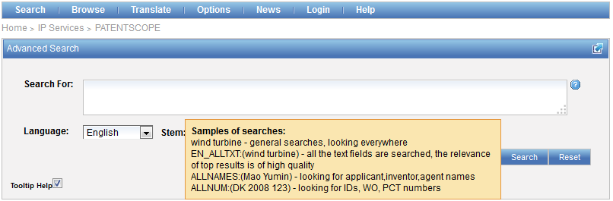
Tooltip help

Slide 32
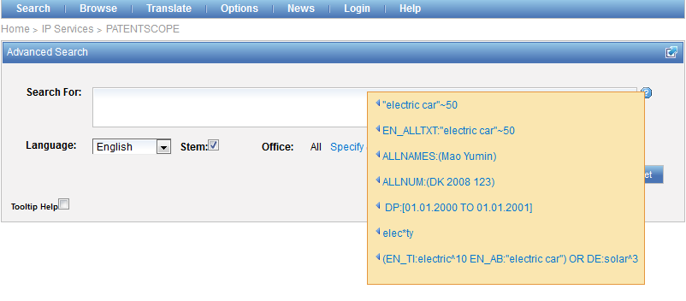
Question mark help

Slide 33
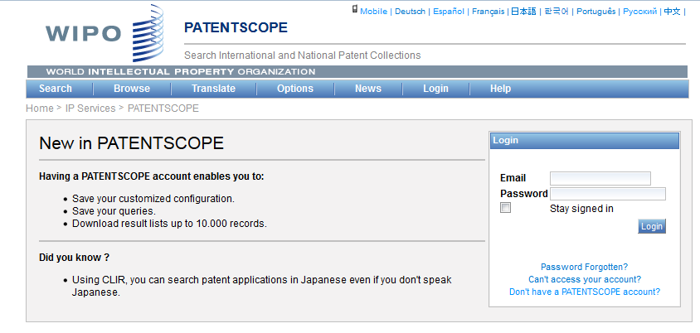
PATENTSCOPE account

Slide 34
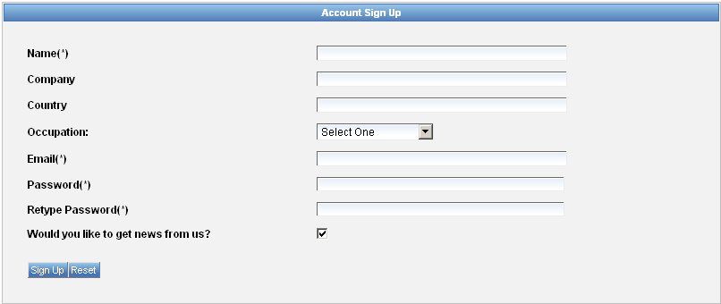
Signing up

Slide 35
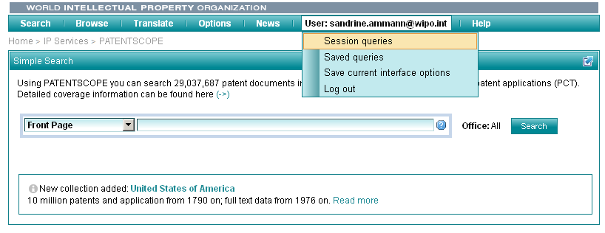
Once logged-in

Slide 36
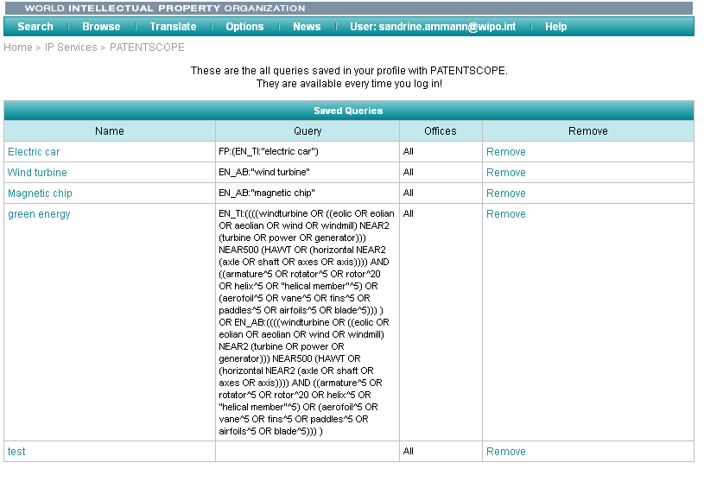
Saved queries

Slide 37
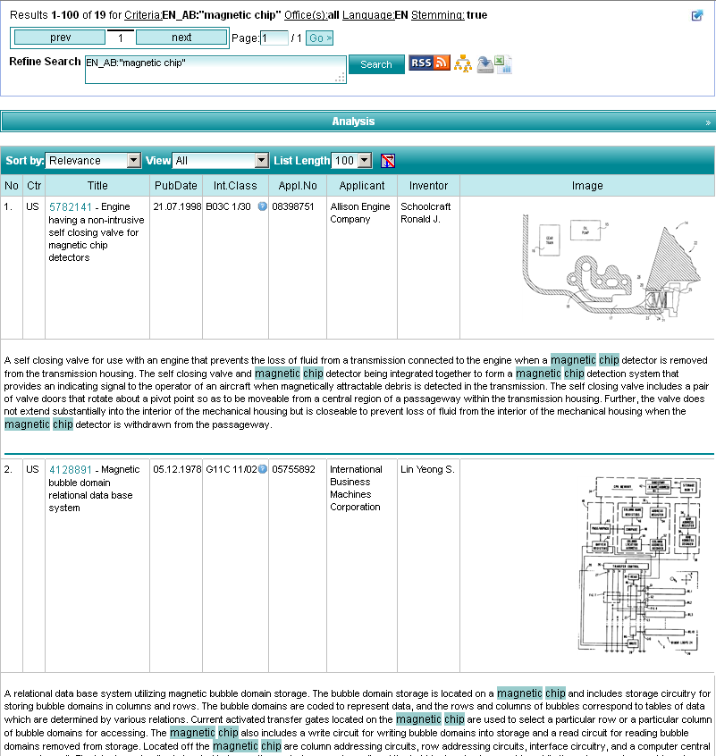
Downloading the results

Slide 38
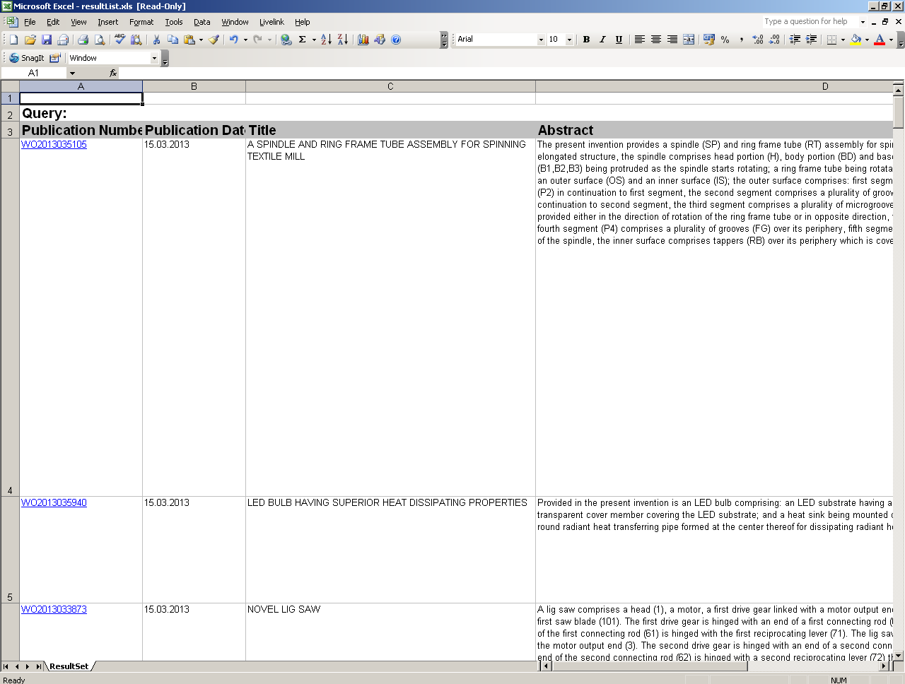
Downloaded results

Slide 39
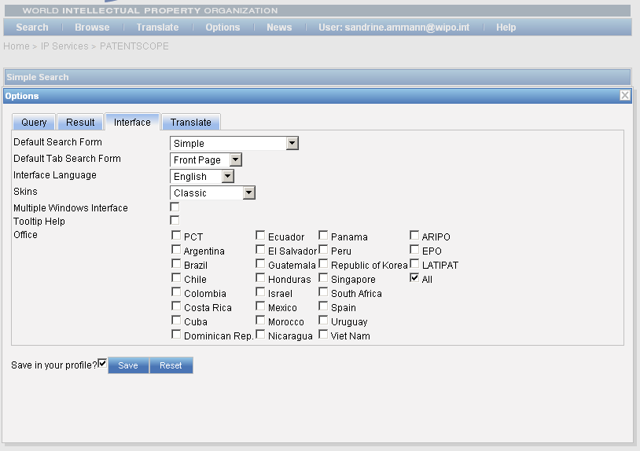
Account customization

Slide 40


Slide 41

Q.1: which fields are not pre-defined fields in the Simple search interface?
A
Applicant nationality
B
Filing language
C
National phase data
D
Front page

Slide 42
Q.1: which fields are not pre-defined fields in the Simple search interface?
A
Applicant nationality
B
Filing language
C
National phase data
D
Front page

Slide 43
Q.2: when you select a collection, you are selecting:
A
PCT national phase entry
B
Collection from a national/regional office

Slide 44
Q 2: when you select a collection, you are selecting:
A
PCT national phase entry
B
Collection from a national/regional office

Slide 45
Q:3: Using the PATENTSCOPE account, can you download the entire result list?
A
No
B
Yes

Slide 46
Q.3: Using the PATENTSCOPE account, can you download the entire result list?
A
No
B
Yes

Slide 47
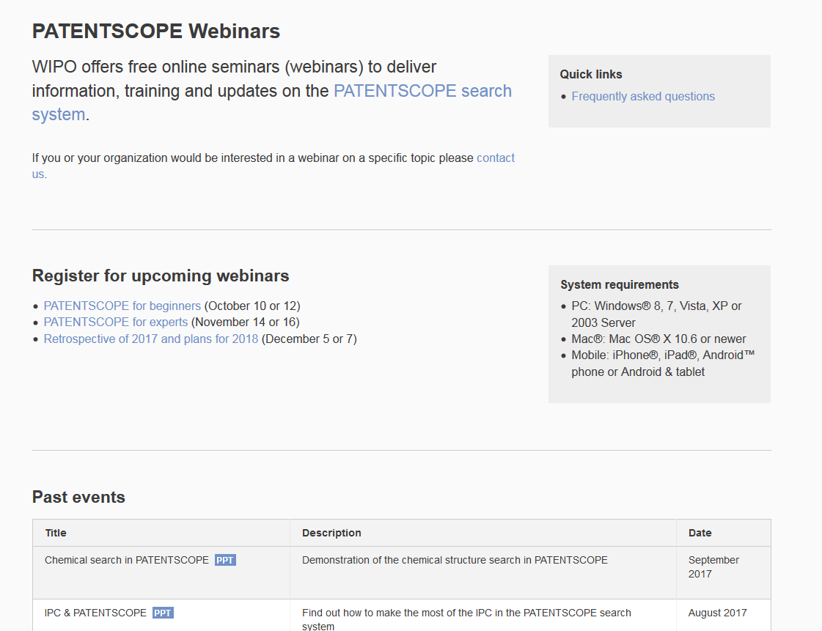
Future/past webinars:
wipo.int/patentscope/en/webinar

Slide 48
Next webinar
PATENTSCOPE for experts
  November 14 at 5:30 pm
  https://attendee.gotowebinar.com/rt/7639402775417310466
  November 16 at 8:30 am
  https://attendee.gotowebinar.com/rt/7639402775417310466

Slide 49
Global Brand Database: webinar
The Global Brand Database: an introduction
  October 17 at 5:30pm CET
  https://attendee.gotowebinar.com/rt/7380644809822317570
  October 19 at 8:30 am CET
  https://attendee.gotowebinar.com/rt/7380644809822317570

Slide 50
Global Design Database: webinar
The Global Design Database: an introduction
  October 24 at 5:30pm CET
  https://attendee.gotowebinar.com/rt/2647760724176844290
  October 26 at 8:30 am CET
  https://attendee.gotowebinar.com/rt/2647760724176844290

Slide 51
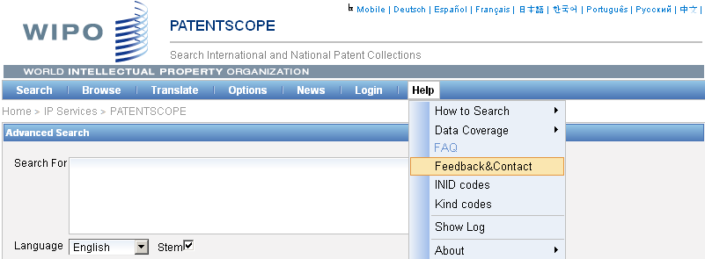
Forum

Slide 52


Slide 53

patentscope@wipo.int

