Slide 1
Complex queries in the PATENTSCOPE search system
Online
March
2017
Sandrine Ammann
Marketing & Communications Officer

Slide 2
“Complexity” of queries depends on:
Skills
Experience level

Slide 3
Q:Would consider yourself as a
A
Beginner seacher
B
Expert searcher

Slide 4
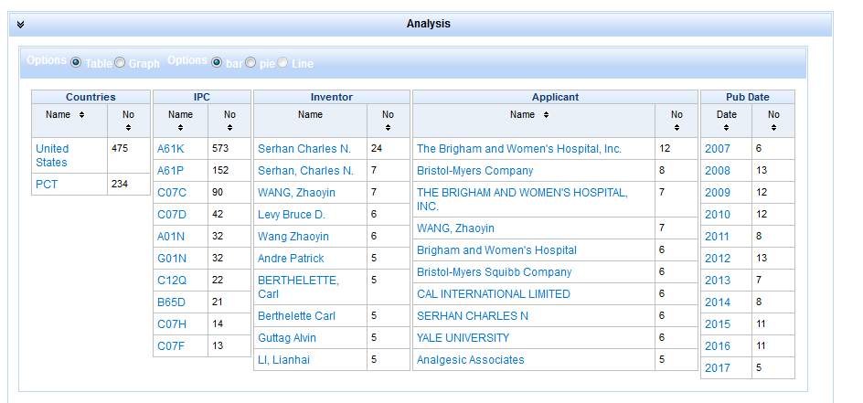
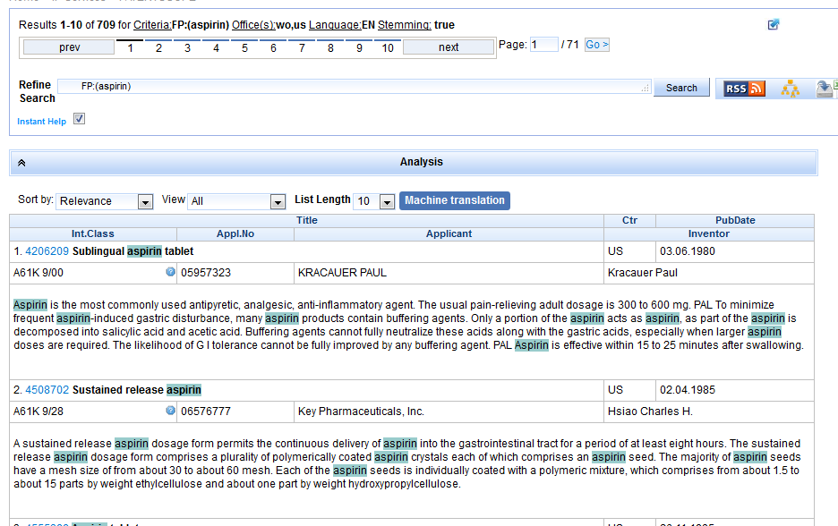
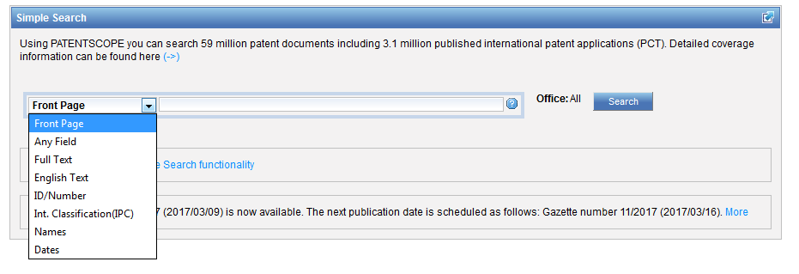
Complexity in this webinar

Slide 5
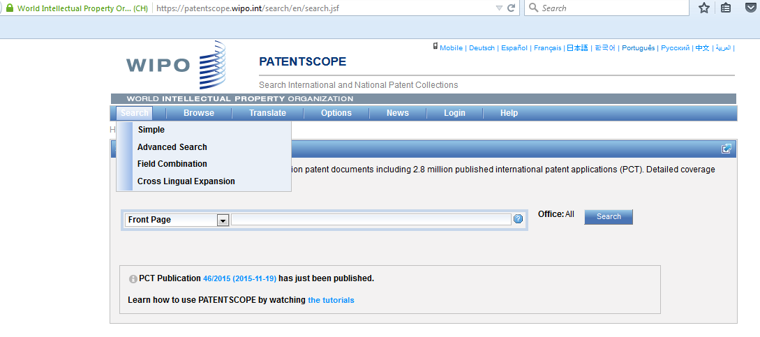
2 interfaces

Slide 6
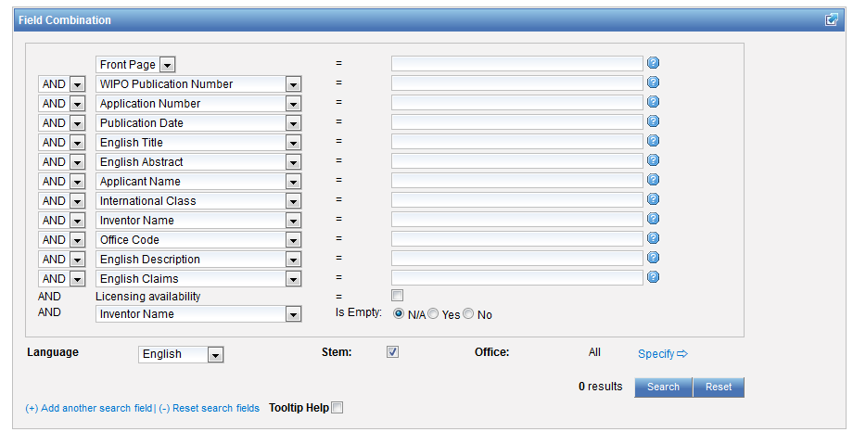
Advanced or Field Combination

Slide 7
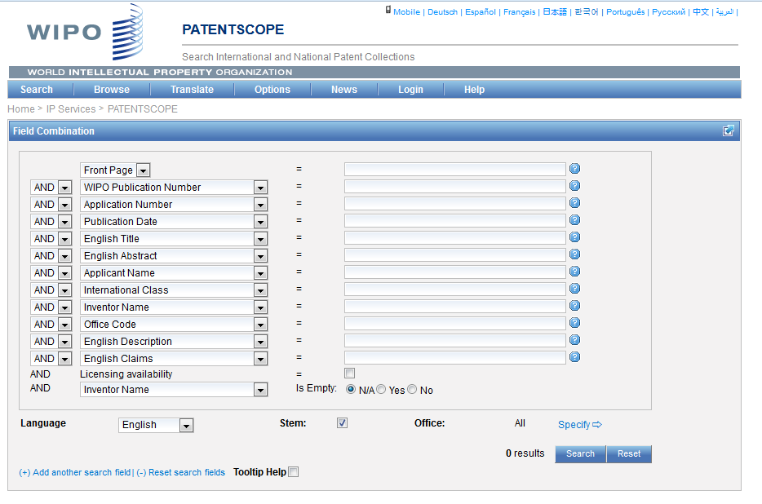
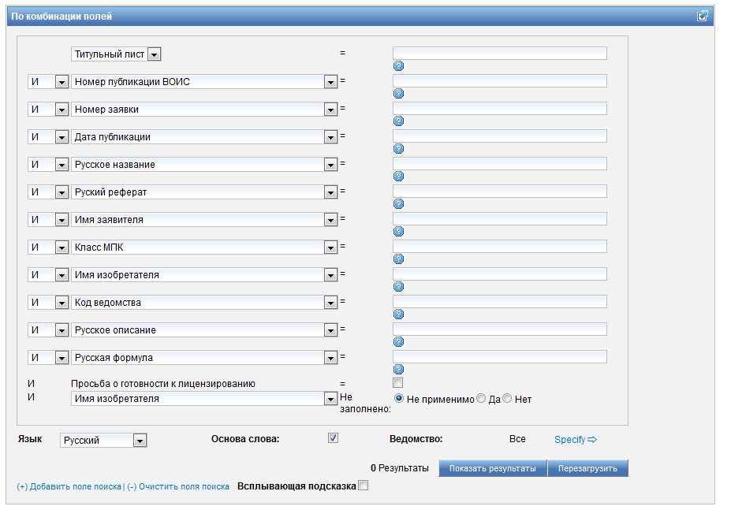
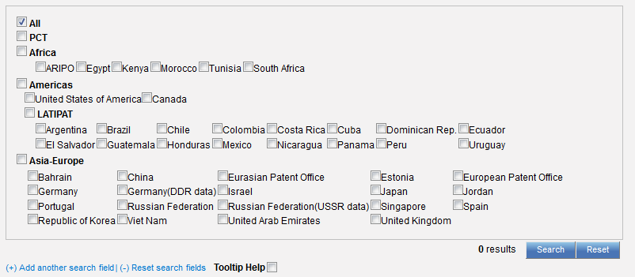

Slide 8
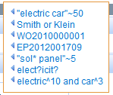
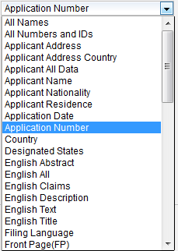
Field Combination

Slide 9
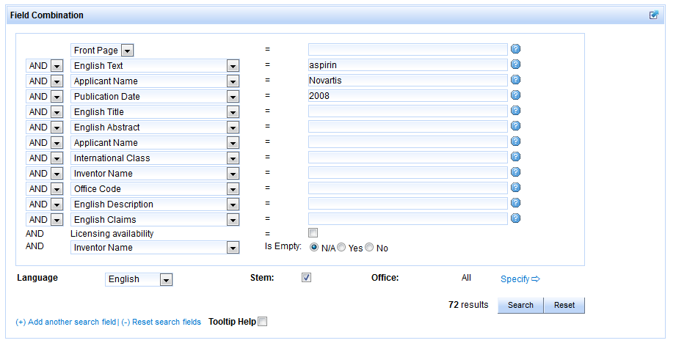
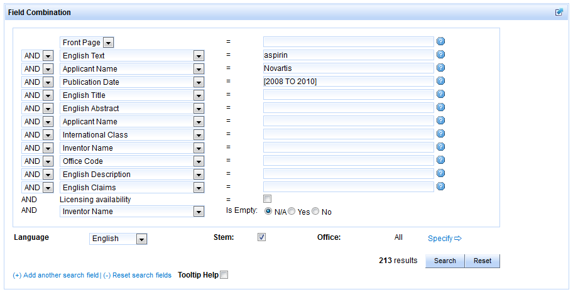

Slide 10
Field Combination - pros
Predefined fields
Immediate results on the same page

Slide 11
Field combination - cons

Slide 12
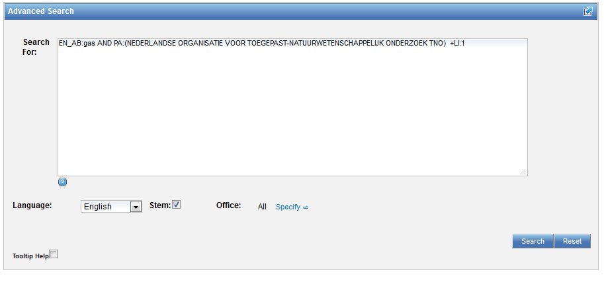
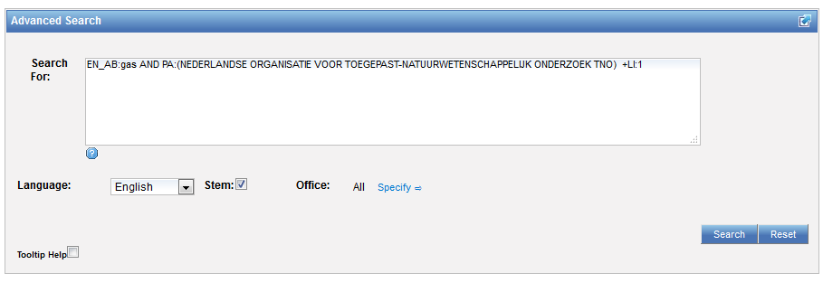
Interface: Advanced search

Slide 13
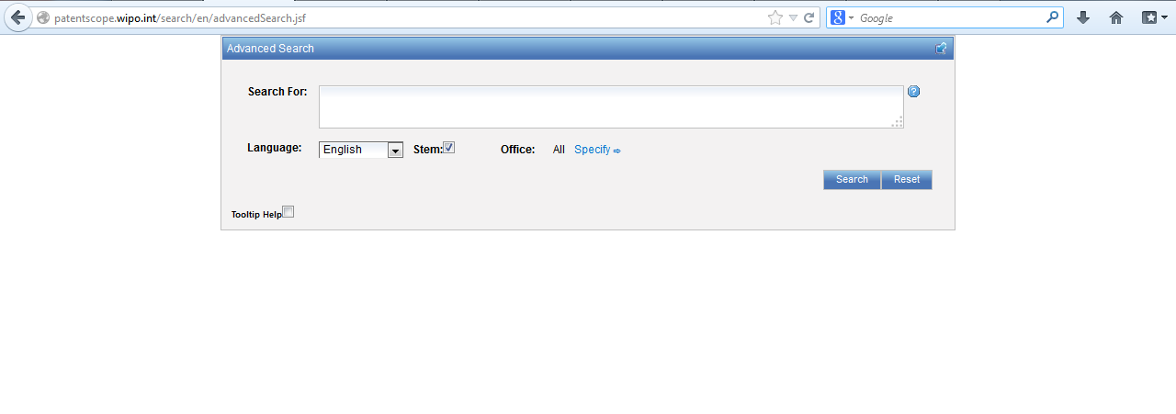
Advanced search interface

Slide 14
EN_ALLTXT; PA; DP = fields
AND = operator

Slide 15
Fields: where to search Source: http://spicewallpaper.blogspot.ch/2012/08/green-fields-with-blue-sky.html

Slide 16
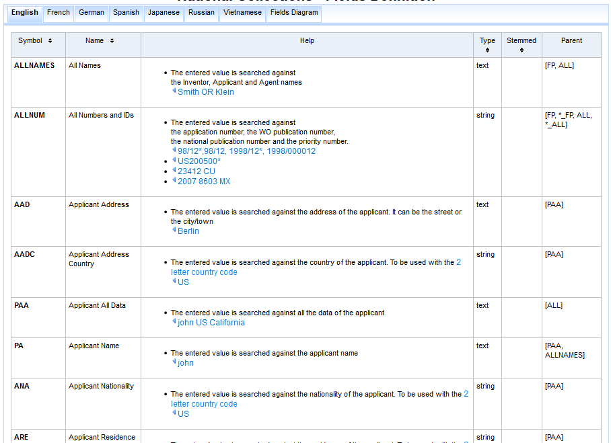
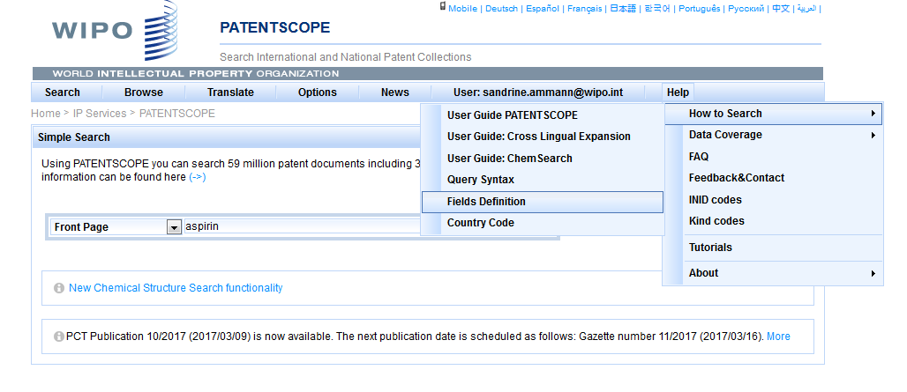

Slide 17
Examples
FP = front page
ALL = all fields
ALL_NAMES = all names
IC = IPC
DP = publication date
CTR = country either WO or country from nat collection
NPCC= national phase entry
AN = origin of PCT

Slide 18
Date search
Simple:
DP:01.02.2000
DP:20000201
DP:02.2000
DP:200002
DP:2000

Slide 19
Example: IPC
IC = International Classification
IC :A
IC :A47
IC :A47L
IC :A47L1
IC:A47L11
IC:A47L11/03

Slide 20
D06F 1/06 will include by default
D06F 1/08
1/10
1/16
To exclude subgroup: IC_EX
ICI = International Classification Inventive
ICN = International Classification Non-inventive
ICI_EX ICN_EX = no subgroup

Slide 21
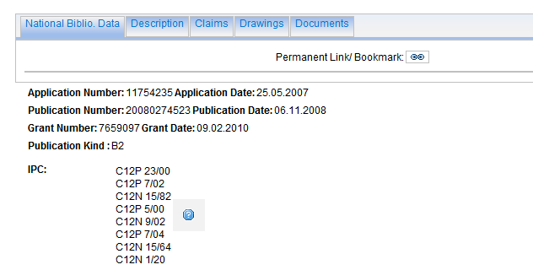
Example: grant

Slide 22
Example: grant

Slide 23
Example: licensing + 3rd party observation

Slide 24
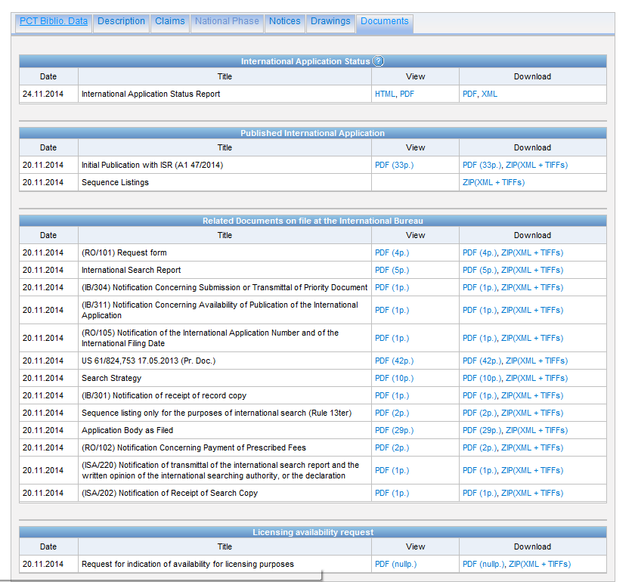

Slide 25
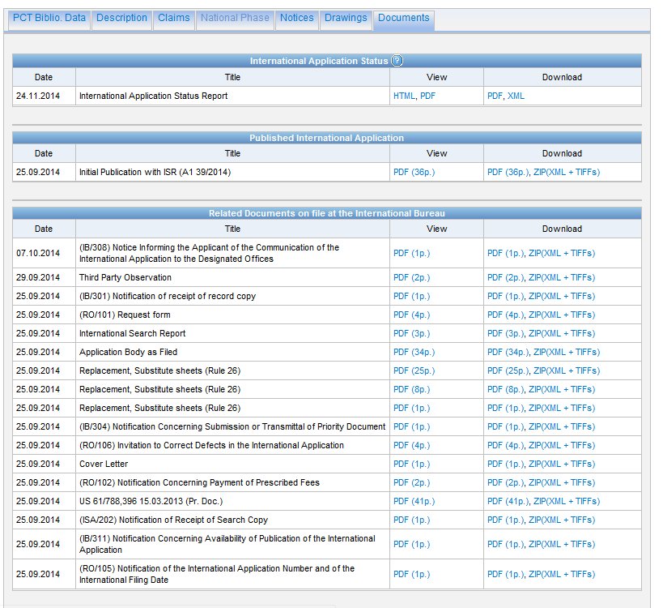

Slide 26
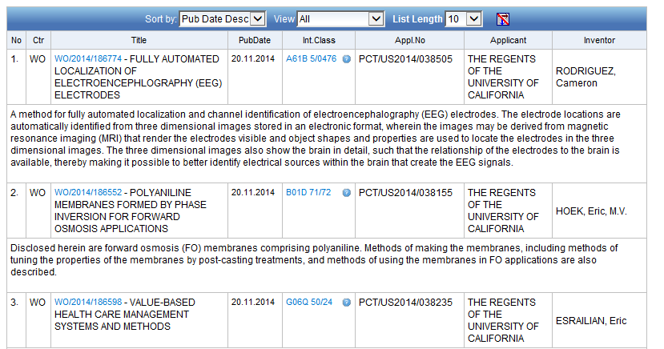
Example: last pub + applicant

Slide 27
New Fields
ISA
ST.3 Office code of the patent authority that performed the preliminary search report
ISA:US and OF:WO
ISR
For an ISR document in status filed (ISR): Report ; if there is an Article 17(2)(a) declaration in status filed (A172A): Declaration
ISR:declaration and OF:WO
SIS
If any Supplementary International Search Report has been received, show status “report”;If no SIS Reports or Declarations are on file, show status “None” SIS:report and OF:WO
IPE
If there is an IPER in status filed (IPER or IPRP2) and the time limit for making the report visible to Patentscope has passed: Report
IPE:report and OF:WO

Slide 28
Fields rules
Basic fields: elements of a patent document
Derived fields
2 letter code = individual field
EN_TI FR_AB ES_DE_S
Convention: language specified by 2 letters
if not specified all languages
S = stemmed
: to separate term without any space

Slide 29
Intuitive queries
PCTHavingThirdPartyObservations
PCTPublishedLastWeek
PCTHavingApplicantFromUS
DP:Last1Year
DP:[Today-1Week TO Today]

Slide 30
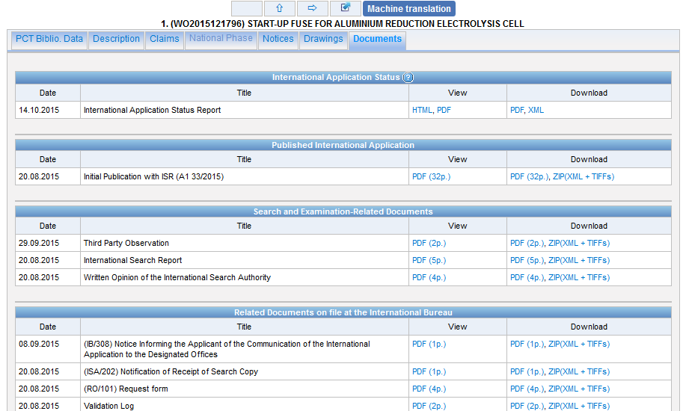
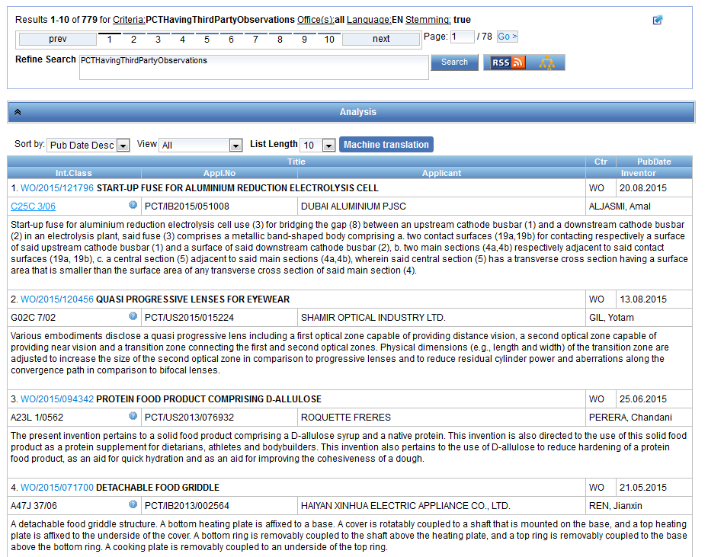

Slide 31
Fields: golden rules
EN_ALL = default field field indicator not required
Field name followed by : ":" or "/"
The field is only valid for the term that it directly precedes, so the query:
EN_TI:("wind turbine" AND electric) solar
"wind turbine" AND electric in the title field "solar" in the default field (EN_ALL ).

Slide 32
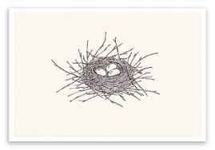
Grouping- nesting

Slide 33
Grouping/nesting
Solar OR (wind AND turbine)
(solar OR wind) AND turbine
EN_TI: electric car
electric will be searched in English title but car in all fields
EN_TI: (electric car)
Both electric and car will be searched in the English title

Slide 34
Range search
Range:
DP:[01.01.2000 TO 01.01.2001]
Can also be used to search non-date fields
IN: {Smith to Terence}

Slide 35
EN_ALLTXT; PA; DP = fields
AND = operator

Slide 36
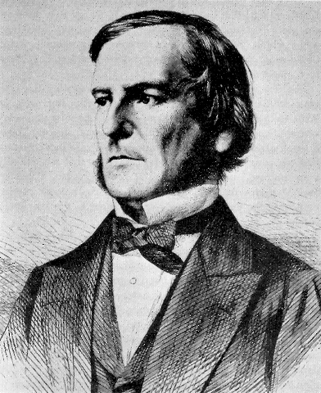
Boolean operators
AND
OR
NOT
ANDNOT

Slide 37
ANDNOT - NOT
Use ANDNOT when searching A excluding B
Ex: bicycle ANDNOT boat
Use NOT when searching all documents except A
Ex:NOT(car AND bicycle AND boat)

Slide 38
Proximity operator NEAR
Finds words that are next to each other
NEAR3 3 = the max nb of word gaps between 2 search terms

Slide 39
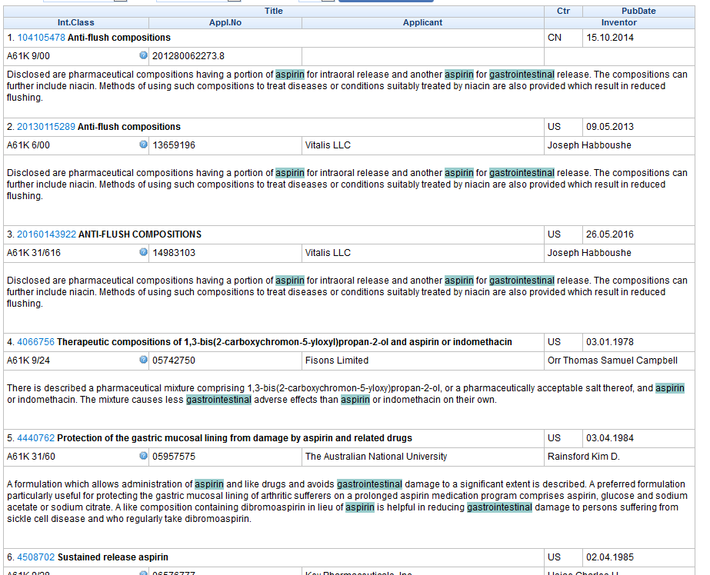
Example

Slide 40
Proximity search: BEFORE
the order of terms is significant.
trunk BEFORE cutting

Slide 41
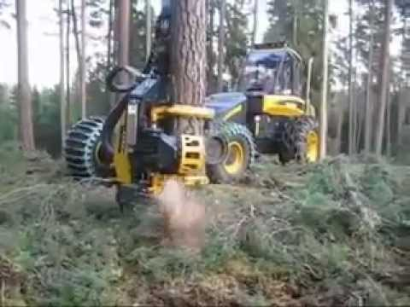
An example

Slide 42
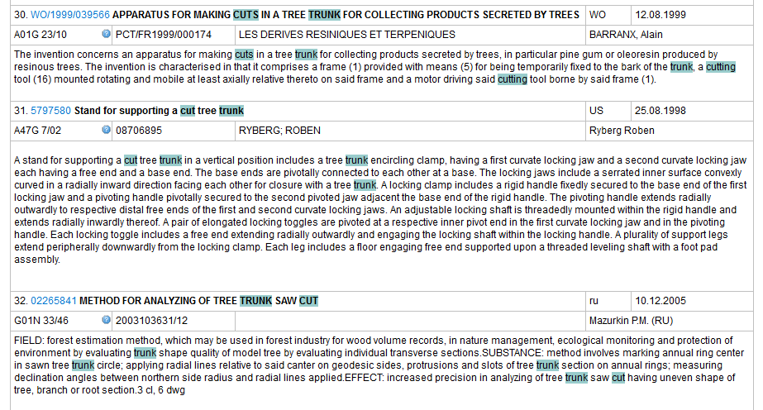

Slide 43
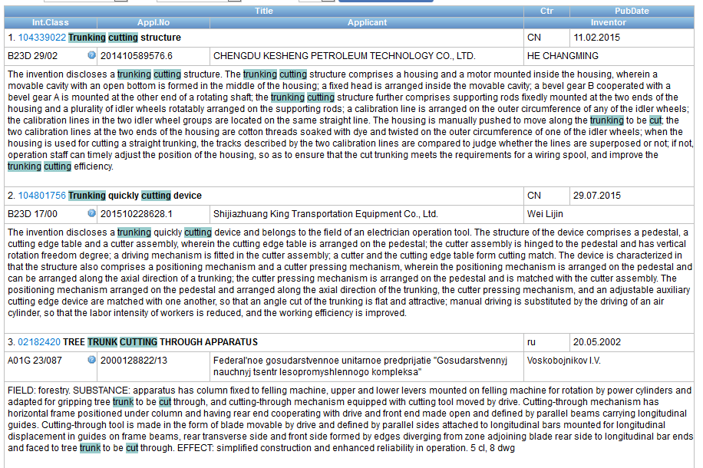

Slide 45
Keywords
Stemming
Wildcard
Truncation
Fuzzy

Slide 46
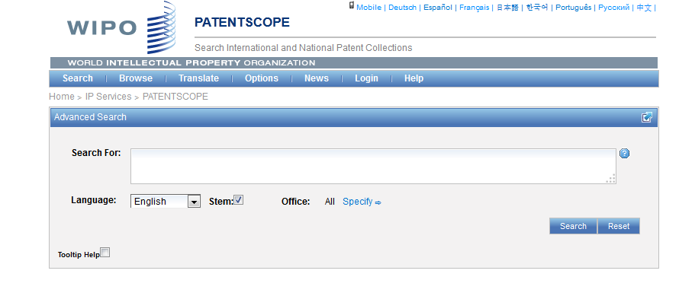
Stemming

Slide 47
Stemming
Stem = stemming
Process that removes common endings from words.
critical critically criticism each word is reduced to ‘critic’
criticisms critics

Slide 48
Stemming
no dictionary includes the necessary technical terms to express patent concepts
Porter Stemming Algorithm finds words that contain common roots
Save time and effort

Slide 49
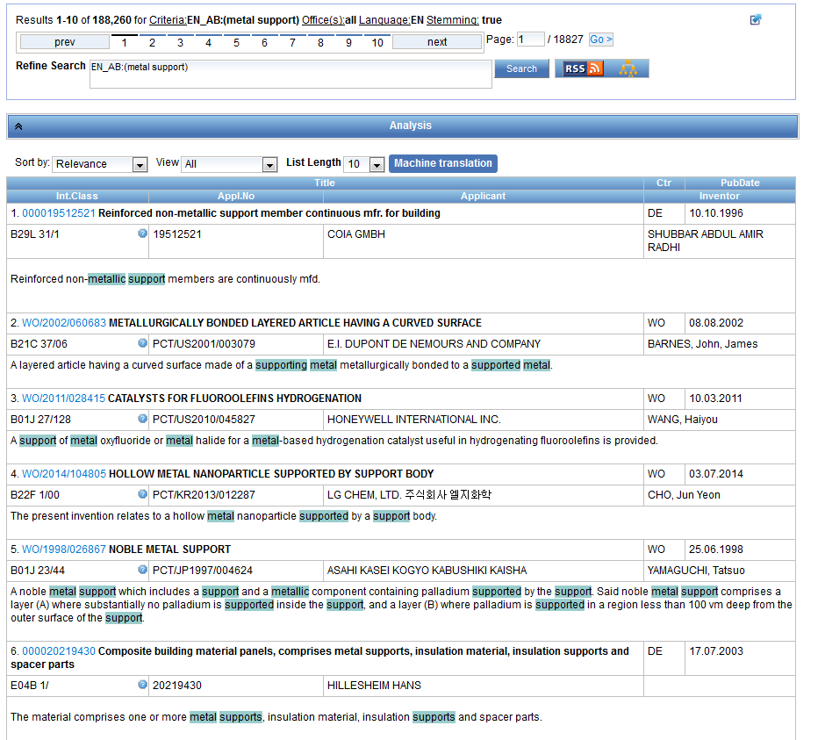
Stemming - example

Slide 50
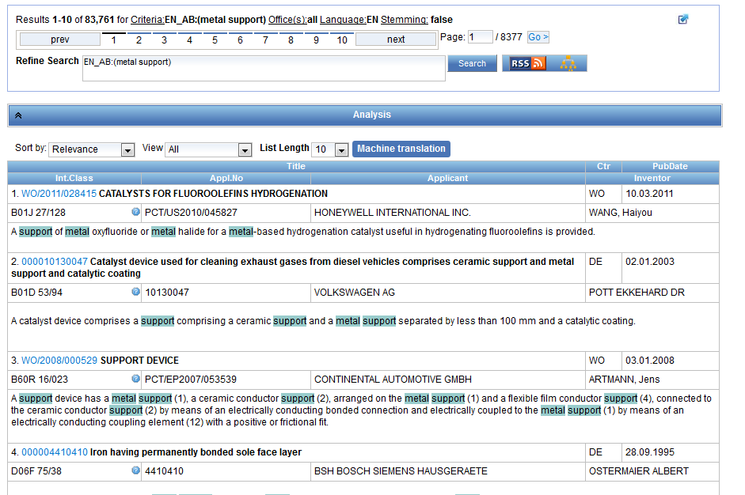
Same search without stemming

Slide 51
Wildcards/truncation : ? *
* stands for 0 or more characters
? stands single character
te?t = test or text
electric* = electrical; electricity
behavi*r = behaviour or behavior
micro?p* = microspeaker, microsporidial

Slide 52
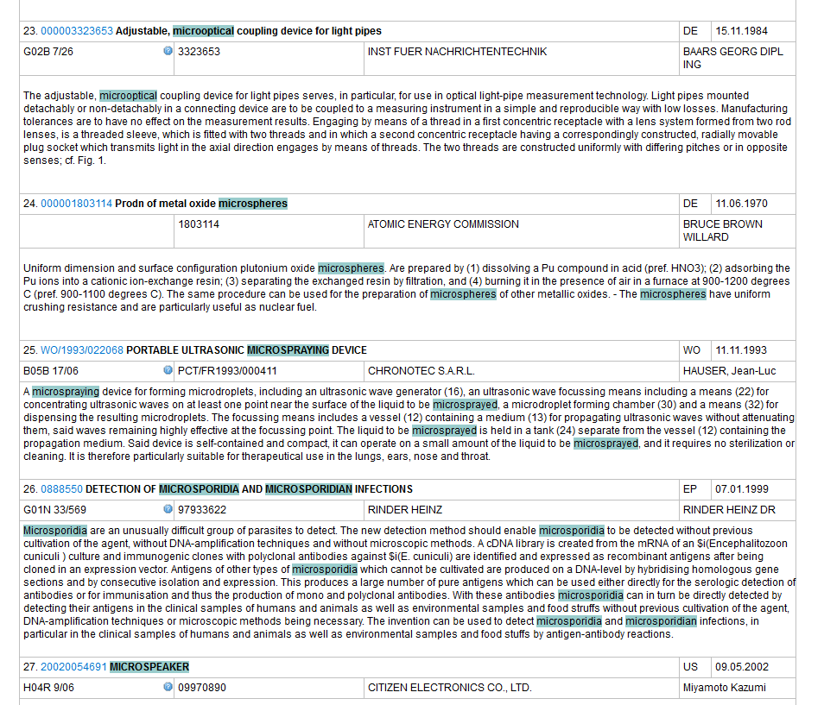
An example

Slide 53
Use of wildcards
Spelling uncertainty (plural, tenses, foreign words):
tyre vs. tire t*re
University vs Universität Universit* Stuttgart
Multiple spelling variants are known:
color vs. colour col*
Preferred option over stemming:
electric vs. electricity electri*

Slide 54
Wildcard vs stemming
Logic results:
navy, navies or naval if nav* = navigating, navigation,
electricity or electric if elect* = electoral

Slide 55
Fuzzy searches
Use of the tilde: ~
Examples:
roam~ foam / roams
Roam~0.8
Useful to find misstpyed, misspelt or mis-OCRed words
Notes:
Smilar in spelling

Slide 56
Q: when you use wildcard, …
A
The results retrieved are all relevant
B
Stemming is turned off

Slide 57
Q: when you use wildcards, …
A
The results retrieved are all relevant
B
Stemming is turned off

Slide 58
^ caret = weighting factor
Same result but ranking will be different
touch^3 AND polarize

Slide 59
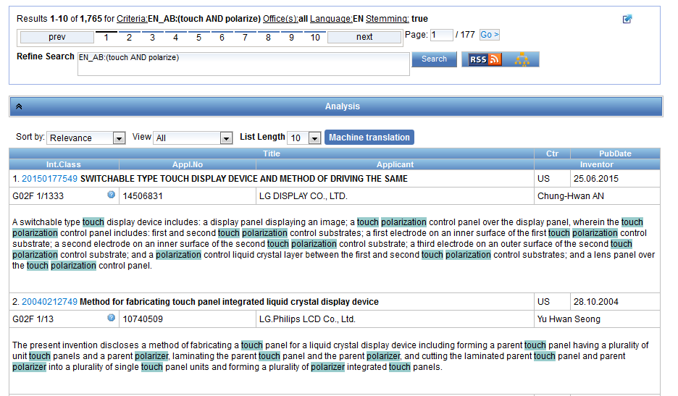

Slide 60
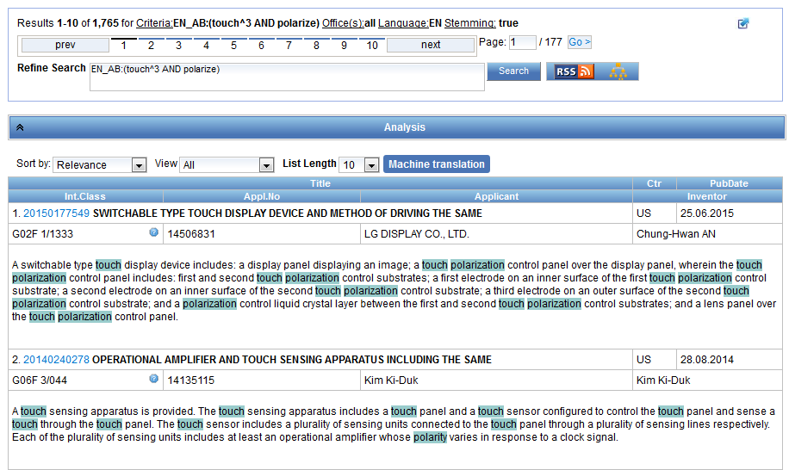

Slide 61
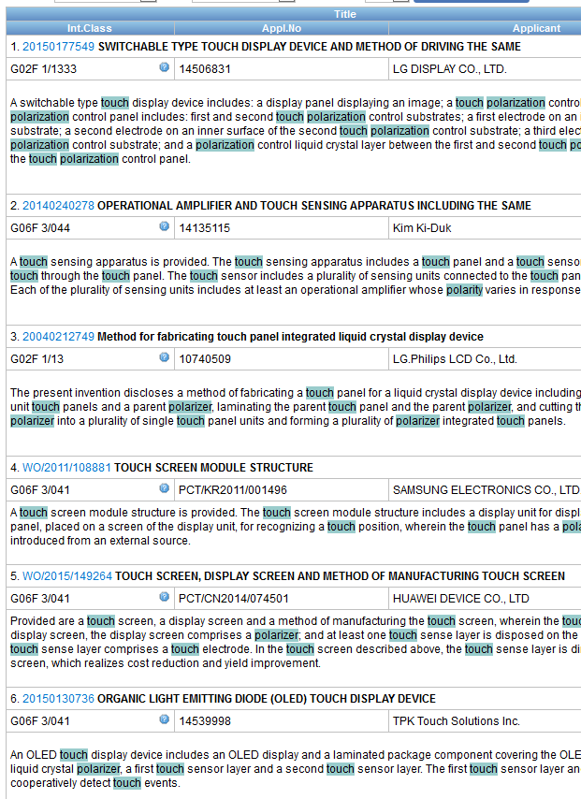

Slide 62
Example: national phase entry
All applications that entered national phase in China in 2012

Slide 63
Example: nb of patent applications from France seeking protection in USA

Slide 64
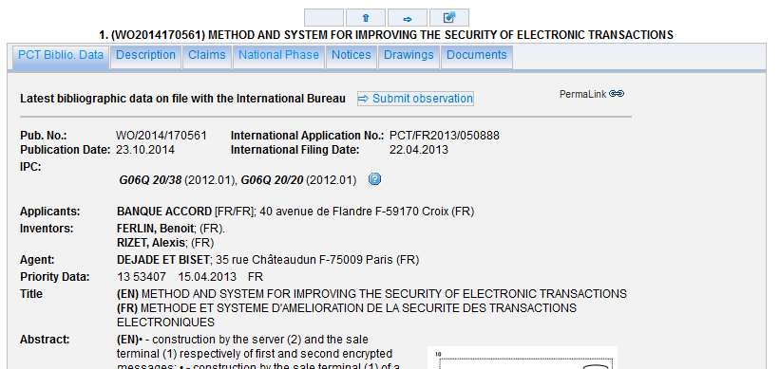

Slide 65
Advanced search interface
Search syntax
Search fields

Slide 66
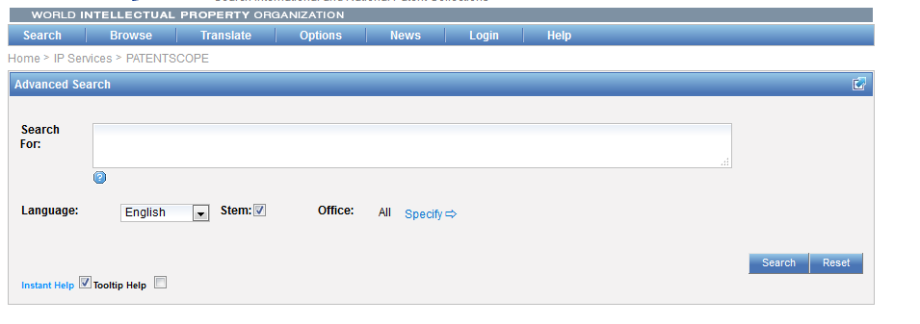
Help

Slide 67
Tooltip help

Slide 68
Instant help
Validates search query
Suggests terms
Provides list of:
IPC codes
countries

Slide 70
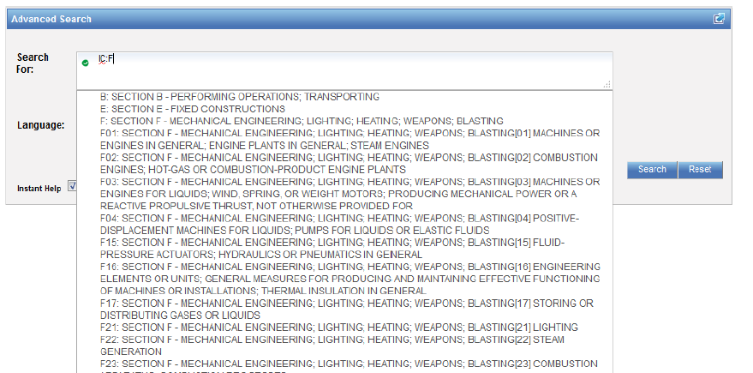

Slide 71
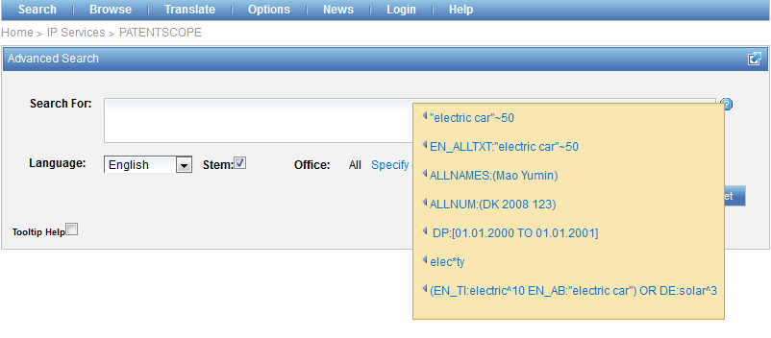
Question mark help

Slide 73
Result combination
Combine search with chemical structure search
Combine search with CLIR

Slide 74
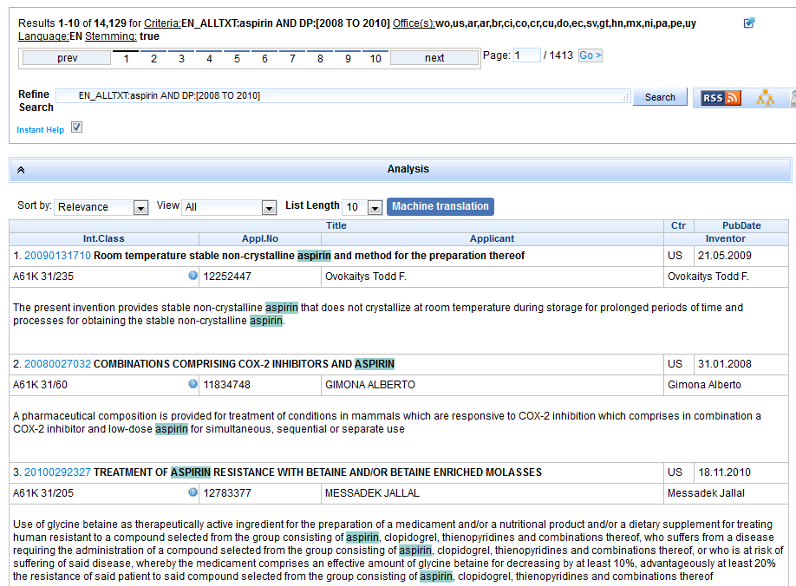
For queries with compounds

Slide 75
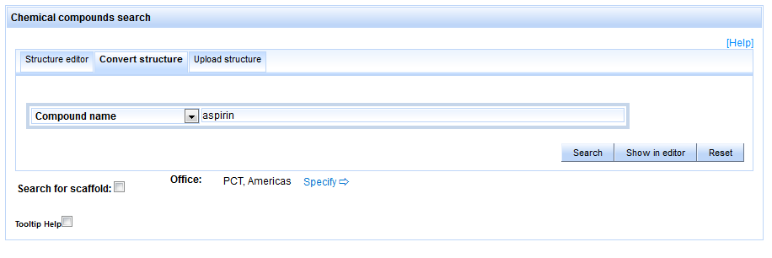

Slide 76
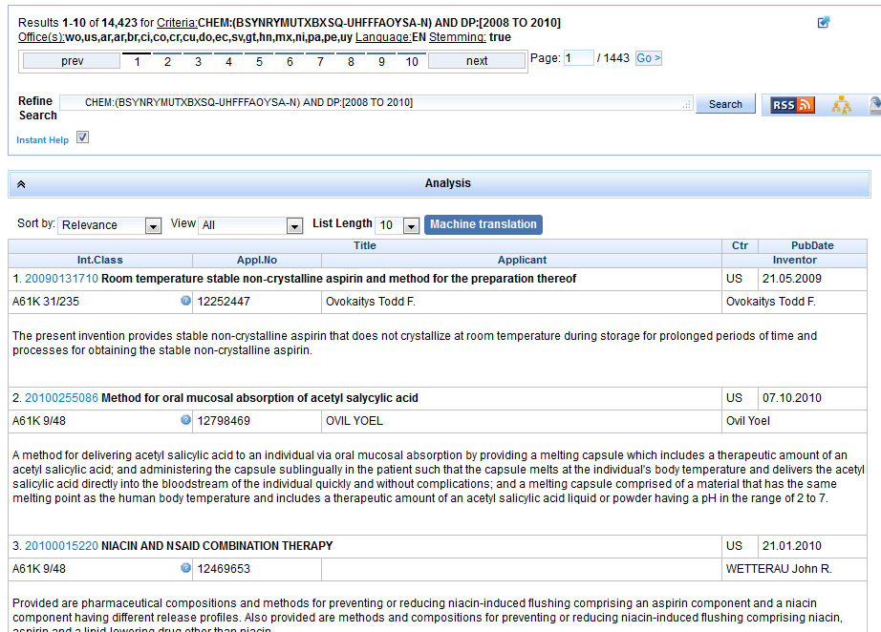

Slide 77
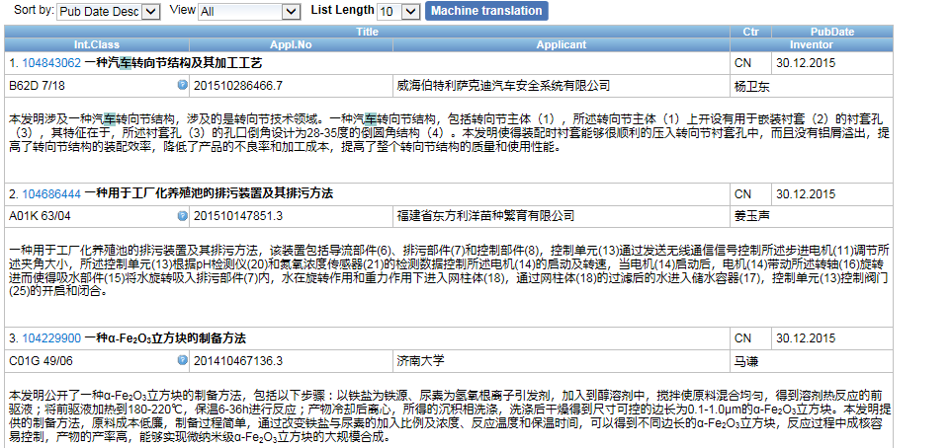
Combining with CLIR

Slide 79
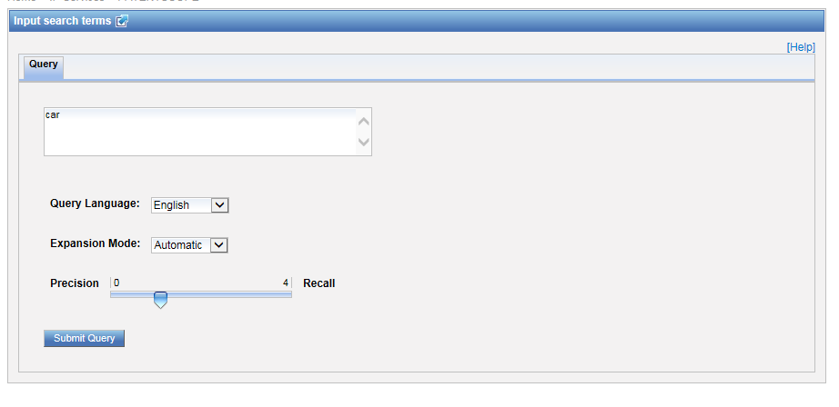

Slide 80
Most common errors
(….) "…"
" not “
Field name
No space
Wildcard at the beginning of a word

Slide 81
Q: how to build a query in order to obtain patents by the company Huawei with at least one innovator from Germany?
A
Huawei AND Germany
B
IN:Huawei AND INA: Germany
C
IADC:DE AND PA:Huawei
D
CTR: Germany AND IN: Huawei

Slide 82
Q: how to build a query in order to obtain patents by the company Huawei with at least one innovator from Germany?
A
Huawei AND Germany
B
IN:Huawei AND INA: Germany
C
IADC:DE AND PA:Huawei
D
CTR: Germany AND IN: Huawei

Slide 83
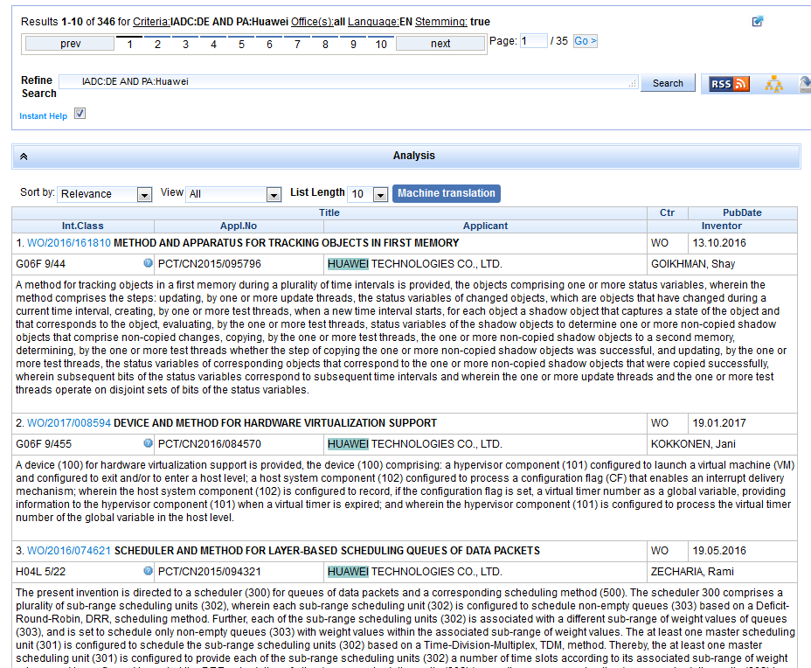
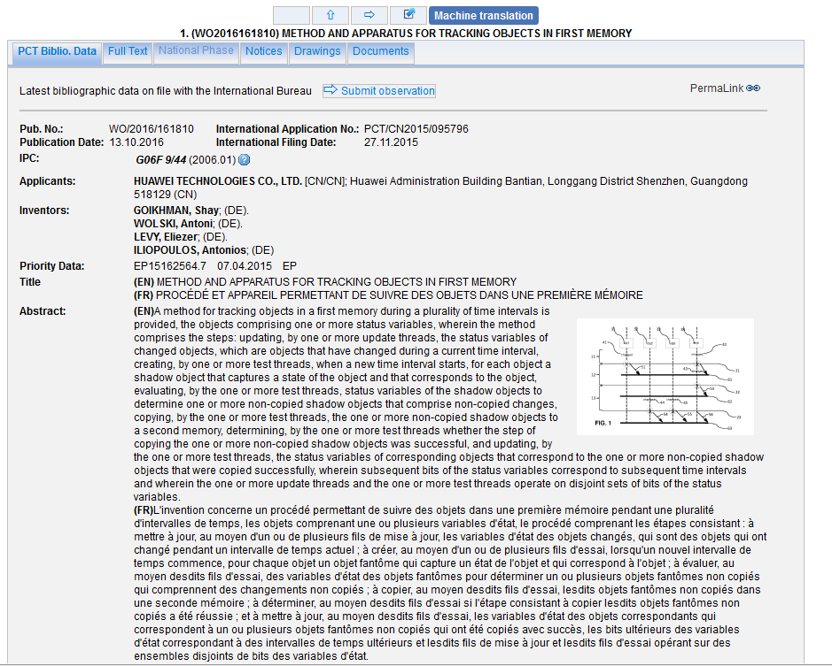
IADC = inventor nationality
PA: applicant name

Slide 84
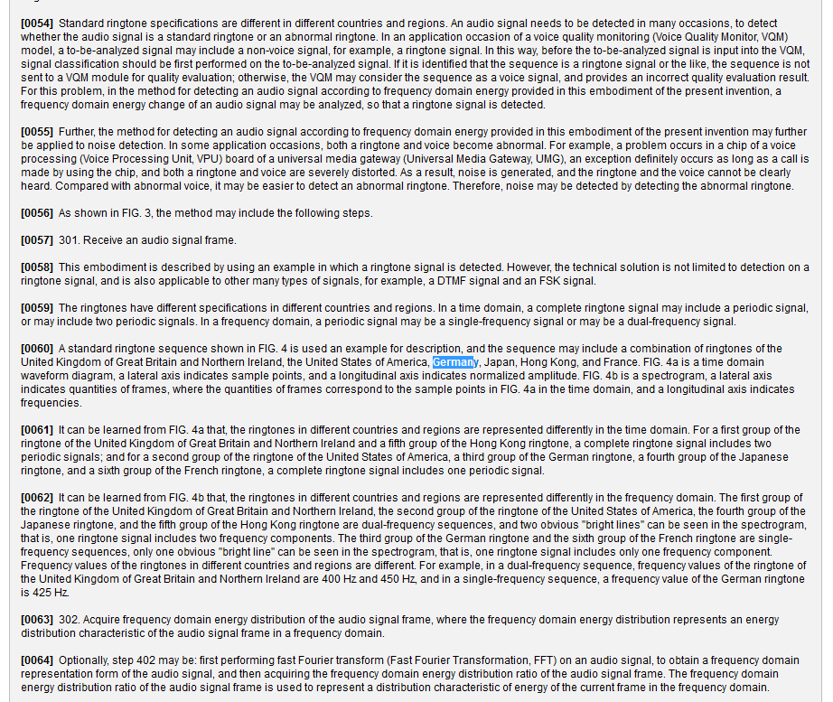
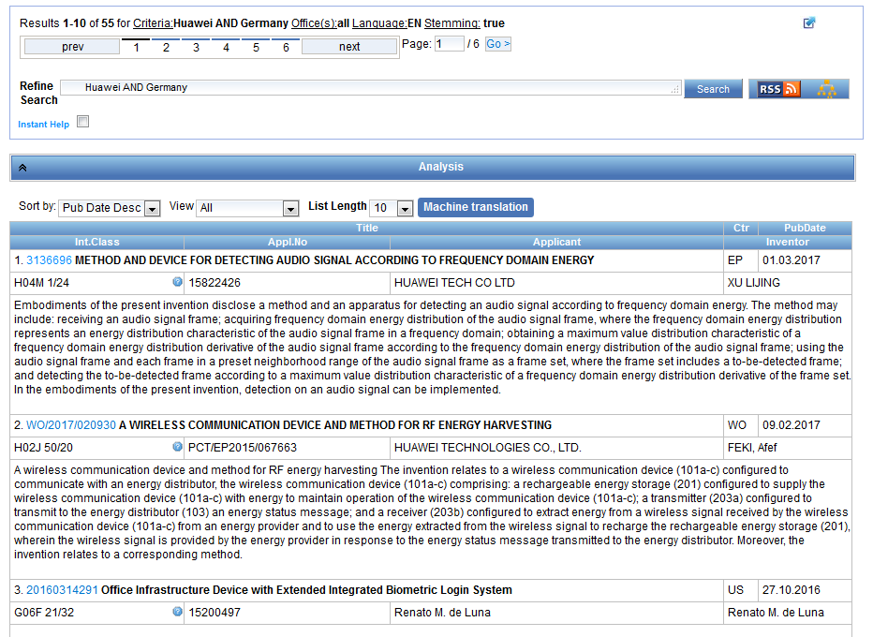
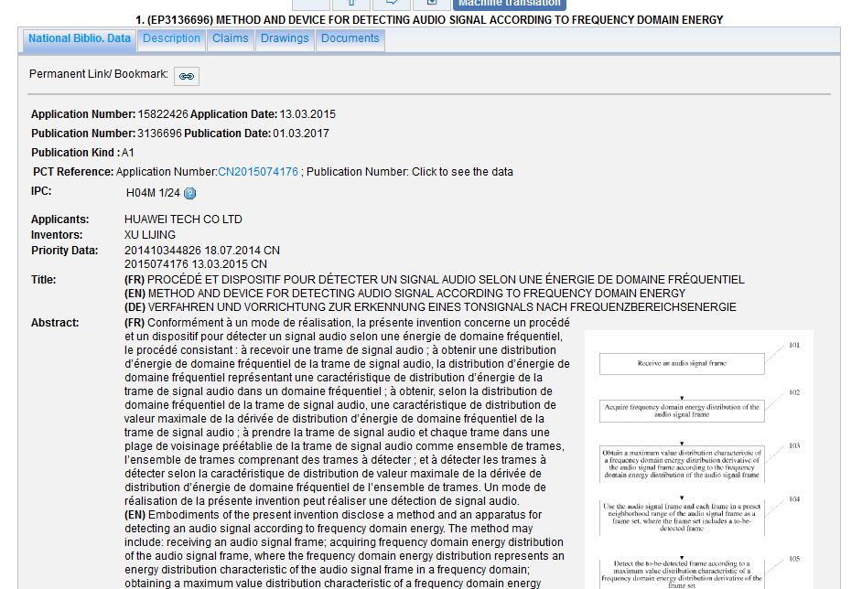

Slide 85
IN = Inventor Name
INA = Inventor all data

Slide 87
Next webinar: April 25 or 27
Result list and analysis tools
To register: https://attendee.gotowebinar.com/rt/3051306774409543428

Slide 88
Future/past webinars:
wipo.int/patentscope/en/webinar

Slide 89
Global Design Database: webinar
The Global Design Database: an introduction
April 4 at 5:30pm CET
https://attendee.gotowebinar.com/rt/2144154707191893761
April 6 at 8:30 am CET
https://attendee.gotowebinar.com/rt/2144154707191893761

Slide 90
Global Brand Database: webinar
The Global Brand Database: an introduction
May 2 at 5:30pm CET
https://attendee.gotowebinar.com/rt/1986878364931494145
May 4 at 8:30 am CET
https://attendee.gotowebinar.com/rt/1986878364931494145

Slide 91
patentscope@wipo.int

Slide 93
patentscope@wipo.int

