Slide 1
PATENTSCOPE
Translation tools
June
2016
Sandrine Ammann
Marketing & Communications Officer

Slide 2

To the PATENTSCOPE search system webinar
Translation tools

Slide 3
Agenda
Latest developments
Translation tools
Quiz
Big News!
Next webinar
Q&A session

Slide 4

Latest developements

Slide 5
New search fields
ISA: International Search Authority
ISR: International Search Report
IPE: International Preliminary Examination
SIS: Supplementary International Search

Slide 6
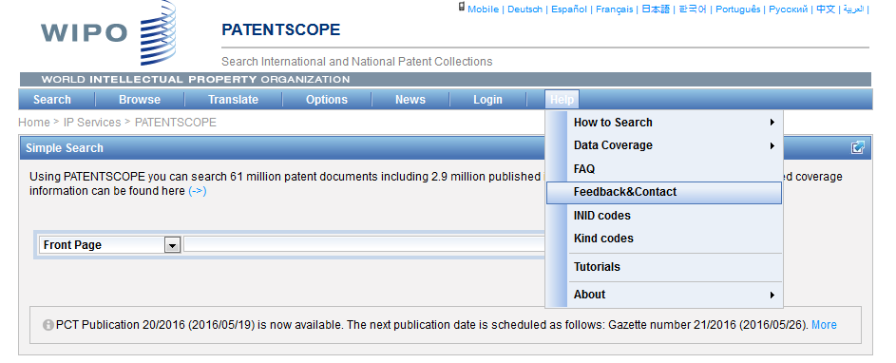
The Forum

Slide 7
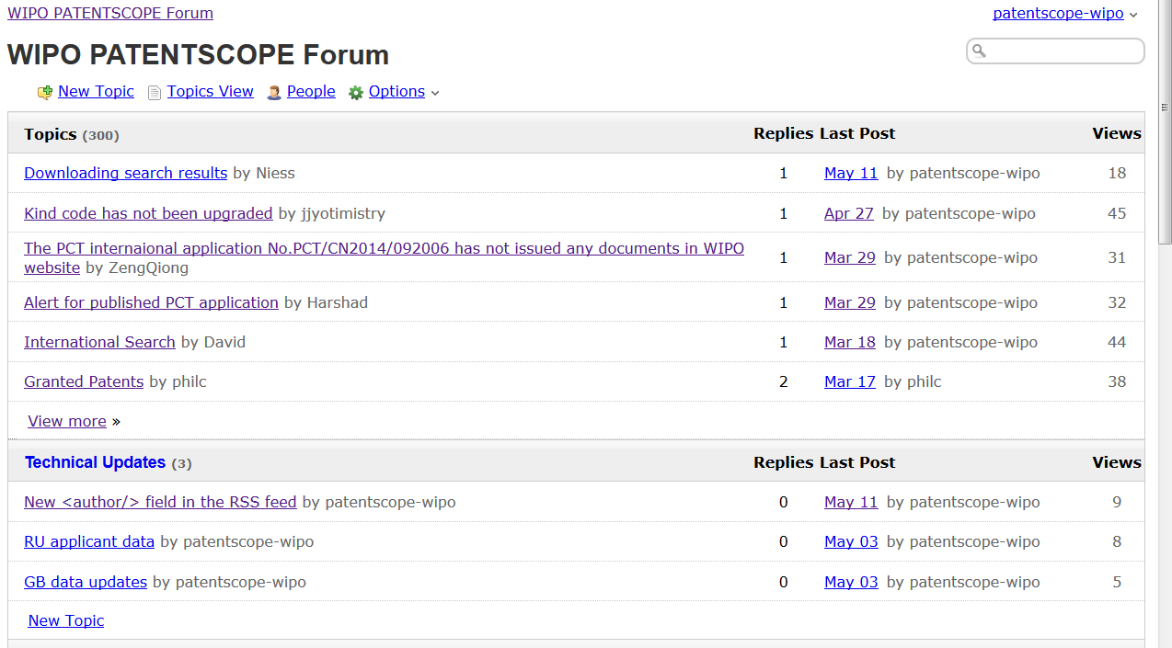

Slide 8
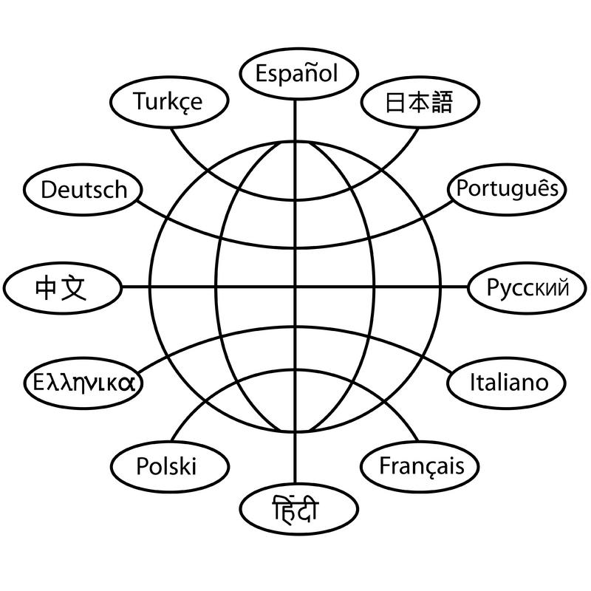
Translation tools

Slide 9
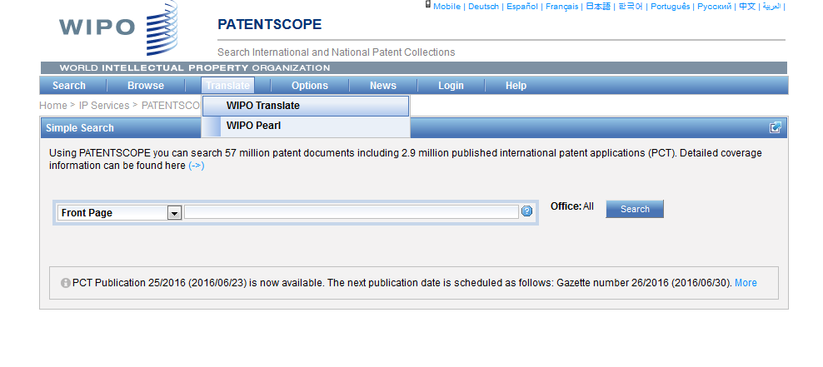
WIPO Translate

Slide 10
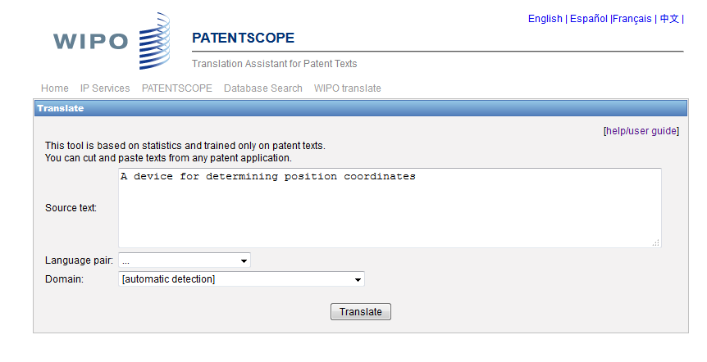
WIPO translate: interface

Slide 11

32 Technical domains from the IPC
[ADMN] Admin, Business, Management & Soc Sci
[AERO] Aeronautics & Aerospace Engineering
[AGRI] Agriculture, Fisheries & Forestry
[AUDV] Audio, Audiovisual, Image & Video Tech
[AUTO] Automotive & Road Vehicle Engineering
[BLDG] Civil Engineering & Building Construction
[CHEM] Chemical & Materials Technology
[DATA] Computer Sci, Telecom & Broadcasting
[ELEC] Electrical Engineering & Electronics
[ENGY] Energy, Fuels & Heat Transfer Eng
[ENVR] Environmental & Safety Engineering
[FOOD] Foods & Food Technology
[GENR] Generalities, Language, Media & Info Sci
[HOME] Home Contents & Household Maintenance
[HORO] Precision Mechanics, Jewelry & Horology
[MANU] Manufacturing & Materials Handling Tech
[MARI] Marine Engineering
[MEAS] Standards, Units, Metrology & Testing
[MECH] Mechanical Engineering
[MEDI] Medical Technology
[METL] Metallurgy
[MILI] Military Technology
[MINE] Mining, Oil & Gas Extraction & Minerals
[NANO] Nano Technology
[PACK] Packaging & Distribution of Goods
[PRNT] Printing & Paper
[RAIL] Railway Engineering
[SCIE] Optical Engineering
[SPRT] Sports, Leisure, Tourism & Hospitality
[TEXT] Textile & Clothing Industries
[TRAN] Transportation

Slide 12
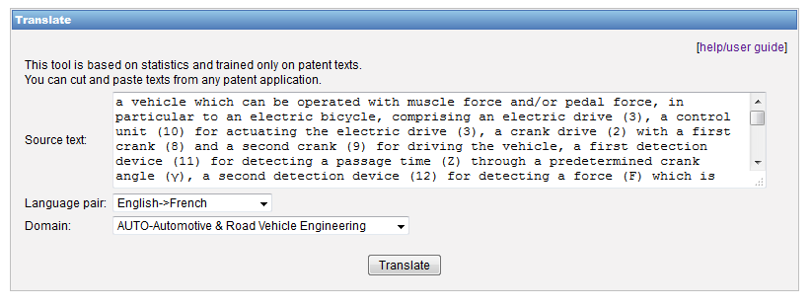
WIPO Translate: an example

Slide 13
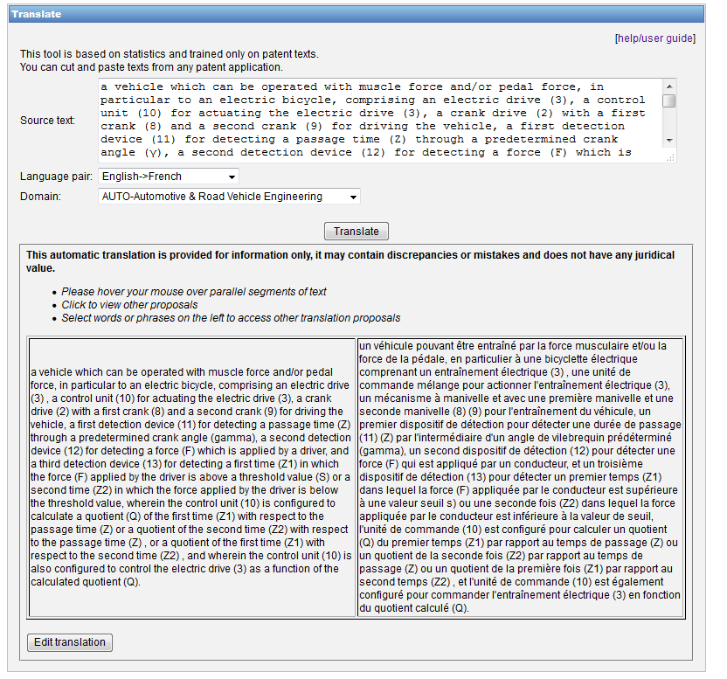

Slide 14
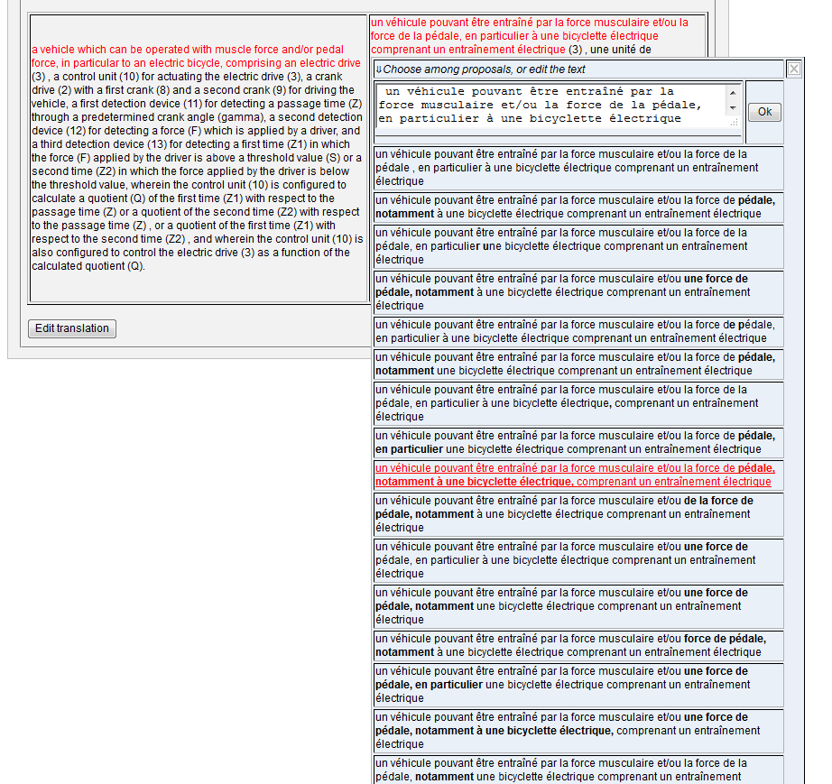

Slide 15
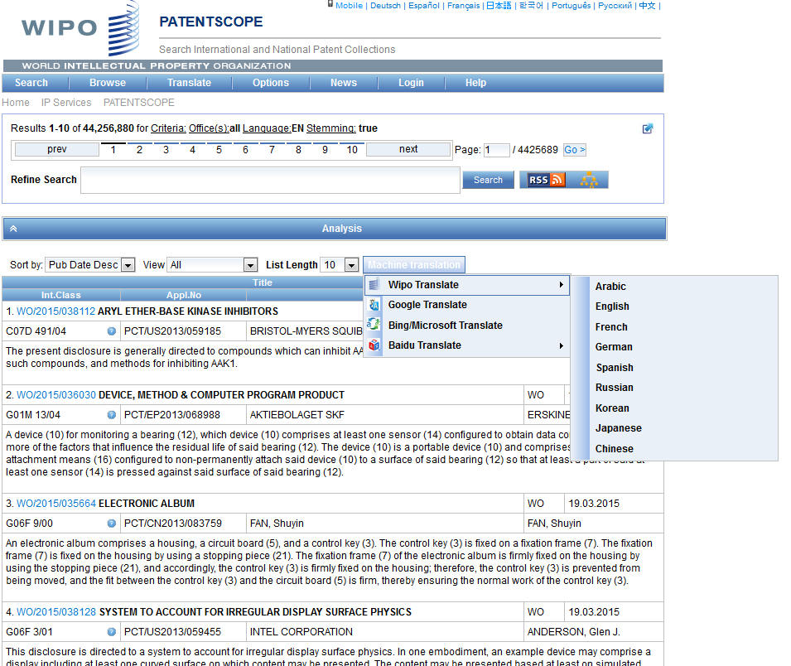
WIPO Translate: search result list

Slide 16
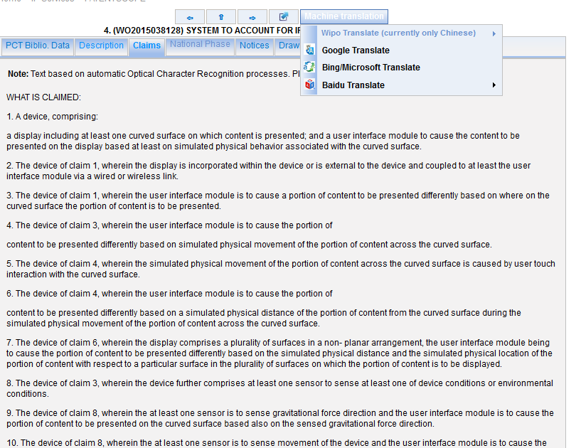
WIPO Translate: description/claims

Slide 17
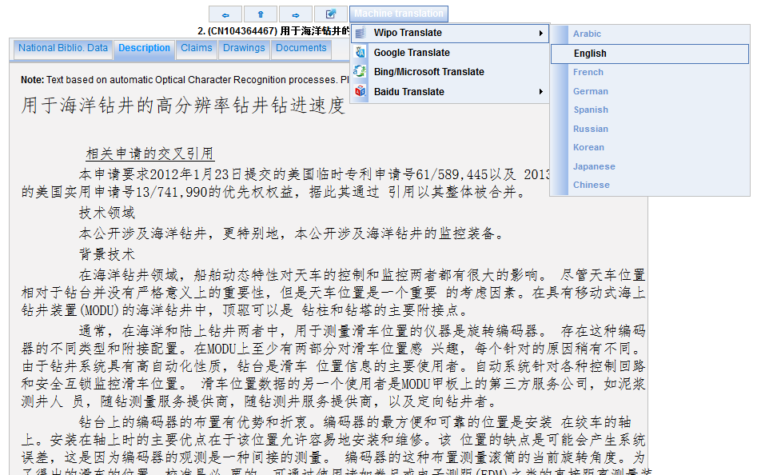

Slide 18
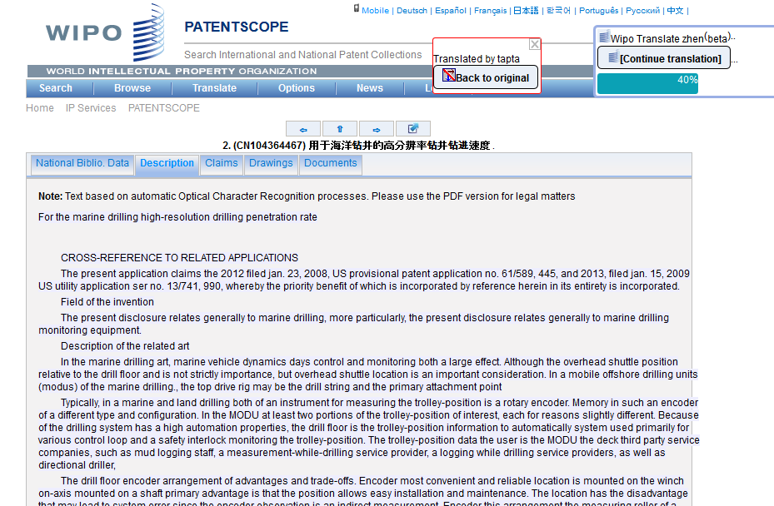

Slide 19
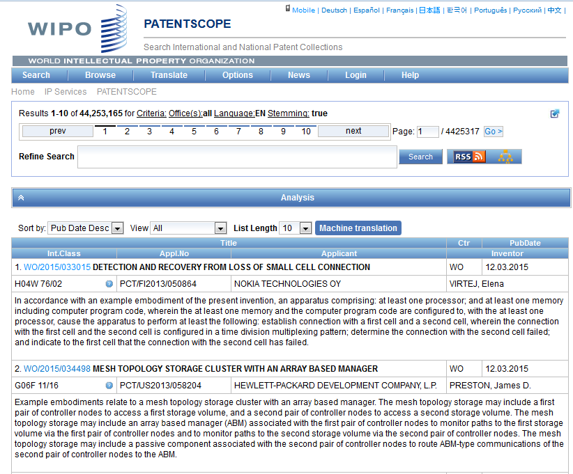

Slide 20
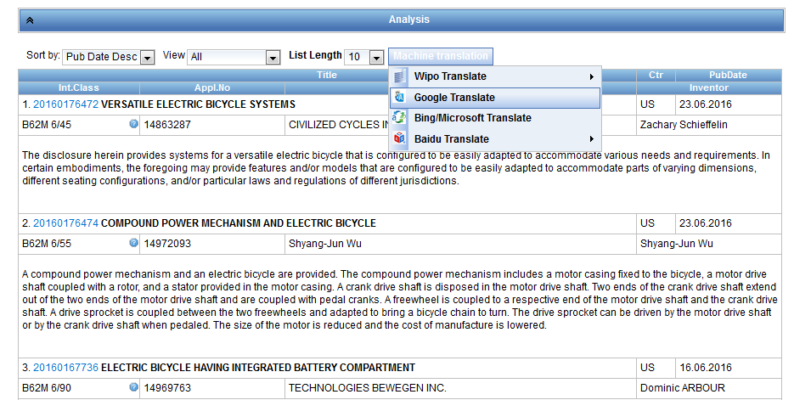
Other MT in result list

Slide 21
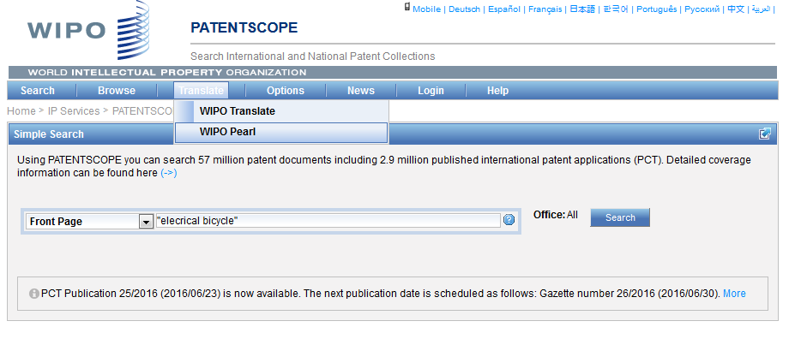
WIPO Pearl

Slide 22
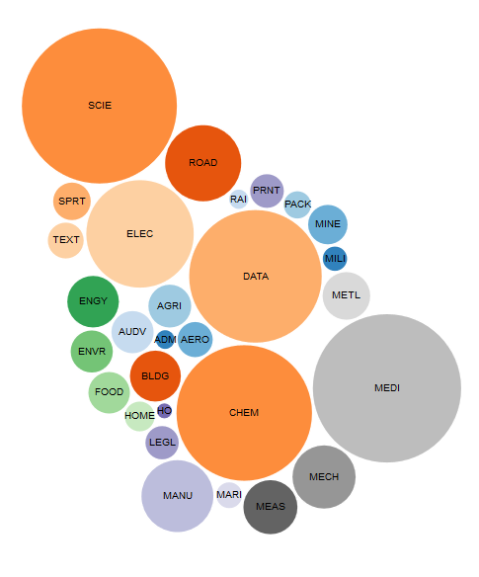
WIPO Pearl http://www.wipo.int/wipopearl/search/home.html

Slide 23

WIPO Pearl
WIPO’s online terminology database
17’000 concepts, 115’000 terms
10 languages
Contents validated by WIPO language experts and terminologists

Slide 24
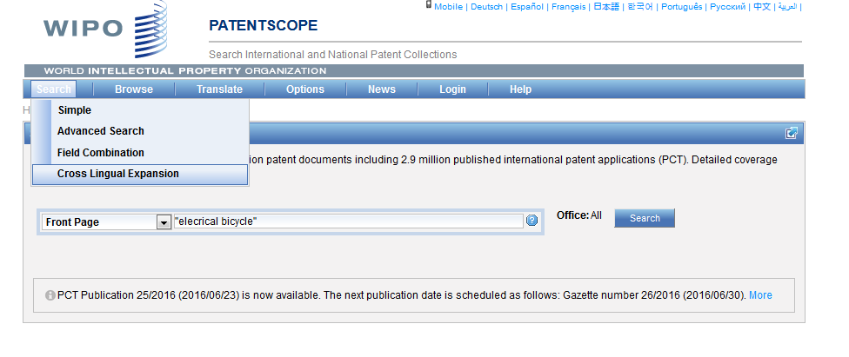
CLIR

Slide 25
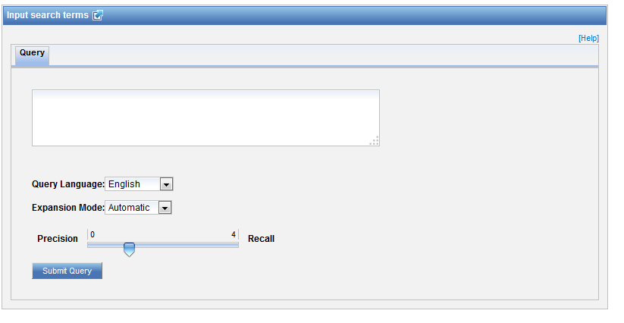
CLIR: interface

Slide 26
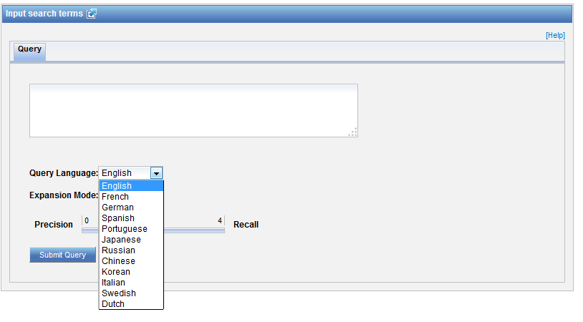
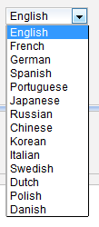
CLIR: query language

Slide 28
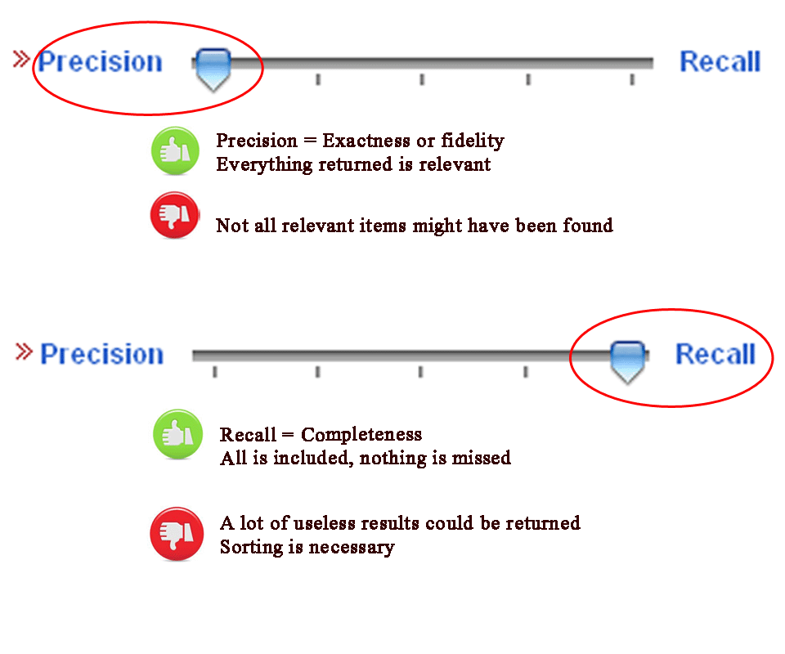
CLIR: precision vs recall

Slide 29
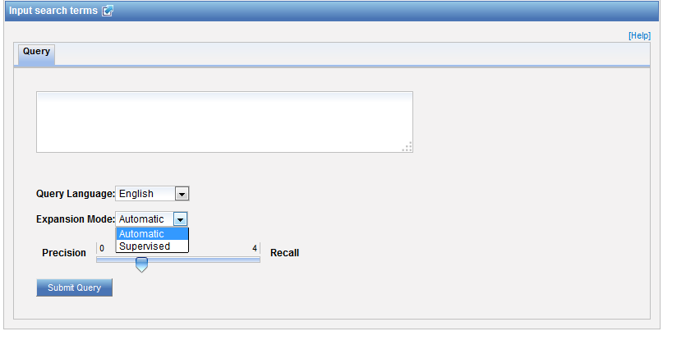
CLIR: expansion mode

Slide 30
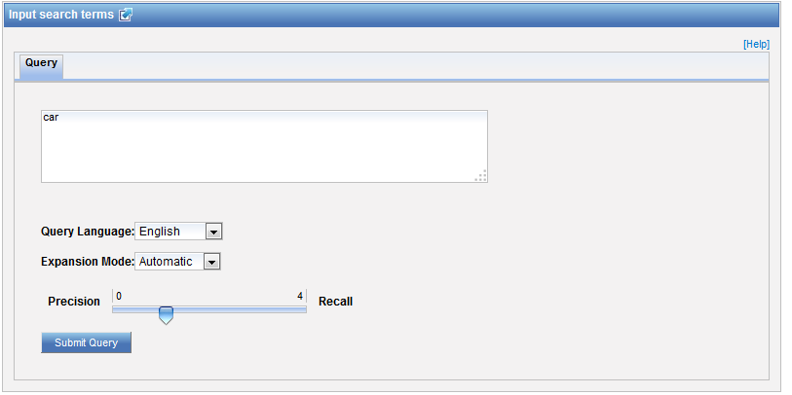
CLIR: an example

Slide 31
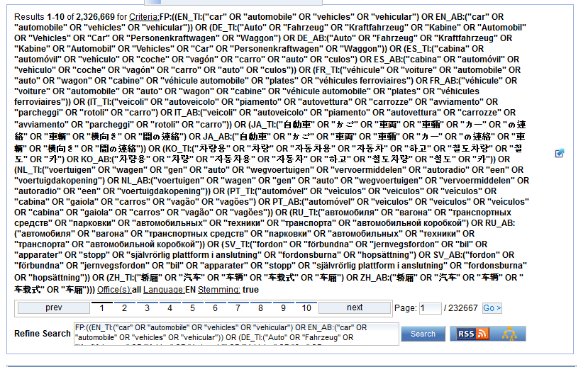
CLIR: an example

Slide 32
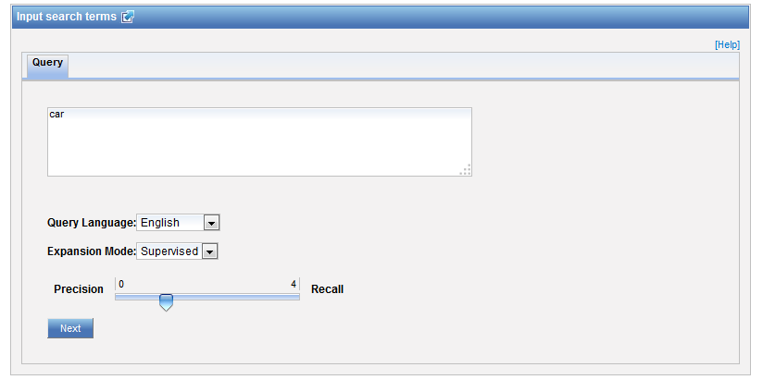
CLIR: supervised

Slide 33
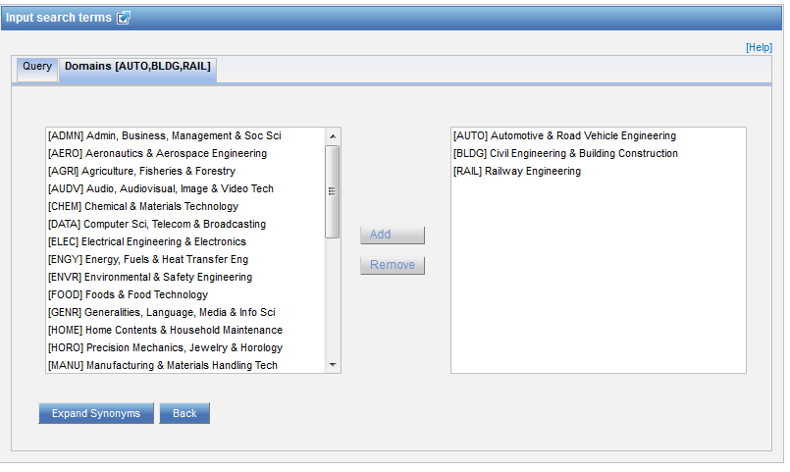
Domain selection

Slide 34
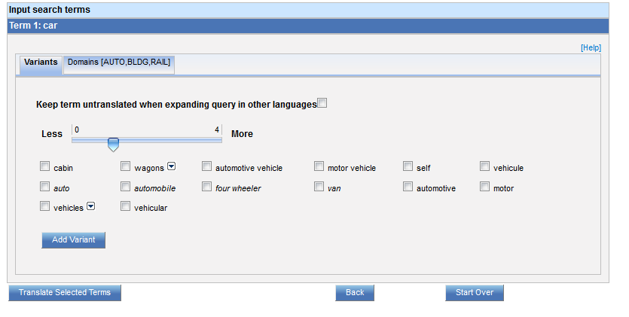
Variants selection

Slide 35
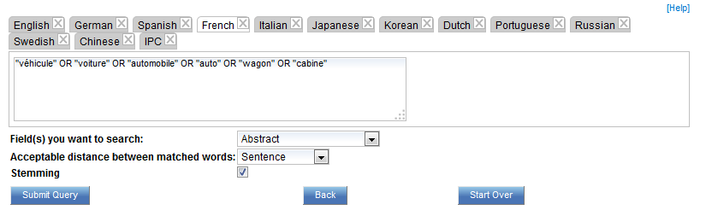
Summary of variants

Slide 36
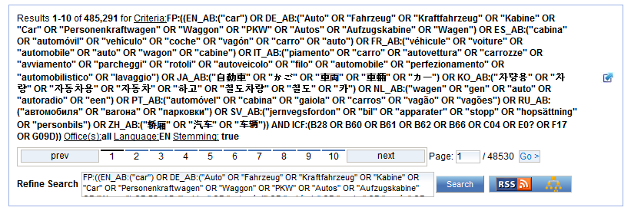
Results

Slide 37


Slide 38
Q:1 Which tool is available to find synonyms?
A
Baidu Translate
B
WIPO Translate
C
CLIR
D
Google Translate

Slide 39

Q:1 which tool is available to find synonyms?
A
Baidu Translate
B
WIPO Translate
C
CLIR
D
Google Translate

Slide 40
Q:2: Which translation tools are available in the result list?
A
Bing
B
WIPO translate
C
Baidu
D
Google

Slide 41
Q:2: which translation tools are available in the result list?
A
Bing
B
WIPO translate
C
Baidu
D
Google
Spain

Slide 42
Q:3: What feature will be available soon?
A
Family-based searches
B
Chemical structure search

Slide 43


Slide 44
Chemical Search function
Target production date: July 2016
Step 1: chemical compounds in PCT applications published in English or German;
Next steps: other languages and national patent collections

Slide 45
July webinar: Browse menu
Tue, July 19
5:30 PM - 6:30 PM CEST
Thu, July 21
8:30 AM - 9:30 AM CEST
To sign up: http://www.wipo.int/patentscope/en/webinar/

Slide 46
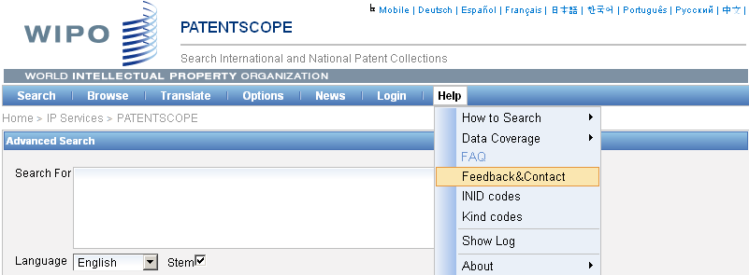

patentscope@wipo.int

Slide 47

mulțumesc
mulțumesc

