Slide 1
Overview of PATENTSCOPE
Internet
January
2016
Sandrine Ammann
Marketing & Communications Officer

Slide 2


To the PATENTSCOPE search system webinar
Overview

Slide 3
Questions/concerns
patentscope@wipo.int

Slide 4
Agenda
PATENTSCOPE:
  What is it?
  What you can do?
  How to do it?
  Options
  Q & A session

Slide 5
Q1: How often do you PATENTSCOPE?
A
A few times a year
B
Every month
C
Every week
D
Every day

Slide 6

What is it?

Slide 7
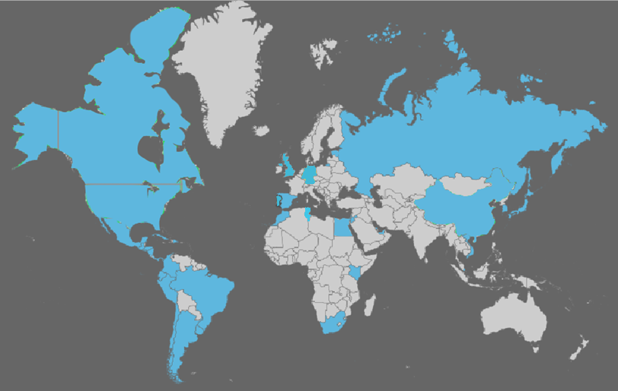
Coverage: what is included?
PCT published applications
National/regional patent collections

Slide 8
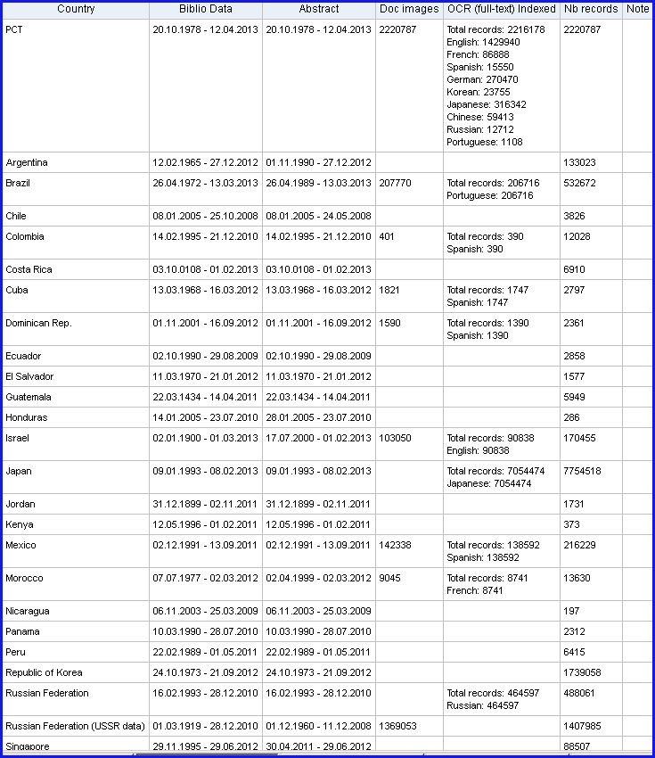
Coverage : Details of collections

Slide 9
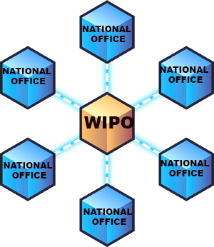
National/regional collections

Slide 10
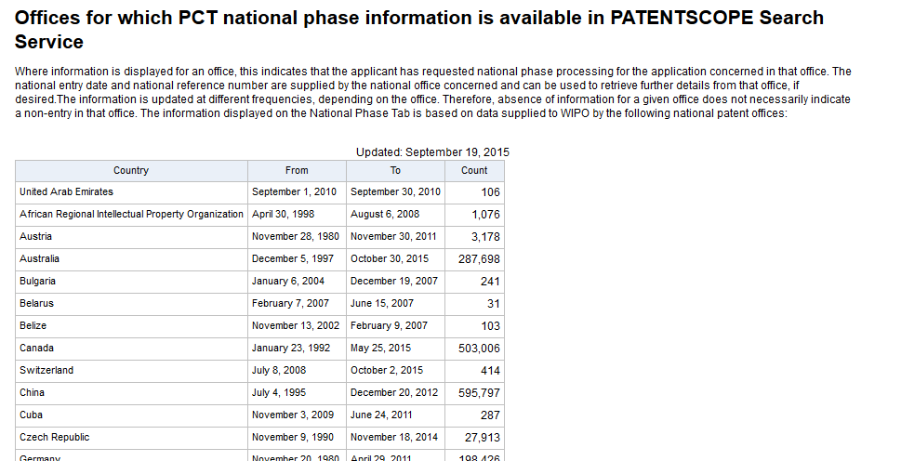
National/regional collections vs national phase
https://patentscope.wipo.int/search/en/nationalphase.jsf

Slide 11
Q2:Were you aware of this difference?
A
Yes
B
NO

Slide 12

What can you do?

Slide 13

PATENTSCOPE
Search
Browse
Translate

Slide 14
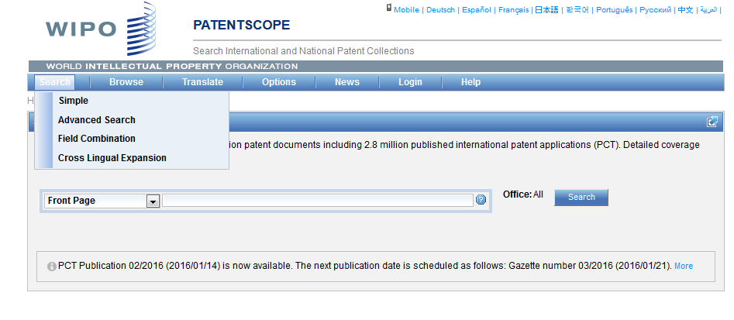
Search

Slide 15
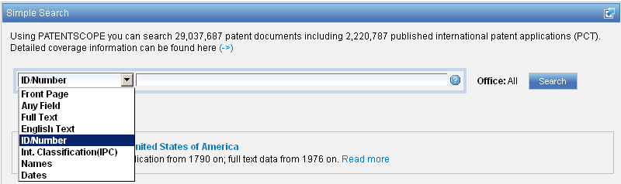
Interface : Simple
Basic search fields are provided

Slide 16
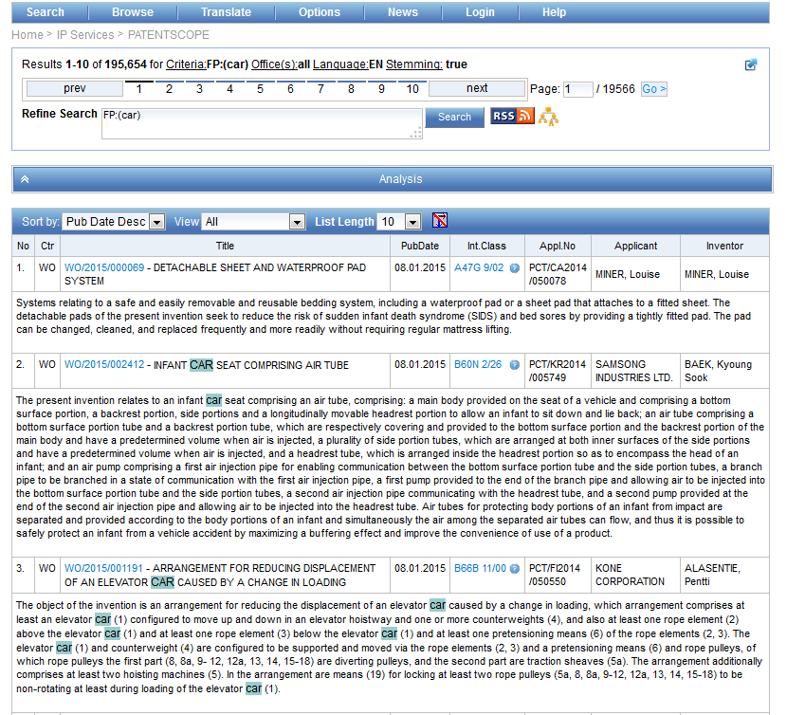
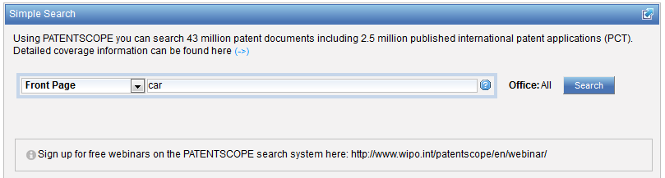
Interface simple - keywords

Slide 17
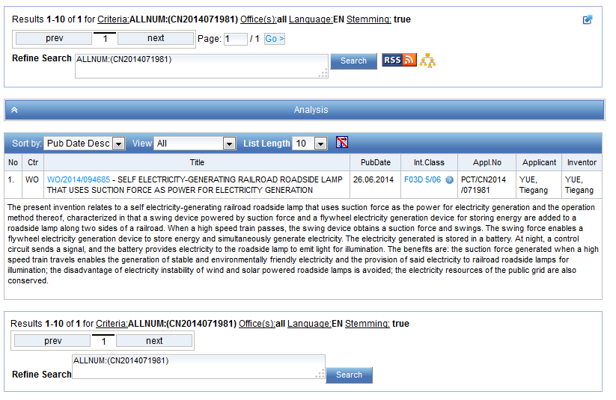
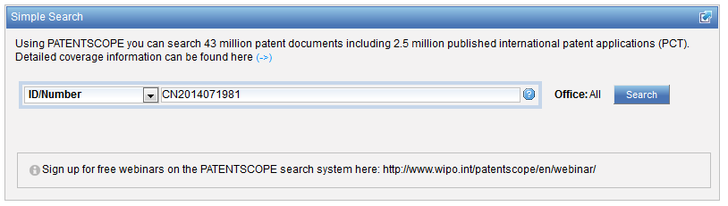
Simple interface - Numbers

Slide 18
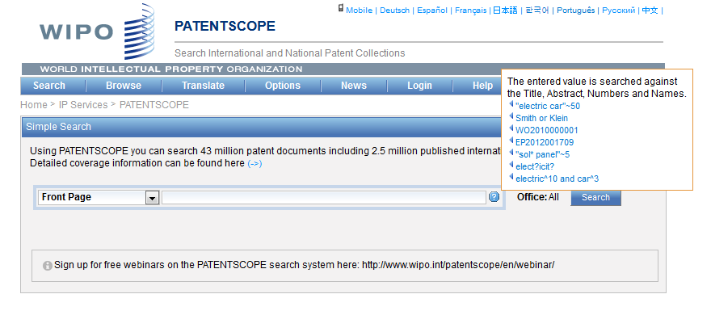
Simple interface - Help

Slide 19
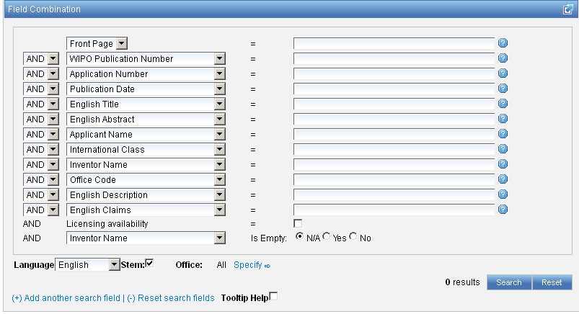
Interface : Field Combination - Structured
Additional search fields can be selected

Slide 20
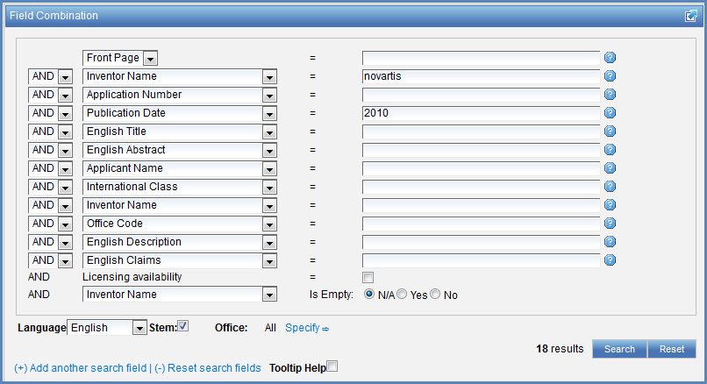

Search examples
Patent documents containing Novartis as inventor and published in 2010
Patent documents without an IPC code
Notes:
20
3. there is also the option to select a field that is empty: for example you could search. On the last line, select the IPC in the drop-down box and tick yes next to empty.

Slide 21
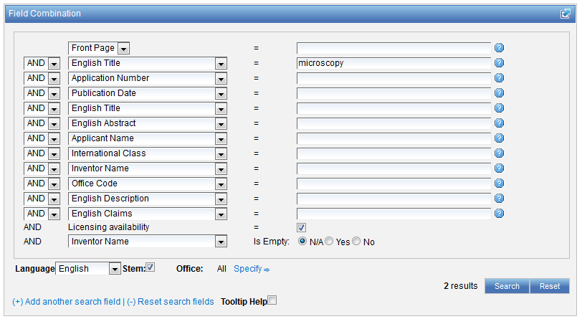
Search examples
Patent documents containing microscopy with licensing availability.
Notes:
21
In the drop-down box, select the field Applicant name and enter Steve Jobs; select AND and the field Publication date and enter 2007
In the drop-down boy, select English description and enter microchip, then tick the Licensing availability box (one before last in the Field Combination interface).

Slide 22
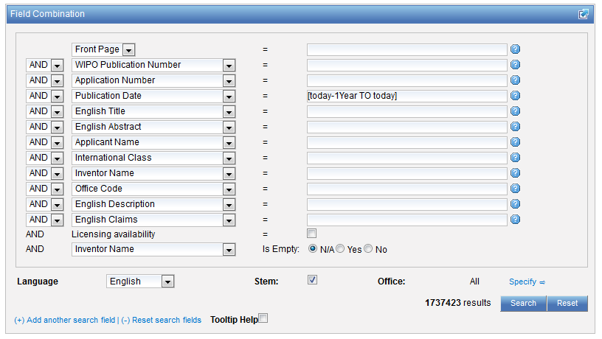

Slide 23
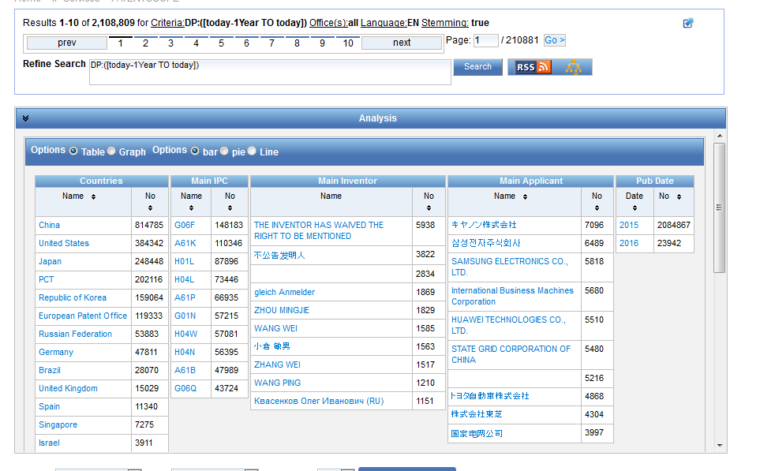

Slide 24
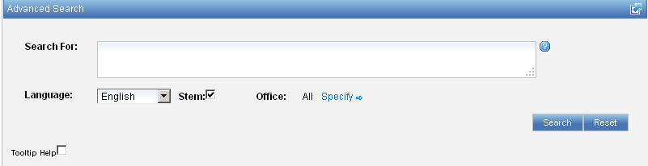
Interface : Advanced
Full flexibilities are enabled

Slide 25
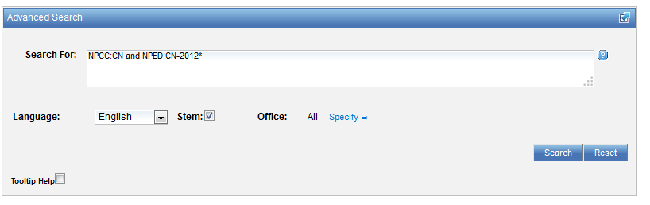
Example: national phase entry
All applications that entered national phase in China in 2012

Slide 26
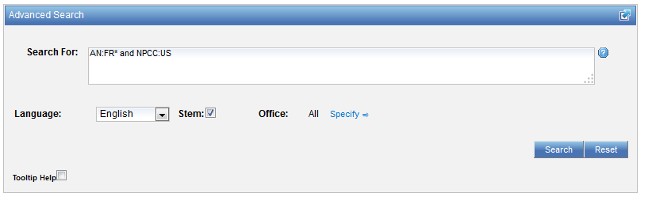
Example: nb of patent applications from France seeking protection in USA

Slide 27
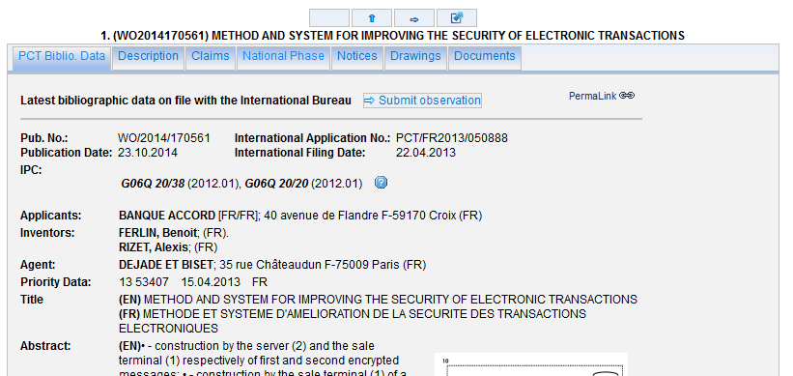
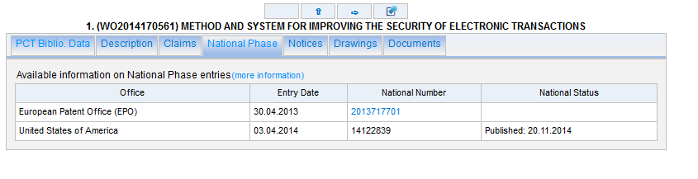

Slide 28
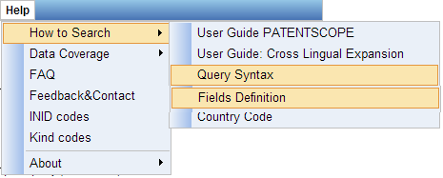
Help menu

Slide 29
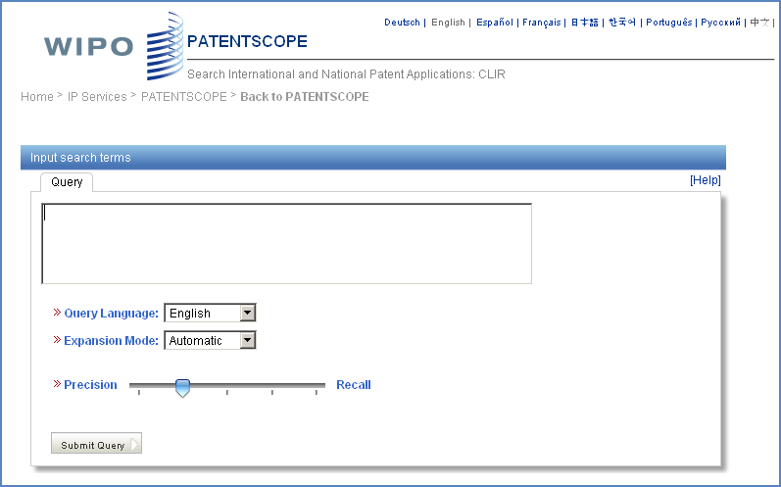
CLIR: the interface
Notes:
29
There is query box
Query language
Expansion mode

Slide 30
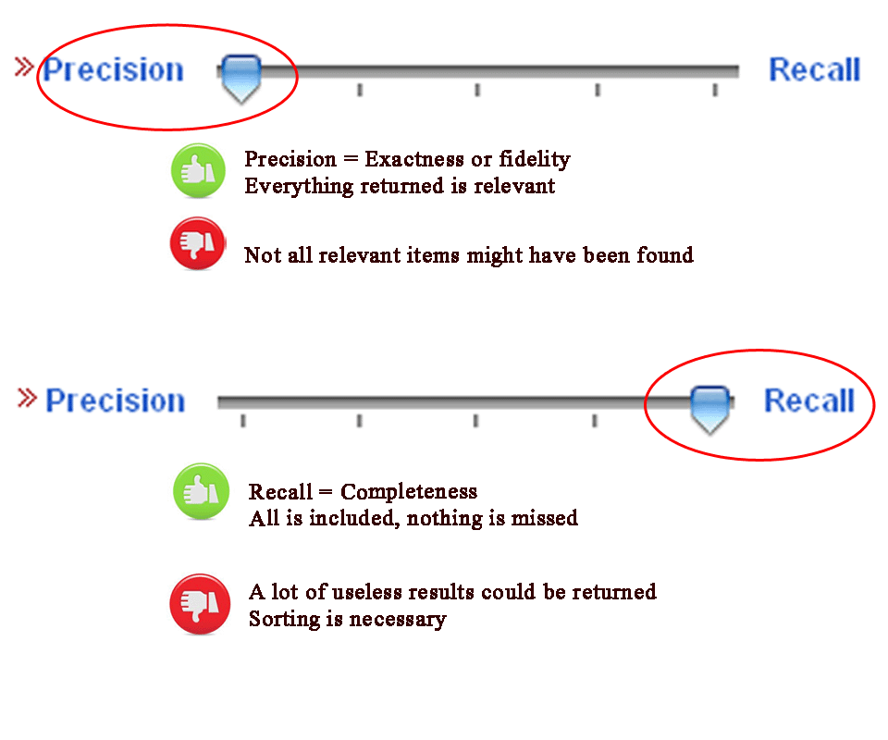
CLIR: precision vs recall

Slide 31
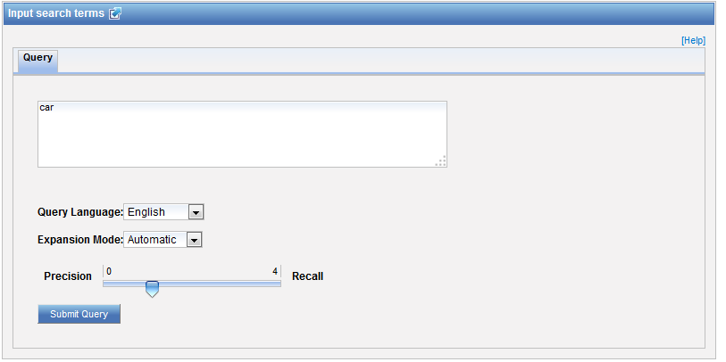
CLIR: an example in automatic mode

Slide 32
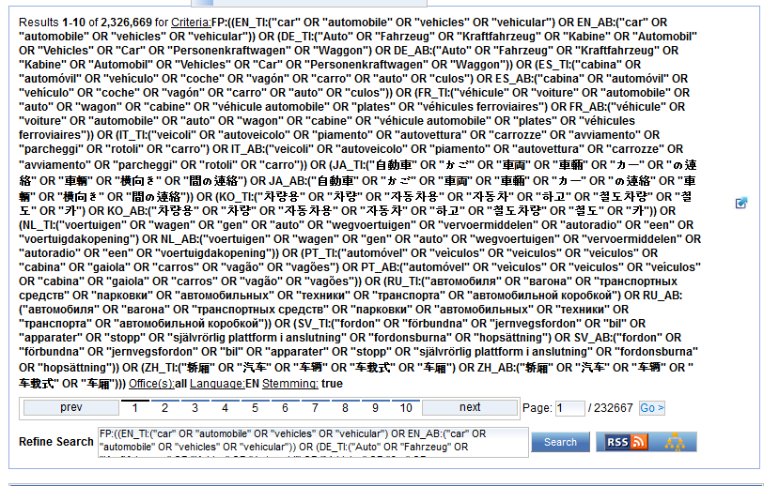
CLIR: an example

Slide 33
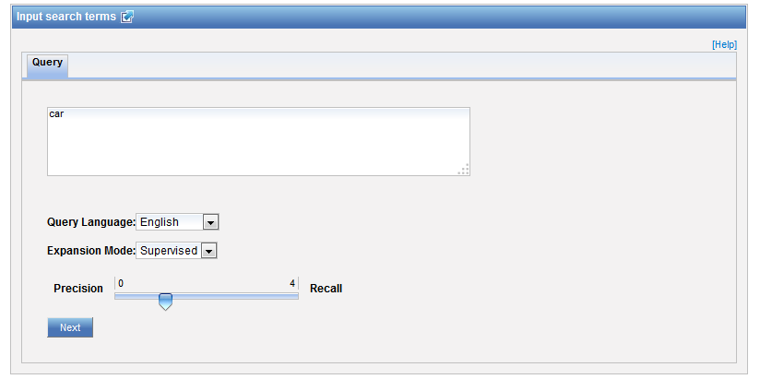
CLIR: an example in supervised mode

Slide 34
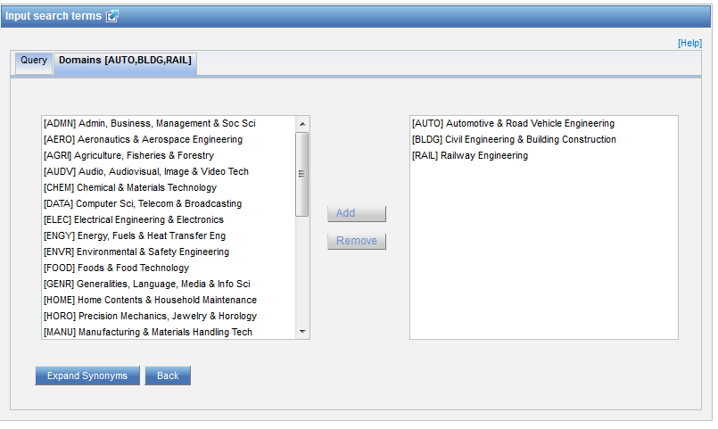
Domain selection

Slide 35
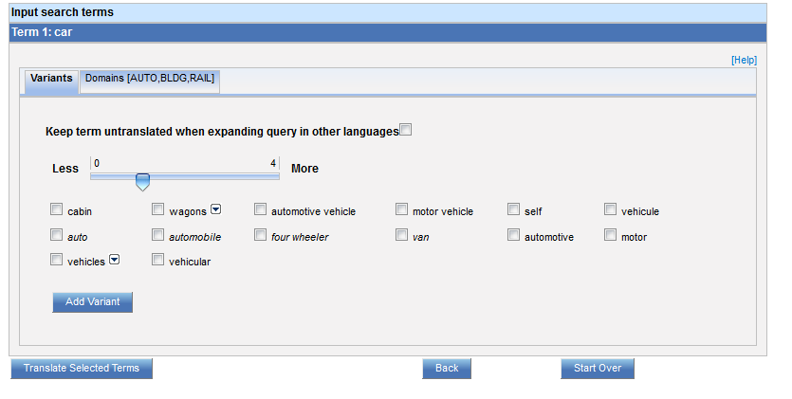
Variants selection

Slide 36
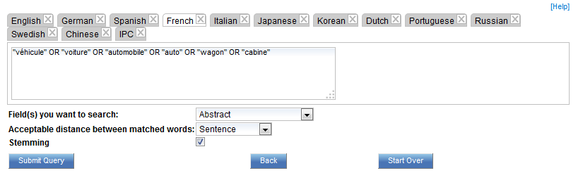
Summary of variants

Slide 37
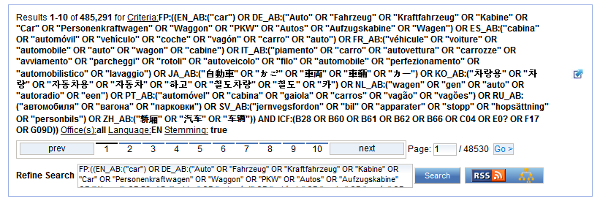
Results

Slide 38
Q3: Had you used CLIR before?
A
Yes
B
No and will not use it in the future
C
No but I will used in the future

Slide 39
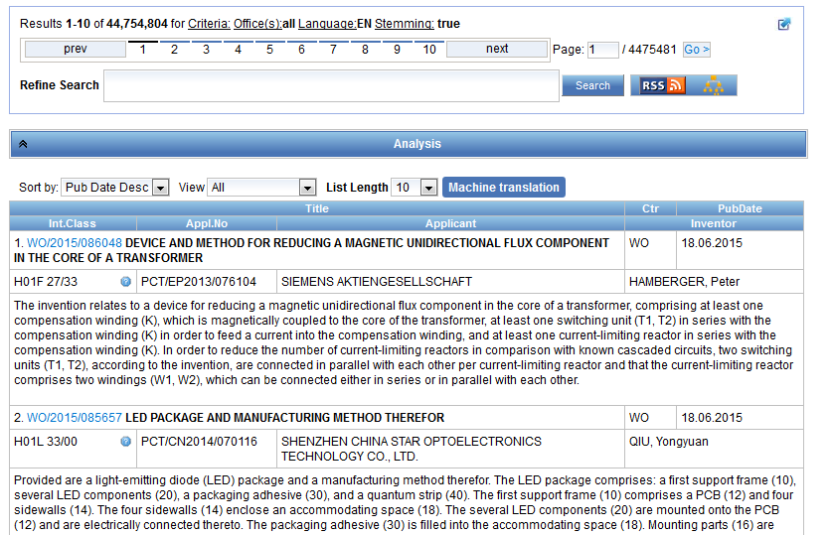
Reading the result list

Slide 40
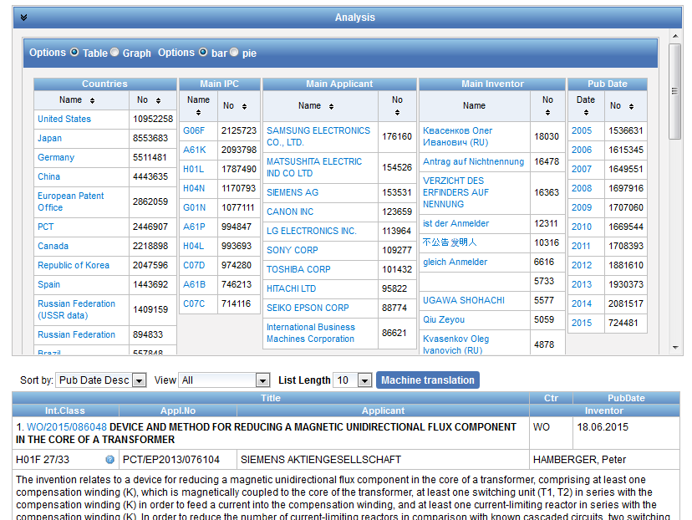
Analysis

Slide 41
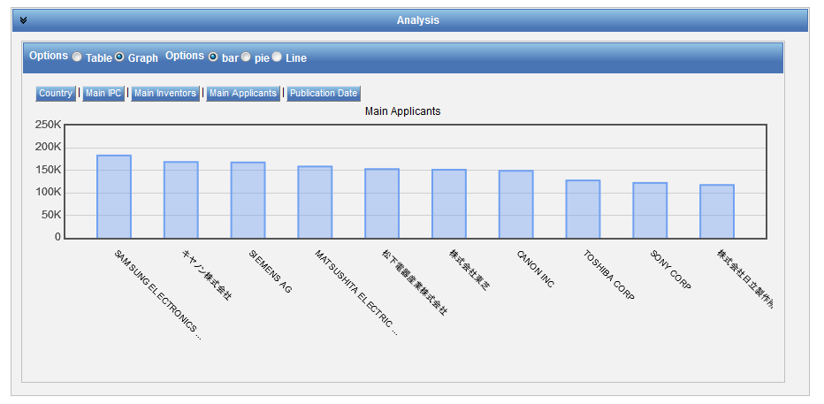
Display options: table/graph –bar/pie

Slide 42
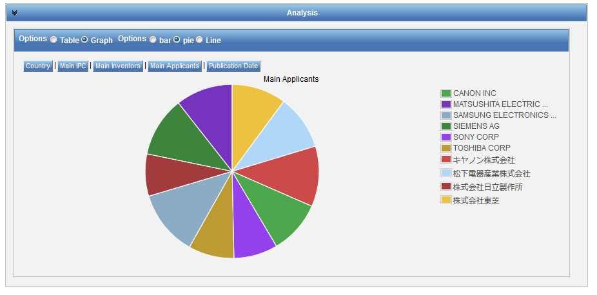
Display options: table/graph –bar/pie
Notes:
42
In both bar and pie options, the tabs allow you to see the information graphically for the Offices, Main IPC, Main Applicant, Main Inventor and Publication Date.
The charts can be saved in GIF format for inclusion in documents or reports by right-clicking in a corner of the image and selecting “Copy image” or “Save image”.

Slide 43
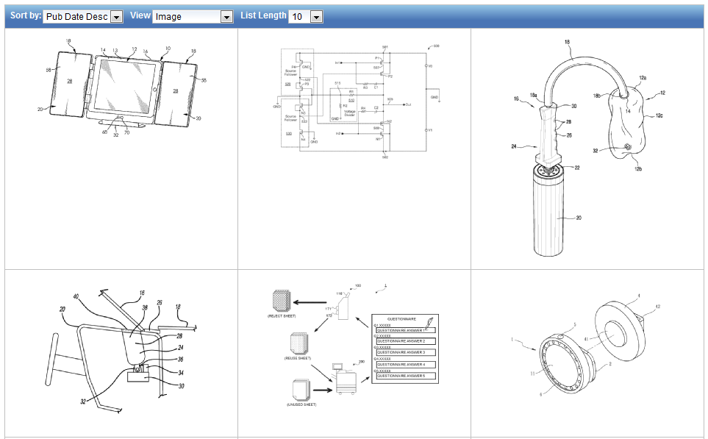
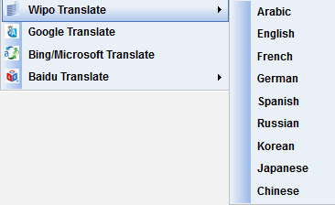
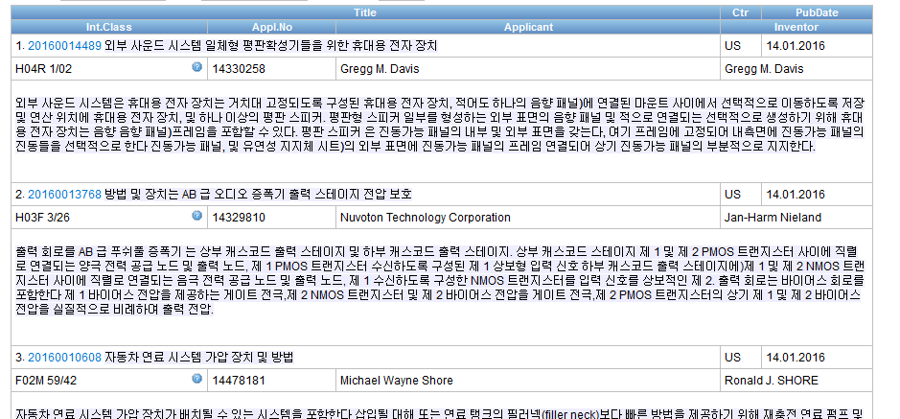
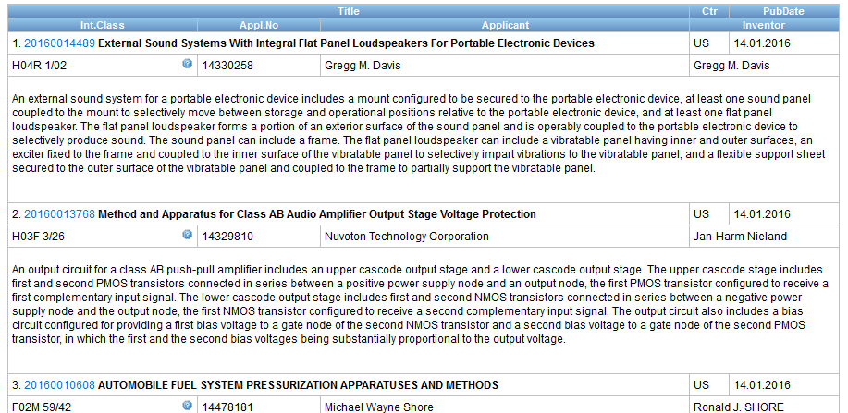



Options

Slide 44
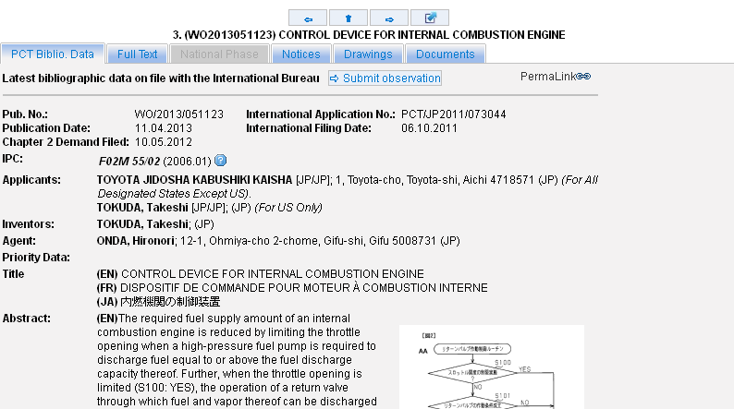
Tabs

Slide 45
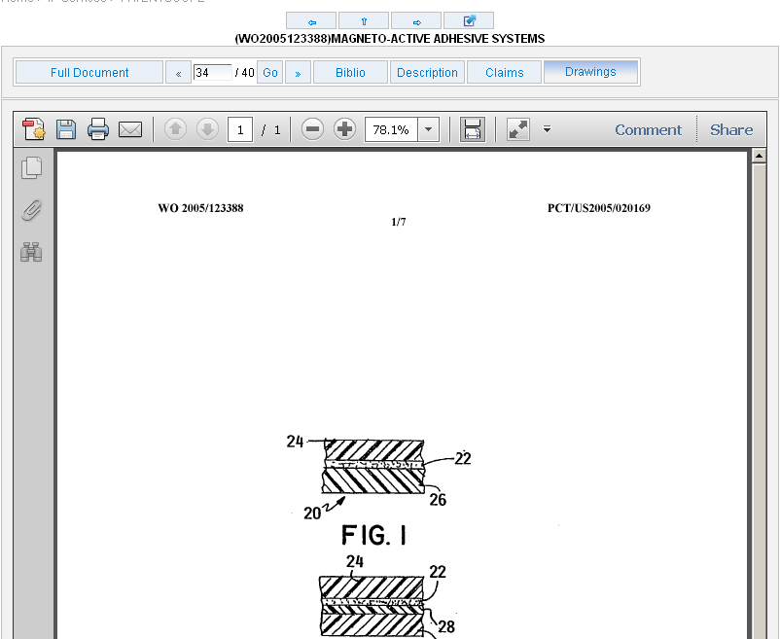
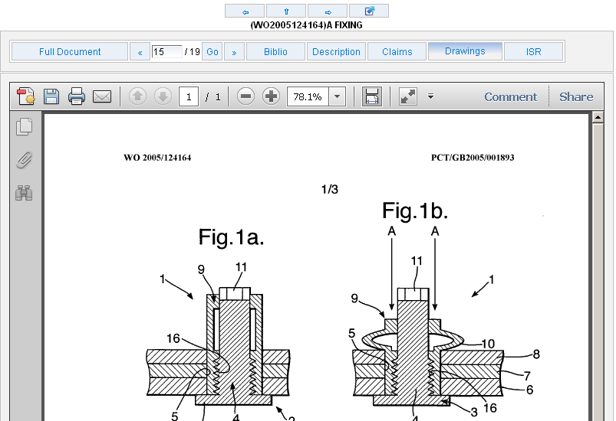
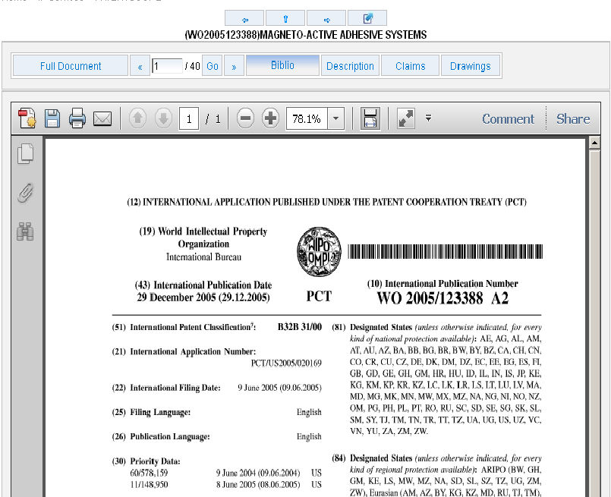
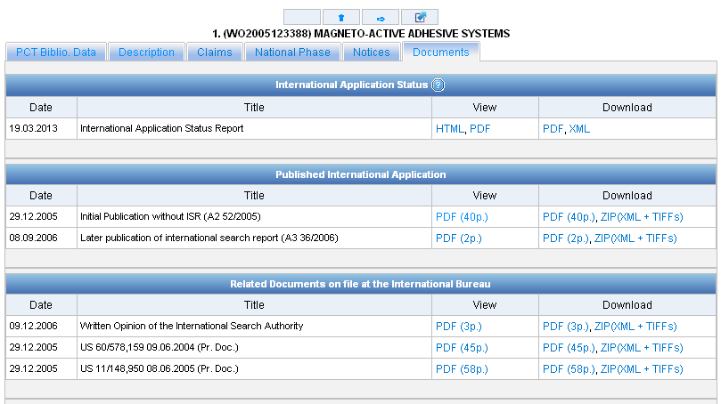
Documents tab

Slide 46
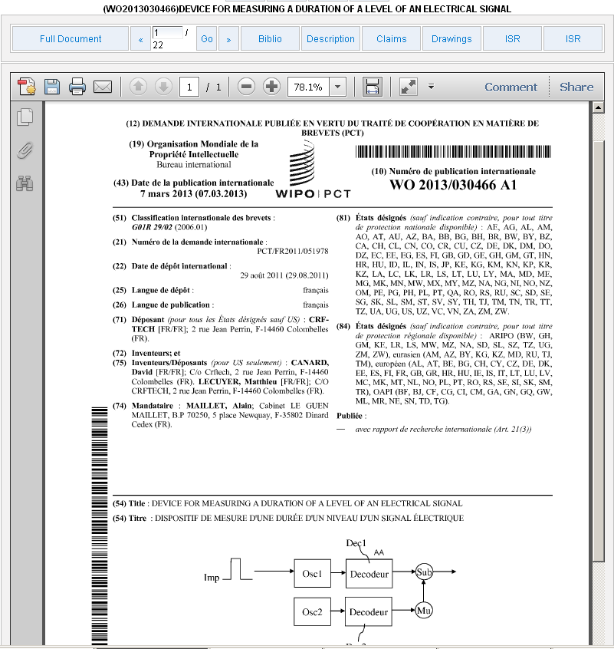
PDFs

Slide 47
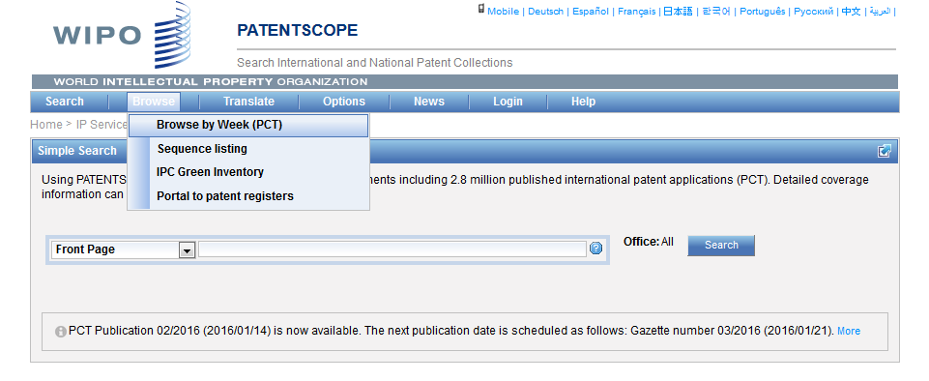
Browse

Slide 48
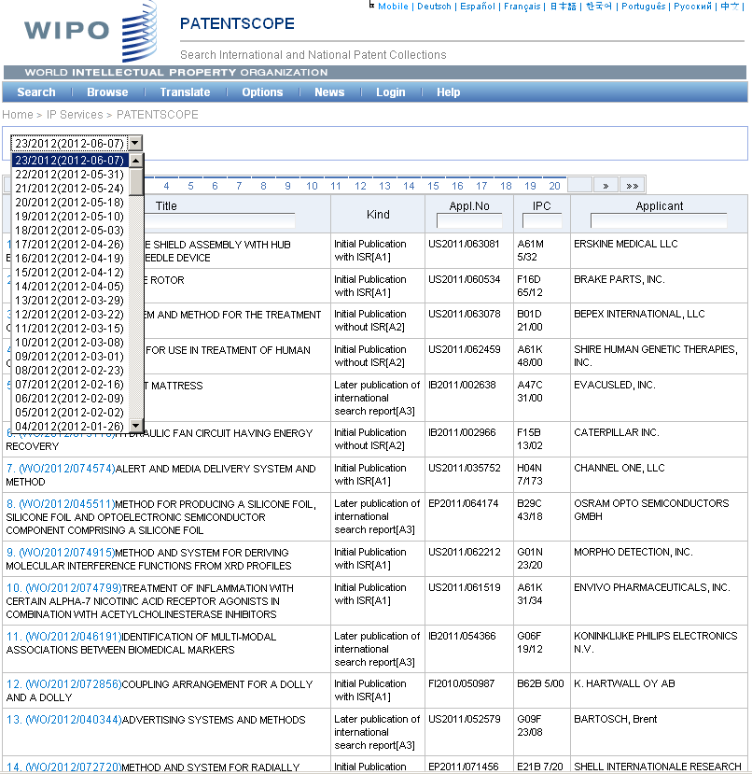

Slide 49
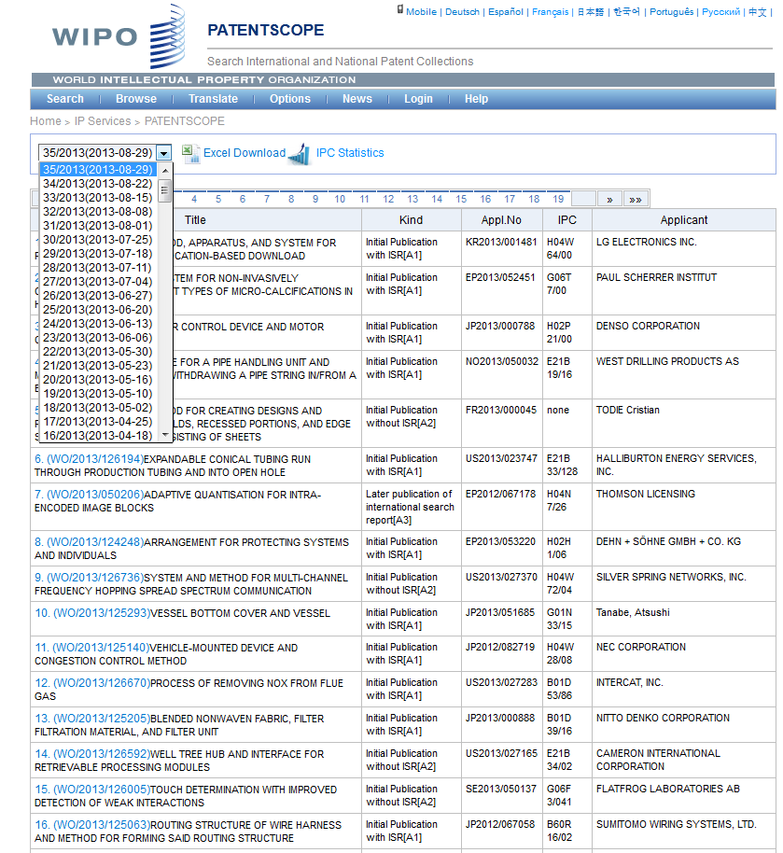

Slide 50
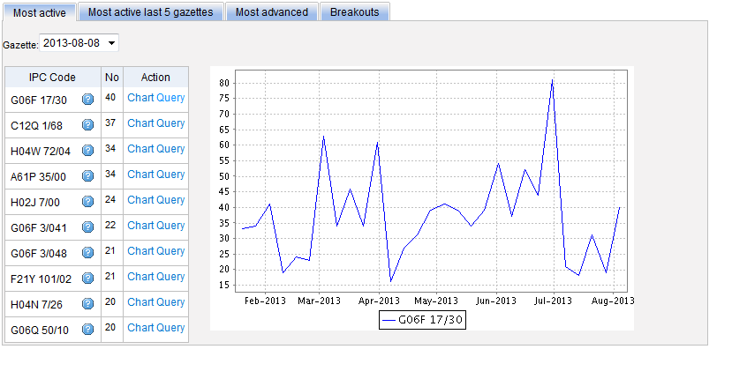
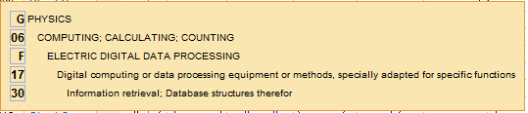
Most active

Slide 51


Slide 52

Most active last 5 gazettes

Slide 53

Most advanced

Slide 54

Breakouts

Slide 55


Slide 56

IPC Green Inventory

Slide 57

Patent Register Portal

Slide 58

Translate
Notes:
58
Language pairs available: EN=>FR, FR=>EN, EN=>ZH, ZH=>EN
Technical domain aware system using 32 domains derived from the International Patent Classification

Slide 59

32 Technical domains from the IPC
[ADMN] Admin, Business, Management & Soc Sci
[AERO] Aeronautics & Aerospace Engineering
[AGRI] Agriculture, Fisheries & Forestry
[AUDV] Audio, Audiovisual, Image & Video Tech
[AUTO] Automotive & Road Vehicle Engineering
[BLDG] Civil Engineering & Building Construction
[CHEM] Chemical & Materials Technology
[DATA] Computer Sci, Telecom & Broadcasting
[ELEC] Electrical Engineering & Electronics
[ENGY] Energy, Fuels & Heat Transfer Eng
[ENVR] Environmental & Safety Engineering
[FOOD] Foods & Food Technology
[GENR] Generalities, Language, Media & Info Sci
[HOME] Home Contents & Household Maintenance
[HORO] Precision Mechanics, Jewelry & Horology
[MANU] Manufacturing & Materials Handling Tech
[MARI] Marine Engineering
[MEAS] Standards, Units, Metrology & Testing
[MECH] Mechanical Engineering
[MEDI] Medical Technology
[METL] Metallurgy
[MILI] Military Technology
[MINE] Mining, Oil & Gas Extraction & Minerals
[NANO] Nano Technology
[PACK] Packaging & Distribution of Goods
[PRNT] Printing & Paper
[RAIL] Railway Engineering
[SCIE] Optical Engineering
[SPRT] Sports, Leisure, Tourism & Hospitality
[TEXT] Textile & Clothing Industries
[TRAN] Transportation

Slide 60

WIPO Translate: how does it work?

Slide 61


Slide 62


Slide 63


Slide 64


Slide 65

Languages of the interface

Slide 66

Interface in Chinese

Slide 67

PATENTSCOPE account

Slide 68

Signing up

Slide 69

Once logged-in

Slide 70

Saved queries

Slide 71

Downloading the results

Slide 72

Downloaded results

Slide 73

Account customization

Slide 74

Https protocol

Slide 75
Conclusion
The most complete and up to date place to search for PCT publications including their related documents
Searchable descriptions and claims
Facilitated patent search in languages not familiar to the user
Powerful Search Operators
Data Analytic Tools

Slide 76


Slide 77

Slides
www.wipo.int/patentscope/en/webinar/index.html

Slide 78


patentscope@wipo.int

Slide 79

Future/past webinars:
wipo.int/patentscope/en/webinar

Slide 80

mulțumesc
mulțumesc

