Slide 1
PATENTSCOPE search system:
Advanced search
Cyberspace
February
2014
Sandrine Ammann
Marketing & Communications Officer

Slide 2


To the PATENTSCOPE search system webinar
Advanced search

Slide 3
Agenda
Future developments & news
Advanced search interface
  Why use it?
  “Cosmectic” features
  Search features
Q & A

Slide 4
Future developments & news
Migration to last version of jsf and lucene
New functionality that allows to break down composed German words
New national collections: Germany and UK
PATENTSCOPE training in Geneva June 3 to 5, 2014
New field codes are being under investigation

Slide 5
Why use the Advanced interface?
Long list of irrelevant results
Conduct very targeted and very complex queries

Slide 6
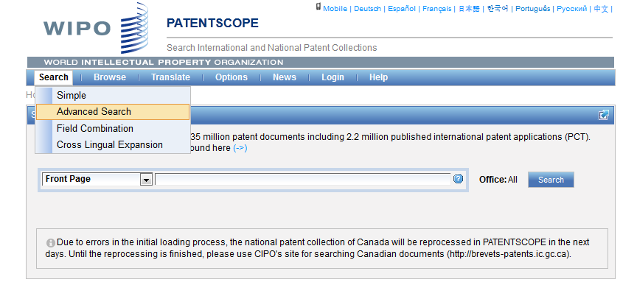
Advanced search interface

Slide 7
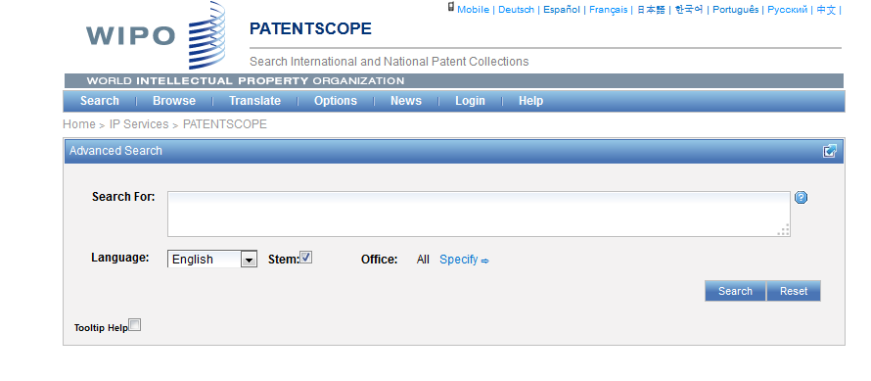
Advanced search interface

Slide 8
Stem
Stem = stemming
Process that removes common endings from words.
critical
critically
criticism each word is reduced to ‘critic’
criticisms
critics

Slide 9
Stemming
no dictionary includes the necessary technical terms to express patent concepts
Porter Stemming Algorithm finds words that contain common roots
Save time and effort

Slide 10
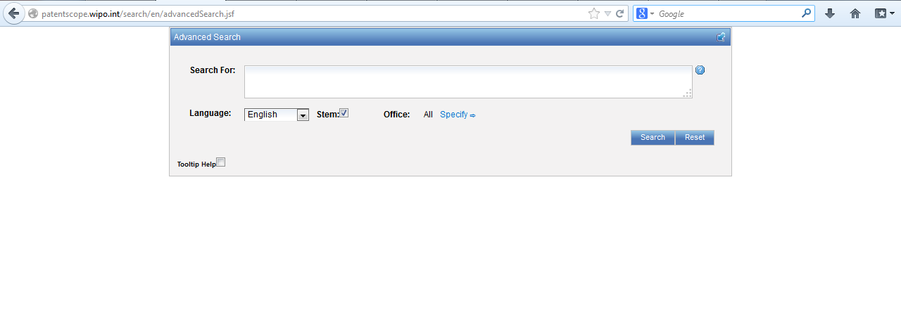
Advanced search interface

Slide 11
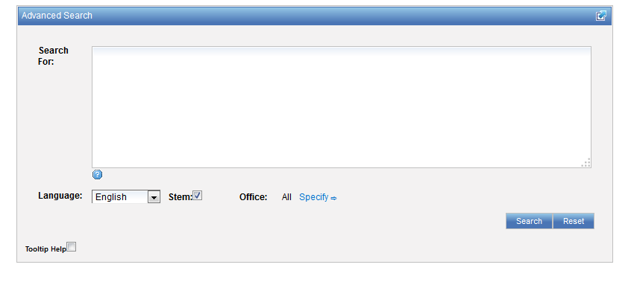
Advanced search interface

Slide 12
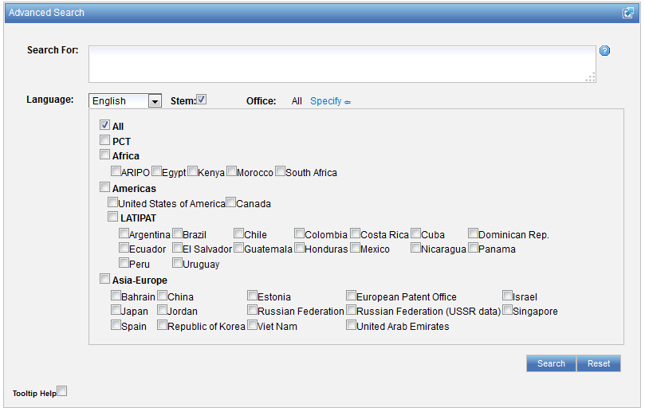
Advanced search interface

Slide 13

Help

Slide 14
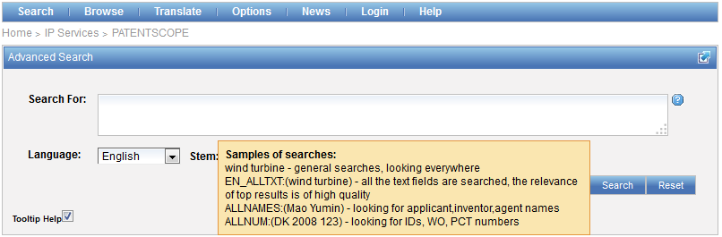
Tooltip help

Slide 15
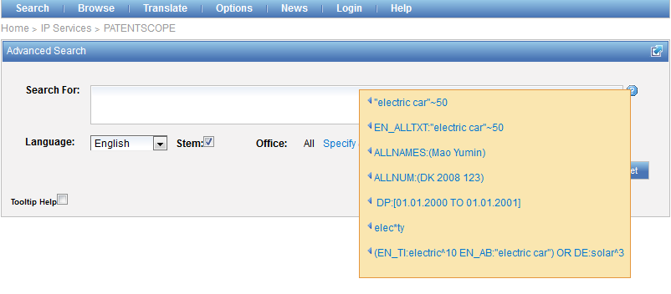
Question mark help

Slide 16
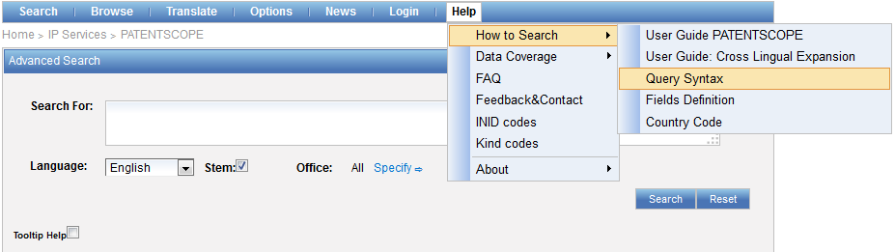
Advanced search interface
Search syntax
Search fields

Slide 17
Query : terms and phrases
Query: single word or multiple words or phrases
Multiple terms can be combined together with Boolean operators to form a more complex query
Notes:
A Single Term is a single word such as "car" or "engine".
A Phrase is a group of words surrounded by double quotes suchas "electric car".

Slide 18
Boolean operators: a quick review
AND
OR
NOT
ANDNOT

Slide 19
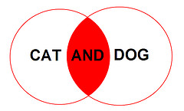
AND
Default = no Boolean operator between two terms AND operator is used
“electric car” solar = “electric car” AND solar

Slide 20
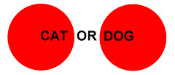
OR
Expands a search. Each result will contain only one of these words, giving you more results.
The more terms you add using OR, the more results you get.

Slide 21
AND/OR
tennis AND (racquet OR racket)
touch AND (screen OR display OR monitor)
television OR (cathode AND tube)

Slide 22
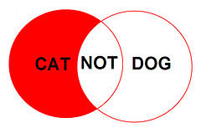
NOT
NOT rejects results that include a certain term. This is best used when trying to remove search results that you don't want.

Slide 23
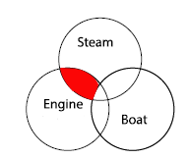
ANDNOT
Restricts the scope of a query excluding one or several terms from your search.

Slide 24
ANDNOT
(steam AND engine) ANDNOT boat
needle ANDNOT ((record AND player) OR sewing)

Slide 25
Proximity search: NEAR
NEAR/tilde, "~"
"electric car” ~ 5 = electric NEAR car

Slide 26
NEAR: an example
carbon AND wheel 99,235 results
"wheels made of carbon", or "carbon may be used to make said wheel“????
carbon NEAR10 wheel 940 results

Slide 27
Proximity search: BEFORE
the order of terms is significant.
trunk BEFORE cutting

Slide 28
Wildcards – truncation: ? *
plural form of a word, or alternative spellings
* stands for 0 or more characters
? stands single character
te?t = test or text
electric* = electrical; electricity
behavi*r = behaviour or behavior
micro?p* = microspeaker, microsporidial

Slide 29
Wildcards - Stemming
elect* would search for words like elect, elects, electron, electrons, electric, electrical, electricity, electoral
electric stemmed will find electricity electrical

Slide 30
Fuzzy searches
Use of the tilde: ~
Examples:
roam~ foam / roams
Roam~0.8
Notes:
Smilar in spelling

Slide 31
^ caret = weighting factor
Same result but ranking will be different
touch^3 AND polarize

Slide 32
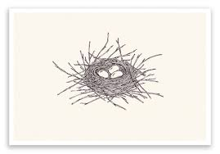
Grouping

Slide 33
Grouping/nesting
Solar OR (wind AND turbine)
(solar OR wind) AND turbine
EN_TI: electric car
electric will be searched in English title but car in all fields
EN_TI: (electric car)
Both electric and car will be searched in the English title

Slide 34

Grouping/nesting
Not all combinations work:
(electric AND car) NEAR power X
power NEAR (electric AND car) X
power NEAR (vehicle OR car)
EN_AB: hearing NEAR aid X
EN_AB: (hearing NEAR aid)
Notes:
Composition rules of operators
Avoid ambiguity

Slide 35
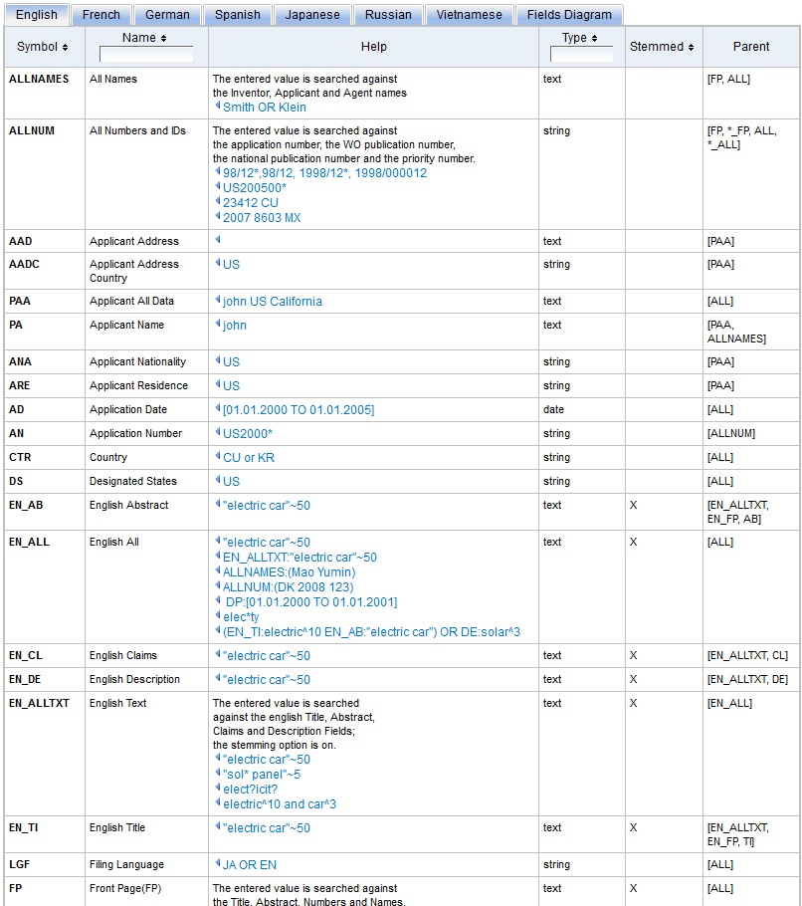
Fields: http://patentscope.wipo.int/search/en/help/fieldsHelp.jsf

Slide 36
Examples
FP = front page
ALL = all fields
ALL_NAMES = all names
IC = IPC
DP = publication date
CTR = country either WO or country from nat collection
NPCC= national phase entry
AN = origin of PCT
http://patentscope.wipo.int/search/en/help/fieldsHelp.jsf

Slide 37
Fields rules
Basic fields: elements of a patent document
Derived fields
2 letter code = individual field
EN_TI FR_AB ES_DE_S
Convention: language specified by 2 letters
if not specified all languages
S = stemmed
: to separate term without any space

Slide 38
Fields: golden rules
EN_ALL = default field field indicator not required
Field name followed by : ":" or "/"
The field is only valid for the term that it directly precedes, so the query:
EN_TI:("wind turbine" AND electric) solar
Results: "wind turbine" AND electric in the title field. "solar" in the default field (EN_ALL ).

Slide 39
Empty field
! Field_Name:[* TO *]
!RU_TI:[* TO *]
Notes:
For example, to search for all the documents where the russian title is not empty, you can use the search:

Slide 40
Date searches
Simple: based on year, month or day
  DP: 01.02.2000
  DP: 2003
Range: value are between the lower and upper bound
  DP:[01.01.2000 TO 31.12.2000]
  DP: [2000 TO 2010]

Slide 41
Classification
How to find symbols

Slide 42
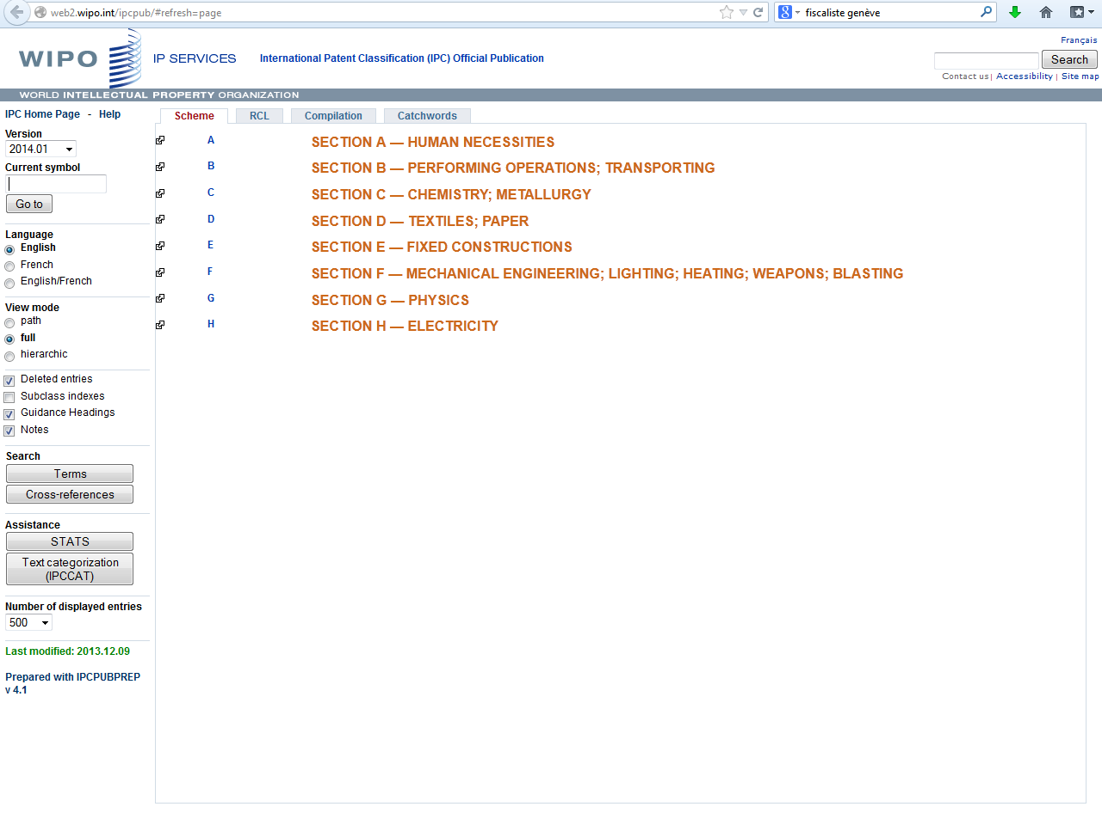

Slide 43
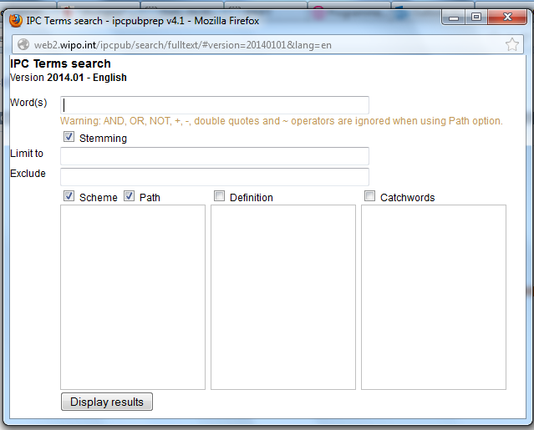

Slide 44


Slide 45
Most common errors
(….) "…"
Field name
No space
No wildcard at the beginning of a word

Slide 46
Challenges
Differences in languages: vent = wind in FR and outlet in EN
Number formatting: 75 percent -75%- ¾- 0.75
Measurement units: : cm/yard/km
Synonyms – homonyms: mobile/cell phone mouse
Human error
Name variation

Slide 47


Slide 48
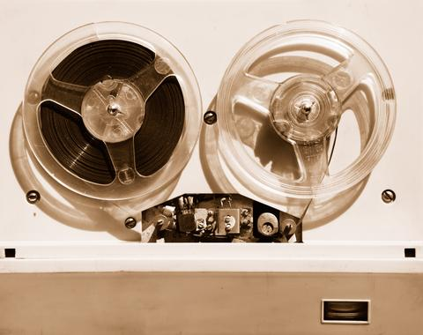

Slides and recording
+
www.wipo.int/patentscope/en/webinar/index.html

Slide 49
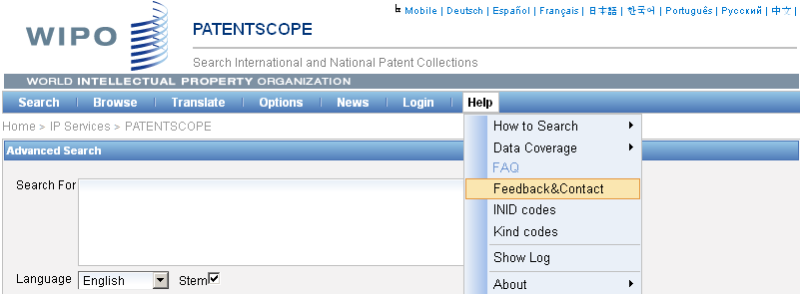

patentscope@wipo.int

Slide 50

mulțumesc
mulțumesc

