Slide 1
The PATENTSCOPE search system
2013 Retrospective
Cyberworld
December
2013
Sandrine Ammann
Marketing & Communications Officer

Slide 2
Agenda
Retrospective 2013
  New interfaces
  Improved navigation
  New collections
  Monthly webinar
      Survey
    2014
Q&A

Slide 3

New interfaces

Slide 4
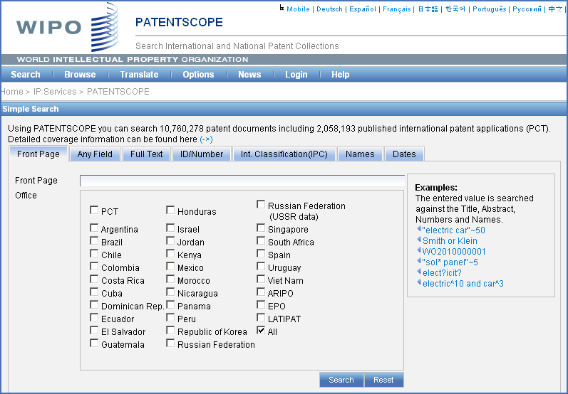
Simple search: before

Slide 5
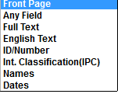
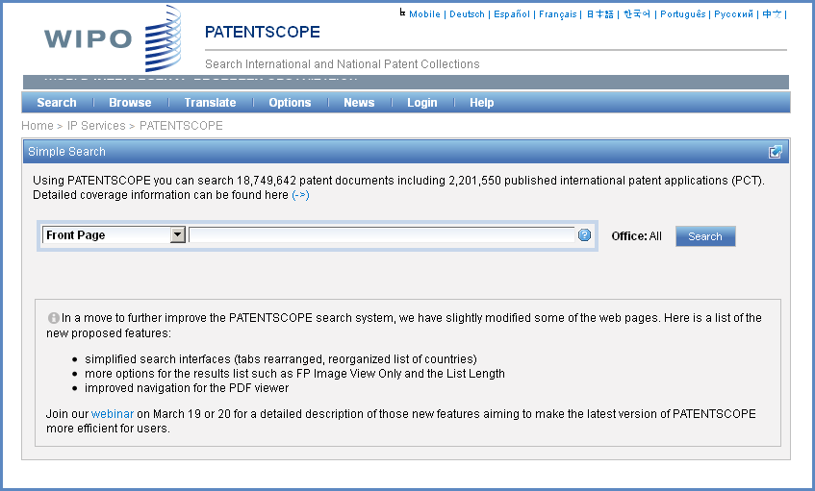
Simple search: after
Notes:
Tabs news box

Slide 6
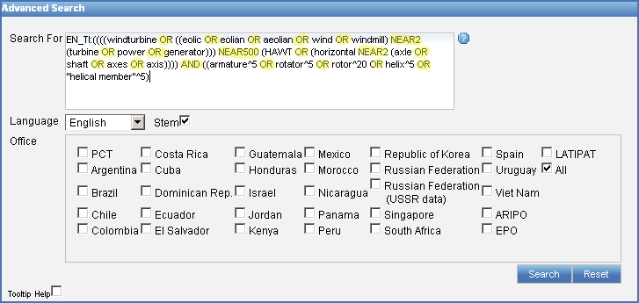
Advanced search: before

Slide 7
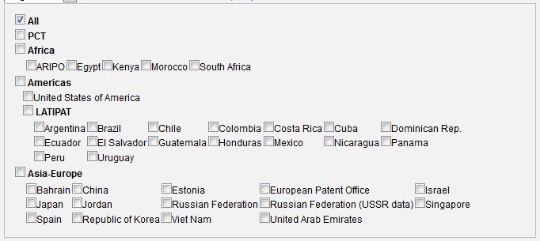
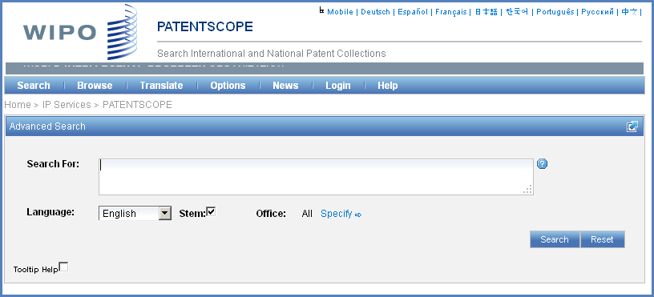
Advanced search: after

Slide 8

Search result list

Slide 9
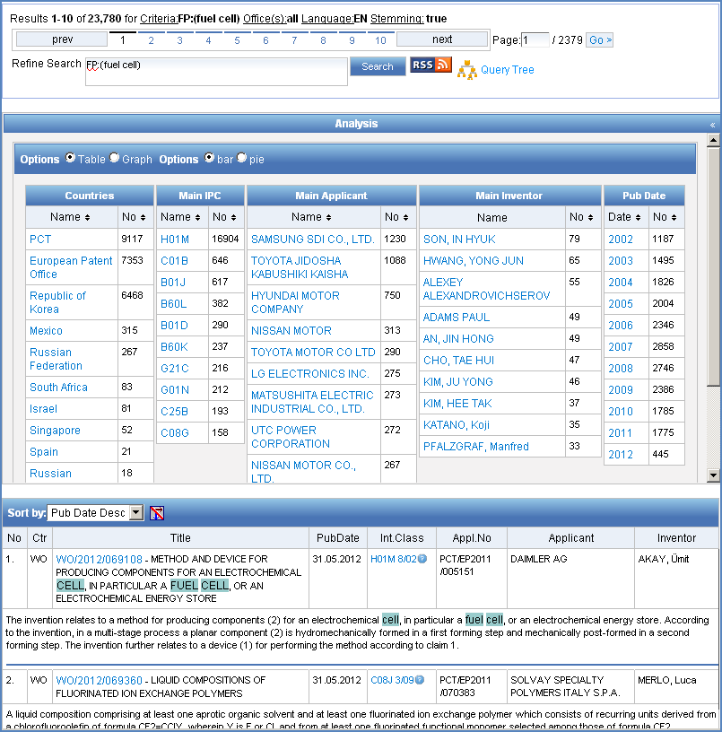
Before

Slide 10
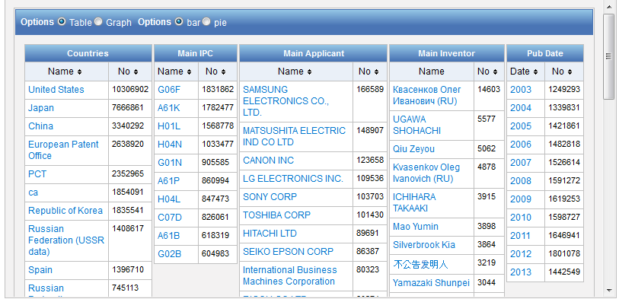
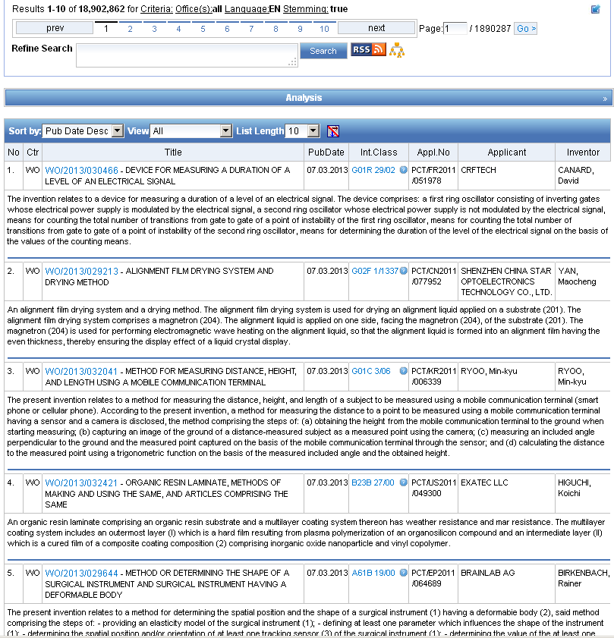
After

Slide 11



Options

Slide 12
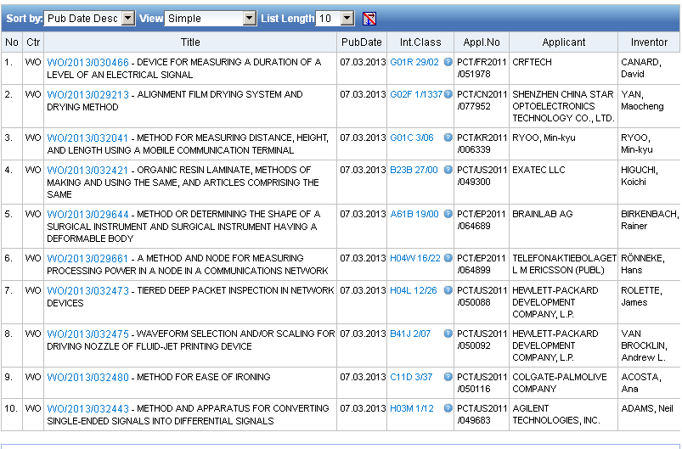
View: simple

Slide 13
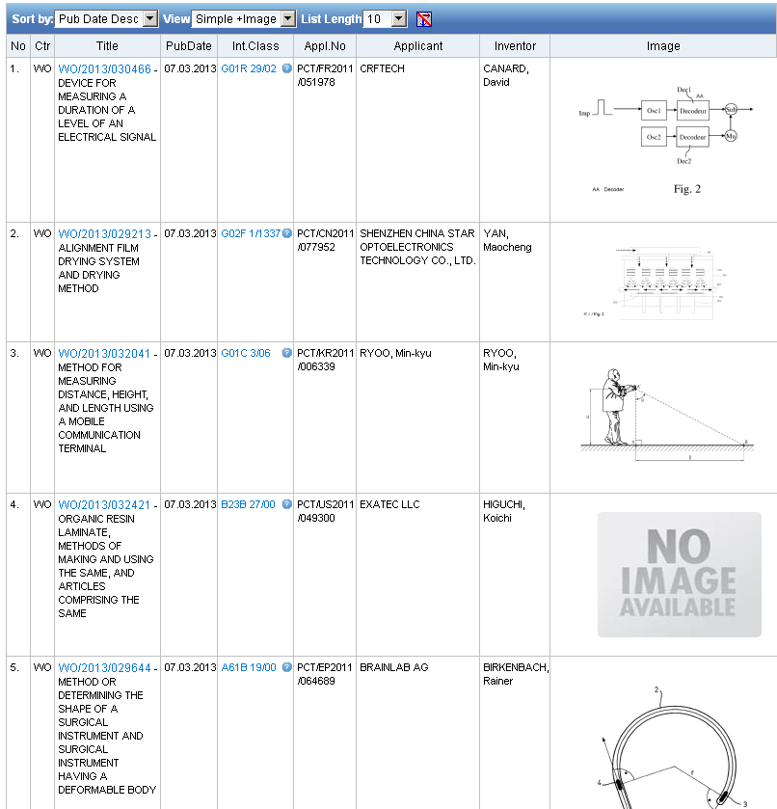
View: simple + image

Slide 14
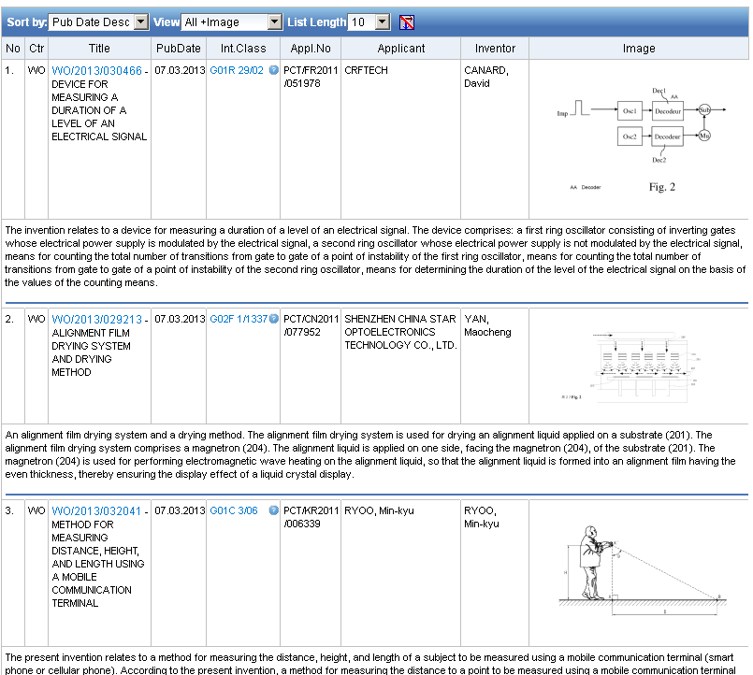
View: all + image

Slide 15
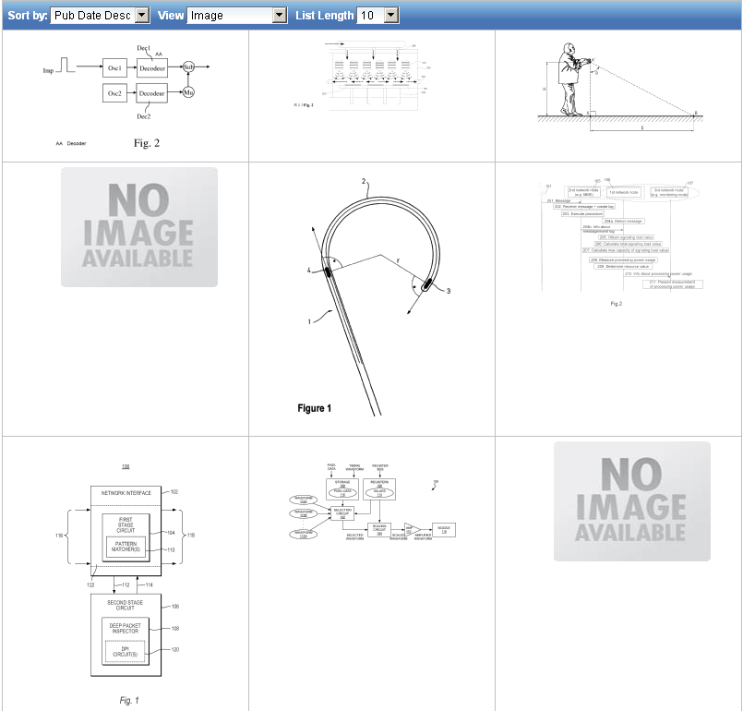
View: image

Slide 16
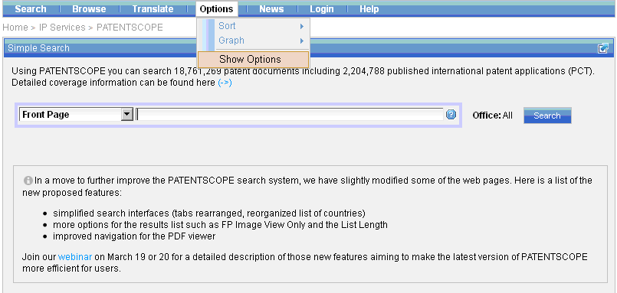
More customization options

Slide 17
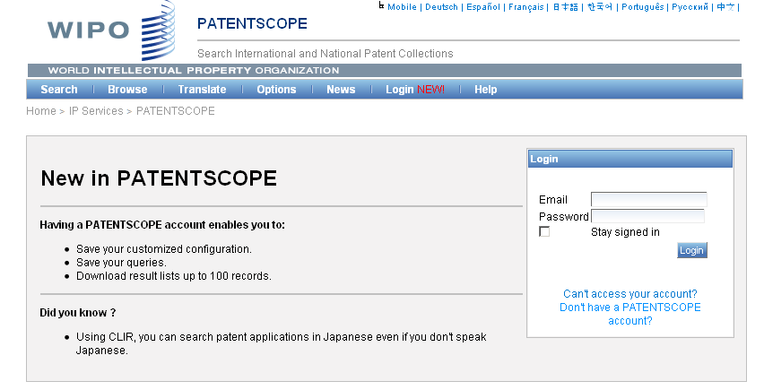
PATENTSCOPE account

Slide 18
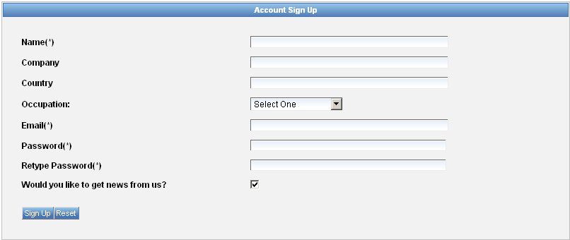
Signing up

Slide 19
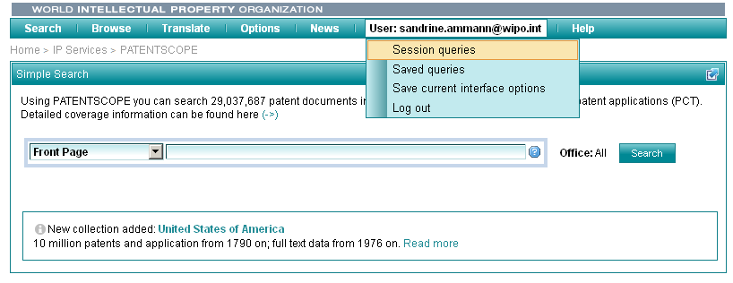
Once logged-in

Slide 20

Improved navigation

Slide 21
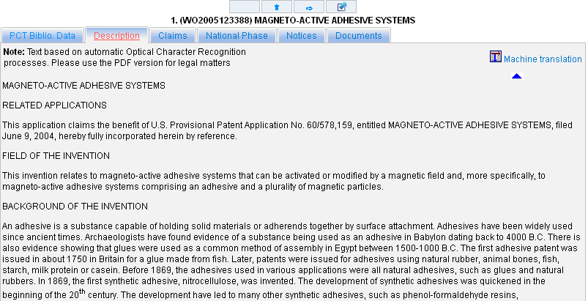
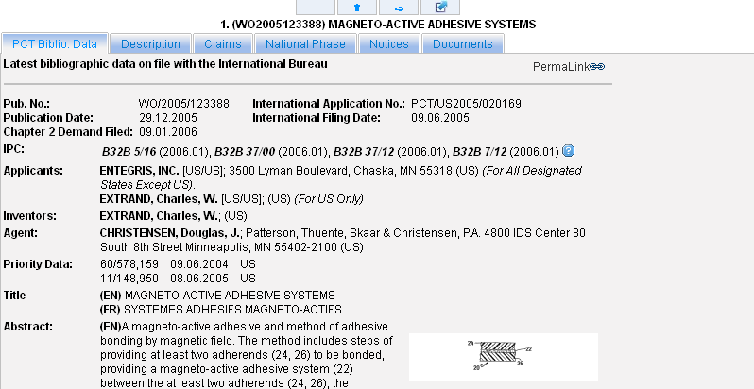
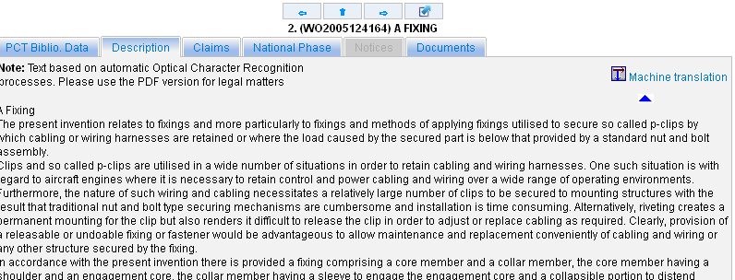
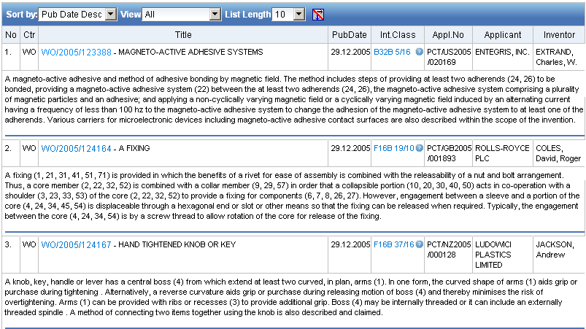
Improved navigation
Tab currently viewed same tab for next applications

Slide 22
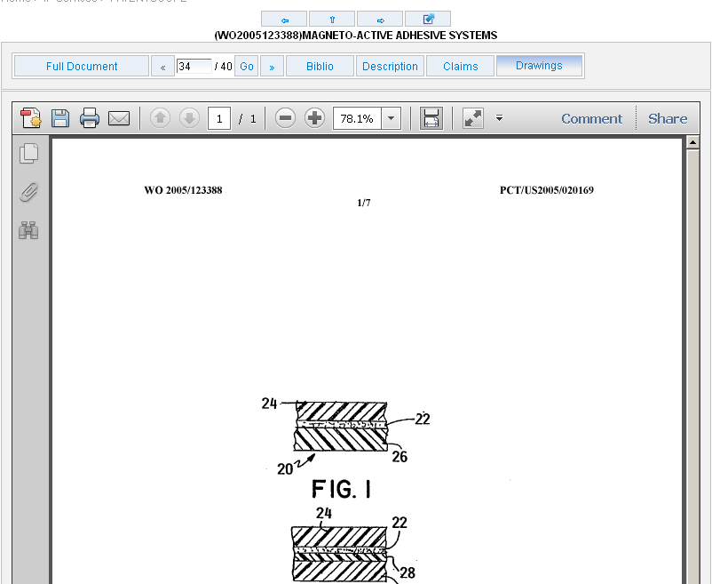
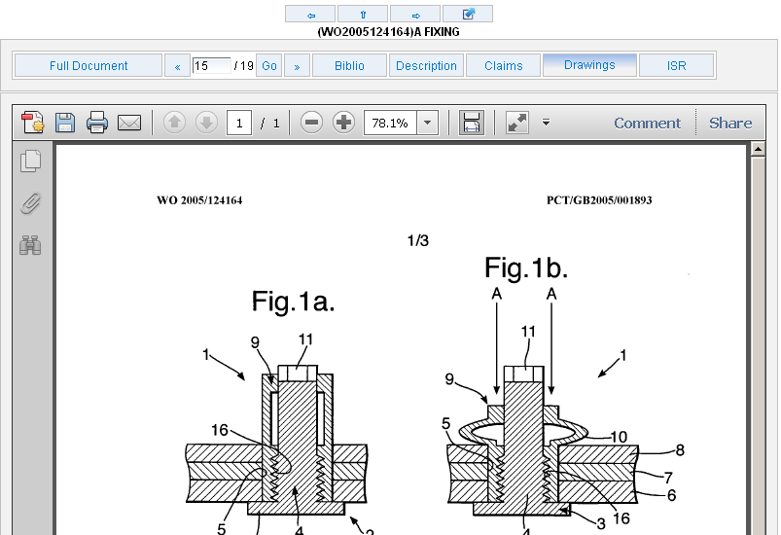
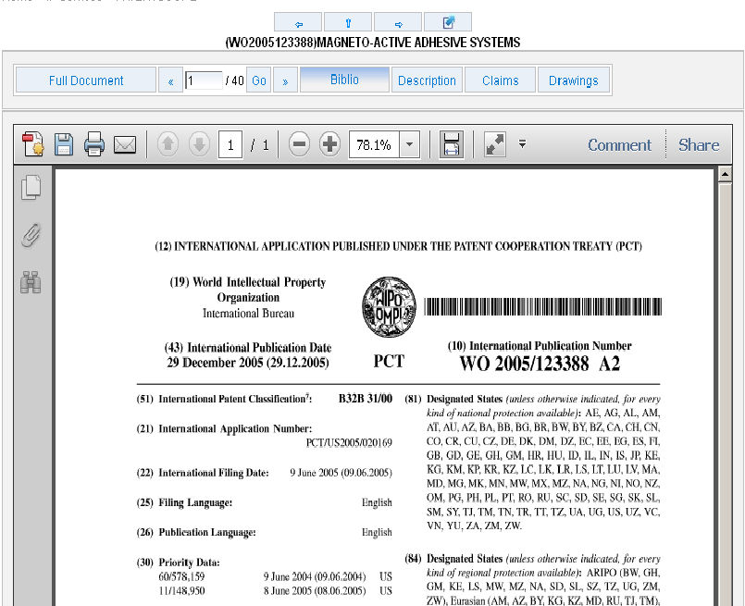
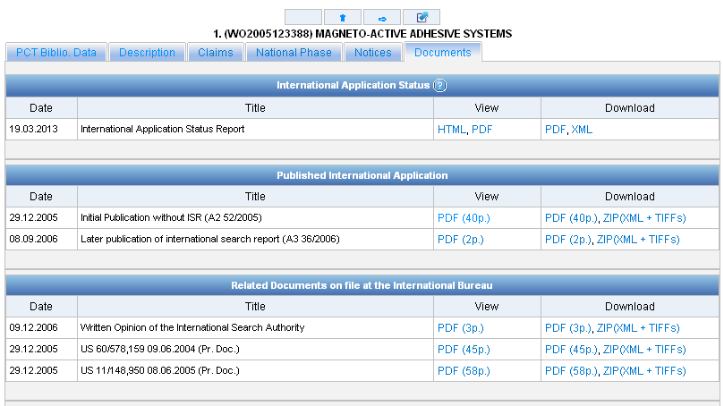
Documents tab

Slide 23
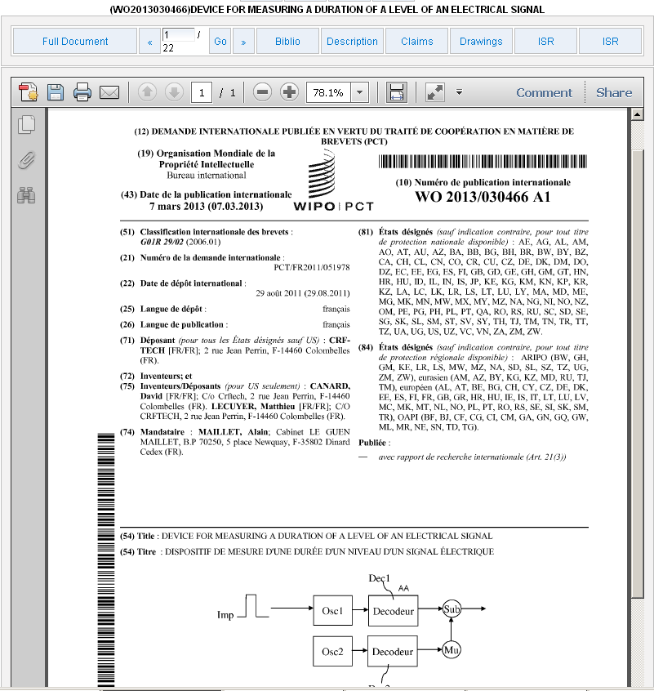
PDFs

Slide 24

THE COVERAGE

Slide 25






New collections

Slide 26



Slide 27


2014

Slide 28
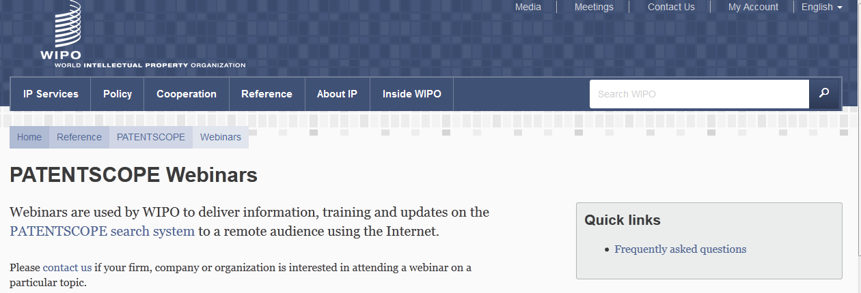
Monthly webinar

Slide 29

Survey

Slide 30
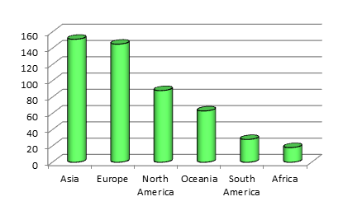
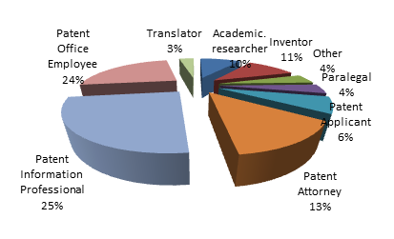
Survey

Slide 31

71.33% : interface is good

Slide 32


Slide 33
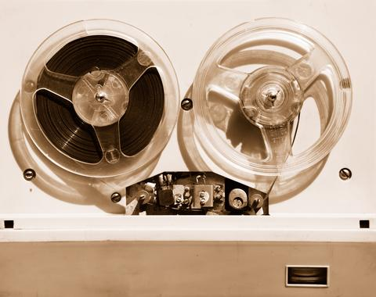

Slides and recording
+
www.wipo.int/patentscope/en/webinar/index.html

Slide 34
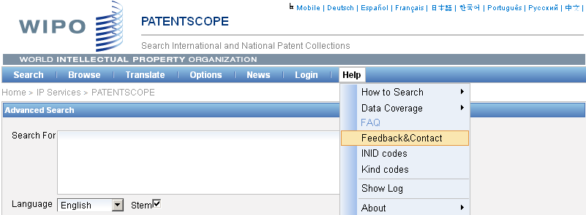

patentscope@wipo.int

Slide 35


mulțumesc
mulțumesc

Slide 36

SEASON’S GREETINGS
WITH
ALL GOOD WISHES FOR THE NEXT YEAR

