Slide 1
Lisbon Webinar Series
Why and How to use the new Lisbon System (Geneva Act) to Protect your GI abroad?
Matteo Gragnani
Legal Officer
Michele Evangelista
Associate Legal Officer
Geneva
March 9, 2021

Slide 2


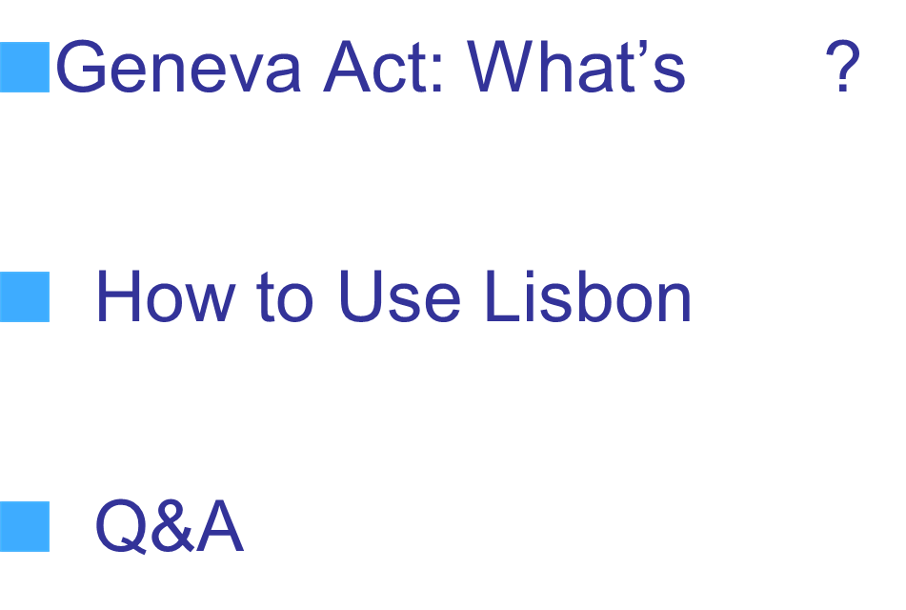


Slide 3

The Geneva Act: What’s ?
Extension to Geographical Indications
Accession of Intergovernmental Organizations (IGOs)
Flexibility on domestic GI systems
Protection
Generics
Safeguards

Slide 4


Extension to GIs
Appellations of Origin
Geographical Indications
Indications of Source
Quality & Origin + Reputation
Lisbon GE Act
Quality / Reputation & Origin
TRIPS GE Act
Origin
Madrid IS

Slide 5



Geneva Act: Definitions (Art. 2)
AO
Protected denomination
Referring to a geographical area or known as doing so
Designating a good as originating therein
Quality or characteristics
+ Reputation
Due to the geographical environment (natural factors and human factors)
GI
Protected indication
Referring to a geographical area or known as doing so
Identifying a good as originating therein
Quality, reputation or other characteristics
Attributable to its geographical origin

Slide 6
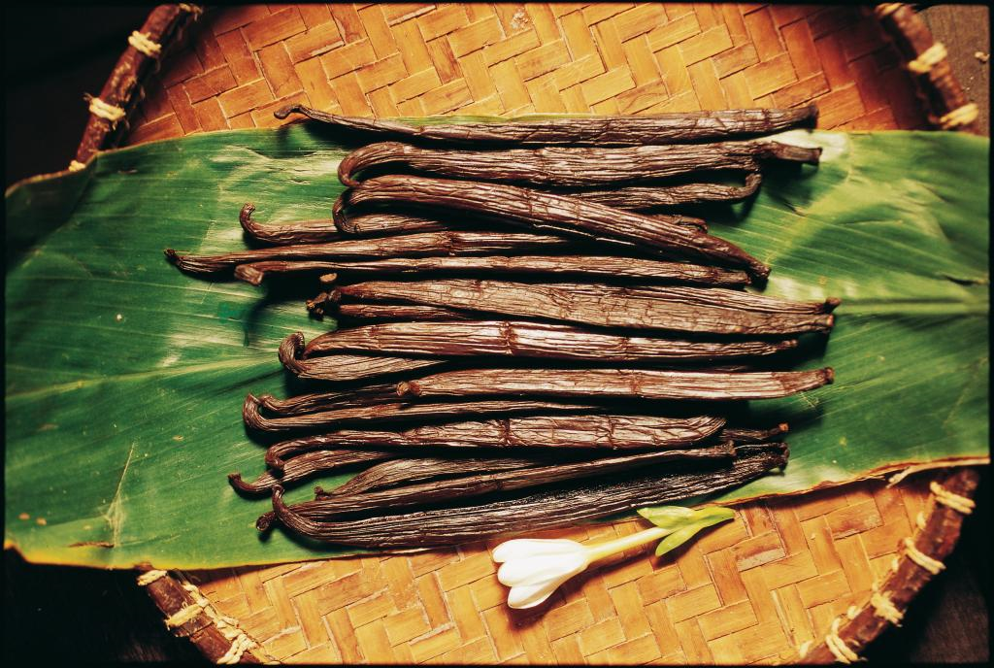

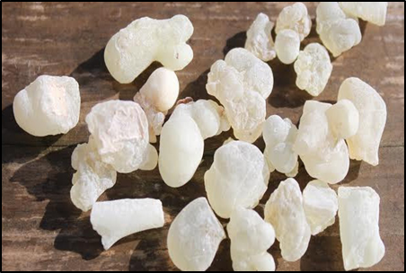
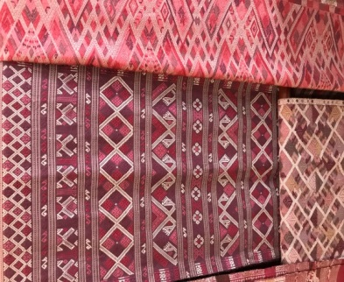
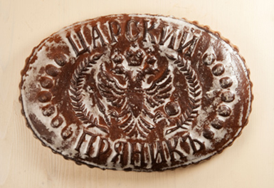

Extension to GIs = more products can benefit from the Lisbon System
Alor Islands Vanilla
(Indonesia)
Jamdani Saree (Bangladesh)
Hojari Luban (Oman)
Luangprabang Silk
(Lao PDR)
Baked Pryaniks (Russian Federation)
Chuao Cocoa Bean
(Venezuela)

Slide 7


The potential of GIs
55800 GI rights were in force in 2019
8566 geographical indications
Notes:
.

Slide 8



Different national means of GI protection allowed (Art. 9 and 10)
Sui generis legislation
Trademark system (collective/certification marks)
Administrative systems
Unfair competition laws

Slide 9




The Geneva Act opens Lisbon to Intergovernmental Organizations
European Union
27 Member States
Acceded on 26/11/2019
Accession Criteria (Art. 28)
At least 1 IGO Member must be a member of the Paris Convention
IGO grants regional titles of protection for GIs
Declaration that the IGO is authorized to become party to the Geneva Act
African Organization of Intellectual Property (OAPI)
17 Member States
African Organization of Intellectual Property (OAPI)
  17 Member States

Slide 10

Protection (Art. 11)
Same kind goods not originating in the area of origin or not complying with other AO/GI requirements
Different kind goods or services suggesting connection with AO/GI beneficiaries and likely to damage their interests or Impairing, diluting or taking unfair advantage of the AO/GI reputation
Against any AO/GI imitation, even if true origin is indicated or AO/GI is translated, or used with delocalizers (ex Greek style)
Any other misleading practice as to the true origin, provenance or nature of the goods

Slide 11
Generics in the Geneva Act
Protection against becoming generic (Art. 12)
Exceptions (Agreed statements, Rule 5.5):
    Prior use as a generic in a Contracting Party
    is a possible ground for refusal
    If the AO/GI contains a term considered generic in the Contracting Party of Origin, other Members are not obliged to protect such term

Slide 12

Safeguards (Art. 13)
Prior good faith trademarks
(applied for/ registered/ acquired through use in good faith)
  (NB: possible coexistence with later AO/GI)
personal names, plant variety or animal breed denominations
  (except if used in such a manner as to mislead the public)

Slide 13
Registration Procedure with the Lisbon System

Slide 14
Who triggers the application procedure? (Art. 5(2))
Beneficiaries: those having the right to use the AO/GI
Natural person or legal entities having legal standing to assert the rights of the beneficiaries

Slide 15
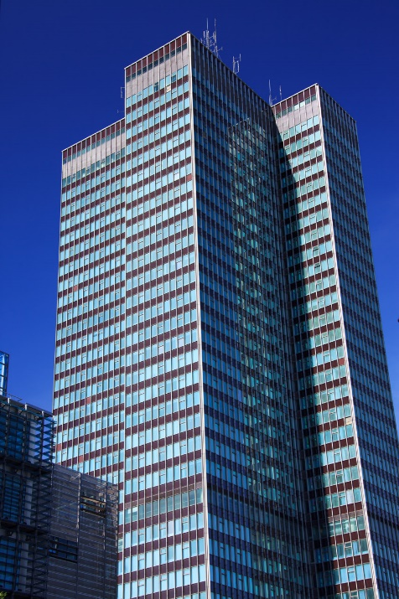

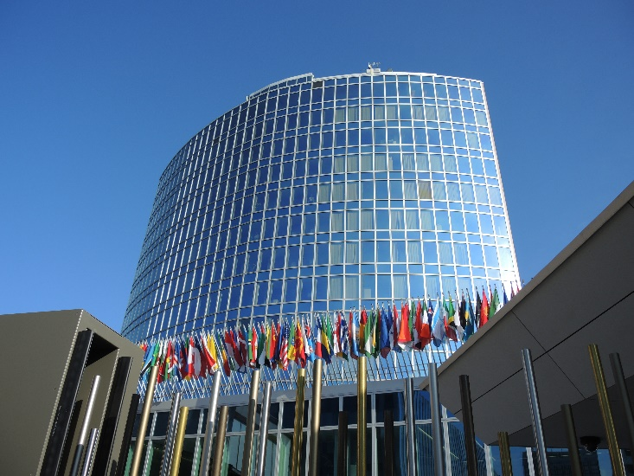
Application procedure (Art. 5)
Application filed by the Competent Authority

Slide 16
Application procedure (Art. 5)
Direct application by interested parties
  subject to a declaration by their Contracting Party

Slide 17

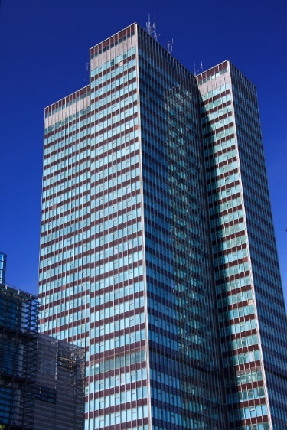

Application procedure (Art. 5)
Joint Application for trans-border AOs/GIs

Slide 18
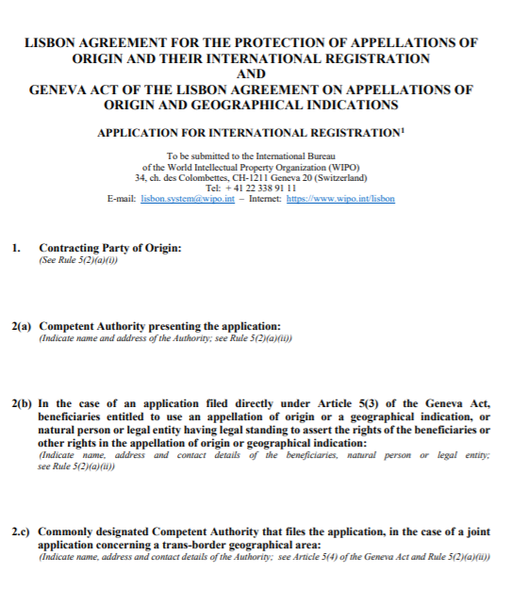
Application form
https://www.wipo.int/lisbon/en/forms/

Slide 19
Application procedure: mandatory requirements (Rule 5(2))
Contracting party of origin
Competent Authority or applicants
Beneficiaries or their representatives
The AO/GI
The good to which the AO/GI applies
The geographical area of origin of the good
Details of the registration, or legislative or administrative provision, or judicial decision, by virtue of which the AO/GI is protected in the Country of Origin
Registration fee

Slide 20
Application procedure: declaration-based requirements
Further information on the connection between the characteristics of the AO/GI and its geographical origin (Rule 5(3))
Signature and/or intention to use (Rule 5(4))
Payment of an individual fee (Art. 7(4))
Non-compliance with DBR → protection renounced

Slide 21
Application procedure: registration (Art. 6)
Formal Examination:
  Mandatory requirements
  Payment of fees
Date International registration: when application is received by the International Bureau
Irregular Applications:
  Chance to remedy
  Three months limit

Slide 22


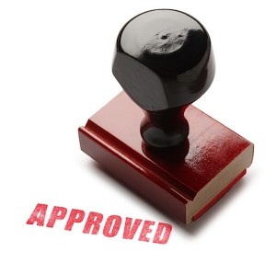

Application procedure: registration
Records the AO/GI in the Lisbon Registry
Issues Certificate of Registration, and
Notifies the AO/GI to Contracting Parties (Rule 7)

Slide 23
Application procedure: registration (Art. 6(5))
Protection in each Contracting Party is granted if:
  grant of protection is notified
  no refusal is notified (silence procedure)
From the date of the international registration
  or different date as indicated in a declaration

Slide 24



Application procedure: refusal (art. 15)
Requirements:
  Time → within 12 months
  Content → explain the grounds
Notification ex officio or at the request of an interested party
Total or partial
Judicial or administrative remedies

Slide 25
Manage your application
Withdrawal of Refusal (Art. 16)
Invalidation (Art. 19)
Modification (Rule 15)
Renunciation (Rule 16)
Cancellation (Rule 17)

Slide 26
How the Lisbon System works (1)
Title of Protection in the Contracting Party of Origin (CPO)
Beneficiaries or Users
Competent Authority of CPO
or direct application
Notify International Application based on the title of protection in the CPO
Stage 1
Formal examination;
Registers the AO/GI in the International Register and publishes in the Bulletin/Lisbon Express Database.
Issues a Certificate of Registration to the CPO and notifies the Registration to the other CPs
WIPO
Stage 2
Protection of the International Registration determined by substantive examination under domestic law,
within 12 months
Competent Authority of Contracting Party
(CP)
Competent Authority of Contracting Party
(CP)
Competent Authority of Contracting Party
(CP)
Stage 3

Slide 27
How the Lisbon System works (2)
Protection of the International Registration determined by substantive examination under domestic law,
within 12 months
Competent Authority of Contracting Party
(CP)
Competent Authority of Contracting Party
(CP)
Competent Authority of Contracting Party (CP)
Stage 3
Refusal
of Protection
(total/partial)
Notification of Grant of Protection (optional)
“Silence Procedure”
(= Protection)
Transitional Period (2-15 years)
Transitional Period (2-15 years)
Withdrawal
of Refusal
(total/partial) or Grant of Protection
Invalidation
_______________
Renunciation
Invalidation
________________
Renunciation

Slide 28
With the Geneva Act, Lisbon is
Extension to GIs = +Accessible
Any means of GI protection = +Flexible
Accession of IGOs = +Global
Protection = +Effective
Individual Fees = +Inclusive
Safeguards = +Modern

Slide 29
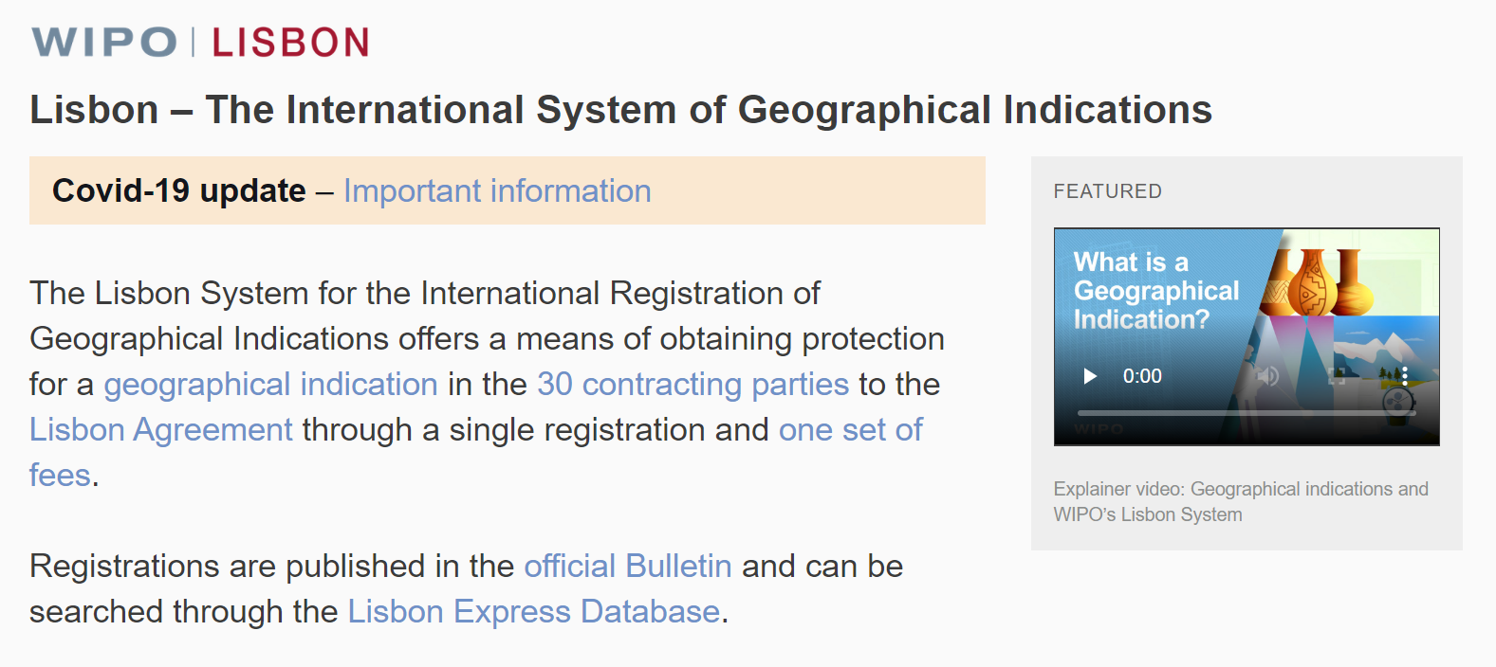
Lisbon System website

Slide 30
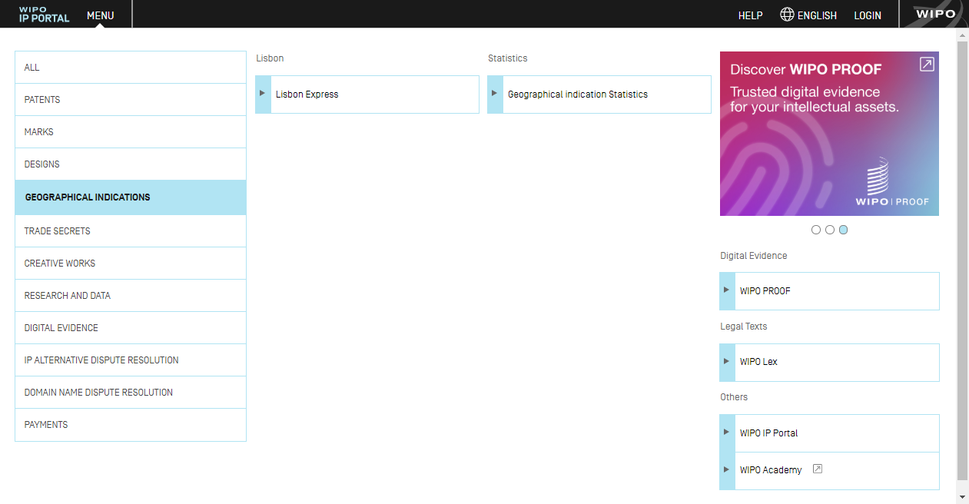
WIPO IP PORTAL

Slide 31

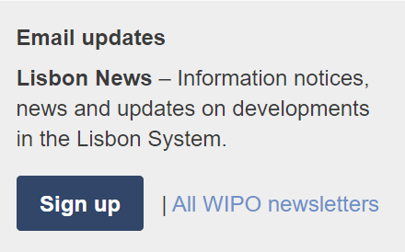
Lisbon News
https://www3.wipo.int/newsletters/en/

Slide 32
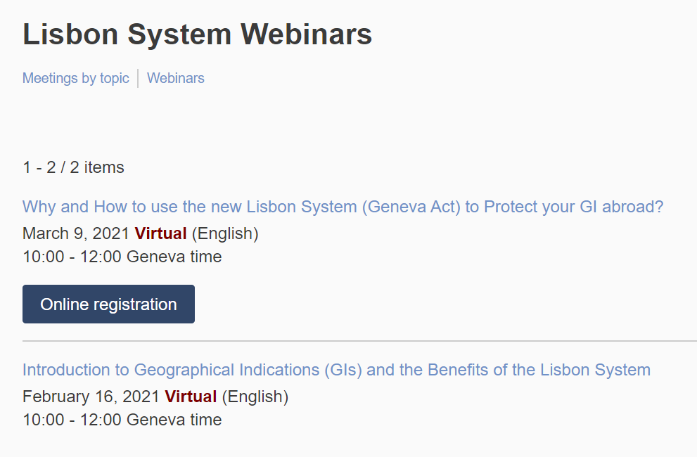
Lisbon Webinar Series

Slide 33
Thank you!
More info www.wipo.int/lisbon/en/index.html
Lisbon Express Database: www.wipo.int/ipdl/en/search/lisbon/search-struct.jsp
Questions?
matteo.gragnani@wipo.int
michele.evangelista@wipo.int

