Slide 1
How to read, save and share your results in the Global Brand Database
Cyberworld
March
2019
Sandrine Ammann
Marketing & Communications Officer

Slide 2
Click the Raise hand button if you hear me otherwise send me a message please!

Slide 5
Questions/concerns
gbd@wipo.int

Slide 6
Agenda
News
All about your results
Webinars
Q&A

Slide 7
Concept image similarity search soon available

Slide 8
Search results

Slide 9
Result area: pager & list

Slide 10
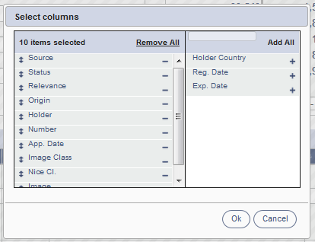
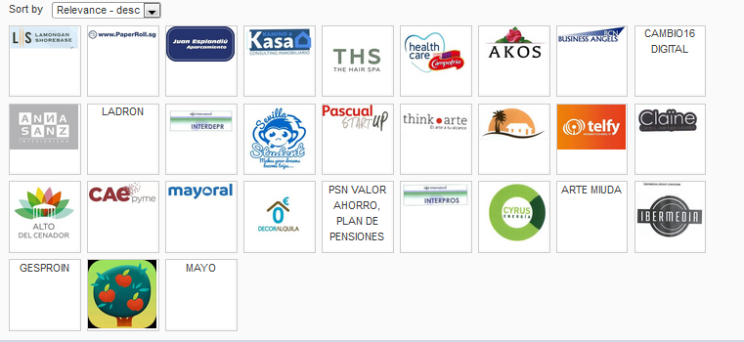
Pager

Slide 11
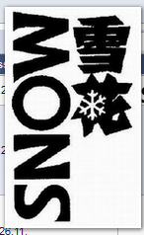
Record list – list format

Slide 12
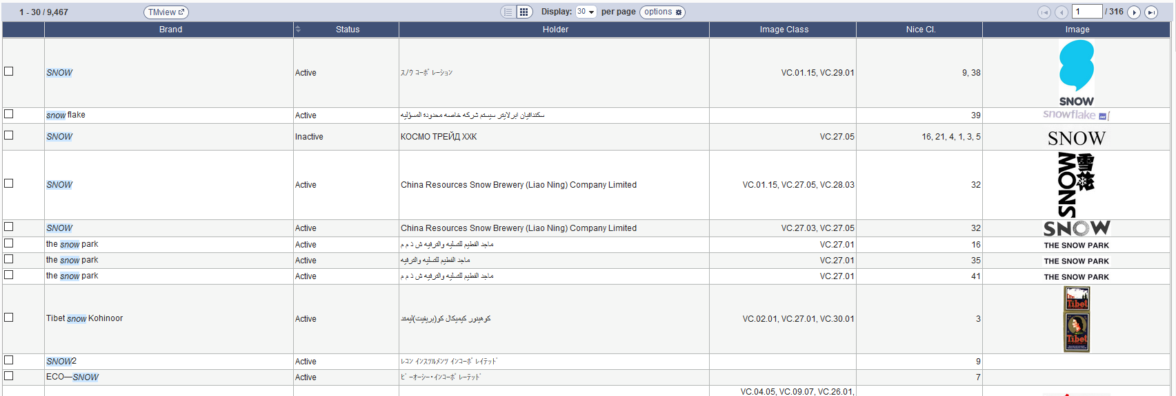

Slide 13
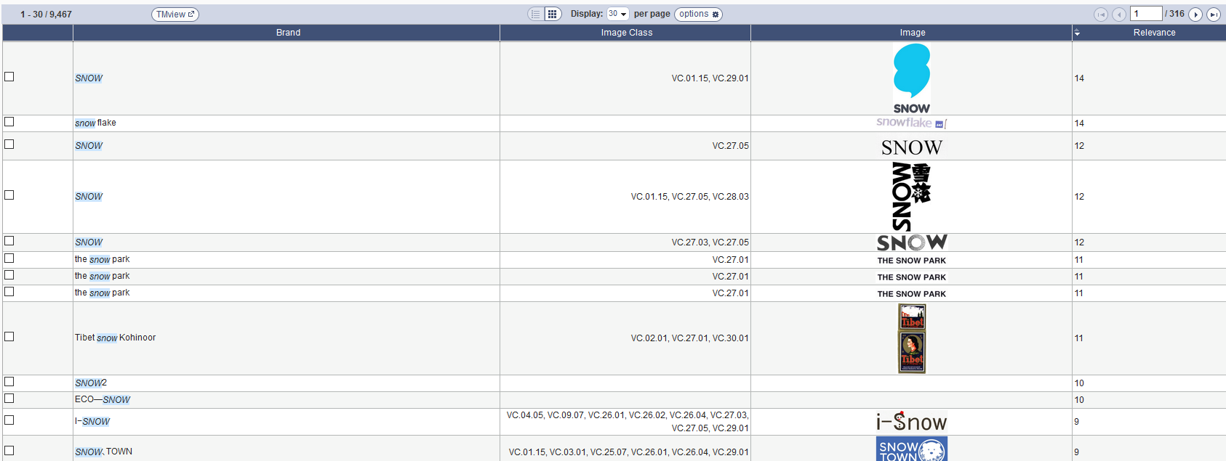

Slide 14
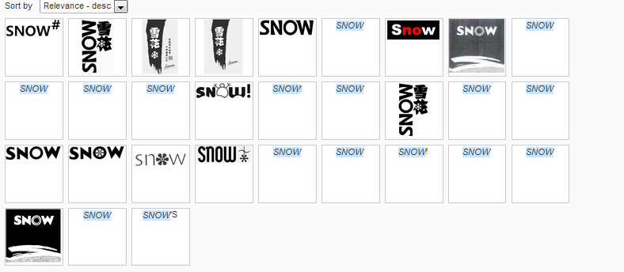
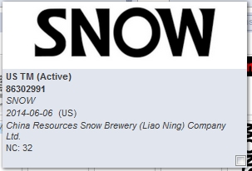
Record list – grid format

Slide 15
Report downloading
First 100 results
Selected 100 results

Slide 16
Download reports

Slide 17
Checkboxes – list format

Slide 18
Checkboxes – grid format

Slide 19
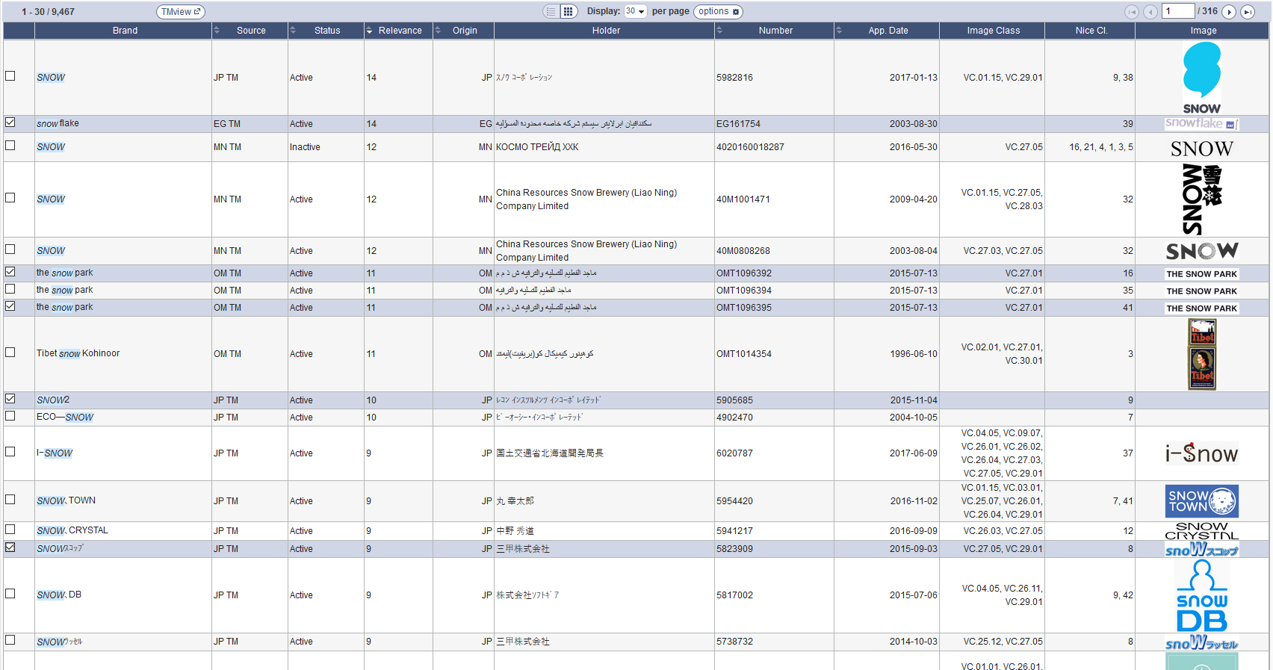
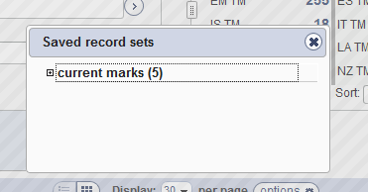

Slide 21
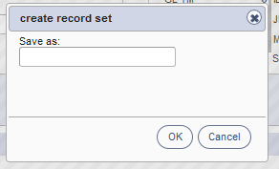
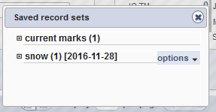

Slide 22
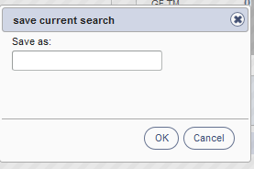
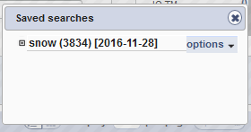
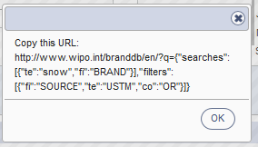

Slide 23
Sharing
Search
Records

Slide 24
Share your search

Slide 25
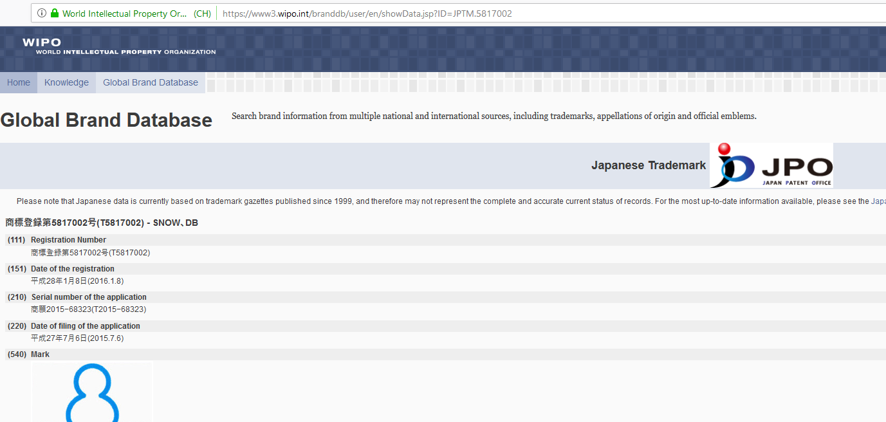
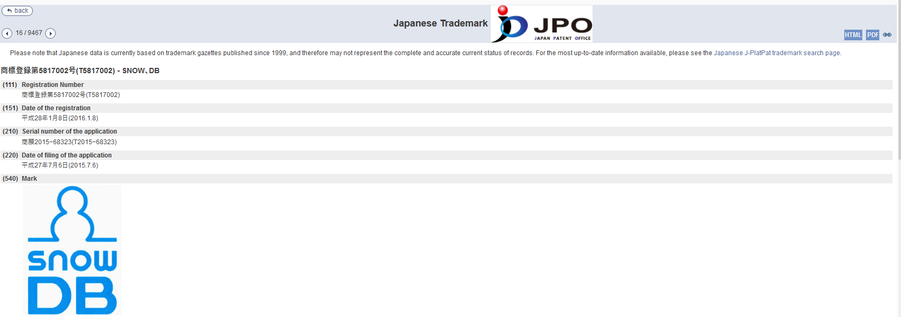
Share record

Slide 26
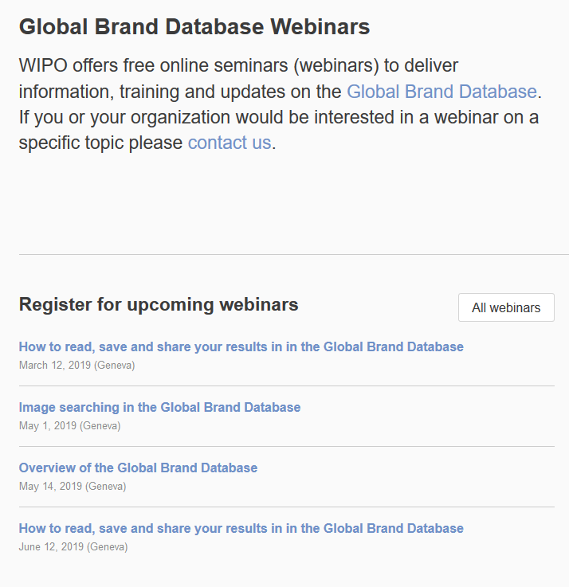

Slide 27
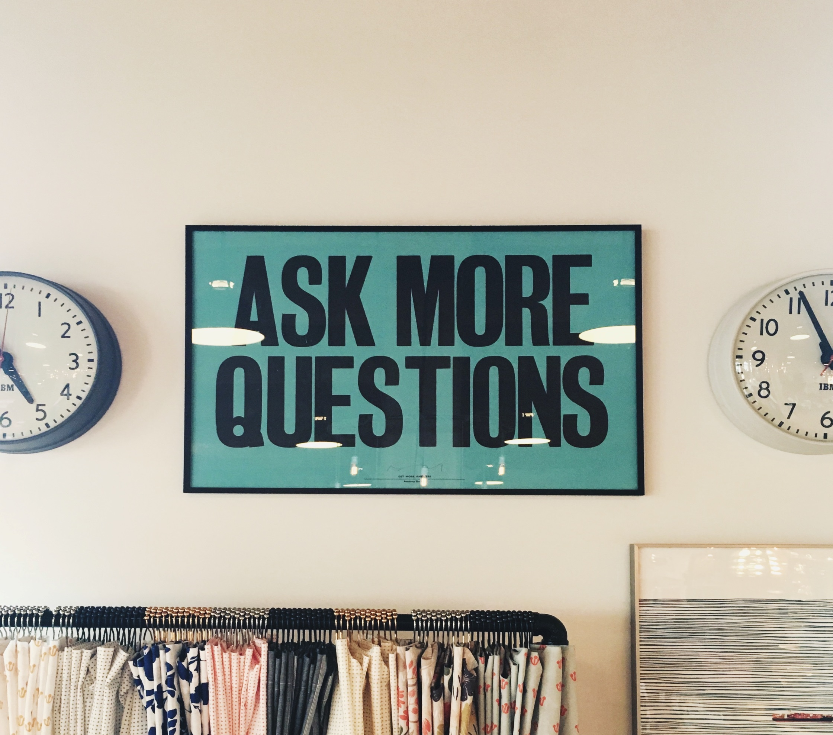

Slide 28
mulțumesc
mulțumesc
gbd@wipo.int

