Slide 1
Global Design Database:
An introduction
May 2019
Sandrine Ammann
Marketing & Communications Officer

Slide 2
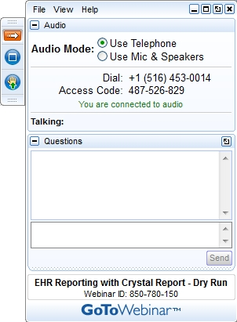
Click the Raise hand button if you hear me otherwise send me a message please!

Slide 3


Slide 4
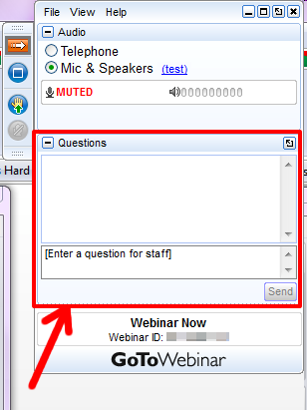

Slide 5
Questions/concerns
gbd@wipo.int

Slide 6
$ 539 Millions

Slide 7



VS

Slide 8
Why is the GDD useful?
Find out if your design already exists.
Find details about a specific design
Explore design landscape

Slide 9
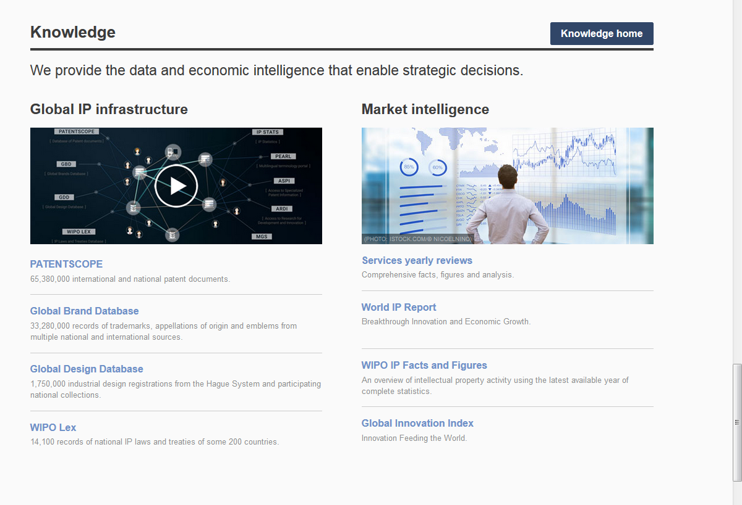
Access: www.wipo.int/designdb www.wipo.int

Slide 11
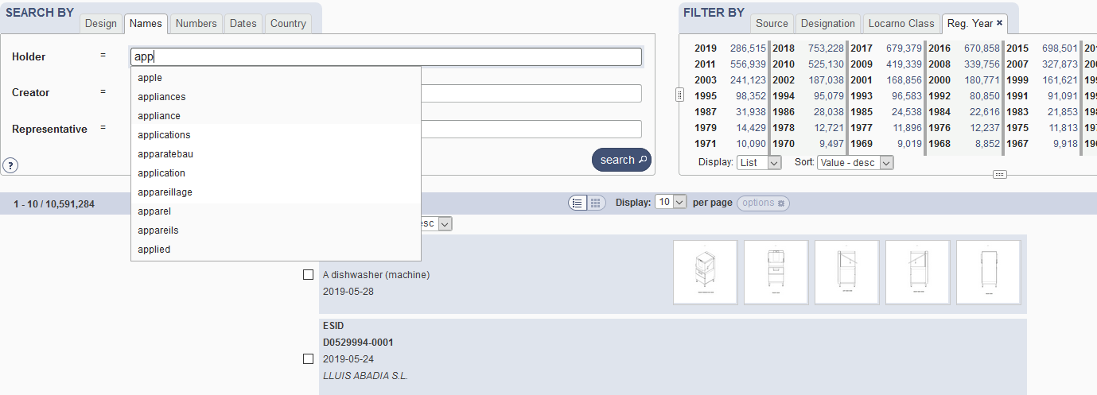

Slide 12
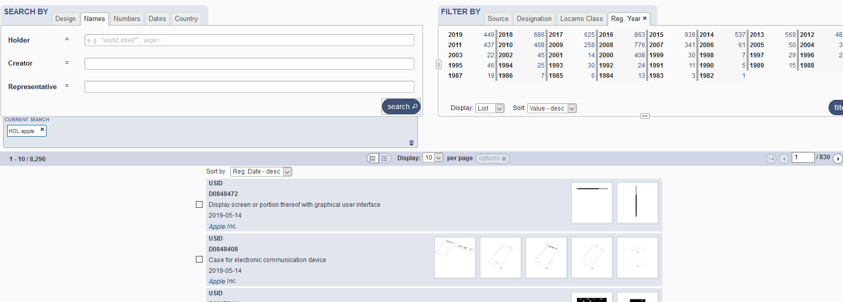

Slide 13
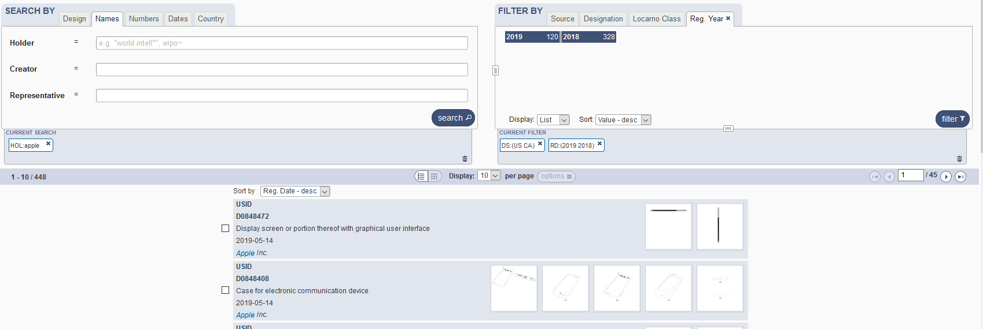

Slide 14
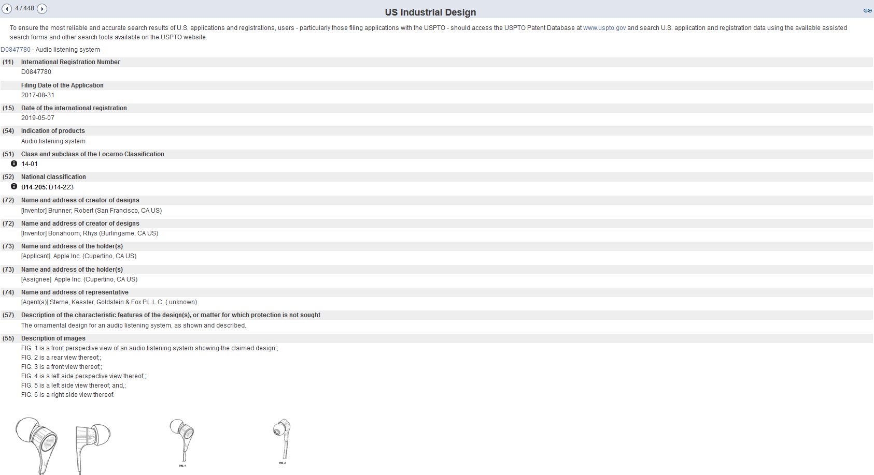

Slide 15
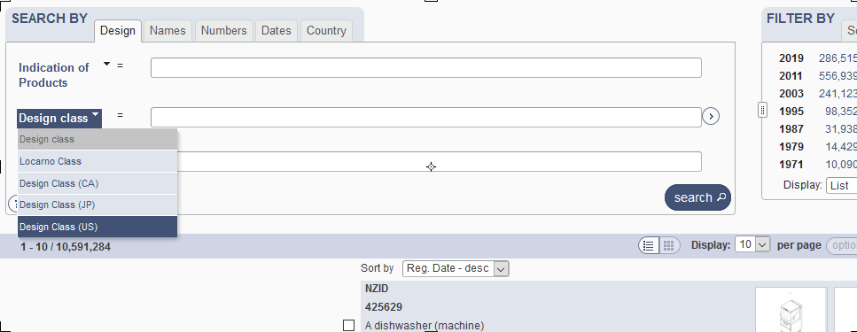
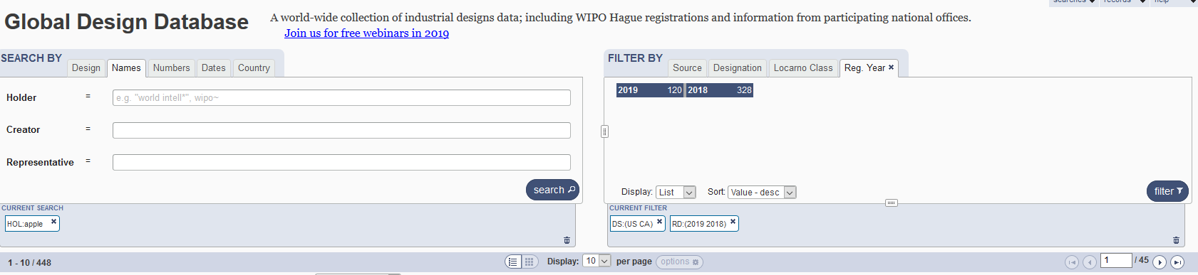
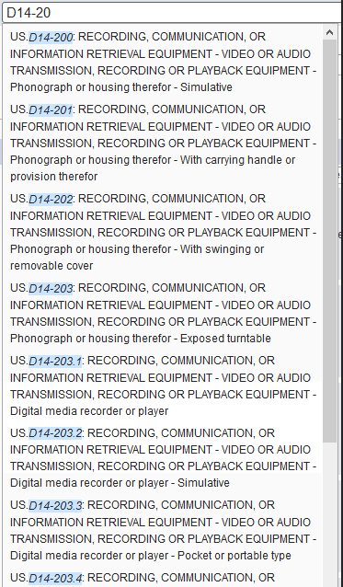

Slide 16
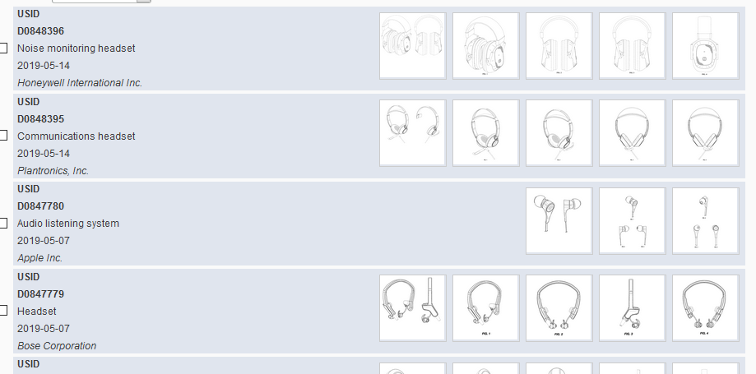

Slide 17
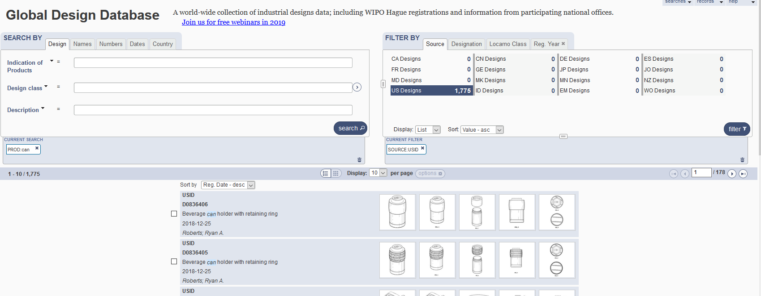
5
1
2
3
4

Slide 18
1

Slide 19
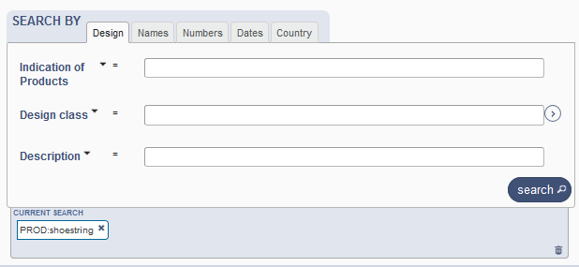
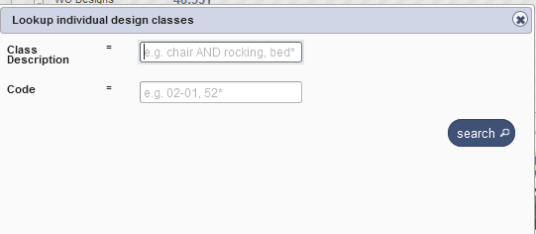
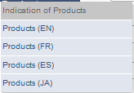
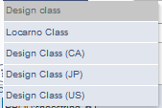
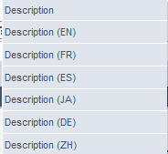
Search by design

Slide 20
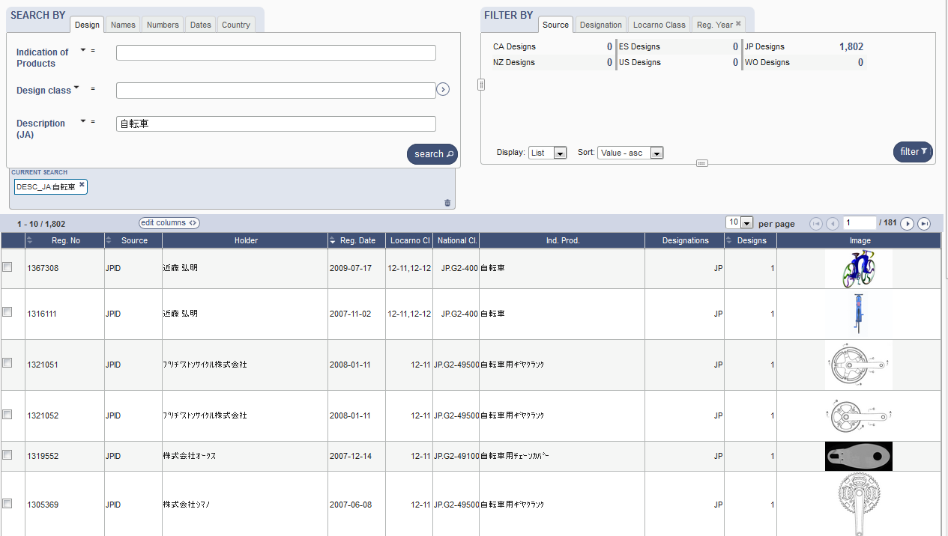
Search by Description JA

Slide 21
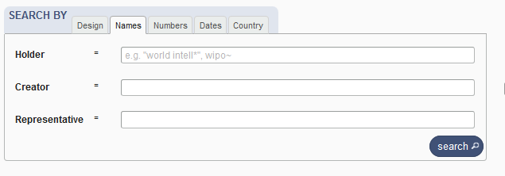
Search by name

Slide 22
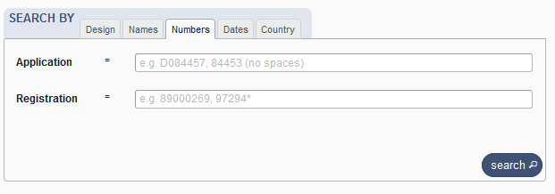
Search by numbers

Slide 23
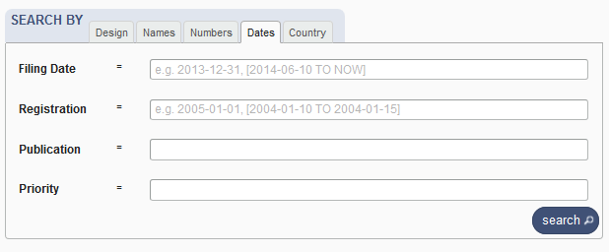
Search by dates

Slide 24
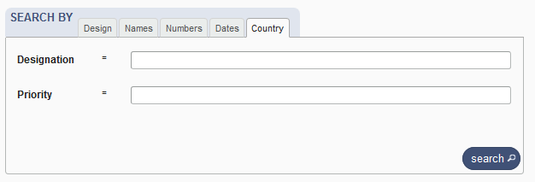
Search by country

Slide 25
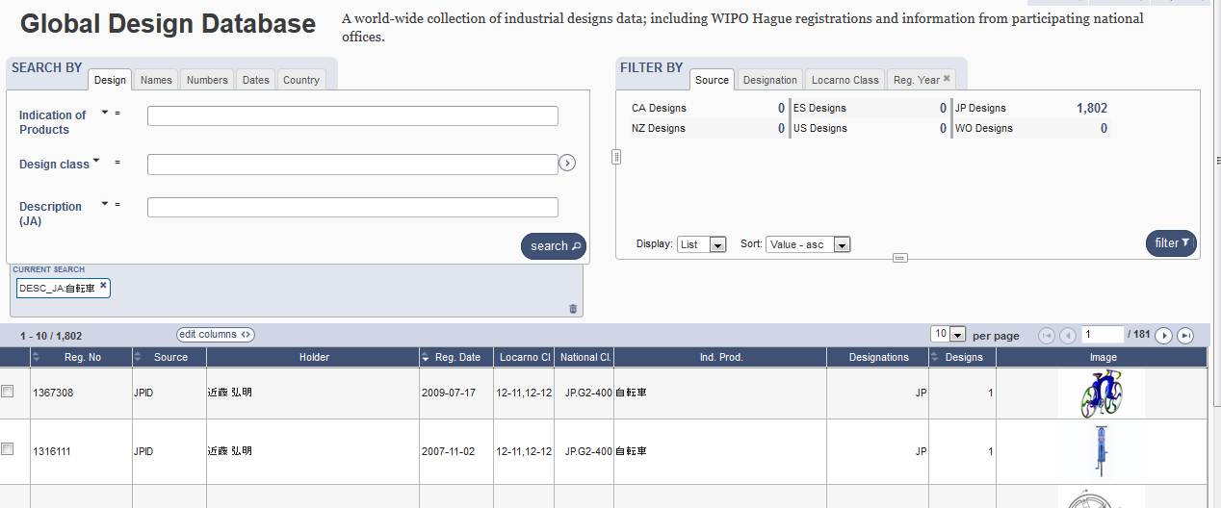

Slide 26
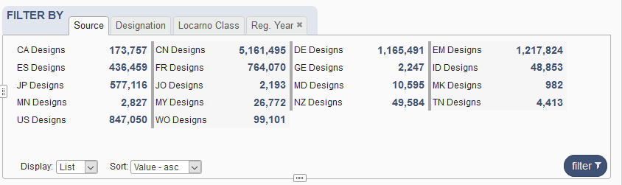
Filter by

Slide 27
Filter by Source

Slide 28
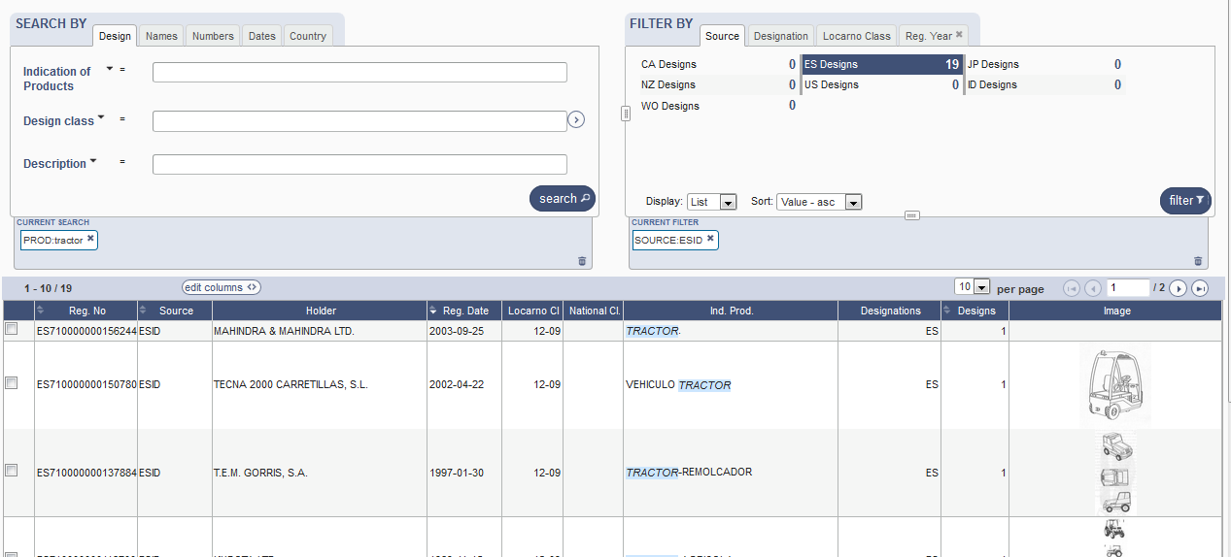

Slide 29
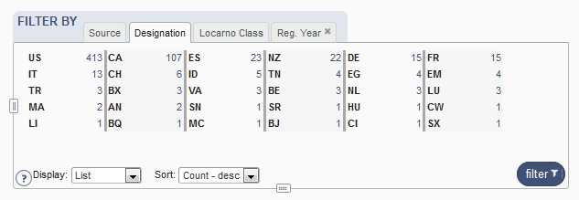
Filter by Designation

Slide 30
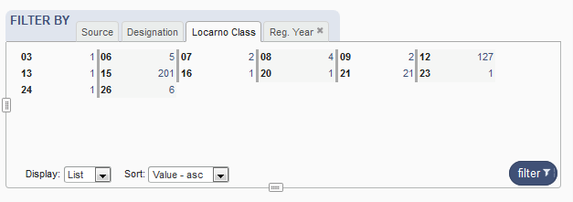
Filter by Locarno Class

Slide 31
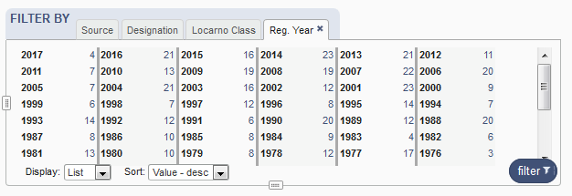
Filter by Registration Year

Slide 32


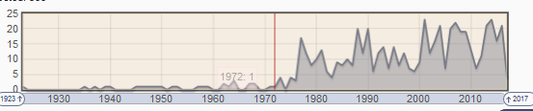
Options

Slide 33
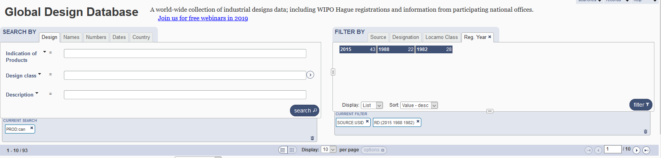
3

Slide 34
4

Slide 35
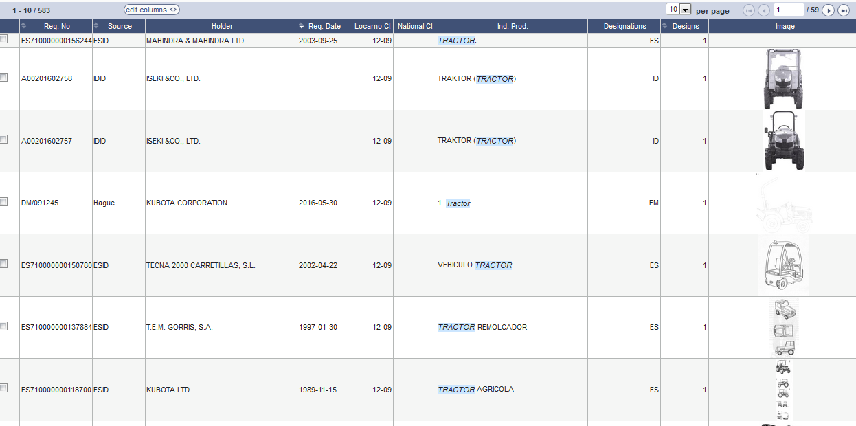
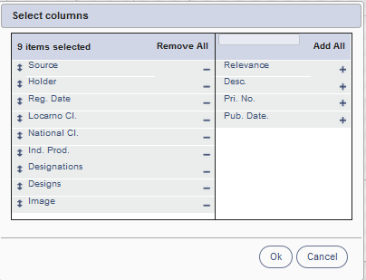
Results

Slide 36
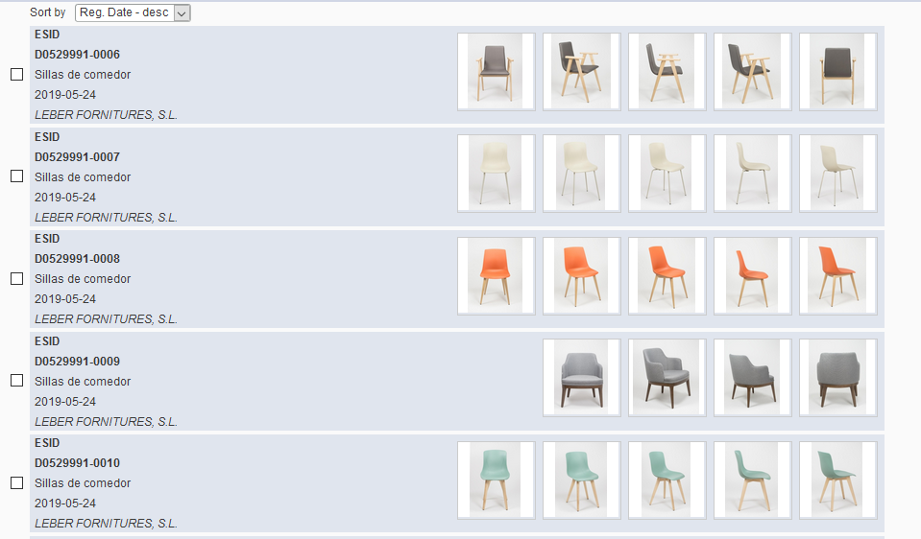
Grid view

Slide 37
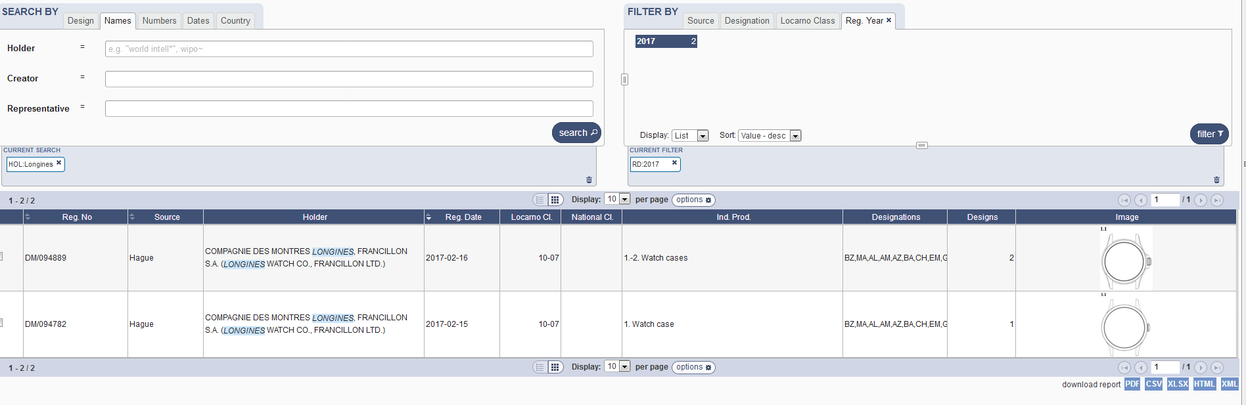

Slide 38
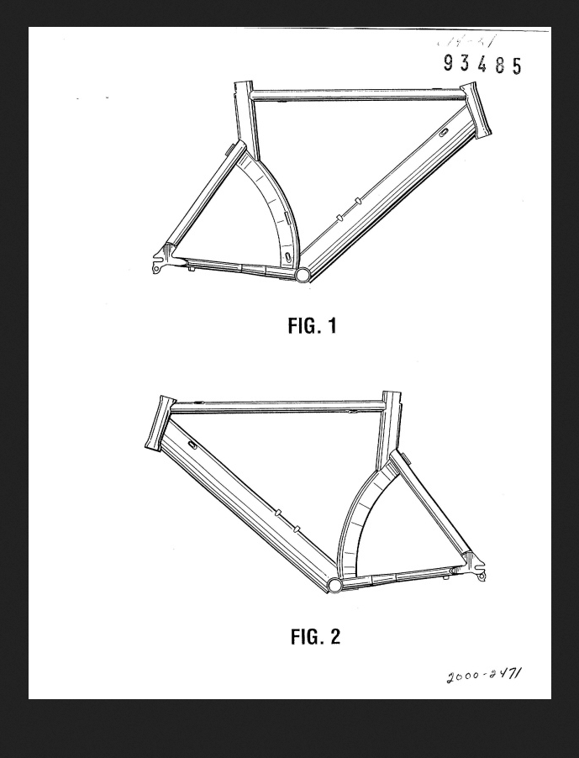
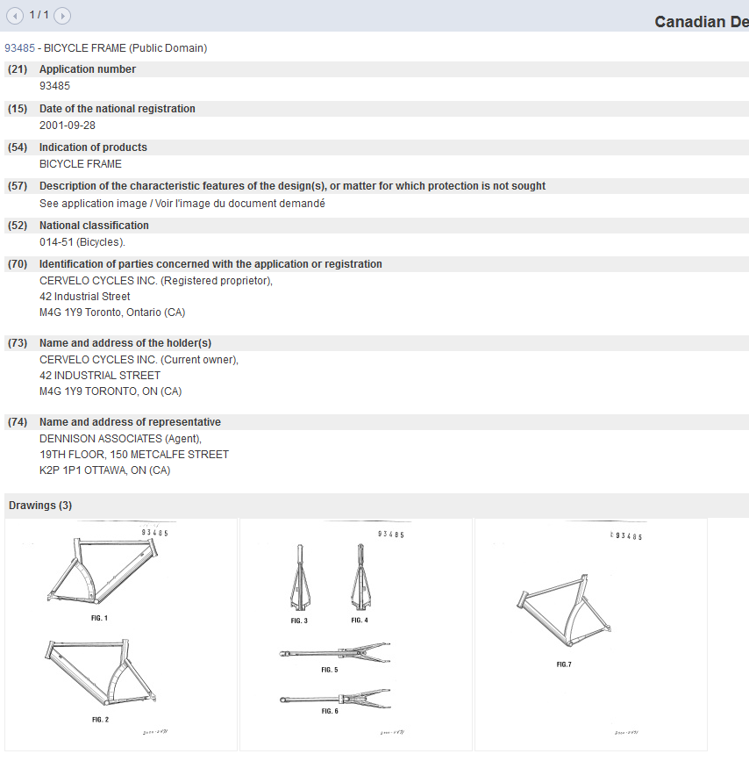
Individual record

Slide 39
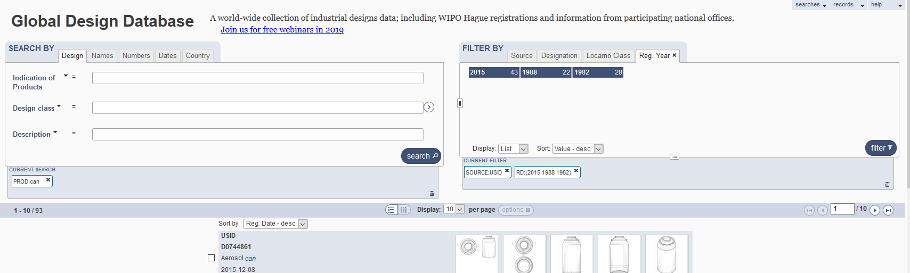
5

Slide 40




Slide 41
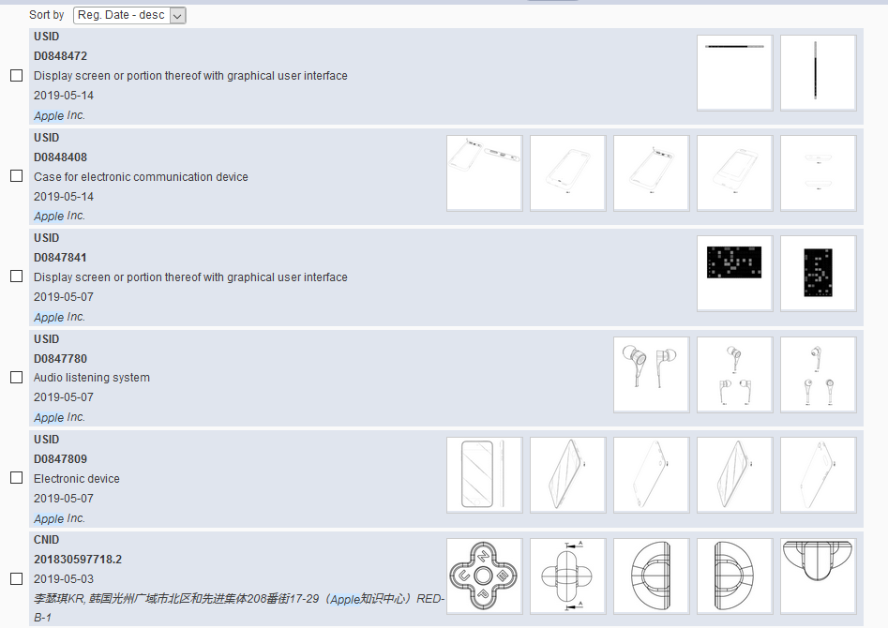

Slide 42
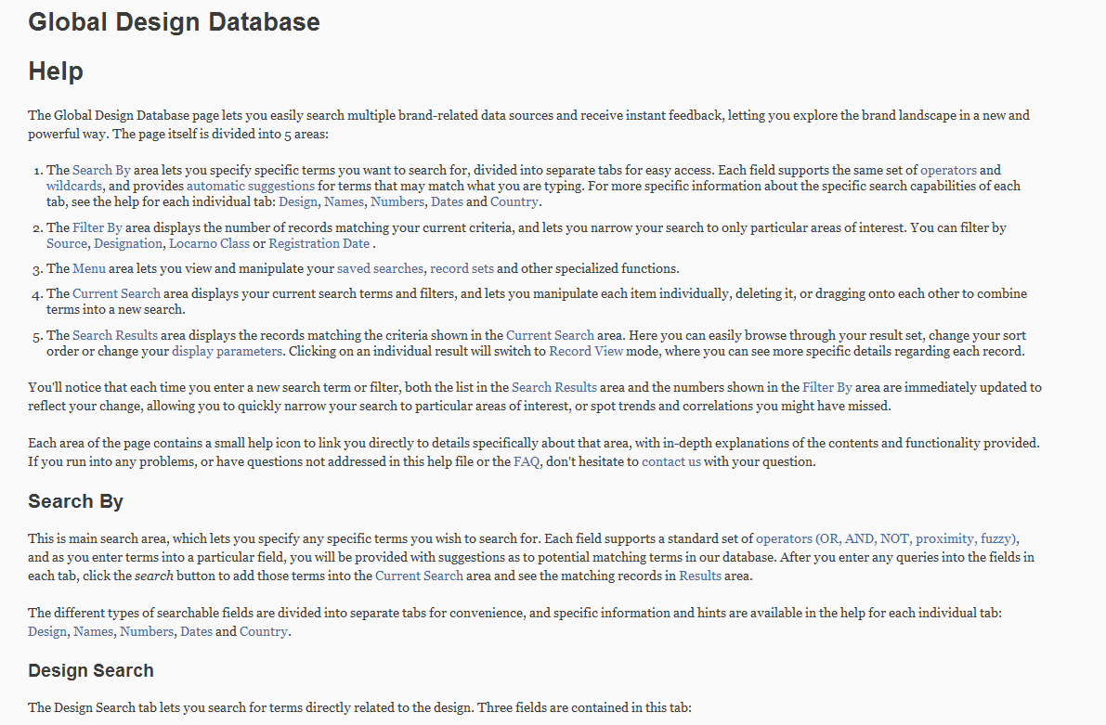
Help

Slide 43
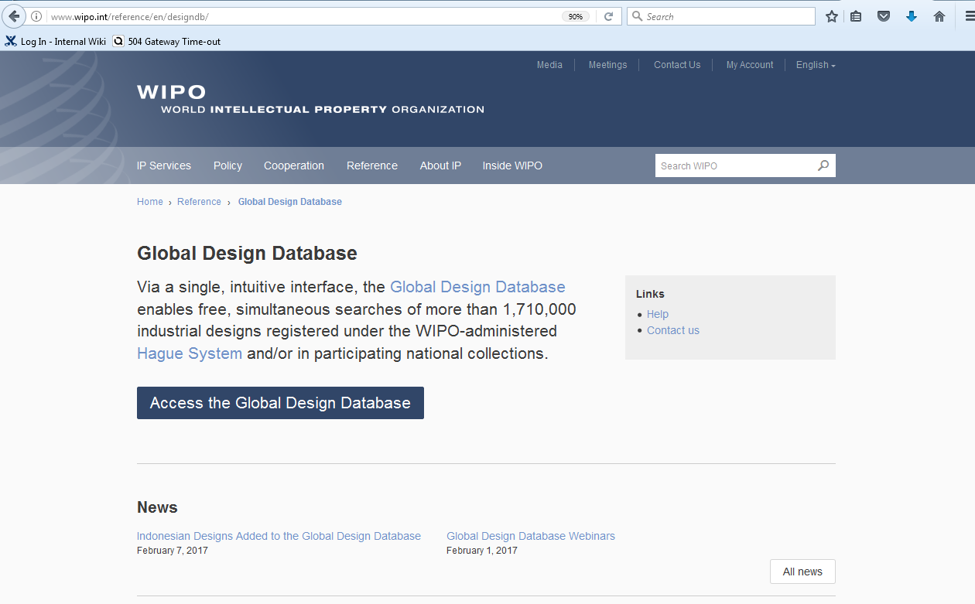

Slide 44
Next webinar
How to read, save & share your results in the GDD
  June 25 @5.30pm
  https://attendee.gotowebinar.com/register/4273995607295080194

Slide 45
Patent database webinar
Chemical strcuture search in PATENTSCOPE
  June 18 at 5:30 pm https://attendee.gotowebinar.com/rt/1699217551444301571
  June 20 at 8:30 am
  https://attendee.gotowebinar.com/rt/1699217551444301571

Slide 46
Global Brand Database webinar
How to read, save & share your results in the GBD
  June 12 at 5:30 pm CET https://attendee.gotowebinar.com/register/1483704476348386818

Slide 47
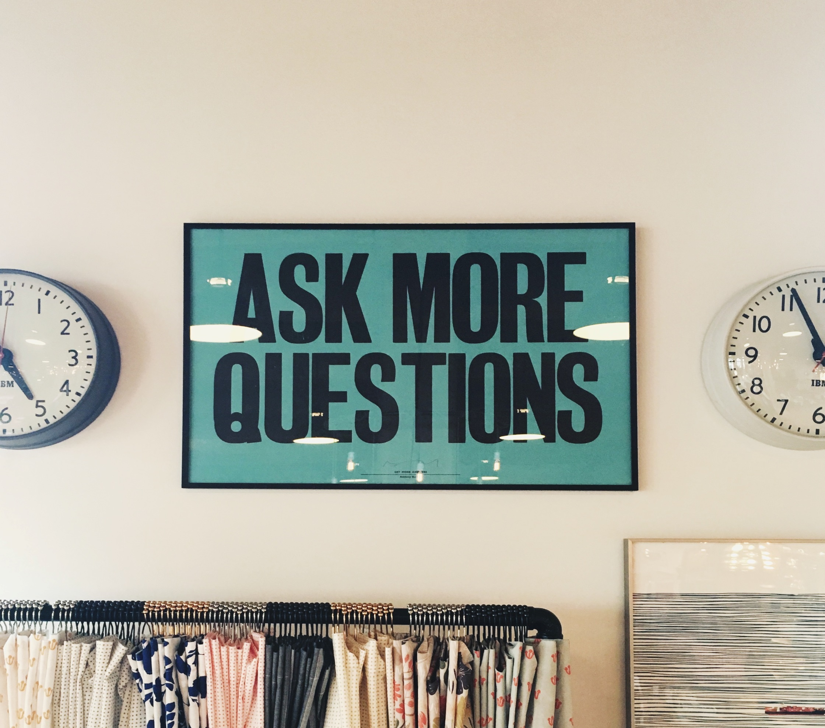

Slide 48

mulțumesc
mulțumesc
gbd@wipo.int

