Slide 1
Global Design Database:
An introduction
April 2017
Sandrine Ammann
Marketing & Communications Officer

Slide 2
Agenda
Interface:
  Coverage
  Search features
  Filter features
  Results
  Menus
  Example
Q&A

Slide 3
Why is the GDD useful?
Find details about a specific design
Explore design landscape to find out if the design you have in mind already exists.

Slide 4
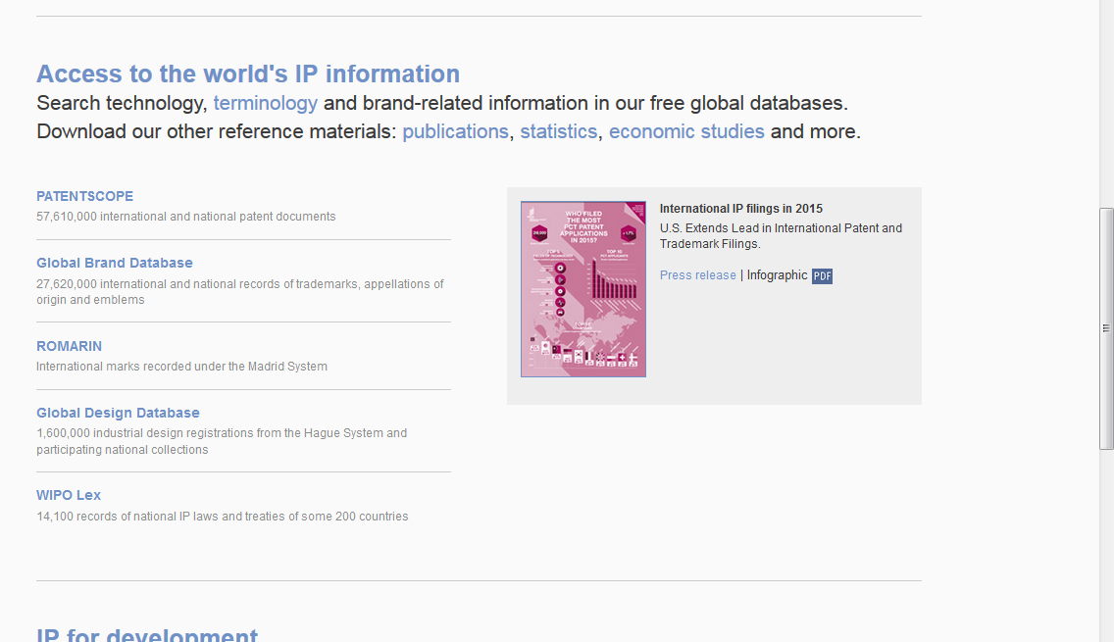
Access
http://www.wipo.int/designdb
www.wipo.int

Slide 5
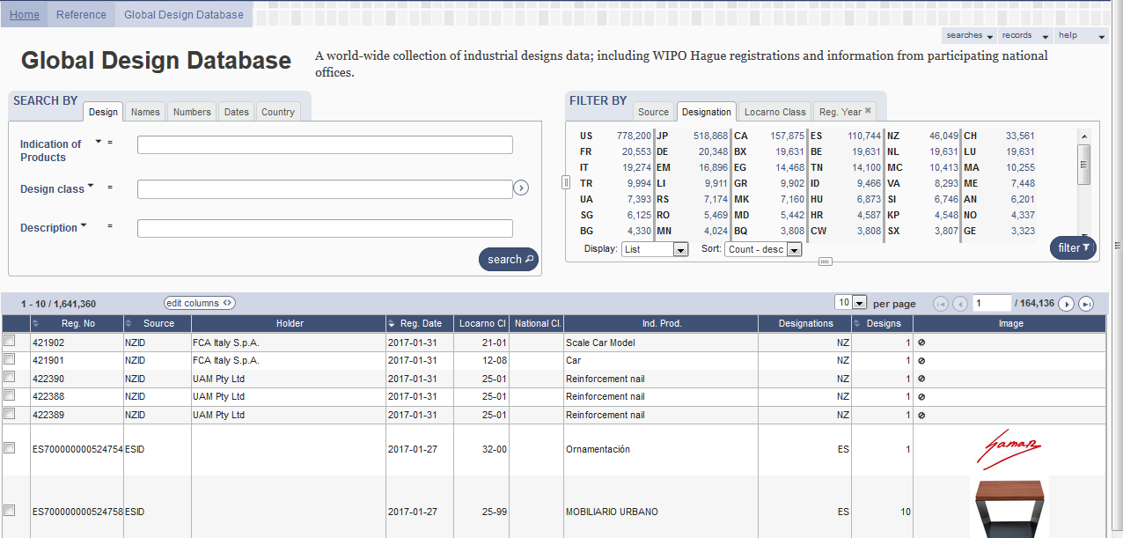

Slide 6
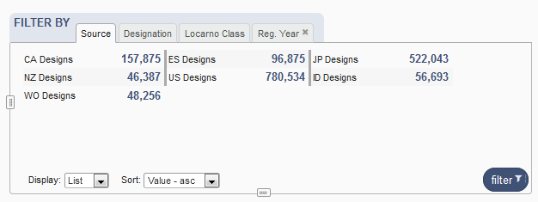

Coverage

Slide 7
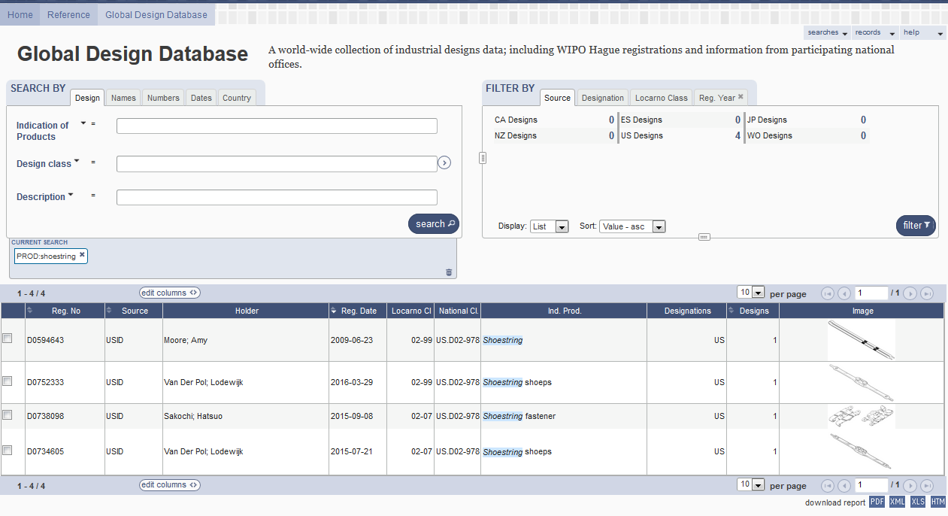
5
1
2
3
4

Slide 8
1

Slide 9
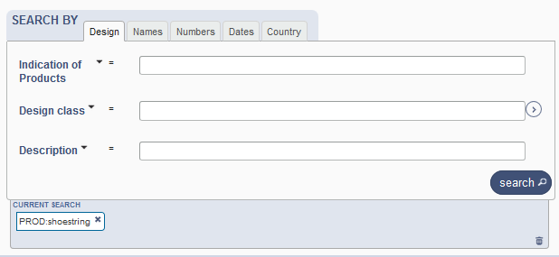
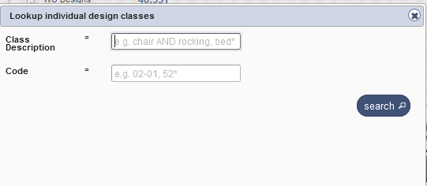
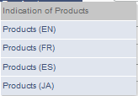
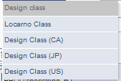
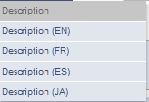
Search by design

Slide 10
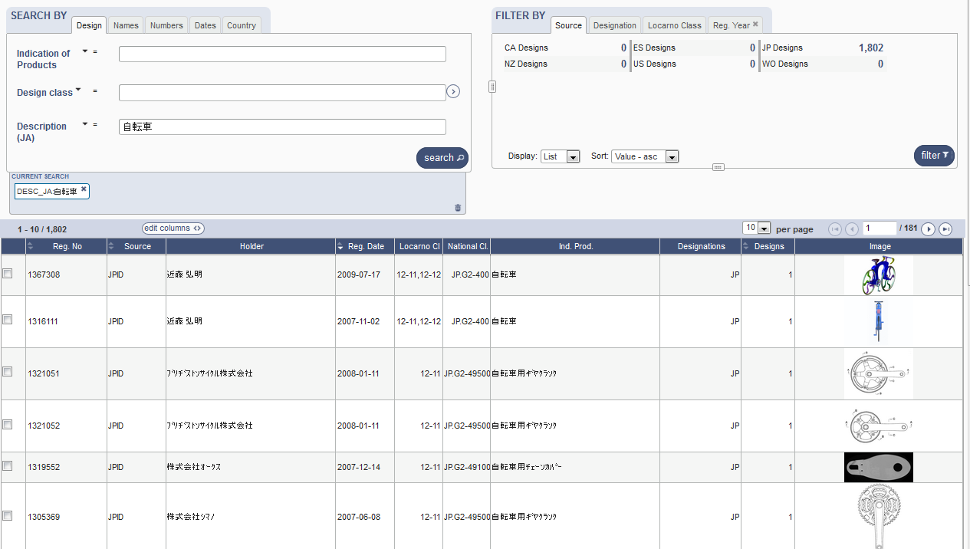
Search by Description JA

Slide 11
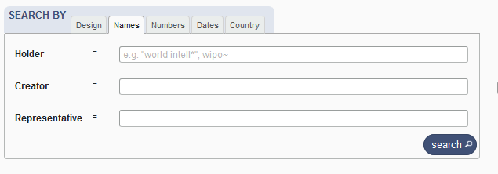
Search by name

Slide 12
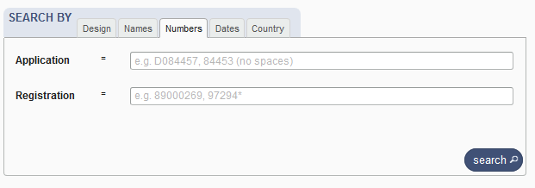
Search by numbers

Slide 13
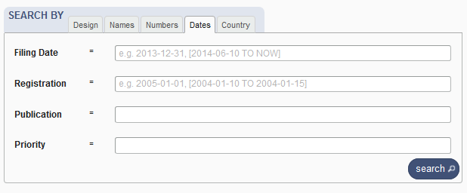
Search by dates

Slide 14
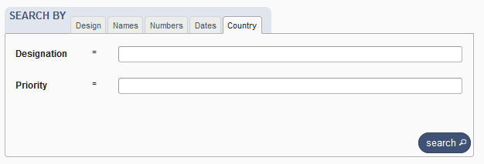
Search by country

Slide 15
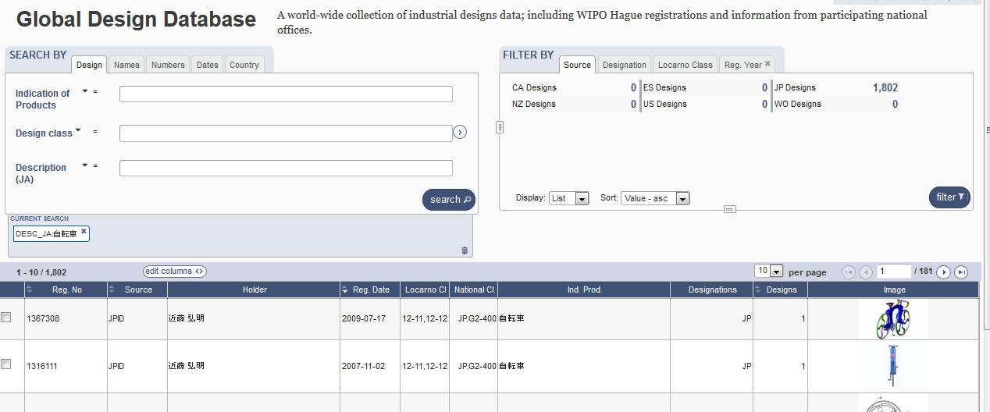

Slide 16
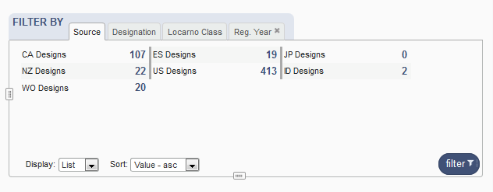
Filter by

Slide 17
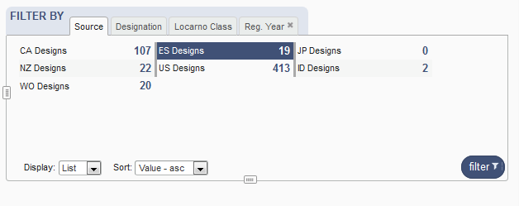
Filter by Source

Slide 18
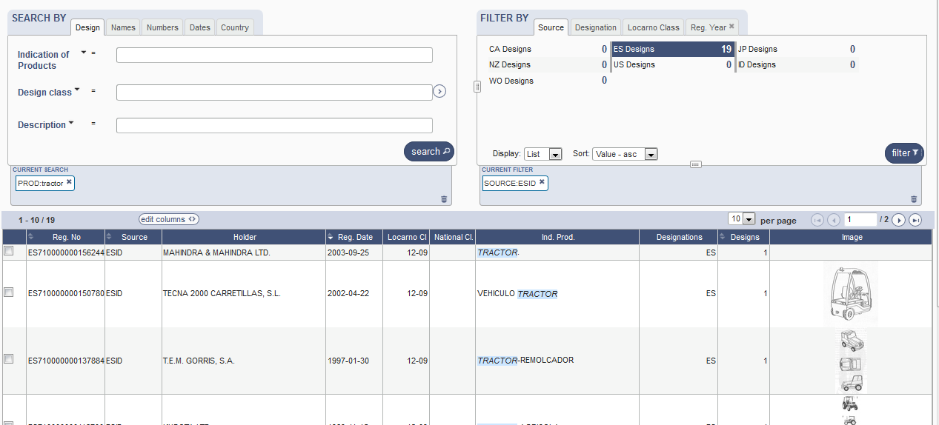

Slide 19
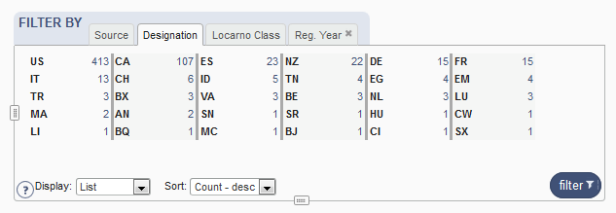
Filter by Designation

Slide 20
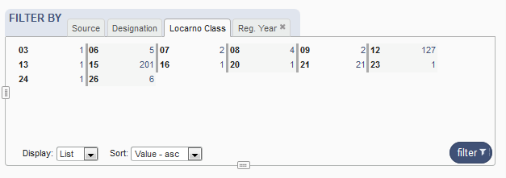
Filter by Locarno Class

Slide 21
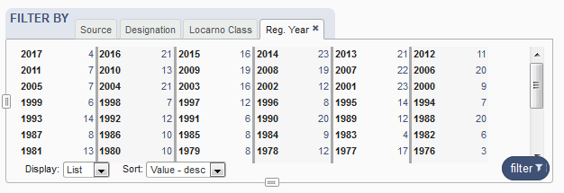
Filter by Registration Year

Slide 22


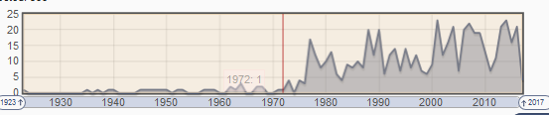
Options

Slide 23
3

Slide 24
4

Slide 25
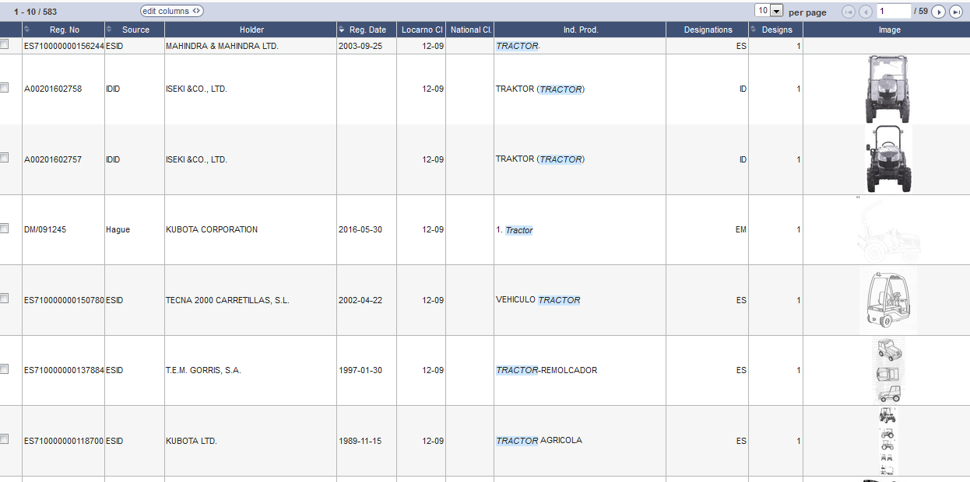
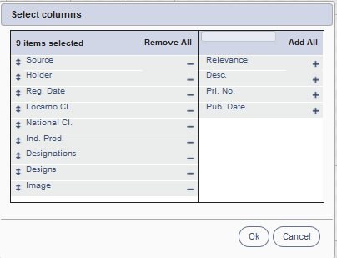
Results

Slide 26
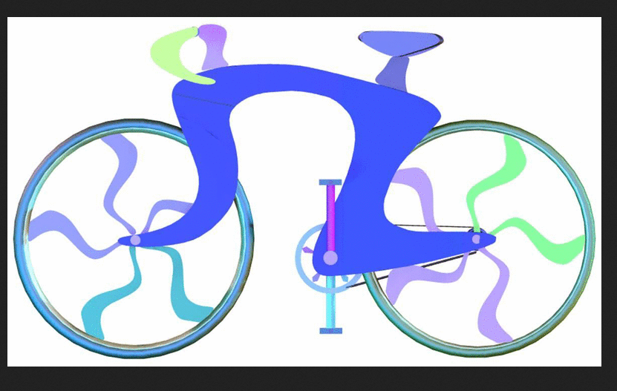
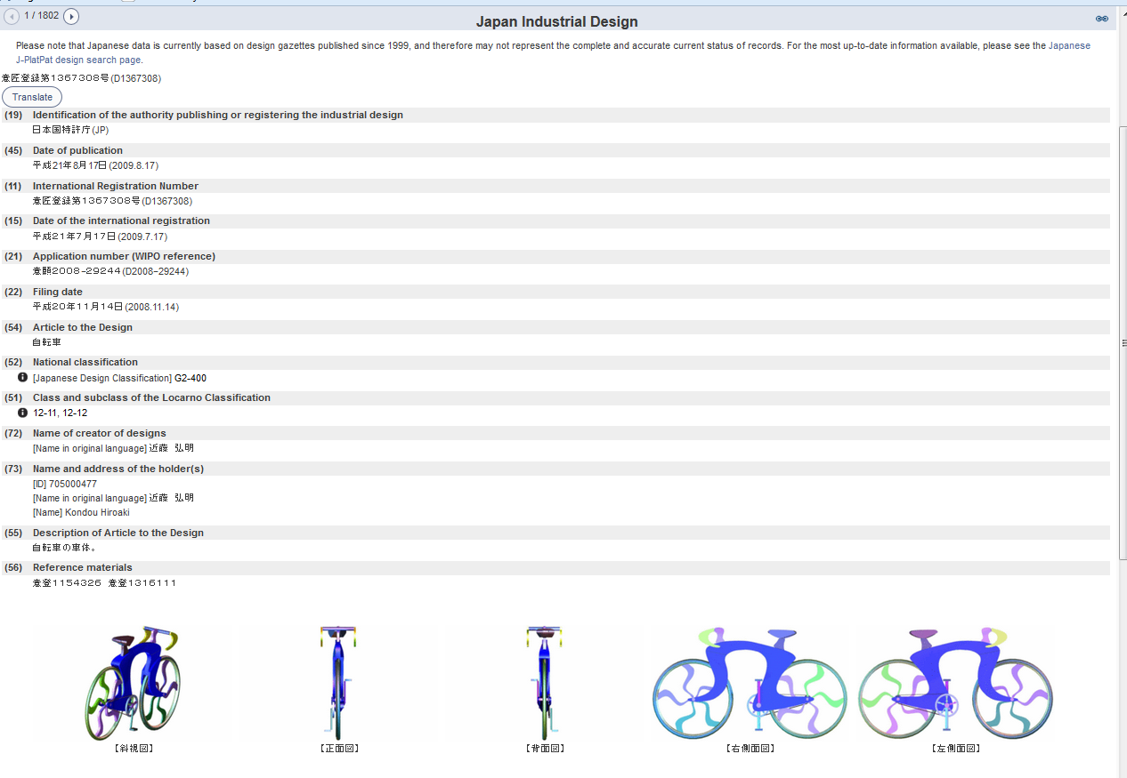
Individual record

Slide 27
5

Slide 28




Slide 29
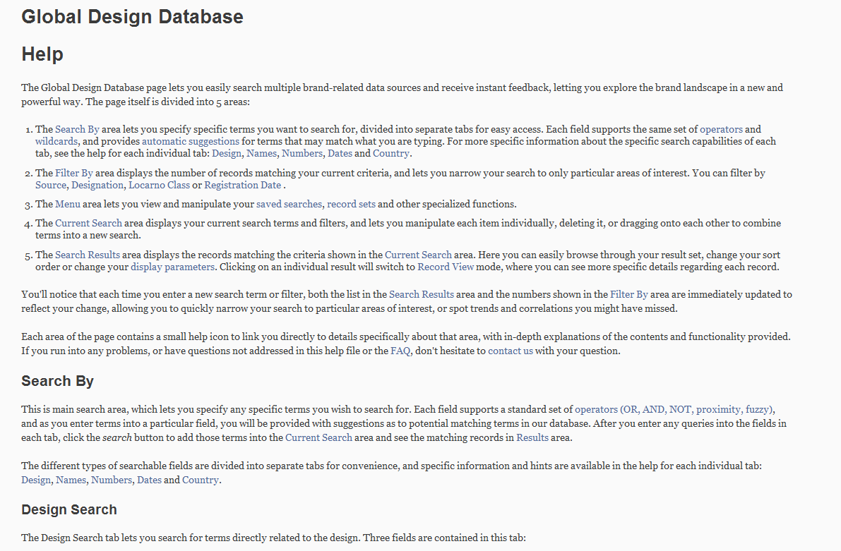
Help

Slide 30


Slide 31
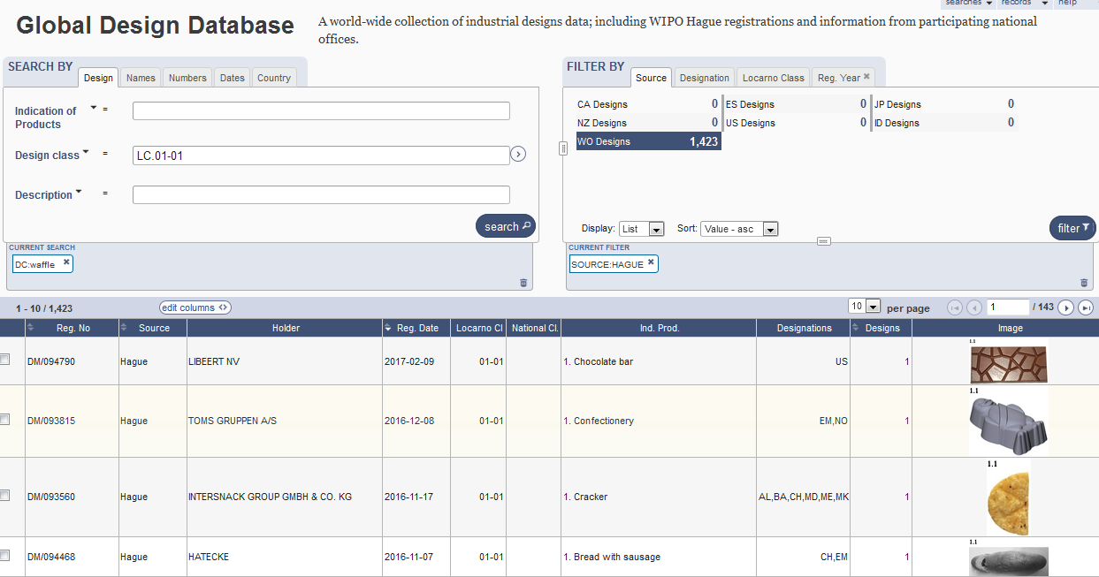
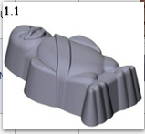

Slide 32
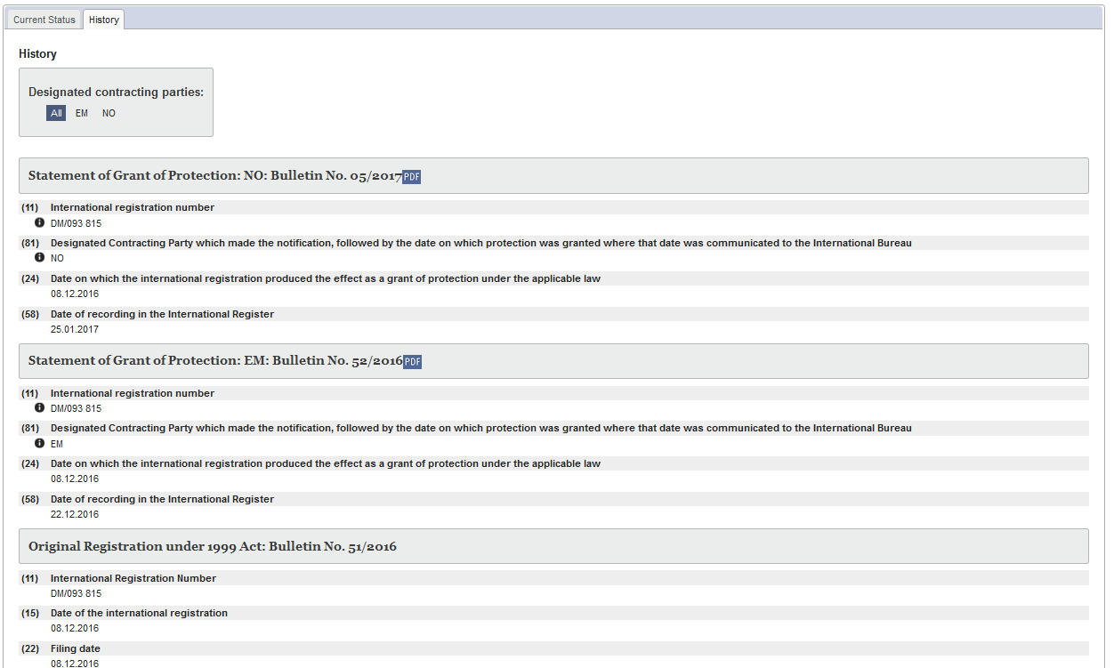
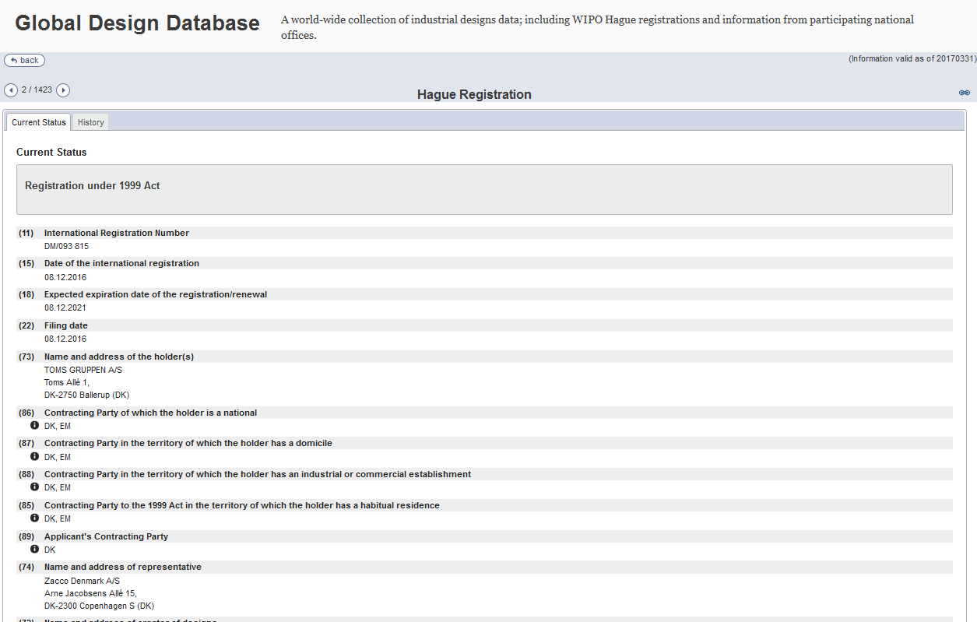

Slide 33
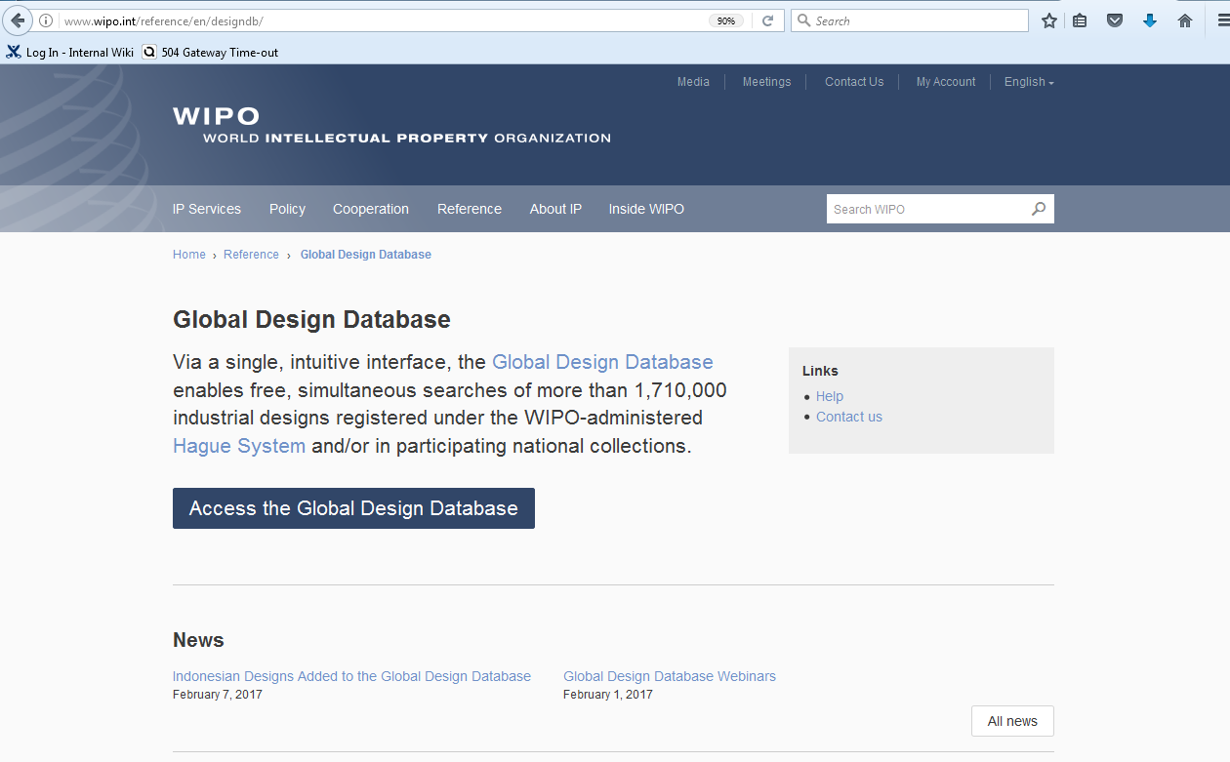

Slide 34

mulțumesc
mulțumesc
gdd@wipo.int

