Slide 1
How to perform a search in the Global Brand Database
Cyberworld
February
2019
Sandrine Ammann
Marketing & Communications Officer

Slide 2
Agenda
Clarification
Interface:
Search features
Filter features
Results
Menus
Q&A

Slide 3
Madrid Monitor

Slide 4
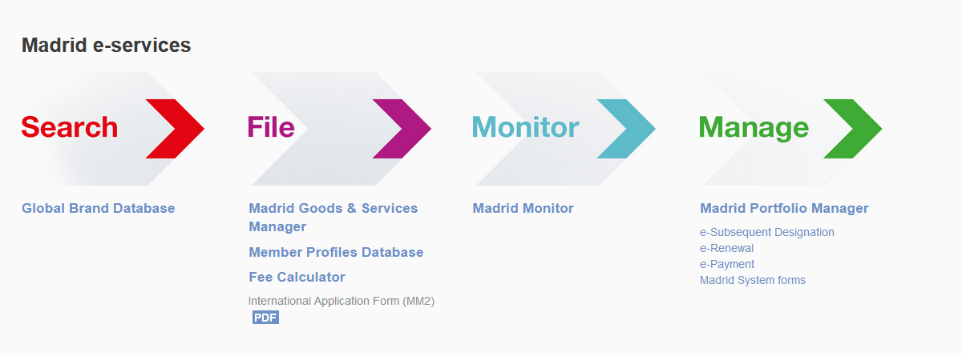

Slide 5
Why is the GBD useful?
Brand landscape
Details about brands

Slide 6
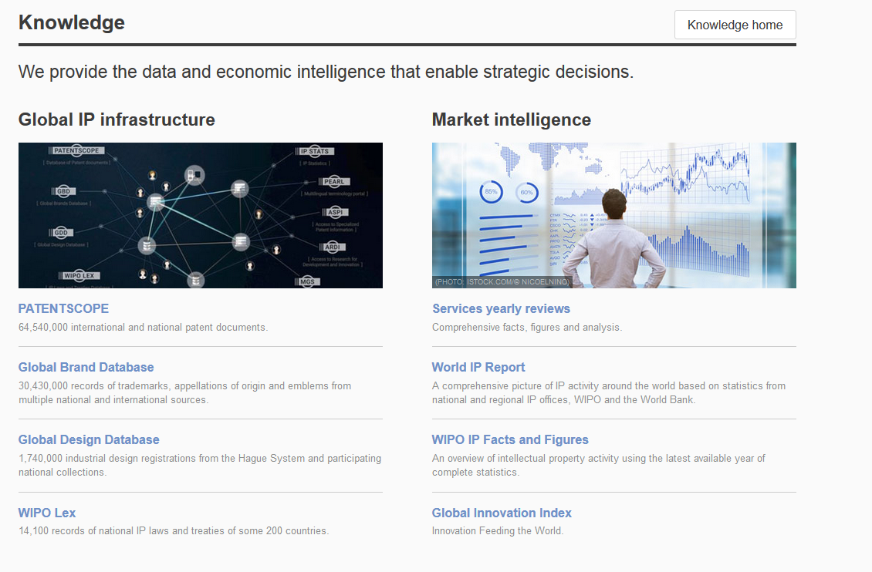
Access
www.wipo.int/branddb
www.wipo.int

Slide 7
Addition of the WHO INNs collection
Over 9,800 records

Slide 8
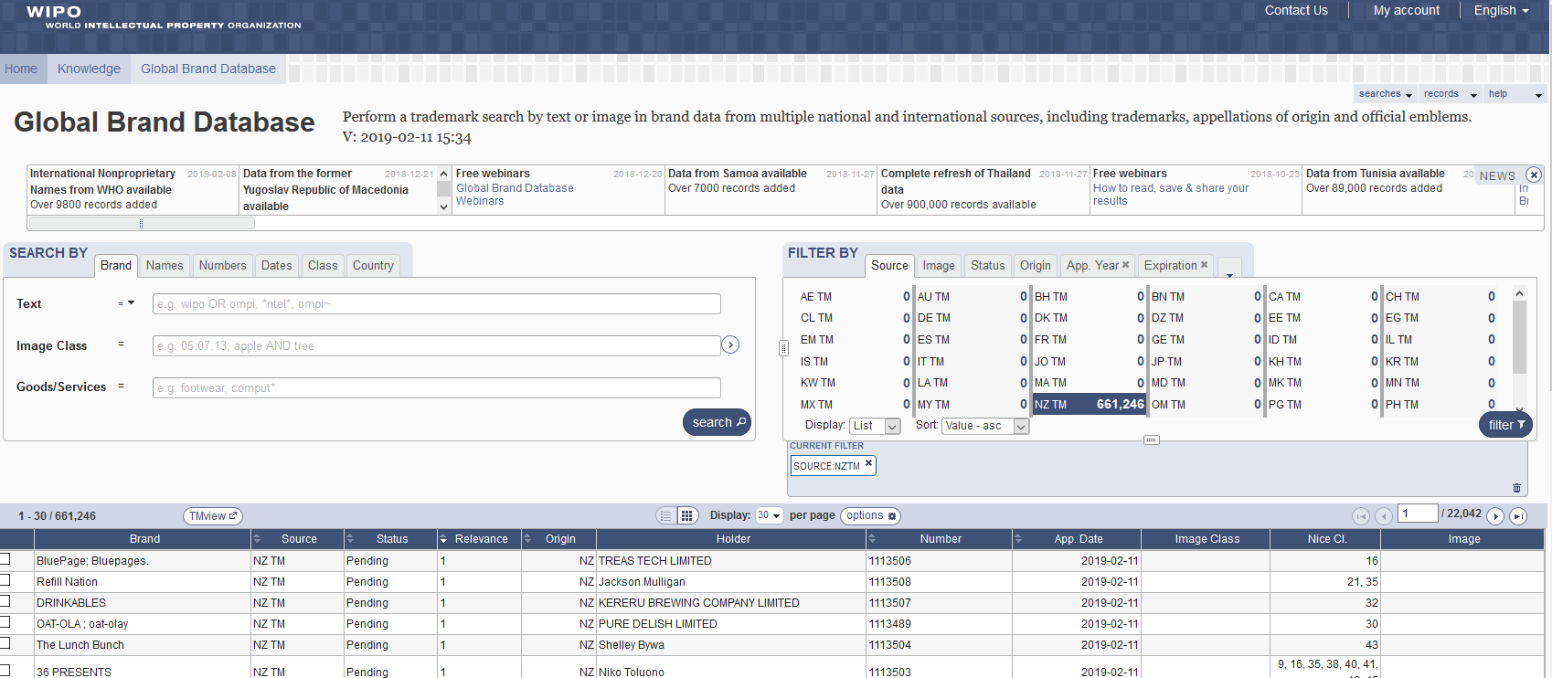
Interface - Account

Slide 9
The principle

Slide 10
Combining many search criterias
Brand Arla
2 Nice classifications: 20 & 43
2 designating countries: Japan & Denmark

Slide 11
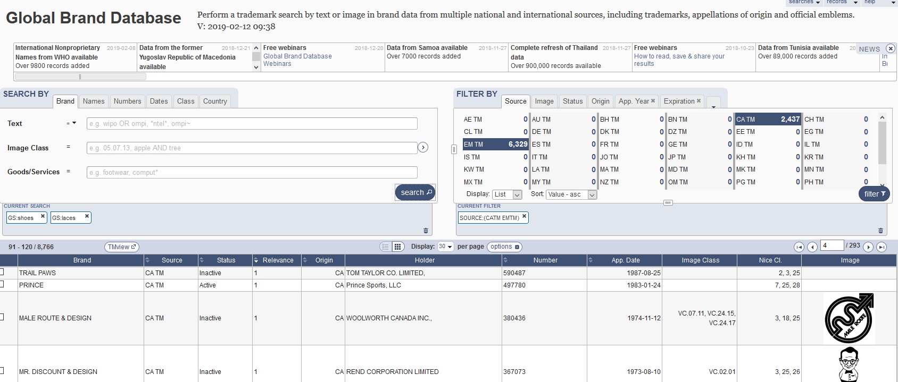
5
6
1
2
3
4

Slide 12
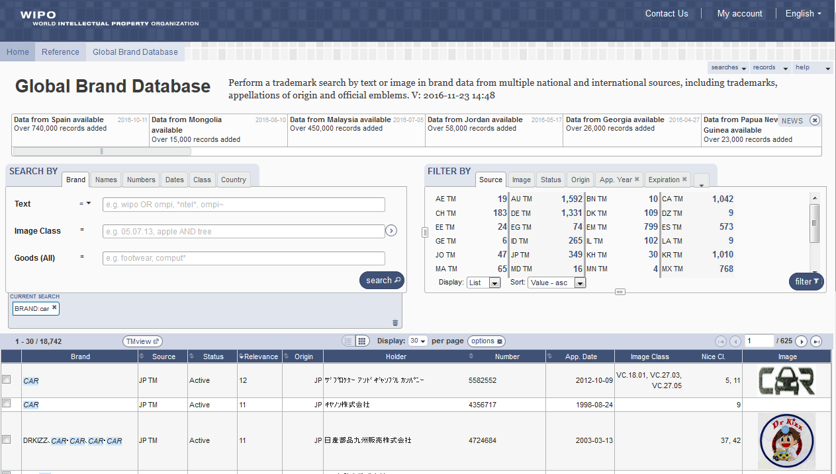
Search by: 1
1

Slide 13
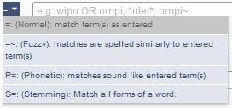
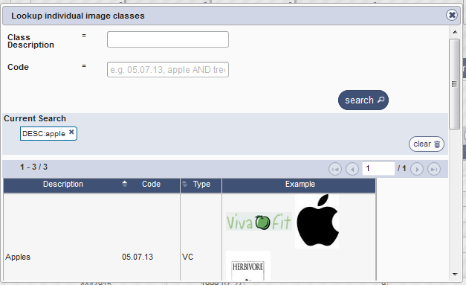
Search by

Slide 14
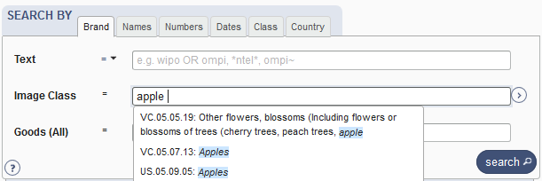

Slide 15
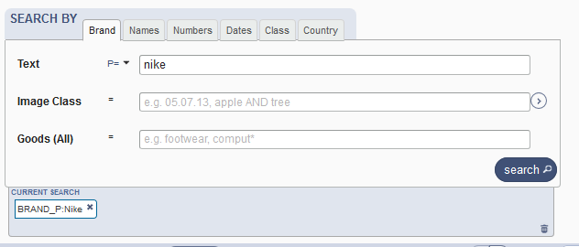
Example: phonetic search

Slide 16
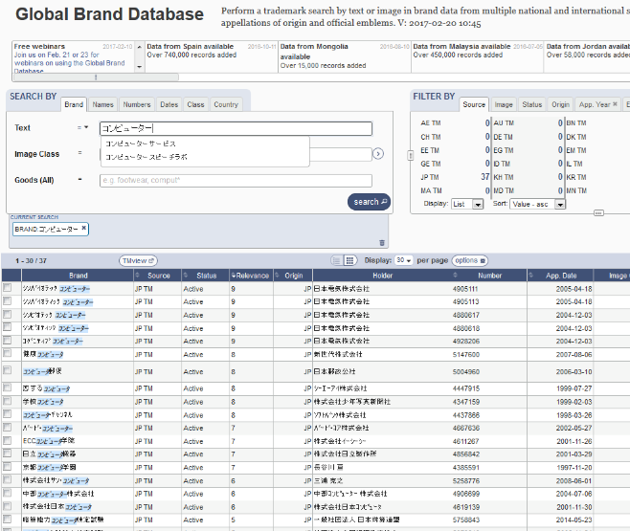
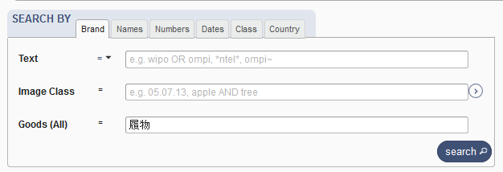
Languages - autosuggestion

Slide 17
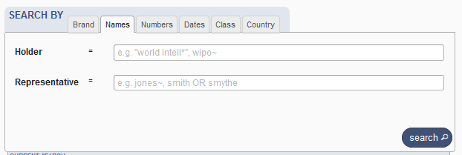
Search by Names

Slide 18
Search by Numbers

Slide 19
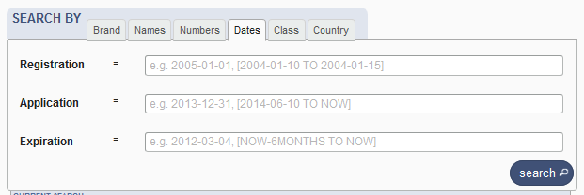
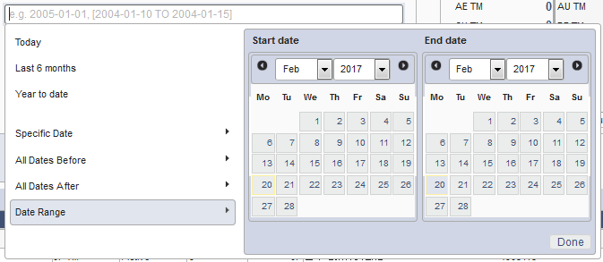
Search by Dates

Slide 20
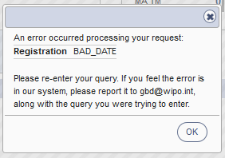
Tips
Range: […]{…} + TO
Error message

Slide 21
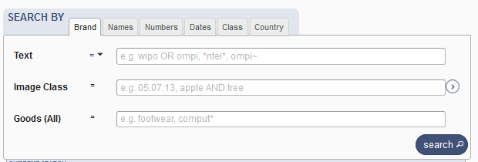
Search by Class

Slide 22
Search by Country

Slide 23
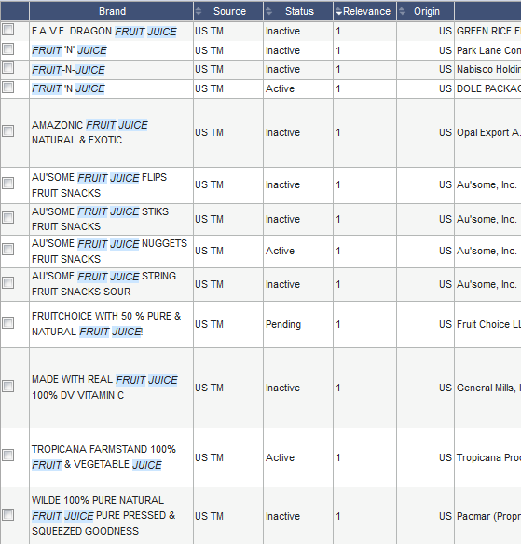
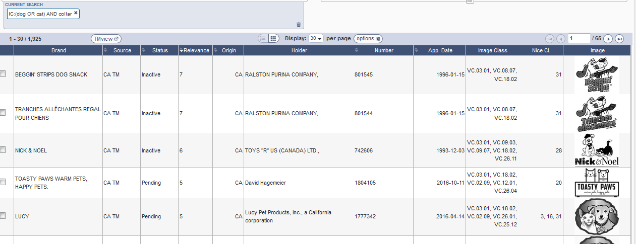
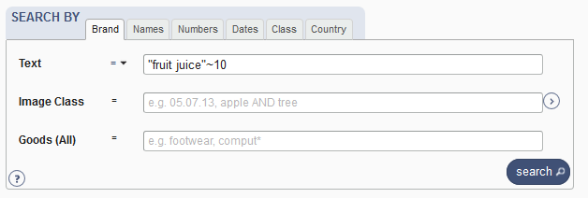
Examples

Slide 24
Tips
OR
Not limit
Needle or "hypodermic needle"
Transliteration:
Korean + Japanese : automatic
Arabic: not supported
Punctuation/ accent: ignored

Slide 25
Wildcards, fuzzy, proximity
Wilcards: * = 0/multiple letter; ? = 1 letter
te?t 'test' and 'text‘
text* 'text', 'texts', 'texting‘
*text or te*t.
Proximity operators: «…» ~10
Fuzzy: ~+ value between 0 and 1
alco~ 'also', 'alcoh', 'asco'

Slide 26
Filter by: 2
2

Slide 27
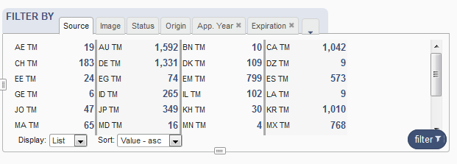
Filter by

Slide 28
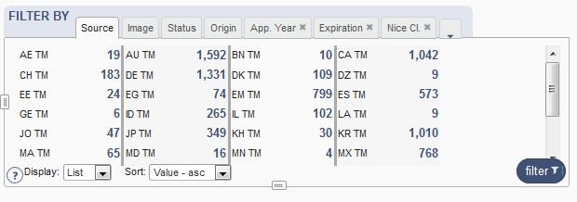
Filter by: Source

Slide 29
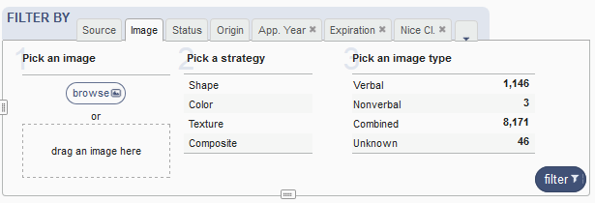
Filter by: Image

Slide 30
Image search
Your search
The results

Slide 31
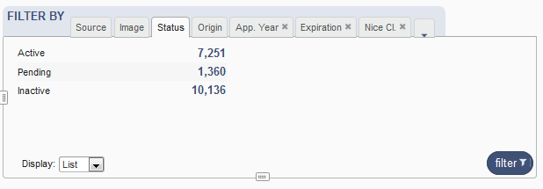
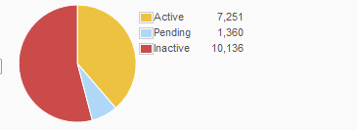
Filter by: Status

Slide 32
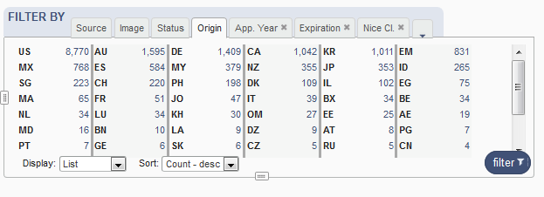
Filter by: Origin

Slide 33
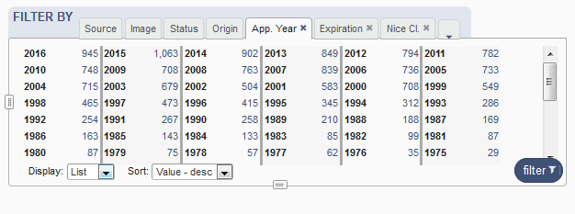
Filter by: Application Year

Slide 34
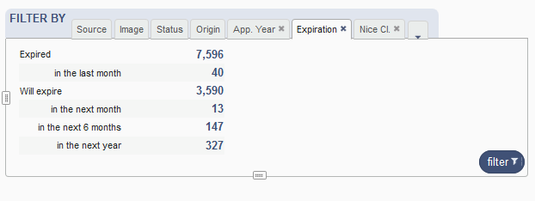
Filter by: Expiration

Slide 35
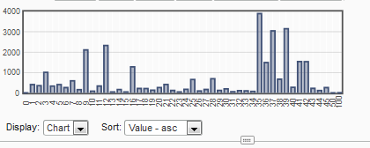
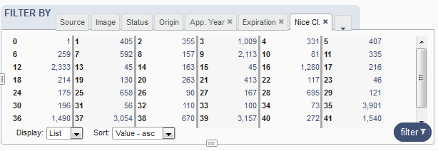
Filter by: Nice Classification

Slide 36
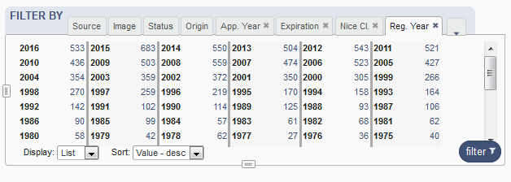
Filter by: Registration year

Slide 37
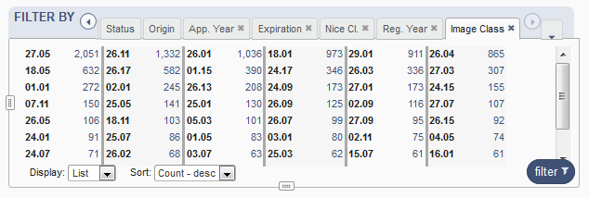
Filter by: Image classification

Slide 38
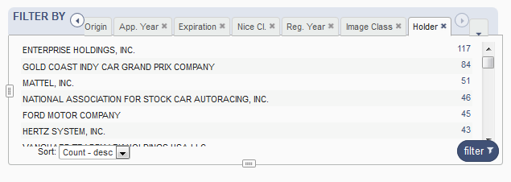
Filter by: Holder

Slide 39
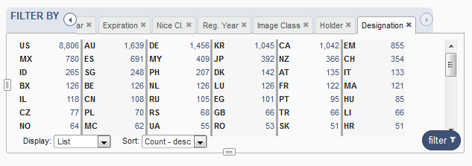
Filter by: Designation

Slide 40
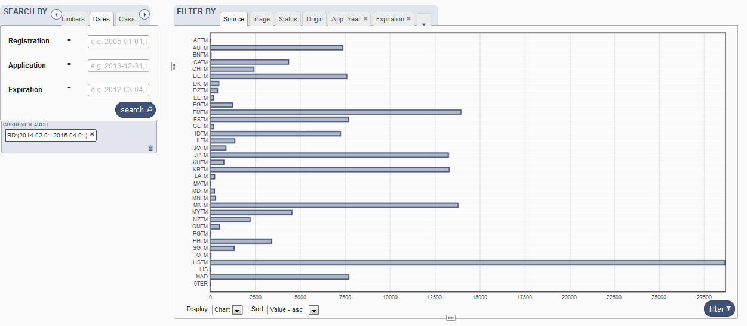
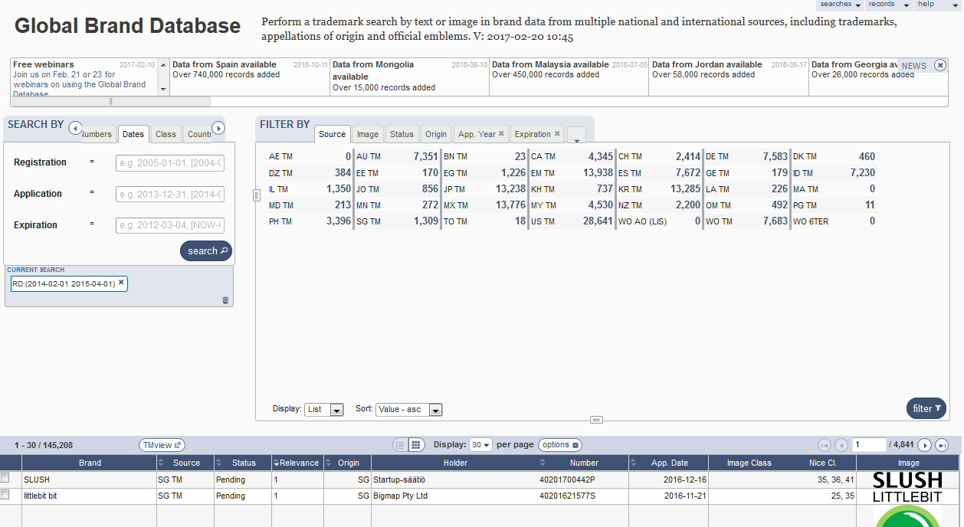
Resize

Slide 41
Current search: 3
3
3

Slide 43
Search results: 4
4

Slide 44
Result area: pager & list

Slide 45
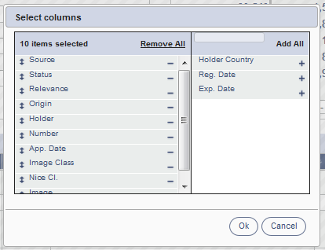
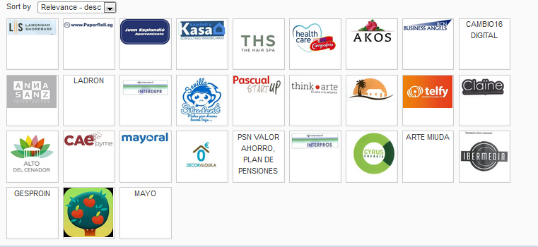
Pager

Slide 46
Record list – list format

Slide 47
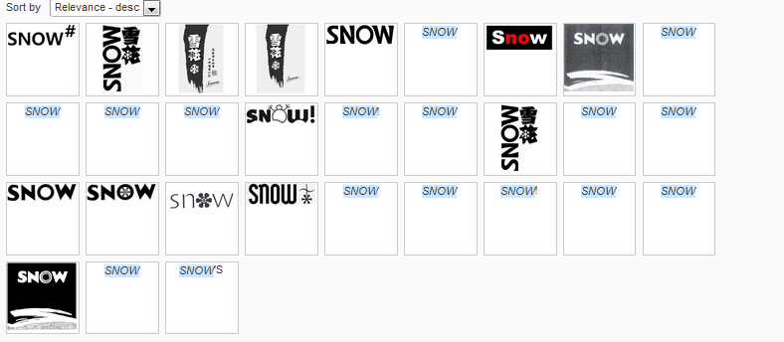
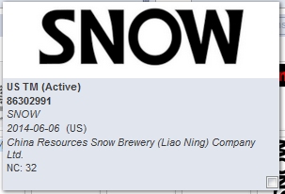
Record list – grid format

Slide 48
Download reports

Slide 49
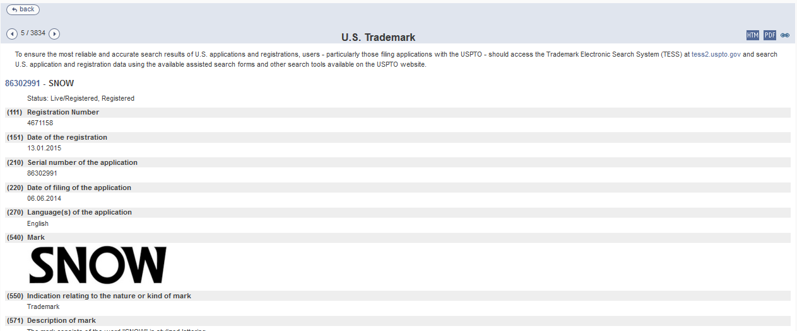
Record view

Slide 50
Menu: 5
5

Slide 51
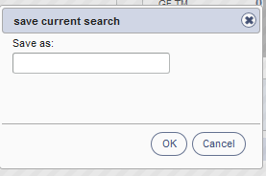
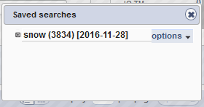
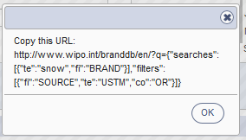

Slide 52
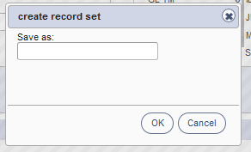
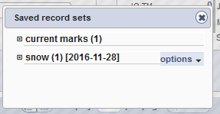

Slide 54
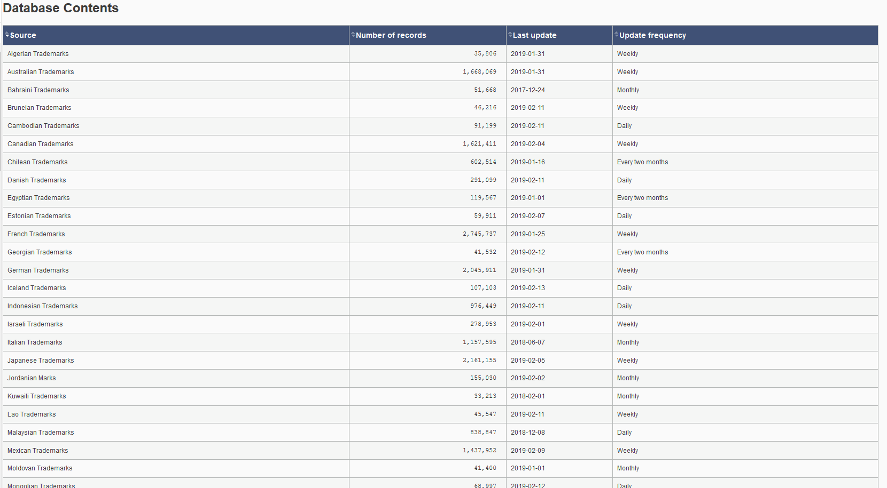
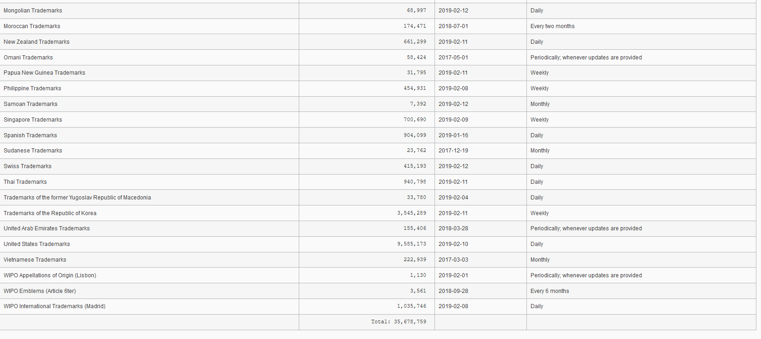

Slide 55
News: 6
6

Slide 56
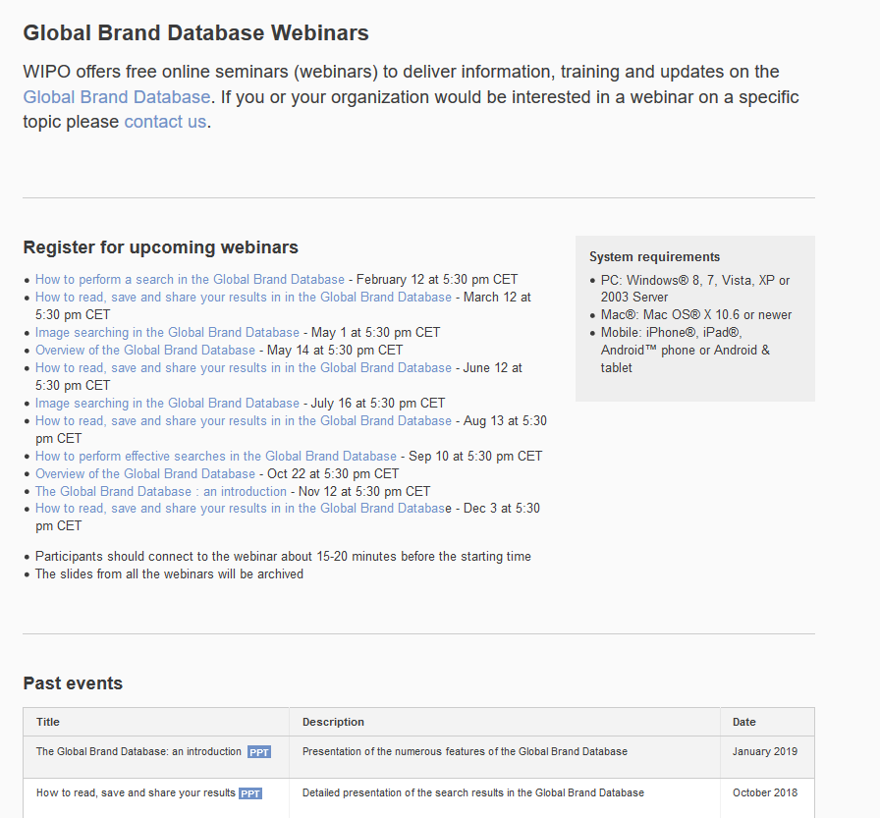
https://www.wipo.int/reference/en/branddb/webinar/index.html

Slide 57
mulțumesc
mulțumesc
gbd@wipo.int

