Slide 1
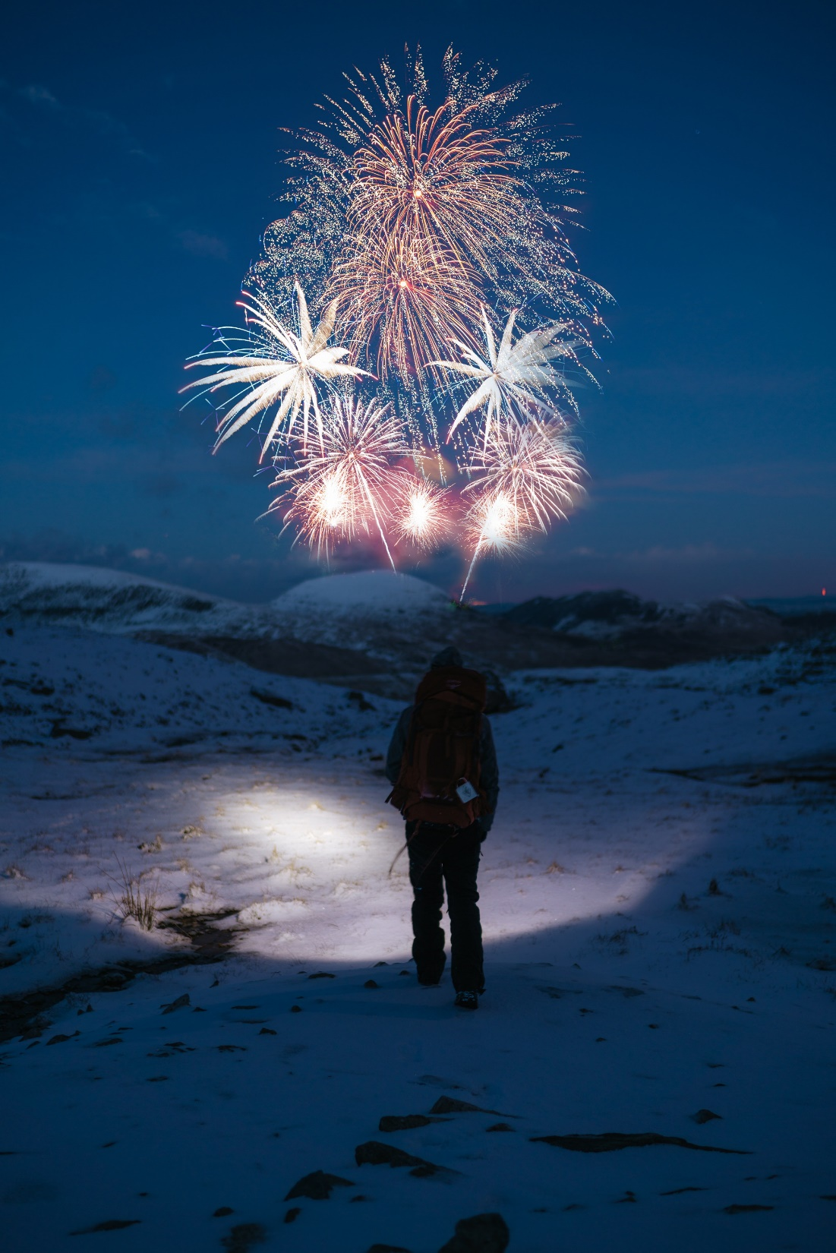
Photo by Simon Migaj on Unsplash

Slide 2
Agenda
Acces
Interface:
  Search features
  Filter features
  Results
  Menus
Q&A

Slide 3
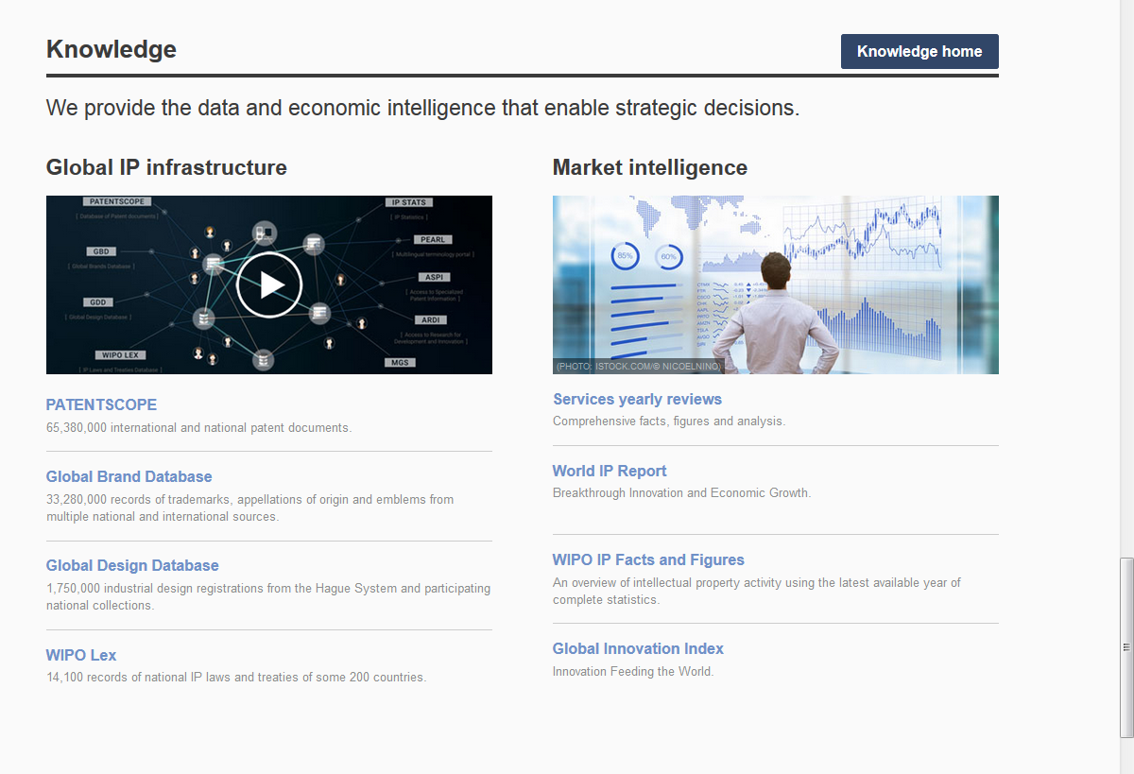
Access
www.wipo.int/branddb
www.wipo.int

Slide 4
Why is the GBD useful?
Find details about a specific brand
Explore mark landscape to find out if the brand you have in mind already exists

Slide 5


Slide 6
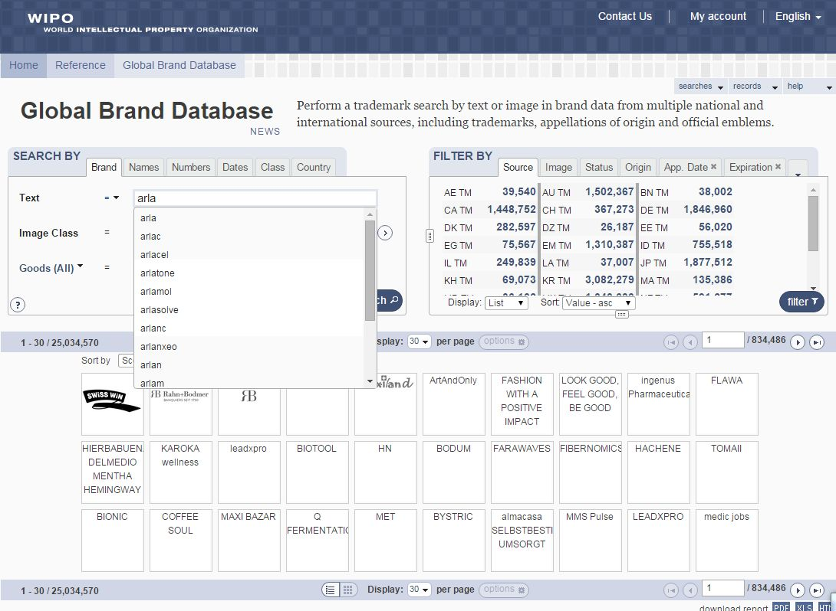

Slide 7
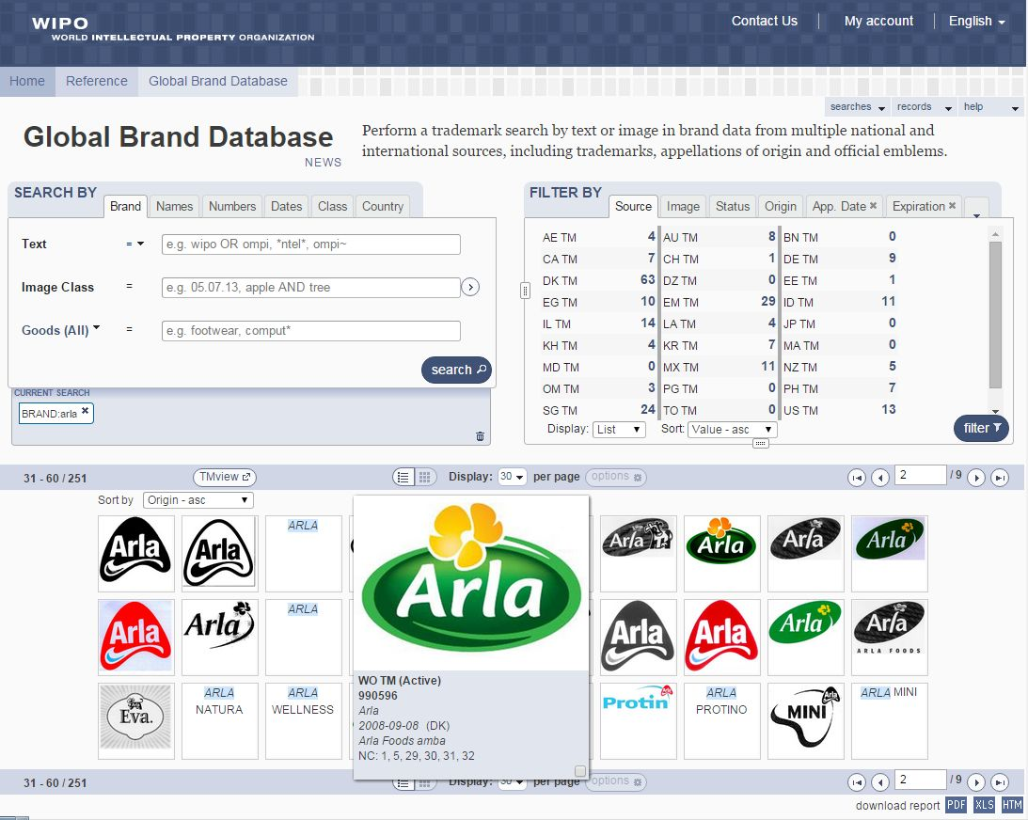

Slide 8
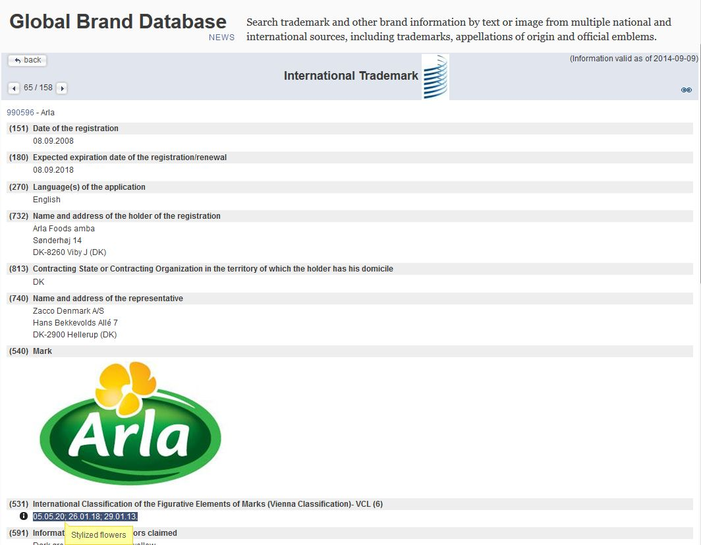

Slide 9
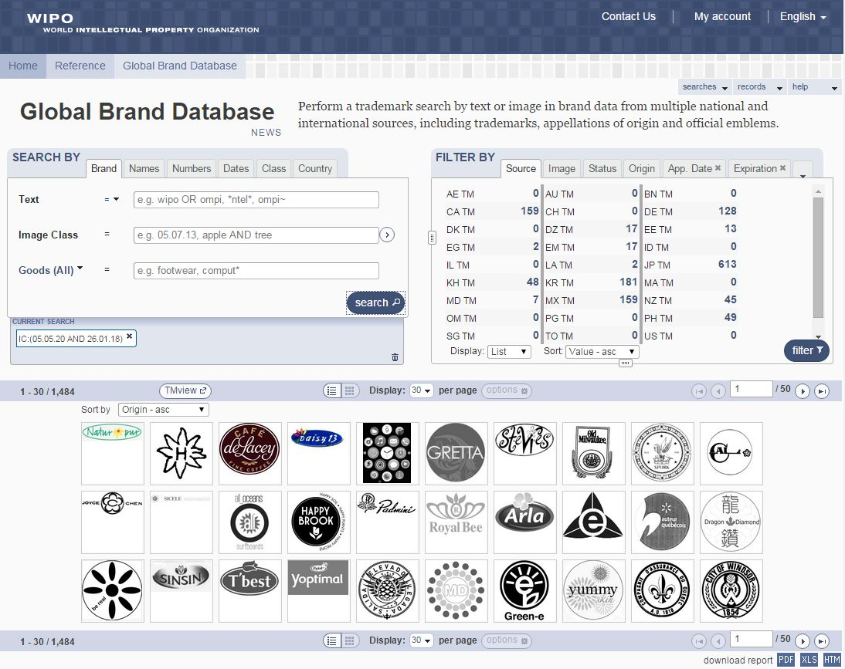

Slide 10
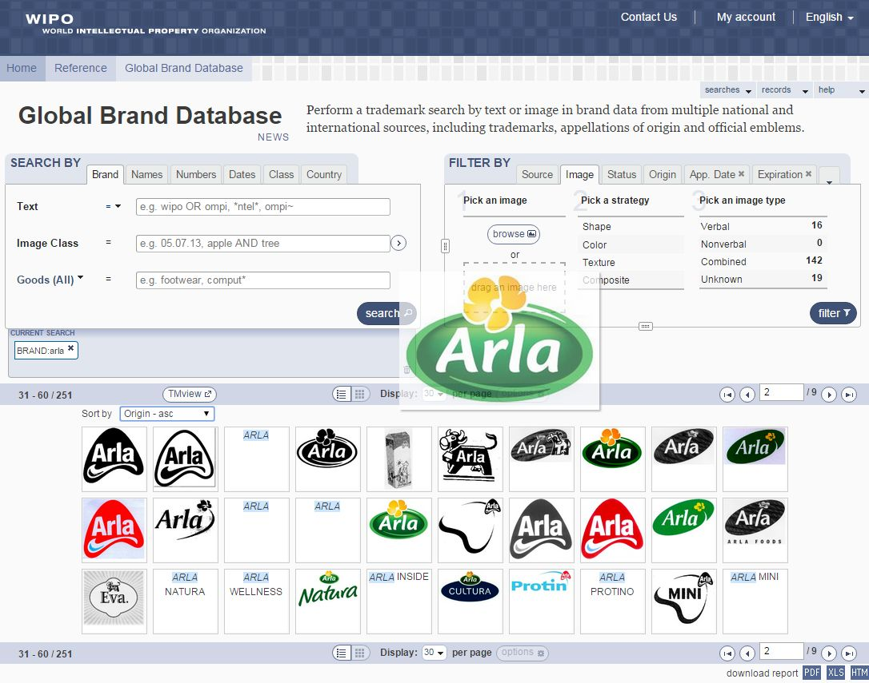

Slide 11
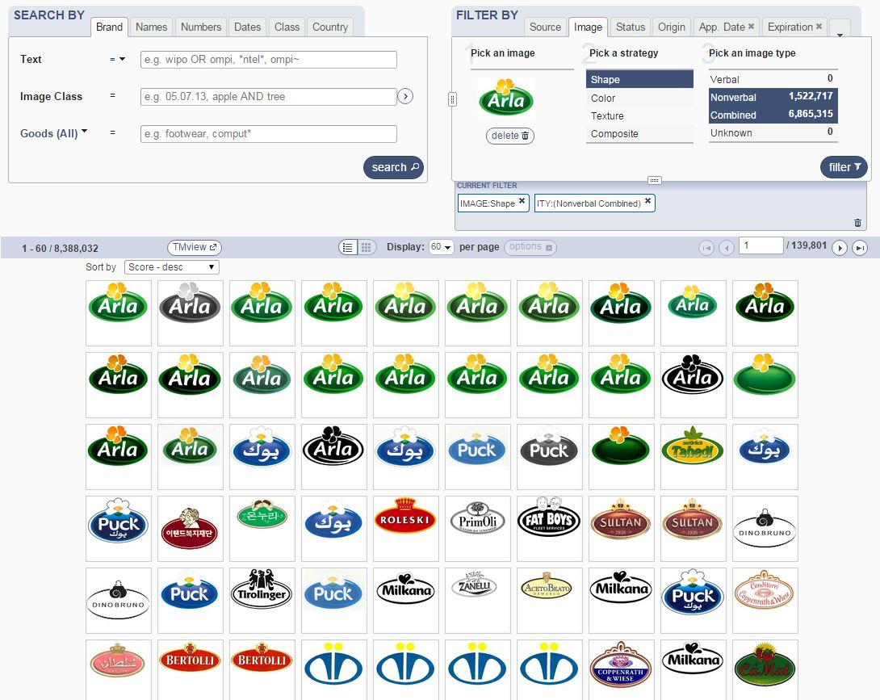

Slide 12
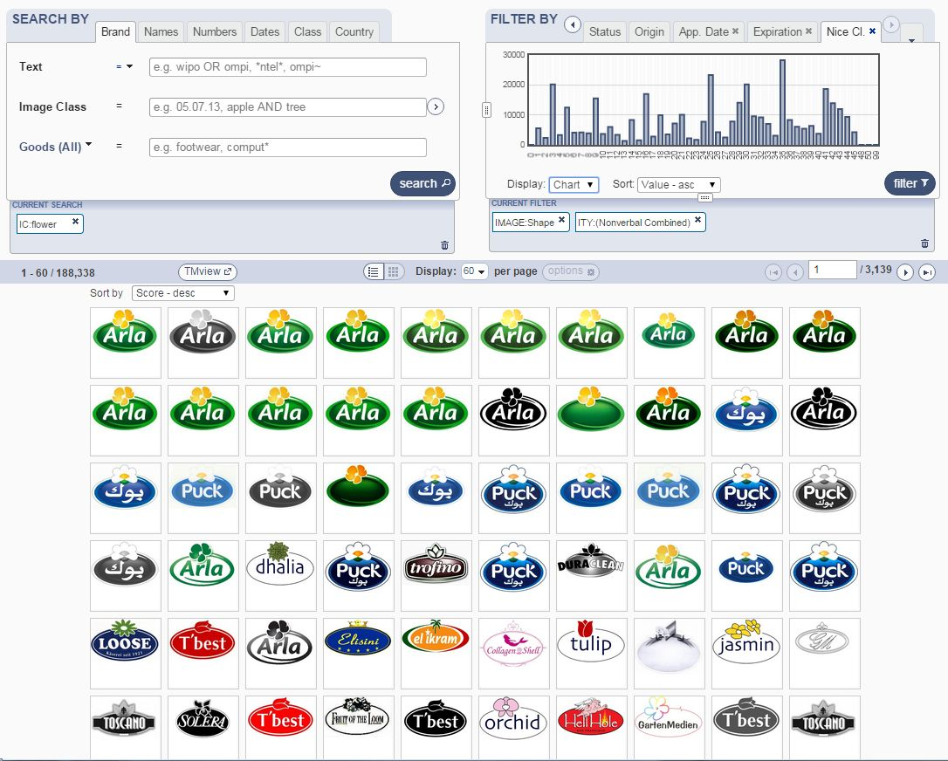

Slide 13
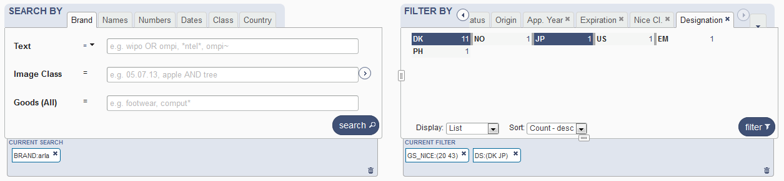
Combining many search criterias
Brand Arla
2 Nice classifications: 20 & 43
2 designating countries: Japan & Denmark

Slide 14
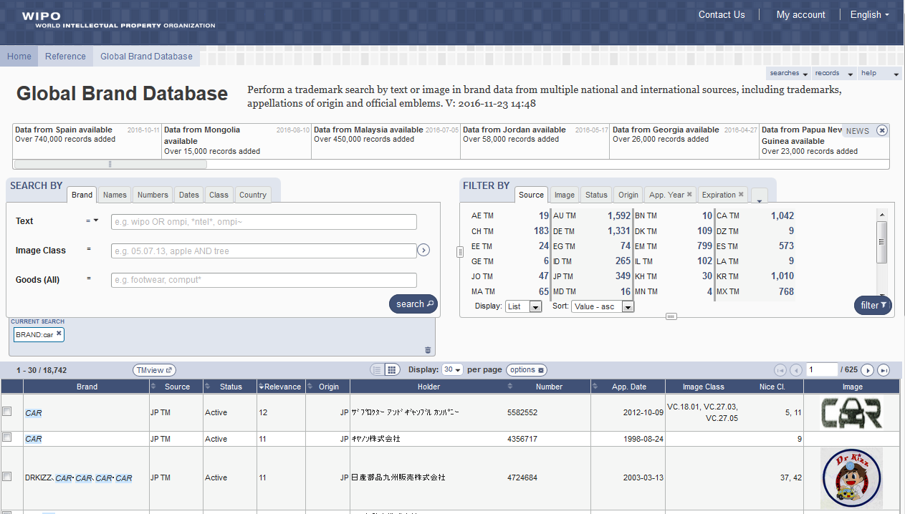
5
6
1
2
3
4

Slide 15
Search by: 1
1

Slide 16
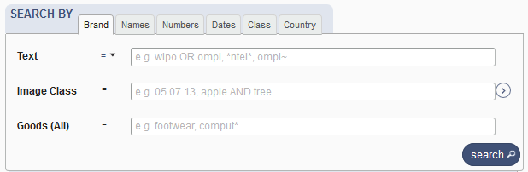
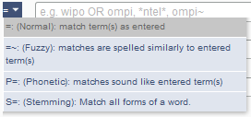
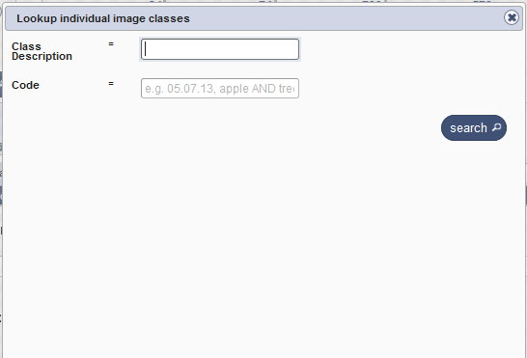
Search by

Slide 17

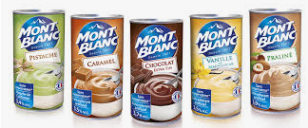
Example

Slide 18
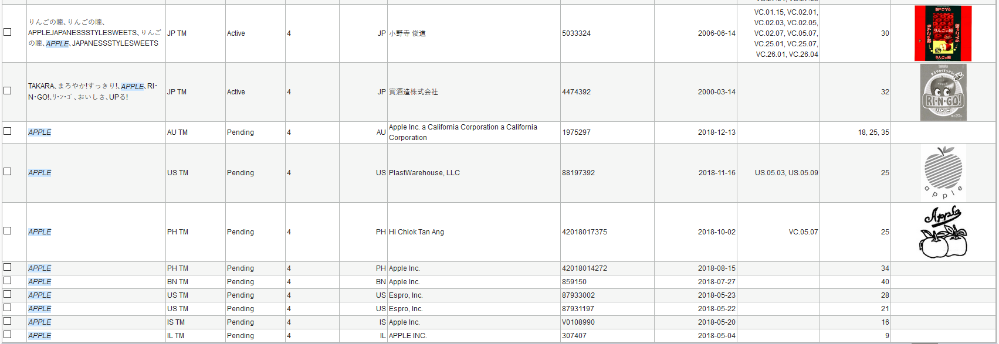
Apple apple apple apple apple
34: Smokers' articles; matches; lighters for smokers; electronic cigarettes
40:Treatment of materials, namely developing of photographic film; electronic recording of photographic images; enlarging of photographic prints; photographic film developing; photographic film printing; photographic image processing; photographic printing; photographic reproduction; transfer of photographs on to compact disc or video tape; online processing, developing and delivery of digital images; online printing of digital images onto photographic paper, photographic books or merchandise; advisory and consultancy services relating to all the aforesaid.
25:Garment, t-shirt, sando, polo shirt

Slide 19
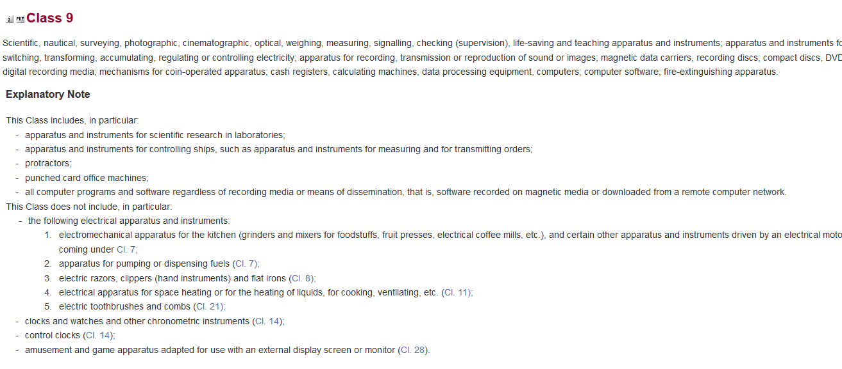

Slide 20
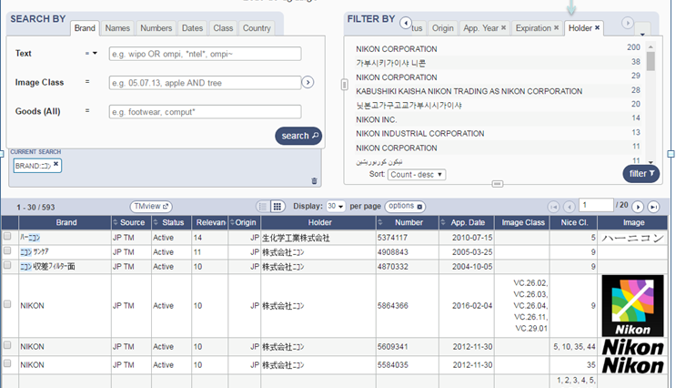

Slide 21
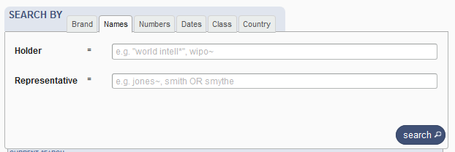
Search by Names

Slide 22
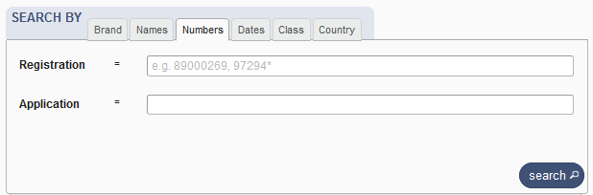
Search by Numbers

Slide 23
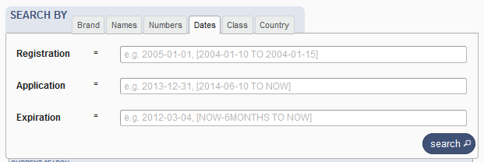
Search by Dates

Slide 24
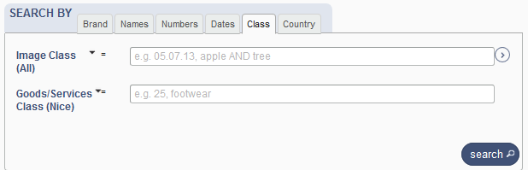


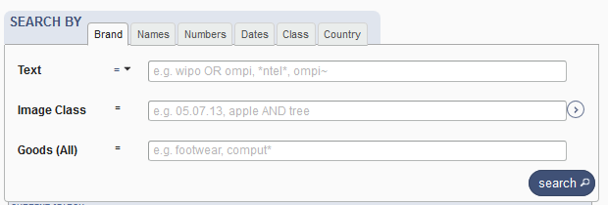
Search by Class

Slide 25
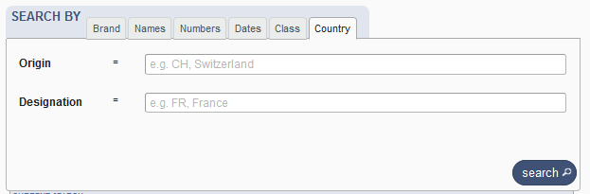
Search by Country

Slide 26
Terms, Operators, Wildcards, Auto-suggest
Each field supports:
  Terms: single or «multiple words»
  Boolean operators: AND, OR, NOT
  Grouping: (…)
  Wilcards: * = 0 or multipple letter; ? = 1 letter
  Proximity operators: «…» ~10
  Fuzzy: ~+ value between 0 and 1
  Range: [..]/{…}
  Suggestions of potential matching terms

Slide 27
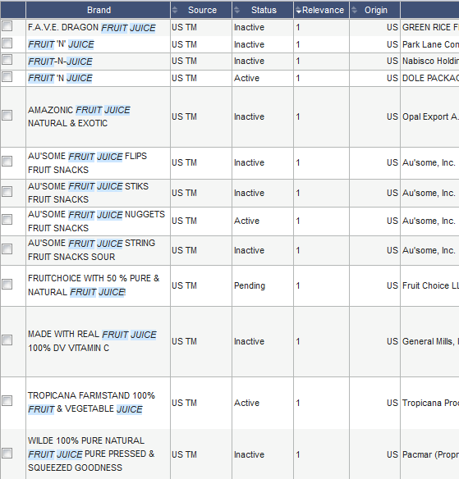
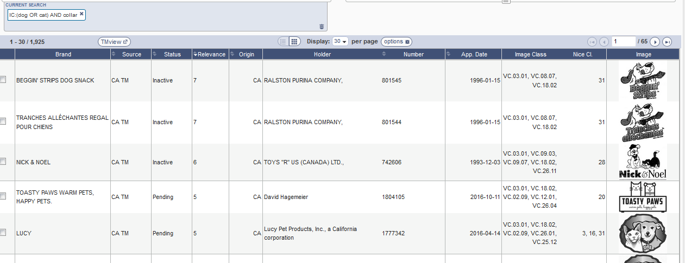
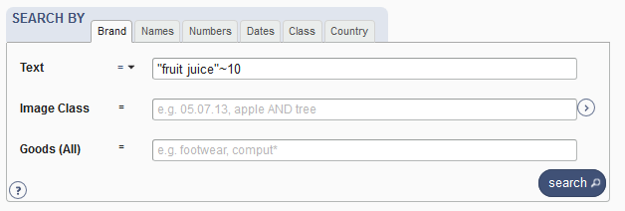
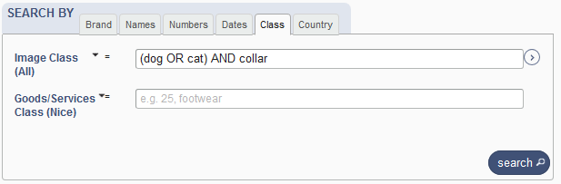
Examples

Slide 28
Filter by: 2
2

Slide 29
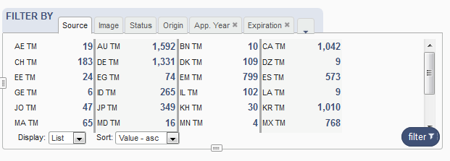

Filter by

Slide 30
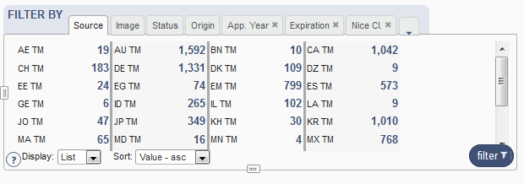
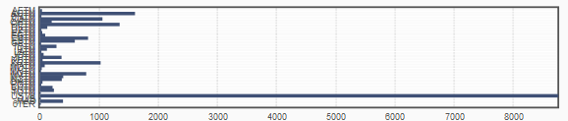




Filter by: Source

Slide 31
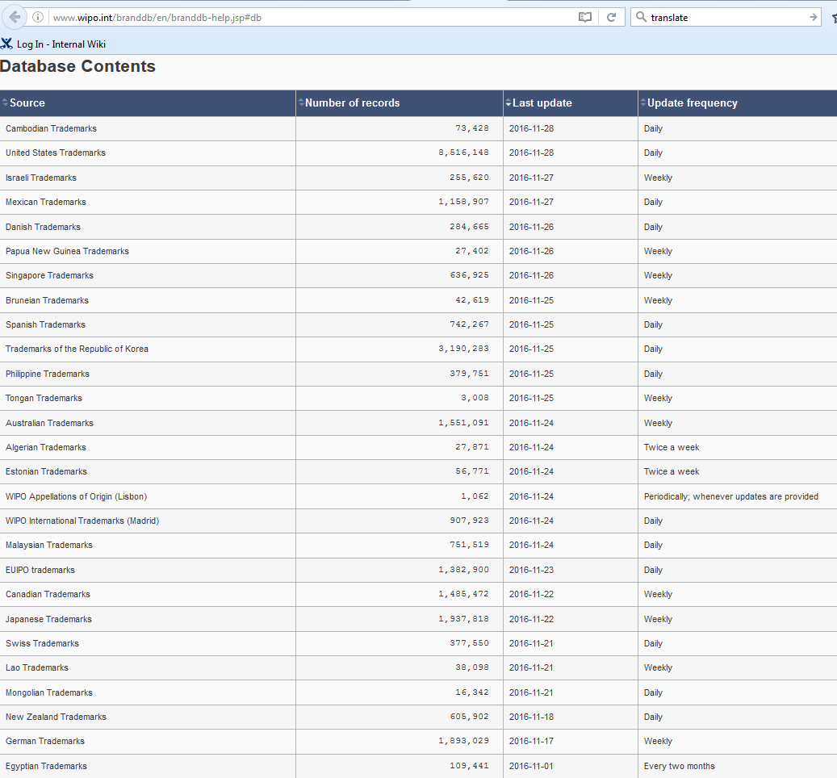
Coverage
http://www.wipo.int/branddb/en/branddb-help.jsp#db

Slide 32
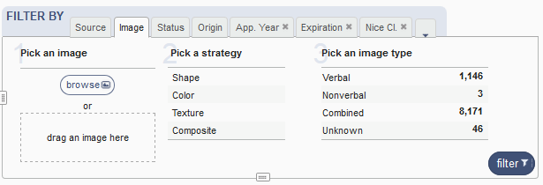
Filter by: Image

Slide 33















Image search
Your search
The results

Slide 34
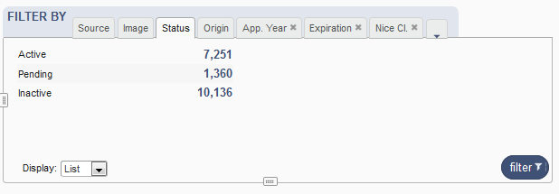
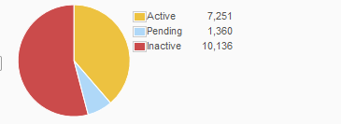
Filter by: Status

Slide 35
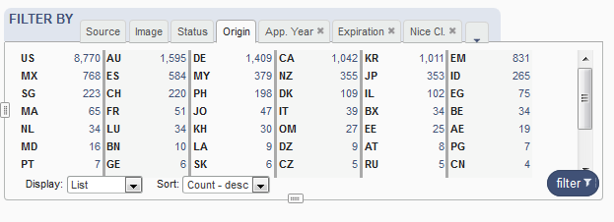
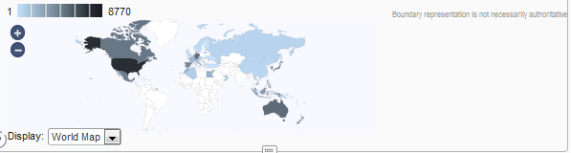
Filter by: Origin

Slide 36
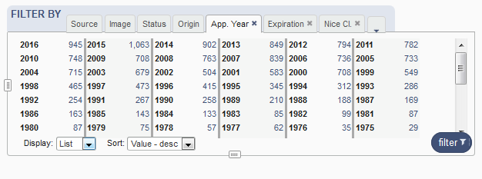
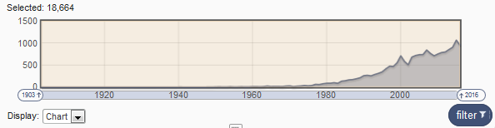
Filter by: Application Year

Slide 37
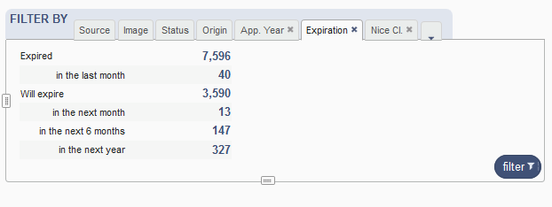
Filter by: Expiration

Slide 38
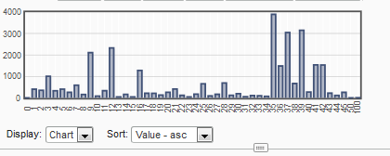
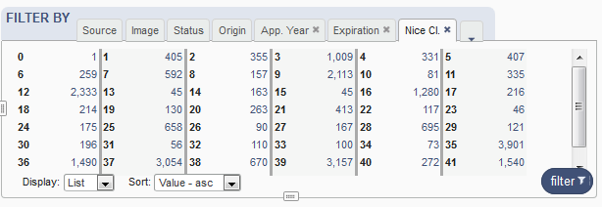
Filter by: Nice Classification

Slide 39
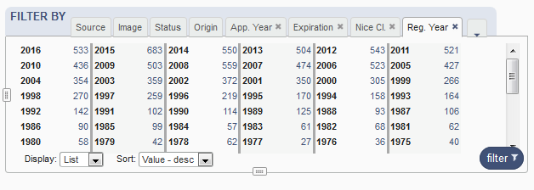
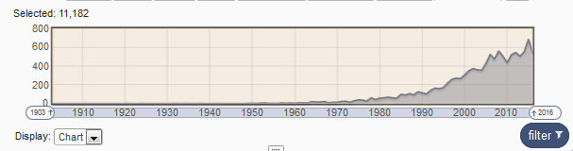
Filter by: Registration year

Slide 40
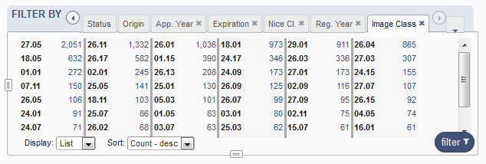
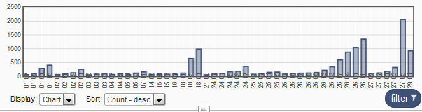
Filter by: Image classification

Slide 41
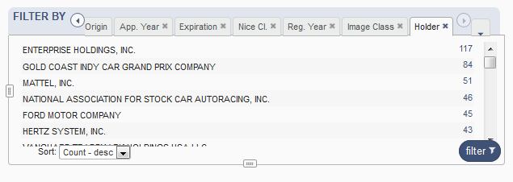
Filter by: Holder

Slide 42
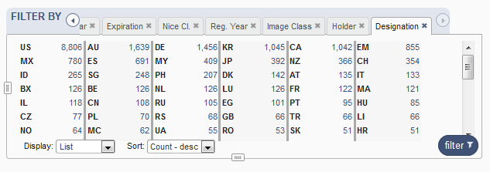
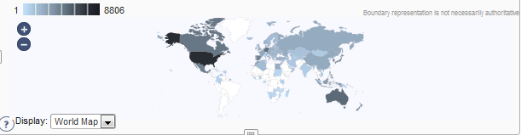
Filter by: Designation

Slide 43
Current search: 3
3

Slide 44
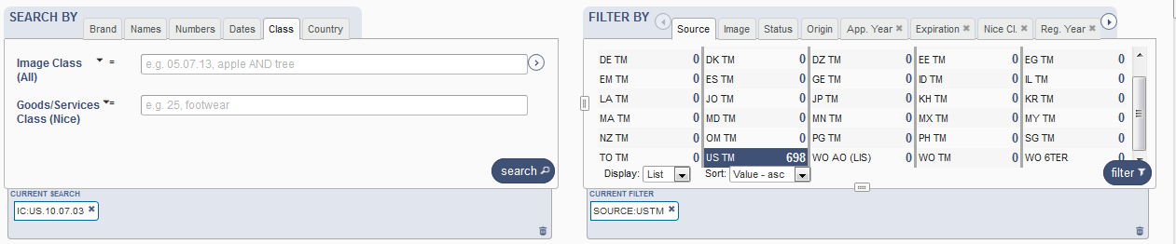

Slide 45
Search results: 4
4

Slide 46

Result area: pager & list

Slide 47


Pager

Slide 48


Record list – list format

Slide 49


Record list – grid format

Slide 50


Download reports

Slide 51

Record view

Slide 52
Menu: 5
5

Slide 53







Slide 54




Slide 55


Slide 56
News: 6
6

Slide 57
Next Webinar
How to perform a search in the GBD
  February 12 at 5:30 pm CET
  https://register.gotowebinar.com/rt/6221141639644416002

Slide 58


Slide 59
Global Design Database: webinar
The Global Design Database: an introduction
  January 22 at 5:30pm CET
  https://attendee.gotowebinar.com/register/8494653509443052290

Slide 60
Patent database webinar
Overview of PATENTSCOPE
  January 29 at 5:30 pm https://attendee.gotowebinar.com/rt/2969857168967245059
  January 31 at 8:30 am https://attendee.gotowebinar.com/rt/2969857168967245059

Slide 61

mulțumesc
mulțumesc
gbd@wipo.int

