Slide 1
Global Brand Database
An Introduction
Cyberworld
May
2017
Sandrine Ammann
Marketing & Communications Officer

Slide 3
Agenda
Interface:
Search features
Filter features
Results
Menus
Examples
Q&A

Slide 4
Why is the GBD useful?
Find details about a specific brand
Explore mark landscape to find out if the brand you have in mind already exists.

Slide 5
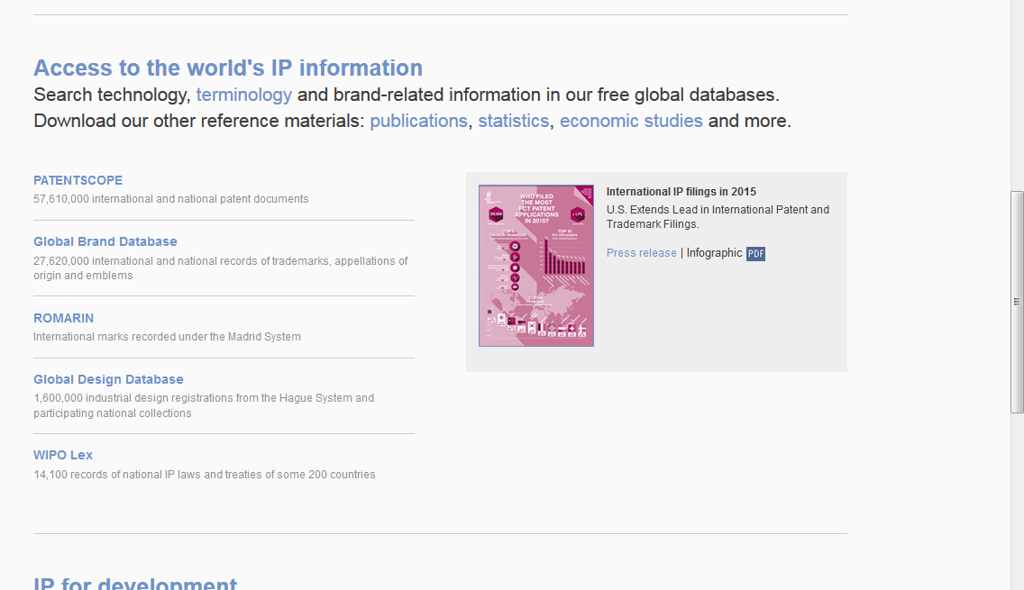
Access
www.wipo.int/branddb
www.wipo.int

Slide 6
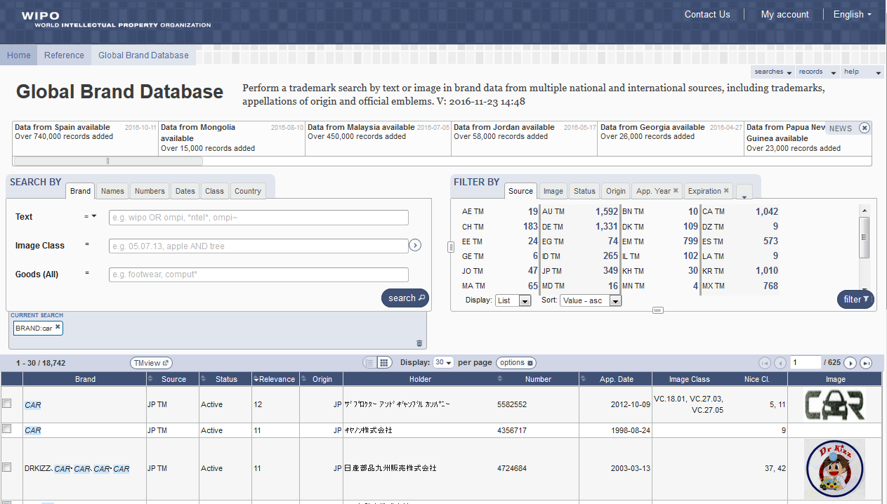
5
6
1
2
3
4

Slide 7
Search by: 1
1

Slide 8
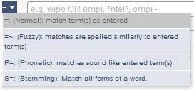
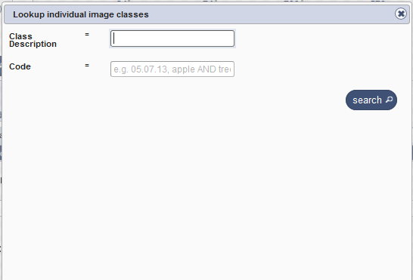
Search by

Slide 9
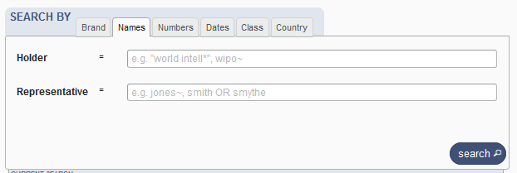
Search by Names

Slide 10
Search by Numbers

Slide 11
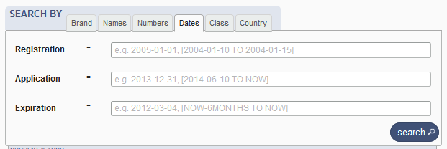
Search by Dates

Slide 12
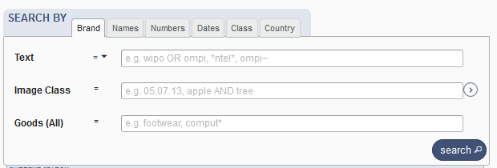
Search by Class

Slide 13
Search by Country

Slide 14
Terms, Operators, Wildcards, Auto-suggest
Each field supports:
Terms: single or «multiple words»
Boolean operators: AND, OR, NOT
Grouping: (…)
Wilcards: * = 0 or multipple letter; ? = 1 letter
Proximity operators: «…» ~10
Fuzzy: ~+ value between 0 and 1
Range: [..]/{…}
Suggestions of potential matching terms

Slide 15
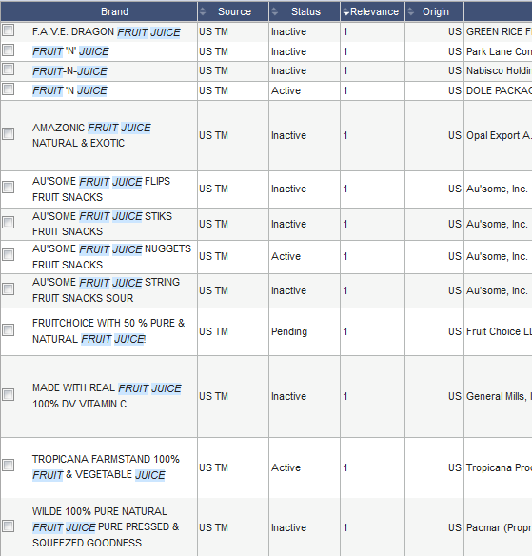
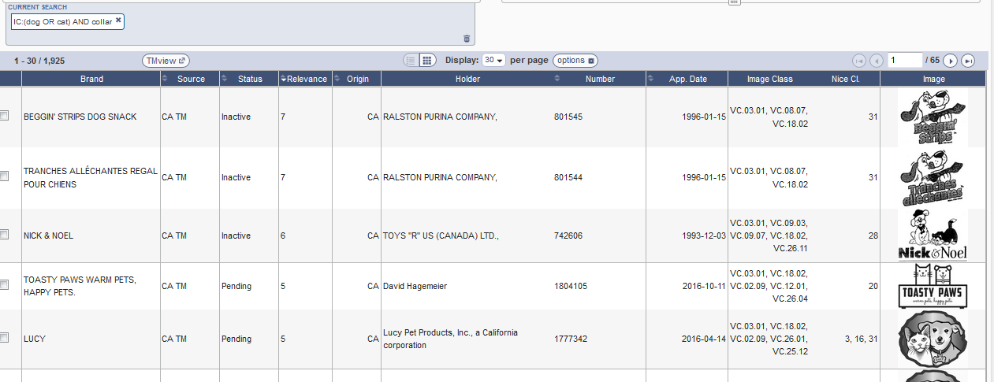
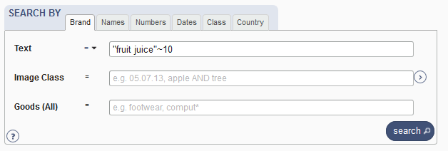
Examples

Slide 16
Filter by: 2
2

Slide 17
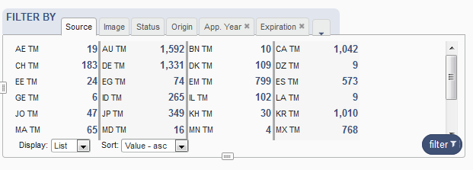
Filter by

Slide 18
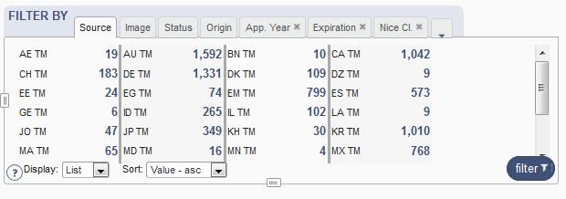
Filter by: Source

Slide 19
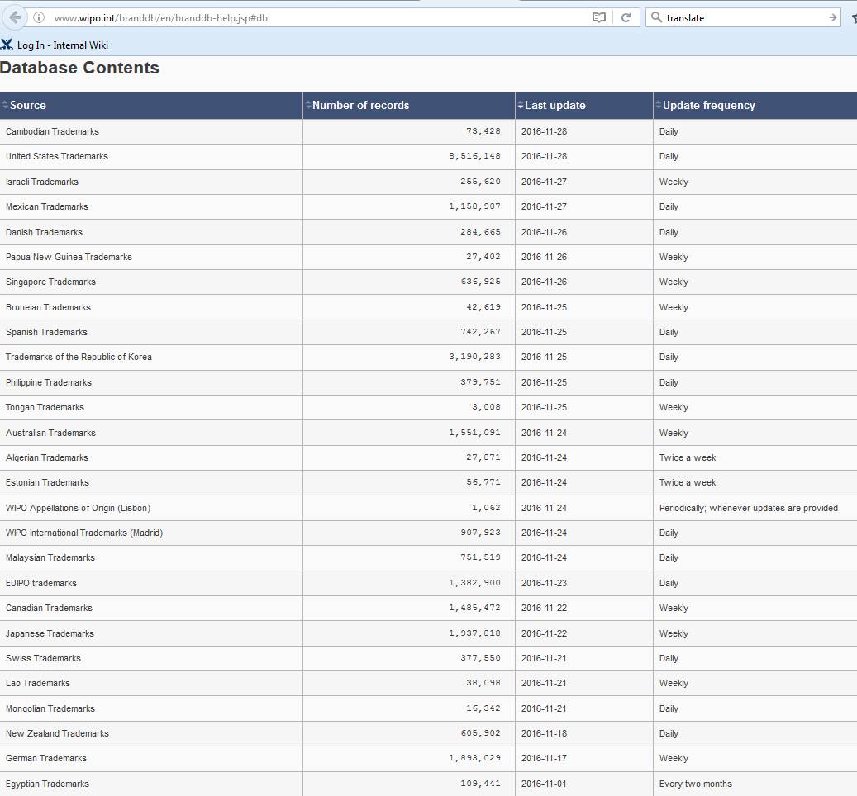
Coverage

Slide 20
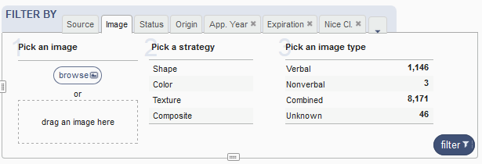
Filter by: Image

Slide 21
Image search
Your search
The results

Slide 22
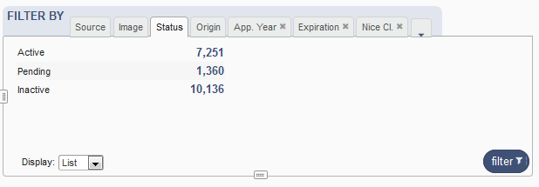
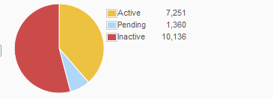
Filter by: Status

Slide 23
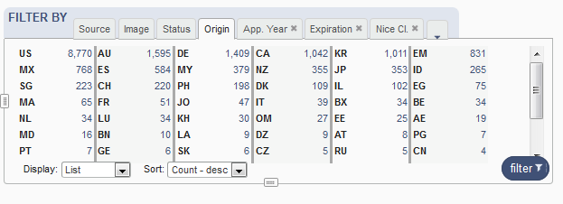
Filter by: Origin

Slide 24
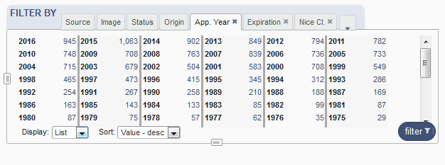
Filter by: Application Year

Slide 25
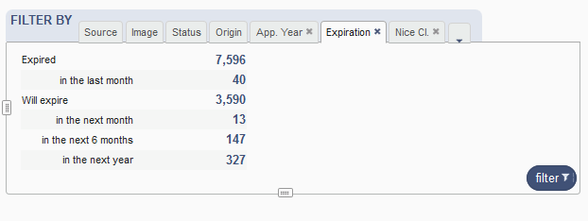
Filter by: Expiration

Slide 26
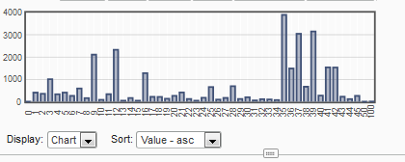
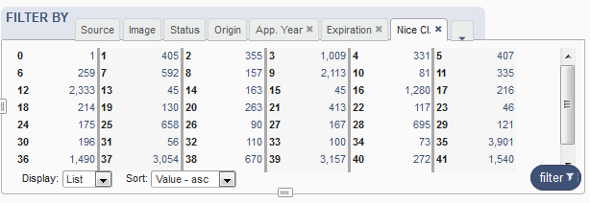
Filter by: Nice Classification

Slide 27
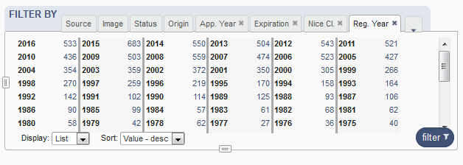
Filter by: Registration year

Slide 28
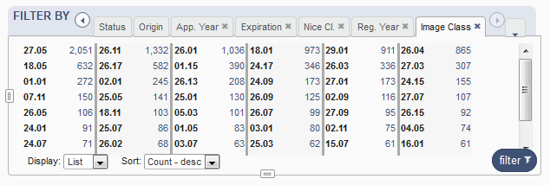
Filter by: Image classification

Slide 29
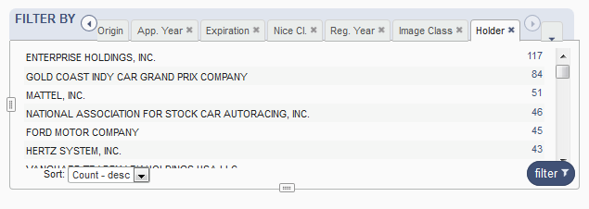
Filter by: Holder

Slide 30
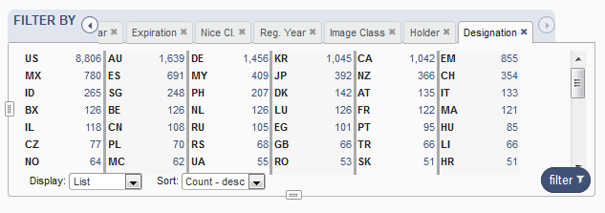
Filter by: Designation

Slide 31
Current search: 3
3

Slide 33
Search results: 4
4

Slide 34
Result area: pager & list

Slide 35
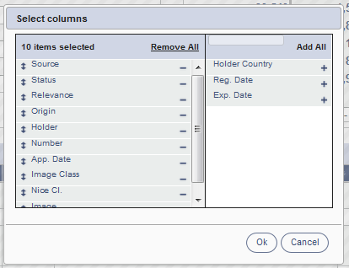
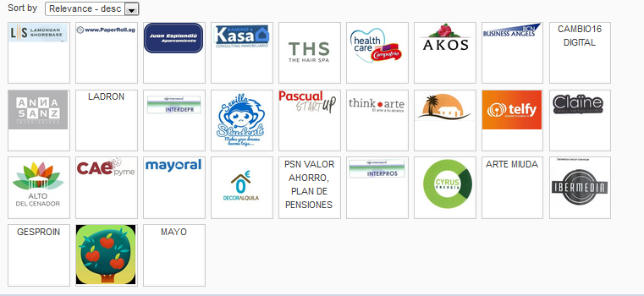
Pager

Slide 36
Record list – list format

Slide 37
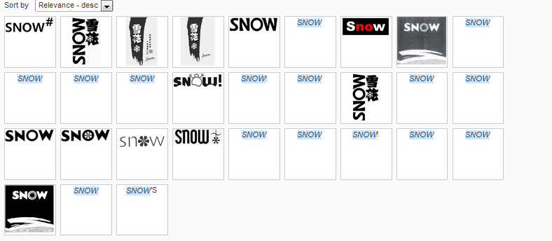
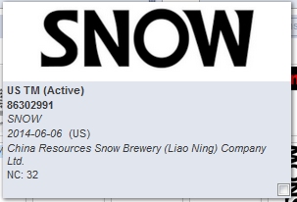
Record list – grid format

Slide 38
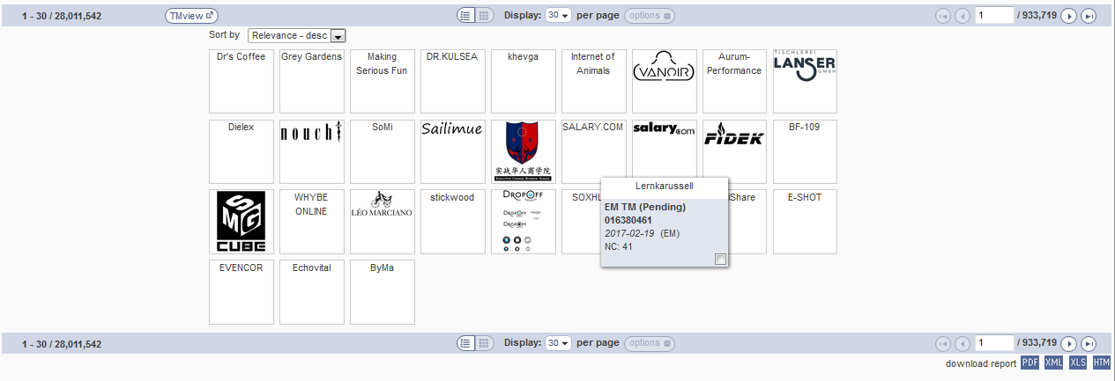
Download reports

Slide 39
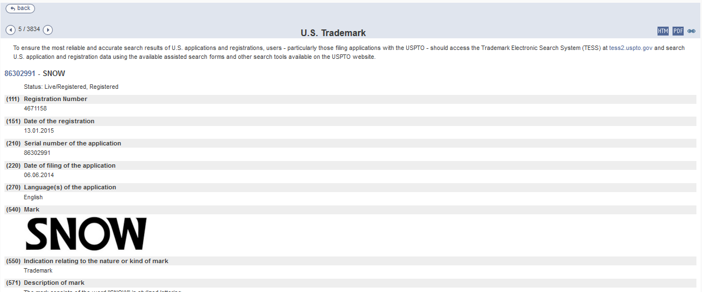
Record view

Slide 40
Menu: 5
5

Slide 41
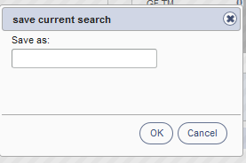
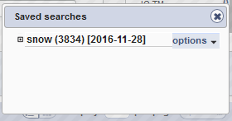
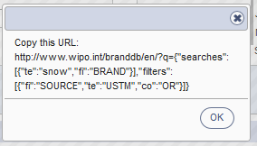

Slide 42
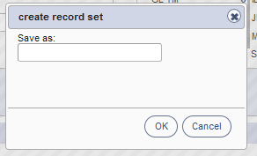
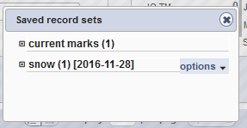

Slide 44
News: 6
6

Slide 45
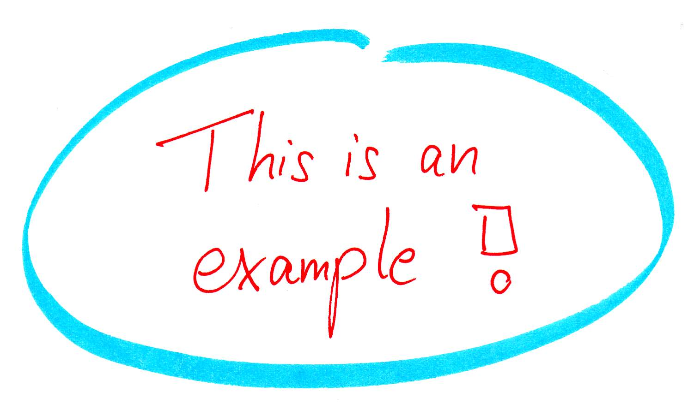

Slide 46
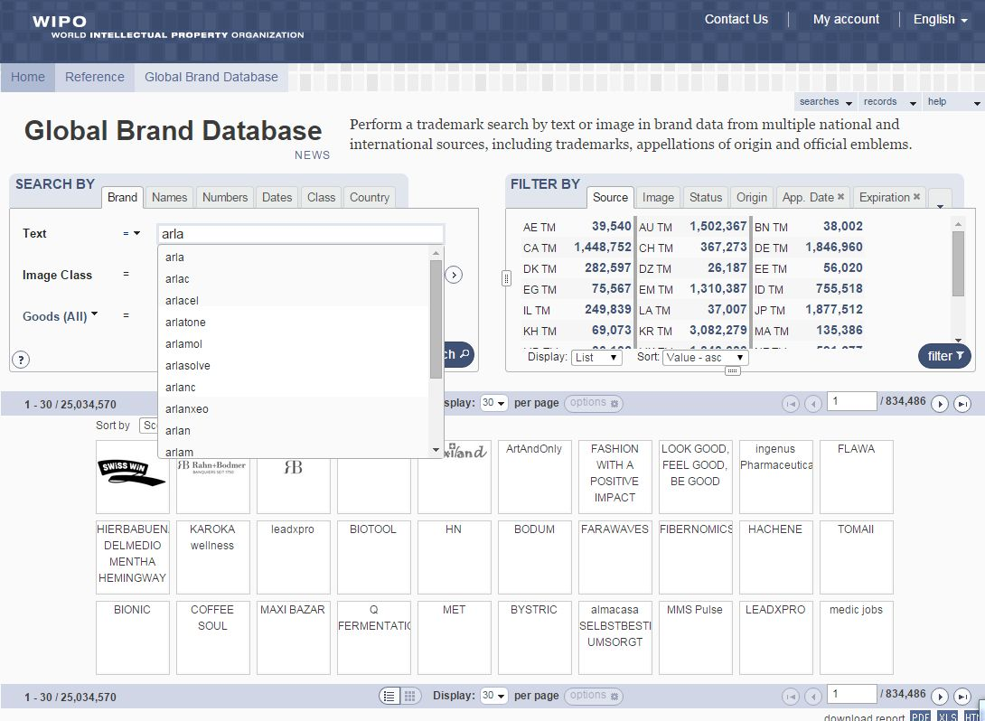

Slide 47
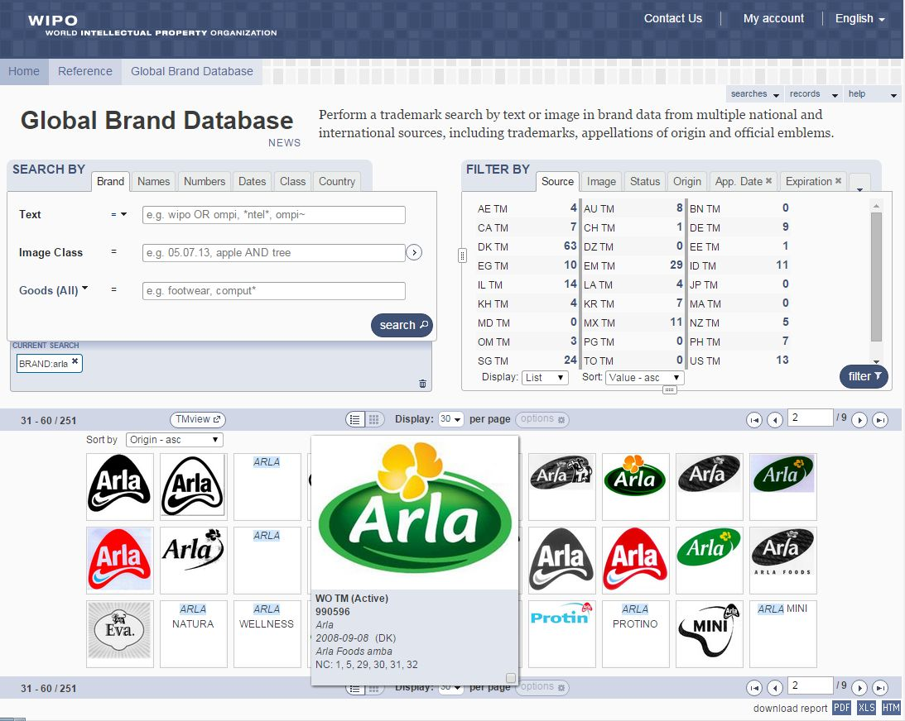

Slide 48
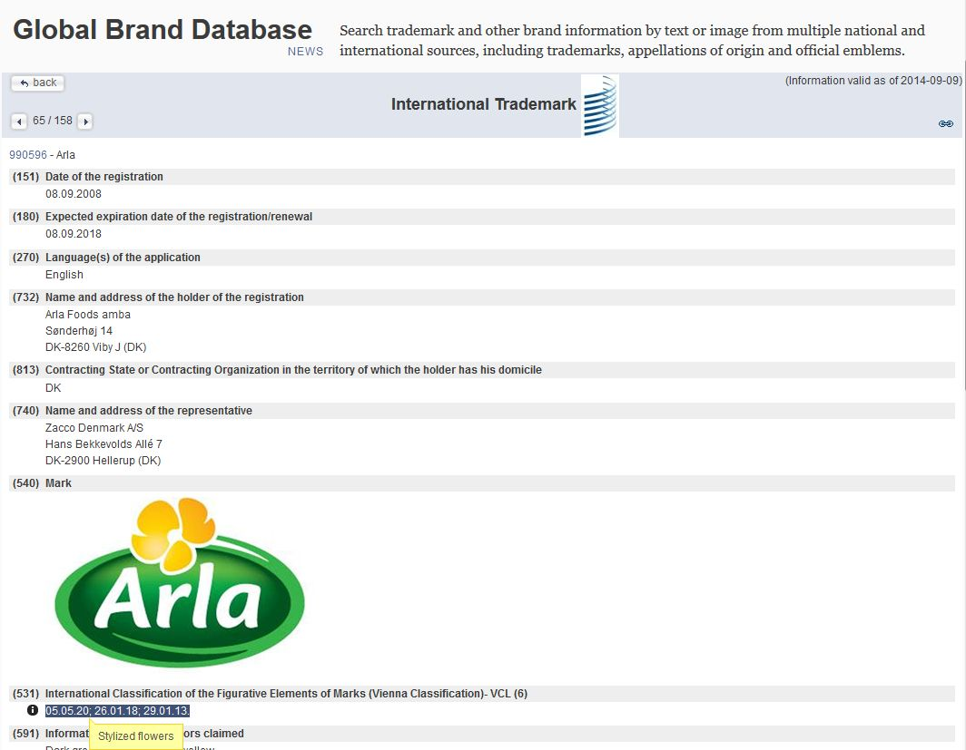

Slide 49
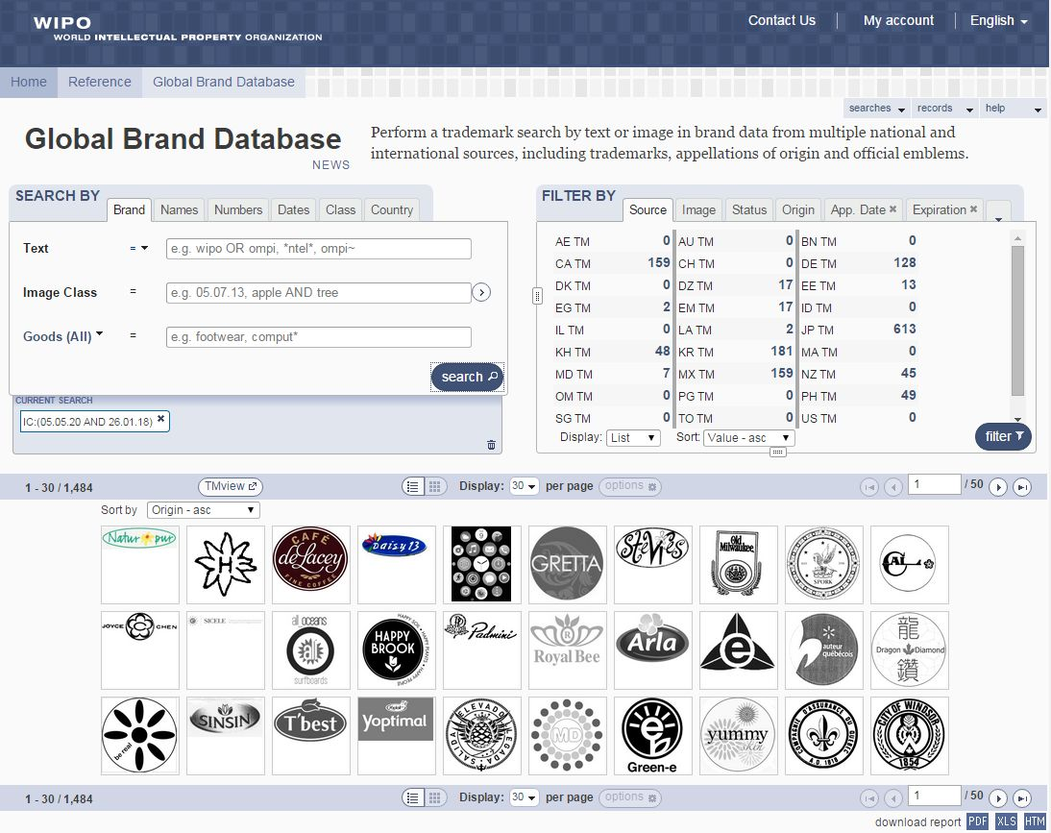

Slide 50
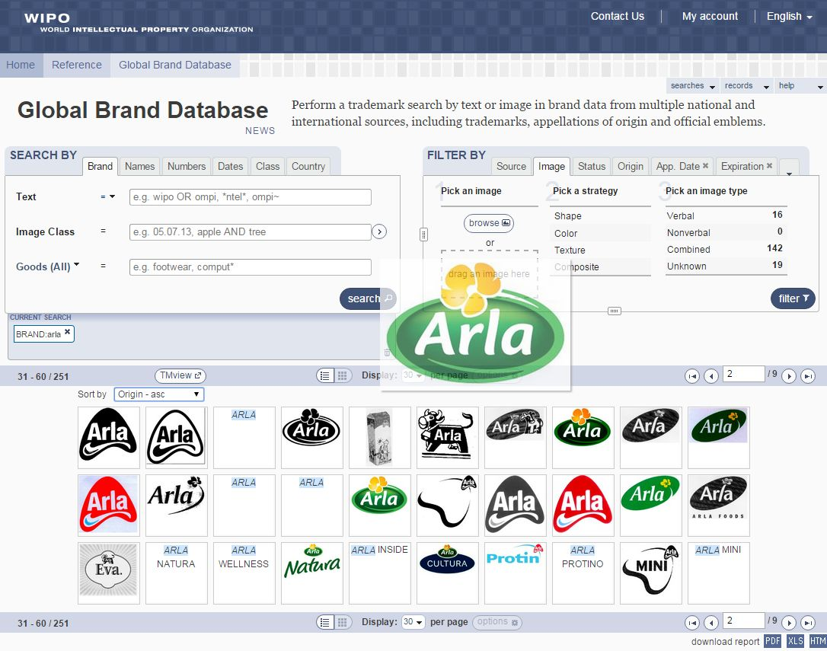

Slide 51
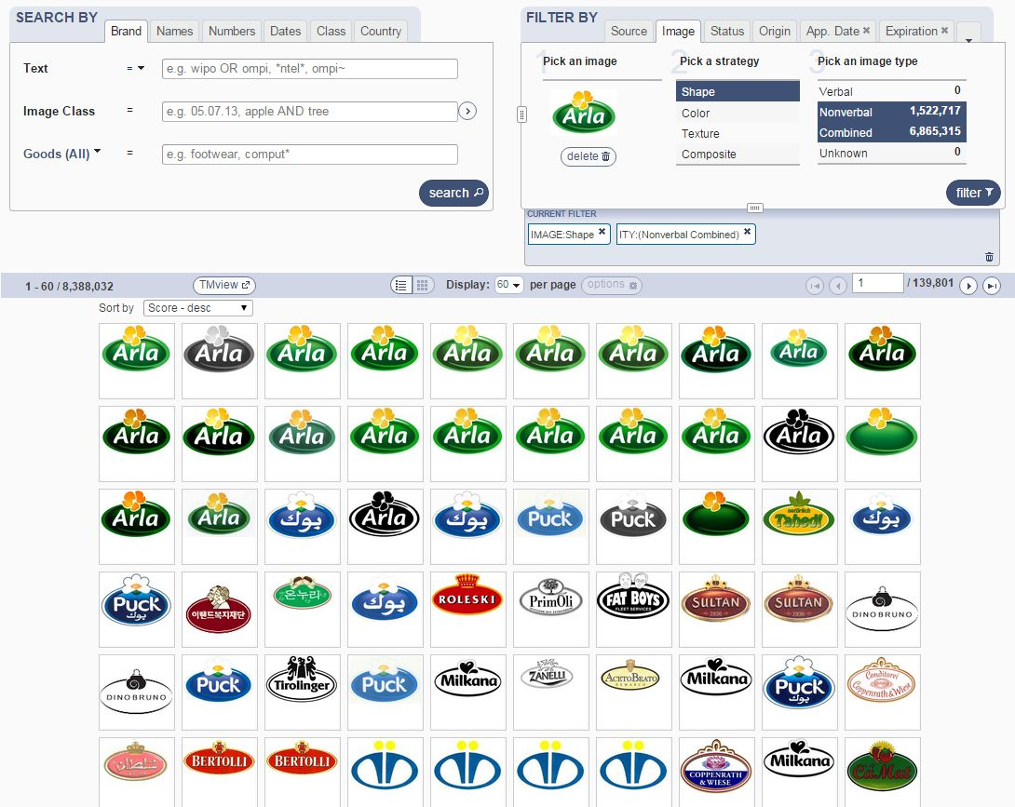

Slide 52
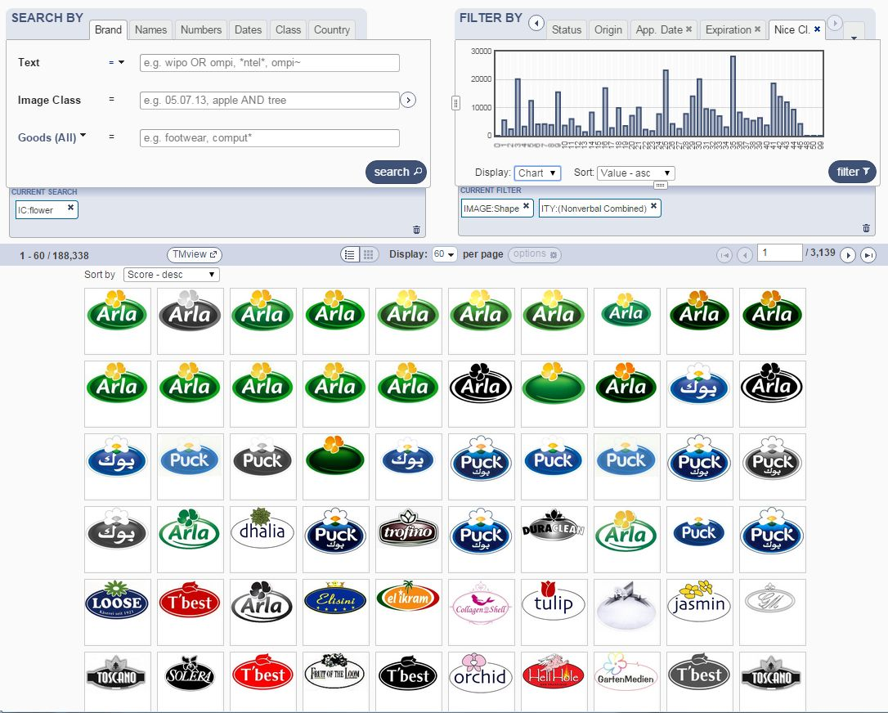

Slide 53
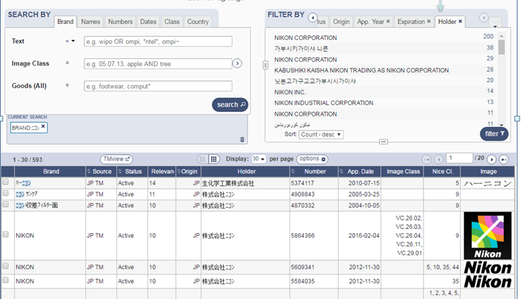

Slide 54
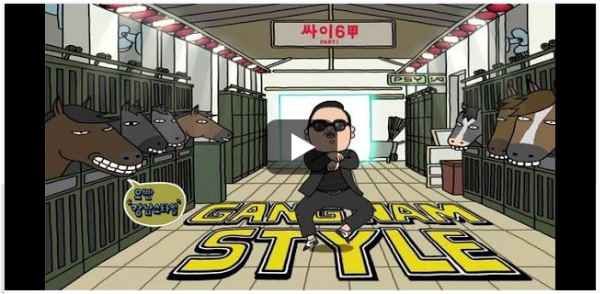

Slide 55
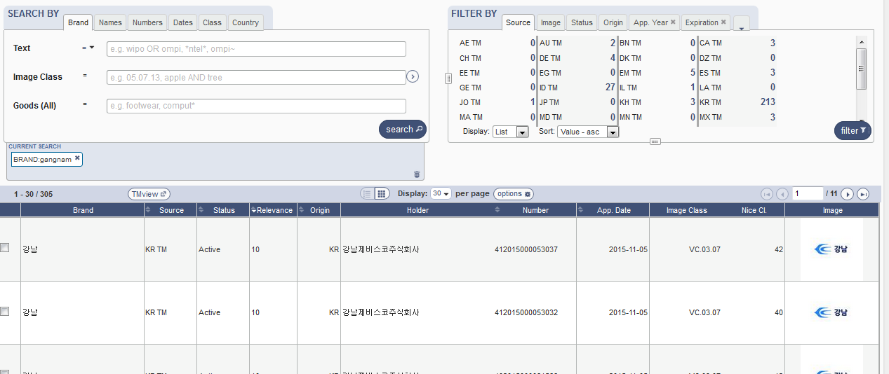
Gangnam

Slide 56
Global Design Database: webinar
The Global Design Database: an introduction
July 25 at 5:30pm CET
https://attendee.gotowebinar.com/rt/1717422151261026817
July 27 6 at 8:30 am CET
https://attendee.gotowebinar.com/rt/1717422151261026817

Slide 57
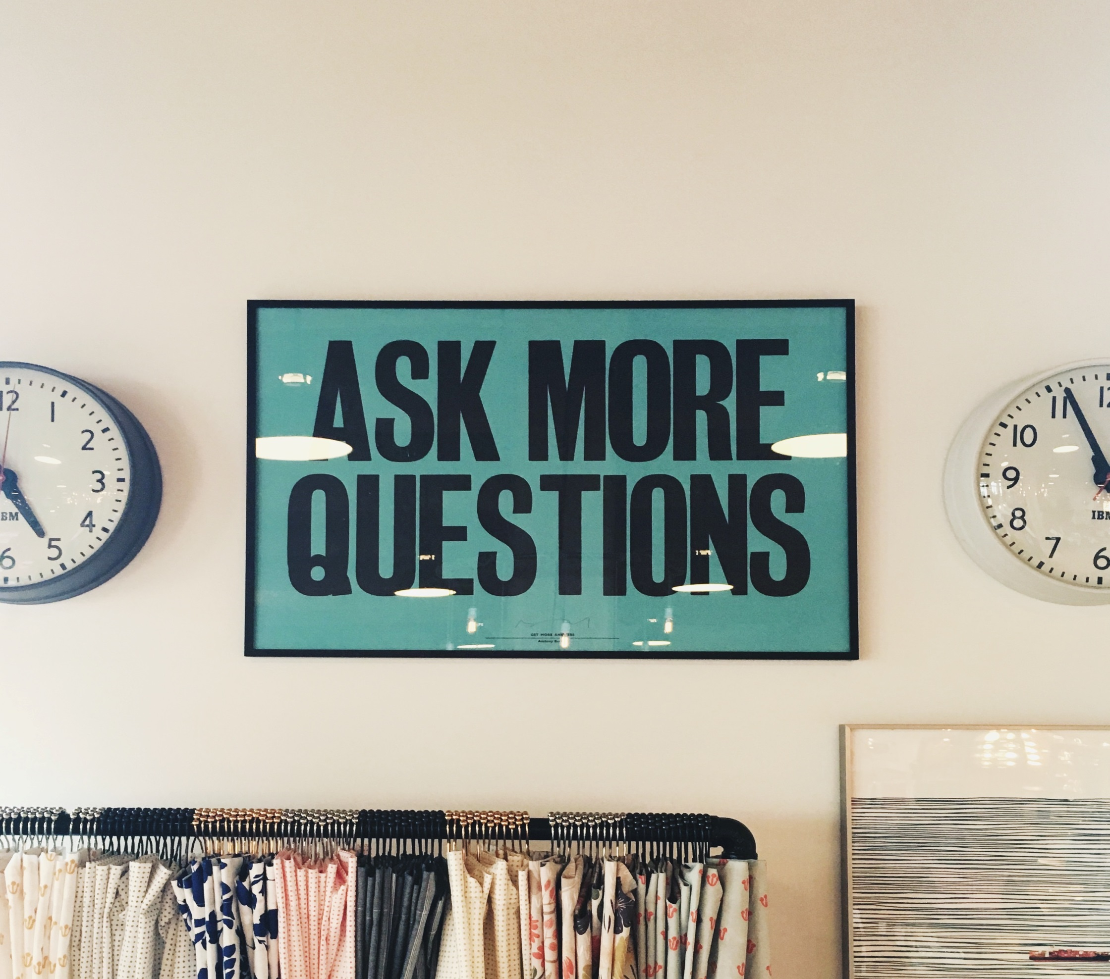

Slide 58
mulțumesc
mulțumesc
gbd@wipo.int

