Slide 1
A New Legal Framework for Data and the Role of IP Law – Korean Experience
Youngjoon Kwon

Slide 2
Purpose of this Presentation
To present what is being discussed and legislated in Korea on Data Law Regime in light of global discussion and legislative moves
To show how IP laws in Korea play their respective roles in such discussion and legislation

Slide 3
Around the World
Europe
Toward Data Economy
Communication on data-driven economy(2014)
Working Document on a Digital Single Market Strategy (2015)
Communication on Building a European data economy (2017)
Data Ownership as Normative Foundation for Data Economy?
EU Working Paper - The economics of ownership, access and trade in digital data (2017)
EU White Paper – Building the European Data Economy – Data Ownership (2017)
No Easy Path to Sui Generis Right
The United States
Debates on data rights (including property right on personal data)
“Own your Own Data” Bill (2019)– “Each individual owns and has an exclusive property right in the data that an individual generates on the Internet”
Data Dividend Project (California, Andrew Yang)

Slide 4
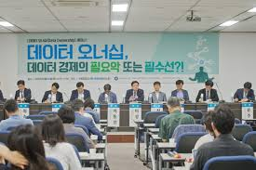
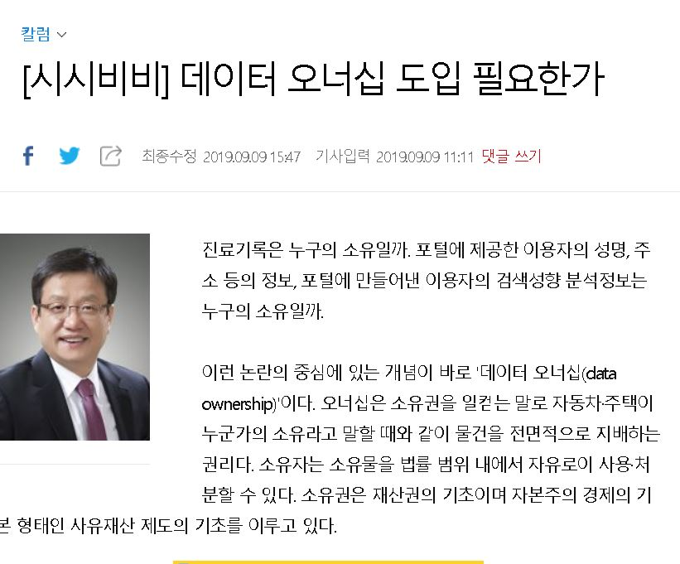
Ongoing discussion in Korea

Slide 5
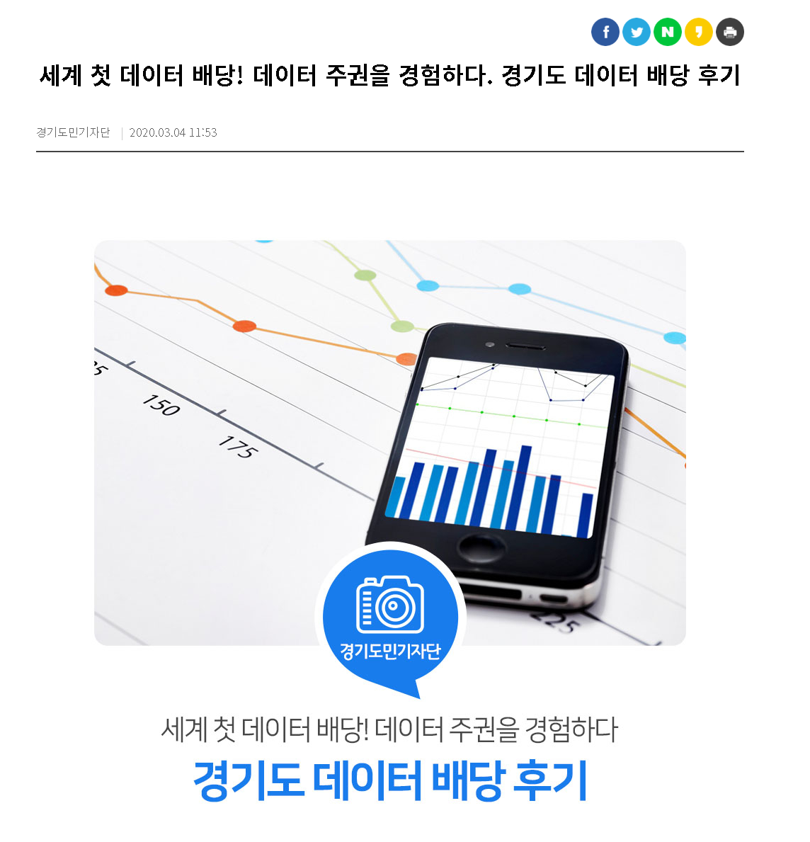
Ongoing discussion in Korea

Slide 6
Starting from Data Ownership
Why Data Ownership?
Efforts to provide foundational legal concept and framework toward new legal regime on data right
Efforts To facilitate data protection and data transaction
Data Protection: Providing Legal Mechanisms to Protect Data Owner from illegal infringement on Data
Data Transaction: Providing Legal Mechanisms to enable Data Owner to transfer, license, or other acts to benefit from such transactions
Overviews of ongoing discussion in Korea on data protection / data transaction, and subsequently the concept of data ownership

Slide 7
Data Protection and Data Transaction
Data protection and data transaction are……
Of different nature with different purposes,
But so closely intertwined with each other
Protection
Transaction
Static
Dynamic

Slide 8
Data Protection – mainly on PI
Expansion of Protection on Data – Personal Data
History of Protecting Private Sphere
Aristotle on Distinction between Public / Private
Legal protection on private sphere since Roman law
Terminology, “Privacy” first used in 15th Century
Warren & Brandeis : Right to Privacy (1890)
Universal Declaration of Human Rights (1948) : Right to Privacy (Art. 12)
Alan Westin (1967): Privacy as "the claim of individuals, groups, or institutions to determine for themselves when, how, and to what extent information about them is communicated to others.“ -- conceptual combination of privacy and information
Development of Information Protection Law: The Data Act (Datalagen) in Sweden (1973) / The Privacy Act in USA (1974), Federal Data Protection Act (Bundesdatenschutzgesetz) in Germany (1978)
OECD Guidelines on the Protection of Privacy and Transborder Flows of Personal Data (1980)
Convention for the Protection of Individuals with Regard to Automatic Processing of Personal Data (1981)

Slide 9
Data Protection
Expansion of Protection on Data – Personal Data
Federal Constitutional Court of Germany on 1983 Census Act
Conceptual combination of ‘information’ and ‘self-determination’
From ‘private information’ to ‘personally identifiable information’
EU Data Protection Directive (1995)
EU Directive on Privacy and Electronic Communications (2002)
Korea: Personal Information Protection Act (2011)
EU Regulation on Notification of Data Breach (2013)
CJEU : Google v Spain (2014) – Right to be forgotten
GDPR (2018)
Rights on personal data gains its independence from right to privacy, based on human right perspectives, thereby dramatically enlarging private dominion on information: Expandability of ‘personal data’

Slide 10
Data Protection
Expanding Private Dominion over Data?
Data Ownership is not necessarily about personal data
In Europe, data ownership postulated non-personal data.
Rights on personal data as human rights, but data ownership as proprietary rights
However, discussion on data ownership is in line with the history of expanding private dominion over data (private data ⇒ personal data ⇒ data in general)
One thing leads to another
The trend of such expansion on data protection naturally leads to lively discussion on data ownership as a means to expand data protection

Slide 11
Data Transaction
Data transaction on the rise and legal response
Adaptation of Personal Data Related Legislation
Korea: Amended Personal Information Act (2020) : Modification of the concept of personal information/New rules on pseudonymous data, including combination of pseudonymous data – Efforts to facilitate personal data transaction
Korea: Credit Information Act (2018) : ‘MyData’ – Efforts to enhance portability of credit information, which in turn will facilitate data transaction
Emergence and expansion of data transaction platform in public/private sector
Data as counter-performance?
Data (including personal data) as goods
Discourse on proprietary nature of data on the rise in Korea

Slide 12
Data Transaction
Need for vitalizing data transaction and discussion on data ownership
In order to better protect data and facilitate data transaction, need for addressing legal issues as to who owns data arises
Data ownership as incentive for producing data
Data ownership as stabilizing mechanism for data transaction
Data ownership as standard for liability arising from data transaction
Data ownership as standard for dividing profits from data transaction
However, it is not certain if establishment of data ownership would lead to the above outcome
Meaningful incentive?
Enhancing certainty?
Accelerating monopolization?

Slide 13
Discussion on Data ownership
Data Ownership – What it means?
What is Data?
What is Ownership?
Data?
What is the object of data ownership?
Ownership?
Same ownership as stipulated in the Civil Code? If not, what is this ‘ownership’ about?

Slide 14
What is Data?
Unclarity of the Concept
Limited to machine-readable data? Dataset?
Data? Information?
Often interchangeably used
‘personal data’ means any information relating to an identified or identifiable natural person (‘data subject’)(GDPR Art. 4(1))
To prohibit the collection of data or information generated on the Internet---(Own Your Own Act)
Data – Reinterpretable representation of information in a formalized manner suitable for communication, interpretation, or processing(ISO)
The term “information” means all kinds of data or knowledge expressed in codes, letters, voice, sound, image, etc., which are processed by optical or electronic means / data (referring to all kinds of data or knowledge expressed in codes, letters, voice, sound, image, etc.) (Framework Act on Intelligent Informatization, KOREA, Art. 2)

Slide 15
What is Data?
Unclarity in object being discussed
Data ownership on personal data?
In line with discussion on propertization of personal data and data sovereignty
Data ownership as a conceptual vehicle more for data protection
Data ownership on non-personal data
In strict sense, the discourse on data ownership is geared toward non-personal data (in particular, machine generated data)
Data ownership as a conceptual vehicle more for data transaction
Difficulties in line-drawing between these two types of data / Organic connection between data (intermingling of PI and non-PI in a dataset) : call for more comprehensive discussion?

Slide 16
What is Ownership?
Unclarity of the Concept
Ownership as envisaged by lawyers: the right, within the scope of law, to use, take the profits of, and dispose of, the “thing” owned (Korean Civil Code Art. 211, 98) – Data is not the object of ownership
Ownership as envisaged by laypersons: anything related to dominion or control (can “own” a bank account, personal information, and even children!) – Data ownership is acceptable and even intuitive
Variability and Flexibility of the concept of ownership
Different notion of ownership throughout history
Different notion of ownership according to legal traditions
Different notion of ownership according to the objects

Slide 17
Skepticism on the notion of data ownership
Practical benefit of using this concept
Amorphous notion of data assisted by solid notion of ownership: Intuitive image-making on “strong data right”
Notion of “Data as goods” intensified
Notion over substance?
Skepticism
Data in nature subject to private control? Mere product of ideological conjecture? Free data as a default?
Coherence with current legal regime: data as free goods + endowing with control right only when necessary and justified (fragmentary approach as opposed to unitary approach)
Data as almost everything: practicality of data ownership
Legal interest underlying data, but not data itself that is to be protected?

Slide 18
Overview on Legal Regime on Data
Overview
Competitions among existent legal doctrines
Legal regime based on civil law
Ownership
Possession
Contract
Torts
Personality rights
Legal regime based on IP law
Copyright
Unfair competition
Legal regime based on personal information protection law
Legal regime based on other areas of law (competition law, secured transaction law, civil execution law, inheritance law, insolvency law, etc)

Slide 19
Legal Regime on Data
Importance of Existent Legal Doctrines
Prior to a sui generis legal regime, importance of reviewing already existing legal doctrines and systematic utilization of such doctrines: example of the notion of traditional property right influencing the development of new copyright in 18th and 19th century +example of traditional doctrines on slaves or animals influencing the legal discourse on autonomous vehicle)
The role of current legal regime to prevent “hype” in a legal sense (overly excessive response to new issues leading to hasty yet underexamined special legislations)
Importance of feedback from data economy back to existent legal doctrines (interaction between traditional legal regime and emerging technology issues)

Slide 20
Legal Regime on Data
Legal doctrines that can be employed immediately
Civil Code: contract, torts, personality rights
Other Statutory Laws: Personal Information Protection Act, Unfair Competition Act
Legal doctrines that are more suitable for long-term legislation design
Civil Code: ownership (including co-ownership), accession
Other Statutory Laws: Copyright Law, Trust Law, Secured Transaction Law, etc.
The function of these legal doctrines
Facilitating Data Protection
Facilitating Data Transaction
Normative Channel to Data Economy

Slide 21
Legal Regime on Data
Data Transaction
Current Issues
Future Issues
Data Protection

Slide 22
Coping with Current Issues - Contract Law
Importance of Contract Law
Suitable in flexibly addressing data issues that are often diverse and amorphous
Versatility of Data Value (depends on who uses it, and how it is used)
Contract is a legal vehicle customized to flexibly address versatile values
For this reason, contract has always been at the forefront in addressing newly emerging issues
Contract law can be more relied on when
trust in the market / patience in accumulating legal norms gradually / adequate mechanism to protect weaker parties
Importance of Standard Form Contract in Data Transaction
Contract as a system in modern economy
Carefully devised model contract or standardized contract needed to ascertain legal certainty in data transaction
Recent Legislation: Data Industry Act (Enacted on 12 October 2021)
Art 21: Responsibility of the Government to prepare a standard contract and to encourage its usage

Slide 23
Coping with Current Issues - law of possession
Importance of the law of possession
No jurisdictions have recognized complete and comprehensive notion of data ownership
Remaining doctrine in the area of right in rem is the doctrine on possession
People do not necessarily own data, but still control data and exclude others from using them – de facto ownership, or possession
Characteristics of the law of possession
Status Quo: ideologically conservative and stability-oriented approach
Technological protection measures to secure possession of data
Data Enclosure
Technology in lieu of Law
Dogmatic challenges
Data is not a thing and therefore not subject to possession?
Possibility of quasi-possession (Korean Civil Code Art. 210) or new concept of “control?

Slide 24
Coping with Current Issues - Law of Torts
Importance of the Law of Torts
Comprehensive approach vs Categorical approach
Comprehensive: Korea, Japan, France
Categorical: Germany, USA, UK
Comprehensive approach in Korea (Civil Code Art. 750)
Protecting nearly all the legal rights and interests
Flexible, catch-all approach
Data protection can easily be captured and addressed by this comprehensive tort provision
Playing an important role in data protection legal regime

Slide 25
Coping with Current Issues - Unfair Competition Act
Importance of unfair competition doctrine
Gap-filling function: Protecting intangible assets or interests that are not subject to protection in the traditional property law or IP law
Constant expansion of protection on intangibles (e.g. trade secret, database, species, semiconductors, online digital contents)
Constant expansion on the concept of unfair competition (e.g. misappropriation) – Amending Korean Unfair Competition Act to embrace an act that misappropriates others’ products out of considerable investment or efforts in an unfair way, thereby infringing economic interests of others (Art. 2 (1))
Strengthening remedies: injunctions in addition to damages claim
Can be utilized in data protection from misappropriation
Recent Legislation: Data Industry Act (Enacted on 12 October 2021)
Art 12: Declaring that data assets based on considerable investment and efforts with proprietary interest should be protected from misappropiration

Slide 26
Coping with Current Issues - Law on Personality Rights
Personality rights and personal data protection
Importance of personality rights in the age of technology
From privacy to personal data
Right to self-determine in personal data as personality right and ultimately human right
Personal data right as a core component of data right regime
No meaningful data right discourse can be done without addressing rights regarding personal data
Significance of utilizing personal data in data economy
Way forward: more nuanced, communicative, harmonious needed
“Mydata” implemented as of 2020 in Korea
Risk-based vs Harm-based

Slide 27
Data Transaction
Contract
Utilizing personal data
(quasi) Possession
Current Issues
Future Issues
Protecting personal data
Personality rights
Unfair competition
Torts
Data Protection

Slide 28
Data Transaction
Current Issues
Future Issues
Data Protection

Slide 29
Toward Future – Ownership
Disaccord between data and ownership
Ownership as a legal concept is not an appropriate tool to be applied to data in general
Diversity of data
Data: About almost everything in the world
Data itself has not been clearly defined.
Connectivity of data
Data becomes more valuable when connected and combined
Connectivity of data makes the application of ownership even more difficult
Inseparability of data
Gene data as mine? My parents”? / Transaction data as mine? Seller’s? / Facebook data as mine? My friends’?
Inseparability of data makes it difficult to attribute the ownership of data to a single person or single entity

Slide 30
Toward Future - Ownership
Disaccord between data and ownership (continued)
Difficulty arising from multiple stakeholders in creating and enhancing the value of data
Difficulty in making legal relationship public: No registration system yet unlike IP rights
Difficulty in harmonizing property law (Heterogeneity in global property law)
Less incentive created by introducing data ownership: Currently immense volume of data are being created without data ownership
Less flexibility, More complexity

Slide 31
Toward Future - Ownership
Data Ownership as sui generis right?
EU Data Ownership White Paper (2017)
Proposal for a non-exclusive ownership right in data
Non-exclusive, flexible, and extensible right that is not an IP type of right with data traceability obligation
Not widely accepted
“Bundle of Rights” may help
Flexible, changeable, and dynamic property right on data?
Right coupled with obligation?

Slide 32
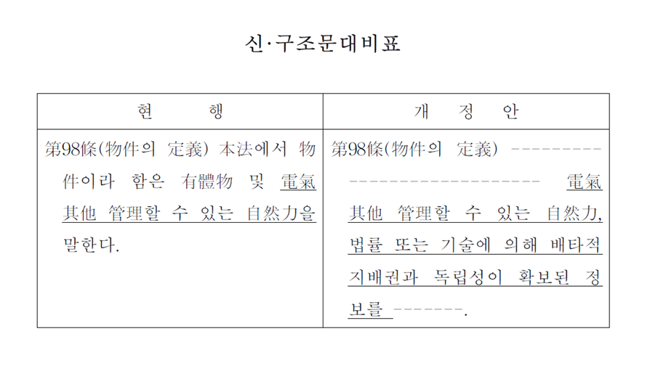
Toward Future - Ownership
Recent bill in Korea to add independent data that is subject to exclusive control either by law or technology as a “thing” in the Korean Civil Code

Slide 33
Toward Future - Copyright
IP rights – in particular, copyright – can meaningfully contribute to ongoing discussion on data right regime
Copyright law: A prototype law on intangible asset
Provisions on database: Source of wisdom
“Bundle of Rights’” notion employed in copyright law
Harmonious regulation on both property right and moral right (personality right)
Refined approach to diverse types of intangible assets
Addresses the issue of cumulative copyrights (derivative works)
Striking delicate balance between monopoly and free use (requiring originality, limitations on author’s economic rights, limitations on the duration of copyright, Setting up public domain)
Not only “property rule”, but also “liability rule” (compulsory license)

Slide 34
Toward Future - Accession
Accession?
Property law concept: method of acquiring property right (ownership) by adding value to other property through labor or new raw materials (Korean Civil Code 259)
Law of accession: almost forgotten field of property law but deserves attention
Data as combined value: many stakeholders sequentially add value
Accession law can be utilized in setting up a new legal regime in determining the attribution of data and distribution of data-generated profits
Contrary to co-ownership doctrine, accession simplifies legal rights while articulates economic distribution: meets expectation of ordinary stake-holders
Giving a legal right on data to who can best control and manage data, while giving economic gains to all the contributors

Slide 35
Toward Future - Trust
Inspiration from trust-based approach
Personal data
Rather than curbing personal data trade, focusing on how personal data can be better managed by a fiduciary and how profits generated therefrom can fairly be distributed – even to data subjects
“Mydata” in Korea is a form of personal data trust while data subjects reserve their control
Non-personal data
Non-personal data can also be traced to individuals and are generated by individuals
Therefore, trust-based approach is still valid in non-personal data
Data Fund? Data Trust? Data Stewardship?

Slide 36
Toward Future - Trust
Utility of Trust-based approach
Flexibility of trust law
From transaction restriction to harm restriction
e.g: Designing Accounting Safeguards to Help Broaden Oversight And Regulations on Data (DASHBOARD) Act : commercial data operators as fiduciaries
From ownership to beneficiary rights
Monopolizing data-generated profits cannot be justified just because consent has been given by data subjects
Relation to basic income (data-generated income as a source of basic income)
Data tax?

Slide 37
Data Transaction
Trust
Accession
Copyright
Current Issues
Future Issues
Ownership
Data Protection

Slide 38
Future discussion
Need for continuous discussion
Need for more clear legal regime on data
Need for more refined discussion
Short-term discussion
No hasty attempt to unify or simplify diverse legal issues surrounding data
Utilization of existing legal doctrines
Focus more on specific types of data in need (e.g. data generated from e-commerce, autonomous vehicle, smart factory, smart city)
Gradual and need-based legislation
Long-term discussion
Developing more refined and comprehensive IP law regime
Shedding light on fragmented notion of ownership
Focusing more on how to better allocate data-generated profits (trust and accessory)
Establishing governmental or inter-governmental organization tailored to data policy

Slide 39
Thank you!

