Slide 1
A European perspective on copyright infrastructure
WIPO Webinar on Copyright Infrastructure
Anna Vuopala
Ministry of Education
and Culture in Finland
17 November 2021

Slide 2
Key issues, take aways
A balanced and functioning copyright system relies on
Identifiers, rights, descriptive, administrative metadata
Up to date and complete
Common practises - Minimum level of metadata, interoperability
Government facilitation and funding
”GLOCAL” – Level playing field for development
Technical and practical work - USE CASES

Slide 3
SUSTAINABLE EUROPE – SUSTAINABLE FUTURE
LINKED TO MAKING THE EU MORE COMPETITIVE AND SOCIALLY INCLUSIVE
AIMING FOR SUSTAINABLE GROWTH IN THE SINGLE MARKET
FINNISH PRESIDENCY
- IP PRIORITIES

Slide 4
How can we achieve a more efficient, inclusive and trustworthy digital marketplace, that provides a win-win-win situation for all?
Increased access to works for the public
Efficient and easy clearance for businesses
Improved revenue streams and recognition of moral rights for authors and other rightholders
visibility of niche repertoires and the enhancement of cultural diversity

Slide 5
Impediments to growth in the creative sector
Offer
Financing of production
Quality
Price
Transaction costs
Finding/identifying works
Identifying and finding rightholders (or their representatives, such as CMO’s)
Negotiating, due diligence etc.
Reporting
DATA FLOWS
Demand
Consumer expectations

Slide 6
AI should be harnessed for the benefit of copyright
AI can help with numerous routine tasks in companies – copyright clearance is a routine
Over 20 years since WIPO internet treaties (1996)
Challenge: IP clearance eats growth potential of the content industry itself
Benefit: AI applications could substantially improve licensing and crediting of works and add the level of revenue from the use of works to authors throughout the whole lifecycle of the work
Balance will lead to sustainable businesses in the Fourth Industrial Revolution
WIPO publication 2019: “You need a strong venture capital ecosystem to drive the technologies to the right application areas and relentlessly focus on user needs and use that to push the scientists to improve the technologies”
Ministry of Education and Culture has invested since 2015 in projects in this field (material available in English)
NEW FORM OF FUNDING DEVELOPED FROM “EU Recovery and Resilience Funds”
EU Horizon funding, WIPO lead projects?

Slide 7
Findings by the Finnish Presidency; 2019 →
Preparation of guidelines setting out minimum requirements and/or best practices at EU level for
1) submitting rights metadata in works
2) when they are created/published
so that it corresponds to the data submitted to the CMOs (where applicable)
Open standards, APIs
Verification of submitted metadata
Explore legal deposit libraries
FIRST STEPS
Government’s role
Studies

Slide 8
2020
EU’s DATA STRATEGY
AI & Data
Economy
- EU IP ACTION
PLAN
WIPO
1996
Internet
Treaties
Business model?
AI enabled techniques for identification
Trusted partner
LEGAL OFFERS
?
2001
Information
Society Directive
RMI
2009 - 2014
Previous initiatives of the Commission and WIPO
Markets
Territories
Products to Services
Piracy
TPMs
Enforcement
Income
Siloes
A2K
IP clearance
Orphan works
Many of the ”technical lack of’s” are fixed
2019
A re-launch of Electronic Rights Management Information, InfoSoc Directive Art. 7 (Rec. 55)
”Blockchain and AI enabled open access repositories of data on works and authors”
CULTURAL PARADIGM
SHIFT
underestimation
of the need for dialogue

Slide 9
TIMELINE ON EVIDENCE GATHERED ON THE NEED FOR IMPROVED COPYRIGHT INFRASTRUCTURE
US & EU directive 2010
FINNISH NATIONAL COPYRIGHT INFRASTRUCTURE INITIATIVE
”The Dialogue portal” with 9 subgroups, 6 workshops, 4 reports
Stocktaking of work and progress
under the Finnish Presidency 15016/19
Co-operation
From all MS
needed
HR, DE, PT
Presidencies

Slide 10
Impact on the EU Commission IP Action Plan
The Commission will further work with relevant stakeholders to promote the quality of copyright data and achieve a well-functioning “copyright infrastructure” (e.g. improve authoritative and updated information on right holders, terms and conditions and licensing opportunities).
The set of rules, technologies and institutions that frame data management practices in the creative industries.
A reference to the Council of the EU document 15016/19 “Developing the Copyright Infrastructure - Stocktaking of work and progress under the Finnish Presidency”.
“SMART 2019/0038 – Study on Copyright and New technologies: copyright data management and Artificial Intelligence”

Slide 11
CAPACITY BUILDING
TYÖN JATKAMINEN
STUDIES,
OPINIONS
INTEROPERA
BILITY
INVEST-
MENTS
CRUCIAL
ROADMAP AND VISION FOR SCOPE AND FUNCTION
OF THE INFRASTRUC-TURE
GENERAL OVERVIEW
OF WORK IN FINLAND
ID’s
Identities of works,
indiviuduals and companies
CONTINUED WORK

Slide 12
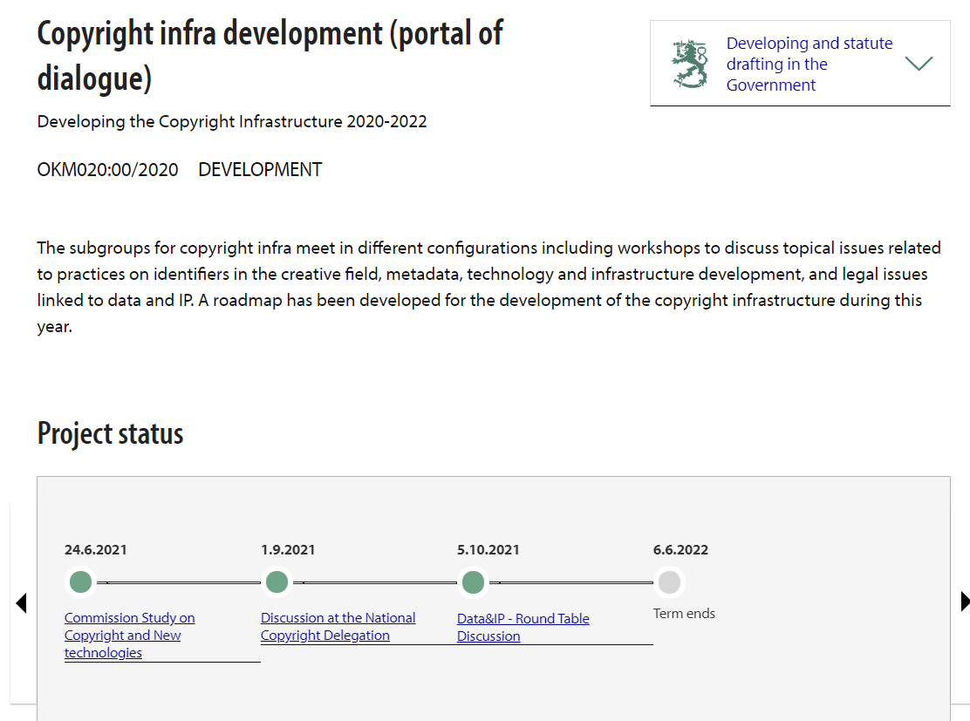
DYNAMIC
ITERATIVE

Slide 13
Draft Finnish IP strategy 2030 – to be approved by end of 2021
The development of the copyright infrastructure is a cross-cutting issue of the EU’s digital strategy.
FUNDING CALLS FROM RRF OPEN 2021 and 2022
to renew Finnish creative industries by investing in training programmes on copyright data (persistent identifiers) in all industries to enable the introduction of data-driven new technologies in the creative industries.
to build application programming interfaces that facilitate data sharing required for efficient management of copyright data (APIs).
Links also with increasing data capacities, data management and re-use of data by businesses which is another dimension of Copyright infrastructure

Slide 14
EU programs & coordinated support
HORISONTAL DIALOGUES
PPP
CO-INVESTMENTS
GOVERNANCE?
Horizon Europe: Artificial Intelligence, data and Robotics and the European Open Science Cloud partnership
Digital Europe: Cyber, AI, skills, deployment
CEF funding for EBSI blockchain technology service infrastructure development
National funding
Funding from EUIPO, etc.
BLTS

Slide 15
We know that we often have
Scope of digital transition of creative sectors in the DSM ?
Challenges with quality metadata
ALL KINDS OF WORKS AND PROTECTED SUBJECT MATTER
AIM for Data networks &APIs
Platforms
Declaration and
verification of copyright data
HOW? MUTUALLY BENEFICIAL
USE CASES
copyright disputess
3. Develop
EU-level standards for quality metadata
FOR
European SMEs, CMOs, creative individuals and society
DATA
FLOW
1.Coherently
available
support
Challenges in accessing data/content
WE NEED
Huge income deficit
boosts sustainability of the copyright system, uptake, resilience and scalability of new technologies
2.COORDINATED
INVEST
MENTS
5. Enable
PPP consortia
Use the EU data strategy goals
Boost data sovereignity
4. Discuss
Choreography
& data models
Research, development and Innovation (RDI)
digitizing licensing/transparent usage rules for content and data re-use
= EU GOAL?
Invest in identities of things, individuals and companies
DSA, DGA DMA, DSM…
Ensure trust and value from available metadata voluntarily
common digital infrastructures/
data spaces for copyright data

Slide 16
QUESTIONS FOR DISCUSSION
How can interoperability be improved (in view of sector-specific and proprietary systems)?
How can access to comprehensive, up-to-date and verified metadata be ensured?
Is there need of awareness-raising activities to ensure all parties in the value chain understand their responsibility for producing, maintaining and providing access to the metadata?
Do we need new metadata or other standards to facilitate transactions and communication of copyright information?
Is there a need to develop voluntary registration systems/metadata repositories?
What other elements are needed to ensure a sufficient level of trust, which is a prerequisite for a well-functioning marketplace and copyright system?

