Slide 1
A European perspective on copyright infrastructure
WIPO series of webinars on copyright infrastructure
17 November 2021
Rodolphe WOUTERS
rodolphe.wouters@ec.europa.eu
European Commission - DG CONNECT

Slide 2
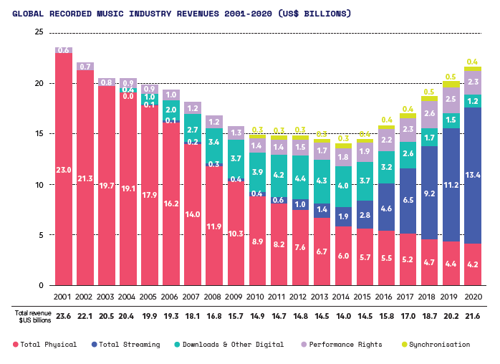
Works are increasingly consumed online
https://digital-strategy.ec.europa.eu/en/library/factsheet-copyrightsheet
IFPI 2021 Report https://gmr2021.ifpi.org/report

Slide 3
Using and protecting works online
When you want to use an online work, questions of licensing may arise
Is it protected by copyright? Is that protection expired?
In case of an exception: to which extent (national rules)? Specific regimes: orphan works, out-of-commerce, text and data mining
Who are the authors or rightholders? From which country/jurisdiction?
Who to contact to take a licence? What terms of conditions? With payment (e.g. reprography, private copying) or not?
When, as an author or rightholder, you publish a work online, the efficiency of protection and enforcement largely depends on the capacity to easily answer the above questions.

Slide 4
Identifying works, rights, rightholders, and licensing terms
Directive 2001/29 on the harmonisation of certain aspects of copyright in the information society
Recognises the role of networks and the need for rightholders to identify better the work [..], the author or any other rightholder, and to provide information about the terms and conditions of use of the work, and to provide such information when putting works or other subject-matter on networks. (Recital 55). Article 7(2) defines such data as rights-management information (RMI)
When present, RMI shall not be removed or altered, and if altered/removed, the work shall not be distributed, imported for distribution, broadcasted, communicated or made available to the public (Article 7(1))
Member States shall provide adequate legal protection against the circumvention of any effective technology measures (Article 6), which may be associated to a work to prevent or restrict acts not authorised by the rightholders (Recitals 47-48).

Slide 5
Effective licensing and remuneration Availability of metadata (1)
« CRM Directive » 2014/26 on collective management of copyright and related rights and multi-territorial licensing of rights in musical works for online use in the internal market
Availability of data to promote effective licensing and remuneration. Article 24 precises what data.
(Recital 41) The availability of accurate and comprehensive information on musical works, rightholders and the rights [..] is of particular importance for an effective and transparent licensing process, for the subsequent processing of the users’ reports and the related invoicing of service providers, and for the distribution of amounts due.
Article 24 (1) Member States shall ensure that a collective management organisation which grants multi-territorial licences for online rights in musical works has sufficient capacity to process electronically, in an efficient and transparent manner, data needed for the administration of such licences, including for the purposes of identifying the repertoire and monitoring its use, invoicing users, collecting rights revenue and distributing amounts due to rightholders.

Slide 6
Effective licensing and remuneration Availability of metadata (2)
No registration required for copyright protection
RMI data is often collected/produced by collective management organisations, publishers, or rightholders.
It is often not attached to the online work itself or, when attached, it may be stripped in the process of making available. “97% of images are stripped of their credit metadata” [1]
[1] 2019 https://blog.imatag.com/state-of-image-metadata-in-news-sites-2019-update

Slide 7
Effective licensing and remuneration Voluntary Standards
CRM Directive encourages voluntary standards on the whole value chain
identification (Art. 24(2)),
exchange of information (Art.26),
usage report (Art.17, Art. 27(2)), and
invoicing (Art. 27(3)).
ISO family of identifiers: ISNI, DOI, ISAN, ISBN, ISRC, ISSN, and ISWC.
Some sectors, such as music, are better standardised across the value chain: identification (ISRC, ISWC), registering (CWR), reporting (DDEX), matching (IPI, ISWC), invoicing (CCID), payment (CRD, DIF)

Slide 8
Effective licensing and remuneration Metadata accuracy
Focus on accuracy of data, as key to ensure efficient licensing/payment:
(Recital 26) ..Accurate distribution is only possible where the collective management organisation maintains proper records of membership, licences and use of works and other subject-matter…
Article 26 Accuracy of multi-territorial repertoire information
1. Member States shall ensure that a collective management organisation which grants multi-territorial licences for online rights in musical works has in place arrangements to enable rightholders, other collective management organisations and online service providers to request a correction of the data
Case law: Balance between accurate monitoring and administrative costs.
C-39587/Tournier: The Court ruled that the fact that a blanket or flat-rate royalty was charged can only be criticised by reference to the prohibition on unfair price practices ‘if other methods might be capable of attaining the same legitimate aim, namely the protection of the interests of authors, composers and publishers of music, without thereby increasing the costs of managing contracts and monitoring the use of protected musical works’. (§45)
C-372/19 SABAM. “a calculation method allowing the precise identification of the musical works performed must not lead to a ‘disproportionate’ increase in those costs” (§84)

Slide 9
Metadata Issues and possible causes
Royalty Black box uses with non-identified rights/owners are not paid
Missed licensing opportunities
Piracy lack of IP information makes enforcement more difficult
Exclusive right Lack of IP information may hinder author’s ability to authorise/prohibit the use of a work
Conflictive claims of ownership
Lack of copyright awareness, and Lack of straightforward licensing mechanisms availed to online users. Licensing information may not be available Metadata not attached to content or inaccurate
Data fragmentation across actors of the value chain
Complexity and data explosion Often a plurality of rightholders Networks of licensing agreements Data management issues: data entry and accuracy, ‘freshness’, ..
Notes:
Royalties: Authors and right holders might be missing a considerable amount of royalty payments (the so-called “Royalty Black Box”) or face delays in payments if their content is used and they are not identified as right holders. They can also be missing information on what the real economic value of their work is (for example, in terms of audience behaviour). This might be particularly important for smaller right holders. Accurate identification of right holders is also key to an efficient management of rights by collective management organisations.
• Licensing: Right holders and distributors might be missing licensing opportunities (national and pan-European) if potential licensors do not have access to the relevant data on the content they wish to use. Consumers in turn may miss the opportunity to access new content
• Piracy remains one of the biggest issue in most IPs
• Moral rights: Lack of IP information may hinder author’s ability to authorise/prohibit the use of a work
Conflictive claims: In the absence of accurate and up-to-date data, several right holders might claim ownership of a single work, giving rise to high transaction costs and risk of double payments for digital distributors.

Slide 10
Examples of Initiatives
Group 1: from the creation side
CISAC, DDEX, EBUCore/EBUtech… : identification, standardisation, and data governance
EUIPO: Orphan works DB, Out of commerce (Art.10 of Directive 2019/790)
Group 2: from the consuming side
Copyright hub: find the data owner based on an identifier
Ardito, Rightsstatement.org (CHI): Facilitate licensing by making rights data and copyright terms and conditions visible along with works being published
Group 3: others
License for Europe: foster a dialogue
And many others…

Slide 11
Intellectual Property Action Plan (2020)
Sets out key steps to improve the protection of IP, boost the uptake of IP by SMEs, facilitate the sharing of IP to increase the technological uptake in the industry, fight counterfeiting and improve the enforcement of IP rights, and promote a global level playing field.
Addresses metadata
Use of high quality metadata and new technologies such as blockchain could also help achieve more transparency and better rights data management, notably with regard to copyright and an improved identification of rights owners
The Commission will further work with relevant stakeholders to promote the quality of copyright data and achieve a well-functioning “copyright infrastructure” (e.g. improve authoritative and updated information on right holders, terms and conditions and licensing opportunities)
COM(2020) 760 https://myintracomm.ec.europa.eu/corp/intellectual-property/policy/Pages/default.aspx

Slide 12
Study on copyright & new technologies
Understand the interplay between the copyright legal framework, the market and new technologies, incl. data, AI and blockchain.
Metadata: take stock of existing initiatives (CISAC, License for Europe, GRD..), identify issues related to metadata management in the copyright industries, and investigate the role of technology in improving the efficiency and transparency of licensing of content and management of rights, while making more content accessible for end-user.
Artificial Intelligence: look at copyright-related challenges raised by the use of AI from two main angles: the use of copyright-protected content as an input to feed AI technologies, and the production of cultural outputs by or with the assistance of AI.

Slide 13
THANK YOU
© European Union, 2021
Except if stated otherwise, this material is licensed under the Creative Commons Attribution 4.0 International (CC BY 4.0) licence (https://creativecommons.org/licenses/by/4.0/). It may be reused, provided that due credit is given and any changes are indicated.
Notes:
Conclusion
The European copyright framework defines and protects the core copyright metadata
It sets data responsibilities on major actors of the value chain
Currently assessing the role of new technologies
The Commission will further work with relevant stakeholders to promote the quality of copyright data and achieve a well-functioning “copyright infrastructure” (IP Action plan)

Slide 14
Annex - References
IP Action plan https://ec.europa.eu/commission/presscorner/detail/en/ip_20_2187
Copyright
https://digital-strategy.ec.europa.eu/en/policies/copyright
Finnish Presidency’s stocktaking exercise related to priority ʻDeveloping the copyright infrastructureʼ. https://data.consilium.europa.eu/doc/document/ST-15016-2019-INIT/en/pdf

