Slide 1
SOUTH-SOUTH AND TRIANGULAR COOPERATION PARTNERSHIPS FOR TECHNOLOGY TRANSFER - Session 4 -
McLean Sibanda
South-South and Triangular Cooperation for Access to Information and Knowledge, Innovation Support, and Technology Transfer
Organised by the World Intellectual Property Organisation (WIPO) in cooperation with the National Institute for the Defense of Competition and Protection of Intellectual Property (INDECOPI) of Peru
Lima, Peru, May 5 and 6, 2015

Slide 2
Presentation Outline
Introduction
Technology Transfer Partnerships / Initiatives
Specific Partnerships in Africa
iThemba Pharmaceuticals (South Africa)
BioVAC / Heber Biotec (South Africa)
East Coast Rapid Diagnostics (South Africa)
African Agricultural Technology Foundation (AATF) (Kenya)
Aspen Pharmacare (South Africa)
Huajan Shoes (Ethiopia)
Concluding Remarks

Slide 3
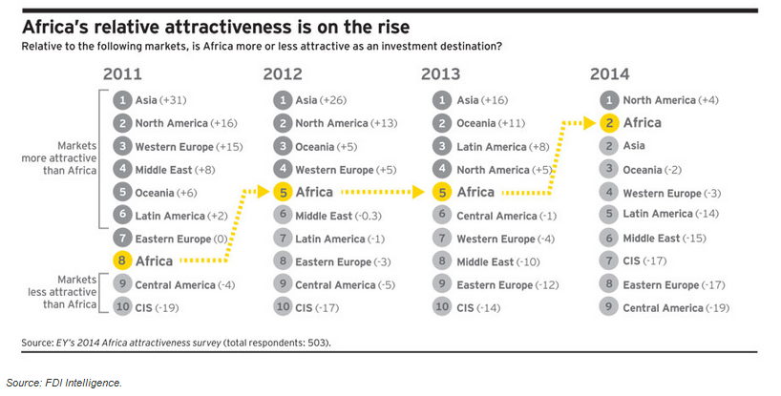
Introduction
Africa’s Attractiveness as an Investment Destination

Slide 4
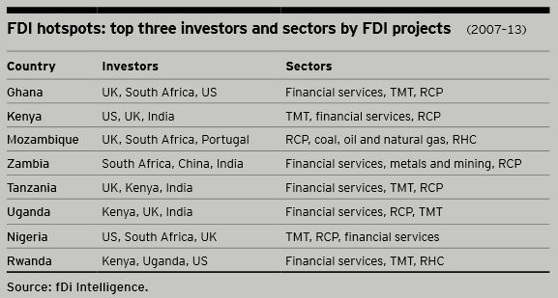
Introduction
Investors per sector in FDI Projects in Africa

Slide 5
Technology Transfer Partnerships / Initiatives
Expanding the National Systems of Innovation
Technology Transfer essential for development of local technological base and capabilities and consequently strengthening the economy of the receiving country
Critical mass of STI human capital a prerequisite
Absorption capacity
Adaptation and endogenous innovative capacity
Building a bridge between R&D and the market (increased focus on commercialisation)
Right mix of institutional arrangements
Appropriate funding instruments and incentives
Expand on the local private sector
Entrepreneurship and building local industries

Slide 6
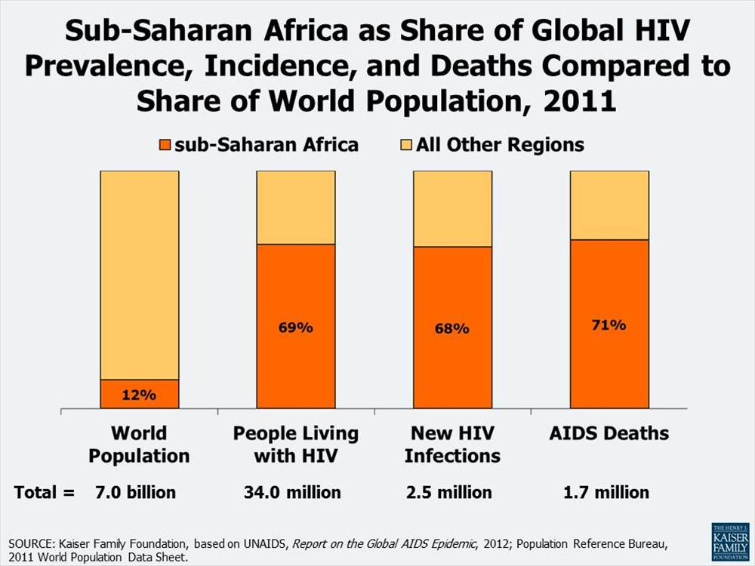
Specific Technology Transfer Partnerships
Emory University (USA) – iThemba Pharmaceuticals (South Africa) … 1
Licensed Patents / know-how:
Synthesis method for Abacavir
Novel compounds for treatment of latent TB infections
Emory University (USA)
Scientific Advisory Board
(top class researchers in USA, UK and SA institutions)
TIA
(SA Government Fund)

Slide 7
Specific Technology Transfer Partnerships
Emory University (USA) – iThemba Pharmaceuticals (South Africa) … 2
Outcomes
R&D capacity developed incl. secondments to Emory
Abacavir process developed
Contract R&D opportunities secured
Human factors
Access to patent pool pipeline
Challenges
Limited funding with constraints
Investor changes (LIFELab / BioPAD to Technology Innovation Agency)
Shareholder challenges owing to change of investors
Unaligned vision
Unstable leadership
Lessons Learnt
Need to secure sufficient funding runway
Investor(s) alignment
Joint ownership with each party realising importance of relationship
Leadership matters
Regulatory hurdles must not be overlooked

Slide 8
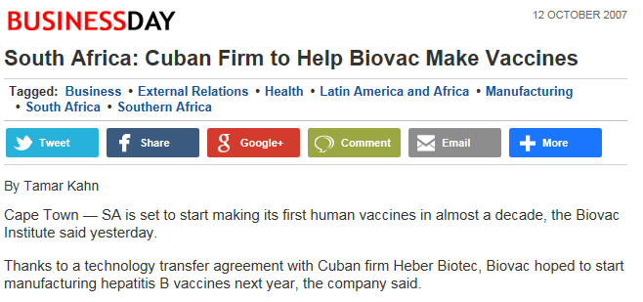
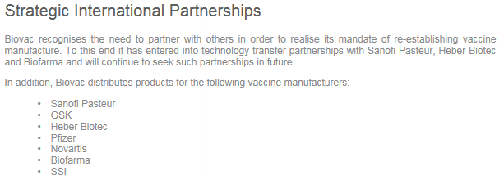
Specific Technology Transfer Partnerships
Cuban Heber Biotec – BioVac Institute (South Africa) … 1
Technology transfer partnerships with Sanofi Pasteur and Biofarma in the area of vaccines

Slide 9
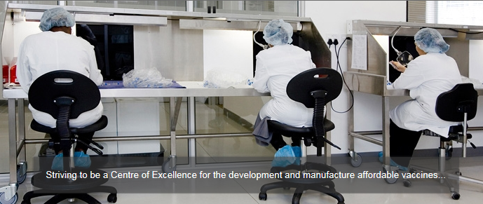
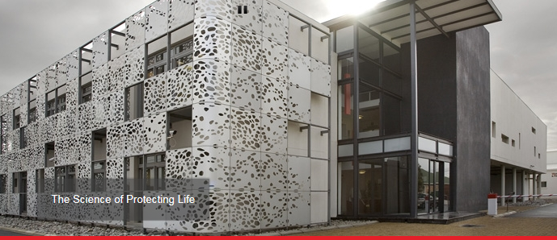
Specific Technology Transfer Partnerships
Cuban Heber Biotec – BioVac Institute (South Africa) … 2

Slide 10
Specific Technology Transfer Partnerships
Cuban Heber Biotec – Biovac Institute (South Africa) … 3

Slide 11
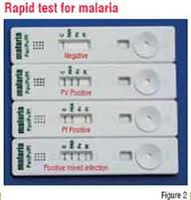
Specific Technology Transfer Partnerships
East-Coast Rapid Diagnostics … 1
Technology transfer from Tulip Group Diagnostics (India)
Malaria
Pregnancy
Urine dip stick technology
Substantial capacity and technical assistance
Facilitated by public biotechology funding agency – LIFElab (Durban South Africa)
Joint Venture (Tulip Diagnostics, LIFELab and LIFEAssay)
South Africa and other African markets

Slide 12
Specific Technology Transfer Partnerships
East-Coast Rapid Diagnostics … 2
Challenges
Lack of capacity to transfer
Absorption capacity
Human factors
Funding
Local partner, LIFEAssay already had a product(s) ready to go to market - competitive advantage
LIFELab merger with other entities to establish Technology Innovation Agency
Lessons Learnt
Clear win-win must be established from the on-set
Sufficient funding run-way essential
Commitment to effecting technology transfer as expediently as possible
Relationships matter
Absence of intellectual property rights makes it more challenging – maintaining competitive advantage

Slide 13
Specific Technology Transfer Partnerships
African Agricultural Technology Foundation … 1
Established in 2003
Focus on Public-Private-Partnerships
transfer, development, production and distribution of technology to smallholder farmers in Sub-Saharan Africa
Based in Nairobi (Kenya)
Addressing food security and climate change
> 30 technologies accessed (US$180m)
Majority accessed have since been developed and adapted in Africa
Manages > 20 technology licenses

Slide 14
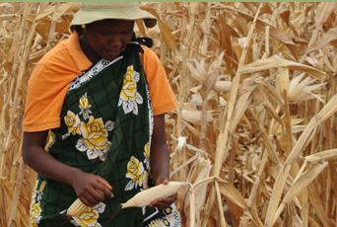
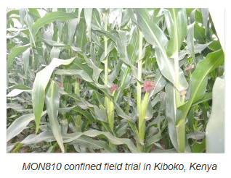
Specific Technology Transfer Partnerships
African Agricultural Technology Foundation: Wema Project … 2
AATF, CIMMYT, Monsanto and National Agricultural Research Systems of Kenya, Mozambique, South Africa, Tanzania, Uganda
Research collaboration to develop and deliver Water Efficient Maize for Africa (“WEMA”)
Elite maize germplasm, advanced breeding methods and biotechnology, national field trials to select the best seed for deployment
Licensed seed companies will not pay a royalty for any intellectual property (“IP”) in maize seed sold to small holder farmers
Each party owns background technology, germplasm and IP contributed to the Project; free to use such outside of the Project
Each party will also own (solely or jointly) the IP that it develops in carrying out the WEMA Project
Germplasm will be owned by the party whose breeding program developed such germplasm

Slide 15
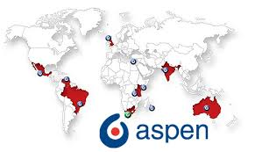
Specific Technology Transfer Partnerships
Pharmaceutical Sector: Aspen Pharma (South Africa)
Multinational patent holders
(incl. GSK, Boehringer Ingelheim
US$3b
Voluntary licences
Technology transfer
Low cost producer
US28.5m pharmaceutical manufacture facility
Strategic Investment Programme (SIP)
Access to market
the dti
(SA Government)

Slide 16
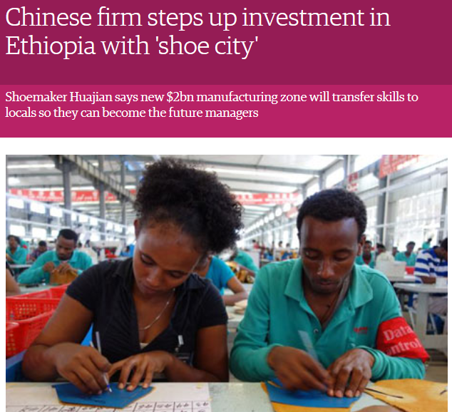
Specific Technology Transfer Partnerships
Chinese Shoemaker Huajian Manufactures in Ethiopia (Jan 2012)
Ethiopian climatic conditions and cheaper labour
Opened factory in January 2012 (Addis Ababa) and now employ >600 people
By 2022 will have created > 100,000 jobs
Local employment and skills transfer / upgrade

Slide 17
Concluding Remarks
Barriers in technology transfer partnerships:
Poor understanding of the IP system
Low supply of high-end skills beyond commodity orientation
Inadequate R&D investment and follow on funding - patient capital
Private sector not involved early enough or simply missing
Some critical lessons:
Securing appropriate funding runway / patient capital
Continuous alignment of vision and purpose
Trust issues: People do business with people
Development oriented IP approach and clauses
Relevant institutions and institutional frameworks
Government incentives, including procurement as a lever for transfer of technology, capacity building, market access

Slide 18
Thank You

