Slide 1
Session 3:
South-South and Triangular Cooperation Partnerships for Innovation Support
An A*STAR Perspective
Ho Cheng Huat, Executive Vice-President,
IP Management Division, ETPL
Tuesday, 5th May 2015

Slide 2
Presentation Outline
Who we are
Innovation Support Initiatives
Summary

Slide 3
What is A*STAR?
Agency for Science, Technology and Research
Lead Singapore agency driving mission-oriented research that advances scientific discovery and technological innovation.
Plays a key role in nurturing and developing talent and leaders for our Research Institutes, the wider research community, and industry.
Together with the other public sector entities, we develop industry sectors by:
  integrating our capabilities to create impact with Multi-National Corporations and Globally Competitive Companies;
  partnering Local Enterprises for productivity and gearing them for growth; and
  nurturing R&D-driven Start-ups by seeding for surprises and shaping for success.

Slide 4
A*STAR
Vision
A global leader in science, technology and open innovation
Mission
We advance science and develop innovative technology
to further economic growth and improve lives
Biomedical Research Council
(BMRC)
Joint Council Office
(JCO)
Science & Engineering Research Council
(SERC)
A*STAR Graduate Academy
ETPL
Interdisciplinary Research
10 Research Units
8 Research Units
Commercialisation
Scholarships
>5,200 Staff
>4,300 Researchers, Engineers and Technical Support Staff
>40% of whom come from >60 countries

Slide 5
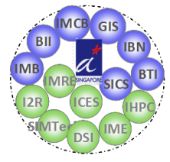
A*STAR’s Strategy Map
Supporting private sector growth through public-private partnerships
Sustaining Knowledge Creation
Growing Innovation Capital
Research
Performers
Innovation Capital
Enterprises
Multinational & Globally Competitive Companies
Integrating for Impact
Small & Medium Sized Companies
Gearing for Growth
Universities, Polytechnics, Hospitals , Research COEs, CREATE, Corp Labs, ADSC
Duke-NUS GMS etc.
Seeding for Surprises
Start-ups

Slide 6
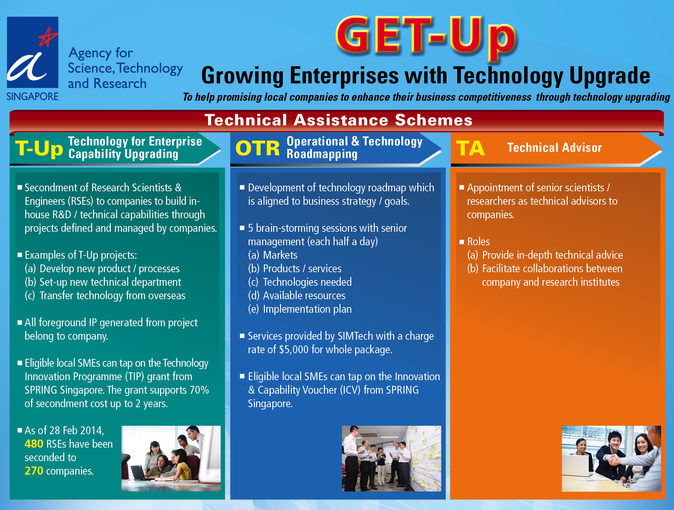
A*STAR’s Initiatives for Innovation Support
http://www.a-star.edu.sg/sme/OUR-PROGRAMMES/GET-Up.aspx

Slide 7
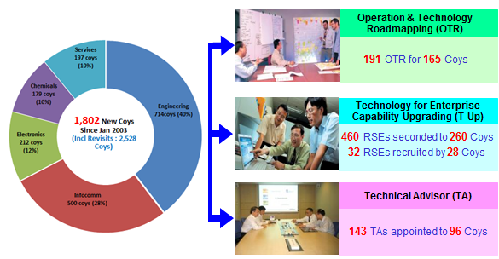
Get-Up
  Growing Enterprises through Technology Upgrade
To help promising local companies to enhance their business competitiveness through technology upgrading.
Cumulativre total to date in June 2014

Slide 8
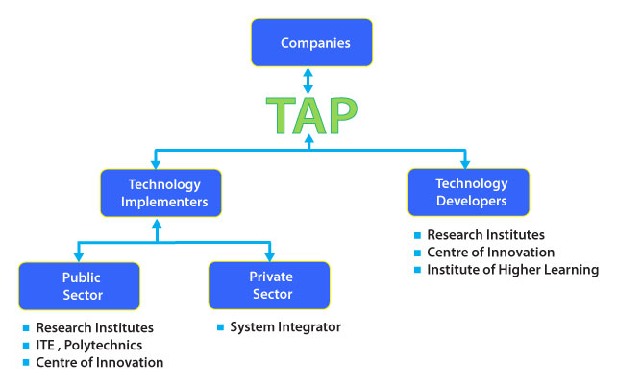
Technology Adoption Programme (TAP)
Launched in July 2013.
Helps to improve the accessibility to technology for small and medium enterprises (SMEs) to enhance their productivity and innovation.
Through this programme, our intermediaries will provide advice and link up the technology needs of these companies to suitable solution providers.
http://www.a-star.edu.sg/sme/OUR-PROGRAMMES/TAP.aspx

Slide 9
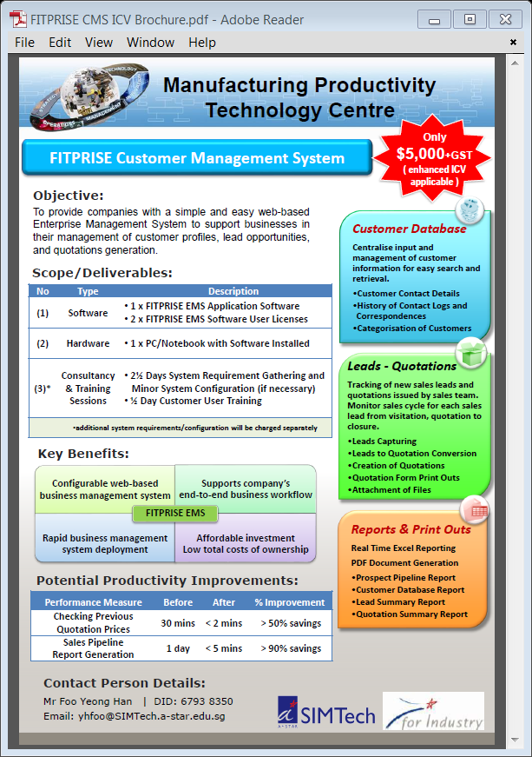
Ready-to-go
Technologies that are packaged for easy adoption by local SMEs.
http://www.a-star.edu.sg/sme/OUR-PROGRAMMES/READY-TO-GO-PACKAGES.aspx

Slide 10
Industry Engagement: Collaboration
A*STAR engages the R&D industry in to drive innovation and advance technology that may be translated to products and services to yield economic benefit. The following collaboration opportunities are some ways in which we work with industry to achieve this objective.
Many to One
STRATEGIC PARTNERSHIP
Many to Many
CONSORTIA
PUBLIC AGENCY
COMPANY
IHL
MNC
SME
LE
A*STAR RI
IHL
A*STAR RI
PUBLIC AGENCY
RIs/PUBLIC AGENCIES INVOLVED
One to One
PARTNERSHIPS | PROJECTS
One to Many
CONSORTIA
RI: Research Institute
IHL: Institute of Higher Learning
MNC: Multi-National Company
LE: Local Enterprise
SME: Small & Medium Enterprise
A*STAR RI
COMPANY
MNC
A*STAR RI
LE
SME
COMPANIES ENGAGED

Slide 11

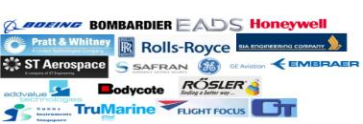
Collaborations
Joint-Research programmes are one-to-one R&D collaborations between a private company with A*STAR research institutes (RIs) that help to enhance the technology edge of the company by the technology transfer from the RI. Examples include the Singapore Bioimaging Consortium (SBIC) – Nikon Imaging Centre, and the Clinical Imaging Research Centre – a joint venture between NUS and A*STAR with industry partner, Siemens.
  Aerospace Consortium
To drive innovation and sustain competitiveness of local aerospace industry through R&D
R&D Focus
Computational Modelling & Dynamics
Advanced Materials
Manufacturing Processes & Automation
Inspection & NDT
Information & Communication
Industry consortia programmes encompass direct basic and applied R&D across the SERC research institutes, and provide the conduit as well as opportunities for local companies to work with industry giants via research collaborations or membership programmes.

Slide 12
Gap Funding
  Developing technology to a higher TRL Level
 | Conceptualization |  |  | Concept Refinement | Technology Development |  | System Development & Demonstration |  |  | Production & Deployment
TRL# | 1 | 2 | 3 | 4 | 5 | 6 | 7 | 8 |  | 9
Relative level of Technology Development | Basic Principles observed | Concept Formulated | Proof of Concept | Component/or system validated in lab. environment | Lab scale, similar system validated in relevant environment | System/sub system or Prototype demonstrated in relevant environment | Full scale/ Prototypical system demonstrated in operational environment | Actual Systems Qualified through test and demonstration |  | Mission proven
A*STAR’s Focus | Output from Research Institutes’ core fund*
 |  |  |  | Commercialisation efforts: Joint lab., RCA, Consortia, Gap Fund, TAP, Translation Centre **
Industries |  |  |  | Product development; customers’ validation and mass production

Slide 13


Gap Funding: Outcomes
Validation Studies
Scaling up
Production
Personal Genomics Solutions
Commercial Outcomes
PRL Monoclonal Antibodies
Driving Collaborations & Licensing
Developing Prototypes
Forging Collaborations

Slide 14
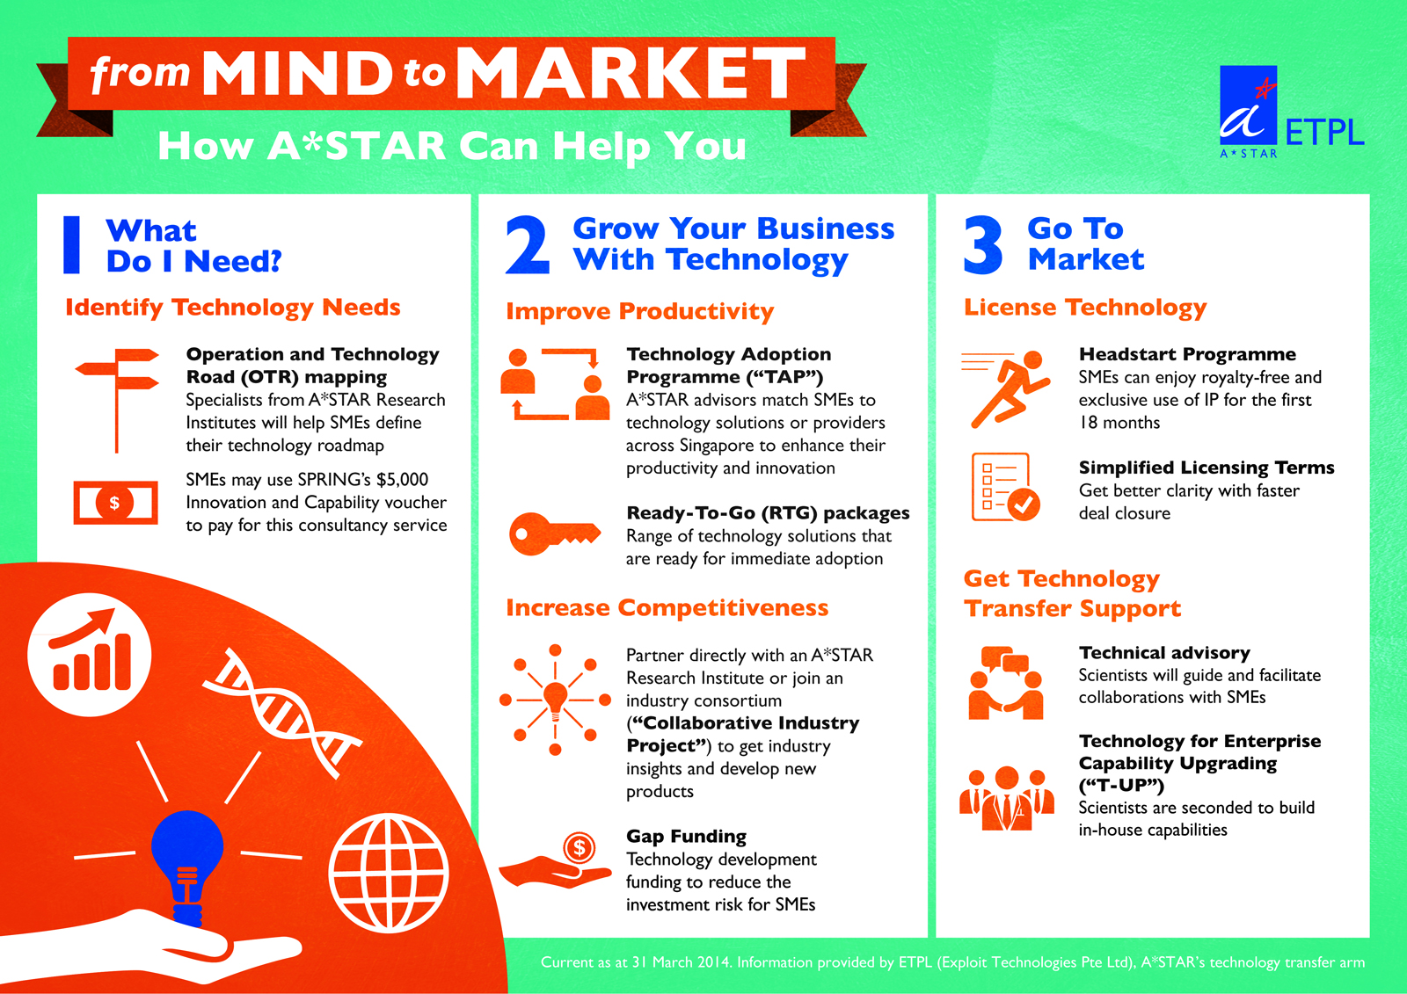
Summary of Innovation Support
Elaboration
on this
in Session 4
“Technology Transfer”

Slide 15

End of Presentation
A*STAR’s website: www.a-star.edu.sg

