Slide 1

TISC Network: Morocco’s Experience

Slide 2
Overview
Presentation of TISC Morocco
Composition, organization and services of the TISC Morocco network
TISC achievements in 2014
TISC Morocco outreach tools
Main Challenges, Next Steps, Opportunities

Slide 3
What is TISC?
Technology and Innovation Support Centers
Network of Technological
Information Centers

Slide 4
Objectives….
Technological development of companies
Promotion of the results of research
Establishment of links between universities and companies

Slide 5
Task
Offer users services that enable them to search patent databases and other sources of technical information through direct and personal assistance
Communicate to users the state of the art in various technological fields
Inform users about their intellectual property rights, in particular patents
Contribute to promoting the results of research

Slide 6
Composition and organization of the TISC network
TISC-OMPIC
TISC-Company
TISC-R&D
TISC-Technical
TISC-Universities
Animation Unit
TISC- OMPIC

Slide 7
Members of the TISC network
43 Members & 58 focal points
18 Public Universities
12 MCINT Delegations
8 R&D Centers
6 Engineering schools
3 Clusters
1 Innovation support fund
1 Faculty of Sciences
1 Technical center
1 IP Office
3 Corporate association

Slide 8
TISC members and focal points
TISC Members
TISC focal points
Notes:
Certains organismes contiennent plus d’un point focal (université de casa)
Les points focaux DPCI ne sont pas comptabilisés en tant que membres

Slide 9
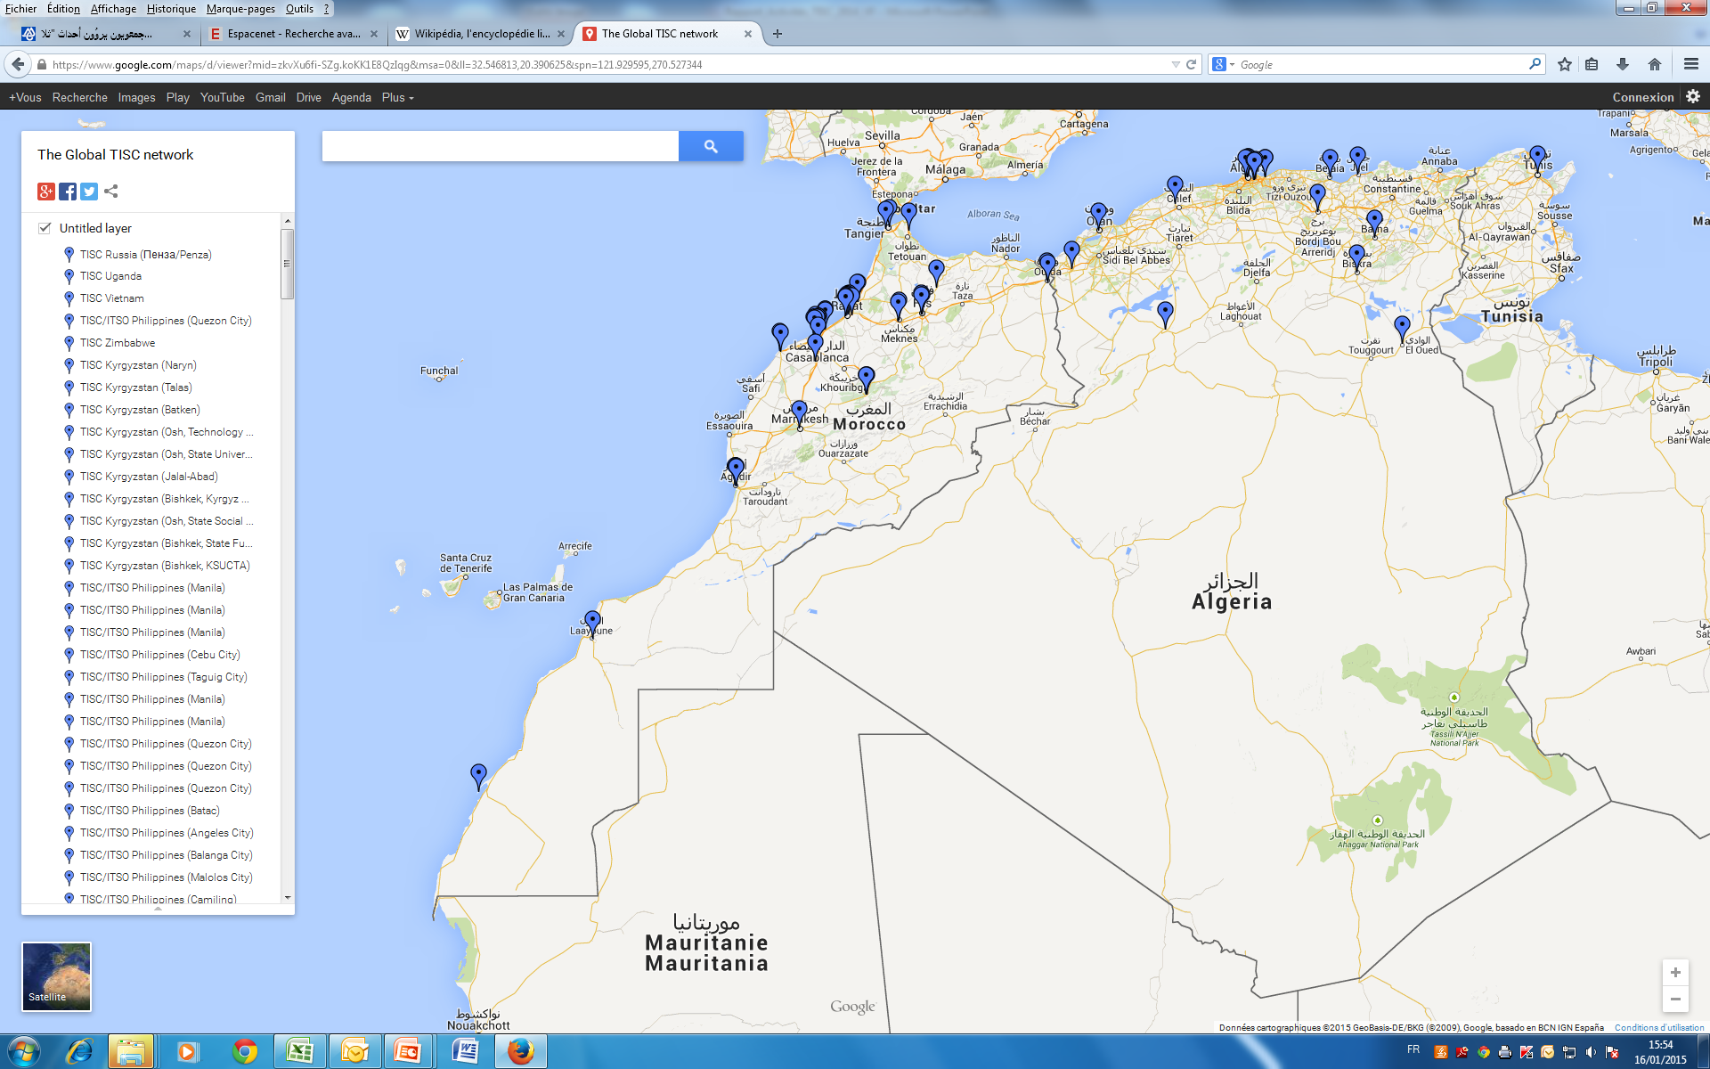
TISC’s national Cartography

Slide 10
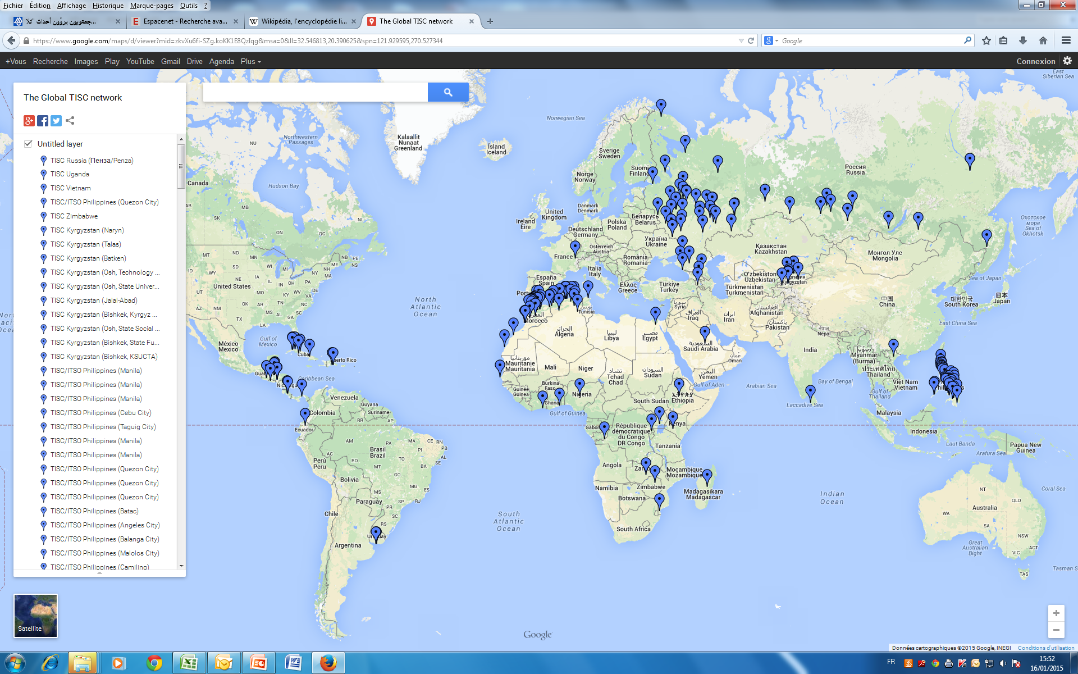
TISC’s international Cartography

Slide 11
TISC network management bodies
Steering Committee
TISC-university
TISC- companies
Animation unit
TISC-R&D
TISC-Technical

Slide 12
The key elements of the organization of the TISC network
Membership agreement
Terms of reference for each category
Confidentiality charter
Code of ethics for heads of focal points

Slide 13
Users of the TISC network’s services
Universities
Lecturers-researchers
Doctoral and other students
Companies
Companies
Professional associations
Private individuals
Inventors
Private individuals
Laboratories and research centers

Slide 14
  TISC resources
Public patent databases (PATENTSCOPE and Espacenet)
Access to the Questel private database (4 licenses)
Notes:
Questel = Base de données commerciale

Slide 15
  TISC network outreach tools
Meeting of the Monitoring Committee to monitor the TISC network’s activities.
Dedicated website (http://www.tisc.ma)
Publication of a newsletter (TISC News)
TISC Morocco group on WIPO’s eTISC platform (http://etisc.wipo.org/)
Daily contact with heads of focal points

Slide 16
Services provided by the TISC network: proximity services
Direct assistance concerning technological information search
Guidance towards innovation protection tools, such as patents
Guidance towards existing funding tools.

Slide 17
TISC network services: advanced services
State-of-the-art search
Anticipation search
Patent mapping
Freedom to operate search

Slide 18
State-of-the-art search
State-of-the-art search shows the level of technical development attained in a given technological sector. Prior to any new development, it is essential to have an overview of the general state of the art in the technological sector in question.
Example
Patents concerning the manufacturing process for phosphoric acid

Slide 19
Anticipation search
Anticipation search gives an idea of the novelty and inventive step of an idea or invention; it also helps to identify any prior disclosures (articles, patents, conferences) which might impede the patentability of an invention.
Examples
Not reinventing the wheel;
Guiding research work;
Evaluation of the invention prior to registration.

Slide 20
Freedom to operate search
Freedom to operate search makes it possible to identify the products and procedures of a given sector which are not protected in Morocco, or which are now in the public domain and can be freely exploited.
Examples
Medicines for free use

Slide 21
Patent mapping
Patent mapping refers to a variety of practices intended to create a diagram of a corpus of patents and the information generated from its analysis.
Examples:
Geographical patent maps.
Maps of cooperation networks based on the analysis of jointly-owned patents.
Representation of links to citations concerning search reports.

Slide 22
TISC achievements in 2014 : key figures
200 search requests
189 patent applications registered at the national level in 2014
24 international patent applications filed at the international level under the PCT
8 organizations joined the TISC network in 2014
3 training events organized for TISC focal points on drafting, promotion and IP policy
2 Monitoring Committee meetings on TISC monitoring held in Casablanca
- 19 focal points registered for WIPO’s advanced online training.
Organization of 15 information half-days in cooperation with local TISCs 1 of the TISC News publication
International cooperation with WIPO, EPO, ICDT, C.U.R.I.E. and PATLIB networks on aspects linked to patent information.

Slide 23
Coopération & Partnership
Organization | Activities | The aim of the project
World Intellectual Property Organization (WIPO) | On line training Organization of a seminar on intellectual property and promotion of research, innovation and competitiveness for African countries 21, 22 et 23 of October 2014 in OMPIC | Capacity strengthening of focal point ‘sTISC Setting up a TISC in Arabic contries (TISC-Africa)
The Islamic Centre for Development of Trade (ICDT) | - Organization of international seminar on support of Innovation and commercialization of patent in 11, 12 et 13 june 2014 in OMPIC | Setting up the network with the islamic member states of ‘OIC’(Organisation of Islamic Cooperation)
European Patent Office (EPO) | On line training Participation of 4 focal points to PATLIB conference in 15 et 16 May 2014 , Istanbul - Publish an article on theTISC in « Patent Information News » of EPO | Capacity strengthening of focal point ‘sTISC Creation of synergy with PATLIB of EPO
Islamic Educational, Scientific and Cultural Organization (ISESCO) | Participation in the second meeting for creating an IP network in Arab countries Participation in experts meeting to establish a dashboard of innovation in the MENA region | Promoting IP in arabic contries establish the innovation situation in MENA countries

Slide 24
TISC search requests in 2014
200 search requests were conveyed by the TISC focal points to the TISC outreach unit hosted by OMPIC, an increase of 98 % from 2011. This increase is due mainly to the widening of the TISC network in 2014.

Slide 25
Breakdown of requests according to type (2014)

Slide 26
Breakdown of search requests according to sector
Notes:
The distribution of search requests according to sector illustrates the preponderance of the chemicals sector, with 41%, followed by the electrotechnical sector with 42%, mechanical 9%, with 20 per cent and 19 per cent respectively of the total number of search requests.

Slide 27
MAIN CHALLENGES
Continuing activities with knowledge transfer to local reference groups
The motivation of focal points of TISC

Slide 28
NEXT STEPS
Certification of focal points
Réorganization of régional network

Slide 29
OPPORTUNITIES
Exploitation of the potentiel of national R&D
Ecosystem favourable to creativity and innovation in Morocco
  Funding Agency for research and Innovation
  Moroccan Stratégy Innovation
  Globalbusinesses(offshoring, Aéronautic, textile, Automotive and agricultural industry)

Slide 30
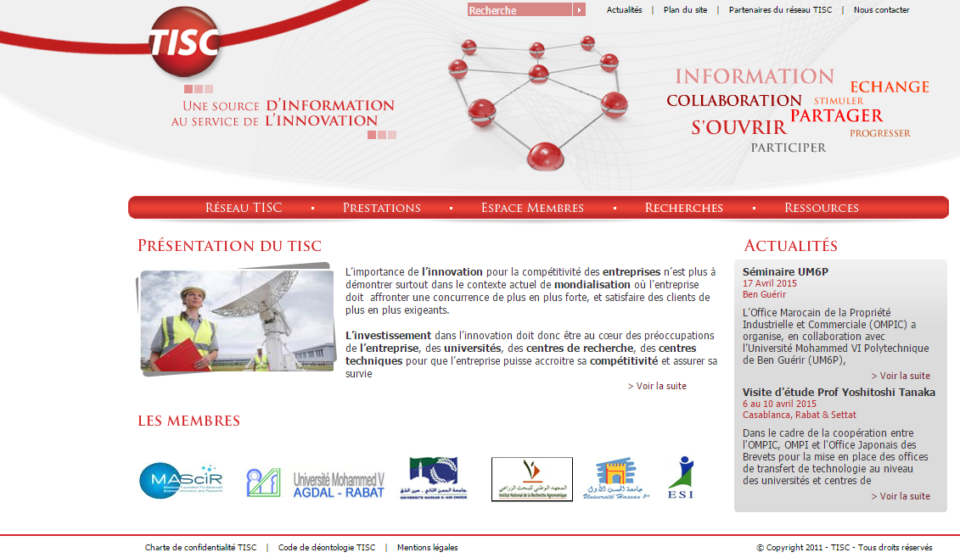

Slide 31
Thank you for your time
www.tisc.ma

