Slide 1
WIPO/INDECOPI Interregional Expert Meeting Lima, 5 - 6 May 2015 South-South and Triangular Cooperation for Access to Information and Knowledge Mauritius
Dr Nitin Gopaul
Mauritius Research Council

Slide 2
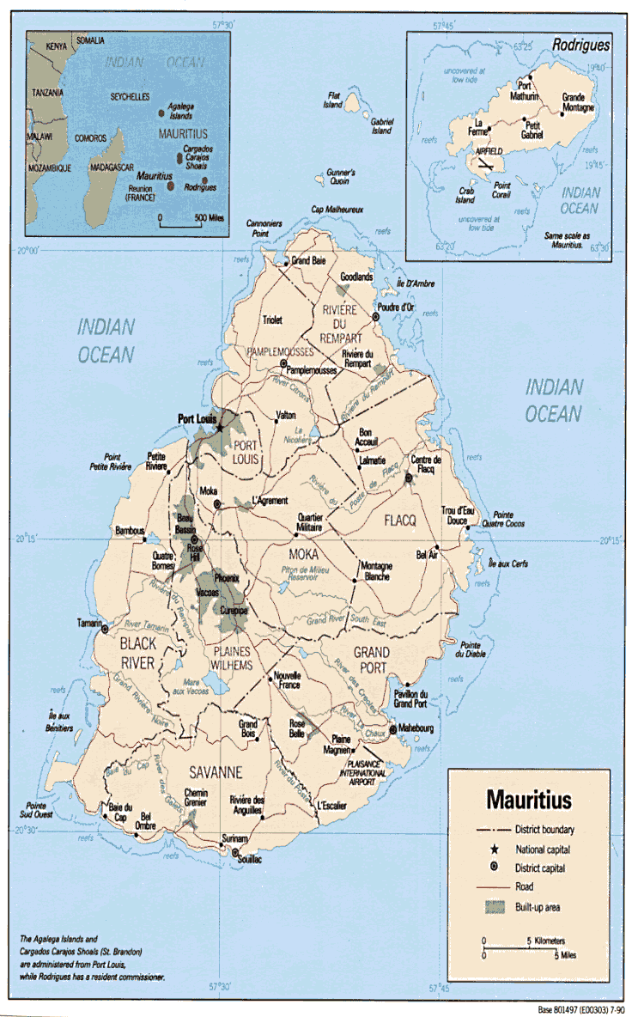
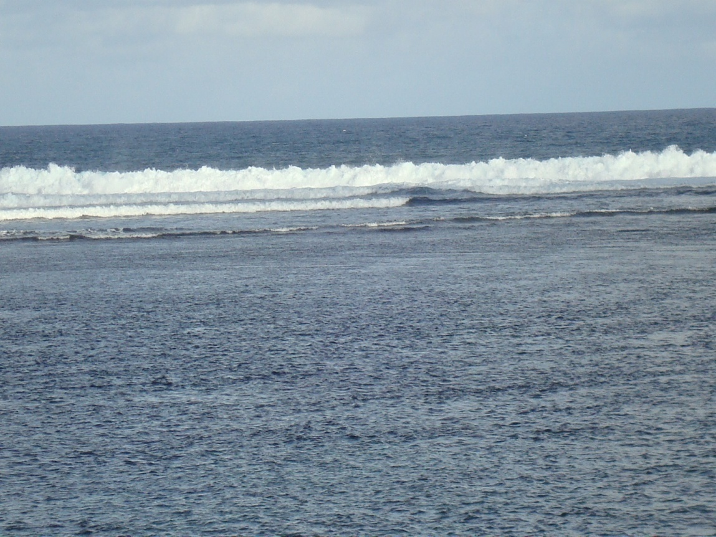
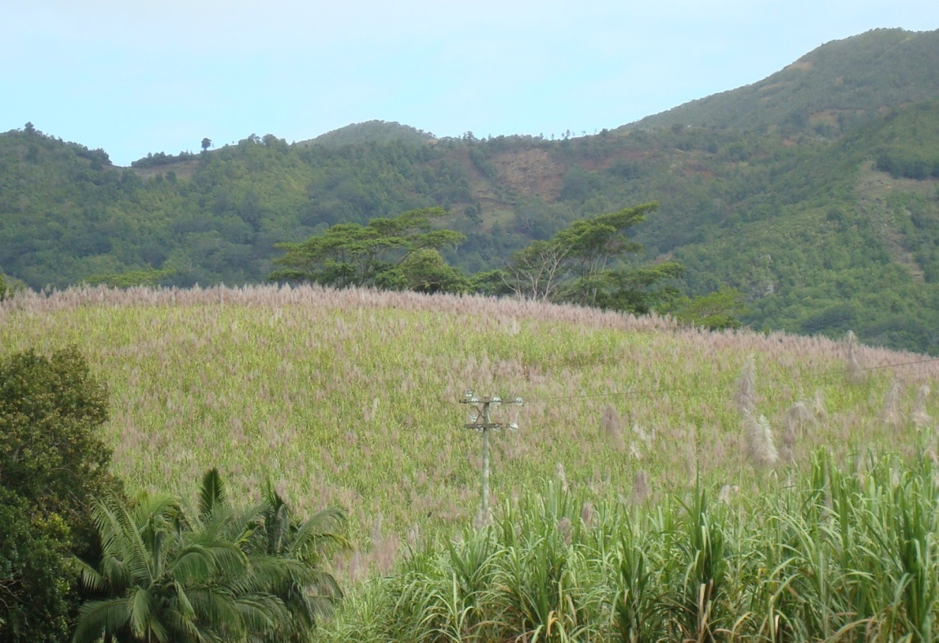
Local Context
Land Area: 2040 km²
Population: 1.3 million
Small Island Developing State (SIDS)
EEZ: 2.3 million km² – Ocean State
Population literacy rate: ~90%
Not much natural resources
Main Assets
People - Knowledge Based Economy
Ocean – Ocean Economy
Faces SIDS vulnerability
Environmental Concerns-Climate Change
Global Economic Shocks
Strategic location: a bridge between Africa/Asia/Australia
Rising economic growth in Africa
Increased level of preparedness
Consolidate partnerships with Africa

Slide 3
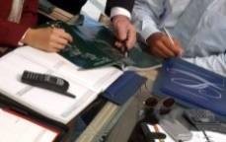
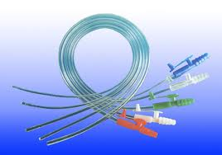
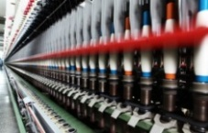
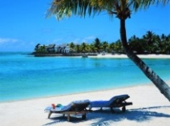
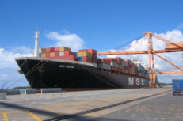
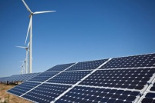
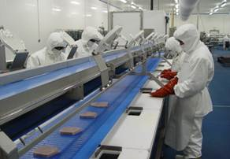
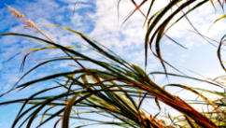
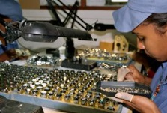
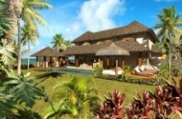
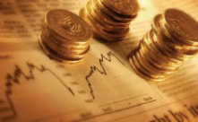
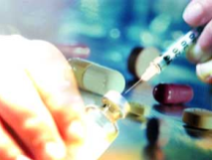
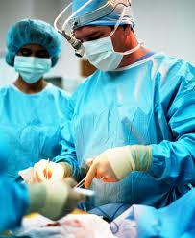
Transformation of the Economic Landscape
US$ 20,000 by 2020s
INNOVATION DRIVEN
USD 8,000
SERVICES
INDUSTRIAL
USD 2,500
MONOCROP
USD 1,000
USD 200*

Slide 4
Technological Readiness & Innovation
Mauritius | 2011/2012 (out of 142) | 2012/2013 (out of 144) | 2013/2014 (out of 148) | 2014/2015 (out of 144)
GCI (Overall Ranking) | 54 | 54 | 45 | 39
Technological Readiness (Sub Indices Ranking) | 61 | 63 | 63 | 63
Innovation (Sub Indices Ranking) | 89 | 98 | 81 | 76
Source: The Global Competitiveness Reports 2011- 2015

Slide 5
Objectives of the Mauritius Research Council MRC (Amendment) Act 2014
Foster, promote and coordinate research and development, and innovation, inline with the economic, technological and social needs of Mauritius
Encourage commercial utilisation of research and development, and innovation, results in the national interest
Foster the development of a research culture
Promote science and technology
Enhance private sector participation in research and development and innovation
FOCUS ON INNOVATION

Slide 6
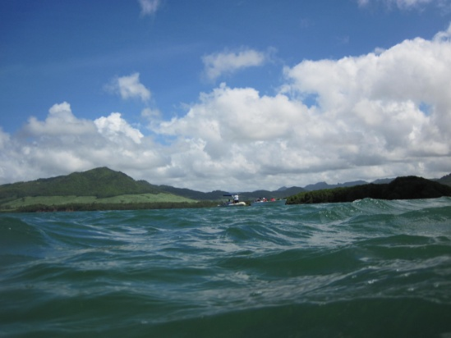
SEAWEED PROGRAMME
IN
MAURITIUS

Slide 7
ENVIRONMENT/ BIODIVERSITY
Seaweed Programme – Rationale / Overview
ECOTOURISM
FOOD SECURITY
Community involvement
Authenticity
Cultural aspect
Increase food security
Promote organic agriculture
Increase livestock production
CAPACITY BUILDING/
COLLABORATION
Specialised training in selected specialist areas
Promote training to potential entrepreneurs in the food sector
Explore regional opportunities to further build capacity
Promote inter-sectoral and inter-institutional collaboration
Identification /Inventory /preservation of biodiversity
Promotion of ecofriendly sustainable agricultural production
Promotion of traditional knowledge
EMPLOYMENT/EQUITY
Green Jobs/Green Economy
Empowerment of coastal communities

Slide 8
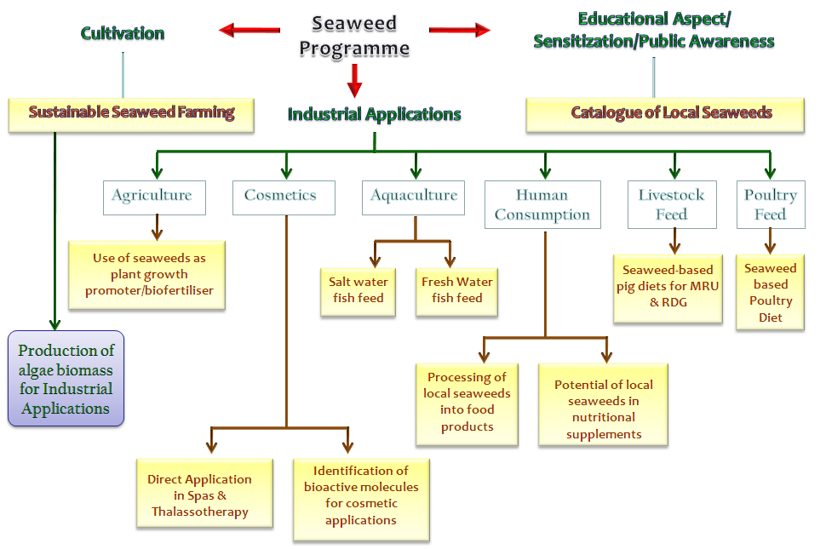
Road Map
Seaweed Programme
Educational Aspect/
Sensitization/Public Awareness
Cultivation
Sustainable Seaweed Farming
Industrial Applications
Catalogue of Local Seaweeds
Agriculture
Cosmetics
Aquaculture
Human Consumption
Livestock Feed
Poultry Feed
Use of seaweeds as plant growth promoter/biofertiliser
Seaweed-based pig diets for MRU & RDG
Seaweed based Poultry
Diet
Salt water fish feed
Fresh Water fish feed
Production of algae biomass for Industrial Applications
Processing of local seaweeds into food products
Potential of local seaweeds in nutritional supplements
Direct Application in Spas & Thalassotherapy
Identification of bioactive molecules for cosmetic applications
Notes:
8

Slide 9
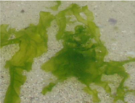
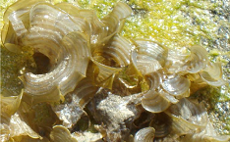
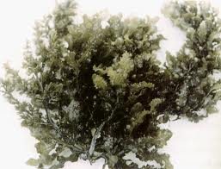
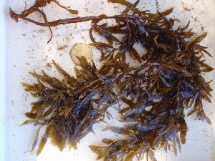
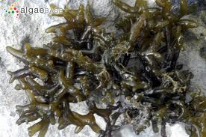
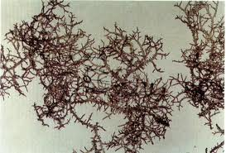
Local Seaweeds of commercial potential
Ulva lactuca
Padina spp.
Sargassum binderi
Sargassum aquifolium
Gracilaria salicornia
Hypnea cornuta

Slide 10
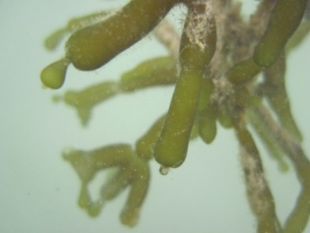
Experimental seaweed farm
Aim:
To set up experimental seaweed farm in Mauritius and Rodrigues
Objectives:
To identify suitable areas for seaweed farming
To identify the most suitable seaweed species
To evaluate farming techniques
To assess growth and yield of cultured seaweed species
To identify challenges and potential solutions
To build up capacity in seaweed farming

Slide 11
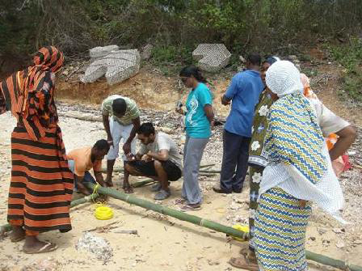
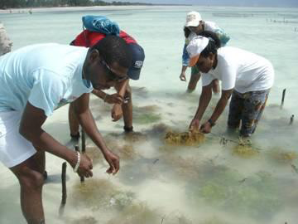
Capacity building – seaweed farming
Aim: acquire technical know-how on seaweed farming, harvesting and processing
Target people:
Researchers (3) from the MRC
Capacity building was done by the expert Dr Flower Msuya (Institute of Marine Science) - Tanzania

Slide 12
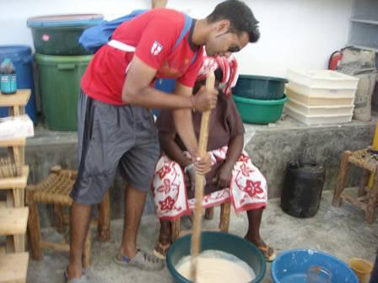
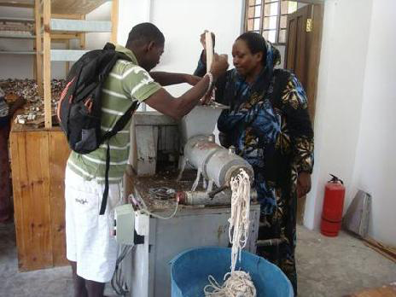
Manual mixing of ingredients
Extrusion of mixed ingredients
Making seaweed soap in Paje, East Coast of Zanzibar

Slide 13
Steps in seaweed farming
1. Scoping – identification of potential farming regions/sites (Nov 2011)
2. Community mapping – sites identification by locals resource users (Dec 2011-Mar 2012)
3. Bio-assessment survey – site ideal or not? (Mar 2012- April 2012)
5. Monitoring (April 2012 - ongoing)
4. Implementation of farms (Mar 2012 – April 2012 )
Phase I
Phase II

Slide 14
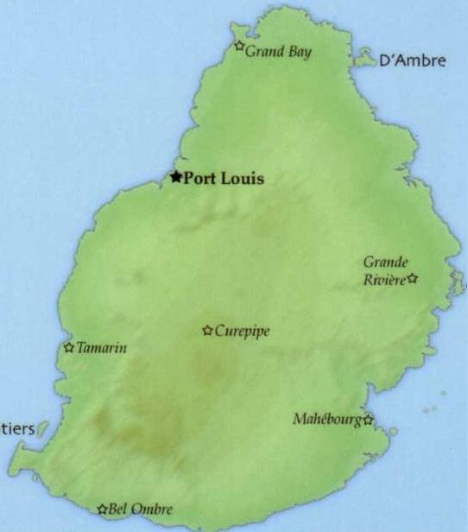
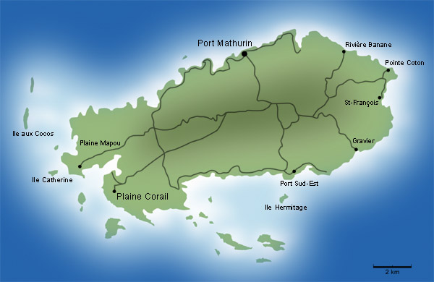
Potential Cultivation Sites
Mauritius
Rodrigues
Poste La Fayette
Jean Tac
Baie du Nord
Albion
Pointe aux Feuilles
Grand/Petit Sable
Petite Butte
Vieux
Grand Port *
Permit applications were aquired for these potential sites
* Note: Vieux Grand Port farm was implemented following a request from the farming community of that region.

Slide 15
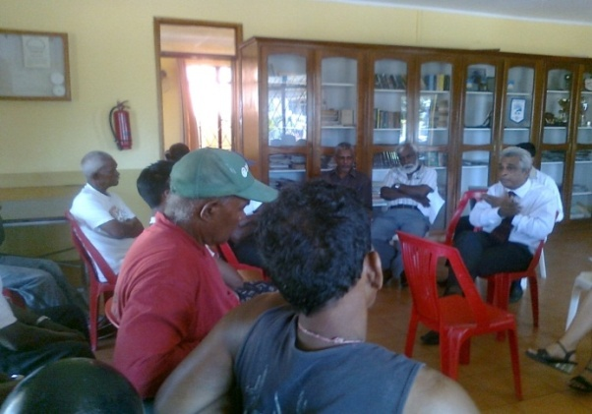
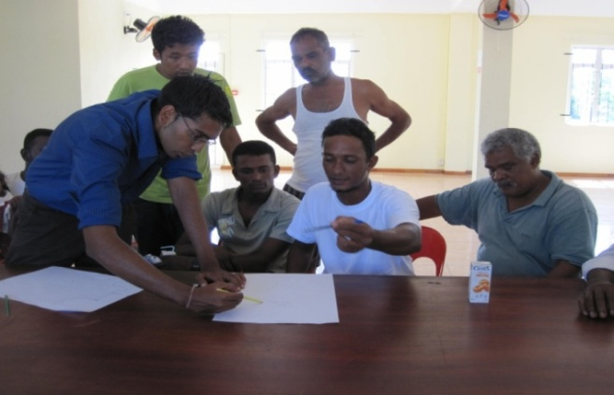
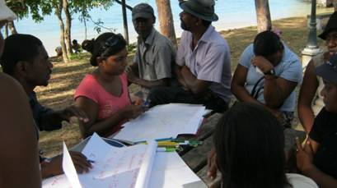
Community Mapping
Aim: to identify the most ideal sites to set up experimental seaweed farm/s
Community mapping:
Fosters community participation
Createss awareness on the project
20 fishermen
30 fishermen
27 fishermen
Albion – Nov 2011
V. G. Port – March 2012
Rodrigues – Nov 2011

Slide 16
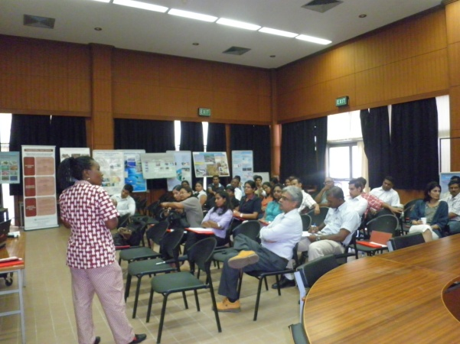
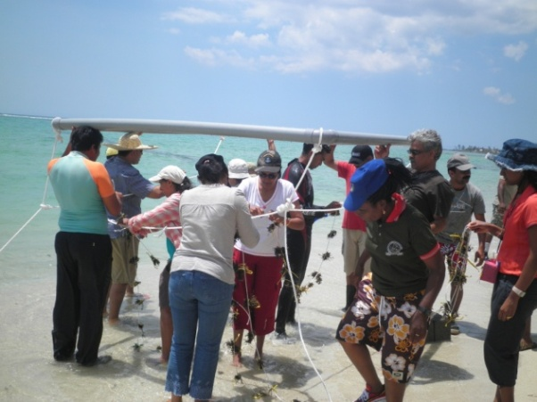
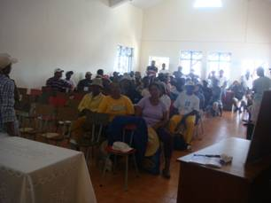
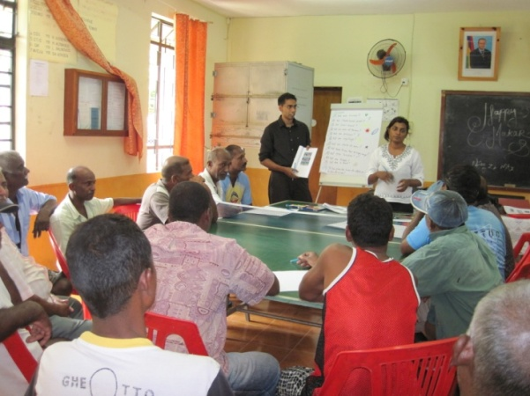
Capacity building – seaweed farming
2. Institutions (9) – 30 participants
3. Coastal community – 110 participants
Rodrigues (Nov 2011) – 60 Mauritius (Vieux Grand Port – April 2012 & Q. Soeur – July 2012) – 50

Slide 17
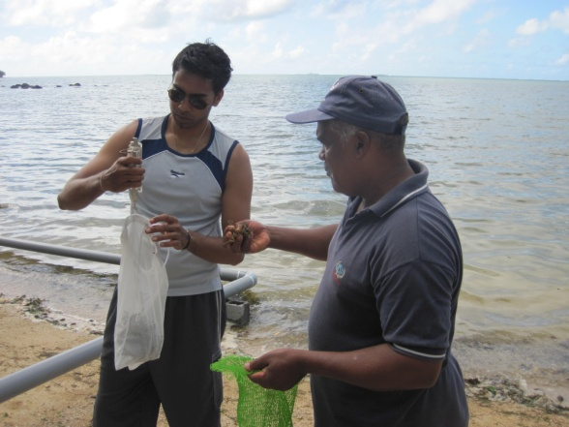
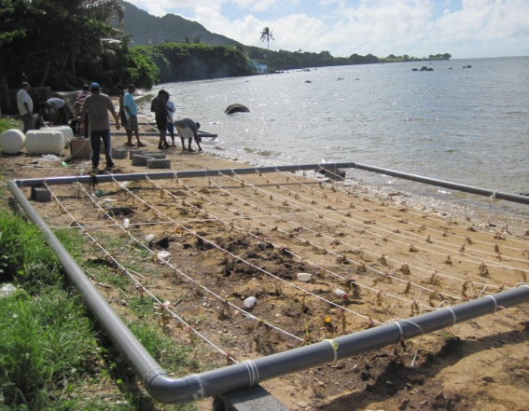
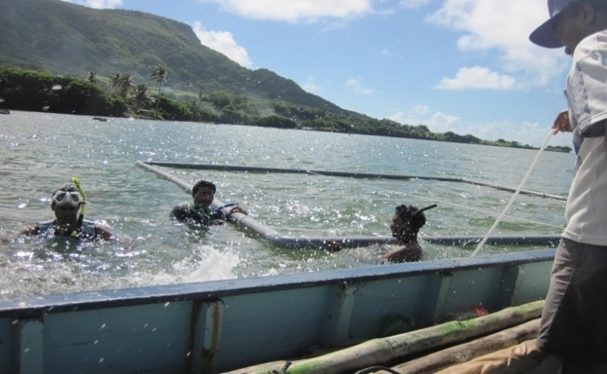
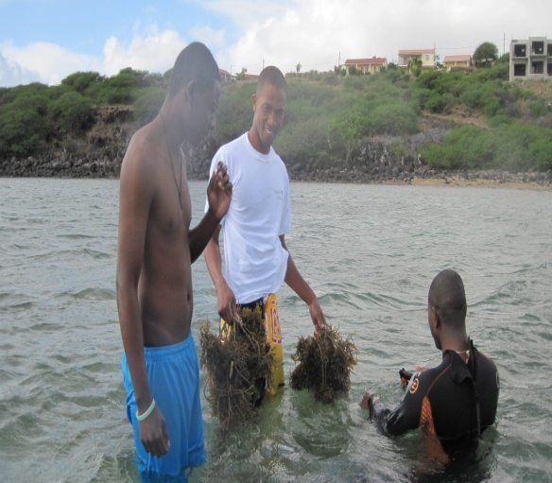
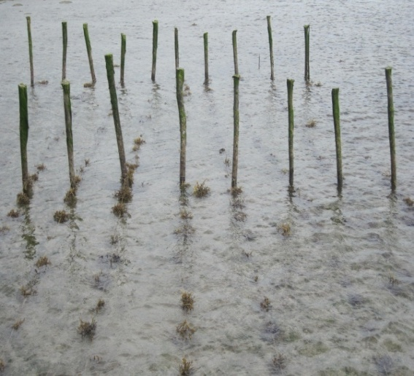
Implementation
Set-up of PVC raft and off-bottom seaweed culture at Vieux Grand Port and Jean Tac respectively with the fisher volunteers and other stakeholders
Implementation in V.G.Port- April 2012
In collaboration with Fisher group , MPF, NCG, AFRC, UOM, MSIRI,MOI & AREU
Implementation in Jean Tac March 2012
In collaboration with Fisher group , FPS, FRTU, SEMPA, and Commission for fisheries

Slide 18
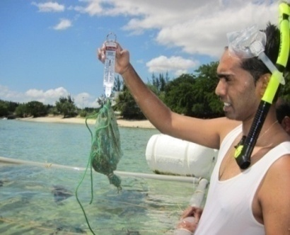
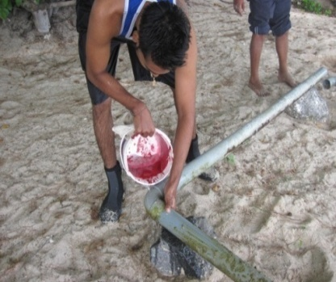
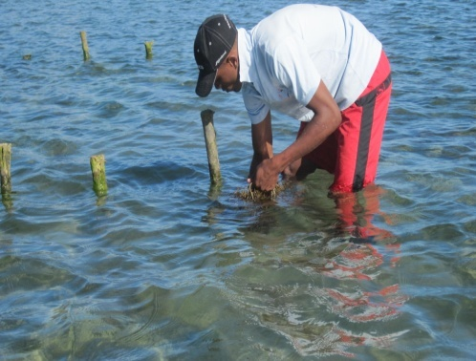
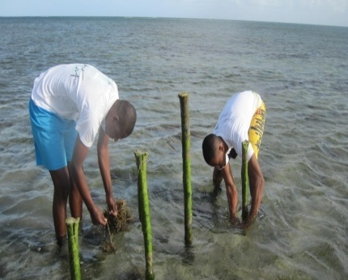
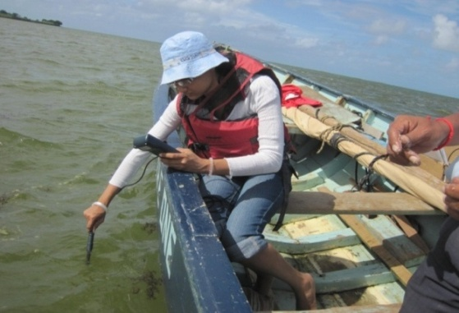
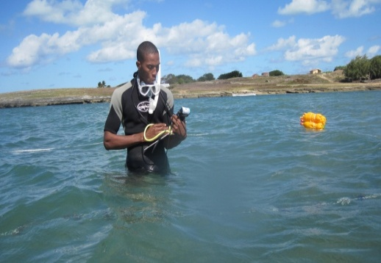
Monitoring
Monitoring was conducted weekly with the assistance of the fishers (volunteer)
Aim
Assess the seaweed cultivation techniques
Assess the growth rate of candidate seaweed species
Assess the water parameters
Maintenance of structures
Vieux G.Port
Jean Tac

Slide 19
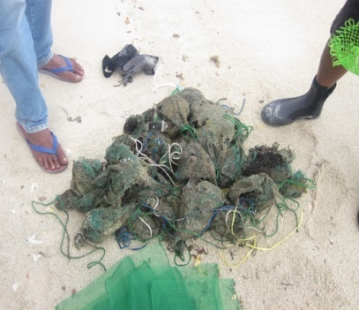
Problem Encountered and Solutions
Mauritius
Problems Encountered | Solutions
Fish Grazing | Net bags
Disintegrated net bags | Use of High Resistance Net bags / Onion Bags
Water infiltration in PVC pipe | Use of high pressure glue/ PVC cement and Silicone sealant
Raft Breakage | Cross Sectional tying of Raft
Gracillaria Bleaching | Culture in netbags at higher depth

Slide 20
Problems Encountered and Solutions
Rodrigues
Problems Encountered | Solutions
Fouling Theft of floats | Manual removal of fouling agents Replace with plastic bottles
Unavailability of quality seaweed for culture | Set up seaweed nurseries to act as reserve for robust and quality seaweed cuttings. - Gracilaria salicornia grows well in winter and provide quality seaweed
Bleaching of Gracilaria salicornia under culture (off-bottom) during summer/winter transition | Shifting the farm to deeper water to ensure constant submersion of seaweed cuttings

Slide 21
Refinements
Validate the results obtained during the preliminary experimental phase
Assess the growth pattern across 1-2 years
Investigate the optimum density of cultivation and assess quality of seaweeds at various stages of growth
Assess the growth of other seaweed species
Develop plans for pilot farming

Slide 22
Developing cooperation through community-based actions
Grand Sable Women Planters Farmers Entrepreneurs Association granted funding from:
Australian Government (AusAID) for Community-Based Adaptation projects in SIDS (SIDS-CBA)
Implemented through UNDP Global Environment Facility Special Grants Programme (GEF-SGP)
GEF-SGP supporting project on ‘Enhancing the livelihood of women at Grand Sable in response to climate change impacts’
Aims to empower the women community on alternate income-generating activities such as, seaweed cultivation and the production of value added products, cultivation of Vetiver, Cassava and other medicinal plants (Ayapana and Citronella), to help them meet the challenges of climate change and sustain their livelihood

Slide 23
Developing cooperation through community-based actions
Community mapping exercise with Grand Sable Women Planters Farmers Entrepreneurs Association in Nov 2013:
Presentations and discussions on community maps
2 potential sites identified
3-day bio-assessment exercise conducted in Dec 2013
Hands-on training workshop run in Mar 2014 to set up community-based seaweed farm of 144m²
Regular monitoring by Association
Technical assistance by MRC

Slide 24
Developing value added products from seaweed
Seaweed Lagoon
Cultivation
Pig Feed
Plant Growth Promoter
Food Processing
High End Products
Low cost of production
Better meat quality
Massage Oil, Soaps, Cosmetic products
Seaweed Cluster Initiative in Mauritius – From Culture to Production
Estimated 2 year budget – MUR10 million (USD270k; PEN814k)
Notes:
24
24

Slide 25
Activities conducted so far
Development of seaweed based food products from Ulva lactuca and Gracilaria salicornia with commercial potential (Nov 2014 – Jan 2015)
Good feedback from sensory evaluation
Shelf life studies being conducted
Final products and processing methods ongoing
Development of seaweed based plant growth promoter (completion in Dec 2015)
2 seaweeds of commercial potential identified from laboratory bioassays
Stabilization of extracts under way
Field testing to be done
Development of seaweed based pig diets (completion in Dec 2015)
Nutritional profile and potential incorporation into pig feed under study
Provides cheaper alternatives to expensive imported raw materials (cereals and fishmeal)
Development of seaweed based soap (Dec 2014)
Production protocols being developed with available raw materials
Potential medicinal and cosmetic applications being studied
Scaling up to pilot production level
Ulva lactuca

Slide 27
Seaweed based food products

Slide 28
Seaweed based cosmetic products

Slide 29
Way forward
Extension of capacity building – potential for knowledge to be exported beyond Mauritius
Detailed assessment and evaluation of seaweed resources
Characterization of wild shore seaweed and their value addition (approx. 40 tons/day)
Development of policy measures for seaweed cultivation, including regulatory and legal framework addressing:
Support for community-based seaweed farming
Sustainable wild harvest of selected seaweed species
Safety and quality of seaweeds for different applications

Slide 30
EXPERIMENTAL WHEAT CULTIVATION IN MAURITIUS
Main objective is to undertake larger scale experimental wheat cultivation: 12 acres
Three wheat varieties
SC Nduna, SC Sky and SC Stallion
Varieties SC Nduna, SC Sky and SC Stallion are commercial wheat varieties obtained from Seed Co Limited located in Zimbabwe

Slide 31
Plant Growth Stages
Flowering
61 DAP

Slide 32
Plant Growth Stages
Dough Formation and Ripening
70 DAP

Slide 33
Plant Growth Stages
Harvest
95 DAP

Slide 34
Yield Data (Phase I)

Slide 35
Quality Grains Produced
Parameters | Test Method | SC Nduna | SC Sky | SC Stallion | Desirable Characteristics *
Moisture % | ISO 712, 3rd Edition | 13.33 | 14.80 | 13.47 | <14%
% Ash (Dry Basis) | ISO 2171 | 1.62 | 1.95 | 1.82 | 0.3% - 1.5%
Falling Number | AACC Method 56-81 | 450 | 490 | 222 | High Falling Number <300
Protein % (Dry Basis) | AOAC 2001.11 | 16.96 | 18.52 | 19.60 | High Protein content-14%-15%
Wet Gluten % | AACC Method 38-12 | 34.5 | 38.5 | 42.0 | Strong Gluten-35%
Gluten Index |  | 80 | 79 | 60 | 75% - 90%
Bug Damage (per 30 g) |  | 5 | 6 | 13 | Nil
Acknowledgement: Les Moulins de la Concorde (LMLC) * Various Sources

Slide 36
Present Landscape
S&T Partnerships with other countries
MoU’S and Agreements
Participation in Regional/International Initiatives/Projects
Signatory to international conventions
Membership/Affiliations to regional/international instances
Mostly Science- and Technically- Driven
Source: www.grandbaie.mu
Source: www.uom.ac.mu
Mauritius Radio Telescope, Bras d’Eau

Slide 37
Ocean Economy
EEZ: 2.3 million km² – Ocean State
Govt Program 2012-2015, Govt of Mauritius:
‘15. Government’s vision is to make of Mauritius, within the next ten years, a nation fully conscious of its immense potential as an Ocean State. This is a key channel through which we can advance economically to greater prosperity.’
1100 x land space of Mauritius
4 x size of France
One Third size of Europe
Mauritius is a big OCEAN STATE

Slide 38
Extended Continental Shelf of Mauritius & Seychelles
Joint submission of Mauritius & Seychelles to the UN Commission on the Limits of Continental Shelf on Extended Continental Shelf in Mascarene Plateau Region of 396,000 km²
March 2011: Mauritius and Seychelles jointly conferred the jurisdiction from UNCLS
Accepted in 2012
Joint submission
avoided a Maritime dispute
demonstrated willingness to collaborate
Source: CLCS Brochure, MOI

Slide 39
The Ocean State
Ocean for Energy
Ocean for Food
Ocean for Water
Ocean for Minerals
Ocean for Leisure
Ocean for Health
SUSTAINABILITY

Slide 40
A Road Map for Ocean Development
2010 | 2011 | 2012 | 2013 | 2014 | 2015 | 2016
Aquaculture
Seaweed Industry
Coral Farming
Ocean Technology Incubator (Ocean EPZ)
Towards
Energy
Security
Jobs
Wealth
Pearl Culture
Commercialisation
Marine Pharmaceuticals
Nutraceutics
Pre-commercialisation
National Oceanic Database
Seawater Desalination
Offshore Wind Farm
Wave Farm
Less
CO₂
MID
Feasibility
Other Ocean Energy
Minerals Exploration Studies
Legal Framework & Licenses
Deep Ocean Water
Human Capacity Building
Satellite Remote Data Collection
Surveillance Security & Satellite ICT

Slide 41
Scientific Partnerships with Africa
Bridge between Africa/Asia/Australia
Bilingual
Various initiatives to promote business & trade in Africa
Initiatives being facilitated by Africa Centre of Excellence (2012)
New Area: Africa STI initiatives
Possibilities for triangular cooperation
ABOUT 2300 KM FROM Eastern coast of Africa

Slide 42
Existing Regional Initiatives
NEPAD SANBIO
South Africa
COMESA
SADC
ICSU - Africa
Hosting of SanBio
Bioinformatics Node (University of Mauritius)
Square Kilometer Array Project (with 8 countries)
SKA Telescope in SA
1 Antenna being located in Mauritius
CBBR COMESA Centre of Excellence
SADC SET Week
SRIM programme for research and innovation
No. of Projects

Slide 43
African Square Kilometre Array (SKA) Project
The MRC forms part of the SKA Radio Telescope Project and contributes on the project together with other member institutions from Ghana, Mozambique, Botswana, Kenya, South Africa and Namibia.

Slide 44
Centre of Excellence for Biomedical & Biomaterials Research (CBBR)
Under the aegis of the University of Mauritius
CBBR officially initiated – April 2011
Multi-disciplinary research centre for Biomedical and Biomaterials Research
Recognised as ANDI centre of Excellence in October 2011
Setting up of Centre is endorsed by Cabinet
National and Political Support
Multi-disciplinary

Slide 45
Industries served by MSIRI
Land under sugarcane cultivation
knowledge
e.g. Sri Lanka
e.g. Barbados
e.g. Fiji

Slide 47
Bringing Quality Research to Mauritius
Collaborative Partnerships with International Research Bodies

Slide 48
Centre for Scientific Research on Diabetes (CSRD)
International collaboration with the following Institutions in the design & implementation of research projects to be carried out by the CSRD being secured via MoUs:
.

Slide 49
MoU with Department of Science & Technology (DST), India
Memorandum of Understanding (MoU) was signed on February 2012.
First Joint Committee meeting on Science and Technology Cooperation was held in Mauritius between the Council and the Department of Science & Technology (DST) - 24th & 25th September 2012.

Slide 50
Institute of Technology (IIT), India
Objective:
To coordinate the set up of an IIT-like institution initially named IIT Research Academy (IITRA)
Aim of IITRA:
To promote scientific excellence and fostering scientific development in Mauritius, to generate new cutting-edge knowledge
IIT, Delhi
Added Value of IITRA:
provide a world class research based educational platform for full-time and part-time post graduate research leading to MS(R) and PhD degree awards
attract foreign researchers to Mauritius, in particular scientific experts from the Mauritian Diaspora
attract foreign students to Mauritius, mainly from Africa and Asia

Slide 51
Thank you for your attention
Mauritius Research Council,
Level 6, Ebene Heights, 34, Cybercity, Ebene, Mauritius
Tel: (230) 465 1235
Fax: (230) 465 1239
Email: mrc@intnet.mu
Website: http://www.mrc.org.mu

