Slide 1
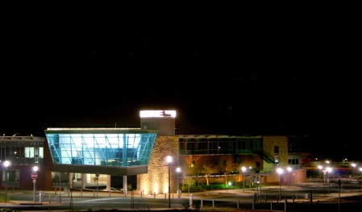
Topic 4: Supporting Innovation, Technology Transfer, Patent Information and Knowledge Dissemination - National and Regional Experiences – _________________________________________________________________________________________________________________________________________________________________________________________________________________________________________________________________________ McLean Sibanda Chief Executive Officer - The Innovation Hub Second WIPO Inter-Regional Meeting on South-South Cooperation on Patents, Trademarks, Geographical Indications, Industrial Designs and Enforcement Organised by WIPO in cooperation with Ministry of Foreign Affairs of the Arab Republic of Egypt and Egyptian Academy of Scientific Research and Technology (ASRT) 6 – 8 May 2013 Cairo, Egypt

Slide 2
Overview
Introduction
The South African Experience
National System of Innovation
Intellectual Property Rights From Publicly Financed Research and Development Act, 2008
The Innovation Hub
Concluding Remarks
Innovation is a lever in socio-economic development
and competitiveness!

Slide 3
Introduction
Defining Innovation
The process by which an idea or invention is translated into a good or service for which people will pay or use, or something that results from this process
❑ Invention is result of process of putting money in and getting knowledge out
Innovation is the result of process of using new knowledge / adapting existing knowledge to new application and getting money out or extracting value from new application
Market-place is important for innovation

Slide 4
Introduction Overview of Patent System
Patents grant a limited negative rights:
Exclude others (without permission) to manufacture, exercise, dispose, import, use the patented invention
Rights owner can grant permission - enable use of invention
Rights are limited
20 year period, subject to maintenance
Territorial – opportunity to exploit where no patent protection
Subject to rights of third parties
Importance of disclosure requirement
Scope of protection clear in claims
Sufficient disclosure of invention
Teach the invention / Enable others to build on

Slide 5
Introduction Patent System: Basis for Competitiveness
Patent document more than just a document
Source of state of art before embarking on R&D
Potential commercialisation partners
Suppliers
Competitor developments
Patents validity and scope
Search reports

Slide 6
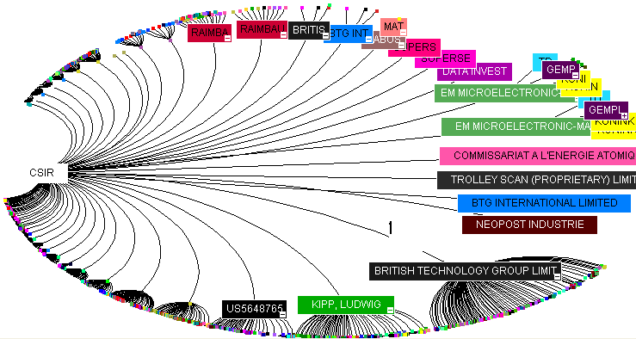
Introduction Patent System - The Patent Document
A source of most up to date technology
State of art before filing a patent application
Avoid duplication in the innovation process
Jump-start own innovation process and ride on back of others developments
Source of market intelligence
citation analysis
assignee analysis
filing rates
inventors and hence resources to be acquired

Slide 7
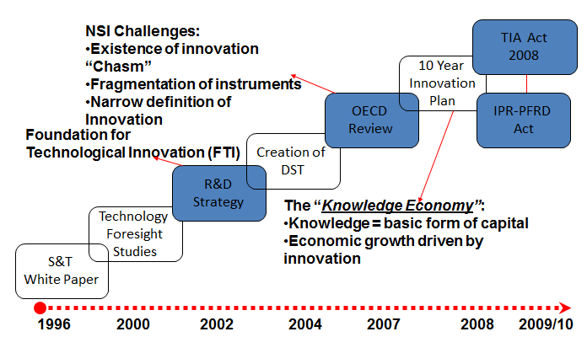
South Africa National System of Innovation South Africa’s Innovation Policy Milestones
1997 Reviews – Science, Engineering and Technology Institutions (SETIs), 12 plus system-wide synthesis report;
1997 Research and Technology Audit
1998 Innovation Fund established
2012 Ministerial Review of Science System

Slide 8
South Africa National System of Innovation Institutional Arrangements
R&D Capacity
to Implement
HEIs
Science Councils
Industry / SMEs
Incubation,
STP, and Support
Services
Incubators
The Innovation Hub
IDC,
Venture
Capital,
Other DFIs
NRF
Technology Innovation Agency
Funding: Proof of concept to commercialisation
Business Advisory & Support Services
Technology Stations Programme
Funding
Agency
Policy &
Regulatory
Government (DST + other)
Basic & Applied Research
Development
Commercialisation
Adapted from TIA

Slide 9
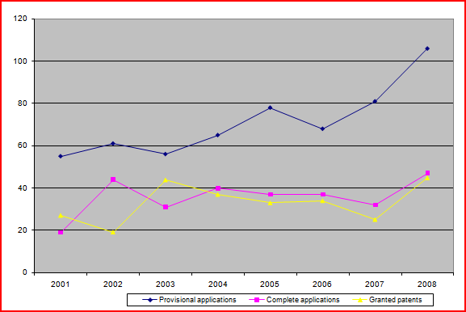
South African National System of Innovation
Research Outputs: Domestic Patenting by Institutions
2002 R&D Strategy
Patent Support Fund
IPR Policy Framework - 2006

Slide 10
IPR-PFRD Act
Background: 2002 R&D Strategy
Drivers for managing IP (2002 R&D Strategy)
Differences in patent rates represents one of the greatest “divides” of the knowledge age
Intellectual Property:
Instrument for wealth creation
Must generate social & economic benefits to Republic
innovation, diffusion of scientific and technical knowledge
Market competitiveness
Legislative framework for IP from publicly financed R&D
Clear rights & obligations

Slide 11
IPR-PFRD Act
Background: Institutional Arrangements
INSTITUTION | IP POLICY | INSTITUTION | IP POLICY
University of Cape Town | Yes | University of Pretoria | Yes
University of Stellenbosch | Yes | North West University | Yes
Nelson Mandela Metropolitan University | Yes | University of the Witwatersrand | Yes
Rhodes University | Yes | University of Limpopo | No
Walter Sisulu Metropolitan University | Yes | Mangosuthu University of Technology | No
Durban University of Technology | No | University of KwaZulu-Natal | No
University of Fort Hare | No | UNISA | No
Cape Peninsula University of Technology | No | University of Western Cape | No
Vaal University of Technology | No | Vaal University of Technology | No
University of Johannesburg | Yes | Tshwane University of Technology | Yes
Central University of Technology | No | University of Zululand | No
CSIR | Yes | Water Research Commission (WRC) | Yes
Medical Research Council (MRC) | Yes | Agricultural Research Council (ARC) | Yes
Mintek | Yes
Different approaches to intellectual property management:
Ownership
commercialisation
Most had no intellectual property policy
Capacity to manage intellectual property
Not all are research institutions
Science Councils / HEIs
Sibanda, M: in THE ECONOMICS OF INTELLECTUAL PROPERTY IN SOUTH AFRICA, edited by WIPO, 2009

Slide 12
IPR-PFRD Act
Object
“The object of this Act* is to make provision that intellectual property emanating from publicly financed research and development is:
identified;
protected;
utilised and commercialised
for the benefit of the people of the Republic……………”

Slide 13
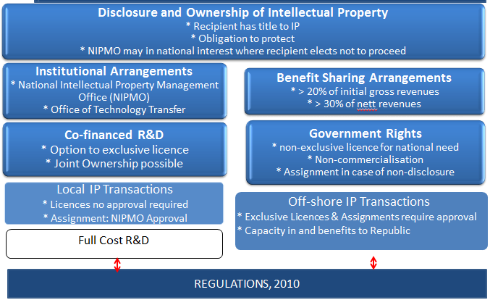
IPR-PFRD Act
Key Provisions

Slide 14
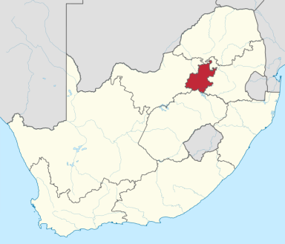
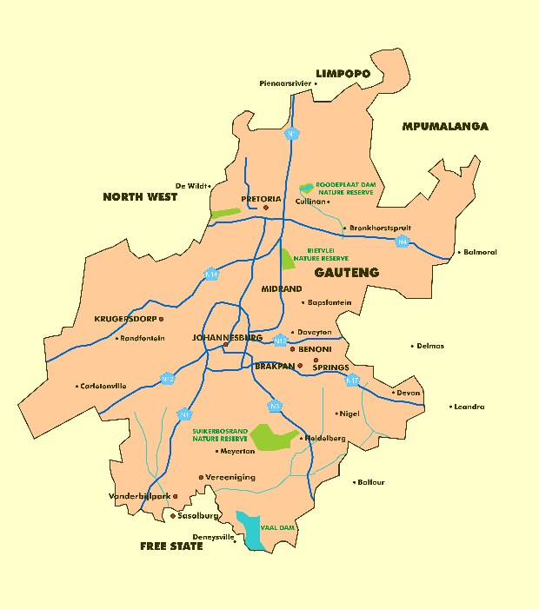
Innovation Hub The Gauteng Province – 4th largest economy in Africa
23.7% of the national population (12.2 million)
35.6% (R675bn) of South Africa’s GDP (> KZN & WC)
10% of Africa’s GDP
52% of the share of national R&D (2008-2009)
63% of national trade
Host to > 40% of South Africa's SMMEs
30% of GHG emissions and power demand
South Africa's strengths and challenges are amplified in Gauteng – opportunity to be a leader in innovation

Slide 15
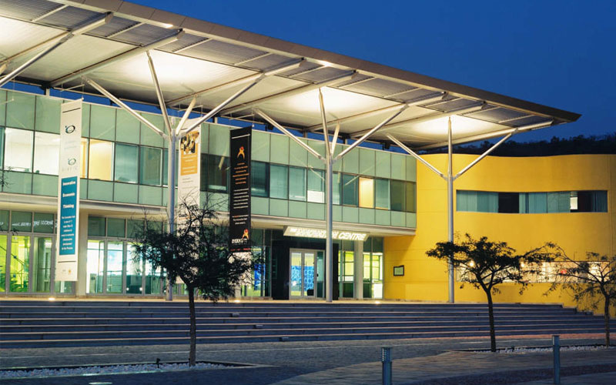
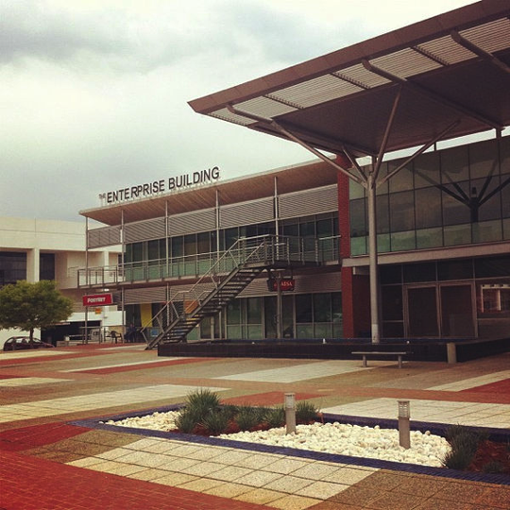
The Innovation Hub Overview
Science and Technology Park established by Government in Gauteng Province as one of Strategic Infrastructure Investments
Gauteng Growth & Development Agency subsidiary
located in Knowledge Axis in Tshwane, Pretoria
High Priority Sectors:
ICT
Green Economy
Biosciences
Industrials
CORE BUSINESS: To establish and manage an enabling environment and initiatives to support innovation, enterprise development and human capital development, in targeted sectors, in order to contribute towards growth of Gauteng economy, creation of decent jobs and poverty reduction.

Slide 16
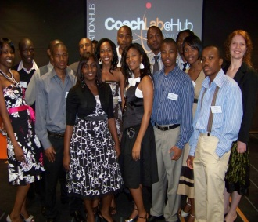
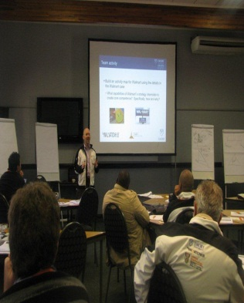
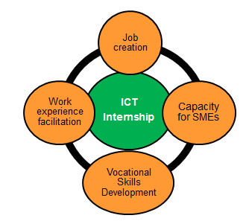
Programs Skills Development
CoachLab: Skills Development and enabling Job Creation
Gauteng Accelerator Programme - Biosciences: Entrepreneurship
9 month ICT Postgraduate Leadership Programme in collaboration with industry
Bridging gap between academia and Industry
Green and Biosciences programmes being developed
Collaboration between Emory University, Atlanta, Georgia & The Innovation Hub, supported by Department of Science and Technology
Biosciences skills and entrepreneurial development
Supporting BioPark Program
Internships: Facilitating access to youth employment
Targeted Workshops and Training: Adding Value to stakeholders
Sponsored by MICT SETA
12 month ICT internships at Gauteng based companies
Facilitating access to employment for unemployed youth and graduates
Innov8
Specialists Training / Courses
Partner programmes:
World Intellectual Property Organisation
1 Day IP Management Workshops
Training Centre Communications

Slide 17
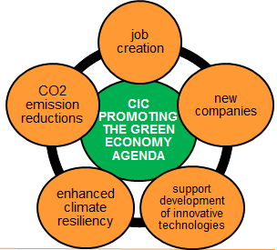
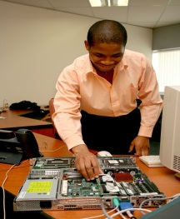
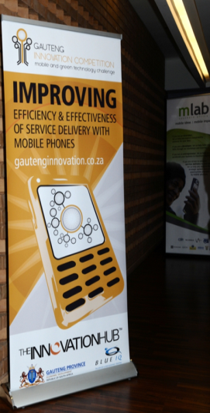
Programs Enterprise Development
Climate Innovation Centre: accelerating local innovations
Maxum: Technology and Business Incubation Support
Support of locally developed climate innovations
Linkages to infoDev network
5 service offerings
Access to finance, business advisory and incubation, policy advisory, access to facilities and equipment, access to networks and partnerships
Technology Business Incubator to fast track the establishment and growth of early stage technology and knowledge based businesses
Pre-incubation and business
incubation
Gauteng Innovation Competition: Fostering Service Delivery
Gauteng Accelerator Programme - Biosciences: Entrepreneurship
Platform to source local innovations to address government service delivery challenges.
Prize money used as seed capital to grow enterprises from innovations.
Procurement of innovations for government service delivery challenges
Collaboration between Emory University, Atlanta, Georgia & The Innovation Hub, supported by Department of Science & Technology
Biosciences skills and entrepreneurial development
Supporting BioPark Program

Slide 18
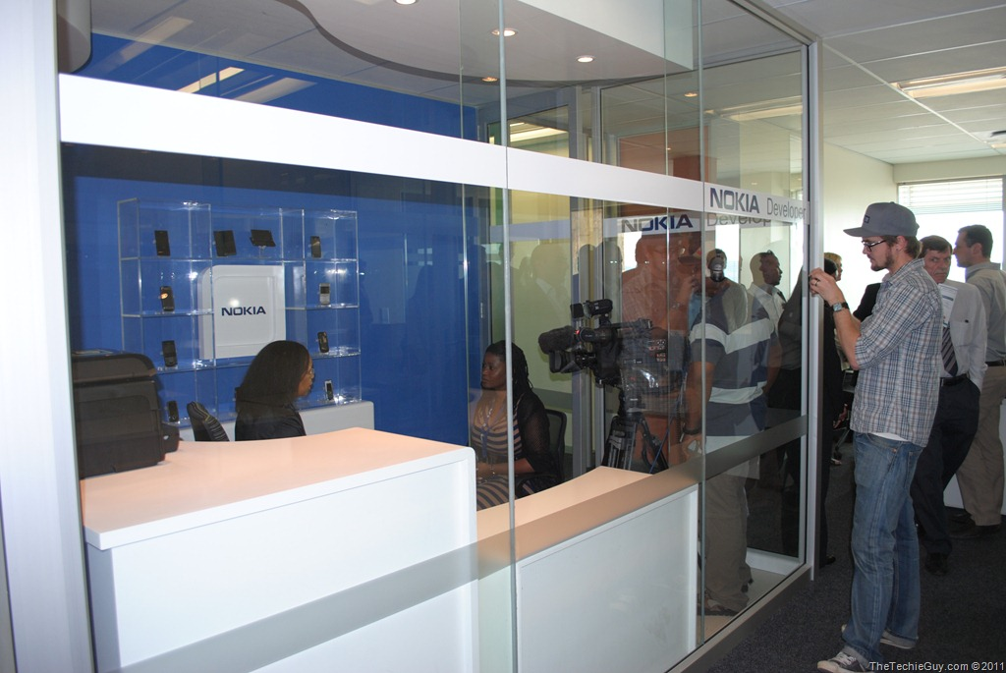
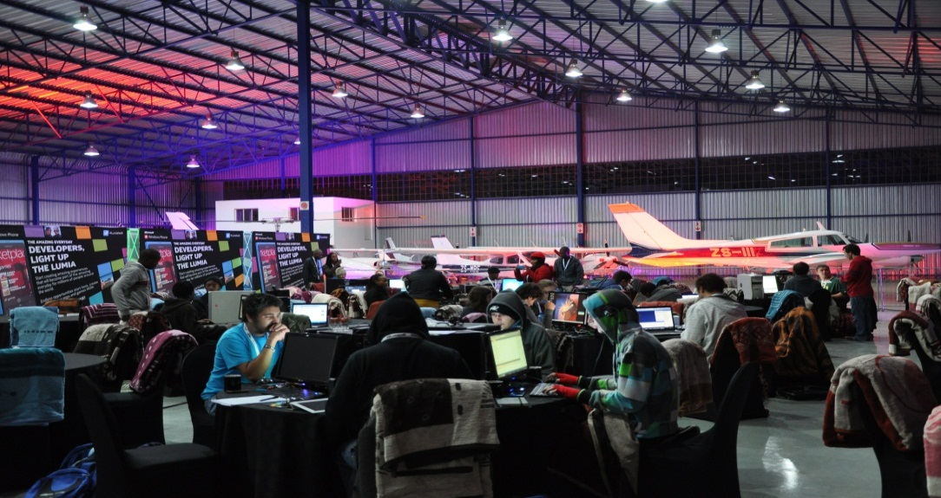
Programs Enterprise Development - mLab
Nokia Test bed @ mLab
Fostering mobile applications development and entrepreneurship
Hackathon: Nokia & Microsoft: 22 – 24 June 2012

Slide 19
Programs Climate Innovation Centre - Service Offerings
Access to Finance
- Inclusivity grants (<ZAR 100k) for prototyping of relevant innovations
- Access to highly flexible, stage-appropriate risk capital and proof-of-concept grants (<ZAR 1m) and seed funding through partners (average ZAR 2.4m)
Technical and Business Advisory (incl. Access to Information)
- Technical and business advisory services and networking.
- Access to information on climate technology market trends, products, etc.
- Original market research in line with South Africa’s climate priorities
- Technology assessments and assistance with technology transfer
Policy Advisory Services
- Dialogue between policy-makers, private sector and civil society to improve climate innovation frameworks and support inclusive growth
- Policy standards based on global best practice for South African context
Access to Facilities
- Flexible office space options and access to facilities and services for start-ups that need prototyping and manufacturing.
- Connecting SMEs to institutes, universities and other laboratories in South Africa with technical equipment for testing and production.
Enabling Eco-system, incl. Regional and International Linkages
- Seminars, roundtables, business plan competitions, network to other CICs.
- Collaborations, knowledge exchange and business linkages
- ‘HUB & SPOKE’ model for South Africa & SADC climate change responses

Slide 20
Programs Value Added Services
ICT: state of the art enabling ICT environment with free bandwidth for incubated companies
Access to Markets:
Collaborations and soft-landing opportunities
International opportunities for companies through the Open Innovation portal and linkages to the IASP network (including open innovation programmes)
DTI Export programme
Market research reports and business networks
Innovation specialists: access to various sector networks, sector specific support programmes, conferences and workshops
Research support and access to equipments + specialists through partner institutions
Networking functions and events @TIH: experts networks, trends, etc.
Access to network of service providers (IP, HR, Legal, Finance, etc)
Intellectual Property Advisory Services to incubated and precinct companies

Slide 21
Concluding Remarks Science and Technology Parks and Other Areas of Innovation
Catalysts / enablers for socio economic development through innovation
"A Science Park is an organisation managed by specialised professionals, whose main aim is to increase the wealth of its community by promoting the culture of innovation and the competitiveness of its associated businesses and knowledge-based institutions.
To enable these goals to be met, a Science Park:
stimulates and manages the flow of knowledge and technology amongst universities, R&D institutions, companies and markets;
it facilitates the creation and growth of innovation based companies through incubation and spin-off processes; and
provides other value-added services together with high quality space and facilities.”

Slide 22
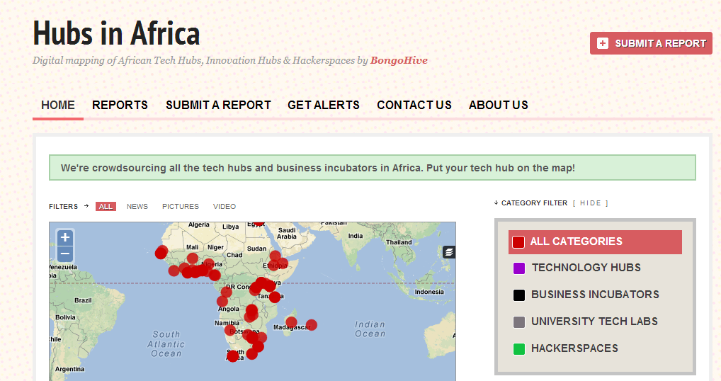
Concluding Remarks African STPs – “Hundred Flowers Bloom
https://africahubs.crowdmap.com

Slide 23
Concluding Remarks
Relevant and appropriate intellectual property system
Enabling and integrated innovation eco-system
Growing role of Science and Technology Parks and Innovation Centres in fostering innovation
Need for champions and good examples

Slide 24
Thank You!
The Innovation Hub
Innovation Catalyst for a Smart Province: Gauteng, Republic of South Africa
www.theinnovationhub.com

