Slide 2
A BRIEF OVERVIEW OF THE INDUSTRY
WORLD-WIDE MARKET
In 1995 when the PlayStation was first introduced in the US, the world-wide video game market was about US$4.3 billion
In 2007, jumped to US$35 billion (intro of the i-phone)
Since 1995 an increase of roughly 3,300% in 25 years
NewZoo reported US$148.8 billion in revenue in 2019 which grew to US$178 in revenue in 2020
A number greater than 156 countries current GDP based on 2020 UN report
Projected to reach US$200 billion by 2023

Slide 3
REVENUES IN COMPARISON
#1 form of entertainment in the world
An amount that exceeds film, book publishing, music, theater, and television
Incredible success achieved in a relatively short period of time compared to other entertainment industries
Greater growth than any other form of entertainment
Unlike other forms of ent., revenue increased in the video game industry in 2020 (record breaking year)
Film Industry
2019 was most successful year reaching US$101 billion
2020 worldwide cinema revenue-$80.8 billion
Book Publishing
Global market estimated to be worth about $92.8 billion in 2019
Global market estimated to be worth about $85.9 billion in 2020
Music Industry
Revenues of $75 billion in 2019
Revenue of $57.5 billion in 2020

Slide 4
REVENUES-IN COMPARISON
NFL (National Football League (US))
Generated @US$16 billion in 2019 and $12 billion in 2020
EA in 2020 signed 5 year deal with NFL for US$1 billion, NFLPA US$500 million and combined US$500 million marketing commitment
English Premier League
@US$7.1 billion in 2018-2019
Consumers spent 4.2 billion (British pounds) on games
Games represented the largest ent. sector compared to film and music
MLB (Major League Baseball (US))
@US$10.7 billion in 2019 ( a record)
@US$4 billion in 2020
Note: Numbers can vary depending on sources

Slide 5
REVENUES IN COMPARISON
NBA (National Basketball Association (US))
@US$8.76 billion in 2018-19
@US$7.9 billion in 2020-21
Take-Two signed an exclusive licensing deal with the NBA for a reported amount in excess of $1 billion dollars in 2019
FIFA
Worldwide revenue in 2018 was close to about US$4.8 billion. (2018-World Cup)
Worldwide revenue in 2019 was close to US$770 million
EA paid FIFA US$160 million in royalties in 2017

Slide 6
INDUSTRY NUMBERS-GAMEBREAKERS
Grand Theft Auto 5 (Take-Two) release:
Within 24 hours of its release in September 2013, the game had earned more than US$800 million dollars
Sold more than 11 million copies world-wide in 3 days
In comparison, the biggest hit movie of the summer of 2013, Iron Man 3 had worldwide sales of US$372 million in it’s first weekend
Has made more money than any other media product
In 2019, earned US$595 million. Primarily driven by micro-transactions and downloadable content
As of August 2021, has made $6.4 billion In 2019, including about $1billion in 2020. In the last few years, a high % driven by micro-transactions (e.g. low cost items)
Has sold over 150 million copies including 20 million in 2020

Slide 7
FORTNITE: BATTLE ROYALE: EPIC NUMBERS-INTERESTING TRENDS
The game costs nothing to play, yet the revenues are record breaking thanks to microtransactions such as in game-purchases
SIDEBAR: A majority of games earn revenue from additional content such as DLC and microtransactions
(items such as weapons, costumes, jerseys, characters, cars)
Power-Ups so players can move faster
Advertising
Loot Boxes*
Has earned a reported $3 billion dollars in profit
Made US$2.4 billion dollars in 2018 (most ever for a game) and US$1.8 billion in 2019 which was tops in games for 2019
US$1.2.billion earned on iOS. Apple made US$360 million from licensing fees
Big stakes in the Epic v. Apple antitrust lawsuit

Slide 8
FORTNITE: BATTLE ROYALE: NEW OPPORTUNITIES
Other ways to make money:
In-game concert with the DJ performer Marshmello watched by 10 million people who logged into the game. At the time (2019), most watched concert of all-time. See the performance at https://www.youtube.com/watch?v=wYeFAlVC8qU
According to Epic Games, Travis Scott’s 10 minute subsequent concert IN 2020 had 27.7 million unique viewers and 45.8 total viewers watched five shows which included the initial show and 4 replays spread over 3 days. See the performance at https://www.youtube.com/watch?v=wYeFAlVC8qU
Ariana Grande’s August 2021 concert drew 78 million viewers. See the performance at https://www.youtube.com/watch?v=RiM0moNk74o
Recently, Epic has announced a new concert series to appear in Fortnite.
Lil Nas X’s virtual performances across four shows in Roblox drew 33 million. See the performances at https://blog.roblox.com/2020/12/explosive-lil-nas-x-concert-paves-way-bold-new-roblox-experiences/

Slide 9
VIDEO GAME REVENUES
Increase in revenue primarily driven by:
Accessibility: Games can be played anytime, anywhere in the world resulting in new markets and growth of established markets
More people playing games because of available hardware (e.g., mobile devices) and digital distribution (mobile-PC-console digital)
Digital Revenue
Generated @US$45 billion in revenue for PC and console digital sales
According to Newzoo: US$77.5 billion for the mobile/tablet mrkt
In 2011, digital accounted for @20% of the market with retail accounting for 80%. In 2019, @80%
For consoles, digital represents about 50% of sales
When PS4 and XBox One launched (2013), digital sales represented 5-10%
Revenue primarily driven from:
Sale of premium games and new content added to games extending life of games (DLC and microtransactions)
Access to games previously unavailable (limited retail space not an issue)
Cloud gaming (Google’s Stadia, Microsoft’s Project xCloud, Sony’s PlayStation Now, Apple’s Arcade, Nvidia’s GeForce, Tencent’s Start, and Amazon’s Luna)
Cross-platform play
Better internet connections

Slide 10
VIDEO GAME REVENUE
Improved gaming experience
More genres of games available (e.g., mobile hyper casual games)
More powerful mobile devices (better graphics, more memory, connectivity to the cloud)
Innovative game play
Games becoming more engaging with community involvement (Twitch, esports, streamers)
Virtual and augmented reality
Different price points ranging from free to play to monthly payments (subscriptions) similar to Netflix
Introduction of next generation of platforms
Growth of live services keeping games relevant with new content

Slide 11
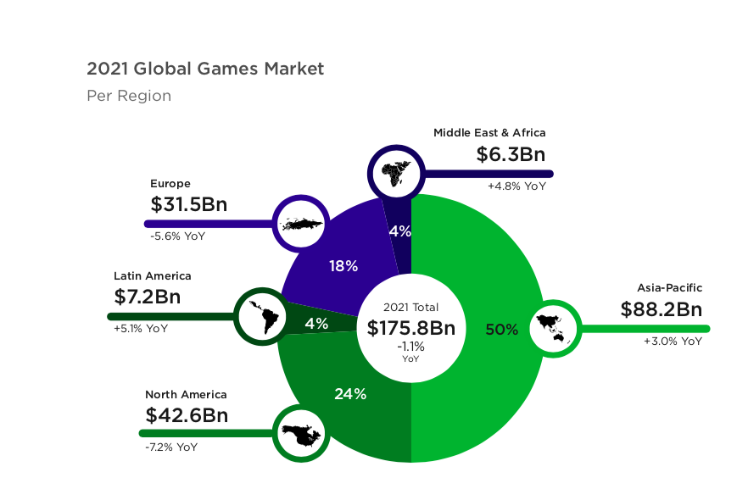
When PlayStation was launched, North America, Japan, and Western Europe were the dominant markets
Consumer spending, game development limited to those markets
Issues with piracy, costs of the hardware, gov’t restrictions (e.g., China), logistics (shipping and manufacturing
Newzoo numbers:

Slide 12
TERRITORIES
The Asian-Pacific market is the largest region in terms of revenue led by China, Japan, and South Korea
According to Newzoo, the market was projected to generate $78.4 billion accounting for @ 50% of the world-wide market
China is the biggest market and projected to hit @ US$36.5 billion
60% of market driven by mobile and projected to grow to about 70% by 2021
Japan is the 3rd largest market driven by a huge mobile market and projected revenue is about US$19 billion
South Korea generated the 4th highest amount of revenue reaching @US$6.2 billion
In addition, the market also includes India with a population over 1 billion could potentially be the next big market

Slide 13
GAME REVENUE-TERRITORY
North America is the second biggest market
Represents @ 25% of the global market
Europe generated @ $30 billion
Huge development community in both western and eastern Europe
Latin America generated US$6 billion
According to Newzoo, the Middle East and Africa will generate about US$5.4 billion and will grow the fastest up from 14.5%

Slide 14
GAME PLAYING FACTS-TERRITORIES
Different tastes for different countries
Different countries have different preferences on how they play games
Console in the U.S. although mobile huge
Mobile in China and Japan is the dominant platform
Growing importance of localization of games
In ’95, games would be localized in EFIGS territories representing the biggest and most lucrative markets
As markets grow, more games being localized in different languages
According to a 2020 analysis based on over 34,000 games on Steam, the top 10 languages were English, German, French, Russian, Spanish, Chinese (simplified), Italian, Japanese, Portuguese Brazil, and Korean
The same study also noted that approximately 19,521 were available in only one language, and about 4,200 games were localized into two languages
Games need to conform to specific territories dealing typically with language (text and/or voice over), content regulation, privacy issues and ratings
Companies will target more games for specific areas incorporating local historical events

Slide 15
WHO IS PLAYING?
25 years ago, the average player was a teenage boy playing alone in front of TV screen typically at home
In 1995, 30 million gamers and 50% were 18 or younger
Today’s demographics regarding average game player:
About 30-35 years old
As likely to be female as male
54% of gamers are male. 46% are female
In some countries, depending on type of game and platform, more woman then men play certain games
In Japan, 2 out of 3 players are female
More than 2.7 billion active gamers
China and US rep most in players and spending
46% or 1.1 billion spend money on games

Slide 16
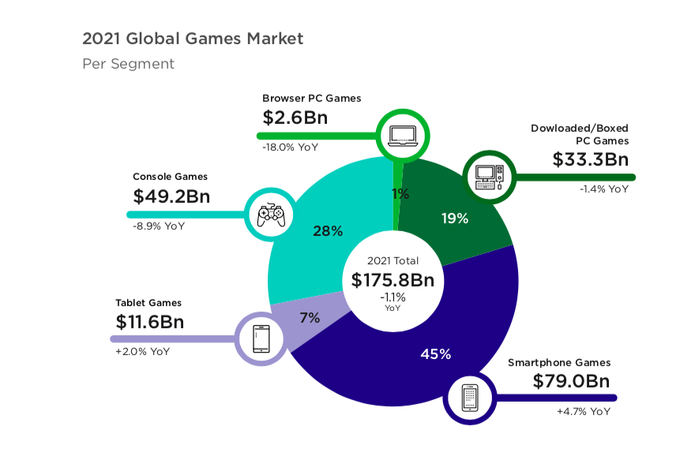
PLATFORMS-REVENUE
Historically, market was dominated by the console manufacturers such as Sony, Microsoft, and Nintendo
Today, mobile represents the biggest share of distribution revenue with digital from console and PC the second biggest revenue stream. See Newzoo chart below
New forms of distribution have revolutionized the industry and helped the industry reach record revenue numbers
How did we get there so fast in a relatively short period of time?

Slide 17
THE CHANGING LANDSCAPE
Barriers of entry began to fall for both consumers and developers
For the consumer:
Accessibility to new devices and forms of distribution
Free to play model exposed a lot of non-gamers to games
Lower costs to play (mobile devices, PC digital, cloud, and different business models)

Slide 18
THE CHANGING LANDSCAPE
For the Developer
Retail no longer the only way to distribute a game which can be expensive and unobtainable for most developers (See subsequent slides)
Click of a button* and can be distributing worldwide
Lower costs to develop depending on platform
Easier to develop games across different platforms thanks to availability of game engines such as Unreal engine by Epic and Unity software
Develop and distribute games independently without a publisher
Publishers would help with:
Finance
Manufacture
Distribute
Market
Testing
Submissions
Licensing
Dealing with 1st parties (i.e., console manufacturers)
In return, Publishers would share revenues with Developers from sales of game or take a distribution fee
1st Parties no longer gatekeepers for distribution
But, too much product. How do you distinguish your game?

Slide 19
CONSOLES
The gate keepers in deciding what games appear on their platforms
Companies collect royalties for permitting 3rd party games on their platforms
Approval procedures
Rules and regulations for submitting and appearing on platform
Console: Initially projected @US$45 Billion* (Newzoo) and is projected to reach US$61.1 billion in 2022
Huge installed base
In 1995, when the PlayStation was released it sold 100,000 units in the first weekend and sold 1 million units in 6 months breaking all sales records for console based systems
Installed base for present consoles
@ 115 million for PlayStation 4 (Nov. 2013)
@ 89 million for Nintendo’s Switch (March 2017 release)
@ 51 million for X Box One (Nov 2013)

Slide 20
EVOLUTION OF DISTRIBUTION
Initially, console manufacturers controlled distribution of games although PC existed as well.
However, no gatekeeper for PC and no fees
Controlled which games were distributed on their platforms
Initial approvals
Game design
Financial responsibility
Subsequent approvals covering:
The game
Games could be rejected because of:
Quality (game wasn’t fun to play)
Similar to other games
Bugs (game would crash)
Marketing, packaging, and press materials

Slide 21
EVOLUTION OF DISTRIBUTION
Physical goods were the means of distribution which required:
Ordering of physical discs
Financial investments upfront to cover costs of manufacturing
Minimum orders
Licensing fee for each physical good ordered
Risks involved
Ordering a correct amount of product
Based on retail orders
Understanding market conditions
Predicting how well a game may sell
Market trends
Similar product
Competing product in the market
Additional challenges dealing with foreign markets
No refunds on orders not sold and paid for
Time issues-needed to order well in advance to have inventory for retail

Slide 22
EVOLUTION OF DISTRIBUTION
Additional issues
Limited space at retail
For some publishers, difficulty in placing product in stores
If a game does not sell initially
It might be pulled from the store or
Drop the price of the game to help push sales and refund money to the retailer (“price protection”)
Retailers may pay late, or not pay at all
May need to provide discounts to retailers
Incur costs to promote the game with a retailer in circulars or within the store
Warehousing products
Shipping
Insurance

Slide 23
EVOLUTION OF DISTRIBUTION
Additional forms of distribution
Expansion of subscription services similar to a Netflix or Spotify. Examples of existing services include Sony’s PlayStation Now, Apple Arcade
Will only succeed with content consumers want and the business model has to work for publishers and developers
Cloud Gaming
Games and content are stored on servers
Players can access games on any device and without the newest hardware or upgrades
High end games (graphic intense, lots of memory)(e.g., triple A titles) can now be played on any device
Backed by major players such as Google, Microsoft, Sony, Amazon, Tencent
May take time to catch on many territories but may be attractive in China and Japan with reliance on mobile devices
High end internet required; may cost more on fees with network provider
Is there enough content to attract players?
Does the business model work for publishers and developers?

Slide 24
THANK YOU-MULTUMESC
SEE MASTERING THE GAME AT https://www.wipo.int/publications/en/details.jsp?id=3233
2ND EDITION COMING SOON!
If you have any questions or comments, please contact me at david.greenspan@yahoo.com
COPYRIGHT 2021GREENSPAN
Screenshots and photos are the copyrights of their respective owners

