Slide 1




Roving Seminar on WIPO Services and Initiatives
organized by
the World Intellectual Property Organization (WIPO)
in cooperation with the Belgian Office for Intellectual Property (OPRI) and the Benelux Office for Intellectual Property (BOIP)
Brussels
23 February
2015
First Name Last Nam
Job Title

Slide 2
Introduction to WIPO
Development of the International Legal Framework
Major Intellectual Property Economic Studies
Brussels
23 February
2015
Erik Wilbers, Director
WIPO Arbitration and Mediation Center

Slide 3
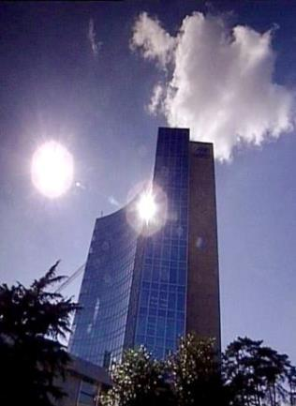
Facts about WIPO
MISSION: Our mission is to lead the development of a balanced and effective international intellectual property (IP) system that enables innovation and creativity for the benefit of all.
MEMBER STATES: 188
OBSERVERS: + 390
STAFF: 1240
ADMINISTERED TREATIES: 26
MAIN BODIES: GA, CC, WIPO CONFERENCE

Slide 4
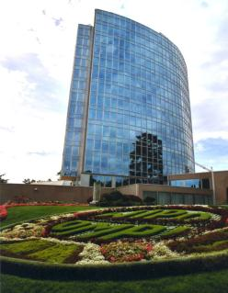
Milestones : 1883 - 2013
2013
2012
MARRAKESH TREATY
2006
BEIJING TREATY
2000
STLT
1996
PATENT LAW TREATY
INTERNET TREATIES
1989
MADRID PROTOCOL
1970
PCT ESTABLISHED
1967
1960
WIPO CONVENTION
1925
BIRPI MOVES TO GENEVA
1893
HAGUE AGREEMENT
1891
BIRPI
1886
1883
MADRID AGREEMENT
BERNE CONVENTION
PARIS CONVENTION

Slide 5

Economic Development
Norm Setting
Services to Industry
Global Infrastructure

Slide 6
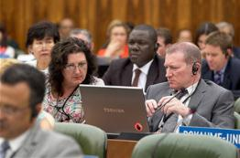


Norm Setting
Development of international IP law that is:
  balanced
  responsive
  effective
  Flexible
Strong connection of norm-setting to WIPO services.

Slide 7

Standing Committees
PATENTS (SCP)
COPYRIGHT & RELATED RIGHTS (SCCR)
TRADEMARKS, DESIGNS & GEOGRAPHICAL INDICATIONS (SCT)
AIM:
      Build consensus on topical issues
      Consider interests of stakeholders for a balanced, efficient, user-friendly, cost-effective system
      N.B. Enforcement issues are discussed in the Advisory Committee on Enforcement

Slide 8
The Standing Committee on Law of Patents
At its most recent session in November, 2014, The Standing Committee on Law of Patents concluded that for its next session fact finding would take place on the following non-exclusive list of topics:
Exceptions and Limitations to Patent Rights.
Quality of Patents including Opposition Systems.
Patents and Health.
Confidentiality of communications between clients and their patent advisors.
Transfer of technology.

Slide 9
Standing Committee on the Law of Trademarks, Industrial Designs and Geographical Indications (SCT)
Latest SCT session: November 24 to November 26, 2014. Among others the following issues were discussed:
Draft Design Law Treaty (DLT); Text shows an advanced degree of maturity, but differences remain over form and content of technical assistance provisions and a possible disclosure requirement for design applications incorporating TK, TCEs and genetic resources.
Protection of country names and nation branding; The Chair requested the Secretariat to organize a side-event to the next SCT concerning that topic.
Geographical Indications: two competing proposals concerning future work – one on the differences of GI protection at the national level in Member States and another on the potential protection of GIs in the Domain Name System. Discussion to continue at next SCT.
Summary by the Chair: SCT/32/5 (http://www.wipo.int/edocs/mdocs/sct/en/sct_32/sct_32_5.pdf

Slide 10
Other Normative Developments
GA September 2013 decided to convene a diplomatic conference for the adoption of a revised Lisbon Agreement on Appellations or Origins and Geographical Indications, to take place in Geneva from May 11 to 21, 2015.

Slide 11
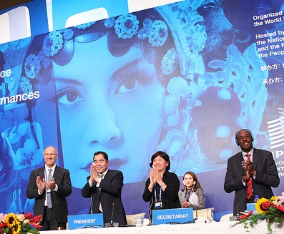
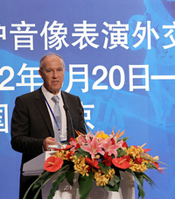
Beijing Treaty on Audiovisual Performances, 26 June 2012

Slide 12
Beijing Treaty
Adopted on June 2012
Strengthen the position of performers, giving them moral and economic rights for the international use of their performances
Parties will pay for the use of foreign audiovisual performances. Some or all of this money will go to performers
“The conclusion of the Beijing Treaty is an important milestone toward closing the gap in the international rights system for audiovisual performers”
- WIPO Director General, Francis Gurry

Slide 13
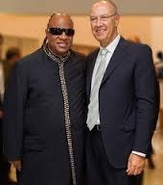
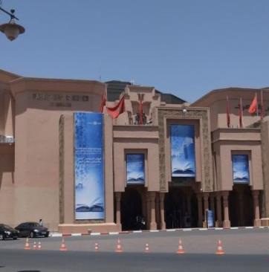
Marrakesh Treaty to Facilitate access to Published Works for Persons who are Blind, Visually Impaired or Otherwise Print Disabled

Slide 14

Marrakesh Treaty
285 million blind and visually impaired persons
90% live in developing countries
Less than 10% of books published are available in braille or other accessible formats
Requires parties to adopt limitations for the benefit the people who are blind, visually impaired, and print disabled
Provides for exchange of accessible format works across borders

Slide 15
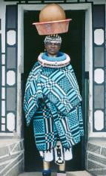
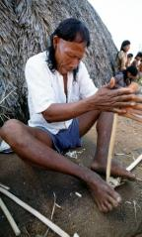
Intellectual Property and Traditional Knowledge, Access to Genetic Resources and Folklore
Objective: Agree on international legal instruments that protect traditional knowledge (TK), traditional cultural expressions (TCEs) and genetics resources (GRs).
  Key Issues to be discussed
  Objectives
  Definitions of TK/TCEs
  Options on protection
  Scope
  Beneficiaries
  Duration

Slide 16

WIPO HELPS YOU ACCESS INTERNATIONAL MARKETS

Slide 17
Provider of Premier Global IP Services
Core business areas:
  Patent Cooperation Treaty (Patents)
  Madrid System (Trademarks)
  Hague System (Industrial Designs)
  WIPO Arbitration and Mediation Center

Slide 18
Budget 2014 – 2015 : CHF 713.3 Million

Slide 19
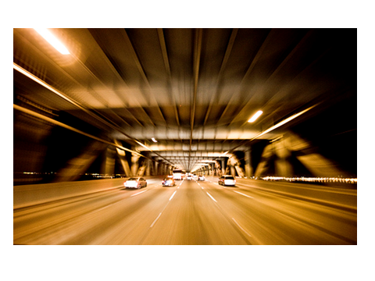
Intellectual Property Infrastructure
“Just as participation in the physical economy requires access to roads, bridges, and vehicles to transport goods, similar infrastructure is needed in the virtual and knowledge economy…

Slide 20
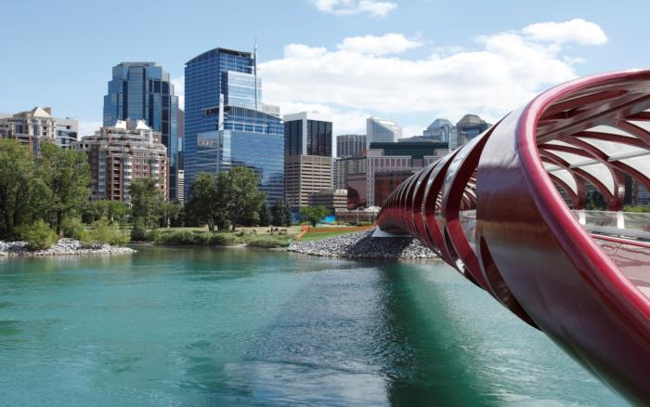
“…However, here the highway is the Internet and other networks, the bridges are interoperable data standards, and the vehicles are computers and databases.” Francis Gurry, Director General of WIPO

Slide 21
Global IP Infrastructure
  Databases
  Common platform for e-data exchange among IPOs
  Other platforms
  Tools
  Standards & technical agreements
  Capacity building & networking by Technology Innovation Support Centers (TISCs)

Slide 22




Major Economic Studies on IP
WIPO Unit – THE ECONOMICS AND STATISTICS DIVISION – Reflects the Growing Consensus on the importance of the Economic Dimension of IP.
The Division applies statistic and Economic analysis to the use of WIPO services.
This structure also improves WIPO economic insight on IP Development.

Slide 23
Economics of IP at WIPO: Organizational Structure
Economics and Statistics Division
WIPO Chief Economist
IP Statistics
Section
Data Development
Section
Economics
Section

Slide 24
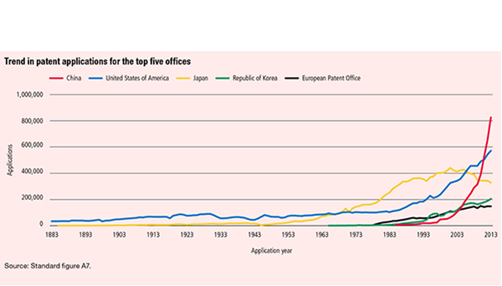
Demand for IP Rights has grown

Slide 25
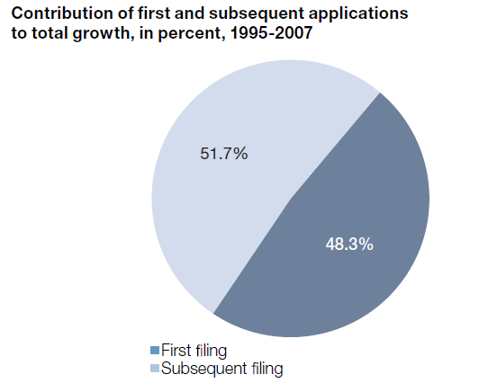
More Inventions and Greater Internationalization

Slide 26
Studies and Reports
World Intellectual Property Indicators (WIPI): This is our flagship IP statistics publication. It provides an overview of latest trend in IP filings and registrations covering more than 100 offices : http://www.wipo.int/ipstats/en/wipi/index.html
The PCT Yearly Review provides an overview of the performance and development of the PCT system. It includes a comprehensive set of statistics for the latest available year See: http://www.wipo.int/ipstats/en/statistics/pct/
Madrid Yearly Review: http://www.wipo.int/ipstats/en/
Hague Yearly Review: http://www.wipo.int/ipstats/en/
The WIPO IP Facts and Figures provides an overview of intellectual property (IP) activity based on the latest available year of statistics. It serves as a quick reference guide for statistics: http://www.wipo.int/ipstats/en/
WIPO IP Statistics Data Center is an on-line service enabling access to WIPO’s statistical data. Users can select from a wide range of indicators and view or download data according to their needs: http://ipstatsdb.wipo.org/ipstatv2/ipstats/patentsSearch

Slide 27

Studies and Reports II
Studies and ReportsThe report looks at how branding behavior and trademark use have evolved in recent history, how they differ across countries, what is behind markets for brands, what lessons economic research holds for trademark policy and how branding strategies influence companies’ innovation activities
For further information and the full report :
http://www.wipo.int/econ_stat/en/economics/wipr

Slide 28

Belgium Profile

Slide 29
The Global Innovation Index
RANKING 2013
RANKING 2014
1. SWITZERLAND
2. SWEDEN
3. UNITED KINGDOM
4. NETHERLANDS
5. UNITED STATES OF AMERICA
6. FINLAND
7. HONG KONG (CHINA)
8. SINGAPORE
9. DENMARK
10. IRELAND
11. CANADA
12. LUXEMBOURG
13. ICELAND
14. ISRAEL
15. GERMANY
…………..
21. BELGIUM
1. SWITZERLAND
2. UNITED KINGDOM
3. SWEDEN
4. FINLAND
5. NETHERLANDS
6. UNITED STATES OF AMERICA
7. SINGAPORE
8. DENMARK
9. LUXEMBOURG
10. HONG KONG (CHINA)
11. IRELAND
12. CANADA
13. GERMANY
14. NORWAY
15. ISRAEL
…………..
23. BELGIUM

Slide 30
Belgium Profile
  Belgium is ranked 23st in the 2014 Global Innovation Index
  Belgium ranks better on the Input sub-index category (22nd) than the Output sub-index category (23rd).
  Input sub-index: Belgium has top 20 rankings on all Innovation Input pillars. Belgium’s strengths at the variable level are in R&D expenditure (6th), intensity of local competition (5th), GERD performed by business, % GDP (12th), GERD financed by business, % (15th) and patent families filed in 3+offices (17th).
  Output sub-index: Belgium scores slightly better in the Knowledge & Technology output sub-pillar (19th) than the Creative outputs sub-pillar (22nd). Belgium’s strengths at the variable level include: PCT resident patent applications (17th) and citable documents H index (13th).
  Opportunities: principally found in Creative Outputs. Opportunities for growth are found in Domestic Resident Trademark and Cultural Goods and Services such as publishing.

Slide 31
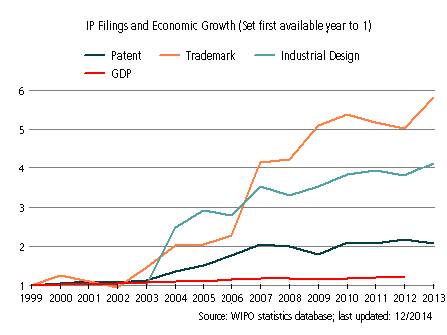
Belgium’s Evolution with Respect to IP Filings and Economic Growth from 1998 to 2012
Filings for trademarks have increased strongly since 1998 despite slow-downs in the periods around 2002 and 2009. This growth has greatly outpaced corresponding growth in GDP.
Growth in industrial designs filings has been strong despite slow-down in the period around 2009..
Filings for patent have grown more slowly since 2007, but maintain a good level of activity.

Slide 32
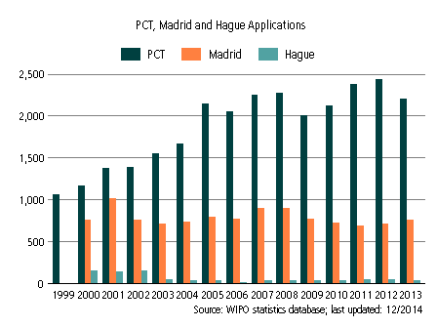
International Applications via WIPO Administered Treaties

Slide 33
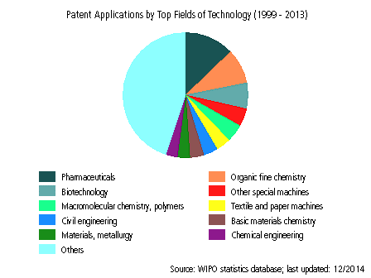
Patent Applications (1998-2012)

Slide 34
Patent Cooperation Treaty (PCT)
Introduction and Future Developments
February 2015
Claus Matthes
Director, PCT Business Development Division

Slide 35
Traditional Patent System
File national application first
Paris Convention gives 12 month “period of priority” from filing first application to file in other countries. Within that time (usually before outcome of procedures in Office of first filing is known):
  appoint local representatives in other countries
  prepare translations
  pay fees
  begin equivalent procedures, all carried out independently
GB grant
Prepare
National search and examination
Prep
National search and examination
Prep
National search and examination
Trans
Prep
National search and examination
AU grant
Trans
Prep
National search and examination
0 months
GB filing
12 months
rest of world filing
24 months
36 months

Slide 36
The PCT ─ 1970
Basic idea: simplify the procedure for obtaining patent protection in many countries, making it more efficient and economical
  filing tool for applicants; and
  work sharing tool for Offices

Slide 37
PCT Basics
Filing Tool for applicants:
  One application, one language, one set of formality requirements, filed with one Office
  Containing, by default, the designation of all Member States, for every kind of protection available, and usual priority claim(s)
  Effect of a regular national filing (including establishment of a priority date) in each designated State
  Delays national processing until 30 months from priority date
  International search and examination reports improve basis for decision making

Slide 38
PCT Basics
Work sharing tool for Offices:
  Central formality checking
  Central international publication
  International search report (ISR)
  International Preliminary Reports on Patentability
    preliminary, non-binding opinion on novelty, inventive step (non-obviousness) and industrial applicability

Slide 39
Traditional Patent System
vs. PCT System
Filing of national applications
& processing by national Offices
Fees for translations, Offices, local agents
(months)
Traditional
0
12
File local
application
Entering of national phase before
& processing by national Offices
Fees for translations, Offices, local agents
delay of processing by national Offices
(months)
International
publication
PCT
0
12
16
18
22
28
30
File local
application
File PCT
application
International
search report & written opinion
(optional)
File
demand for
International
preliminary
examination
(optional)
International
preliminary report on patentability

Slide 40
The PCT System
Express intention and take steps to pursue to grant in various states
Typically filed in same national patent office--one set of fees, one language, one set of formality requirements--and legal effect in all PCT States
Disclosing to world content of application in standardized way
Enter
national
phase
International
publication
(months)
0
12
16
18
22
28
30
File local
application
File PCT
application
International
search report & written opinion
(optional)
File
demand for
International
preliminary
examination
(optional)
International
preliminary report on patentability
Typically a national patent application in the home country of the applicant
Report on state of the art (prior art documents and their relevance) + initial patentability opinion
Additional patentability analysis, designed to assist in national phase decision-making
Request an additional patentability analysis on
basis of amended application

Slide 41
PCT International Searching Authorities
  .
Australia Austria Brazil Canada China Chile Egypt Finland India Israel | Japan Republic of Korea Russian Federation Singapore (not yet operating) Spain Sweden Ukraine (not yet operating) United States of America European Patent Office Nordic Patent Institute

Slide 42
Prior Art for International Search
Prior art:
  everything which has been made available to the public,
  anywhere in the world,
  by means of written disclosure,
  which is capable of being of assistance in determining that the claimed invention is or is not new and that it does or does not involve an inventive step,
  provided the making available to the public occurred prior to the international filing date.

Slide 43
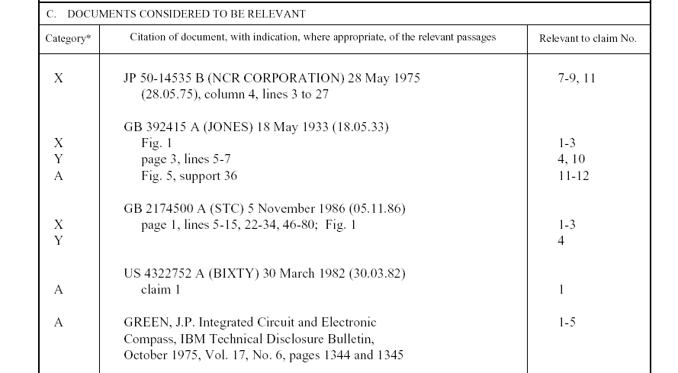
Example: PCT International Search Report
Symbols indicating
which aspect of patentability
the document cited is
relevant to (for example, novelty, inventive step, etc.)
The claim numbers
in your application to
which the document is
relevant
Documents relevant to whether or not your invention may be patentable

Slide 44
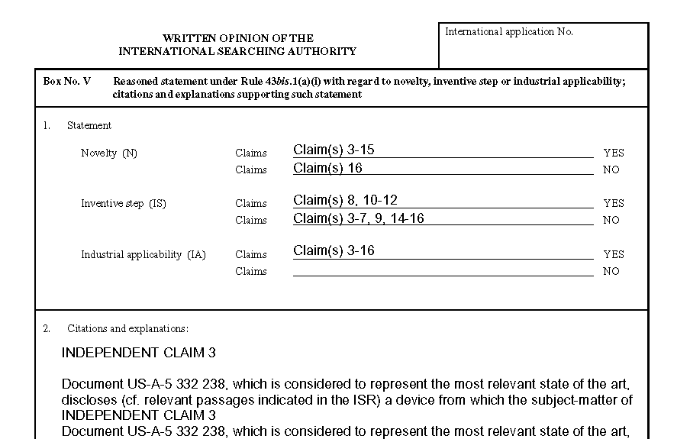
Example: PCT Written opinion of the International Searching Authority
Reasoning supporting the assessment
Patentability assessment
of claims

Slide 45
The PCT System
Express intention and take steps to pursue to grant in various states
Typically filed in same national patent office--one set of fees, one language, one set of formality requirements--and legal effect in all PCT States
Disclosing to world content of application in standardized way
Enter
national
phase
International
publication
(months)
0
12
16
18
22
28
30
File local
application
File PCT
application
International
search report & written opinion
(optional)
File
demand for
International
preliminary
examination
(optional)
International
preliminary report on patentability
Typically a national patent application in the home country of the applicant
Report on state of the art (prior art documents and their relevance) + initial patentability opinion
Additional patentability analysis, designed to assist in national phase decision-making
Request an additional patentability analysis on
basis of amended application

Slide 46
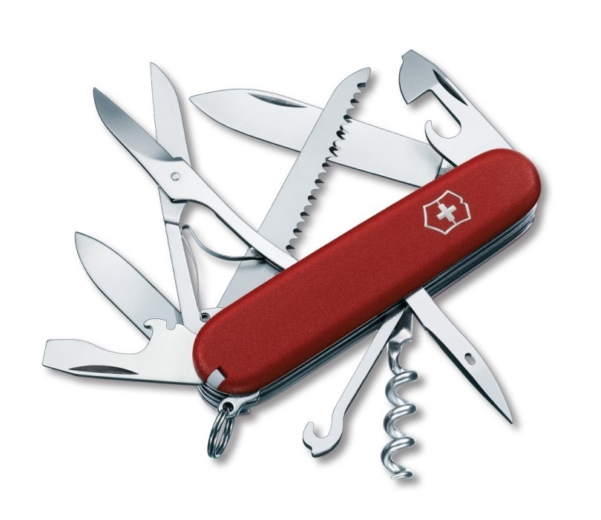
The PCT
filing tool for applicants with global reach
harmonized formalities
work-sharing tool for Offices
allows for
correction of errors
ePCT filing
and processing
buys time
patentability analysis
flexibility,
keeps options open

Slide 47
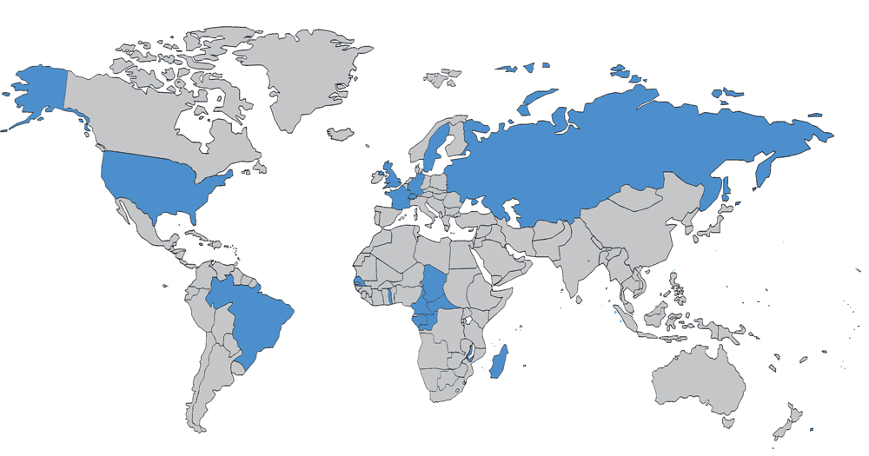
The PCT in 1978

Slide 48
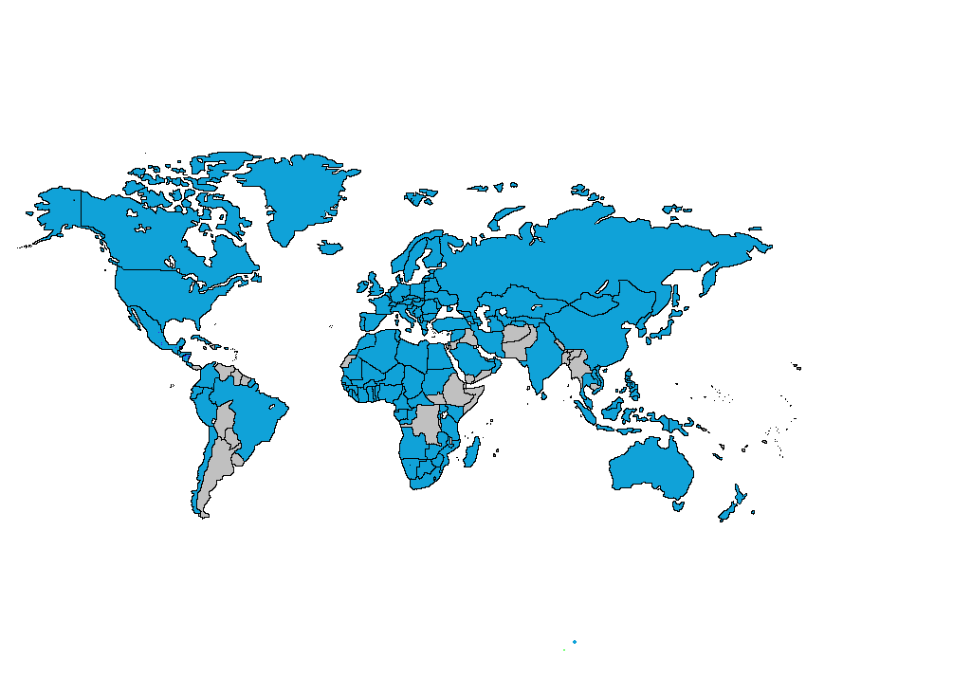
PCT Coverage Today

Slide 49

148 PCT States
=PCT
Albania
Algeria
Angola
Antigua and Barbuda
Armenia
Australia
Austria
Azerbaijan
Bahrain
Barbados
Belarus
Belgium
Belize
Benin
Bosnia and Herzegovina
Botswana
Brazil
Brunei Darussalam
Bulgaria
Burkina Faso
Cameroon
Canada
Central African Republic
Chad
Chile
China
Colombia
Comoros
Congo
Costa Rica
Côte d'Ivoire
Croatia
Cuba
Cyprus
Czech Republic
Democratic People's
Republic of Korea
Denmark
Dominica
Dominican Republic
Ecuador
Egypt
El Salvador
Equatorial Guinea
Estonia
Finland
France,
Gabon
Gambia
Georgia
Germany
Ghana
Greece
Grenada
Guatemala
Guinea
Malawi
Malaysia
Mali
Malta
Mauritania
Mexico
Monaco
Mongolia
Montenegro
Morocco
Mozambique
Namibia
Netherlands
New Zealand
Nicaragua
Niger
Nigeria
Norway
Oman
Panama
Papua New Guinea
Peru
Philippines
Poland
Portugal
Qatar
Republic of Korea
Republic of Moldova
Romania
Rwanda
Russian Federation
Saint Lucia
Saint Vincent and
the Grenadines
San Marino
Sao Tomé e Principe
Saudi Arabia
Senegal
Serbia
Seychelles
Sierra Leone
Singapore
Slovakia
Slovenia
South Africa
Spain
Sri Lanka
Sudan
Swaziland
Guinea-Bissau
Honduras
Hungary
Iceland
India
Indonesia
Iran
Ireland
Israel
Italy
Japan
Kazakhstan
Kenya
Kyrgyzstan
Lao People’s Dem Rep.
Latvia
Lesotho
Liberia
Libyan Arab Jamahiriya
Liechtenstein
Lithuania
Luxembourg
Madagascar
St. Kitts and Nevis
Sweden
Switzerland
Syrian Arab Republic
Tajikistan
Thailand
The former Yugoslav
Republic of Macedonia
Togo
Trinidad and Tobago
Tunisia
Turkey
Turkmenistan
Uganda
Ukraine
United Arab Emirates
United Kingdom
  United Republic of Tanzania
  United States of America
Uzbekistan
Viet Nam
Zambia
Zimbabwe
Notes:
49

Slide 50
Countries not yet in PCT
Afghanistan
Andorra
Argentina
Bahamas
Bangladesh
Bhutan
Bolivia
Burundi
Cambodia
Cape Verde
Democratic Republic of Congo
Djibouti
Eritrea
Ethiopia
Fiji
Guyana
Haiti
Iraq
Jamaica
Jordan
Kiribati
Kuwait
Lebanon
Maldives
Marshall Islands
Mauritius
Micronesia
Myanmar
Nauru
Nepal
Pakistan
Palau
Paraguay
Samoa
Solomon Islands
Somalia
South Sudan
Suriname
Timor-Leste
Tonga
Tuvalu
Uruguay
Vanuatu
Venezuela
Yemen
(45)

Slide 51
PCT Applications in 2013
2013: 205,300 PCT applications (+5.1%)
2014: 214,100 PCT applications (+4.3%)

Slide 52
International Applications Received
in 2013 by Country of Origin
CN: +15.6%
US: +10.8%
SE: +10.4%

Slide 53
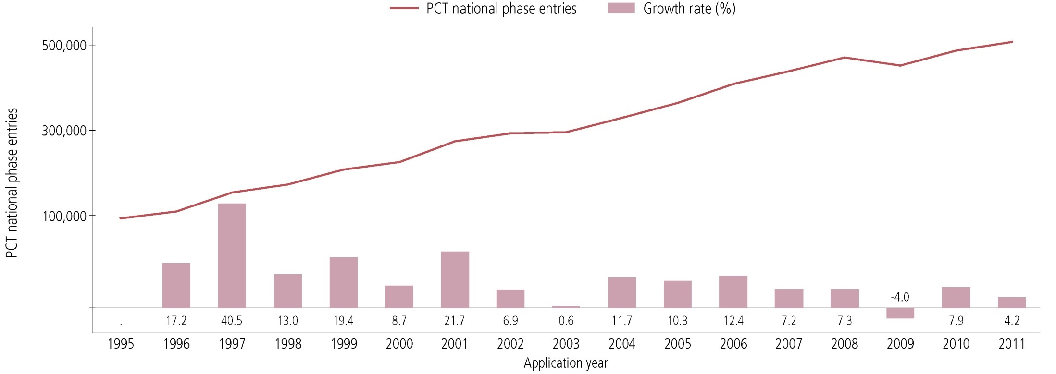
PCT National Phase Entries—Total
507,400 national phase entries estimated in 2011 (+ 4.2%)
431,800 (about 85%) of NPEs are from non-resident applicants, making PCT NPEs responsible for 54.9% of all non-resident patent applications filed worldwide in 2011

Slide 54
PCT National Phase Entries 2011—
by Target Office (1)
USPTO most preferred DO for National Phase Entries; had highest growth among the IP5 Offices (+7.3%)
Brazil (+12.6%) and India (+9.8%) had highest growth rates among top 10 Offices

Slide 55
PCT National Phase Entries 2011—
by Target Office (2)

Slide 56
Top PCT Applicants 2013
Panasonic—JP (2881)
ZTE—CN (2309)
Huawei—CN (2094)
Qualcomm—US (2036)
Intel—US (1852)
Sharp—JP (1840)
Bosch—DE (1786)
Toyota—JP (1696)
Ericsson—SE (1467)
Philips—NL (1423)
Top University Applicants 2013
University of California (US)
MIT (US)
Columbia University (US)
University of Texas (US)
Harvard University (US)
Johns Hopkins (US)
Korea Advanced Institute of Science and Technology (KR)
Leland Stanford University (US)
Cornell University (US)
Cal Tech (US)

Slide 57
The PCT “Market Share”
*

Slide 58
PCT Key Advantages
Postpones major costs of internationalizing a patent application
Provides a strong basis for patenting decisions
Harmonizes formal requirements
Helps applicants to correct errors
Evolves to meet user needs

Slide 59
The PCT ─ 1970 to Today
As filing tool: PCT extremely successful
  Preferred route for international patenting (> 200,000 applications in in 2013, > 54% “market share”)
  Harmonization of formal and procedural requirements, beyond PCT (national laws; Patent Law Treaty (PLT))

Slide 60
The PCT ─ 1970 to Today
However: as work sharing tool not as effective in practice for addressing national quality of examination and (for some Offices) backlogs
  Expectation was: “flying start” for offices; completing, checking
  and criticizing …
  Reality is: many Offices start “from scratch”, perhaps not in complete isolation, but …
What is needed: building trust between patent offices, so that duplicative international phase and national phase processing can
be reduced

Slide 61
PCT Areas of Work
Improve the quality and consistency of PCT international phase
work products
Develop quality metrics for measuring usefulness of work products and identifying areas of further work
Develop quality feedback system for offices
Help designated Offices to better understand reports
  Search strategies, standardized clauses, explanations of relevance of cited documents, …
Explore collaborative search and examination
Third party observations system

Slide 62
PCT Areas of Work
Improve timeliness of actions in international phase
Develop metrics for entire PCT system
Create incentives for applicants to use system efficiently
  Encourage high quality applications and early correction of defects and filing of amendments
  PCT/PPH
Improve access to national search and examination reports
  Patentscope, CASE, Global Dossier

Slide 63
PCT Areas of Work
Helping developing countries benefit from the PCT
  Top 10 countries responsible for 87% of IAs published in 2013;
  top 15 countries = 92%; top 20 countries = 96%
  Improve training for examiners, better coordinate training already offered
  Improve access to affordable online search systems
Making PCT accessible to applicants of all types from all Contracting States
  Fee reductions (SMEs, universities, research institutes, individual applicants)

Slide 64
PCT Areas of Work
ePCT: Seeks to provide electronic interface to entire PCT international phase process (RO, ISA, IPEA, IB)
  Real time access to IB files and bibliographic data
  Flexible applicant-controlled access rights system
  Increasing access to RO, ISA, IPEA documents not traditionally held by IB
  Increasing transmission of documents to RO, ISA, IPEA
  Where possible, replace letters with directly usable information
  Notifications of significant events and approaching deadlines

Slide 65
PCT Training Options
29 video segments on WIPO’s Youtube channel and WIPO’s PCT page about individual PCT topics
PCT Distance learning course content available in the 10 PCT publication languages
PCT Webinars
  free updates on developments in PCT procedures and PCT strategies
  also for companies or law firms
In-person PCT Seminars and training sessions

Slide 66
PCT Resources/Information
For further information about the PCT, see
http://www.wipo.int/pct/en/
For general questions about the PCT, contact the PCT Information Service at:
      Telephone: (+41-22) 338 83 38
      Facsimile: (+41-22) 338 83 39
      E-mail: pct.infoline@wipo.int

Slide 67
Thank You!
Claus Matthes
Director, Patent Cooperation Treaty (PCT) Business Development Division
World Intellectual Property Organization (WIPO)
34 chemin des Colombettes, 1211 Geneva 20, Switzerland
T + 41 22 338 98 09; claus.matthes@wipo.int; www.wipo.int

Slide 68
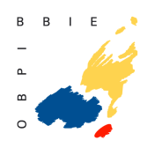

Global IP Systems:
The Madrid System
The Hague System
David Muls
Senior Director
Madrid Registry
Camille Janssen
Senior Lawyer
Benelux Office for IP
Brussels, February 23, 2015
Notes:
68

Slide 69
The Madrid System

Slide 70


Slide 71
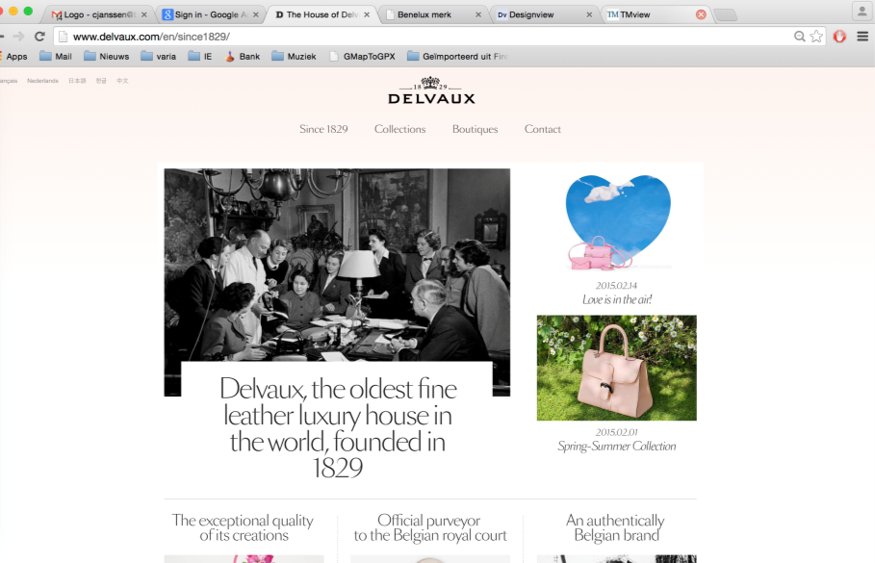

Slide 72


Slide 73
Trademark
Exclusive right to use a sign
  A tool to prevent the use of that sign or confusingly similar signs by competitors
Indicator of origin
  Individualises the producer, not the product
Bears the goodwill of a company
In a specific territory
  National, Regional

Slide 74
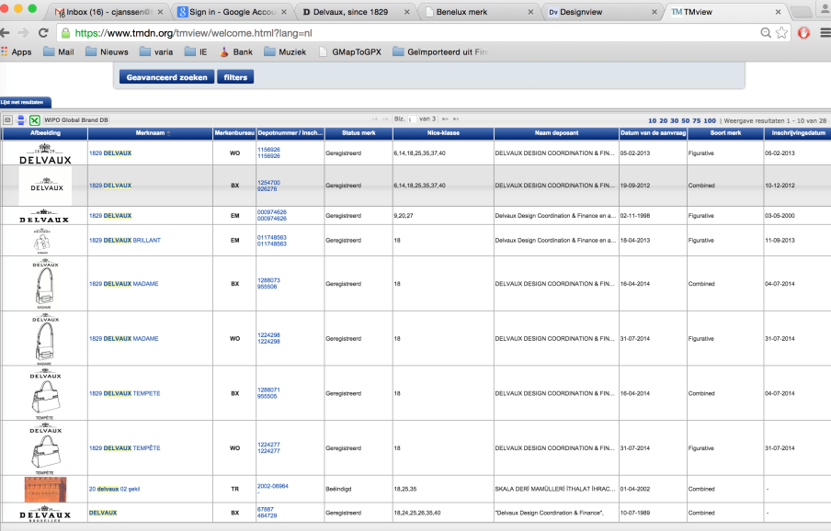

Slide 75
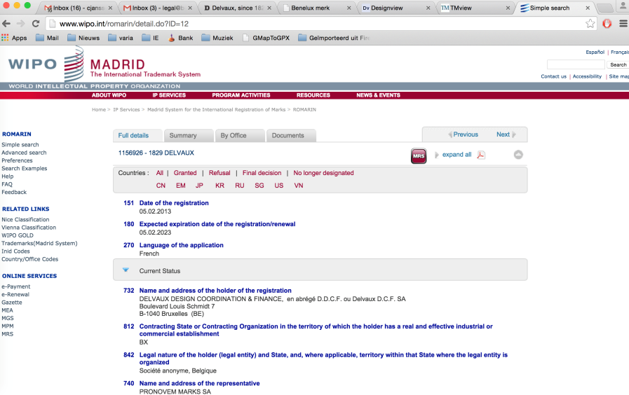

Slide 76
Or international…
If you want to protect your trademarks abroad: consider the Madrid System!

Slide 77
Why?
Easier
Cheaper
File
Manage
Trademarks
Internationally

Slide 78
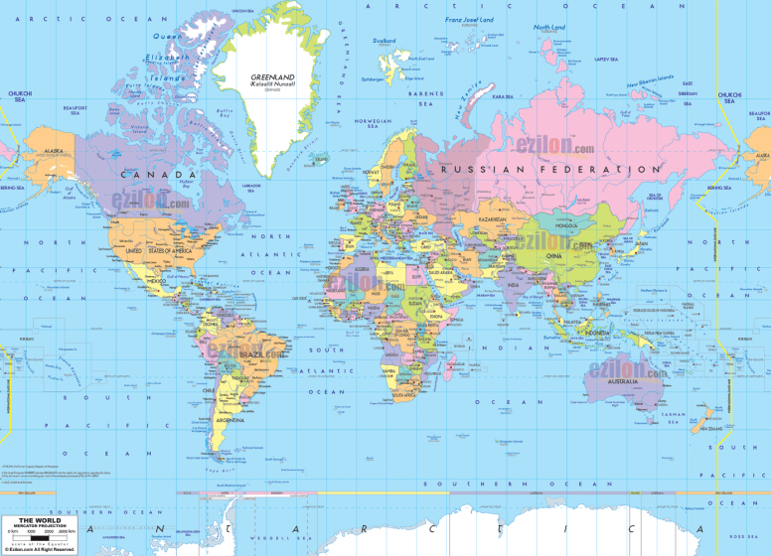
ezilon.com

Slide 79
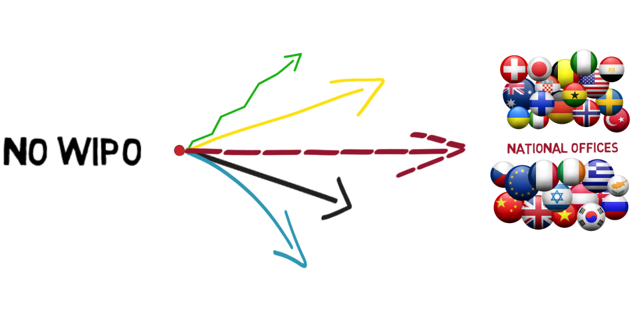

Slide 80
The Madrid System
A centralized filing and management procedure
You file once and you designate countries in which you seek protection
You manage your rights in all the countries centrally through WIPO

Slide 81
How does it work?
Office of Origin
Designated Contracting Party
Designated Contracting Party
Designated Contracting Party
WIPO
Applicant
Certifies the application and forwards it to WIPO
Conducts the formal examination; records the mark in the International Registry and publishes the international registration in the Gazette. Issues a certificate of registration and notifies the designated Contracting Parties
Entitlement
Basic Mark
Scope of protection of the international registration will be determined by the substantive examination under domestic law, within 12/18 months

Slide 82

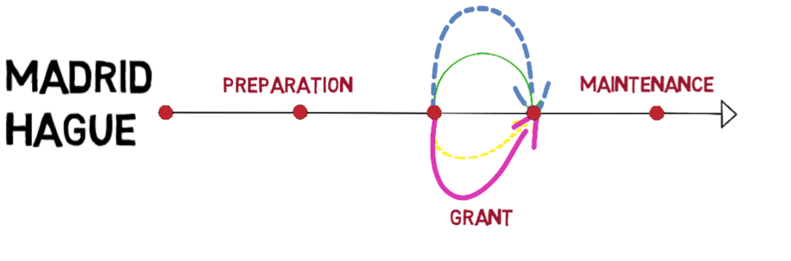

Slide 83
Which countries are covered?
1 Agreement only
39 Protocol only (including EU and OAPI)
54 Agreement and Protocol
94 Members

Slide 84
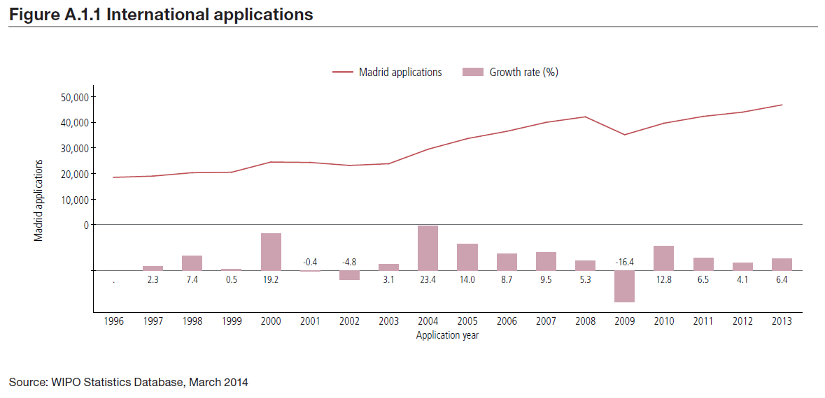
International Applications

Slide 85
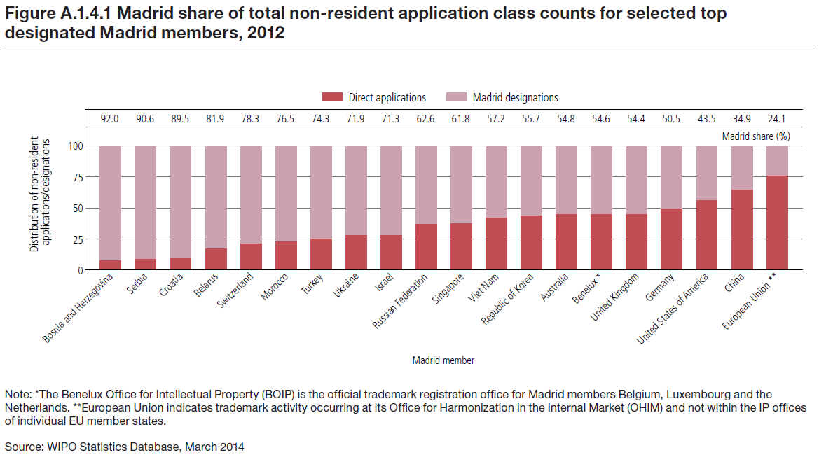
Market Share

Slide 86
Top offices of origin – 2013
Contracting Parties | 2013
European Union | 6,814
United States of America | 5,893
Germany | 4,357
France | 3,514
Switzerland | 2,885
China | 2,455
Italy | 2,118
Japan | 1,855
Benelux | 1,784
United Kingdom | 1,580

Slide 87
Top designations – 2013
Contracting Parties | 2013
China | 20,275
Russian Federation | 18,239
European Union | 17,598
United States of America | 17,322
Switzerland | 13,215
Japan | 13,179
Australia | 11,675
Republic of Korea | 10,967
Turkey | 9,838
Ukraine | 9,589

Slide 88
How much does it cost? (simplified)
Filing fee (CHF)
  Basic fee: 653 (b&w) / 903 (color)
  Fee per designated country
  Average in 2013: 2926 (6 to 7 designations)
Management fees (CHF), examples:
  Renewal: 653 + fee per designated country
  Subsequent designation: 300 + fee per designated country
  Name or address change: 177 (regardless of number or registrations)
Important remarks
  Recent appreciation of the Swiss francs
  Cost of agents/attorneys

Slide 89
Avoid common mistakes
Invest in your trademarks
Have a long-term strategy
Choose the right route
Be careful in some jurisdictions
Madrid is simpler, but not that simple

Slide 90
National – CTM – Madrid
Pro: Specific
Con: Need to go to each specific NO
Pro: Complete EU in one application
Con: All or nothing
Pro: Simpy enlarge what you have back home
Con: Protection is a matter of national legislation

Slide 91
Madrid: Going out
Based on existing Benelux TM
IRPI: Full electronic application
  Indicate which countries
  Use French or English
Formalities check
Forwarding to WIPO
  And into the world…
National processing in designated countries
Notice of Grant of Protection per country

Slide 92
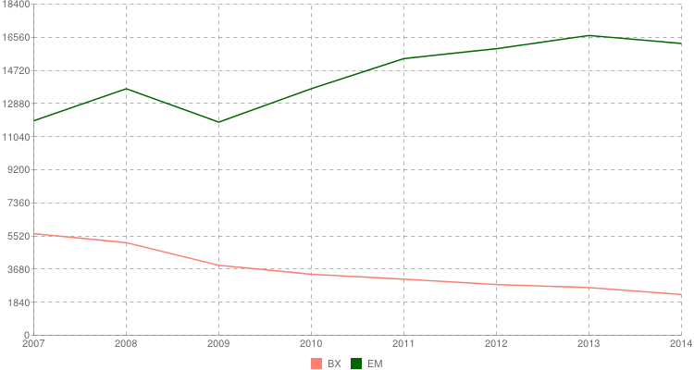

Slide 93
Madrid: Coming in
WIPO notifies BOIP
Check on Benelux legal requirements
  Absolute grounds check
  Opposition
BOIP notifies WIPO that protection is granted

Slide 94
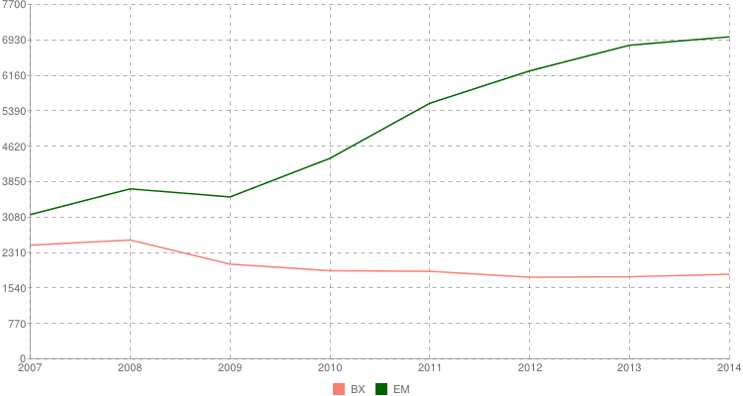

Slide 95
The Hague System:
The International Design System

Slide 97
Design
Exclusive right on the design of a product
  A tool to prevent competitors to make a product that looks the same
The product itself is protected
For 25 years
In a specific territory
  National, Regional

Slide 98


Slide 99
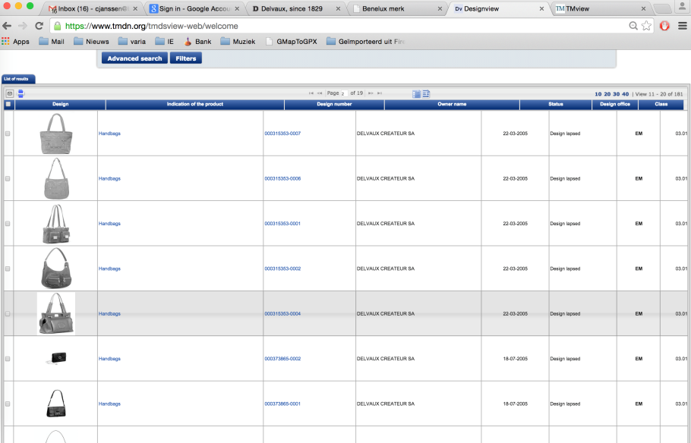

Slide 100
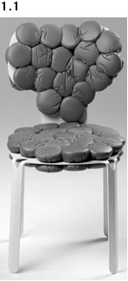
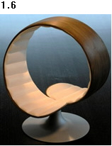
WIPO Director General Francis Gurry:
“Design is one of the principal means of differentiating a range of mass produced household and consumer items, such as chairs and tables, for which the technological possibilities for development have been exhausted.”
DM/075065 DM/076022
« Chair » « Chair »

Slide 101
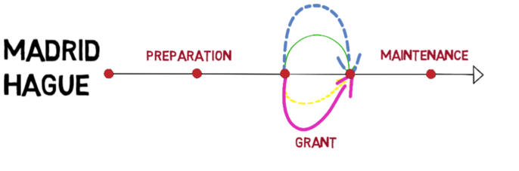
The Hague System
Similar system as Madrid
Focus on the differences
Notes:
101

Slide 102
Hague Union in 2014
46 Geneva Act (1999) (including EU and OAPI)
15 Hague Act (1960)
61 Contracting Parties

Slide 103
Hague Union in 2015
49 Geneva Act (1999) (including EU and OAPI)
15 Hague Act (1960)
64 Contracting Parties

Slide 104
Other key differences with Madrid
No Basic Design concept
Direct filing at WIPO possible
Up to 100 designs in single application (same class)
Renewal
  Madrid: 10 years (indefinitely)
  Hague: 5 years (as a rule up to 15 years)
No subsequent designation concept

Slide 105
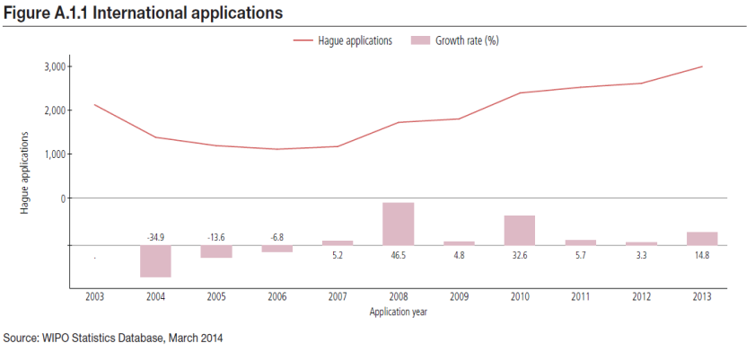
International Applications

Slide 106
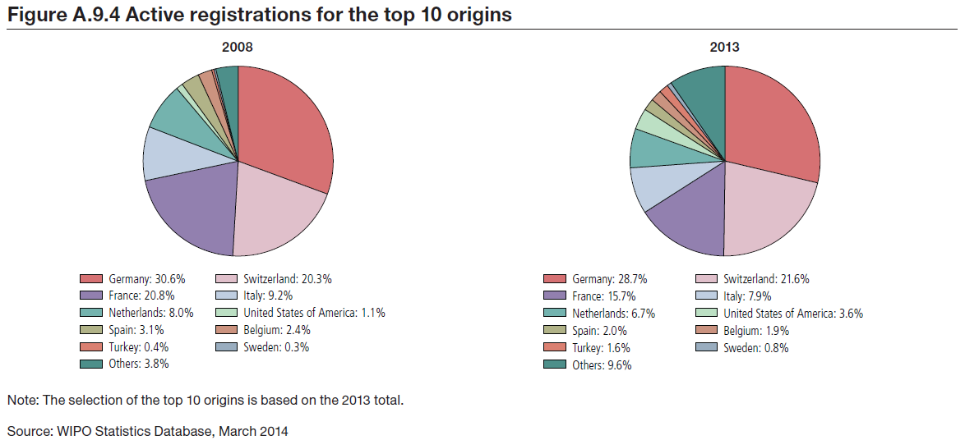
Origin of International Registrations

Slide 107
2013: Top Designated Contracting Parties
Number of designs recorded:
1. European Union (10178 designs, 79.5%)
2. Switzerland (9287 designs, 72.5%)
3. Turkey (5993 designs, 46.8%)
4. Norway (3152 designs, 24.6%)
5. Ukraine (2911 designs, 22.7%)
6. Singapore (2639 designs, 20.6%)
7. Morocco (1932 designs, 15.0%)
8. Croatia (1884 designs, 14.7%)
9. Monaco (1724 designs, 13.5%)
10. Liechtenstein (1706 designs, 13.3%)

Slide 108
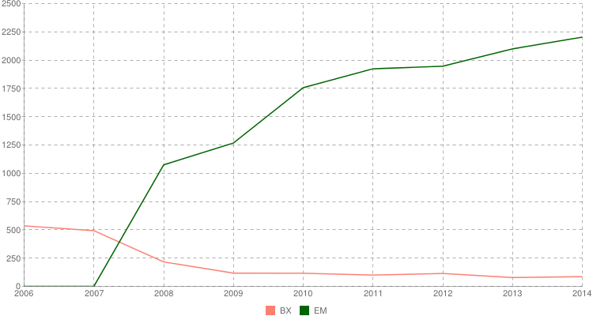
The Hague System in Benelux: inward

Slide 109
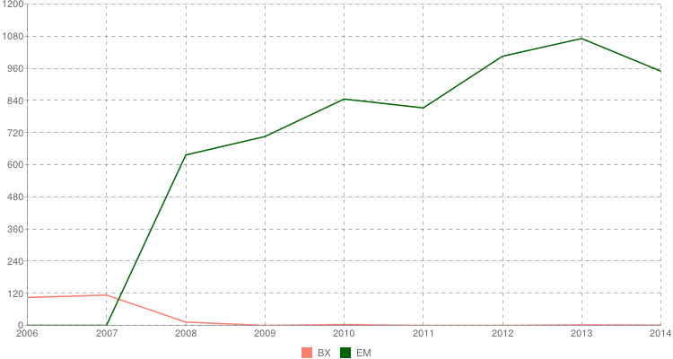
The Hague System in Benelux: outward

Slide 110
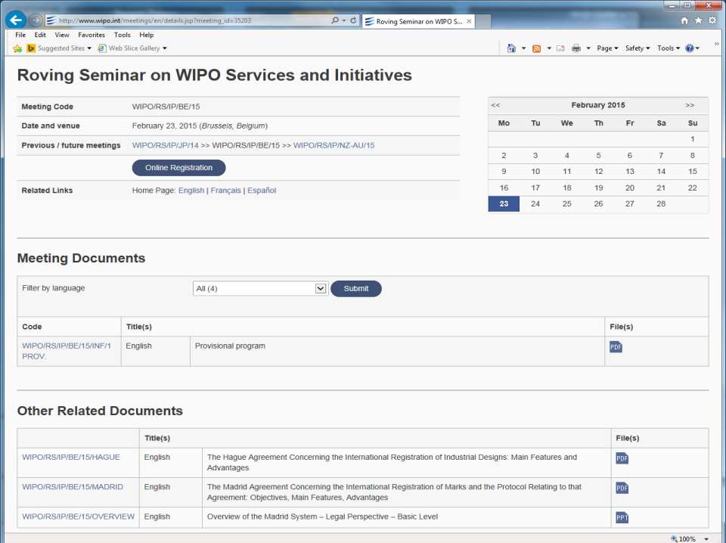

Slide 111
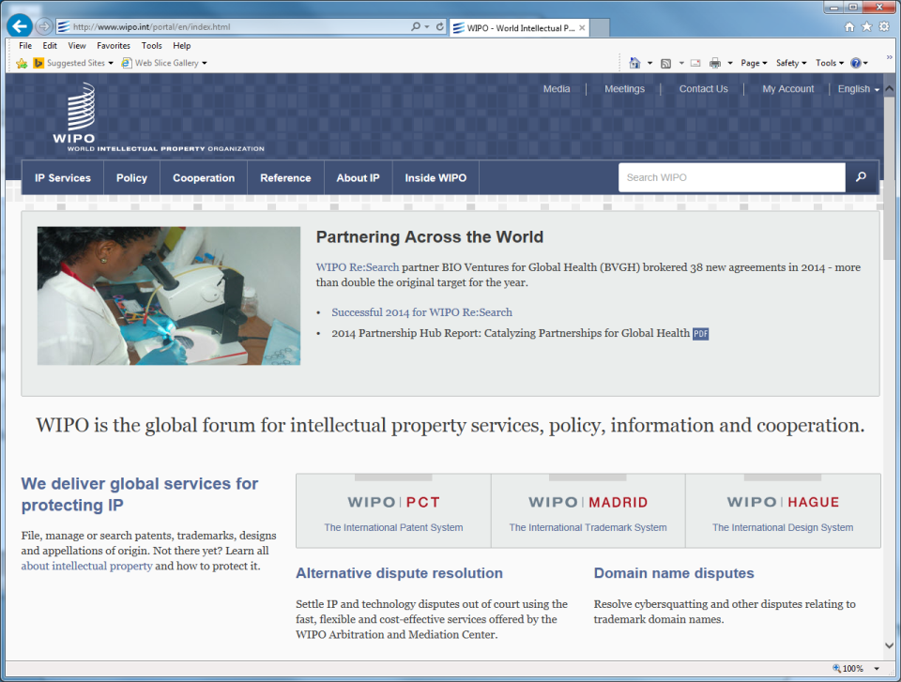

Slide 112
Thank you
david.muls@wipo.int
c.janssen@boip.int

Slide 113

WIPO Alternative Dispute Resolution
Seminar WIPO Services and Initiatives
Brussels
February 23, 2015
Erik Wilbers
Director, WIPO Arbitration and Mediation Center

Slide 114
WIPO Arbitration and Mediation Center
Facilitates the resolution of commercial disputes between private parties involving IP and IT, through procedures other than court litigation (“Alternative Dispute Resolution”: ADR)
ADR of IP disputes benefits from a specialized ADR provider
  WIPO panel members experienced in IP and technology - able to deliver informed results efficiently
  Competitive WIPO fee structure (including reduced fees for PCT and Madrid applicants)
  International neutrality
  Offices in Geneva and Singapore

Slide 115
Mediation, Arbitration, Expert Determination
Mediation: an informal consensual procedure in which a neutral intermediary, the mediator, assists the parties in reaching a settlement of their dispute, based on the parties’ respective interests. The mediator cannot impose a decision. The settlement agreement has the force of a contract. Mediation leaves open all other dispute resolution options.
Arbitration: a consensual procedure in which the parties submit their dispute to one or more chosen arbitrators, for a binding and final decision (award) based on the parties’ respective rights and obligations and enforceable as an award under arbitral law. Arbitration constitutes a private alternative to court litigation.
Expert Determination: a consensual procedure in which the parties submit a specific matter (e.g. technical question) to one or more experts who make a determination on the matter, which can be binding unless the parties have agreed otherwise.

Slide 116
Why ADR for IP Disputes?
Prohibitive cost of IP court litigation
  Calls for cost-effective procedures
Internationalization of creation/use of IP
  Calls for cross-border solutions
Technical and specialized nature of IP
  Calls for specific expertise of the neutral
Short product and market cycles
  Calls for time-efficient procedures
Confidential nature of IP
  Calls for private procedures
Collaborative nature of IP creation and commercialization
  Calls for mechanisms that preserve relations

Slide 117
WIPO ADR Options
WIPO Contract Clause/ Submission Agreement
Party Agreement
(Negotiation)
First Step
Mediation
Expert Determination
Expedited Arbitration
Arbitration
Procedure
Determination
Settlement
Award
Outcome

Slide 118
WIPO Model Clause Example: Mediation followed by Expedited Arbitration
"Any dispute, controversy or claim arising under, out of or relating to this contract and any subsequent amendments of this contract, including, without limitation, its formation, validity, binding effect, interpretation, performance, breach or termination, as well as non-contractual claims, shall be submitted to mediation in accordance with the WIPO Mediation Rules. The place of mediation shall be [specify place]. The language to be used in the mediation shall be [specify language]”
If, and to the extent that, any such dispute, controversy or claim has not been settled pursuant to the mediation within [60][90] days of the commencement of the mediation, it shall, upon the filing of a Request for Arbitration by either party, be referred to and finally determined by arbitration in accordance with the WIPO Expedited Arbitration Rules. Alternatively, if, before the expiration of the said period of [60][90] days, either party fails to participate or to continue to participate in the mediation, the dispute, controversy or claim shall, upon the filing of a Request for Arbitration by the other party, be referred to and finally determined by arbitration in accordance with the WIPO Expedited Arbitration Rules. The place of arbitration shall be [specify place]. The language to be used in the arbitral proceedings shall be [specify language]. The dispute, controversy or claim referred to arbitration shall be decided in accordance with [specify jurisdiction] law."
http://www.wipo.int/amc/en/clauses/index.html
Notes:
118

Slide 119
Active WIPO Case Management
General procedural information, training programs
Initiation of procedure and subsequent case communication (option of WIPO Electronic Case Facility)
Neutral appointment in full consultation with parties
  Over 1,500 specialized neutrals
  From around the world, including from Belgium
  Mediators, arbitrators, technical experts
  All areas of IP/IT
  New neutrals added in function of specific case needs
Setting fees, financial management
Availability of procedural guidance to neutral
At request, hearing/meeting logistical assistance

Slide 120
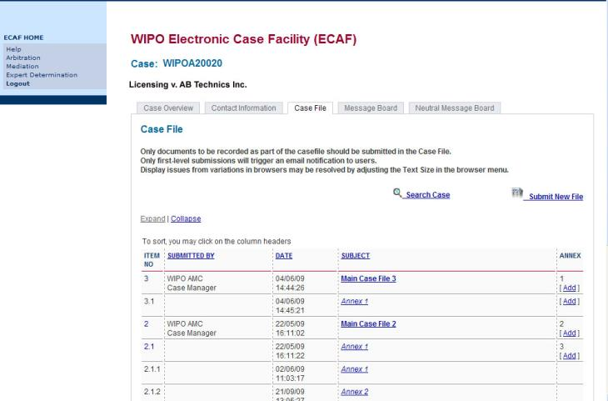
WIPO Electronic Case Facility (ECAF)
Easy; instant; centralized; location-independent; secure; available at parties’ option

Slide 121
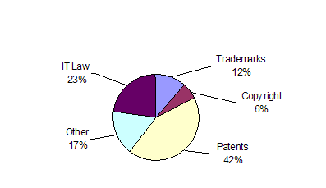
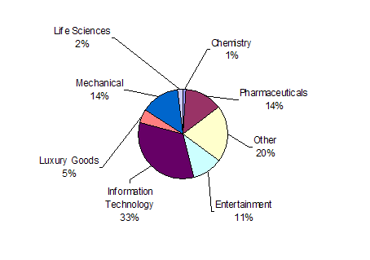
WIPO Cases
Subject Matter
Business Areas

Slide 122
Typical Subject Areas of WIPO Cases
Contractual
  patent licenses
  software and other information technology
  research and development agreements
  trademark coexistence agreements
  patent pools
  distribution agreements
  joint ventures
  copyright collecting societies
  IP settlement agreements
Non-contractual infringement of IP rights

Slide 123
WIPO Mediation Example 1 (I)
US company/Swiss company
Patent infringement dispute related to US patents owned by US company in automotive sector
Settlement agreement 2007
Dispute resolution clause: WIPO Mediation followed if necessary by WIPO Arbitration
Request for mediation in 2009
WIPO proposed a shortlist of candidates
Parties chose from such list a patent practitioner, fluent in English, with knowledge of US patent law and experience in patent infringement mediation

Slide 124
WIPO Mediation Example 1 (II)
Two-day session in Geneva at WIPO
Mediator explained ground rules of the session (e.g. confidentiality, caucus) and his role
Early agreement on framework for royalty payments
Final Settlement:
  ‘Term sheet’: down payment, annual instalments, net sales-based royalty
  Re-drafted original licensing agreement, final agreement by September 2009
End of two-year dispute within 5 months, parties avoided (US) arbitration, option of further collaboration

Slide 125
WIPO Mediation Example 2 (I)
Patent infringement dispute
  R&D company holding patents disclosed patented invention to manufacturer during consultancy
  No transfer or license of patent rights
  Manufacturer started selling products which R&D company alleged included patented invention
  Negotiation patent license failed
  Parallel infringement proceedings in several jurisdictions?
Parties submitted to WIPO Mediation

Slide 126
WIPO Mediation Example 2 (II)
WIPO appointed an experienced mediator with expertise in the subject matter of the dispute
Parties and mediator met during one week
Settlement agreement reached, including grant of license for royalties, and a new consultancy agreement
Process duration: 4 months
Mediator fees: USD 24,000

Slide 127
WIPO Arbitration Example 1
Finance agreement in connection with artistic production
  German party - Swiss/Panamanian party
  WIPO Expedited Arbitration clause
  Each represented by US lawyers
Urgent solution required: issue of contract interpretation under German law
WIPO appointed Germany-based US arbitrator
Short deadlines for written submissions
One-day hearing
Award rendered five weeks after case commenced

Slide 128
WIPO Arbitration Example 2
Major agreement for creation of web presence for national newspaper
  WIPO Mediation followed by WIPO Expedited Arbitration
Mediator appointed; no settlement, but mediation narrowed down and informed the issues
Arbitrator appointed; parties settled after hearing
Total timeframe: within eight months from commencement

Slide 129
Examples of Tailored WIPO ADR for Specific Sectors
Domain Names (45,000+ cases since 1999)
Film and Media
Intellectual Property Offices (ADR options for parties in administrative procedures before the Office)
Research and Development/Technology Transfer
http://www.wipo.int/amc/en/center/specific-sectors/

Slide 130
WIPO International Survey on Dispute Resolution in Technology Transactions
Place of Survey Respondent
Business Operations
Type of Survey Respondent
Notes:
Question 7

Slide 131
Scope of Agreements: Parties/Technology
91% of respondents conclude agreements with parties from other jurisdictions.
+80% of respondents conclude agreements relating to technology patented in multiple jurisdictions.

Slide 132
Top Ten Considerations in Choice of Dispute Resolution Clause
Domestic Contracts | International Contracts
Costs – 71% | Costs – 71%
Time – 59% | Time – 57%
Quality Outcome – 44% | Enforceability – 53%
Confidentiality – 33% | Quality Outcome – 44%
Enforceability – 33% | Neutral Forum – 36%
Business Solution – 30% | Confidentiality – 32%
Neutral Forum – 18% | Business Solution – 29%
None in Particular – 9% | Support Provided by Institution – 9%
Setting Precedent – 6% | None in Particular – 6%
Support Provided by Institution – 6% | Setting Precedent – 5%

Slide 133
How Are Technology Disputes Resolved?

Slide 134
Relative Time and Cost of Technology Dispute Resolution

Slide 135
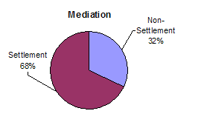
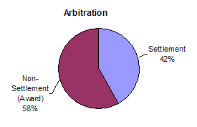
Settlement in WIPO-Administered Cases

Slide 136
WIPO Recommendations from Survey Results
Contracting on technology should anticipate disputes
Dispute policy should prepare for likelihood of international aspect in parties, rights, and law
Dispute policy should be designed to minimize time and cost, more than other considerations
Dispute policy should include mediation
Between arbitration and court litigation, consider arbitration as the faster and cheaper option
When choosing arbitration, subject to dimension of dispute, consider expedited versions
In non-contractual disputes, there is scope for greater use of party negotiation and mediation

Slide 137
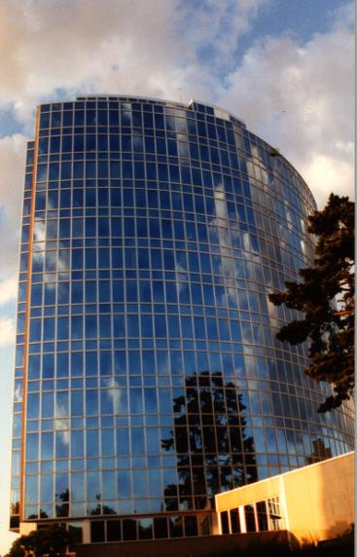
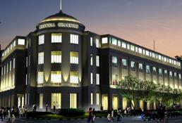
Information and WIPO Contract Clauses
wipo.int/amc
arbiter.mail@wipo.int
WIPO Center Office in Geneva
WIPO Headquarters
+41 22 338 8247
WIPO Center Office in Singapore
Maxwell Chambers
+65 6225 2129

Slide 138

Global Databases for IP Platforms and
Tools for the Connected Knowledge Economy
Speaker: Christophe Mazenc, Director, Global Databases Division, Global Infrastructure Sector

Slide 139
Strategic Goals of Global Databases and Tools
2 related goals:
  “Coordination and Development of Global IP Infrastructure”
  “World Reference Source for IP Information and Analysis”

Slide 140
Benefits to Stakeholders
For Business/Research:
  Providing search facilities for IP collections (patents, trademarks, industrial designs)
  Simplifying application procedures to multiple IP authorities
  Providing IP related matchmaking services
For IP offices:
  Assisting automation, IP information dissemination to the public, and exchange of IP documents with other offices

Slide 141

GLOBAL DATABASES, TOOLS, AND PLATFORMS FOR IP BUSINESS (FREE)
PATENTSCOPE
Global Brand Database
Global Design Database
WIPO Lex
WIPO Pearl
WIPO IPAS, WIPO DAS
WIPO CASE
WIPO RE:SEARCH
WIPO GREEN

Slide 142
PATENTSCOPE
2.6 million published PCT applications (first publish every week, high quality full text)
41 million patent applications from 40 countries or regions
Full text data from 20 countries or regions
15,000 pageviews per hour
Analyze results by graphs and charts
Search and read in your language

Slide 143



Slide 144



Slide 145


Electric car - only 16,000 hits
Search Query
(synonyms & technologically related terms)

Slide 146


Slide 147

???

Slide 148


Slide 149


Slide 150





PATENTSCOPE what’s new?
Possibility to export the 10’000 first bibliographic data records of any search query in Excel format to build Patent Landscape reports
Q4 2014
  Inclusion in PATENTSCOPE of the complete full text of the national patent applications and grants from DPMA (more than 5'000'000 full text records)

Slide 151

German decompounder
Special care has been taken to index efficiently compound words in German language
Example: WO2014/00729
Gasballongetragener Flugroboter
With decompounding, any of the following queries will match the WO2014/00729 document:
  “gasballon” AND “roboter”
  “gasballon” AND “flugroboter”
  “ballon“ AND “roboter”
  “getragener” AND “roboter”
Notes:
151

Slide 152
PATENTSCOPE what’s next?
New intuitive query syntax with placeholders:
PCTPublishedLastNMonths
XXNationalPatentsForTheLastNWeeks
PCTReceivingOfficeXX
PCTHavingInventorFromXX
Coverage: Inclusion in PATENTSCOPE of
  the complete full text of the national patent applications and grants from KIPO in Korean Language
  National collections of New Zealand, Australia and United Kingdom

Slide 153

TAPTA

Slide 154


Slide 155



Slide 156

Monthly webinar

Slide 157
GLOBAL DATABASES, TOOLS, AND PLATFORMS FOR IP BUSINESS (FREE)
PATENTSCOPE
Global Brand Database
Global Design Database
WIPO Lex
WIPO Pearl
WIPO IPAS, WIPO DAS
WIPO CASE
WIPO RE:SEARCH
WIPO GREEN

Slide 158
GLOBAL BRAND DATABASE
16 million records relating to internationally-protected trademarks, etc.
Free of charge simultaneous brand-related searches across multiple collections, including:
  Trademarks registered under Madrid System
  Appellations of Origin registered under Lisbon System
  Emblems protected under the Paris Convention 6ter
  19 national collections and growing: AE, AU, BN, CA, CH, DK, DZ, EE, EG, ID, IL, KH, MA, MX, NZ, OM, PH, SG and US

Slide 159
Global Brand Database
Coming in 2015: JA, KR, RU
Video demo:
http://www.wipo.int/pressroom/en/articles/2014/article_0007.html

Slide 160




Global Brand Database – Features
Single intuitive interface to search 19 data collections
Image Search by example
Interactive & dynamic search with immediate feedback
Fuzzy, phonetic and word-stem matches
Automatic term suggestion
Easy search of US or Vienna image class
Full Boolean, proximity and range options
Unlimited, customizable results browsing
Saved searches and record sets
Instant, graphical data analysis

Slide 161



Slide 162


Slide 163





Slide 164


Slide 165




Slide 166


Slide 167





Slide 168
GLOBAL DATABASES, TOOLS, AND PLATFORMS FOR IP BUSINESS (FREE)
PATENTSCOPE
Global Brand Database
Global Design Database
WIPO Lex
WIPO Pearl
WIPO IPAS, WIPO DAS
WIPO CASE
WIPO RE:SEARCH
WIPO GREEN

Slide 169
GLOBAL DESIGN DATABASE
URL: http://www.wipo.int/designdb
Launched on January, 9th 2015.
Free of charge simultaneous design-related searches across multiple collections, including:
  designs registered under the Hague System
  national design collections of CA and NZ
  other national collections to be added in the future

Slide 170


Slide 171


Slide 172
GLOBAL DATABASES, TOOLS, AND PLATFORMS FOR IP BUSINESS (FREE)
PATENTSCOPE
Global Brand Database
Global Design Database
WIPO Lex
WIPO Pearl
WIPO IPAS, WIPO DAS
WIPO CASE
WIPO RE:SEARCH
WIPO GREEN

Slide 173


Slide 174


Slide 175


Slide 176


Slide 177
GLOBAL DATABASES, TOOLS, AND PLATFORMS FOR IP BUSINESS (FREE)
PATENTSCOPE
Global Brand Database
Global Design Database
WIPO Lex
WIPO Pearl
WIPO IPAS, WIPO DAS
WIPO CASE
WIPO RE:SEARCH
WIPO GREEN

Slide 178

WIPO Pearl
WIPO’s online terminology database
15’000 concepts, 90’000 terms
10 languages
Contents validated by WIPO language experts and terminologists
http://www.wipo.int/wipopearl/search/home.html

Slide 179
GLOBAL DATABASES, TOOLS, AND PLATFORMS FOR IP BUSINESS (FREE)
PATENTSCOPE
Global Brand Database
Global Design Database
WIPO Lex
WIPO Pearl
WIPO IPAS, WIPO DAS
WIPO CASE
WIPO RE:SEARCH
WIPO GREEN

Slide 180
IPAS AND DAS
IPAS (IP office Administration System) used by 60 IPOs
A WIPO software enabling small IPOs to electronically process patent, trademark, design applications
DAS (Digital Access System) used by 11 IPOs
A System that allows IPOs and applicants to securely exchange or submit a digital copy of priority documents to multiple IPOs
Notes:
Those are software systems developed and maintained by WIPO for IP offices of its member states.
The first one IPAS, which is an acronym for IP Office Administration System) is used by 60 small IP offices and enable them to electronically process patent, trademark and design applications.
The second one is named DAS, which stands for Digital Access System, is used by 11 IP offices and allows them and their applicants to securely exchange certified digital copies of priority documents among themselves.

Slide 181
GLOBAL DATABASES, TOOLS, AND PLATFORMS FOR IP BUSINESS (FREE)
PATENTSCOPE
Global Brand Database
Global Design Database
WIPO Lex
WIPO Pearl
WIPO IPAS, WIPO DAS
WIPO CASE
WIPO RE:SEARCH
WIPO GREEN

Slide 182
WIPO CASE
“Centralized Access to Search and Examination Reports”
Started with an initiative of IP Australia and the Vancouver Group (AU, CA, UK)
Online patent work-sharing platform for patent examiners worldwide—secure sharing search and examination documentation
IPOs can enhance quality and efficiency of patent examination
CASE will be linked to Open Portal Dossier of IP5 to become the Global Portal Dossier

Slide 183


Slide 184




GLOBAL DOSSIER PLATFORM (WIPO-CASE, OPD AND PATENTSCOPE)
Public Users
(including IP office users)
Examiner of IP5 Office not participating in WPO/CASE
OPD
Feed dossier information that OPD/CASE Offices agree to publish
Public Domain
OPD
WIPO CASE
Not accessible to the public and for PTO official use only
IPAS+
CASE depositary
System
Examiner of CASE participating office
Examiner of IP5 Office participating in WPO/CASE
CASE depositary Office using IPAS
CASE depositary Office using own EDMS
E.g. Australia

Slide 185
GLOBAL DATABASES, TOOLS, AND PLATFORMS FOR IP BUSINESS (FREE)
PATENTSCOPE
Global Brand Database
Global Design Database
WIPO Lex
WIPO Pearl
WIPO IPAS, WIPO DAS
WIPO CASE
WIPO RE:SEARCH
WIPO GREEN

Slide 186


Broad aims:
  Match-making for technology transfer and collaborations
  Reduce transaction costs
  Build on comparative advantages of multi-stakeholder approaches
  Demonstrate practical means for the global policy issues
Based on the recognition that:
    Users want access to technologies, not just patent rights
    Collaboration (e.g. training) is crucial to tech transfer

Slide 187

WIPO RE: SEARCH
A Global Database and Platform to bridge partners to use IP (including know-how and data) to facilitate R&D on neglected tropical diseases, tuberculosis, and malaria.
Royalty-free for R&D, manufacture and sale in LDCs
Over 90 partners (pharmaceutical industry, research institutes such as NIH, Universities)
As of January 2015, 82 collaborations

Slide 188













WIPO RE:SEARCH
Sharing Innovation in the Fight Against Neglected Tropical Diseases
Get involved:
As a user
As a provider
As a supporter
(Adhere to Guiding principles, contact email: re_search@wipo.int)
…

Slide 189
WIPO GREEN
A global database allowing users to make green technologies available for licensing or partnership, enter technology needs, search for technologies and needs
Started a pilot with Japan Intellectual Property Association in 2011
Launched in November 2013
as of January 2015, over 1700 offers
Green tech providing companies in Germany, Japan, US etc.
Partners include companies, universities, UN agencies, governments, IPOs, NGOs, etc.

Slide 190






























Partners of WIPO GREEN

Slide 191

www.wipo.int/green

Slide 192

Six Areas of Green Technology Markets

Slide 193

The Challenge
International Transfer of wind power technology, 1988-2007,
OECD 2010

Slide 194
Get Involved
Become a Partner and shape the further development of WIPO GREEN
Register to:
    communicate your green innovation and technology needs
    advertise your inventions, technologies, products and services
    connect with the innovation and business communities globally

Slide 195
Thank you for your attention

