Slide 1
HOW EDUCATION CAN CLOSE THE GENDER GAP
THE INTERNATIONAL CONFERENCE OF WIPO INTELLECTUAL PROPERTY TRAINING INSTITUTIONS
Narcis Tejada
Head of the National Intellectual Property Academy
Dominican Republic

Slide 2
In 2011, the Dominican Republic signed an agreement to open the National Intellectual Property Academy with WIPO.

Slide 3
TRAINING OF TRAINERS
Through a WIPO ‘training of trainers’ program with six modules, 19 professionals were trained and certified. They then went on to become Academy trainers.

Slide 4
TRAINING ACTIVITY STATISTICS 2011-2022
YEAR | NUMBER OF ACTIVITIES | NUMBER OF PARTICIPANTS
2011 | 3 | 88
2012 | 12 | 268
2013 | 16 | 420
2014 | 20 | 617
2015 | 44 | 1,287
2016 | 25 | 830
2017 | 99 | 2,890
2018 | 117 | 4,295
2019 | 143 | 3,341
2020 | 47 | 1,513
2021 | 154 | 5,921
2022 (up to May 15) | 72 | 2,442

Slide 5
TOTAL TRAINING ACTIVITIES
554
TOTAL PARTICIPANTS
16,969

Slide 6
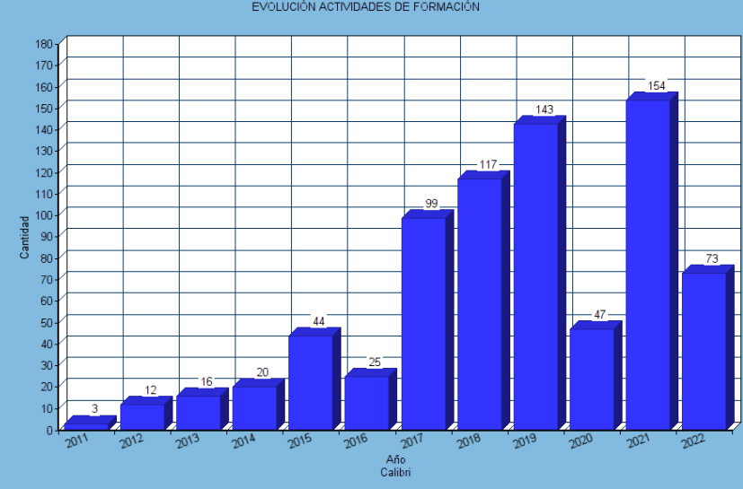
NUMBER OF ACTIVITIES OVER THE YEARS

Slide 7
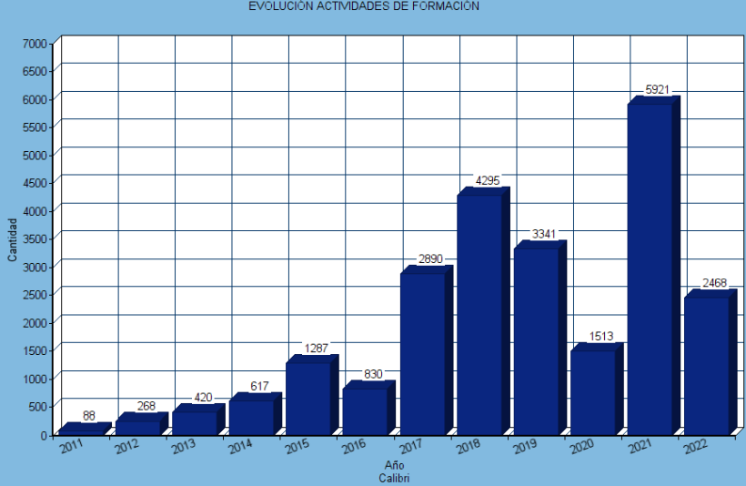
NUMBER OF PARTICIPANTS OVER THE YEARS

Slide 8
PEOPLE TO WHOM THE TRAINING IS AIMED
High school students
Inventors
Entrepreneurs
University students
Researchers
MSMEs
Professors

Slide 9
HOW EDUCATION CAN CLOSE THE GENDER GAP

Slide 10
Gender discrimination
Lack of incentives
Imbalance between work and family life
Source: https://www.ieie.eu/retos-de-las-mujeres-emprendedoras-latinoamericanas/

Slide 11
WOMEN INVENTORS
Patents belonging to women in the Dominican Republic
Percentage of patent applications in which women participated in 2017
82%
18%
Source: Department of Inventions, National Office of Industrial Property (ONAPI)

Slide 12
Essential factor: EDUCATION

Slide 13
Higher education statistics, Dominican Republic
2010-2018
SEX | NUMBER
Female | 1,906,785
Male | 1,096,752
Total | 3,003,537
Source:
https://mescyt.gob.do/transparencia/wp-content/uploads/2018/11/INFORME-DE-ESTADI%CC%81STICAS-2017.pdf

Slide 14
LACK OF STEM CAREERS
2017
Chemical engineering : 100
Degree in physics : 21
Degree in biology : 16
Biotechnology : 3

Slide 15
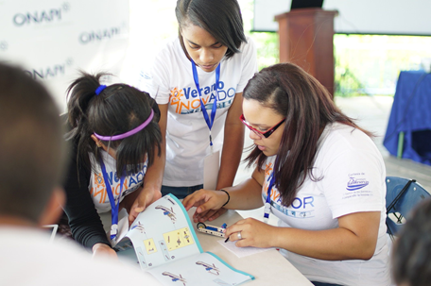
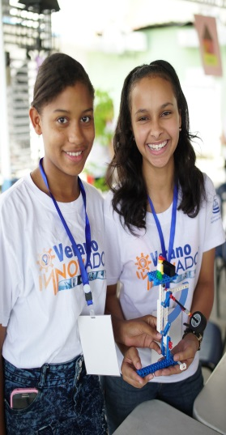
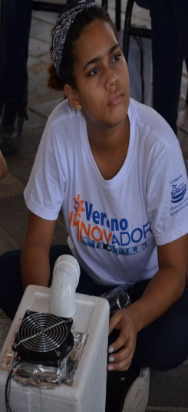
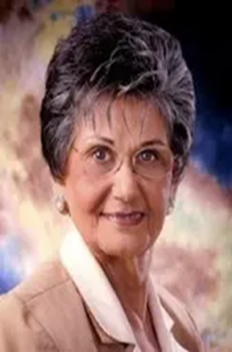
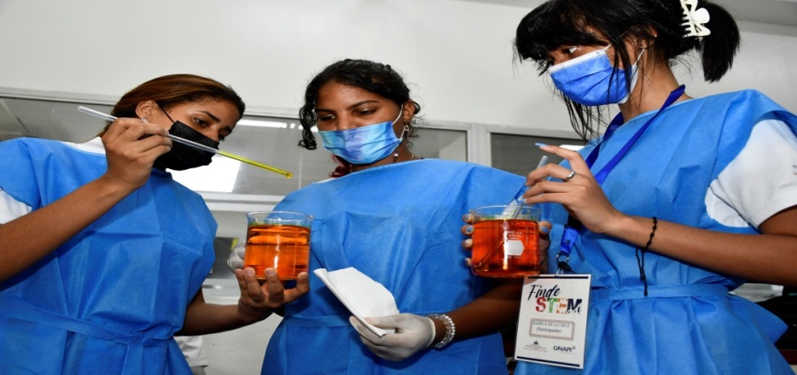
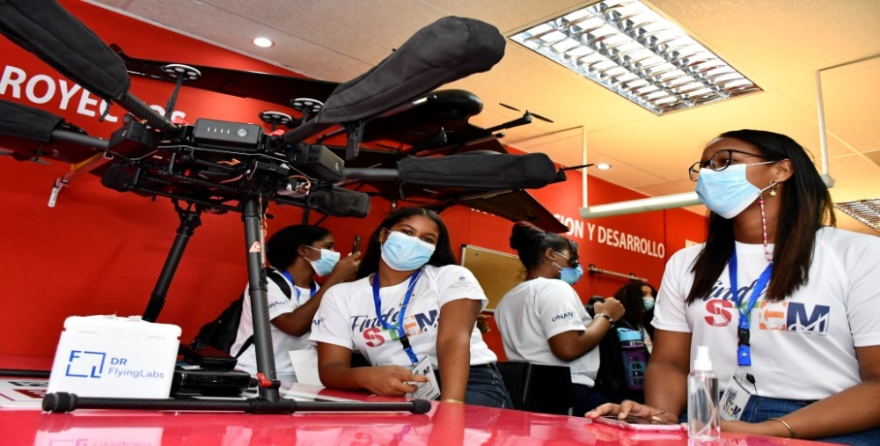
WOMEN IN STEM CAREERS: Introduction of women to science and technology and immersion in industrial property
In response, ONAPI is carrying out the INNOVATOR SUMMER CAMP. With the support of public and private institutions, it aims to encourage high-achieving students to learn about and become interested in the world of patents and STEM careers.

Slide 16
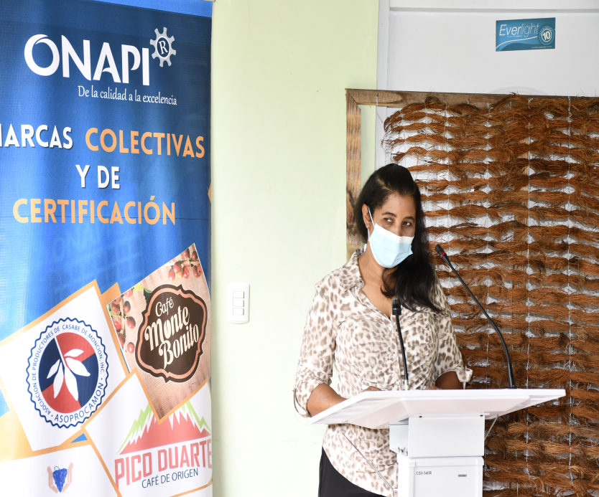
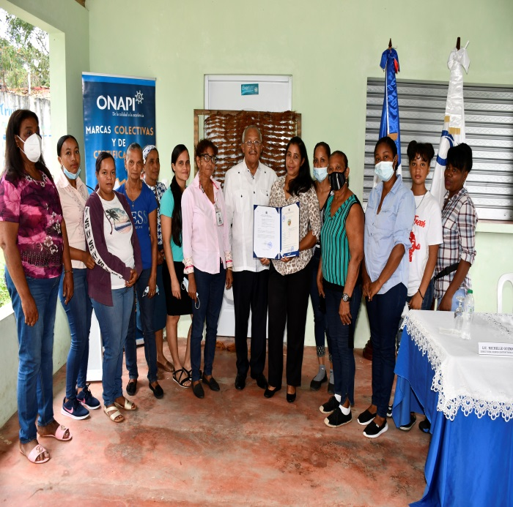
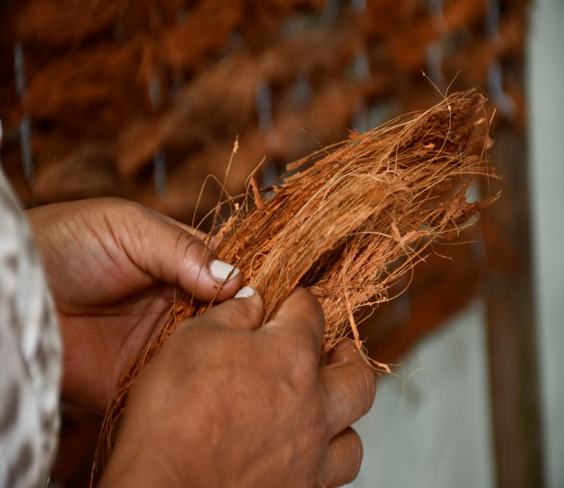
ENTREPRENEURIAL AND CREATIVE WOMEN: Distinctive signs to help female entrepreneurship
Collective mark granted to the Hatillo Women's Association

Slide 17
WOMEN INVENTORS Patents as a tool for competitiveness
Sharely Acevedo, chemical engineer
AUTOMATIC CUP VISCOMETER
This is an automatic flow cup viscometer. It is portable and has a modern design and a practical function. It is quick and effective and measures the kinematic and dynamic viscosity of liquids to gage the quality of oils, paints and varnishes.

Slide 18
WOMEN DESIGNERS Industrial designs to protect creativity

Slide 19
WHAT ARE WE DOING?
Creating links with the private sector, industry and free trade zones.

Slide 20
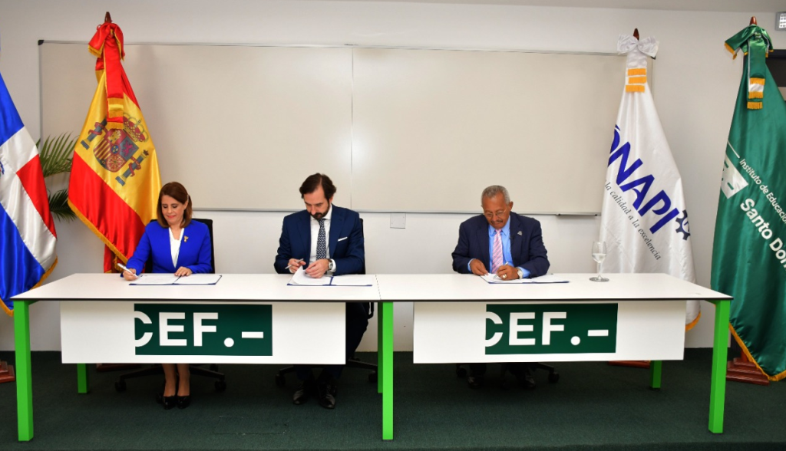
WHAT ARE WE DOING?
Signing an agreement for an intellectual property diploma and other training programs

Slide 21
WHAT ARE WE DOING?
CAPACITY-BUILDING PROJECT FOR SMES
In the framework of the COVID-19 package.
In partnership with the WIPO Academy.

Slide 22
SCOPE
IP outreach activities for children
Specific programs for technical groups
Open curriculum design
Accreditation by the Ministry of Higher Education, Science and Technology (MESCYT)

Slide 23
THANK YOU FOR YOUR ATTENTION
Narcis Tejada
National Intellectual Property Academy (ANPI)
Dominican Republic
n.tejada@onapi.gob.do

