Slide 1




UKRAINE
BOOTH COPY – CONFIDENTIAL – CHECK AGAINST DELIVERY
National IP Training Center of
Ukraine
IP Academy
Intellectual Property Academy Department
State Enterprise "Ukrainian Intellectual Property Institute" (UKRPATENT)

Slide 2


In the framework of the implementation of the IP Academy
under the MoU between the WIPO and the Ministry of Economy of Ukraine, signed on October 03, 2019:
developed and approved the Project Document on the establishment of the National IP Training Center in Ukraine;
developed and approved the Business Plan 2022-2025;
developed IP courses in English in cooperation with the WIPO Academy;
held ToT for the preselected group of national trainers;
establishment of the IP Library.
Status: Academy in progress

Slide 3


IP Academy audience:
Children and Youth
Scientific and pedagogical staff of educational institutions
Representatives of the public sector
Students
Representatives of small and medium enterprises and startups
Representatives of the legal sphere and specialists in the field of IP

Slide 4


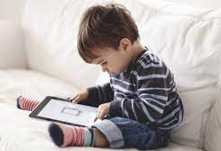

Modern generations of children differ significantly from predecessors
early familiarity / late familiarity with technologies
high information load / low and moderate information load
immersion in the virtual world / real outdoor games
ease of meeting needs / efforts to meet needs
reduced creativity / high creativity

Slide 5



In modern aspects of education, new ways of communicating information are in the lead
Since high school children do not have a special subject in Ukraine on intellectual property, but only acquire knowledge based on the study of law and practical life experience, we used gamification to prepare materials for children as the main way to convey information.

Slide 6



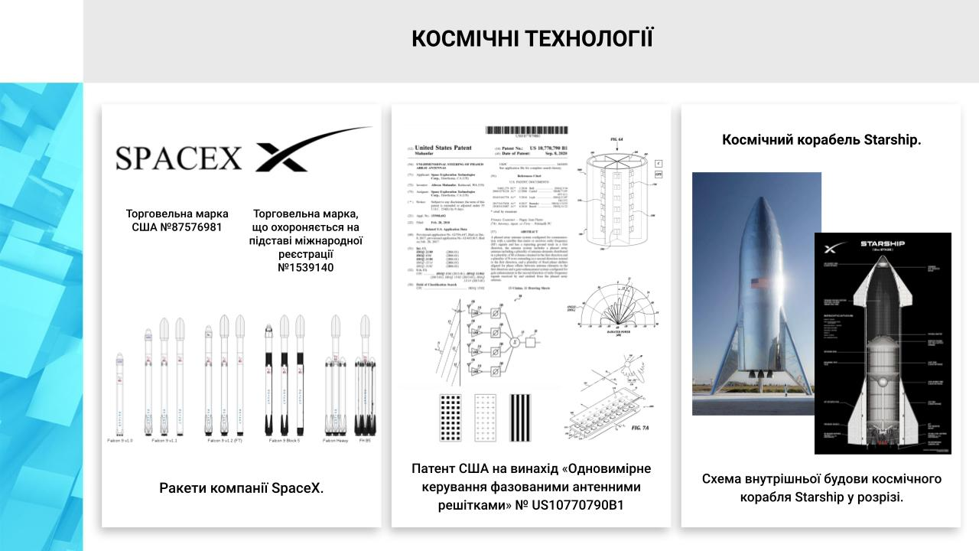
Events
Online and Offline
More than 80 online and offline educational events, including interactive games, poster contests, offline classes, online lectures using both author's developments and offered materials.
More than 4,000 people, including students and schoolchildren participated.

Slide 7
Online lectures and seminars on current issues
IP for students
Some of on-line events:
GameDev and IP in cooperation with the Polish Patent Office;
IP Commercialization for students of HEI, including:
Law Clinic at the National University "Odessa Law Academy";
Taras Shevchenko National University and Bohdan Khmelnytsky National University;
Vasyl Stus Donetsk National University, Vinnytsia;
Engineering and Pedagogical Academy, Kharkiv and other.
Online webinar:
Academic integrity in hiegher educational institutions as a norm or a new challenge for the subjects of the educational process.
IP Mediation

Slide 8
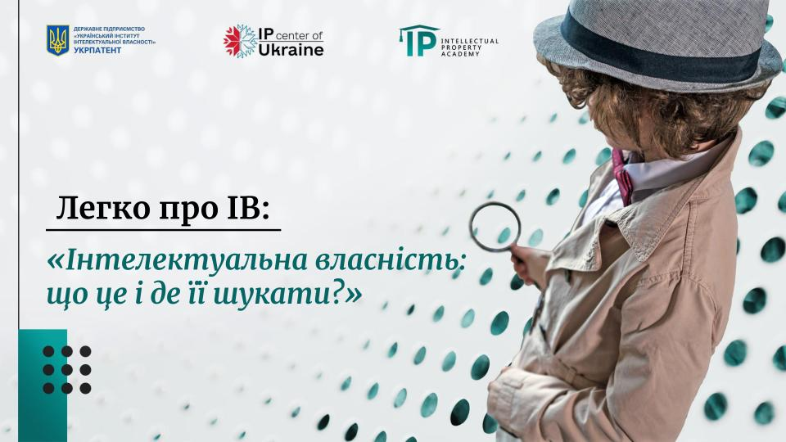
Trainings for schoolchildren:
Online seminar on “IP Basics".
As part of the celebration of the Day of Inventor and Innovator for Children held an open lesson on the basics of IP on the basis of the National Ecological and Naturalistic Center for Student Youth (NENC).
Online webinar on the topic of academic integrity for secondary schools.
A series of lessons-seminars for children of secondary and high school. The meetings took place in schools of Kyiv.
Lessons for children of Ukrpatent staff.

Slide 9


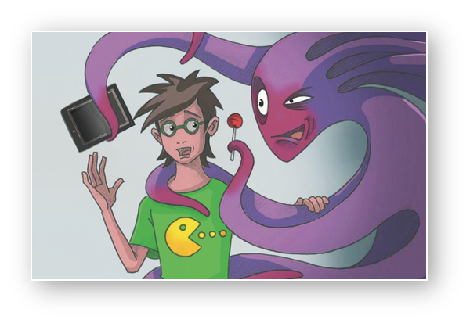
Comic manga for children on the basics of IP law
A series of comics on copyright, brands and technologies in modern and accessible languages ​​has been prepared for children and adolescents. The publication was made by Ukrpatent and the Ministry of Economy as part of the implementation of the project "Application and implementation of the EU-Ukraine Association Agreement in the field of trade", implemented by the German federal company Deutsche Gesellschaft fur Internazionale Zusammenbereit (GIZ) GmbH on behalf of the German government. The beneficiary of the project is the Ministry of Economy.

Slide 10

IP Library
A library with foreign and Ukrainian literature in the IP field was created on the basis of the WIPO Depository Libraries project in the Ukrainian National IP Training Center.
To date, with the support of WIPO, about 96 books have been sent to the National IP Academy. In the future, by pooling the resources of WIPO and Ukrpatent (Public Patent Literature Fund), it is possible to expand the library and access of citizens / participants of trainings and training programs of the IP Academy to high-quality books and reference books.
After completing the process of creating and filling the library, registered users will be given access in offline format.

Slide 11
Future plans and goals
Use IP Academy resources for the rehabilitation of children and adults affected by the war in Ukraine with the help of IP
Restore the regularity of online educational activities (at least 40 / year)
Resume work on training projects for patent attorneys, business and IP stakeholders (more than 6 training programs have already been prepared)
Hold 2 all-Ukrainian competitions to support inventors and creators (competition for students and pupils, and online marathon)
Complete the IP library project and open access to all applicants
Complete Training of Trainers for the National IP Training Center (interrupted due to war)
Strengthen cooperation with partners from foreign IP Training Centers (now in progress☺)

