Slide 1
TRINIDAD Y TOBAGO – Nicholas Gayapersad
BOOTH COPY – CONFIDENTIAL – CHECK AGAINST DELIVERY

Slide 2
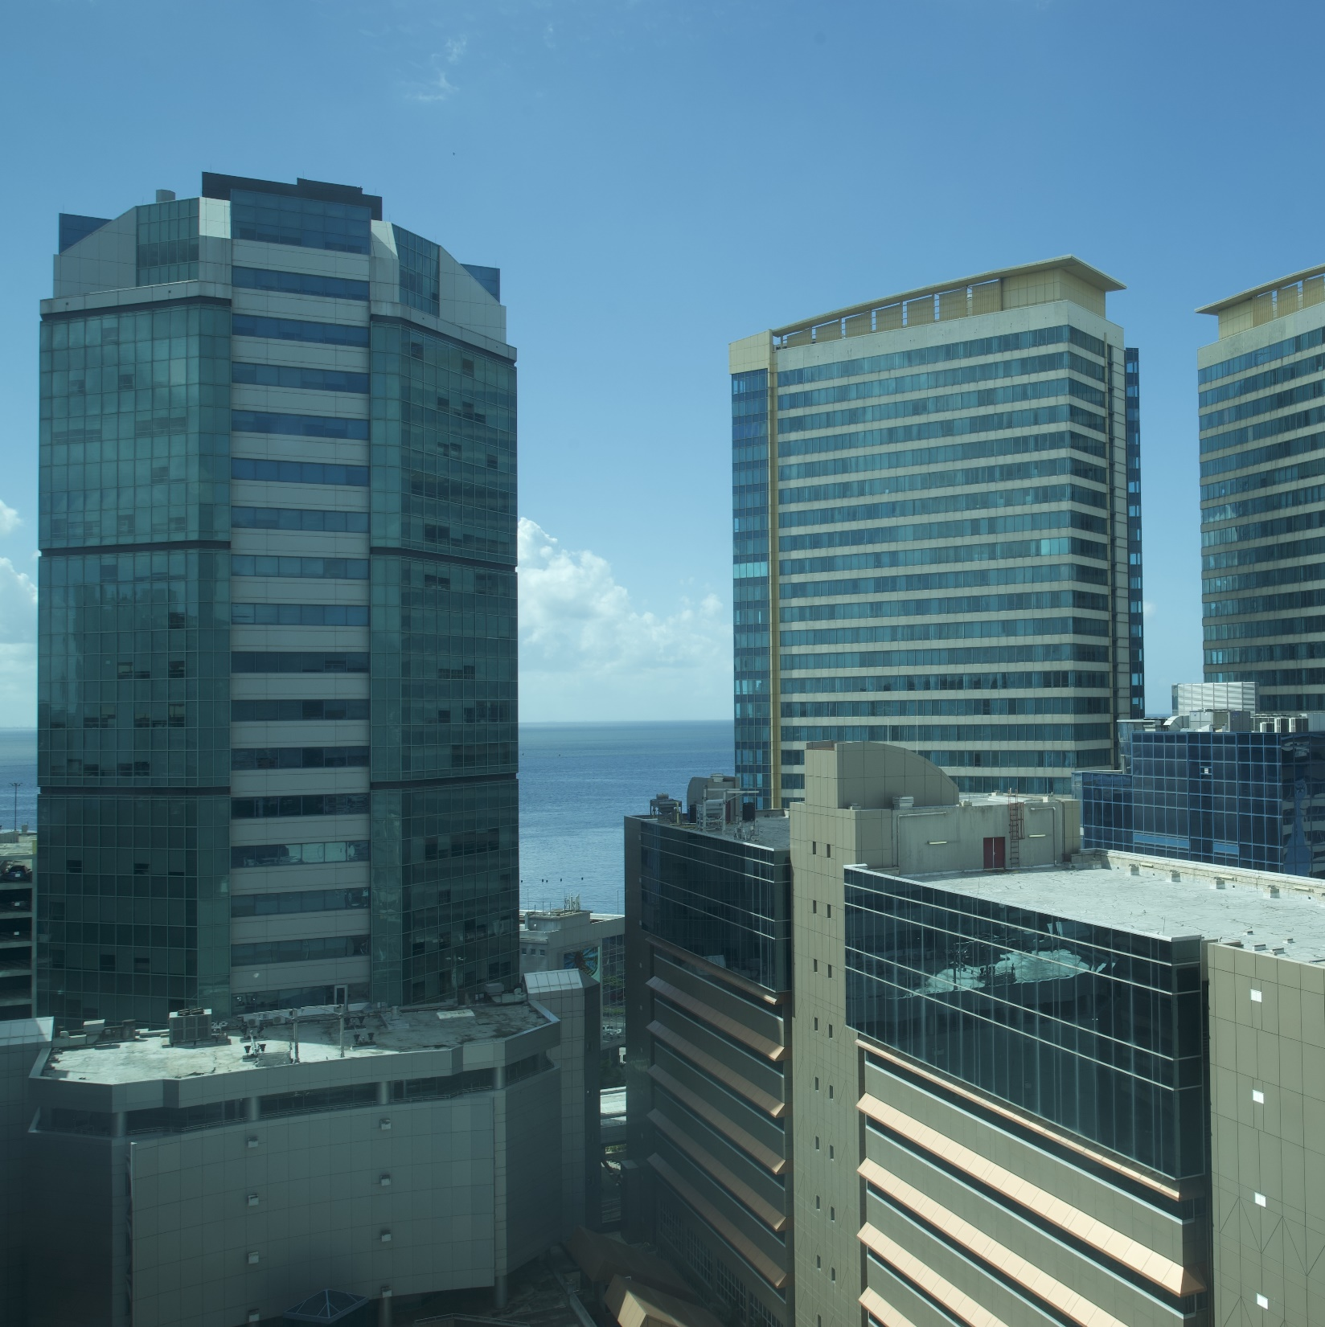
The Trinidad and Tobago National Intellectual Property Training Center
Presented by:
Mr Regan Asgarali, TTIPO
Ms Laura D’abreau, CARIRI
Mr Nicholas Gayahpersad, TTIPO

Slide 3
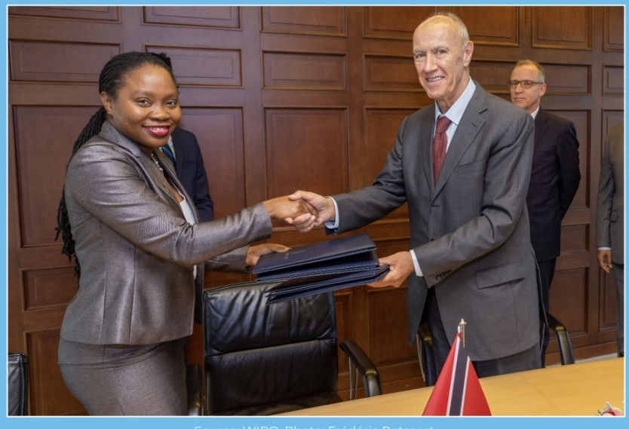
The Mandate
The Trinidad and Tobago Intellectual Property Office (TTIPO) with respect to education, is responsible for making Intellectual Property information available to the public.
Since its creation, the TTIPO has engaged in numerous educational initiatives across Trinidad and Tobago.
In order to foster a culture of respecting IP, education, information and training needed to be formalized.
The TTIPO is currently integrating IP education into the curricula.
The Trinidad and Tobago Intellectual Property Office executed a MOU with WIPO towards the establishment of the NIPTC.

Slide 4
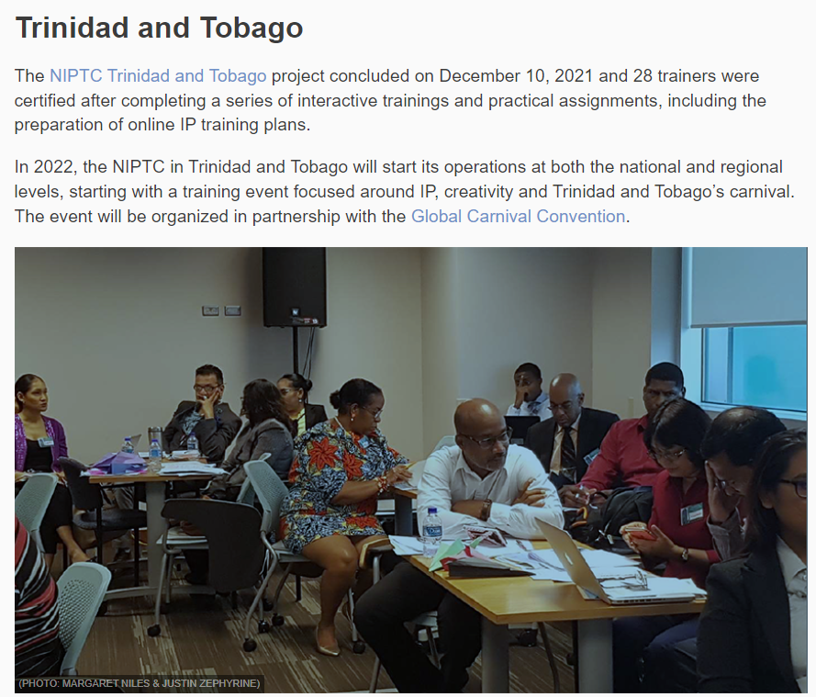
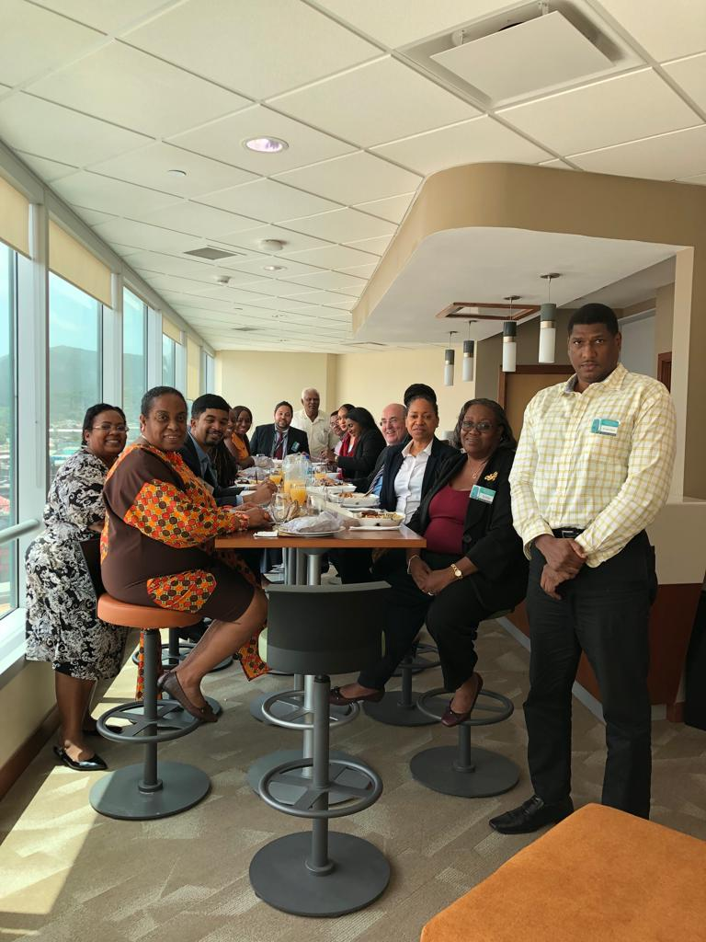

Slide 5
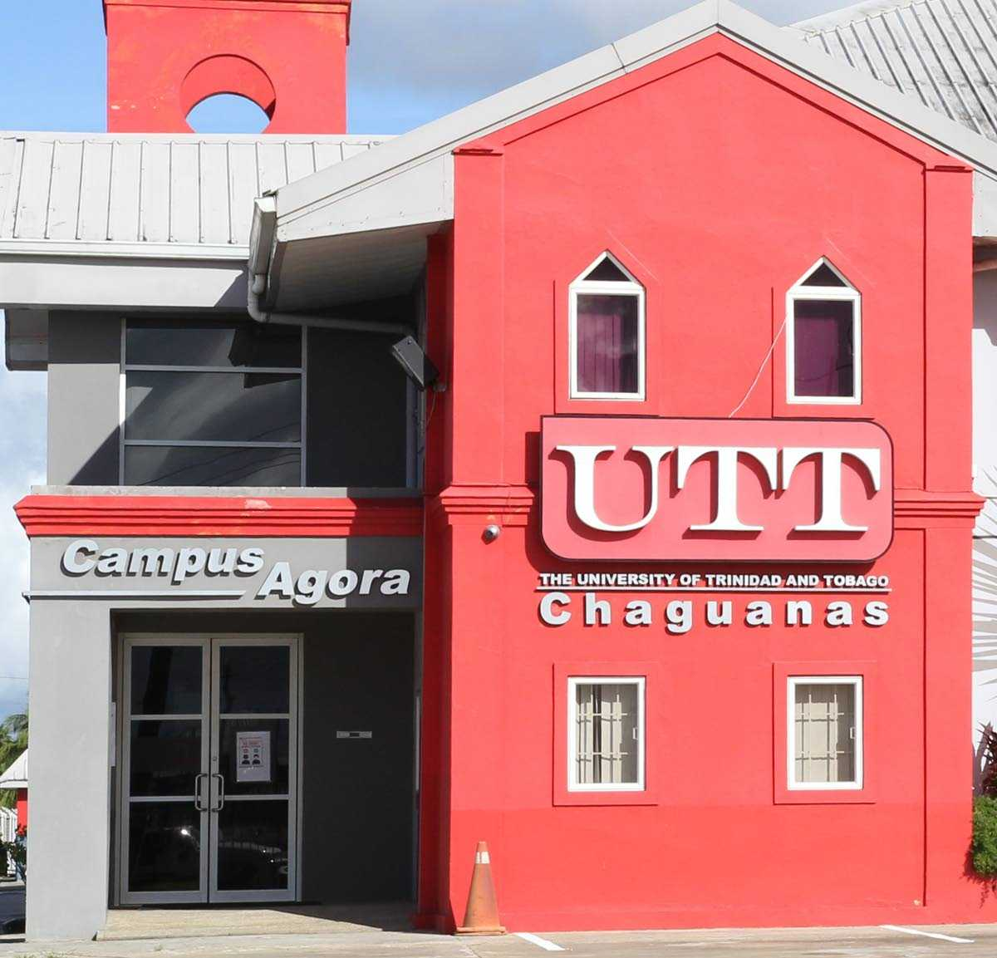
Upcoming Programmes
Introduction to Intellectual Property

Slide 6
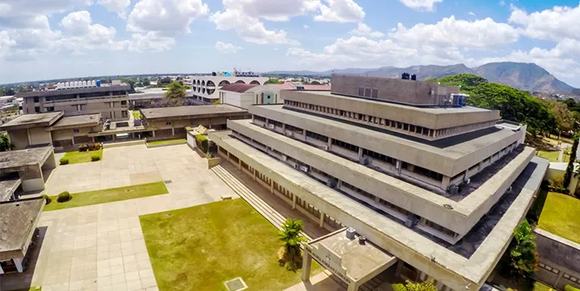
Proposed Programmes
Provision of professional development courses and an extra curricular course (Intro to IP) at a 3 weight at the University of the West Indies.
Intellectual Property and Enforcement for the Trinidad and Tobago
Police Service, Customs Division.
Intellectual Property for SMEs workshop to be held in collaboration with CARIRI on a yearly basis.
Development of an IP course for the Creative Industry with a focus on film, fashion, music and mobile apps.

Slide 7
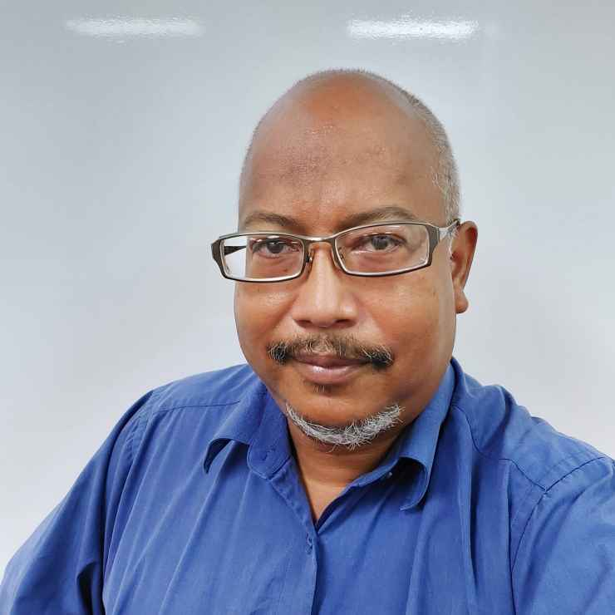
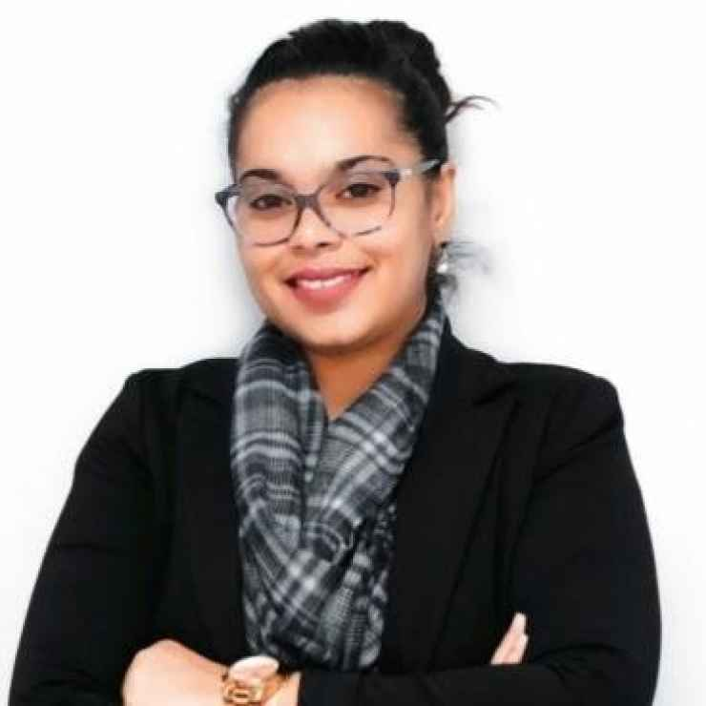
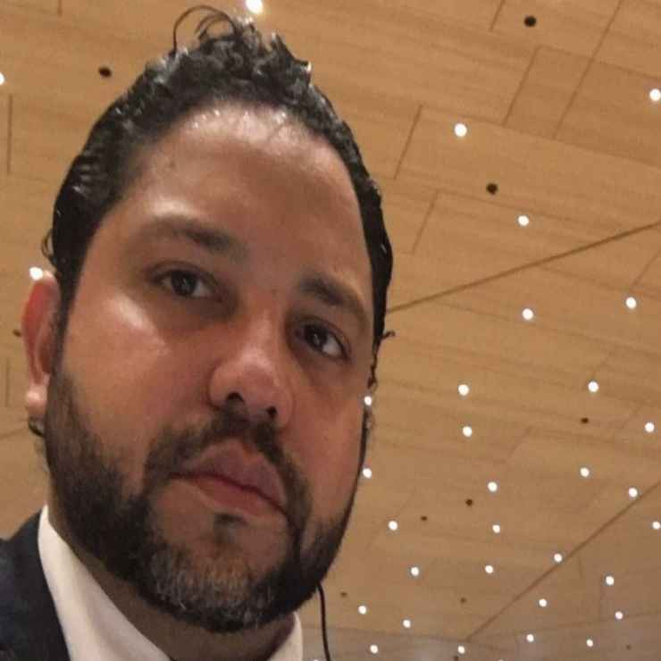
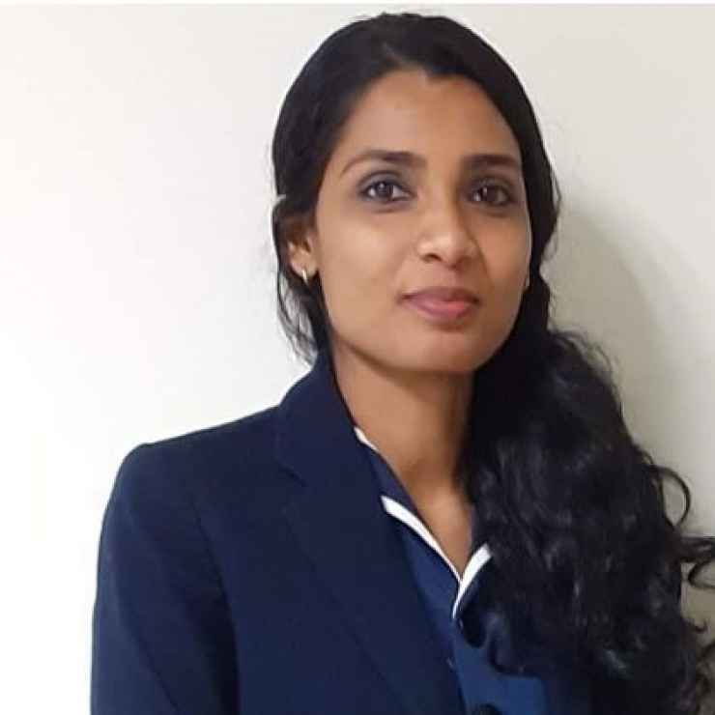
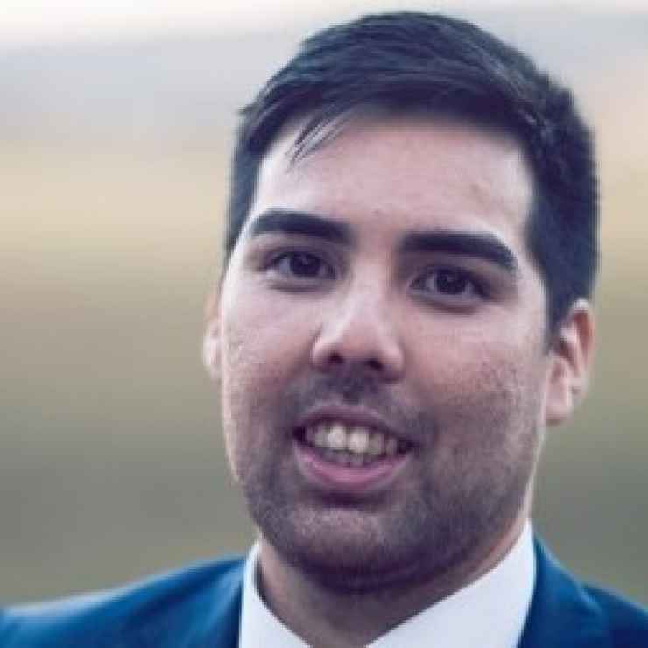
Our Trainers
On July 8th to 12th, 2019, the very first Train the Trainer Workshop for the establishment of the National Intellectual Property Training Centre (NIPTC) was held through the assistance of the World Intellectual Property Organization (WIPO) for the future administrative and teaching staff of the NIPTC.
28 persons became certified trainers for the NIPTC. Our trainers represent highly established professionals coming from both the public and private sector with backgrounds in Law, Science, Business and the Creative Arts.

Slide 8
The Food & Beverage workshop “The Recipe for Success”
On November 18th and 19th 2021, the TTIPO through the proposed NIPTC in collaboration with the Caribbean Industrial Research
Institute (CARIRI), hosted a two half-day virtual
workshop for entrepreneurs and SMEs in the Food and
Beverage industry.
Participants of this workshop had the opportunity to
learn about varying aspects of intellectual property in
particular, how they can utilize specific types of
intellectual property rights to safeguard their unique creations.
WIPO supported this workshop tremendously and was able to assist in securing Mr Sergio Chuez of INDECOPI to speak about IP and Gastronomy and also Mr Fernando Cano Trevino who spoke about the importance of Geographical indications.

Slide 9
Did the Food and Beverage workshop “Digest” well?
67% Female
33% Male
54
participants
Trinidad & Tobago
US
Caribbean
Stats for our culinary enthusiasts and aficionados in attendance

Slide 10
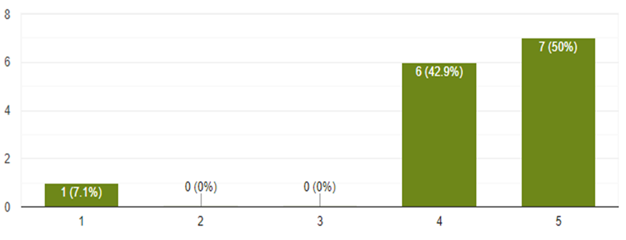
Did the Food and Beverage workshop “Digest” well?
93.8% found the information
to be useful
92.9% found the presenters to be of a high quality
92.9% found the quality of information to be of a high quality

Slide 11
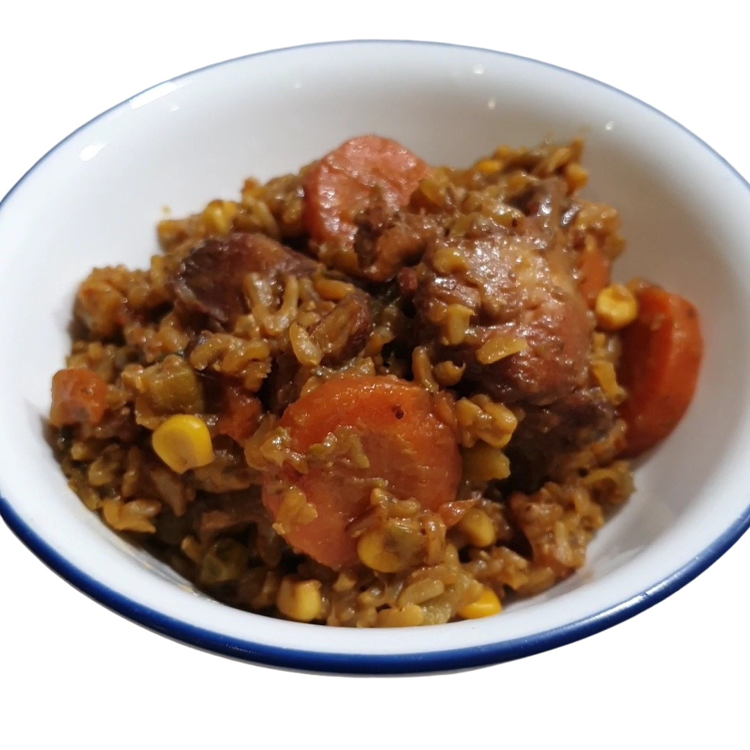
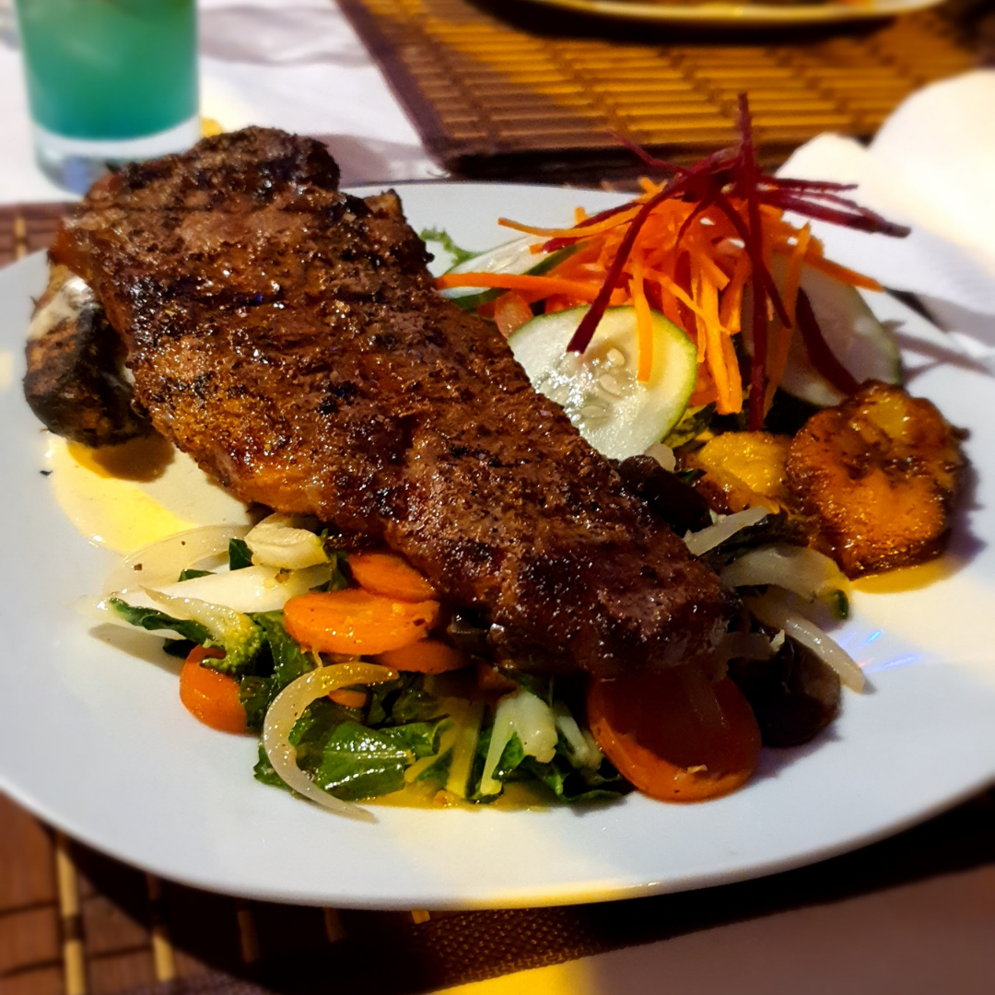
What Happened Next?
IP Clinic: TTIPO & CARIRI Collaborative Initiative
Product Standardization and Recipe Documentation
Exploration of the Implementation of Proper Food Safety Practices
Increased interest in Brand Protection

Slide 13
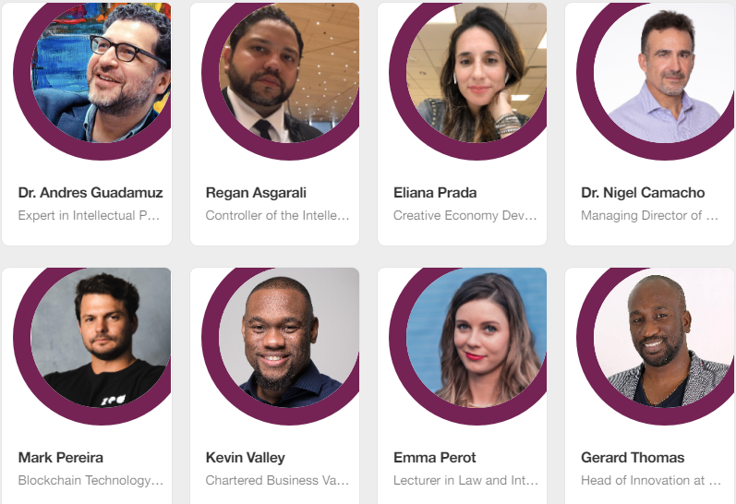
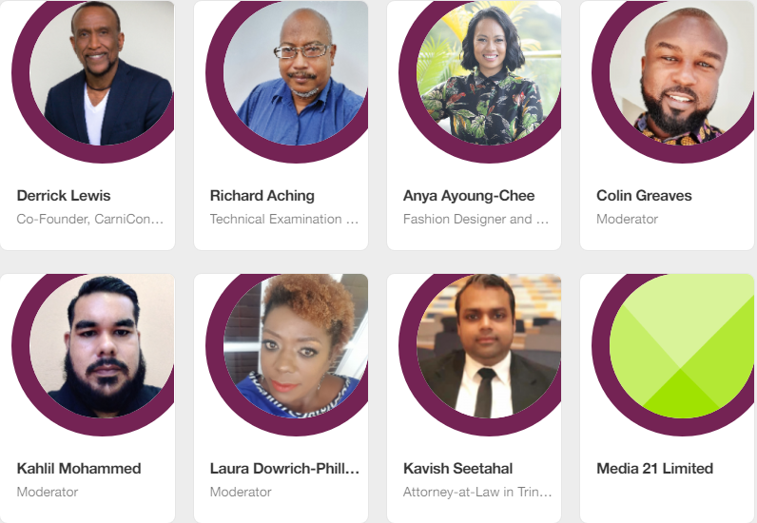
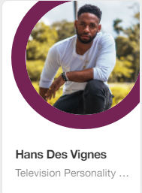
Masterclass On Identifying, Protecting, Valuing, And Earning From Your Creative Assets In Our Evolving Economy

Slide 14
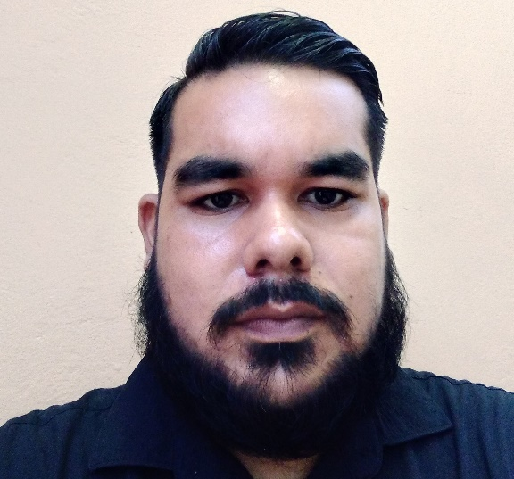
After coming up with the concept of the Ideas Empowered event, I approached TTIPO for a possible collaboration which was successful and snowballed into support by the WIPO Academy. Ideas Empowered provided content aimed at broadening the horizons of all creatives and was delivered in the form of powerful discussions on intellectual property rights and its application in the digital world and innovation; the exploration of opportunities in blockchain; & measuring value in creative industries. The event ended with a campfire discussion providing insight on how the various touch points discussed throughout the day could aid the development and growth of the Trinidad & Tobago Carnival Industry.
The WIPO Academy in this regard provided the support in the form of Dr. Andres Guadamuz, who as the event’s featured speaker provided genius insight on IP, Innovation and the Blockchain. The event also provided the platform for the launch of NIPTC, where TTIPO achieved the honor of having the 12th WIPO Academy IPTI in the world. The WIPO Academy and by extension the NIPTC has led by action in using Intellectual Property as a tool for the holistic development of human capital. With myself being involved in this industry from 2014 to present the impact of all WIPO’s global initiatives have been constantly recognized and appreciated. Recognition as well has to be extended as well to Mr. Regan Asgarali, Controller of TTIPO for his unwavering dedication in collaborating with WIPO to foster the development of TTIPO’s capabilities and operations, & in spearheading the national approach to Intellectual Property Awareness.
Mr. Kahlil Mohammed
Intellectual Property Consultant

Slide 15
1st IA filed through the TTIPO
Brazil
Japan
Canada
United States
of America
United Kingdom
European Union

Slide 17
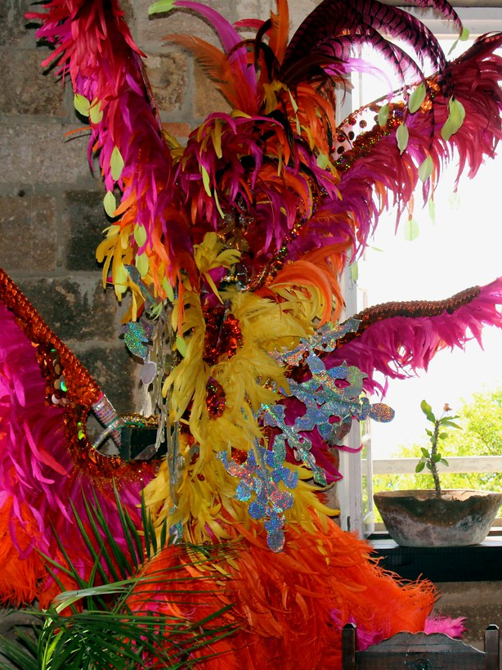
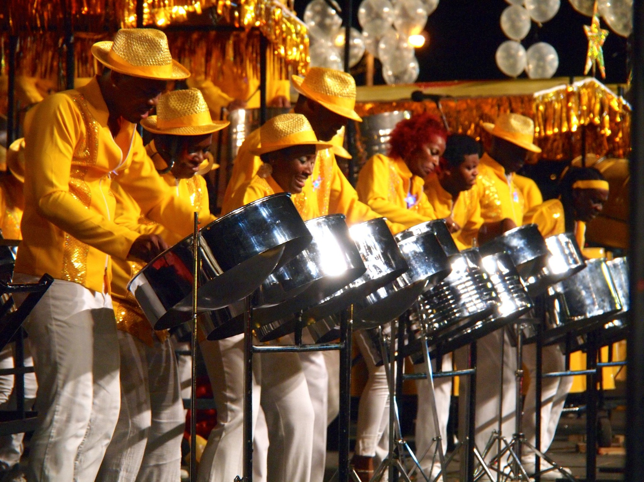
290 persons Registered
Topics covered had great potential to aid the Carnival Industry of Trinidad and Tobago
Peak attendance of 129
Discussions were held to make this a yearly event

Slide 18
Topics Covered
Intellectual Property: The key ingredient in Creation and Innovation
2. Panel Discussion: Maximizing Benefits from Intellectual Property Rights (Licensing,
Franchising, Merchandising, Inventors Rights, etc.)
3. Exploring the types of IP, how IP is protected and scope of protection
4. Demystifying NFT’s: The digital future of Creative Expression
5. Understanding the NFT Ecosystem
6. Smart Contacts & Marketplace Best Practice as the catalyst for IPR's in NFT's followed by the launch of the Modcomm NFT Marketplace (& initiatives)
7. Identifying, Quantifying & Monitoring Value in the Creative Economy
8. The Economic Power of Creativity & Culture
9. A Creative Industry Stakeholder Discussion
10. Fete of The Minds
11. Pivoting & Reinventing your Carnival Brand/Business
12. An All Inclusive “Mind-Fete” on the opportunities for Bands, Brands, Events, Mas, History, Art & Tradition in the Future of Carnival

Slide 19
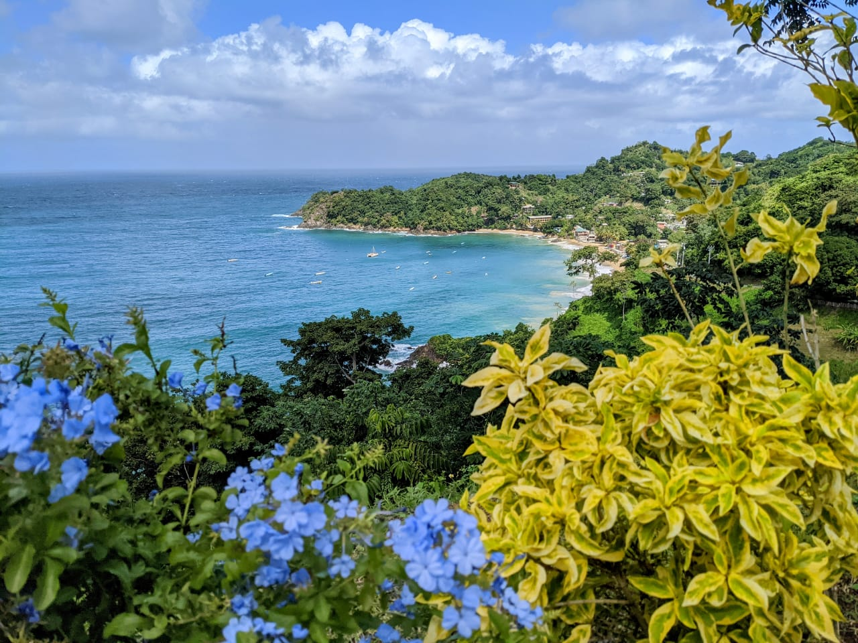
Thank you!

