Slide 1
WIPO International Conference
Intellectual Property Training Institutions
“IP skills to boost SMEs for sustainable growth”
Arabia Saudi
BOOTH COPY – CONFIDENTIAL – CHECK AGAINST DELIVERY

Slide 2









introduction of IP Academy
Content
Support SME,s IP Education
Intellectual Property Training Institutions
IP Academy Achievement
Customer Testimonial
2

Slide 3

Brief introduction of IP Academy
01

Slide 4
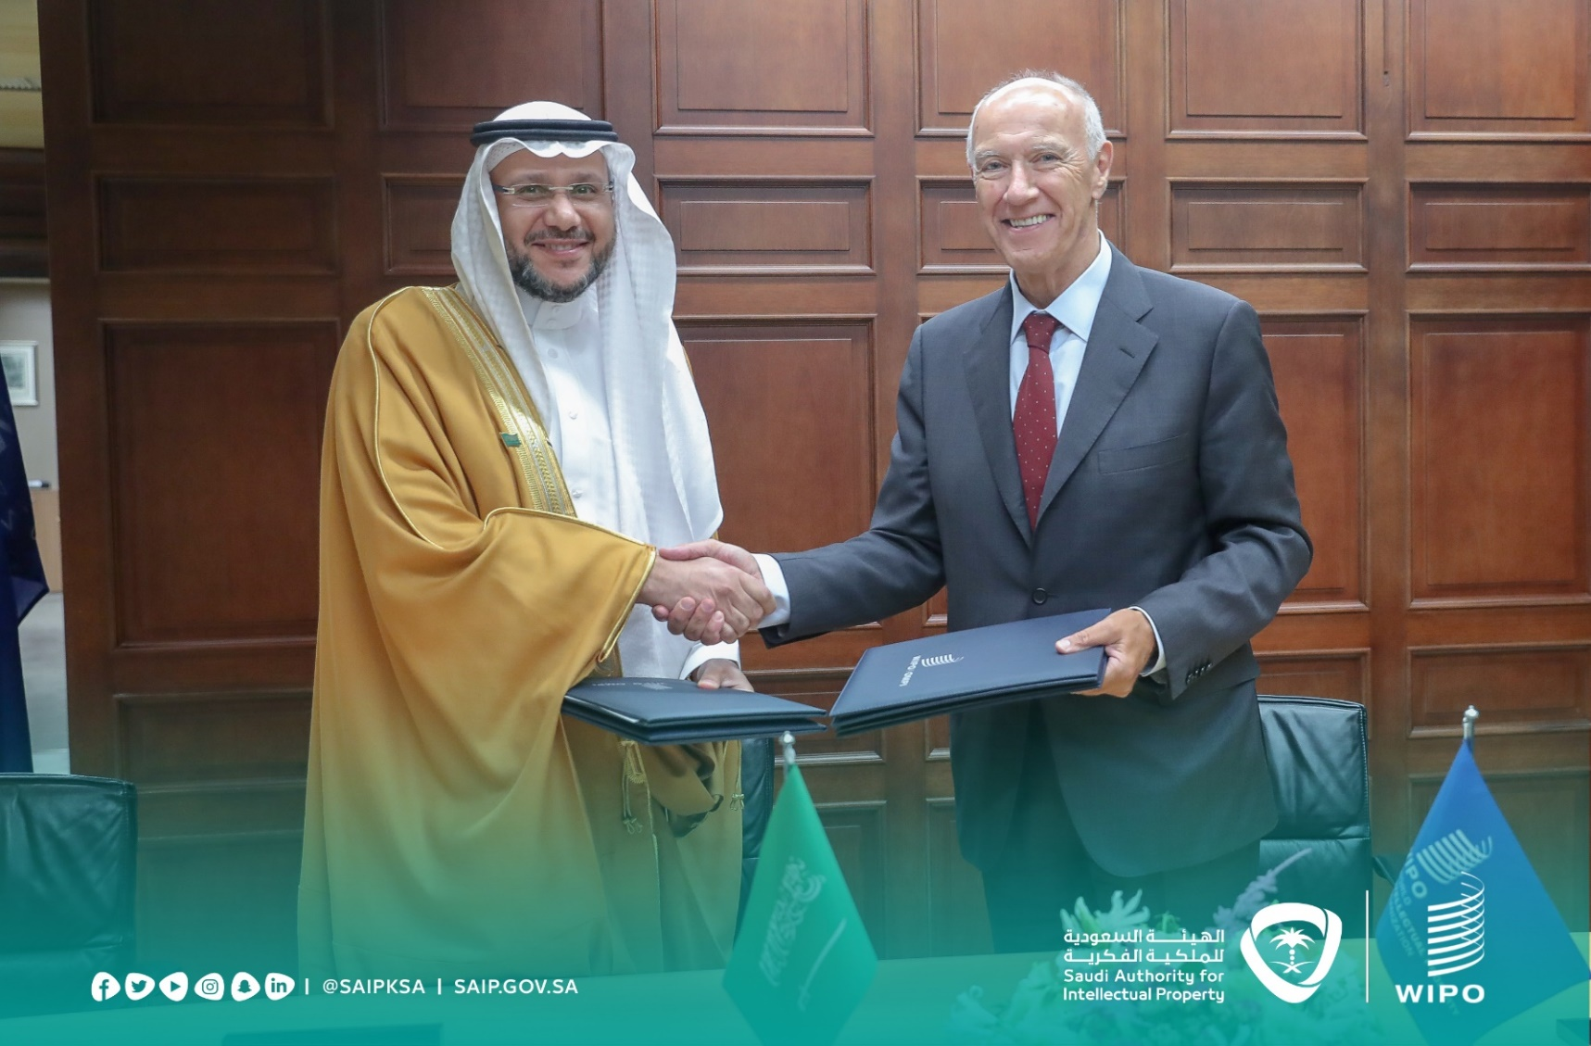
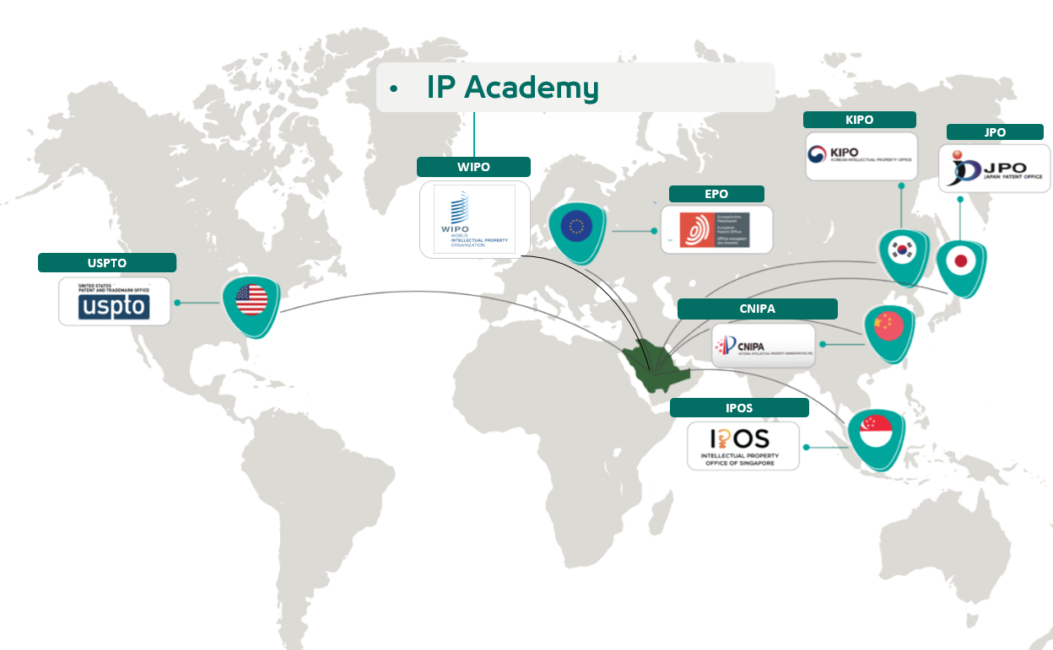
Establishing IP Academy
Saudi Authority For Intellectual Property and WIPO singed an memorandum of cooperation to establish a specialized IP Academy in Saudi Arabia Oct 2nd, 2019.
IP Academy Objectives
Current Partners
Building IP capacity on KSA.
Raising awareness on IP.
Cooperating with general and privet sector in IP.

Slide 5








IP Academy Major Projects and initiatives
Training Need Analysis
(Calendar)
Training IP trainers with WIPO
IP Master degree with WIPO
IP specializing Diploma
IP Library
IP in general education
IP Professional Exams
Summer School
Supporting IP education for SMEs

Slide 6

Support SME,s IP Education
02
6

Slide 7

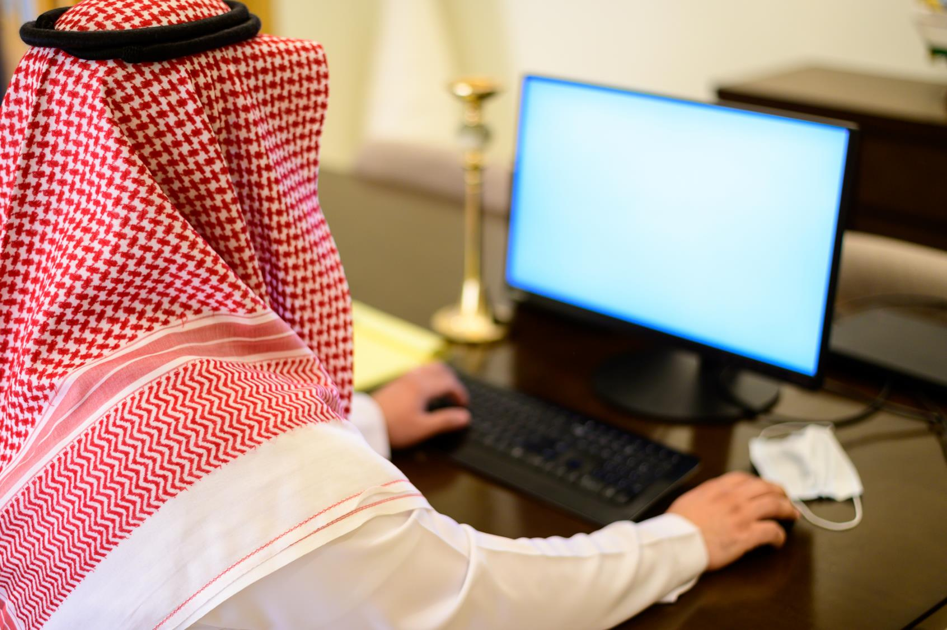
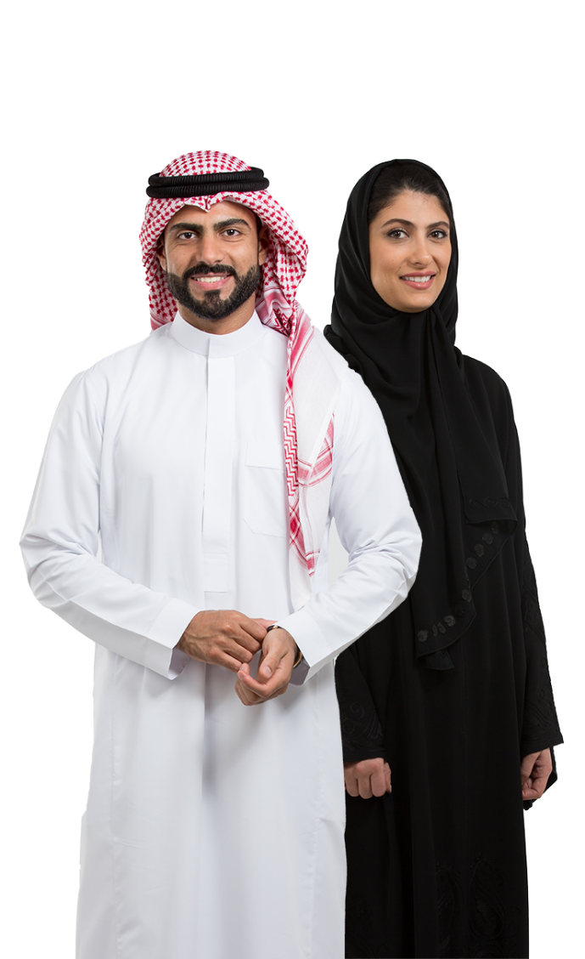

Support SME’s IP education
SMEs creative activities are essential and should be performed by all employees, including the CEO. SMEs do not have proper budget and resources for IP, Therefore SAIP helps to create an IP-centered business environment in SMEs in which the company's technologies are turned into IP rights and used to strengthen corporate competitiveness and create added value.
SAIP enhances the SME’s IP by providing customized IP training based on the duties and level of employees

Slide 8
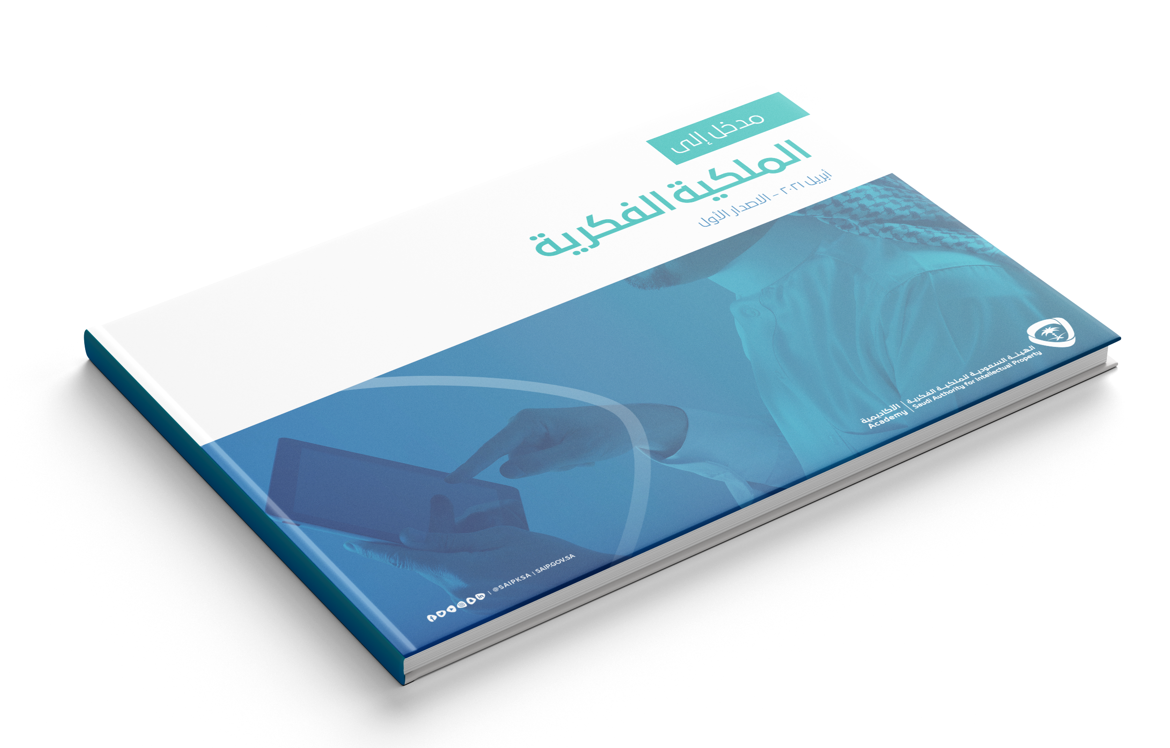
SME IP education strategy
Target
Technology developers (Researchers), administrative workers and management (including CEO) in enterprise
How
Provide customized IP training tailored to their roles and responsibilities
IP creation training : provide training on IP creation to technology developers, core R&D resource in company
IP management training : provide IP administration training to those in charge of IP management in company
CEO IP training: hold a seminar to raise awareness of IP among corporate executives(VP, CIO, CLO and above)
Develop IP contents
Build up an trainers pool
Develop standard IP educational contents
by level of employees
(employees, managers, CEO)
Recruit expert by educational program
(Prior art search) Examiner etc.
(Patent analysis) IP lawyers, IP analysis experts
(IP management) IP legal advisor etc.
(IP theory) SAIP employees, IP professors

Slide 9




Methodology
  IP for high ranked officer: (CEO, CIO)
Aware the importance of IP in managing company
Share success case of IP management and know how
Focus on IP awareness and respect
1
  IP creation: (Technology developers)
How to use inventing strategy for their product
Prior art search for avoiding possible infringement and time/resources wasting
Focus on IP enablement
2
Tailored program
3
  IP Management:(Administrative workers)
Basic IP for understanding technology
Administrative skill for due application and protection.
Focus on IP enablement and commercialization

Slide 10

IP Academy Achievement
03
10

Slide 11
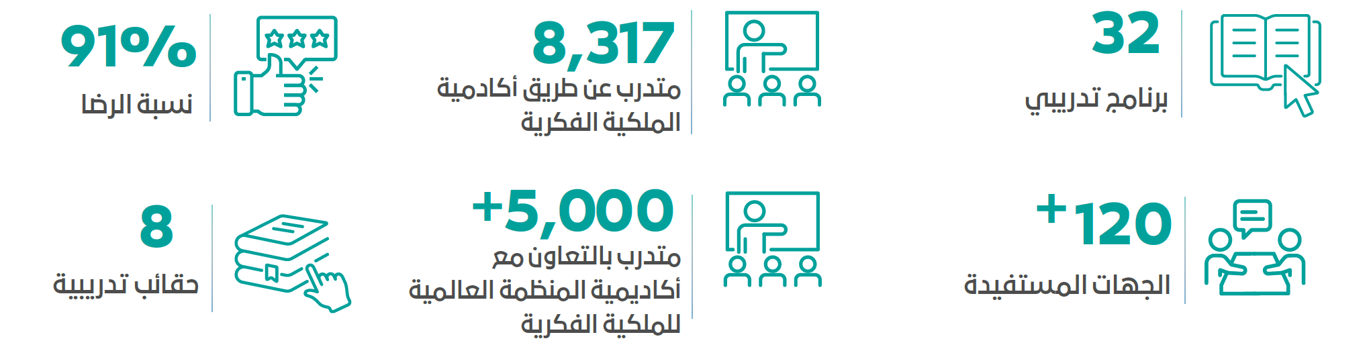



Academy Achievements 2021
8,317
By IB Academy
3,733
Participants from SMEs
91%
Satisfaction
+ 5,000
Collaboration with WIPO
32
Training program
56 SME
Beneficiaries
WIPO basic IP 101(Distance learning)
customize DL-101 to Saudi Arabia's regulations and laws.
Summer School
Global training program offered to 55 trainees of 9 different nationalities
Training Program Guide
For 2021 and 2022

Slide 12
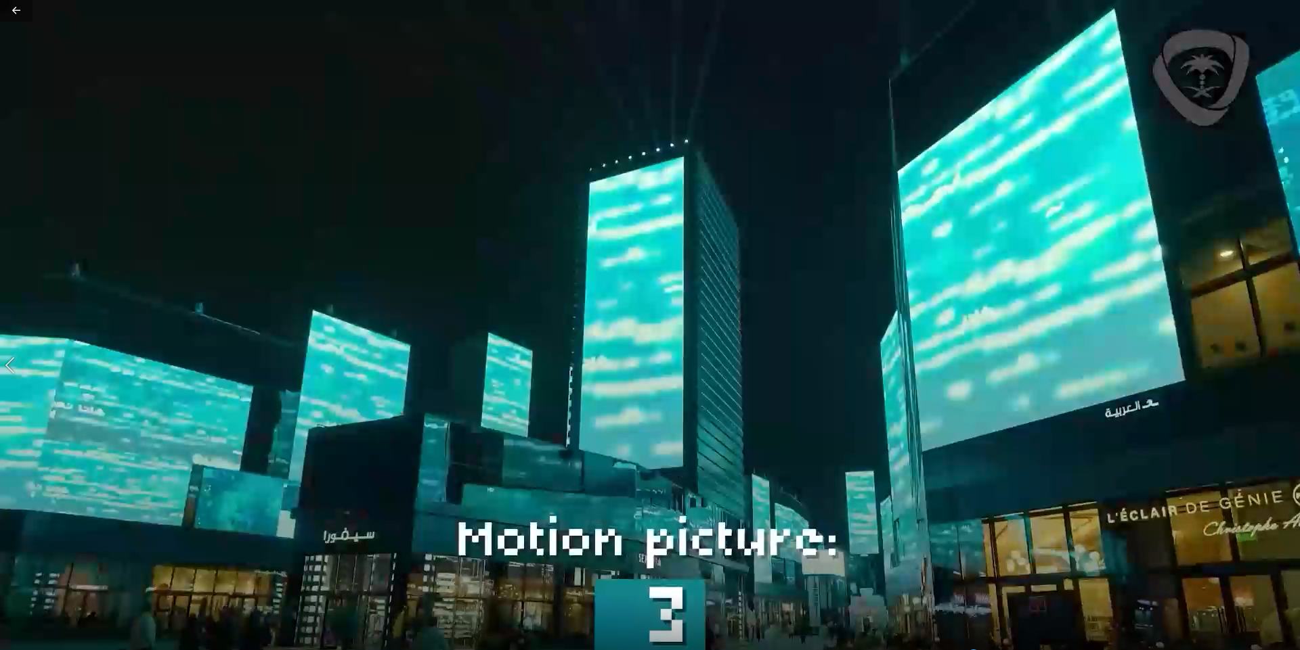
IP Day Video

Slide 13
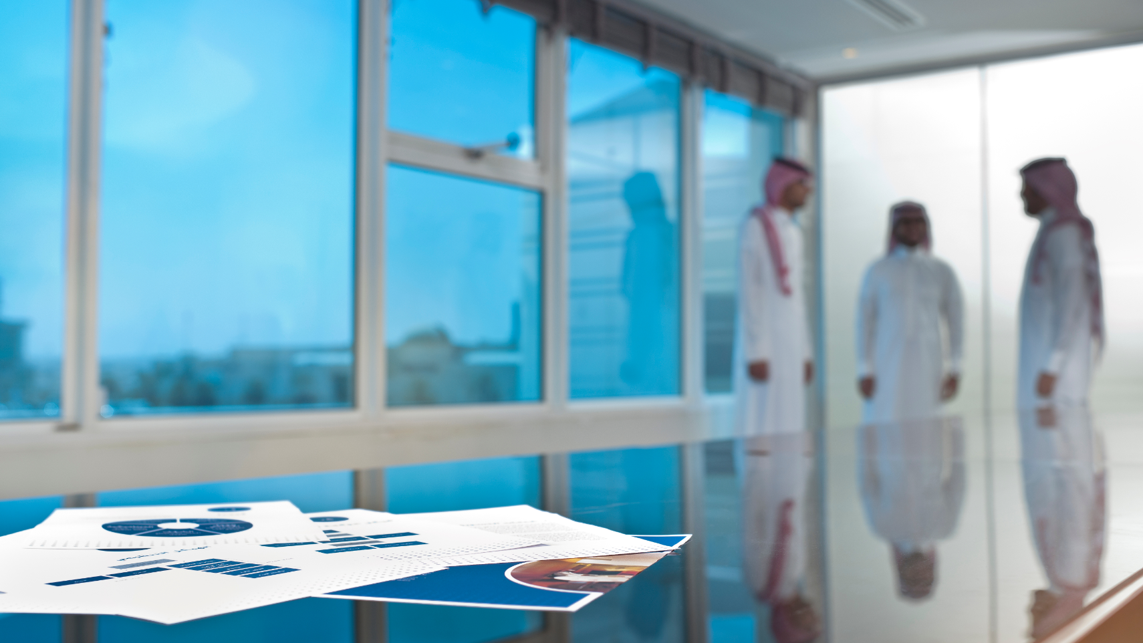
04
Testimony
13

Slide 14
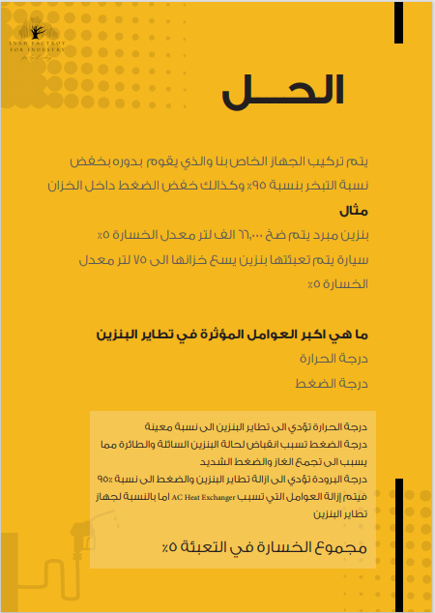
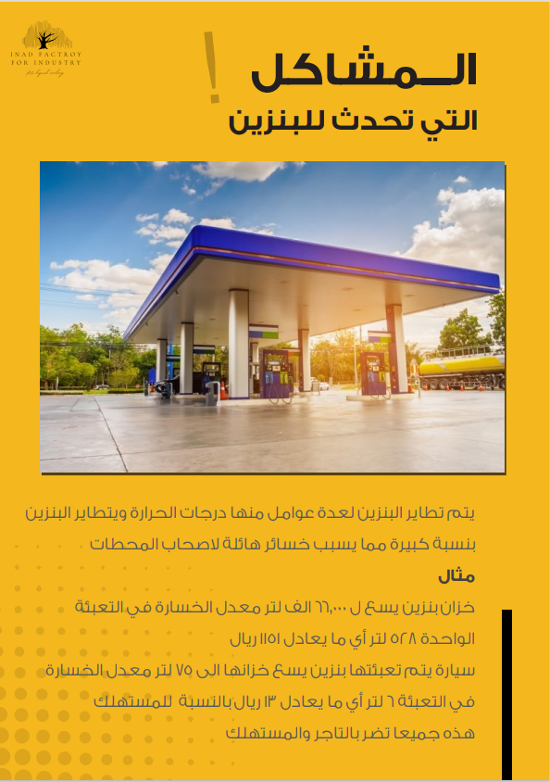
SME,s Testimony
Name of Inventor:
Mr.Enad Al-Qurashi
Name of the Invention:
Fuel evaporation prevention device.
Benefits to SME,s sector:
Profit Increase by stop wasting fuel.
Environment protection.
IP Academy program the inventor attended:
Introduction to IP.
Customized DL 101 program.
Building a Technology and IP Infrastructure.

Slide 15
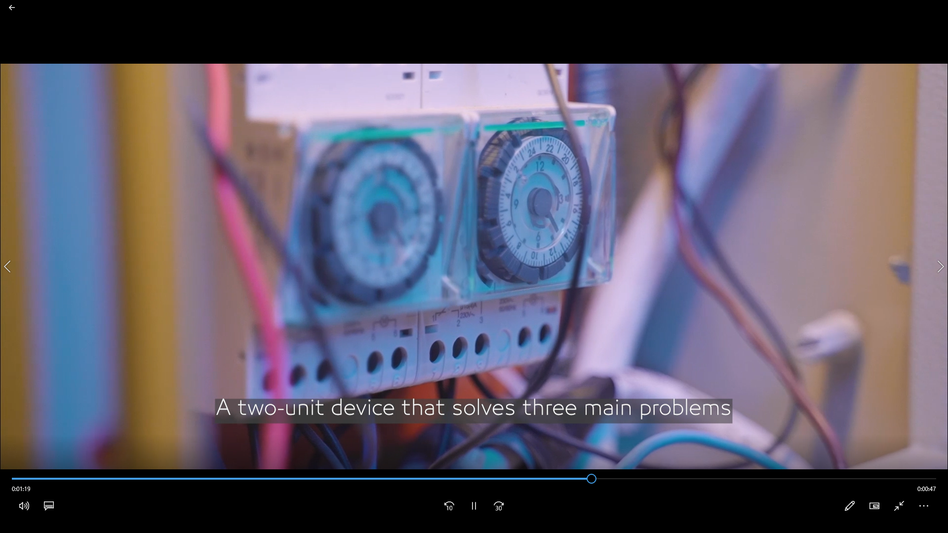
SME,s Testimony customers Video

