Slide 1
Georgia – Ana Dalakishvii
BOOTH COPY – CONFIDENTIAL – CHECK AGAINST DELIVERY
Leveraging IP Education for SMEs and
Agricultural / Handicraft Producers
IPTC OF GEORGIA
2022

Slide 2
I
II
III
HISTORY
REPORT 2021
FUTURE PLANS

Slide 3
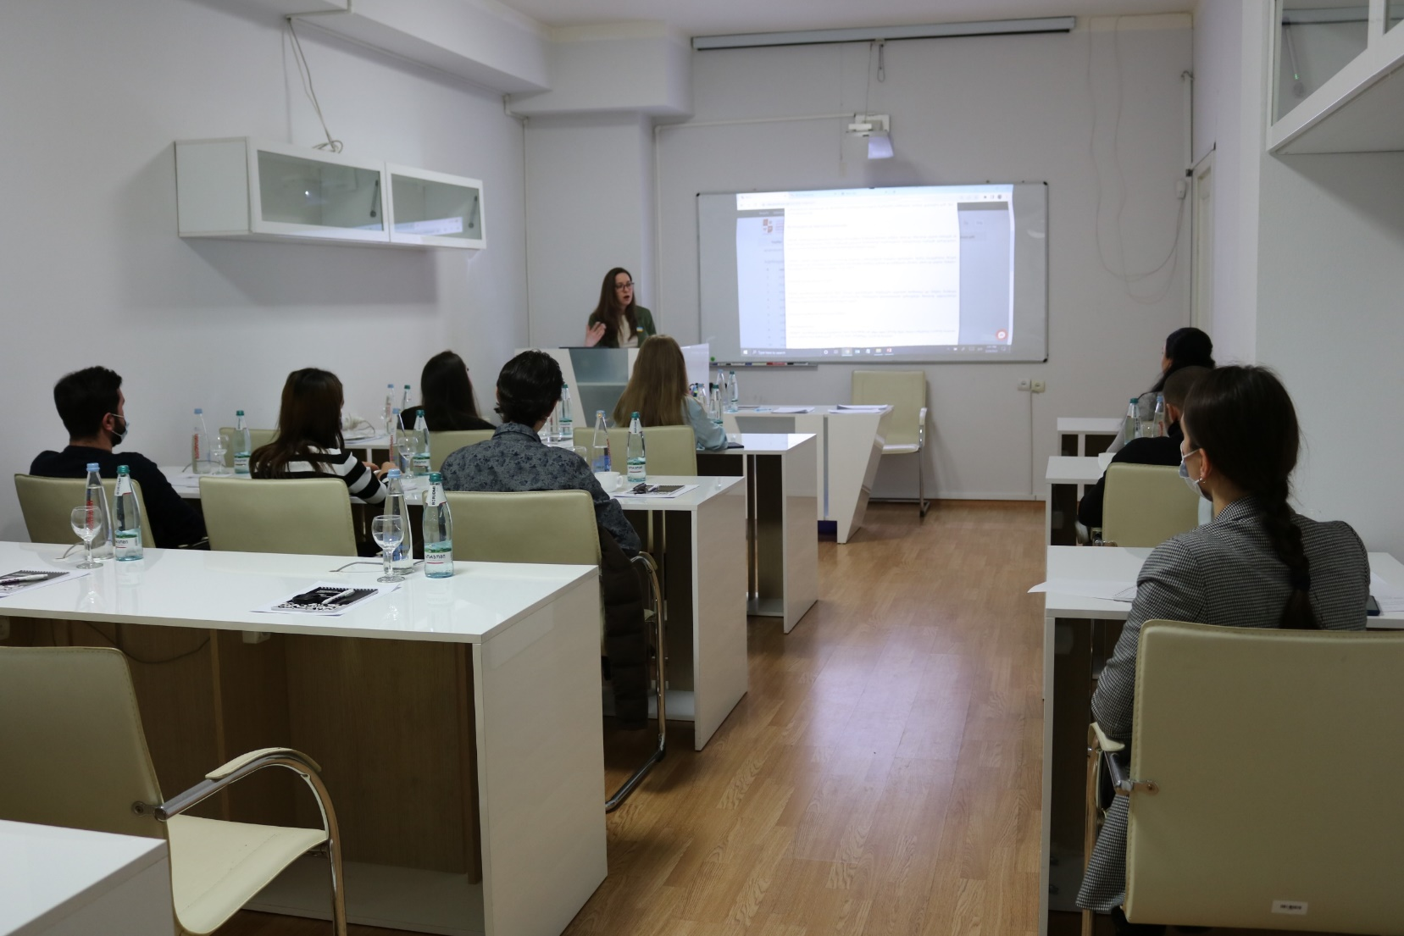
I
History
Established – 2015
WIPO/Sakpatenti MOU
Awareness Raising/Professional Development
3 employees + 13 – Certified WIPO Academy Trainers
History

Slide 4
I
II
III
HISTORY
REPORT 2021
FUTURE PLANS

Slide 5
II
ACTIVITIES
PARTICIPANTS
Report
275%
86%
DATA
REGISTRATIONS on DL101GE
66.2%

Slide 6
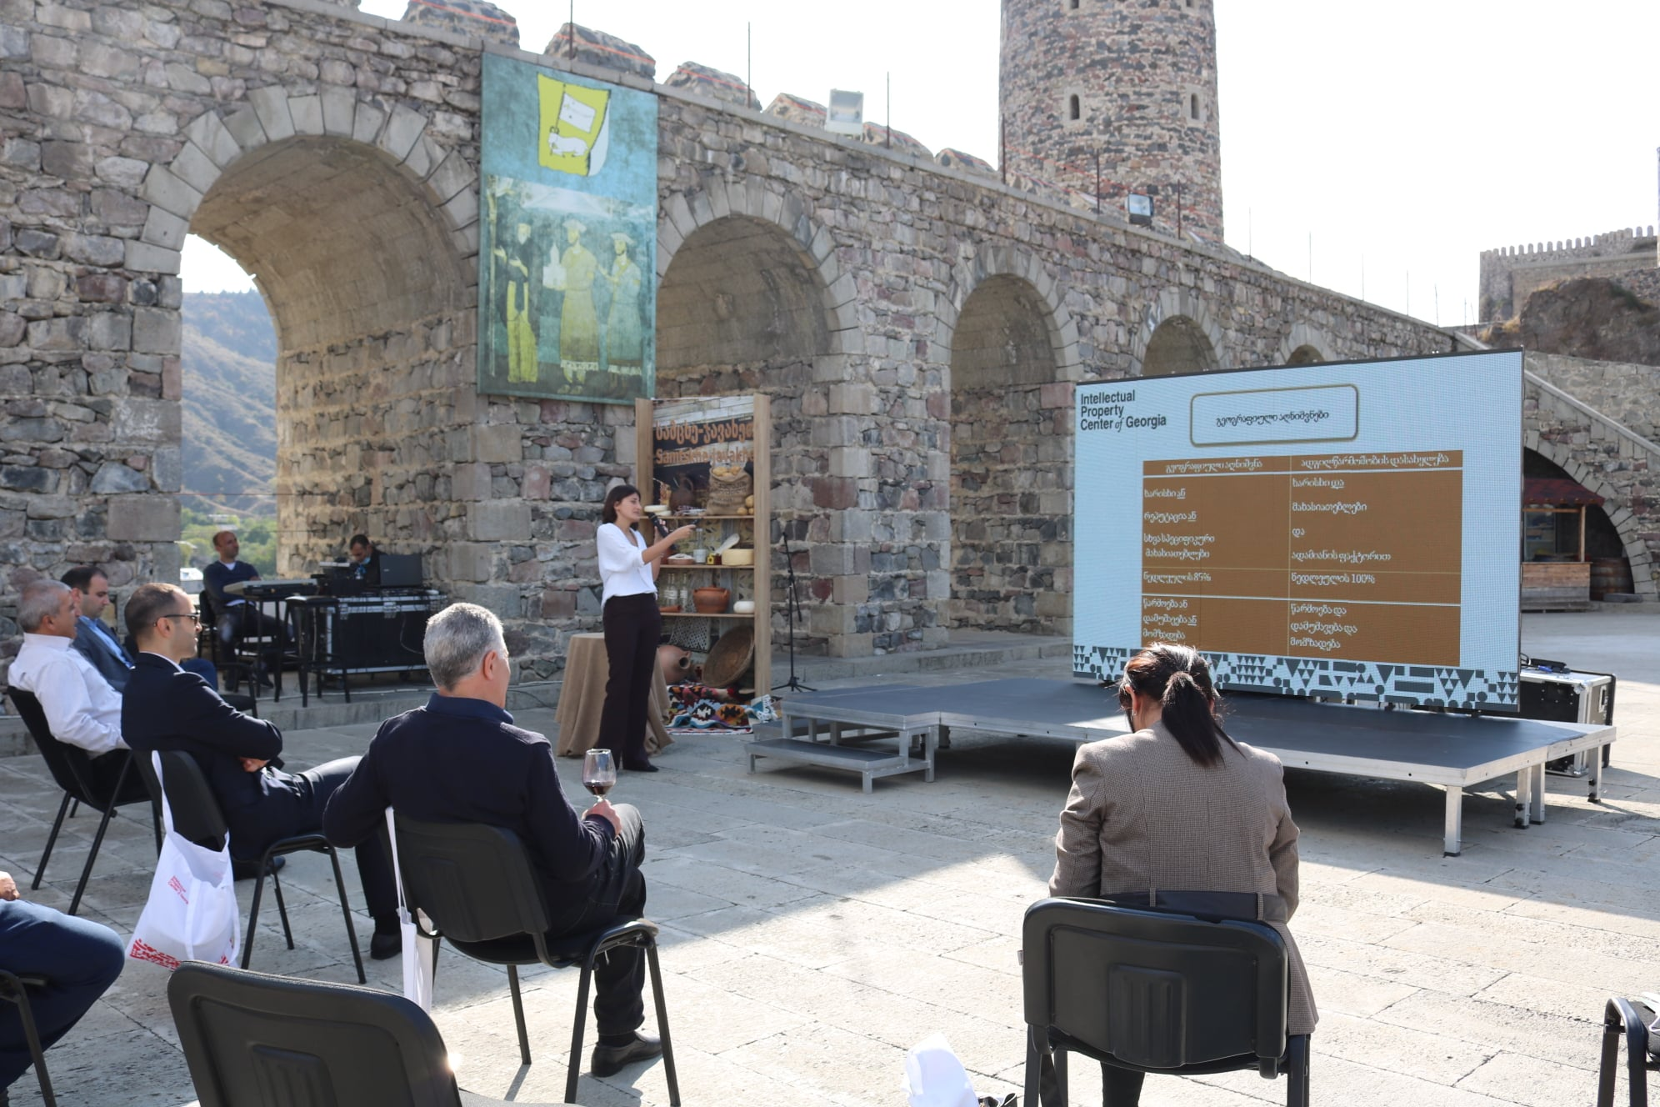
II
Trainings on GIs
Report
WIPO/IPTC of Georgia PDP on GI
1. For Ninotsminda Honey Producers
20 participants;
Objective;

Slide 7
II
Results
Report
Registration as a GI
35% Growth - SALES
50% Growth – PRICE
Export In 2022

Slide 8
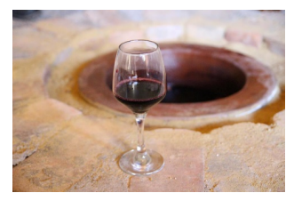
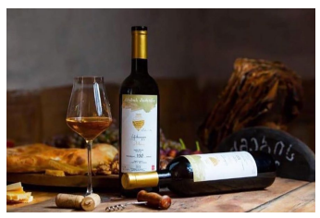
II
Report
2. For WINE PRODUCERS
50 participants;
Objective;

Slide 9
II
Results (Bolnisi Wine)
Report
Registration as a GI
100 % Growth - SALES
733% Growth – PRICE
Export In Australia

Slide 10
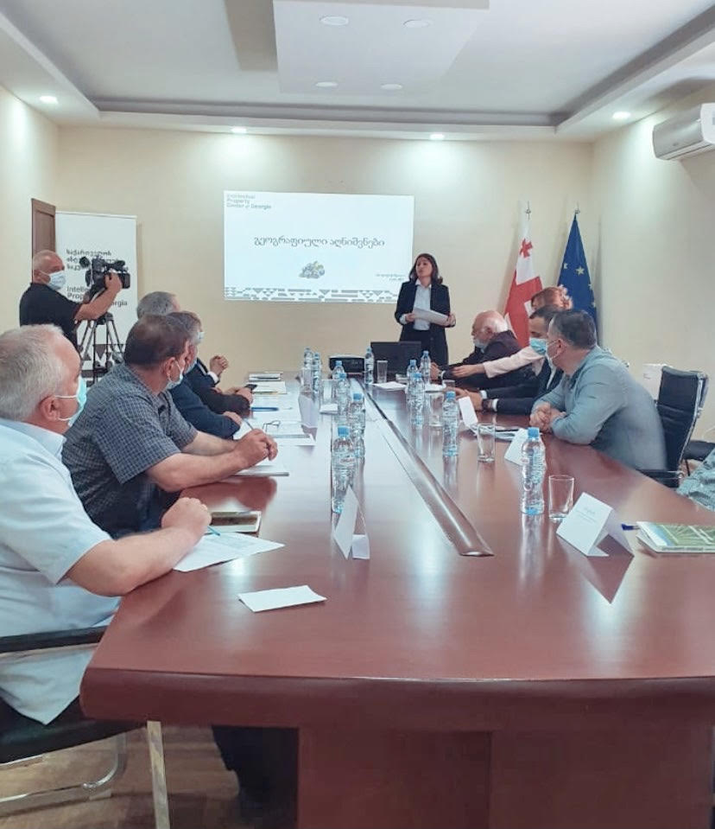
II
Trainings on GIs
Report
3. For Blueberry Producers
15 participants;
Objectives;
Results – Interest on Registration

Slide 11
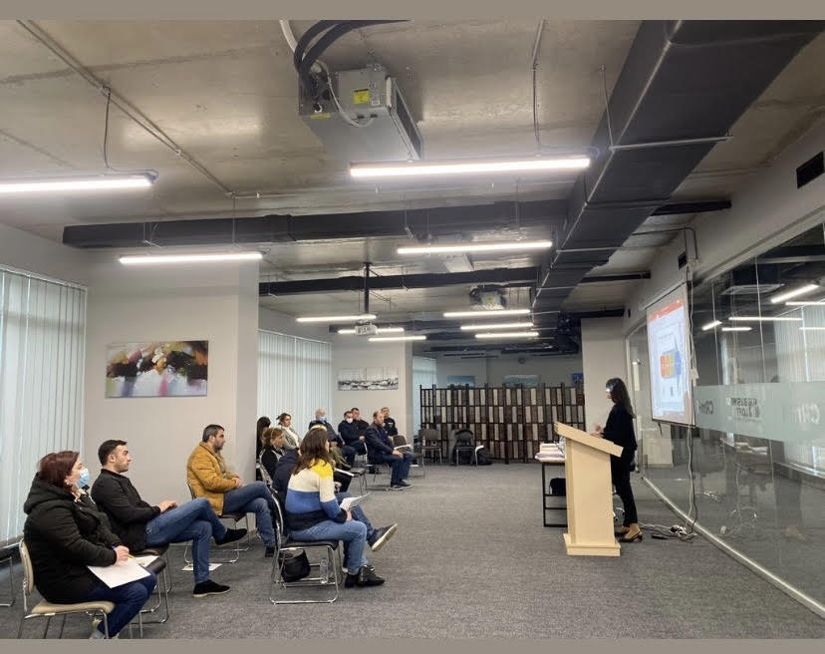
II
Trainings on GIs
Report
4. For ADJARA REGION Producers
(including non Agri GI Producers)
50 participants;
Aim of the training;
Results - Interest on Registration

Slide 12
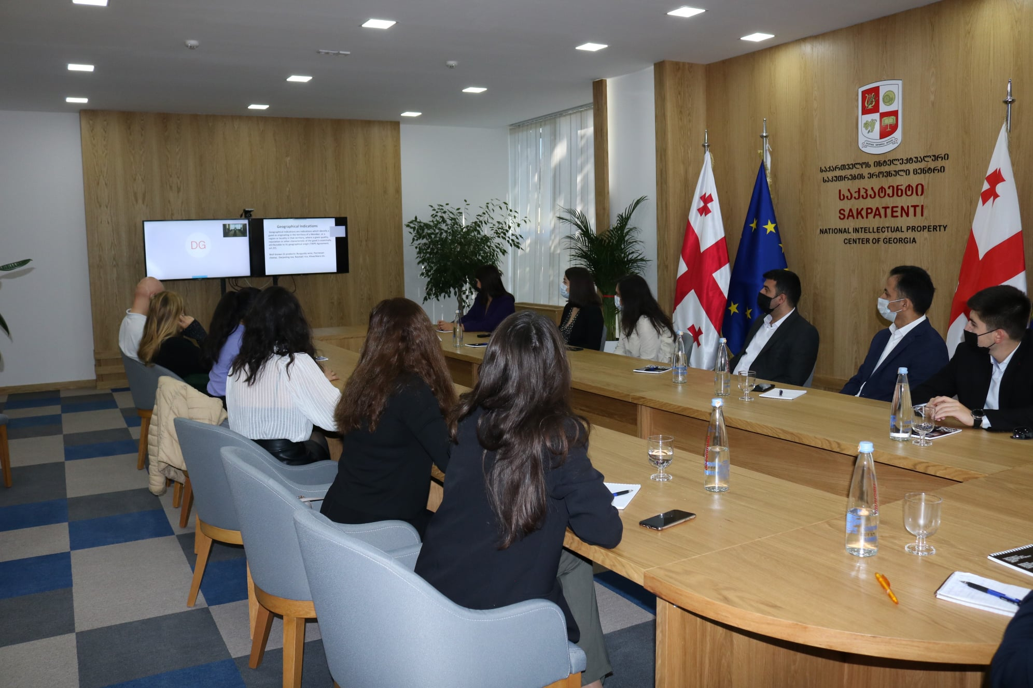
II
Trainings on GIs
Report
5. For Ministry of Agriculture and Economy of Azerbaïdjan
20 participants;
Aim of the training;
Results.

Slide 13
II
Trainings on GIs
Report
2005 – 2021 ➔ 57 GIs;
2015-2021 ➔ 15GIs;
2019/2021 ➔ After GI Trainings 4 new GIs.

Slide 14
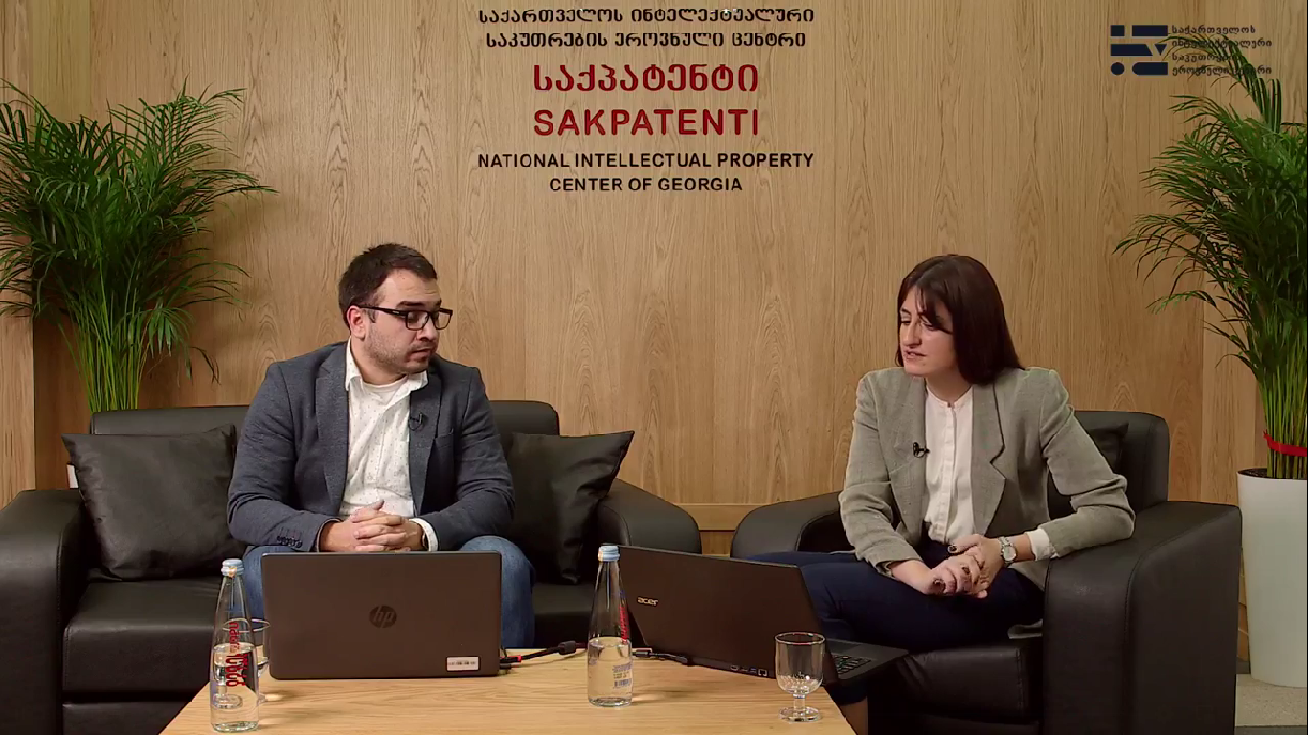
II
Trainings For SMEs
Report
1. Webinar on monetization of Music for Copyright/Related rights owners
Aim of the Webinar;
140 Participants

Slide 15
II
Trainings For SMEs
Report
2. Webinar “Commercialize your Ideas!”
Aim of the Webinar;
100 Participants

Slide 16
II
Trainings For SMEs
Report
3. EUIPO/IPTC Course “IP as a valuable Business Asset”
Aim of the Course;
Results.

Slide 17
I
II
III
HISTORY
REPORT 2021
FUTURE PLANS

Slide 18
III
FUTURE PLANS
2022
GIS/SMES
Trainings for Potential Geographical indications producer’s Association (11 Region);
Training on GIs for GI’s Producers;
IPTC Course on Trademarks;

Slide 19
III
FUTURE PLANS
2022
Capacity building
TOTs for Trainers;
Trainings for Law Students;
Trainings for IP lawyers/judges;
Working on Manual on IP.

Slide 20
FUTURE PLANS
Thank you !

