Slide 1
NATIONAL INSTITUTE FOR THE DEFENSE OF COMPETITION AND PROTECTION OF INTELLECTUAL PROPERTY
"Reactivating Peru: IP education as a tool for economic recovery post-COVID-19"
Rosa Cabello Lecca
Head of the Office for Technical Cooperation and Institutional Relations

Slide 2
National IP training for the SMEs, entrepreneurs and economic sectors most impacted by COVID-19

Slide 3
Index
Introduction to Indecopi's responsibilities. Intellectual Property. Directorates.
I. National School of Indecopi
II. Cooperation agreement between WIPO (Academy) and INDECOPI (October 2019)
III. People who received intellectual property training through the agreement
IV. National TISC network in Peru
V. Reactivating Peru
VI. Global Innovation Index 2021
VII. Action plan
VIII. Testimonial
Beneficiary of the training

Slide 4


Slide 5
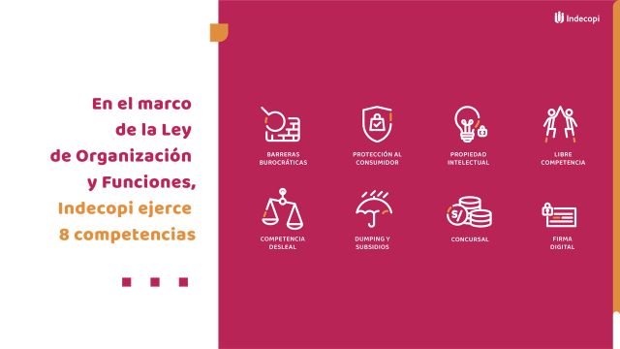

Slide 6
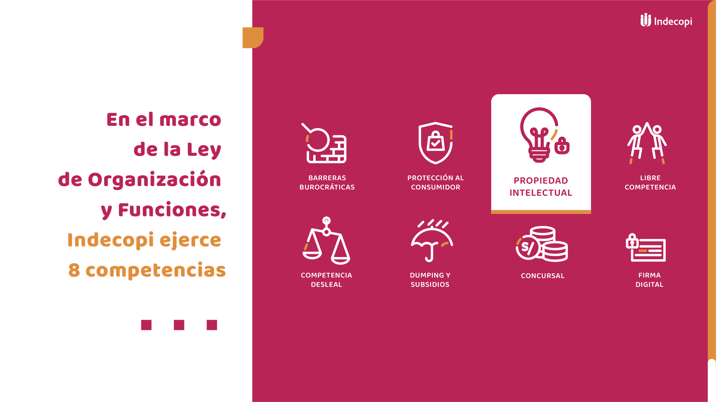

Slide 7
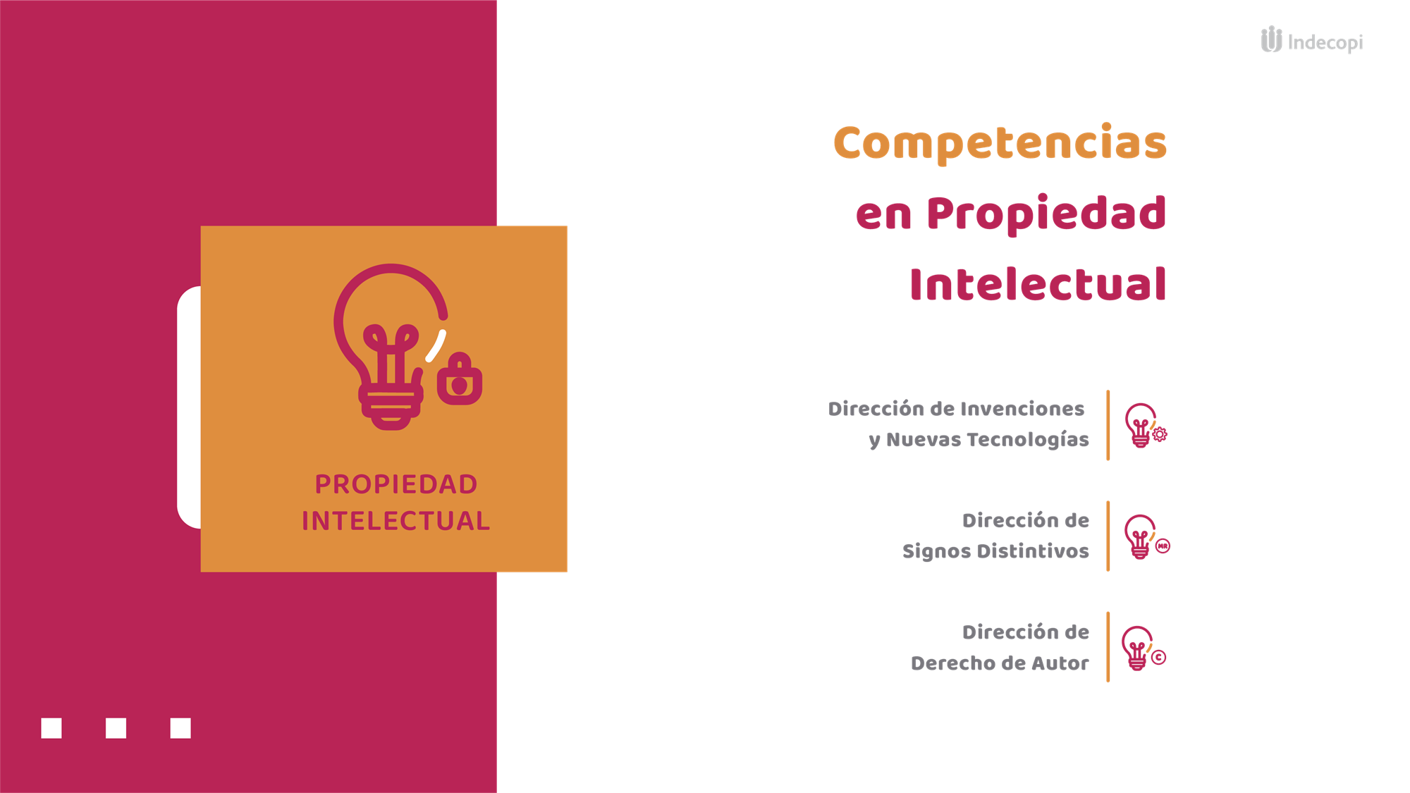

Slide 8



I. National School of Indecopi
- Indecopi line agency for capacity-building, created on June 23, 2009.
- It develops training activities, including intellectual property activities, in the eight areas in which Indecopi operates.
- Between 2013 and 2021, it carried out over 513 intellectual property training activities for 41,591 participants (more than 50% of whom were women and more than 46% of whom were from the private sector).

Slide 9
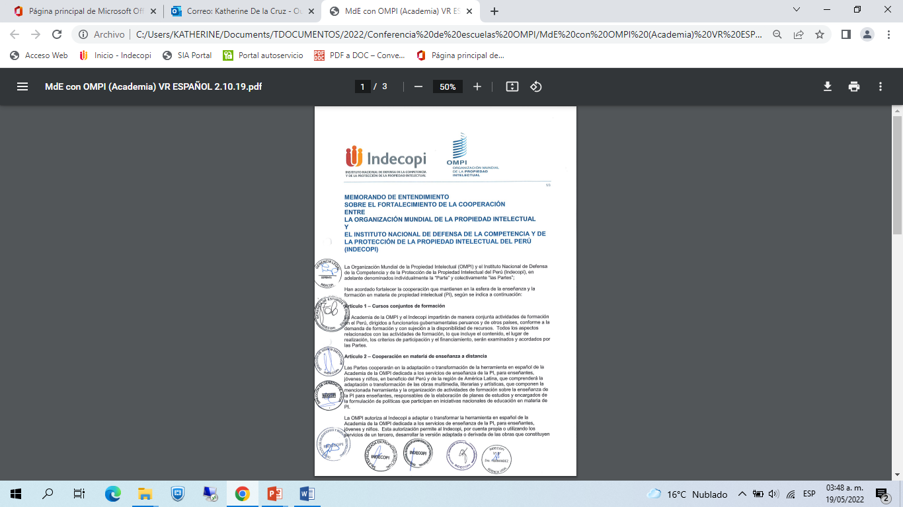
II. Agreement between WIPO (Academy) and INDECOPI (October 2019)
Jointly provide training activities in Peru for government officials from Peru and other countries.
Adapt the Academy IP teaching tool (available in Spanish) to students, young people and children to benefit Peru and Latin America.
Jointly create, run and manage new and similar distance learning courses in Spanish.
Exchange training material, such as course catalogs, academic agendas, teaching material, guides, etc.

Slide 10
III. PEOPLE WHO RECEIVED INTELLECTUAL PROPERTY TRAINING THROUGH THE AGREEMENT
2020 - 2021

Slide 11
III.1. Intellectual Property Topics
In 2020 and 2021, the topics of the academic intellectual property activities were the following:
Inventions and new technologies
Patents
Distinctive signs
Nation branding
Appellations of origin
Copyright
Copyright for the creative industries
Related rights
Industrial designs
Trade secrets
Innovation and creativity
Certification marks
Public domain
Protection of works
Collective marks
Trained sectors:
Gastronomy
Textiles
Tourism
Agriculture
Entrepreneurs
Women creators
Micro and small enterprises
Universities
Research institutions
General public

Slide 12

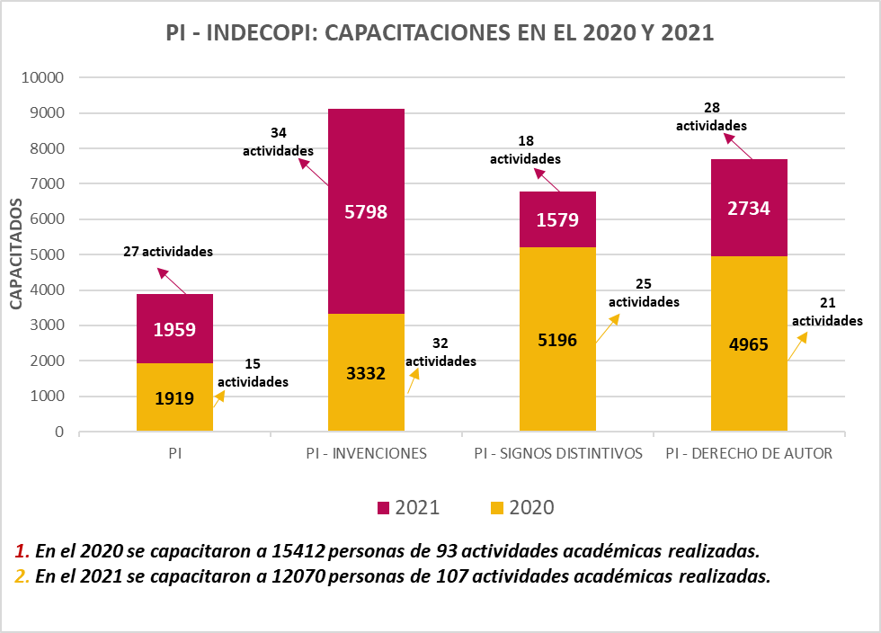
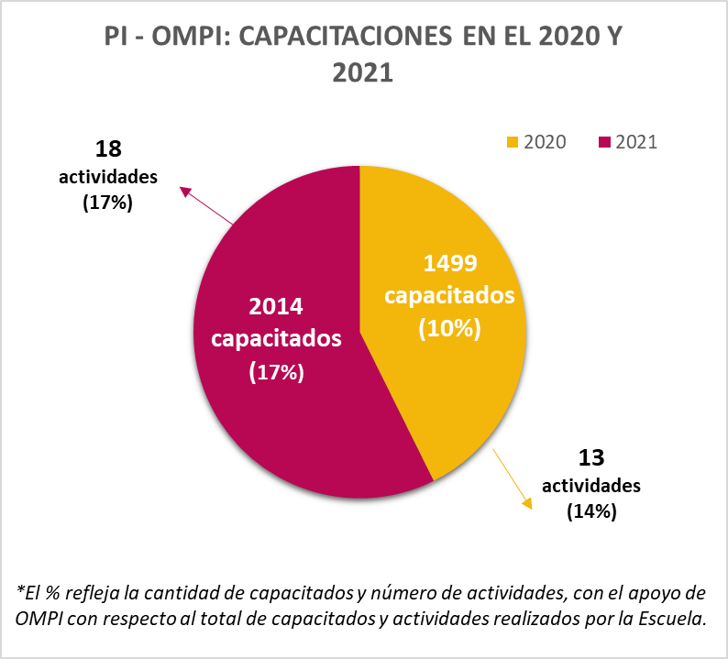
III.2. Intellectual Property Training (School and WIPO)

Slide 13
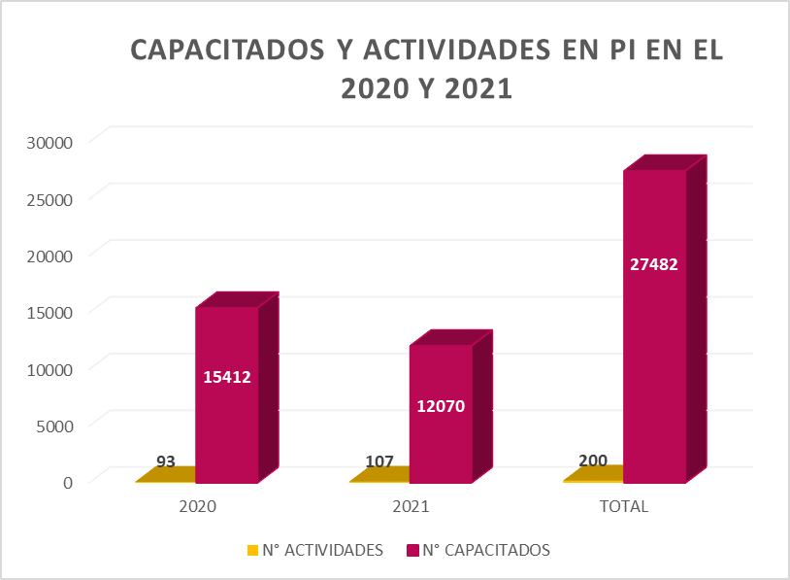
III.3. People who received intellectual property training in the framework of the 2020 - 2021 Agreement

Slide 14

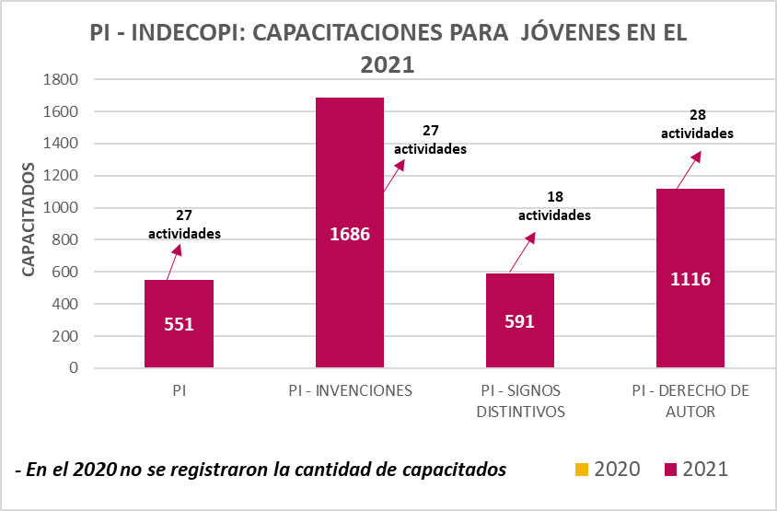
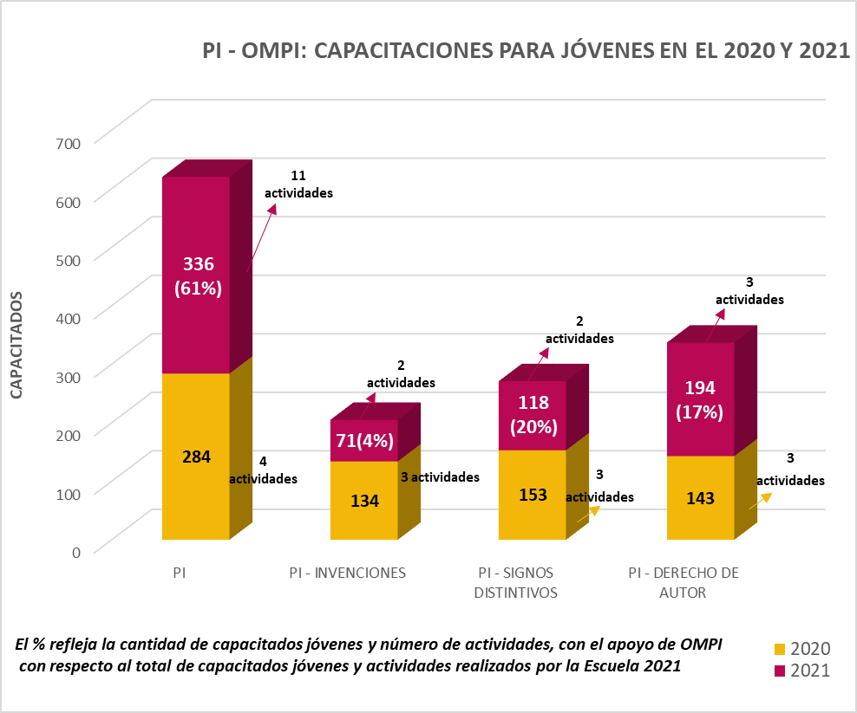
III.4. Training for young people (School and WIPO)

Slide 15
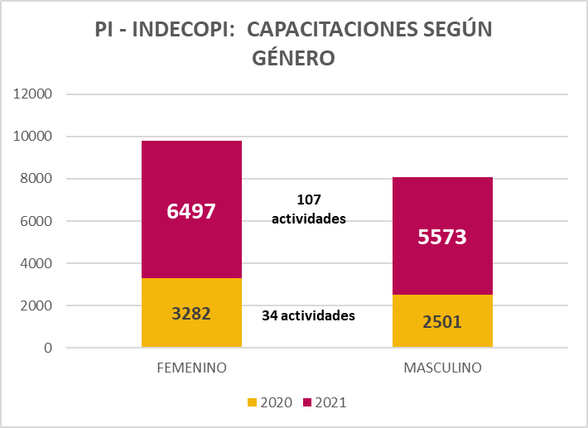
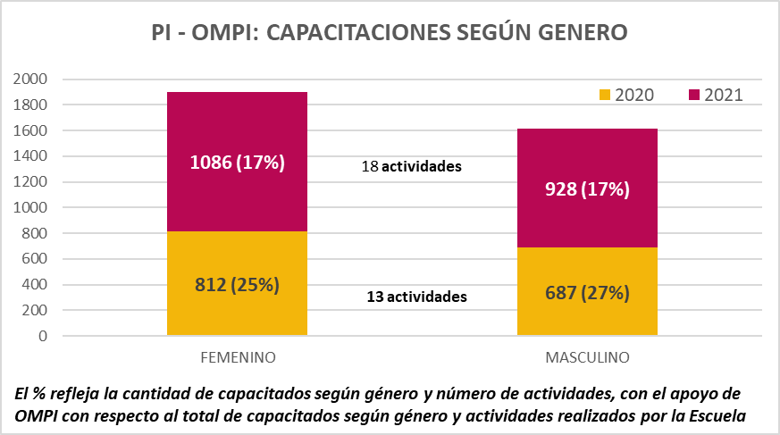
III.5. Training based on gender

Slide 16
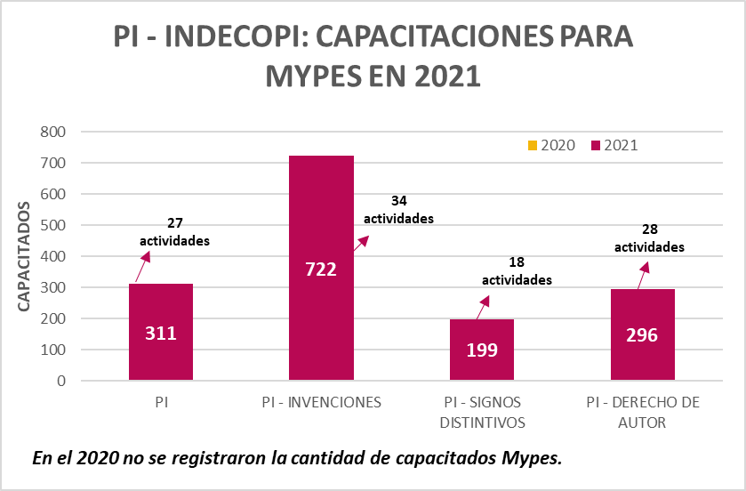
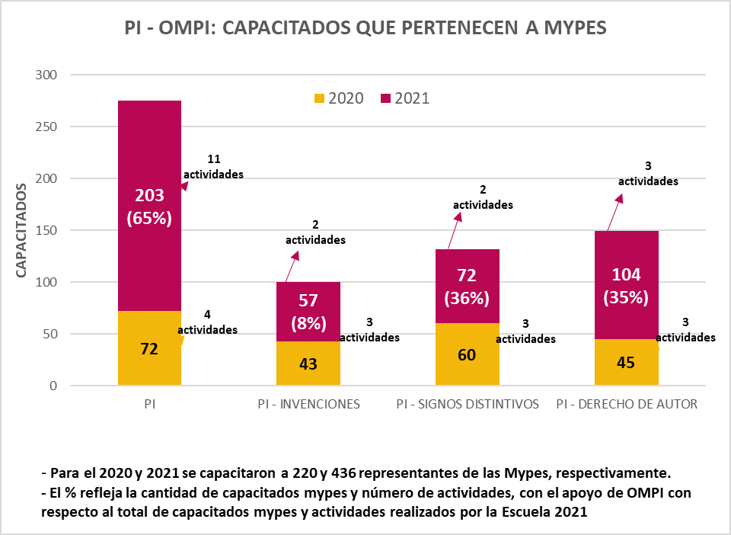
III.6. Trained micro and small enterprises

Slide 17
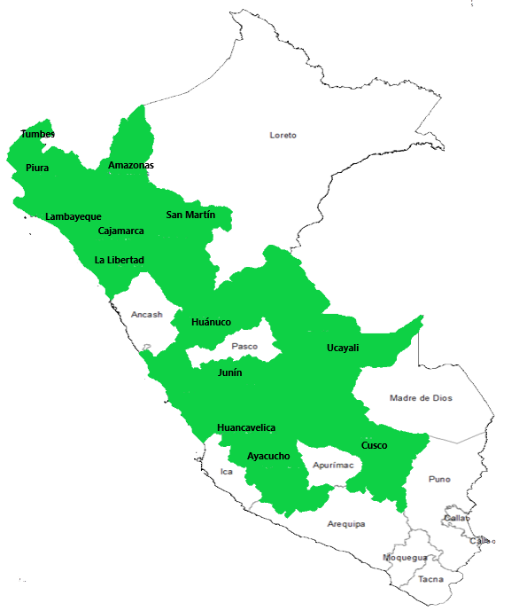
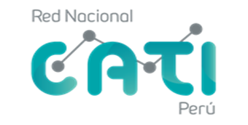
IV.
TISCs are technology and innovation support
centers.
WIPO and Indecopi signed an Agreement
regarding the provision of services to promote the establishment and development of a national TISC network.
Thirty-seven agreements have been signed at national level with universities.

Slide 18
V. Reactivating Peru
The national government’s “Reactivating Peru” program aims to respond to the liquidity needs of businesses following the impact of the COVID-19 pandemic. It provides guarantees to micro, small, medium and large enterprises so that they can access working capital loans and meet their short-term obligations to their employees and suppliers of goods and services.
In 2021, Indecopi worked to promote, spread and raise awareness of the benefits of the intellectual property system.
The Distinctive Signs Office received 42,605 applications to register trademarks.
The Inventions and New Technologies Directorate received 2,299 dossiers.
The Copyright Directorate received 2,889 dossiers.

Slide 19
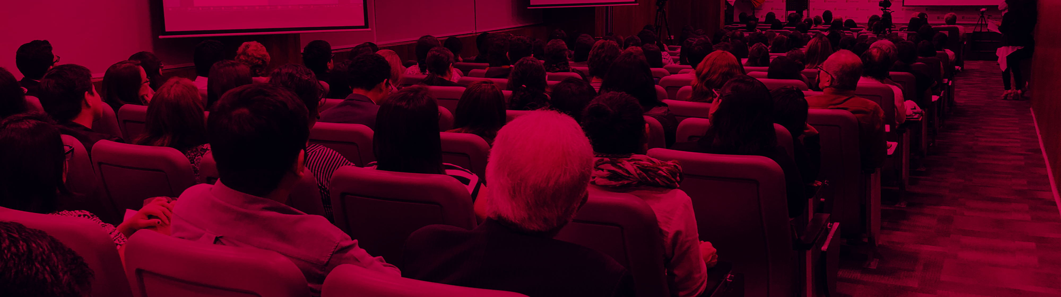
VI. Global Innovation Index 2021
Peru ranks seventieth and has moved up six ranks since the Global Innovation Index 2020. In the region, it ranks seventh after Chile, Mexico, Costa Rica, Brazil, Uruguay and Colombia.
It has a better ranking for business and market sophistication (ranked thirty-seventh and thirty-eighth respectively).
Greater efforts need to be made with regard to knowledge and technology outputs (ranked eighty-seventh and seventy-seventh respectively).

Slide 20

VII. Action plan
Indecopi National School

Slide 21
VIII. Testimonial
Training beneficiary
EVELIN CONTRERAS LUJÁN
TISC network specialist

Slide 22
THANK YOU

