Slide 1
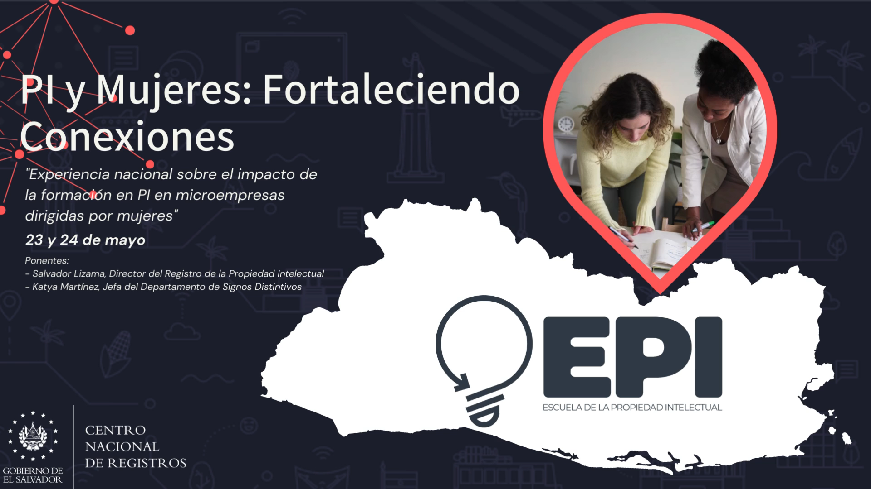

Slide 2
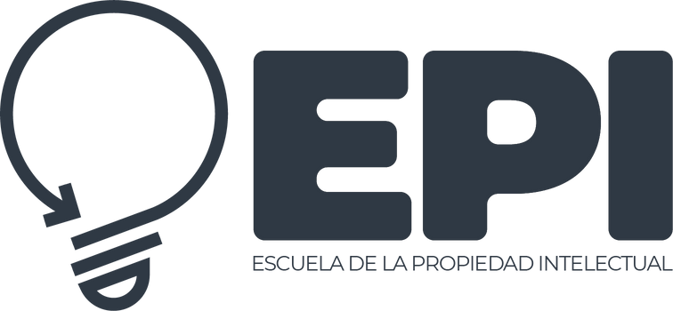







BACKGROUND
Cooperation between WIPO and the School of Intellectual Property (EPI)
On November 17, 2015,
a cooperation agreement between
the National Center of Registries (CNR) of El Salvador and the World Intellectual Property Organization (WIPO) was signed to establish a national intellectual property training center.
Relevant internal information
2022.........
45% of intellectual property trainers are women
75% of leaders within the IP Registry are women
Rebranding ESFOR and, at the same time, restructuring the
Development of ENPI, which is aligned with the policies and regulations of El Salvador.
20
LEADERSHIP
STRATEGY
EPI
OPPORTUNITIES

Slide 3
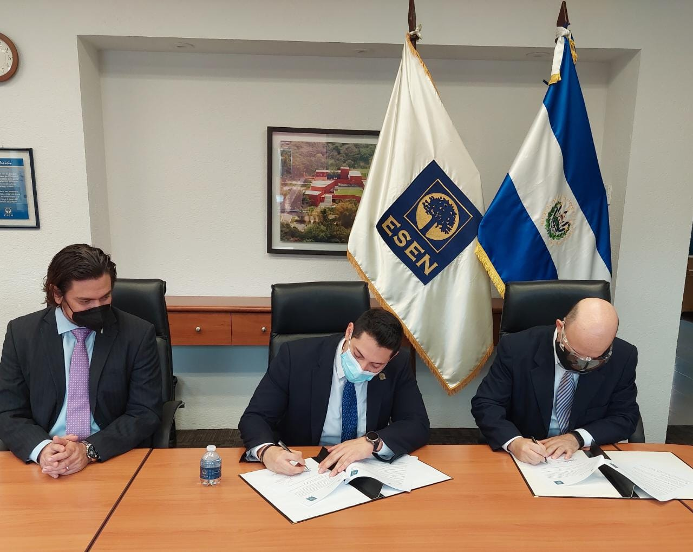


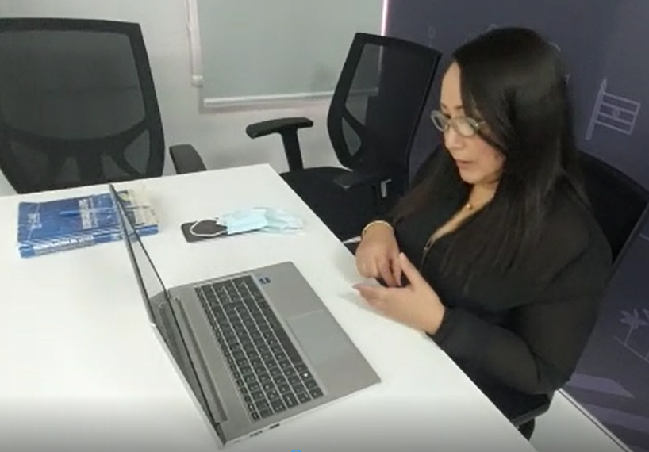
TRAINING
  In 2021, 38 training activities were carried out with 4,172 participants. Among those participants, 37.8% were women.
  Since January 2022 to today, there have been 27 activities that have reached 651 participants, 55% of whom were women (private sector 57%, academia 38%, public 5%).
ACADEMIC SECTOR
CASE MONITORING AND SUPPORT
  Cooperation agreements with higher education institutions (two signed and six underway)
  National Commission for Micro and Small Enterprises (CONAMYPE)
  Fourteen centers for the development of micro and small enterprises (CDMYPE)
  El Salvador Development Bank (BANDESAL), etc.
Relevant external information
IP

Slide 4

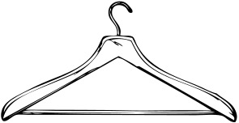
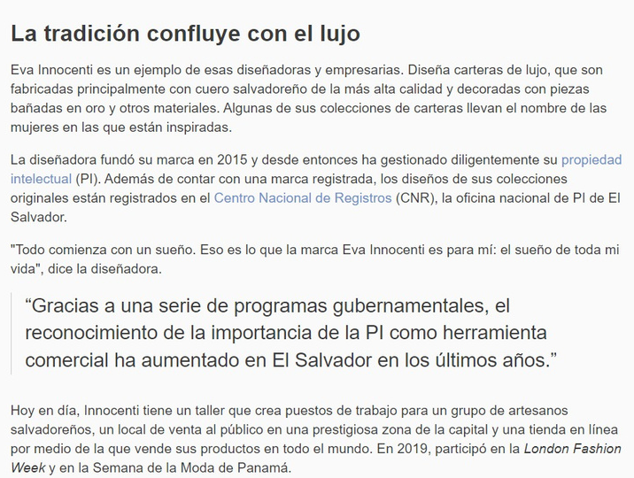
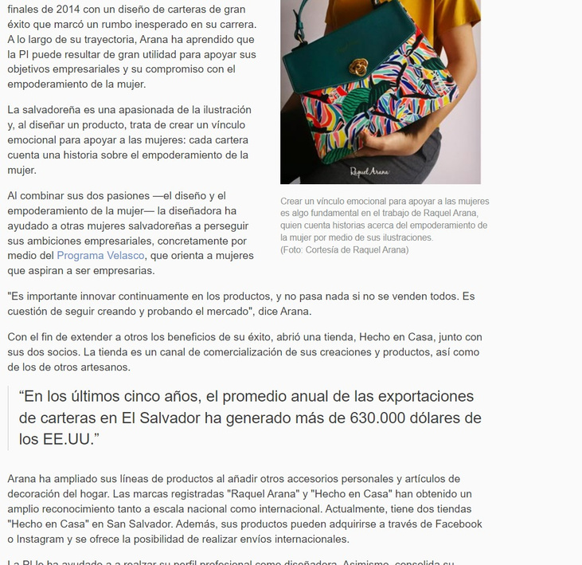
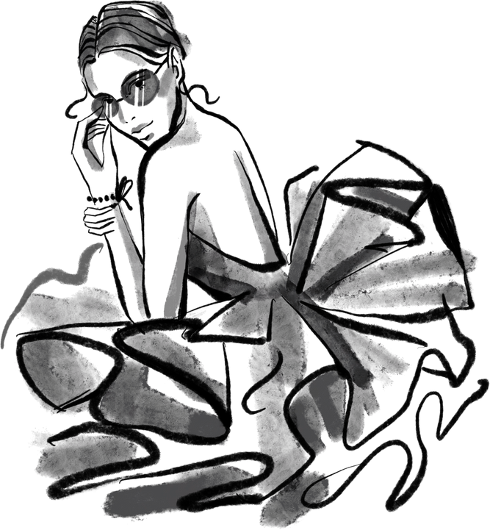
Eva Innocenti
Raquel Arana
Source:
https://www.wipo.int/wipo_magazine/es/2020/04/article_0003.html#:~:text=Salvador%20produce%20dividendos

Slide 5




In view of the work carried out and the training and strategies to promote and raise awareness of IP in our country, 2021 was a year of historic achievements with more patent applications:
IP IN NUMBERS
Distinctive Signs
Copyright
Growth of more than 20% in 2020
Growth of more than 40% in 2020
Impact on the IP system
Without a doubt, it was the year with the best results in the history of intellectual property in El Salvador.
Sectors with the greatest impact
EL SALVADOR
Fashion sector
Tourism sector
There has been a 41.07% increase in the fashion sector, which includes jewelry, costume jewelry, leather goods, fabrics, textiles, clothing, shoes, hats, embroidered items and tapestries.
There has been a 44.68% increase in the tourism sector, which includes artisanal ceramic, tile and clay products, wooden furniture, the organization of trips, entertainment services, sport and cultural activities.

Slide 6


Slide 7


The impact of women on SMEs in El Salvador
of the total population of El Salvador are women. (EHPM 2020).
53.3%
are created by women because they are owners of SMEs and they have a significant impact in this important business sector.
52%
61.64%
of micro and small enterprises are owned by women.*
of jobs
57%
of business ventures are led by women.*
of microbusinesses and
69%
26%
are owned by women*
of small and medium enterprises
Source: Dynamic survey on micro and small enterprises 2017. DIGESTYC-CONAMYPE

Slide 8




MAIN IMPACTED SECTORS
In El Salvador, more than 70% of women in the export sector work in three areas:
Textiles, clothing and footwear
Agro-industry
Other services
50.1%
15.4%
9.1%
Source: Dynamic survey on micro and small enterprises 2017. DIGESTYC-CONAMYPE

Slide 9


OTHER WAYS TO IMPROVE
Include specific measures in the national intellectual property strategy that enable women to improve their skills with regard to using the IP system.
Expand the measuring systems that evaluate progress in women’s use of IP tools.
Raise awareness of the importance of protecting IP assets.
Educate students who will use IP in the future.
Work with strategic partners to reach more groups of people.

Slide 10

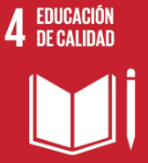
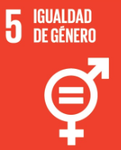
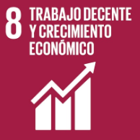


SDGs
Sustainable Development Goals
In 2015, the UN approved the 2030 Agenda for Sustainable Development. It is an opportunity for countries and societies to follow a new path that improves the lives of everyone without leaving anyone behind. The Agenda has 17 SDGs.
Achieving gender equality and empowering women and girls is an integral part of each of the 17 SDGs. Guaranteeing respect for the rights of women and girls through all of these goals is the only way to ensure justice, inclusion and economies that work for all.
https://www.unwomen.org/es/news/in-focus/women-and-the-sdgs

Slide 11
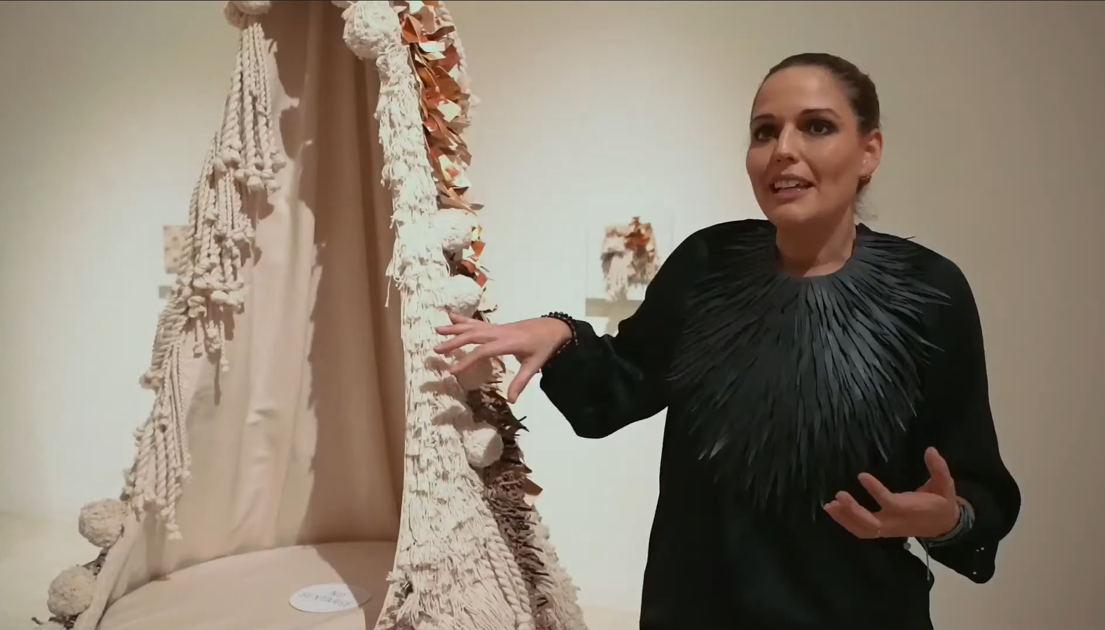
“Registering a trademark is the best advice that I can give to any entrepreneur”
IP WEEK 2021 - discussion with LULA MENA

Slide 12

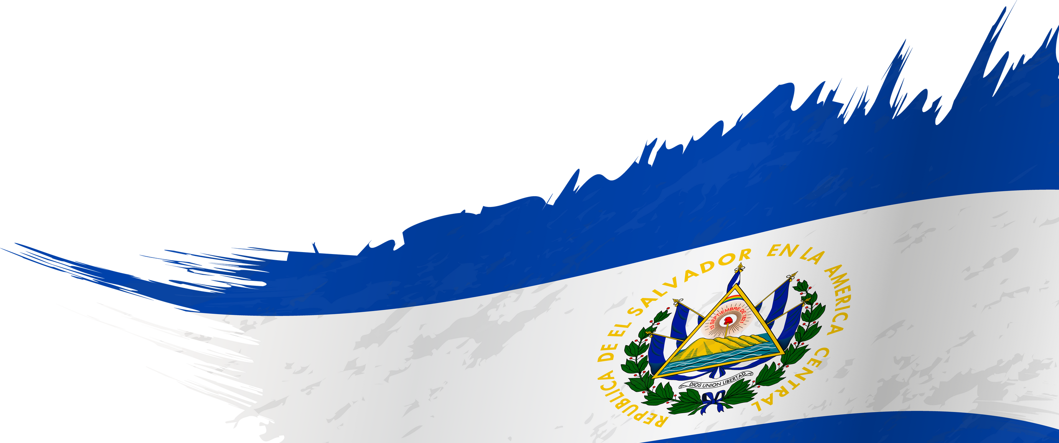
Success stories

Slide 13
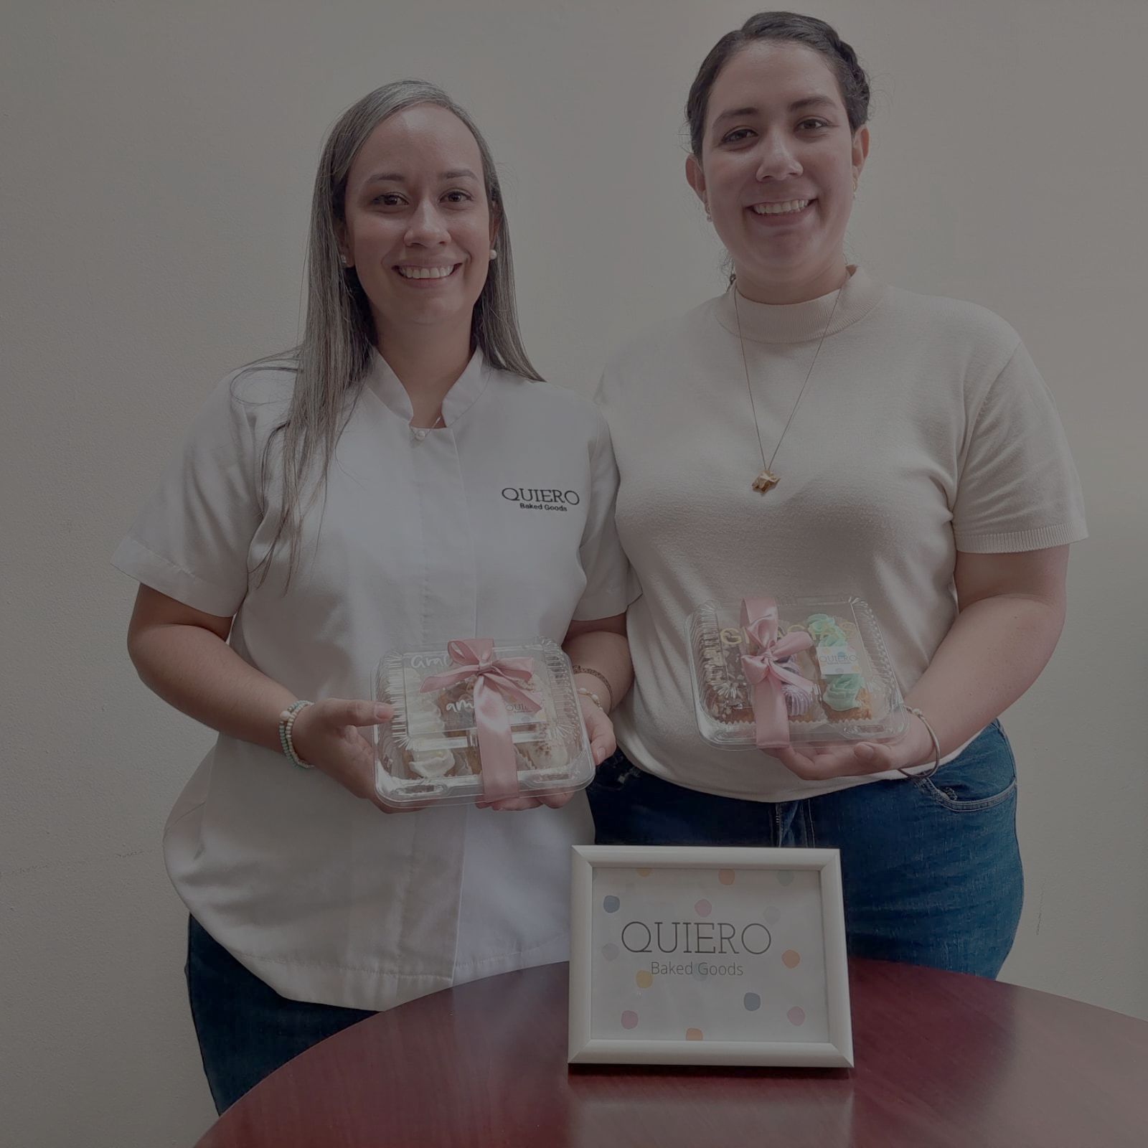


Daniela Marcela Carranza Guardado Camila Andrea Carranza Guardado

Slide 14


Luisa Elena Sanchez González

Slide 15

