Slide 1
Marketing communication and unfair competition
Iveta Chadimová
Ph.D. student
Metropolitan University Prague

Slide 2
The aim of the presentation
The aim of the presentation is to seek connections between marketing communications and the unfair competition.
We will note which marketing communications are or may be deemed to be fair or unfair.

Slide 3
Definitions of marketing, marketing communication and basic types of competitive behaviour punishable by unfair competition law
Marketing is a business strategy, which aims to sell as many goods as possible at premium prices.
Marketing communications are signals by which the competitor is trying to influence the behaviour of consumers, rival companies and other market participants.
Competitive behaviour is possible to divide as fair or unfair. The extreme poles of fair and unfair behaviour are:
LURING versus DECEPTION, INITIATIVE versus AGGRESSION, SYMBIOSIS versus PARASITISM
We can find marketing communications, betwen the extreme poles, which fairness is not clear. We say that they are in grey zones. Their fairness or unfairness can be judged by court.

Slide 4
Private law legislation of unfair competition in the Czech Republic under New Civil Code
The unfair competition is included in the Act 89/2012 Coll. (called New Civil Code) from the 1th of January 2014.
The Act provides us the conditions under which marketing communication could be described as fair or unfair.
The unfair competition law is based on general clause (§2976 (1) NCC) and on the illustrative list of special legal classifications (§ 2976 (2) NCC).
The list is only illustrative , which means that, the other competitive activities of unfair competition can occur in practice.
Special legal classifications are the most common competitive conducts of unfair competition, which are conceived more specifically in the provisions §§ 2977 – 2987 NCC.
Means of legal protection against unfair competition and the persons entitled to request application in the court, are governed in provisions §§ 2988 and 2989 NCC.

Slide 5
General clause and judge made (judicial) legal classification of unfair competition – parasitism or „free - riding“
General clause in provision § 2976 (1) NCC contains the basic conditions to be done for the Unfair competition:
Acting in the economic contact,
The conduct is contrary to good morals of the competition,
The conduct is capable of causing injury to other competitors or other customers.
The basic conditions of the general clause must be met cumulatively – they are necessary and sufficient.
The unfair competitive conducts under general clause which repeated often in the practice are called „judge made legal classifications“.
Judge made legal classifications are not expressly governed in NCC, but they can be inferred on the basis of the three conditions of the general clause.
The example of one of the judicial legal classifications of the unfair competition is parasitism or „free – riding“.

Slide 6
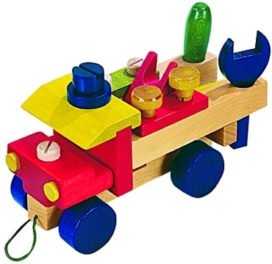
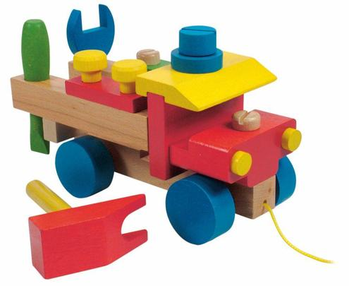
Judicial legal classification: „Free - riding“ – take apart lorry and slavish imitation
Original Slavish imitation
Child´s toy – take apart lorry Child´s toy – take apart lorry
Producer: DETOA Albrechtice s.r.o. Producer: WOODYLAND s.r.o.

Slide 7
Judicial legal classification: „Free - riding“ – take apart lorry and slavish imitation
The parasitic competitor made its toys in China. The price at the Czech market was much lower than of the original toy.
The parasitic competitor imitated full details, including colours, so that both of the products were completely identical.
Marketing communication, in this case unfair, was the attractive appearance of the product (its design), combined with interesting functional principle of the toy.
The slavish imitation is clear parasitism or "Free - riding" on the work of the original producer.
It's an exploitation of development, testing at the market, finances and mental effort of the original producer.

Slide 8
Special legal classifications of unfair competition where we can find deception
Deception: it´s the unfair competitive conduct, when a competitor is trying by different marketing communications to mislead a consumer about the product, service or the rival company, therefore the consumer would make a buying decision, which would not make otherwise.
The opposite of deception is luring (e.g. advertising exageration which is allowed).
The marketing communications that mislead are:
Misleading advertising (§ 2977 NCC)
Misleading designation of goods or service (§ 2978 NCC)
Common provision on misleading advertising and misleading designation of goods or service (§2979 NCC) – sometimes it´s even possible to mislead with true information.
Comparative advertising, which is not allowed by law (§ 2980 NCC) – explicitly or by implication identifies a competitor or his goods or service (there can be either deception, or parasitism or aggression).
Likelihood of confusion (§ 2981 NCC) - provided that this conduct is likely to cause confusion or false idea of connection with the competitor´s undertaking, trade name, trademark, registered design, artistic performance, appearance of the product or domain name etc.

Slide 9
Special legal classifications of unfair competition where we can find parasitism
Parasitism or „Free – riding“ differs from deception. There is not made the impression about different entity or different product or service.
The competitor is presented under the real name, but he often claims that his product has the same characteristics as the branded product of the rival competitor, but it´s cheaper.
The opposite of parasitism is symbiosis.
Symbiosis means that not always, the parasitic conduct is detrimental to the competitor, whose reputation is riding on. Some sort of symbiosis is in accordance with law ( e.g. the case „Champomy“ in the case law of the Court of Appeal of Paris 2007)
Champomy was a sparkling apple drink. The word was derived from the French word "Pomme" - an apple.
The court concluded that children who have accustomed to drink Champomy during their birthday parties, would be more likely to consume Champagne in their adulthood.
The rival's company conduct could be to the benefit of producers of Champagne.

Slide 10
Special legal classifications of unfair competition where we can find parasitism
The marketing communications that are parasitic are:
Free - riding on reputation of the undertaking, product or service (§ 2982 NCC)
Commercial Bribery (§ 2983 NCC) – a special sort of parasitism

Slide 11
Special legal classifications of unfair competition where we can find aggression
Aggression is an unfair act of competitor towards consumers, or rival competitors, that is not expressely governed in New Civil Code, but it could be inferred under lines of special provisions of the unfair competition :
Denigration (§ 2984 NCC) – the example of denigration is damaging of the goodwill of another competitor by untrue or true information. It must be capable to cause him a damage. Denigration is often a marketing communication.
In some cases even „Violation of trade secret“ (§ 2985 NCC) can be judged as aggression – there is a double protection of trade secret in the Czech law – as a right in rem (§ 504 NCC) and also as the special legal classification of the unfair competition.
Unacceptable nuisances (§ 2986 NCC) – new special legal classification, which was inserted into NCC due to the development of electronic means of communications and unfair trade practices that appeared with them.
Threat to human health or the environment (§ 2987 NCC) – e.g.the toy at the market, which is dangerous for the health of the child. In this case it is not directly marketing communication , but the product itself, which occurs at the market and it is dangerous.
The opposite of aggression is initiative. The abstract measure are good morals of competition.

Slide 12
Means of legal protection and the persons entitled to request application.
Means of legal protection against unfair competition include:
Cease and desist order (e.g. refrain from specific advertising)
Order to withdraw or recall (e.g. Change of the trade name and registering of the new trade name in the Commercial Register)
Compensation as a remedy of the non-pecuniary damage (e.g. an apology in the press, or payment in cash, if there are reasonable grounds).
Damages (if the property of a specific competitor diminished, because of the unfair competitive practice of another competitor)
Unjust enrichment (e.g.illegal profit by a specific competitor who enriched himself by copying another imaginative product)
Person who is actively entitled (locus standi) to request application in the court (e.g. Not only a competitor or a customer, but also a natural person, whose name was unfairly used in advertising).
Person (passively) entitled to request application in the court (e.g. a competitor who committed the unfair competition or an auxiliary person who made a contribution to the disclosure of trade secret or bribery)

Slide 13
Conclusion
The most important private standard in the Czech Republic, which regulates the protection against unfair competition from the 1 th January 2014 is Civil Code no. 89/2012 Coll. (New Civil Code)
NCC also regulates the area of fair use of marketing communications. Crucial part is that one, which contains legislation protecting against unfair competition.
The law against unfair competition in the NCC doesn‘t differ significantly from the previous legislation for unfair competition.
As for legislation and practical use, NCC is built on the philosophy of natural law.

Slide 14
Thank You for your attention
Iveta Chadimová

