Slide 1
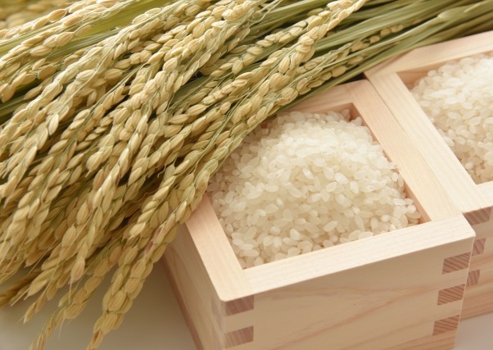
Tsuyahime the challenge of a rice variety from Yamagata
Asahi SUZUKI
Managing Director,
Agricultural Administration Planning Division
Yamagata Prefecture, JAPAN

Slide 2
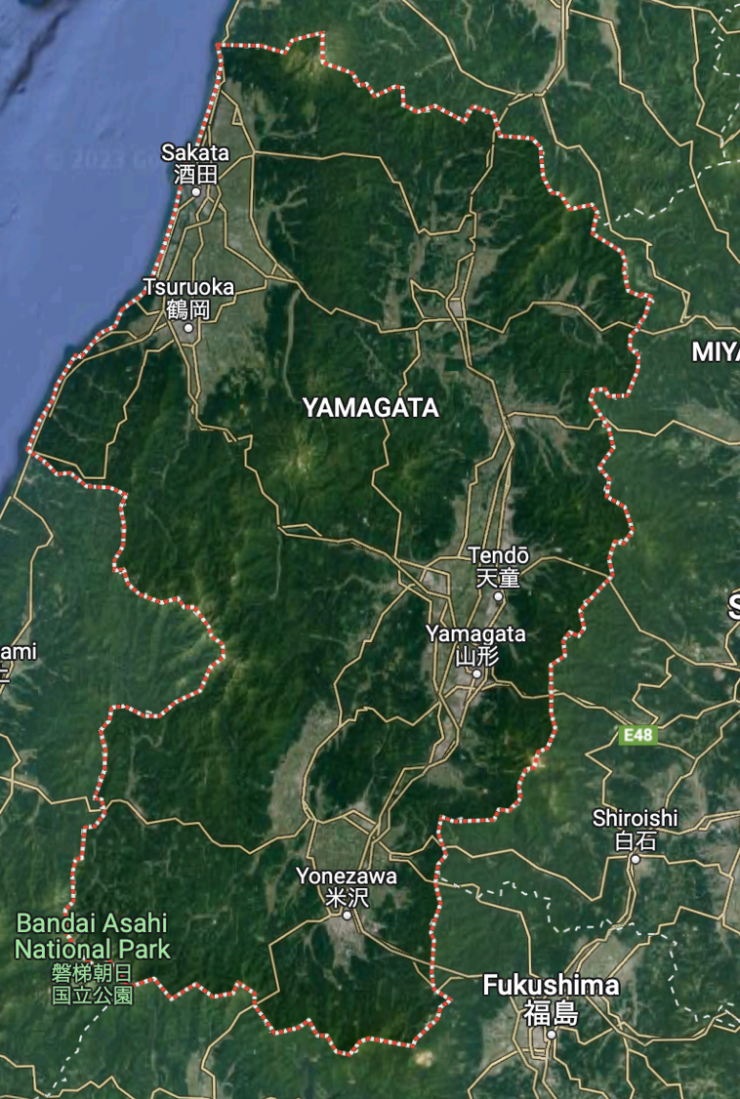
Yamagata Prefecture
Population: 1,080,000
Area: 9300 ㎢
Yamagata
Tokyo

Slide 3
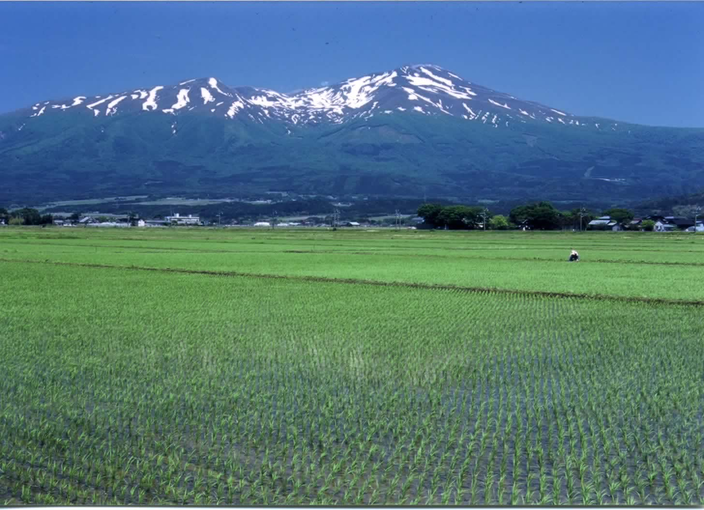
Agriculture in Yamagata
Agricultural Production: Total ¥25.1 billion ($209 million) (2020)
1,158 ㎢ agricultural land
(12.4% of total prefectural area)
39,034 farming households
28,241 farming entities
27,233 individual farms
1,008 organizational farms
(626 corporate farms) （Agricultural Census 2020）

Slide 4
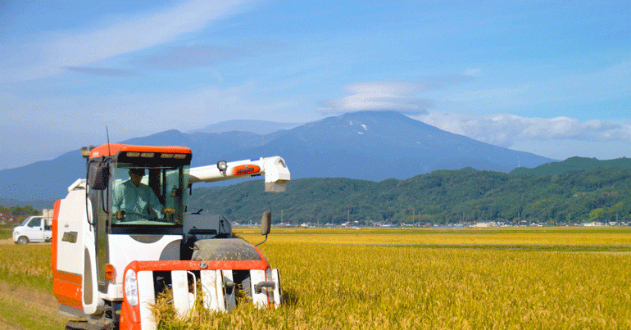
Rice Production in Japan

Slide 5
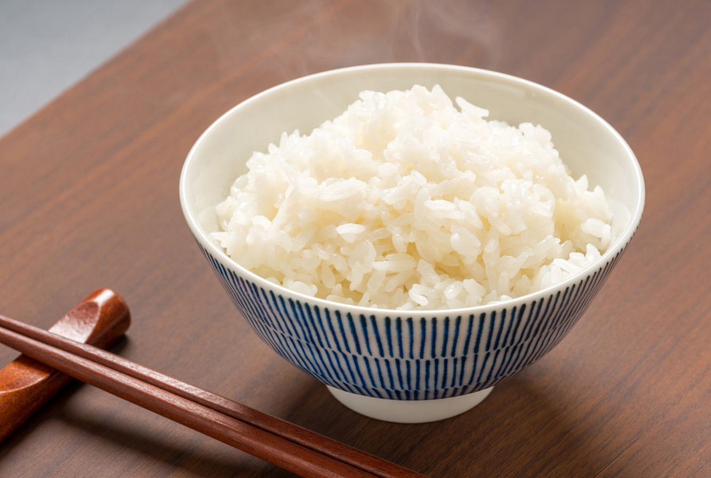
Rice Consumption Trends in Japan
(kg/year)
Rice consumption has declined due to the diversification of Japanese diet
Consumers have become more conscious of quality and taste of rice

Slide 6
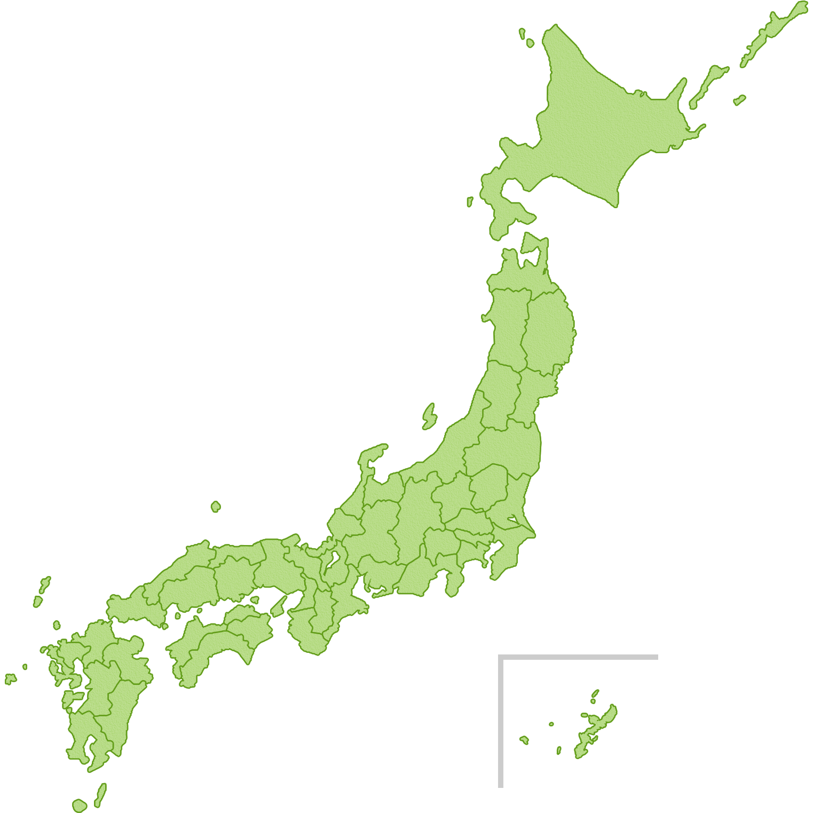
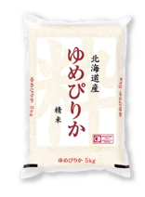
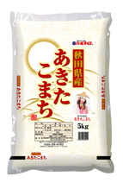
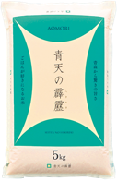
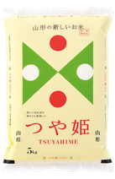
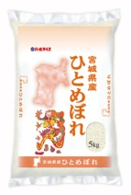
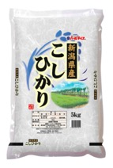
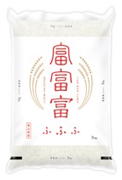
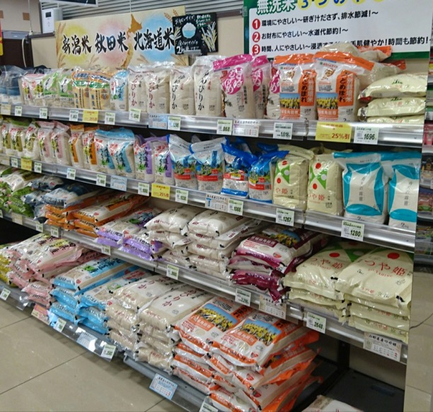
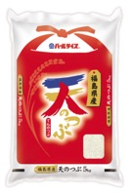
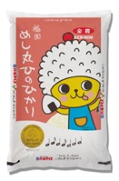
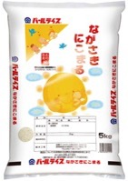
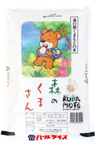
Brand Name Rice
Rice is branded by production areas (prefectures) and varieties
Japanese rice market is one of the most competitive in the world

Slide 7
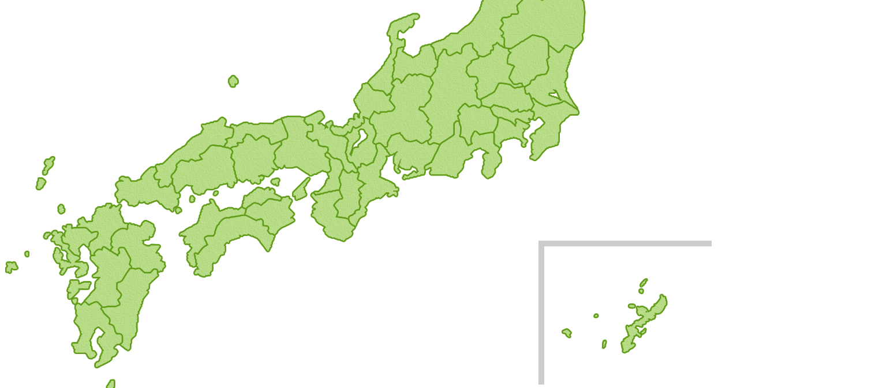
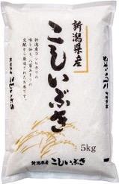
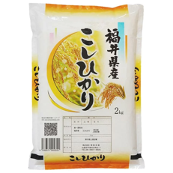
Brand Name Rice – Pricing Examples
Variety (example) | Region | Price (60kg)
Koshi-hikari | Nigata (Uonuma) | ¥16,611 (¥21,090)
Koshi-ibuki | Nigata | ¥13,405
Koshi-hikari | Fukui | ¥13,867
Average | Nationwide | ¥13,880
（September 2022）

Slide 8
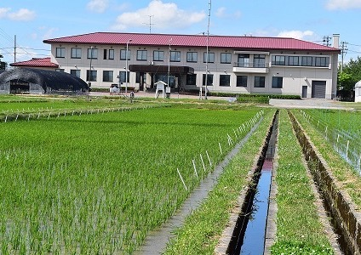
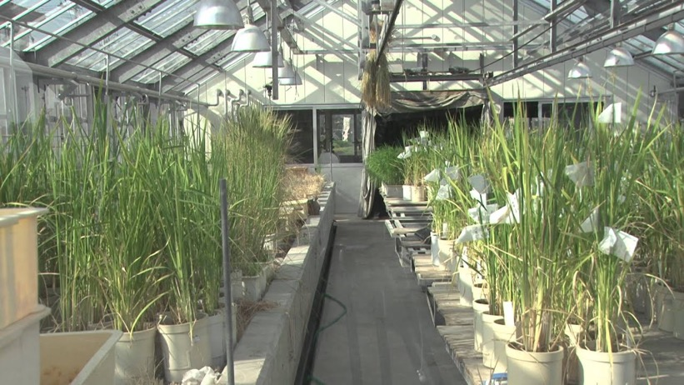
Development of the Rice Variety “Tsuyahime”
Rice Breeding and Crop Science Research Institute,
Yamagata Integrated Agricultural Research Center
1998~ | Cross-breeding, selecting
2008 | Adopted as a recommended variety of the prefecture
2009 | Apply for Plant Breeder’s Right
2010 | Debut (Full scale planting)
2011 | Granting Plant Breeders’ Right

Slide 9
Branding Strategy
Production Plan emphasizing on quality and taste
Branding strategy targeting the premium end of the market
Motto: “the most delicious rice brand in Japan, highly appreciated by consumers throughout the country”
Public relations strategy to improve its reputation and visibility

Slide 10
Intellectual Property for the Branding of Tsuyahime

Slide 11
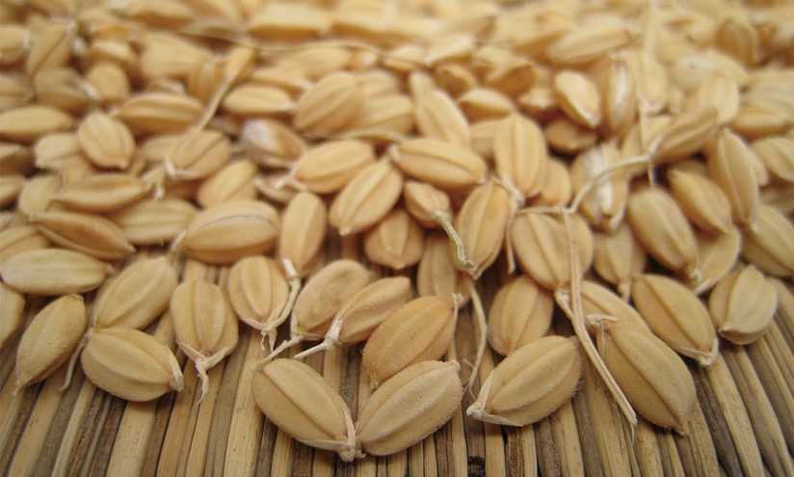
Variety Registration under UPOV System of Plant Variety Protection
Registration of the new rice Variety under the Japanese Law for PVP
Registered Variety Name: “Tsuyahime”
Breeder’s right holder: Yamagata Prefecture
Registration: August 2011
Period of protection: 25 years

Slide 12
Plant Variety Protection with Breeder’s Right
Certification as Tsuyahime grower
Prefecture Yamagata
(Breeder’s right holder)
Farmer
Shipping as rice
license to produce and sell seeds
Original seeds
of Tsuyahime
Rice Seed Production Associations
Self-seeding
Transfer
as seeds
Tsuyahime seeds
Other Farmers

Slide 13
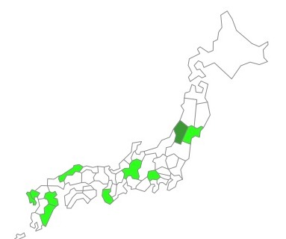
Utilization of Breeder’s right
License to produce and sell seeds
Restricted cultivation
Right to produce and sell Tsuyahime seeds is granted to:
Two Seed Production Associations in Yamagata
Seed Production Associations in nine other prefectures
(adoption as a recommended variety, similar cultivation practice to Yamagata)
Open strategy to nationwide branding
Producer Certification to limit farmers to grow Tsuyahime rice under our special cultivation practice
Production Strategy

Slide 14
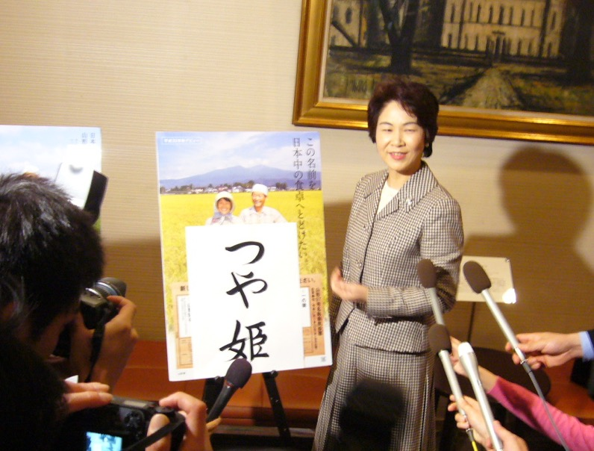
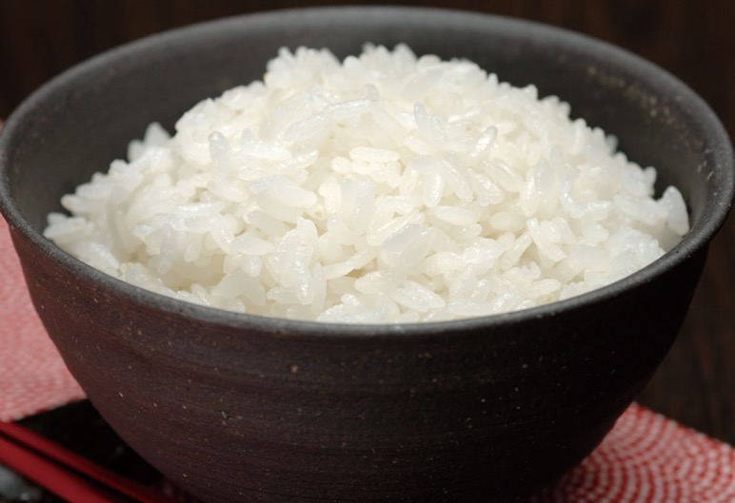
Trademark
Named through public suggestions and competition
”Tsuya” : Luster
“Hime” : Princess
Announcement of the name by the governor

Slide 15
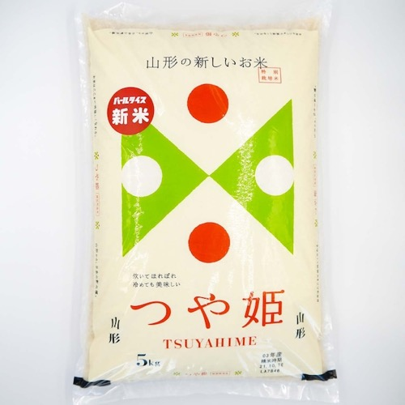
Trademark – Logo type and Symbol
Package design
米※
(rice)
Sales Promotion by the Governor

Slide 16
Trademark - Overseas
Countries and regions where Tsuyahime’s trademark is registered
Trademark in Chinese Characters
“滋雅”
Zi Ya
(Tasty and elegant)

Slide 17
Production Strategy of Tsuyahime

Slide 18
Suitable Farmlands Map, Cultivation Manual, and Shipping Standard
Suitable Farmlands Map
Cultivation Manual
Planting (timing, method…)
Fertilization（kinds, amount, timing…）
Pesticides and Herbicides (kinds, amount, timing…）
Water management
Harvest (timing)
Shipping Standard
Content of amylose, protein and water
Uniformity in grain size
best
Suitable
normal
forests

Slide 19
Producer Certification
Certification Criteria
Farmers;
who cultivate suitable farmlands according to the map
who comply with the cultivation manual and the shipping standard
who cultivate Tsuyahime eco-friendly (organically or with reduced agrochemical use )
Certification by the Governor

Slide 20
Production of Tsuyahime in Yamagata
4,894 Farmers
10,048ha
2,520 Farmers
2,500ha
Total: 61,934 ha (2021)

Slide 21
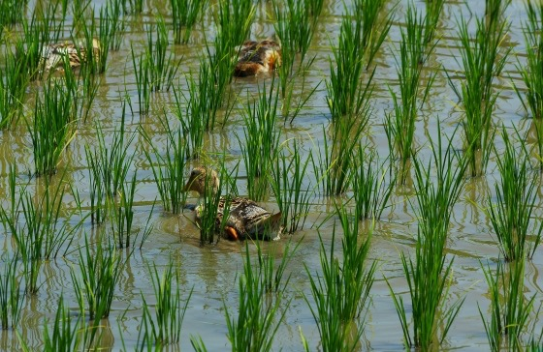
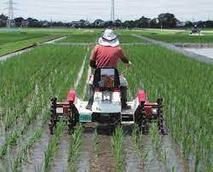
Ecological Farming of Tsuyahime
Organic Cultivation
Cultivation without using agrochemicals (chemical pesticides, herbicides and fertilisers)
”Special Cultivation”
Control weeds
using ducks or specialized machines
Cultivation with reduced use of agrochemicals to less than 50% of customary level in the region

Slide 22
Branding Success
¥21,090
¥18,613
¥13,880

Slide 23
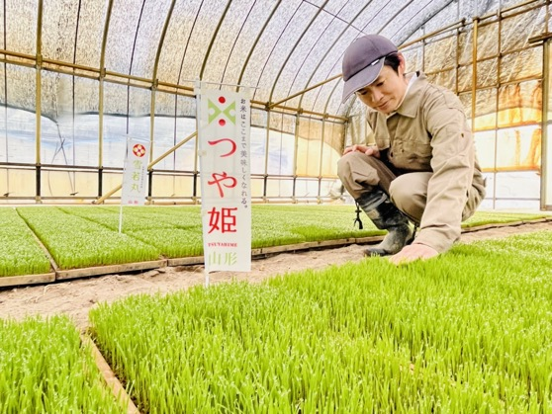
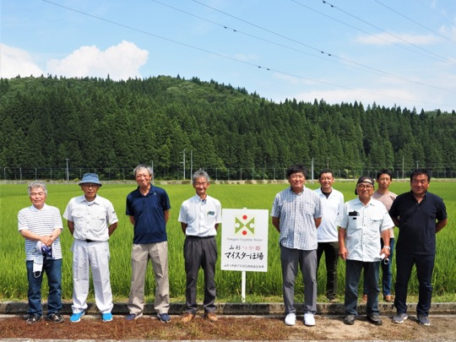
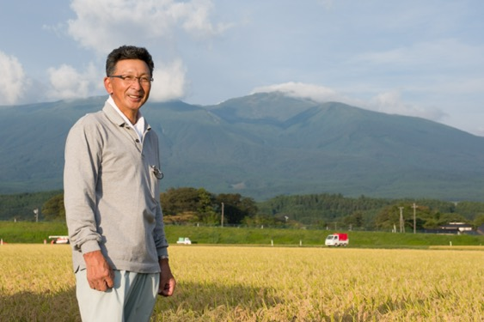
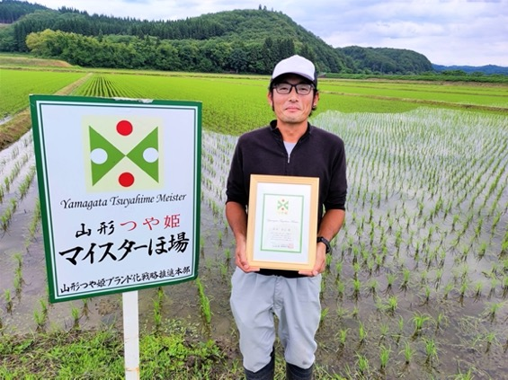
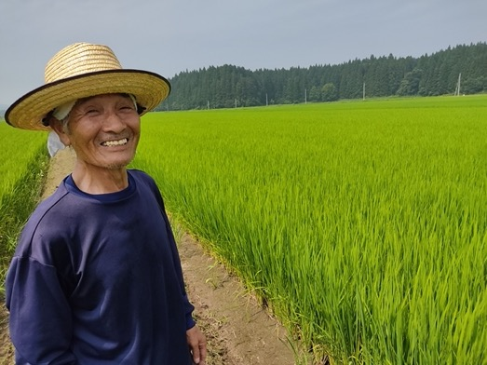
Farmers’ Motivation

Slide 24
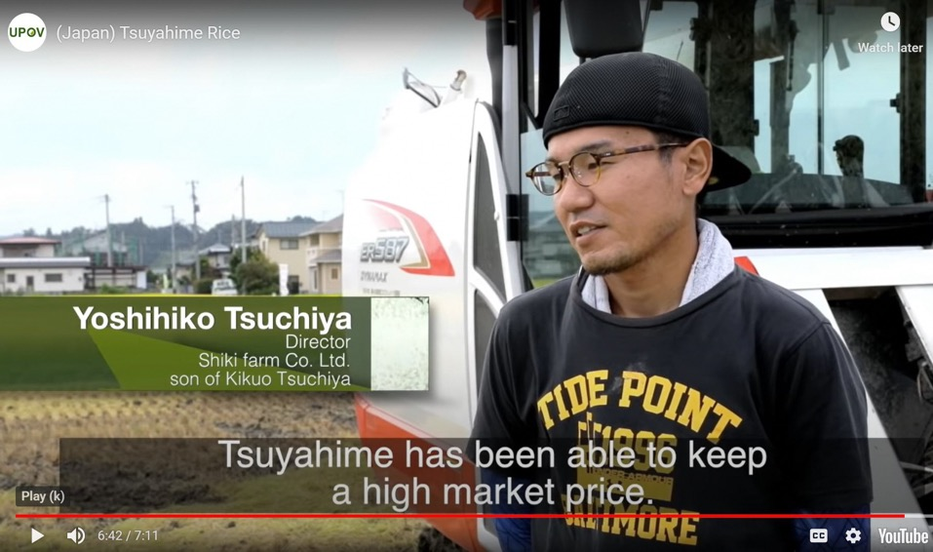
Video Clip by UPOV
UPOV made a video in cooperation with Yamagata Prefecture about Tsuyahime in regard to the perspective of its branding strategy using IP
https://www.upov.int/about/en/benefits_upov_system.html

Slide 25
Conclusion
Tsuyahime was branded using the combination of PVP and trademarks
The strategy focusing on high quality production satisfied consumers
Successful branding results in better income for farmers
Tsuyahime is a growing movement towards sustainable agriculture in Yamagata

