Slide 1
Panel 1: Agricultural Land and Inputs – Preparing the ground
WIPO International Conference on Intellectual Property (IP) and Development –
IP and Innovation for Sustainable Agriculture
Peter Button
Vice Secretary-General, UPOV
April 24, 2023

Slide 2
Preview
Agricultural productivity in the context of climate change
Role of plant breeding and plant variety protection
Examples

Slide 3
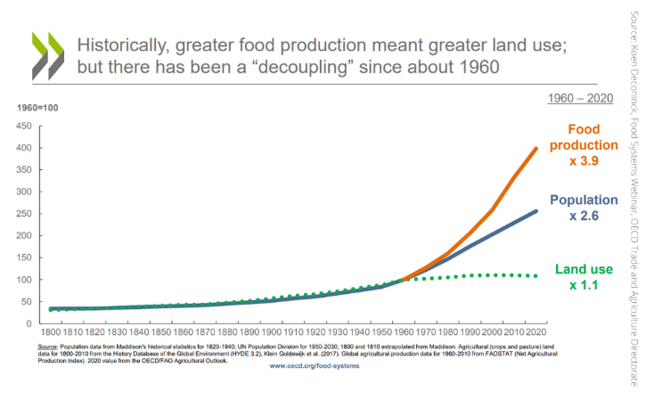
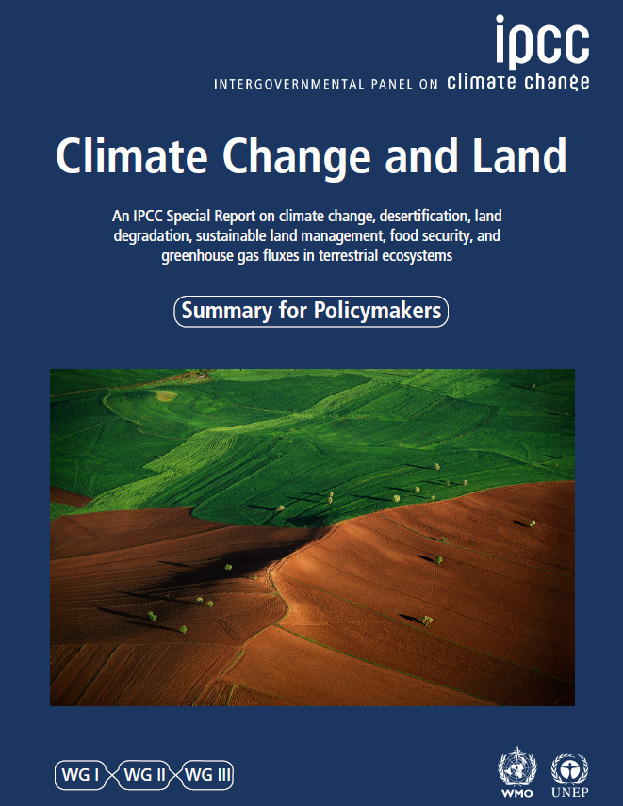
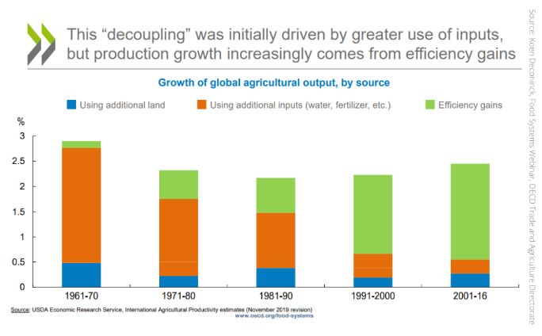
Importance of increased food productivity

Slide 4
Preview
Agricultural productivity in the context of climate change
Role of plant breeding and plant variety protection
Examples

Slide 5

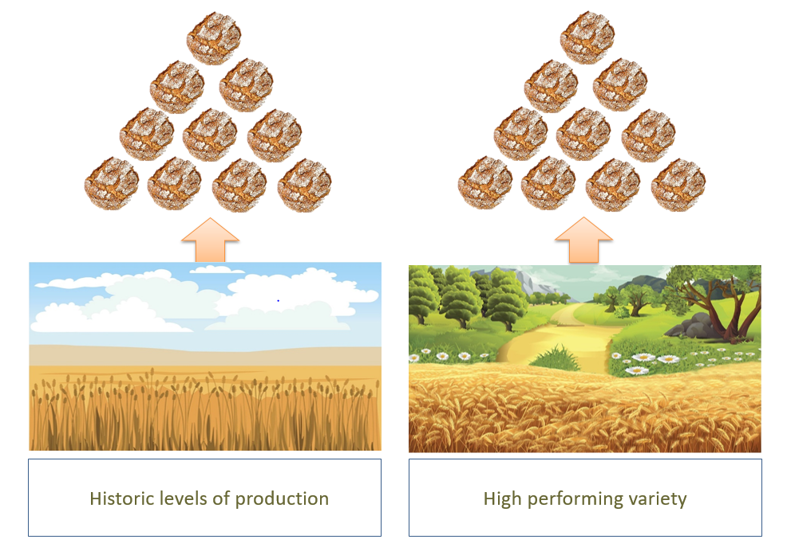
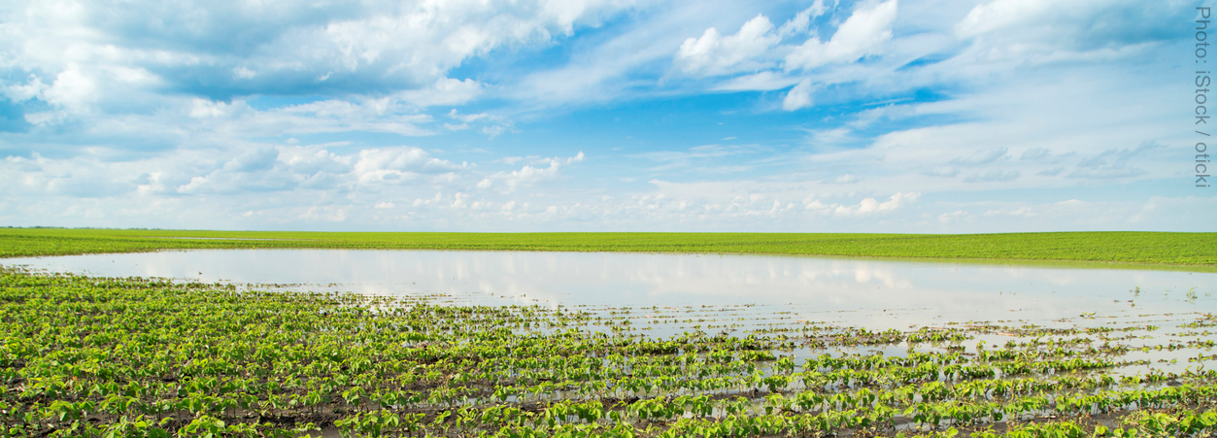
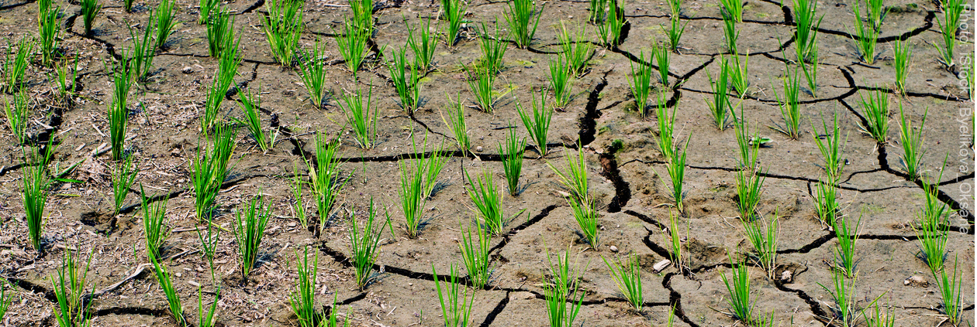
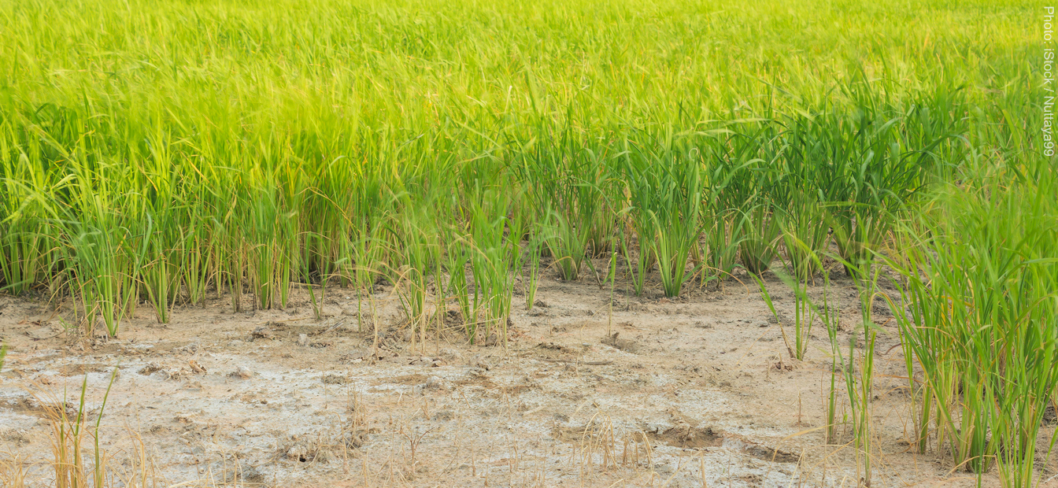

Slide 6

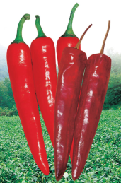
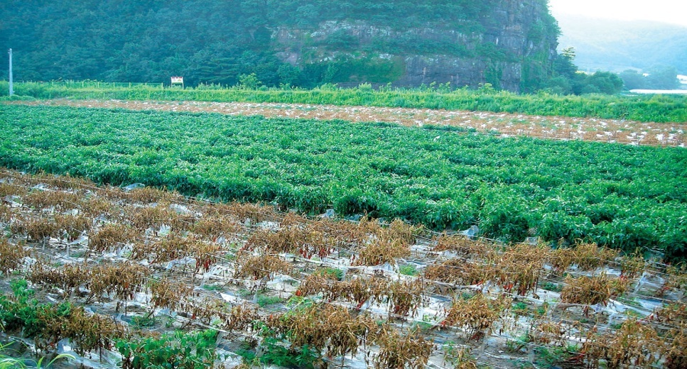

Improved Varieties
Dok-Ya-Cheong-Cheong
Resistant to phytophthora blight/virus
Phytophthora blight (Fungal disease):
- above : Resistant variety
- below: Susceptible variety
Chang Hyun Kim, Second World Seed Conference
Notes:
6

Slide 7
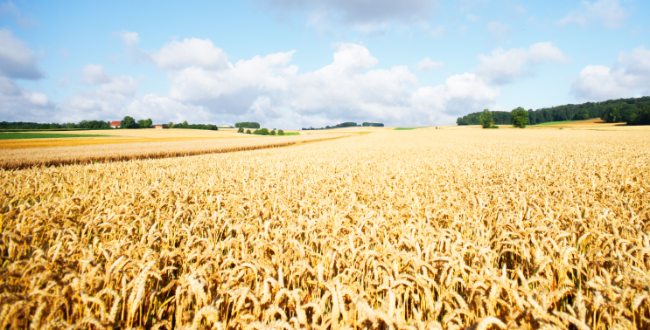
Lodging
Height
Earliness
Resistance to sprouting
Mildew
Yellow rust
Brown rust
Septoria nodorum
Septoria tritici
Eyespot
Fusarium ear blight
Orange wheat blossom midge
Yield: treated/untreated
Yield: early sown/late sown
Yield: light soil/heavy soil
Breadmaking quality
Biscuit making quality
Feed quality
(Photo: istockphoto/Ziva_K)

Slide 8

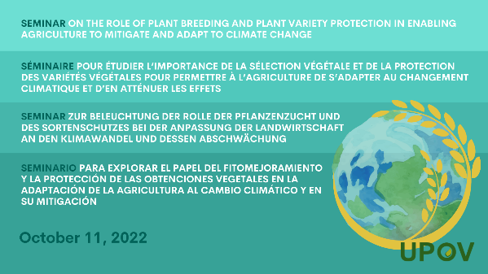
Seminar on the role of plant breeding and plant variety protection in enabling agriculture to mitigate and adapt to climate change
Climate change is increasingly affecting everyone around the world: farmers, breeders and consumers. Effects are biotic (new pests and diseases) and abiotic (heat, drought, rain, seasonal changes).
A range of strategies is needed to respond to the challenges. Plant breeding has a vital role to play in these strategies; farmers need new plant varieties to adapt to climate change but also to sustainably increase productivity in order to minimize climate change.
Plant breeding is a long-term process that requires long-term investment from public institutions and from private companies. Plant breeders need a regulatory environment that promotes innovation and supports the conservation and utilization of genetic resources.
The UPOV system enables plant breeders to provide farmers with the varieties they will need to feed the world in the face of climate change.
https://www.upov.int/meetings/en/details.jsp?meeting_id=71391

Slide 9
BREEDERS
Improved varieties
Income according to farmers’ and consumers’ needs
NEW VARIETIES
FARMERS,
GROWERS
CONSUMERS

Slide 10
The Breeder’s Exemption
Protected
Variety A
Non-protected
Variety B
Breeder 1
Breeder 2
Breeder 3
Authorization
of Breeder 1
NOT
required
Authorization
of Breeder 2
NOT
required
Variety C
Authorization
of Breeder 1
NOT
required*
Authorization
of Breeder 2
NOT
required
Commercialization
* Except for:
(i) varieties which are essentially derived from the protected variety, where the protected variety is not itself an essentially derived variety,
(ii) varieties which are not clearly distinguishable in accordance with Article 7 from the protected variety and
(iii) varieties whose production requires the repeated use of the protected variety.

Slide 11
Preview
Agricultural productivity in the context of climate change
Role of plant breeding and plant variety protection
Examples

Slide 12
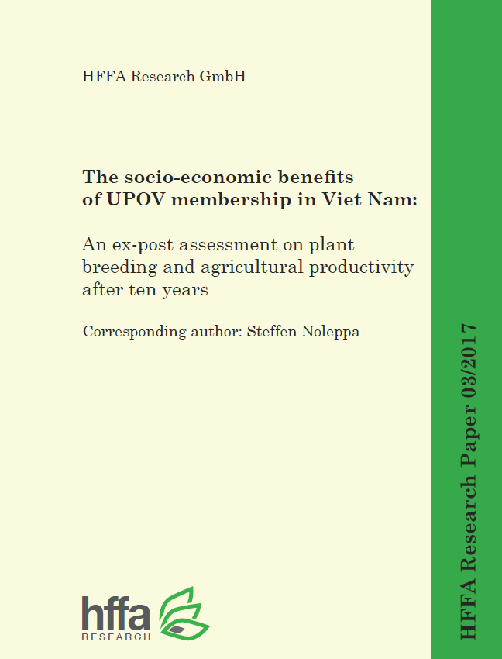
STUDY in VIET NAM*
Annual land productivity developments since Viet Nam joined UPOV in 2006 in
1995-2005: increase in yield mainly through increased level of inputs – no detectable increase due to plant breeding
2006-2016: annual land productivity increase due to plant breeding
  Rice 1.7 %
  Corn 2.1 %
* “The socio-economic benefits of UPOV membership in Viet Nam; An ex post assessment on plant breeding and agricultural productivity after 10 years” (Corresponding author: Steffen Noleppa) by HFFA Research GmbH

Slide 13

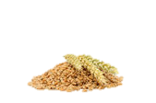

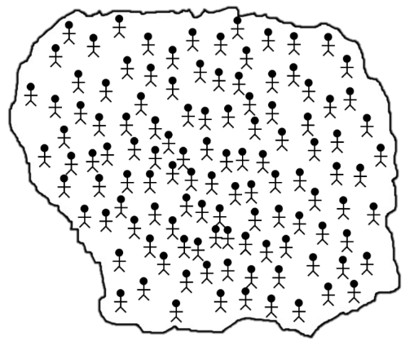
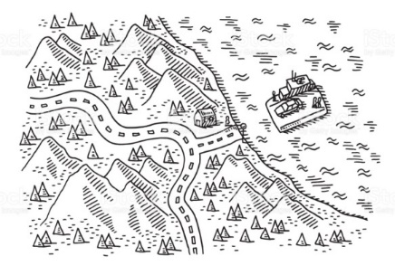






PRIVATE SECTOR
PUBLIC SECTOR
BREEDERS
International
Breeding (Institute)
National Breeding Institute
Large enterprises
(e.g. companies, cooperatives)
SME’s
Individuals
(e.g. farmers)
SEED
INFORMATION
SEED PRODUCERS / PLANT PROPAGATORS
PRODUCTION
&
DISTRIBUTION
SEED
PBR LICENCES
SEED
SEED
SEED
DISTRIBUTORS
SEED
SEED
SEED
FARMERS

Slide 14
  IMPACT OF PVP/UPOV SYSTEM ON VN’S AGRICULTURE
NGUYEN THANH MINH, PVPO, MARD/VIETNAM
PHILLIPINES, August - 2018

Slide 15

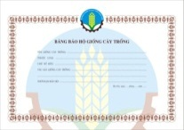
Seed distribution system of new varieties
Change the mode on the agriculture production (Viet Nam (Minh 2017))
BEFORE PVP
AFTER PVP
License
Breeders
Breeders
Company
Royalty
No Professional distribution
system
Good professional distribution
system
Farmer
Farmer
Not professional
Seed quality control difficult
Good service for the farmer;
Better seed quality due to professional distribution

Slide 16
STUDY in VIET NAM
Annual value added:
  Arable farming $2.3 billion
  Horticulture $1.0 billion
  Floriculture $ 0.2 billion
  GDP added upstream/downstream (value chains)
  $1.5 billion
  TOTAL ADDED: $5 billion
  (> 2.5% GDP)

Slide 17
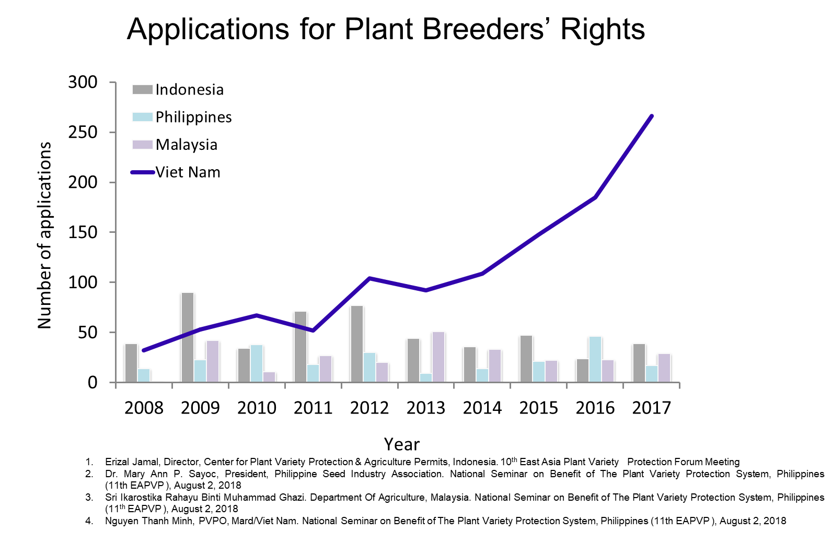

Slide 18
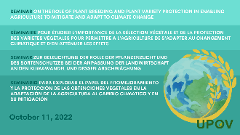
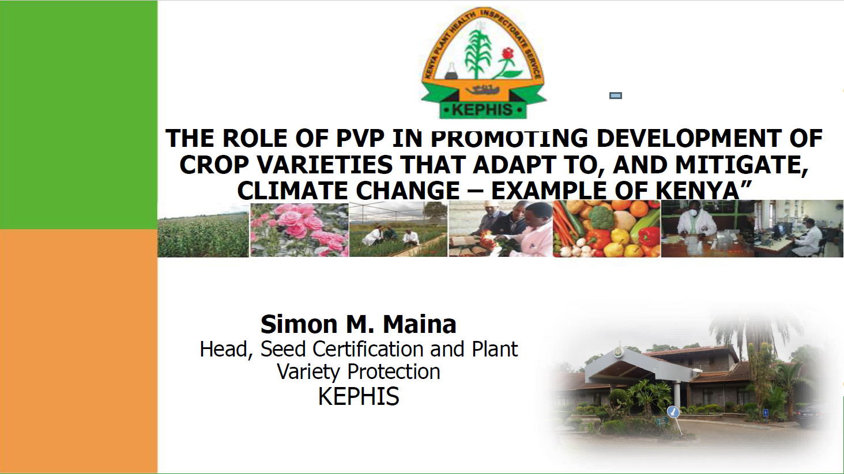
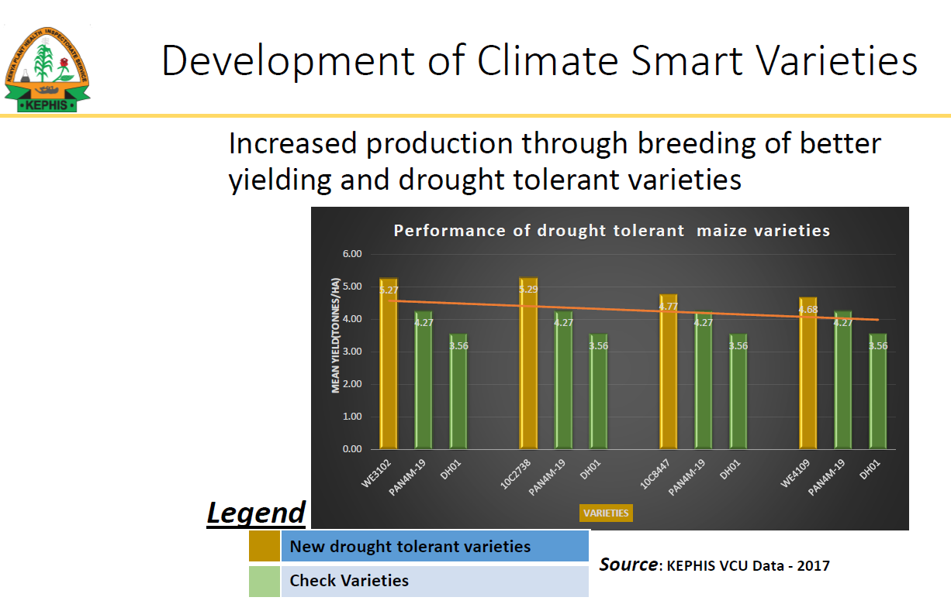
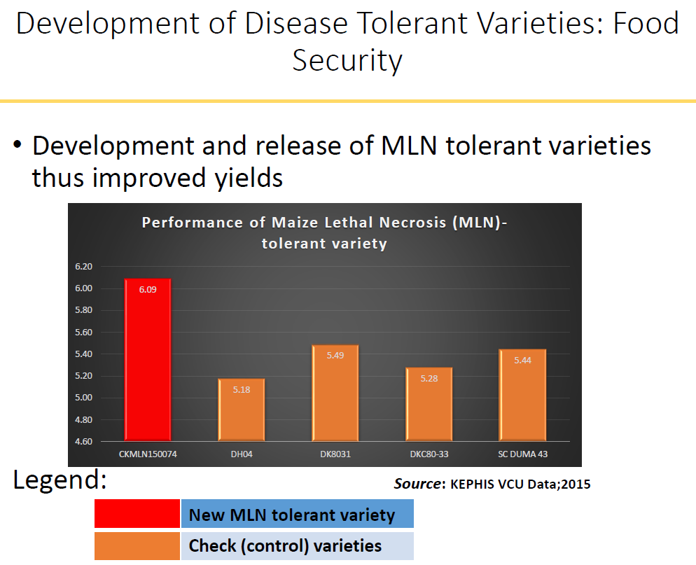

Slide 19
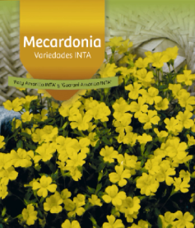
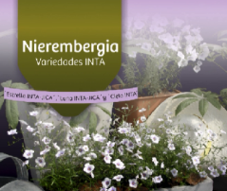
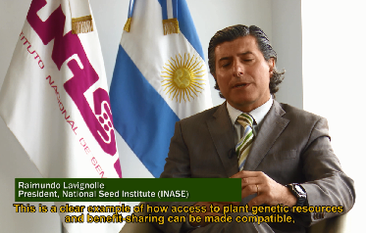
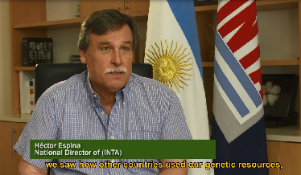
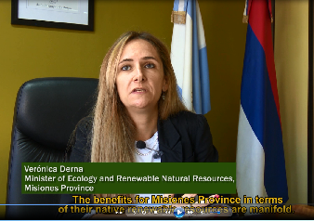
Using the UPOV System to benefit custodians of native wild germplasm in Argentina
“The royalties derived from commercialization of the variety are shared between the breeder and the provinces that contributed the native plant genetic resource.”
“The erosion/loss from their natural habitat is reduced
and this is therefore our own contribution, working together with INTA, for the conservation of our native natural resources.”
“A large part of the profits, basically, 50 per cent, that are generated from the commercialization return to those provinces.”
Notes:
The good example UPOV system is contributing the conservation of native natural plant resources in Argentina
In Argentina, Public reseach Institute (INTA) has been implementing a program to breed ornamental species from native flora as initial variety (Calibrachoa, Petunia).
The provinces of Argentina are the owners of natural resources and responsible for the access and use of the genetic recourses.
So the provinces and INTA and breeding companies signed an agreement on the access to native plant genetic recourse. And INTA obtained plant breeders’ rights on the new varieties developed
As much as 50 % of the royalty generated from the commercialization returned to the provinces, and province use this fund to conserve natural wild varieties. the erosion/loss from their natural habitat is reduced
This is a clear example of how the PVP and access to plant genetic resources and benefit-sharing can be made compatible : To achieve two objective which are UPOV system and the Convention on Biological Diversity (CBD), such as the conservation of biodiversity, access and benefit sharing from the use of natural genetic resources.

