Slide 1
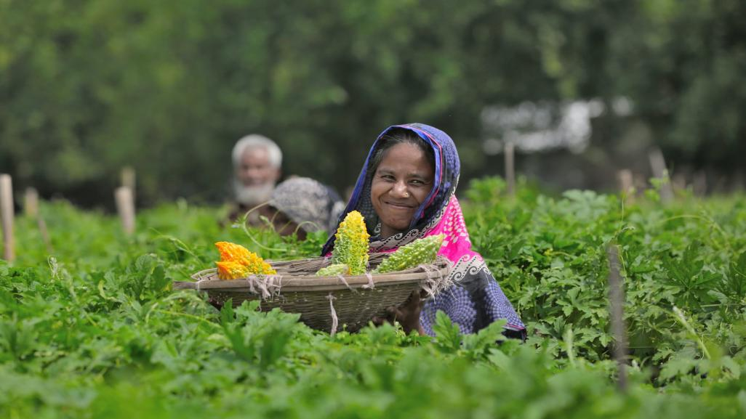
iFarmer Democratizing Agriculture Financing and Supply Chain

Slide 2
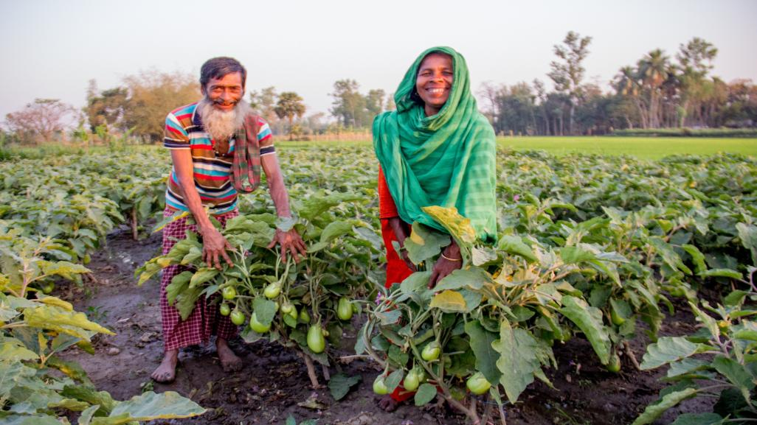
Problems for Smallholder Farmers in Bangladesh
17% farmers have access to formal credit
80% farmers opt for low quality inputs
50% loss in revenue for farmers due to middlemen
70% financing in Agri is from informal sources
30% of the inputs in the market are fake
$2.5b annual loss due to inefficient supply chain
Annual target for private and public banks for agriculture credit is about $2B. But they can meet 20-30% of that due to lack of access to data of the farmers and lack of infrastructure and resource to reach the farmers .

Slide 3
Bangladesh – a market of 170 million people
Agriculture Market Size is about $50 billion
20 million
16 million
0.5 mn
Smallholder Farmers
Smallholder Farmer lacking access to formal credit facilities
Farmers served through iFarmer by 2025
Agriculture sector generates employment for 37% of the overall working population and almost 80% of the rural population
Bangladesh will have to feed 230+ million people by 2050 and is expected to be the 11th largest consumer economy by 2030

Slide 4
iFarmer is a Full stack agri-tech platform
09
01
03
Finance
Input
Market
iFarmer
Advisory
Creating access to finance for farmers and Agri MSMEs, by connecting them with financial institutions
Enabling farmers and agro producers to sell their produce without any hassle and transparent pricing
02
04
Providing access to high quality inputs, for farmers and agri input retailers coupled with training on appropriate input usage
Creating access to smart and relevant advisory services for the farmers to make the right decisions at the right time
Launching Agri-Insurance product in Q1 2023
Launching access to farm mechanization product Q2 2023
Notes:
We make it easy for farmers to access financing , high quality agriculture input and to sell their produce at a higher price. iFarmer bundles everything a farmer needs: financing, farm inputs, advice, insurance, and market access, when possible.

Slide 5
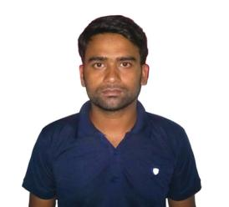
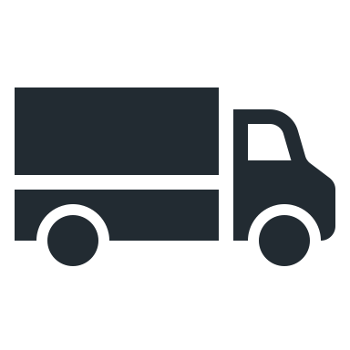
iFarmer business model
03
Agriculture Experts
Agri Input
companies
Central Markets
iFarmer Agents
Super shops
Soil Testing and farm advisory services
Farmers
Partner input
retailers
Collection and Distribution
Of Farm produce
Online Groceries
Banks, Insurance and Non-Banking Financial Institutions
Processors and Exporters
Agri-Machinery
Service Providers
iFarmer bundles everything a farmer needs: financing, farm inputs, advice, insurance, and market access

Slide 6
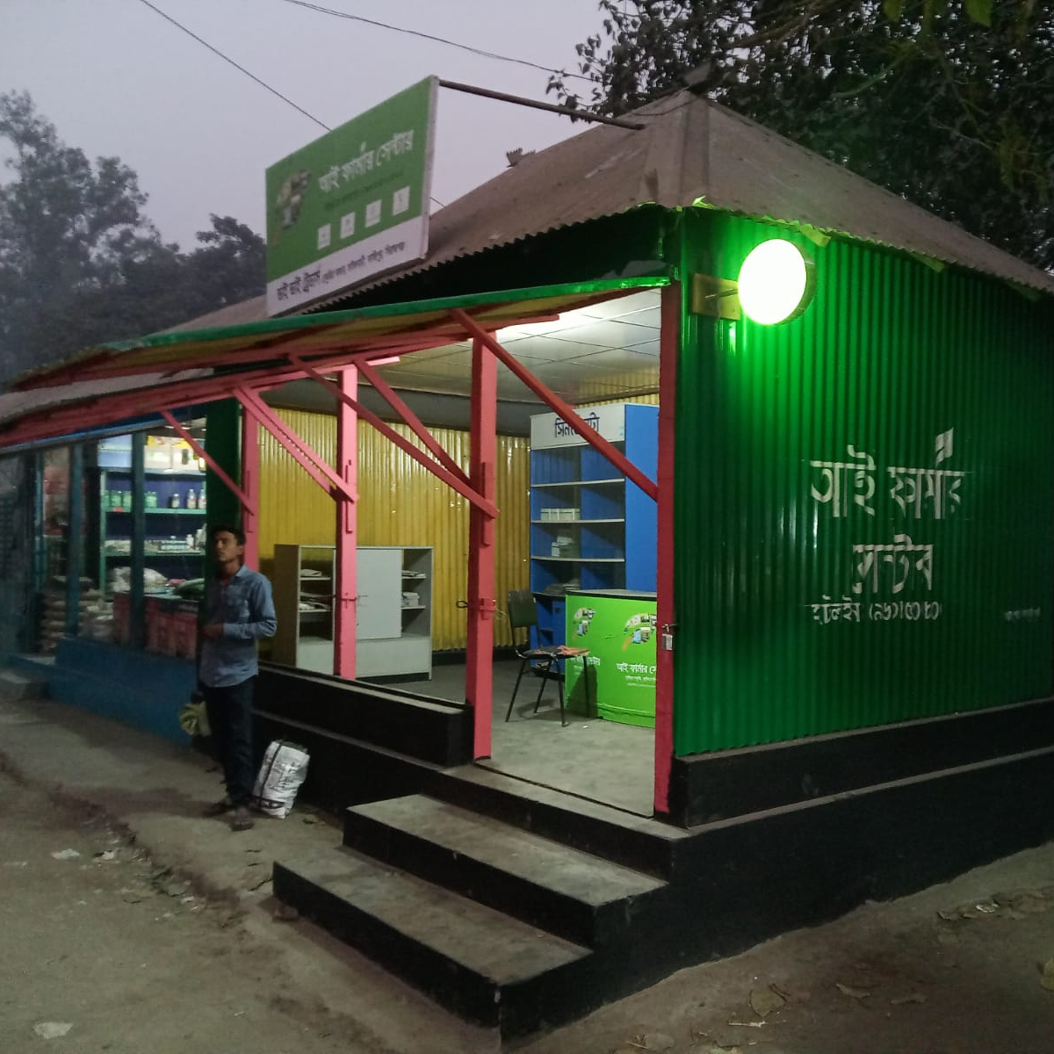
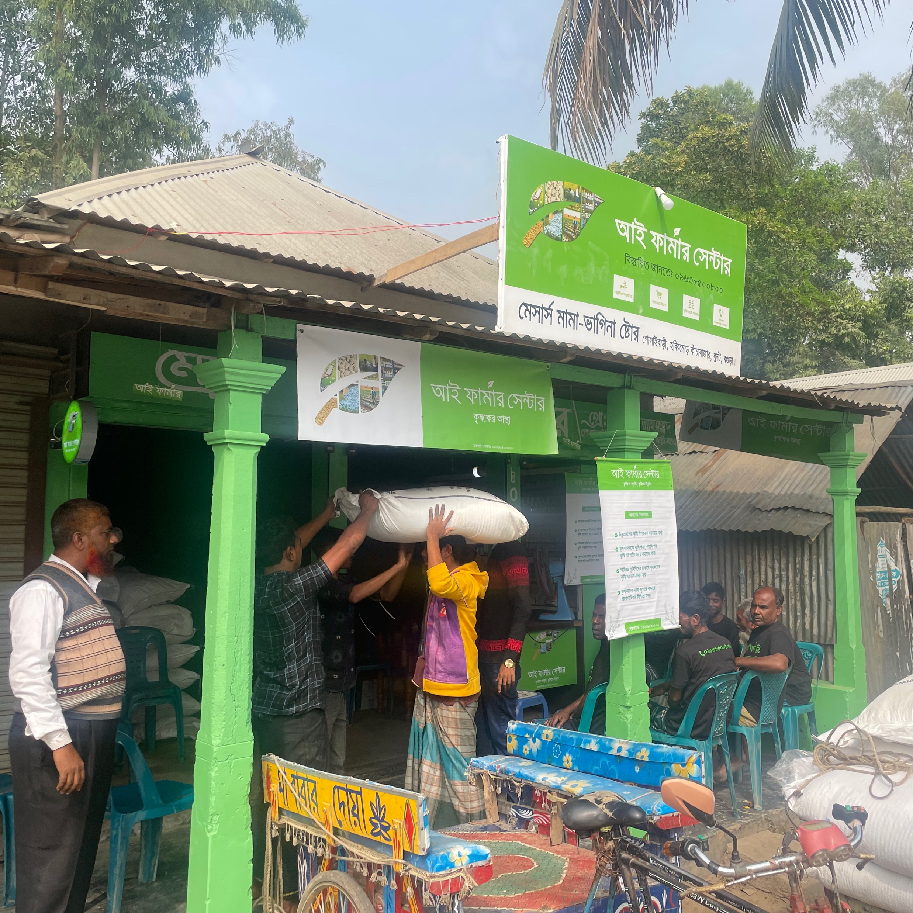
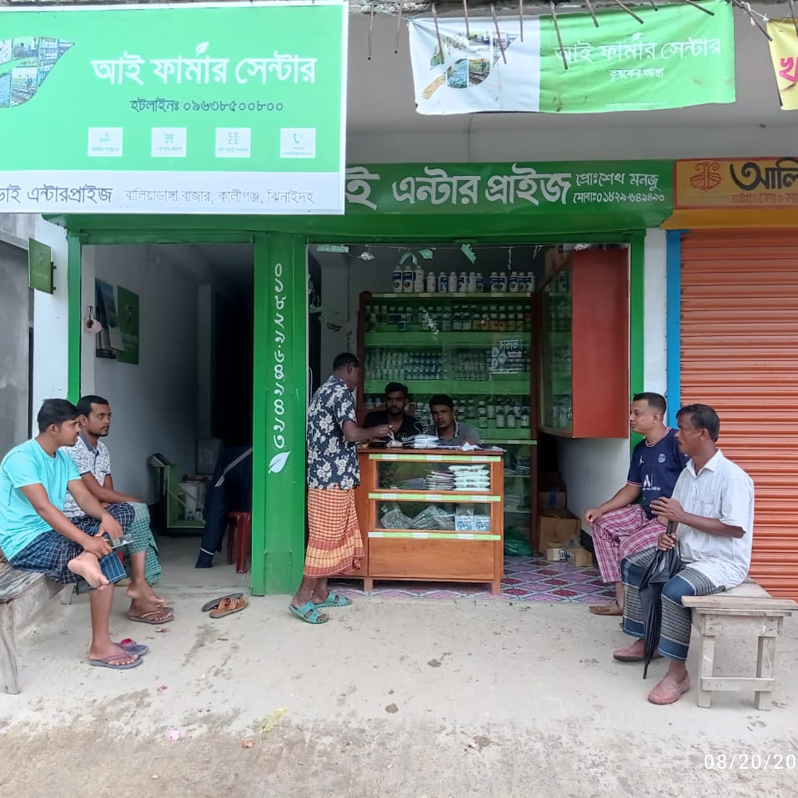
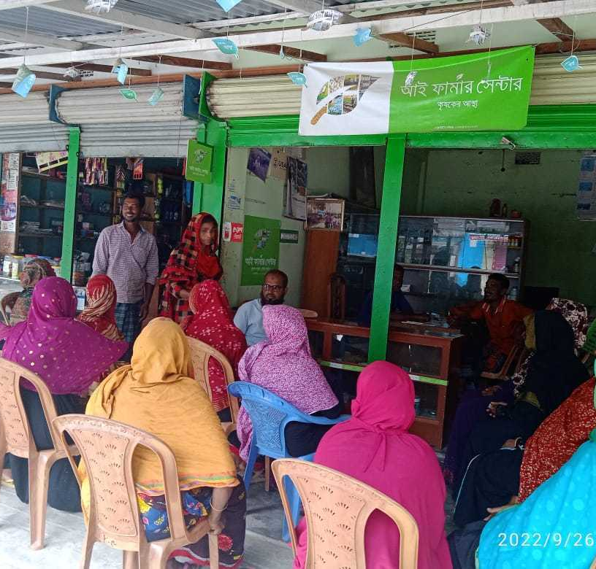
One Stop Solution for the Farmers
iFarmer centers are branded partner Agri-input retail shops, which serve as a one-stop solution for the farmers to apply for financing, buy input, get advisory services and sell their produce
Farmers can receive advisories, ask questions, and order input through the call center
iFarmer field facilitators work as last-mile aggregators of data, help connect farmers with iFarmer Centers, and organize field training and other interactions with the farmers

Slide 7
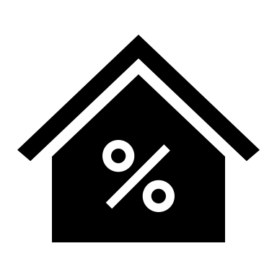
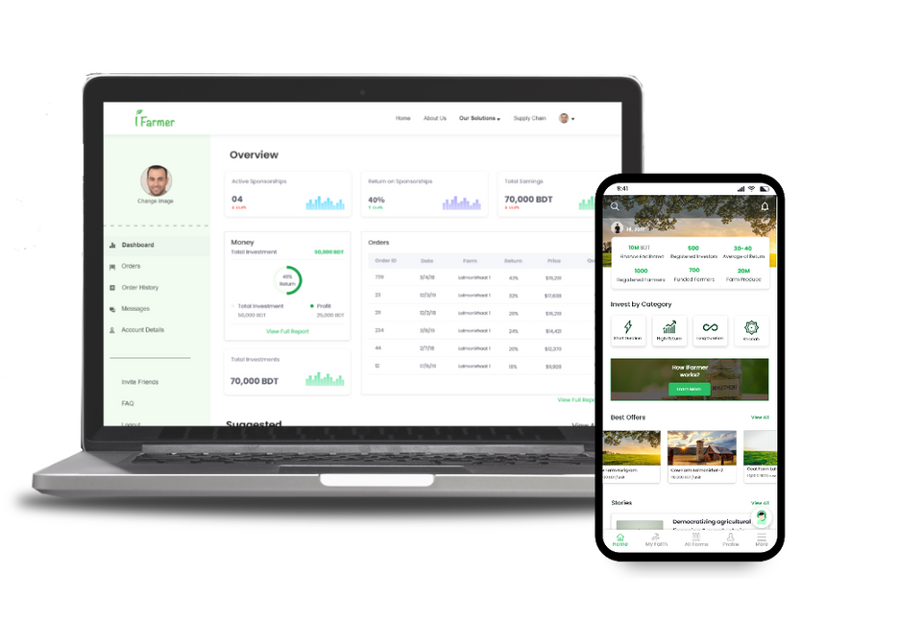
Innovation in access to finance for the farmers
Individuals can use iFarmer App to fund insured farms and can earn upto 20% annualized return
iFarmer channels the fund to the farmers sells quality, provide advisory, and help to sell the produce
Farmers can choose if they want retail investment or bank financing
Banks use iFarmer dashboard and risk score to give loans to the farmers without any collateral

Slide 8
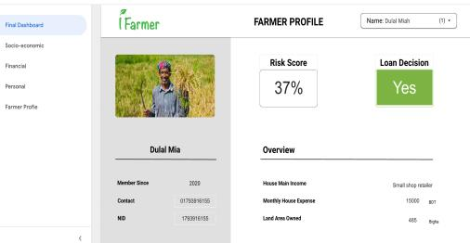
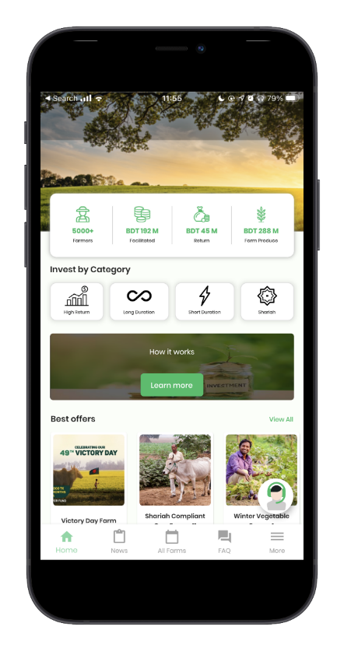
Tech Enabled Operations and proprietary farm-level data
Data collected by GIS remote sensing
Individual farm-level boundary demarcation
Active/inactive and current status of farms
Stages across the crop cycle (date of culture, harvest, etc.)
Historical cropping pattern for a particular farm
Data collected by the ground team
Farmer KYC with socioeconomic data
Crop status data (growth, harvest, etc.)
Sales/transaction data of the farms
Farmer’s purchase history of farm inputs
Data collected by CRM system
Farmer engagement details with field agents
Details of pest, disease, and advisory service
SOFOL App- for field agents and iFarmer Centers to collect farmer data and loan applications
KRISHOP App- for input retailers to order high quality agri input
iFarmer Investor app- for retail investors to fund farms and track progress
iFarmer generates a risk score for every farmer helping them to get access to mainstream financing
Proprietary ERP software to manage all the data, transactions and farmer profiles

Slide 9
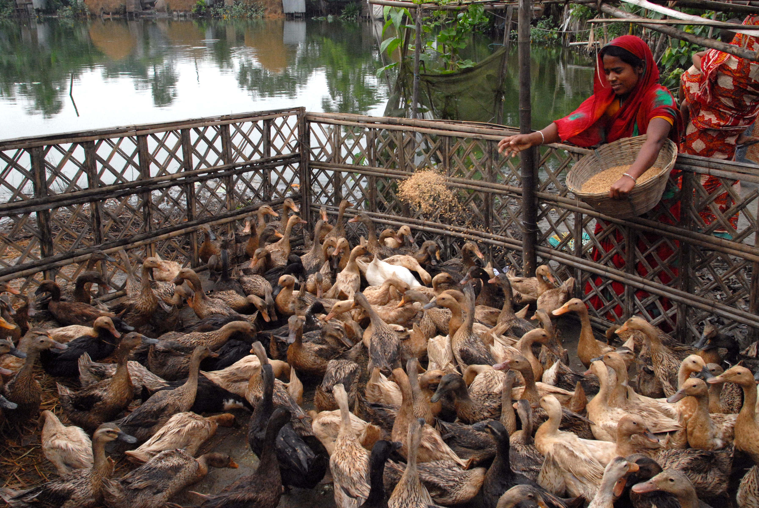
$10m revenue in 2021 which is a 7x increase from 2020
$42.4m revenue in 2022 (January-December)
100,000+ farmers 80% smallholder
150+ iFarmer centers
$25m financing facilitated to farmers
10,000 tons of produce collected monthly from farmers
10,000+ Agri input retailers in our network
99%repayment from farmers

Slide 10
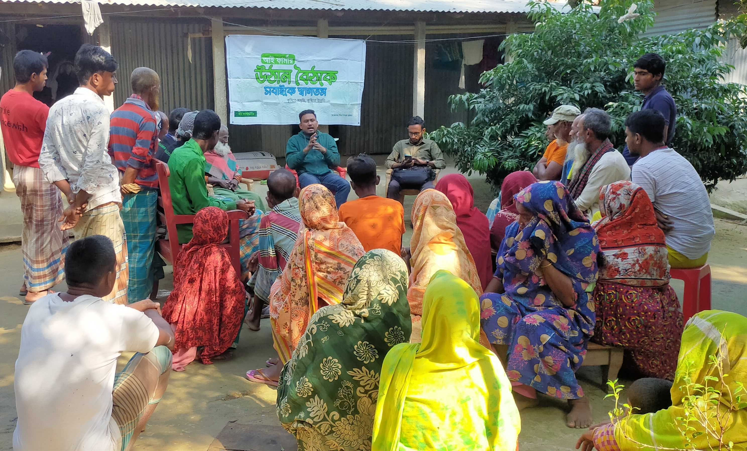
40% women farmers
34% women farmers are landless
38% of women farmers reported higher yield
23% of women farmers got better market access
Our Impact
30% reduction in the cost of capital for farmers
14% reduction in the cost of fertilizer due to advisory services
2000 farmers under crop insurance
100% of the claims got paid
61% cost-to-income ratio of iFarmer farmers

Slide 11
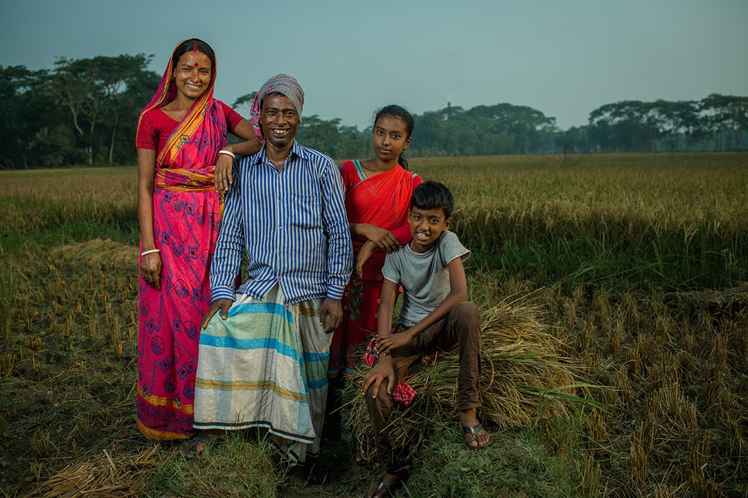
One Question we frequently get asked
What happens to the farmer/farm data?

Slide 12
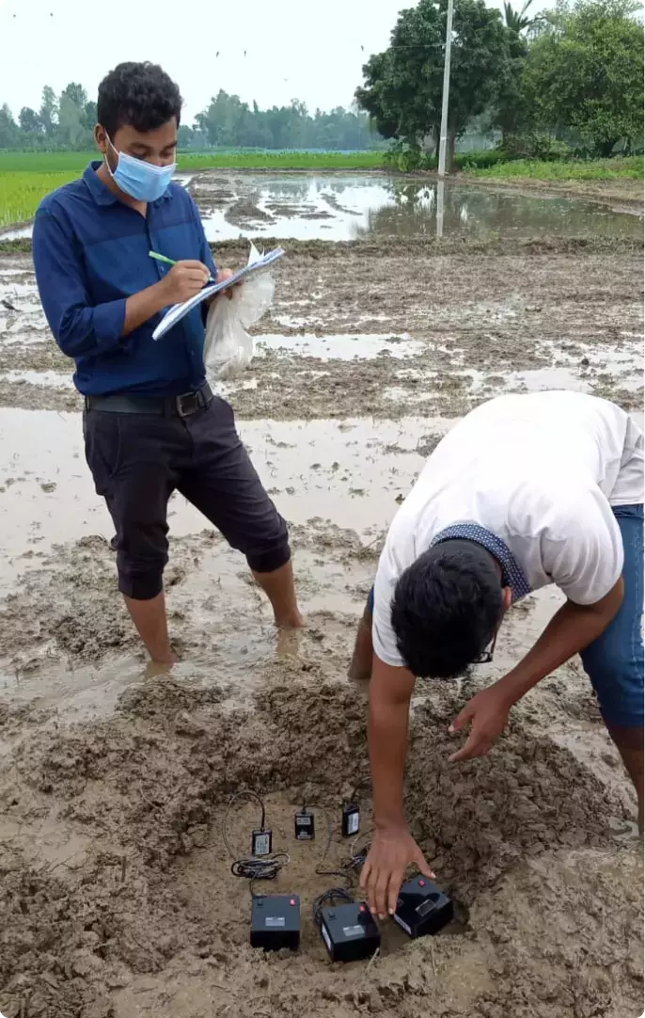
Digital Agriculture=Data driven Agriculture
Some call it precision agriculture, others digital agriculture or Agriculture 4.0. In the end, it’s about new digital technologies that make it possible to produce an ever-greater amount of data about farms and use those data to improve food production, delivery, and sales to consumers.
The emergence of digital agriculture technologies has increased the amount and detail of farming data collected. Data increases farm profitability by complementing digitally connected equipment, improving on-farm decision-making, and facilitating access to services such as inputs, finance, advisory, and so on.

Slide 13
Who truly owns farm data?
The operator who originates the data through their farm equipment, the landowner who considers farm data an attribute of the farm field, or perhaps the service provider who supplies custom farming or agronomic input application services?
Ambiguous property rights to farm data and the potentially sizable transaction costs associated with negotiating over farm data ownership pose significant challenges to capturing the value of this data.
Experts consider the potential of data generated on farms as untapped because of a fragmented and unclear policy environment governing the use of agricultural data.
Notes:
To sort out some of the issues concerning ownership, consider what it means to “own” something. Legally, ownership provides the right to:
–POSSESS –USE –ENJOY –EXCLUDE OTHERS FROM
–TRANSFER
–CONSUME or DESTROY

Slide 14
There needs to be multiparty cooperation, development of framework and guidelines
Data is the new “Input”- that helps farmers to become climate-smart and adopt sustainable agriculture practices.
Agritech companies will need access to farm data to continue product and service innovation.
Farmers, govt. agencies and other relevant stakeholders must acknowledge that the value of data is in its use and not just its possession.
If farmers start monetizing the data or legal barriers are put around agri data acquisition, then it will be difficult and expensive for the agritech companies to do business and innovate.
Farmers need to be educated on their data rights when working with service providers.
It should be a legal requirement for the farmers to give their explicit consent for the collection of data, and there must be an agreement on the use of the data.
There is a difference between raw data and aggregated data. Raw data has been collected in the field while aggregated data is the data that has been augmented to reveal patterns. Policymakers and other stakeholders must be aware of this.

Slide 15
Until the legal framework catches up to agricultural technology
Countries, farmer organizations, and agritech companies might have to adopt guidelines and principles that works best for their respective market systems
1. What control will the farmer have over the data?
2. Is the data portable between computer media or transferable to other entities?
3. Can the farmer share the data if he/she switches to another service provider?
4. How will the data be aggregated and kept anonymous?
Can the data later be deleted after use? What measures are used to delete data or otherwise make it unusable?
Does the contract require affirmative consent before data can be shared with a service provider or a third party or modified?
5. Will the farmer be notified of changes to a service provider’s privacy policies?
6. Does the agreement prohibit a service provider from using data for speculation in commodities markets?
7. Can the service provider modify the data? Remember, if the service provider changes the data itself, the service provider can claim ownership, thus destroying original ownership.
8. What security measures does the service provider use to prevent data breaches? What internal and external auditing procedures are in place?
Notes:
Accordingly, the Copa-Cogeca Code provides definitions for roles and processes in data sharing in agriculture and articulates five principles dealing with: (1) data ownership, (2) data access, control and portability, (3) data protection and transparency, (4) privacy and security, and (5) liability and intellectual property rights. The Copa-Cogeca Code also contains a contract checklist for ag-data which facilitates an assessment of a contract following a practical set of questions:

Slide 16
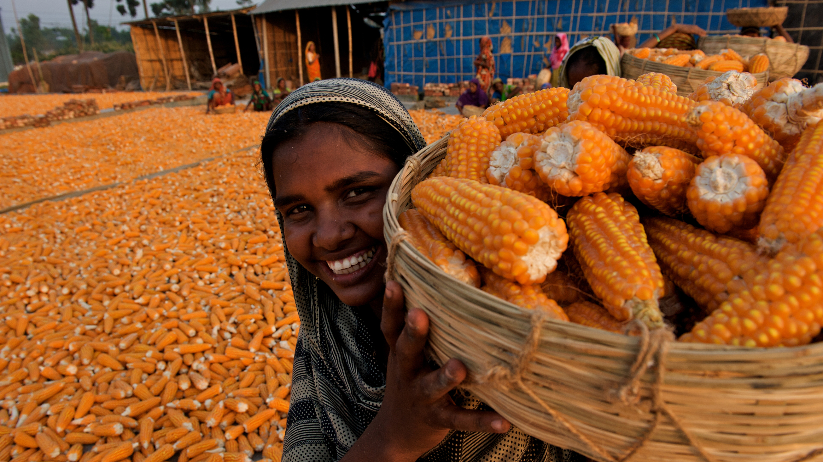
Thank You
fahad@ifarmer.asia
www.ifarmer.asia

