Slide 1
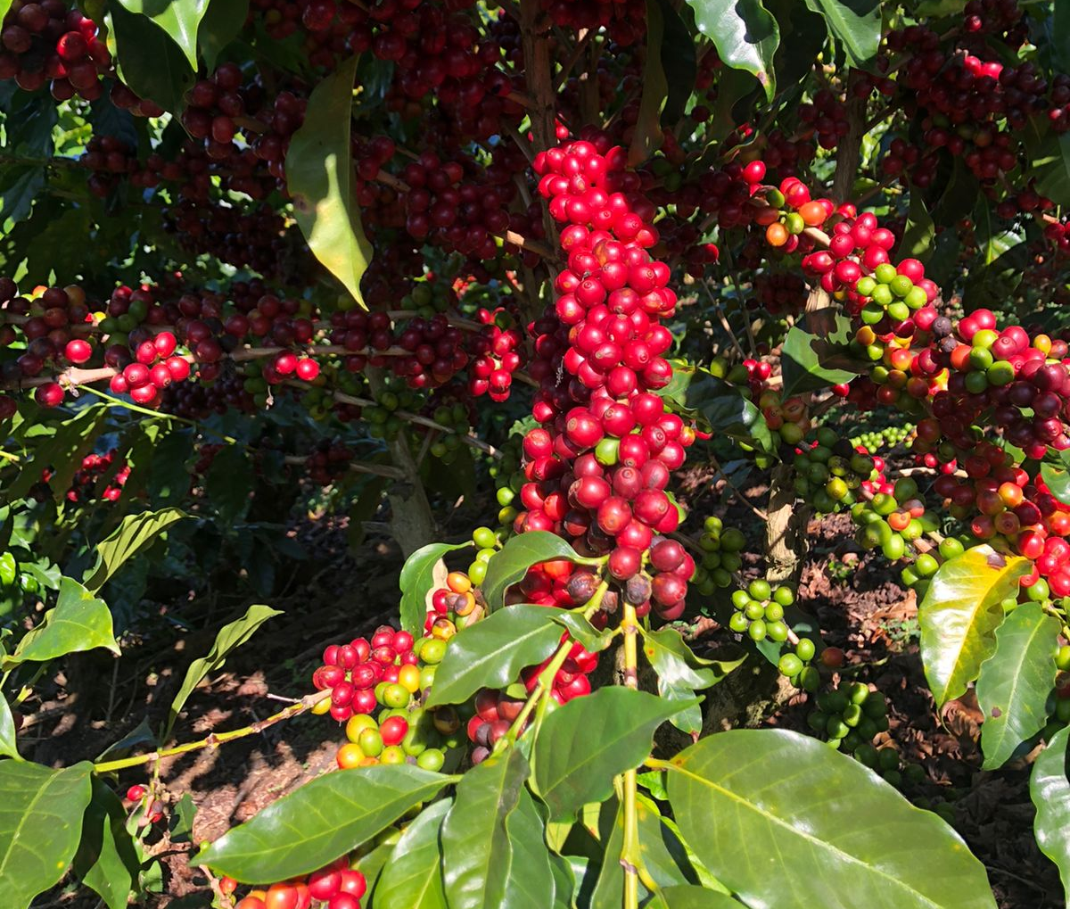
International Conference on Intellectual Property (IP) and Development – IP and Innovation for Sustainable Agriculture Adding value to Costa Rican coffee: The role of intellectual property
Silvia Salazar Fallas
silvia.salazar@ucr.ac.cr
PROINNOVA/University of Costa Rica
WIPO, Geneva. April 24, 2023

Slide 2
Key message
Branding and other IP tools have supported the evolution of Costa Rican coffee industry from coffee grain production to the commercialization of value added products for the benefit of Costa Rican coffee producers and consumers.

Slide 3
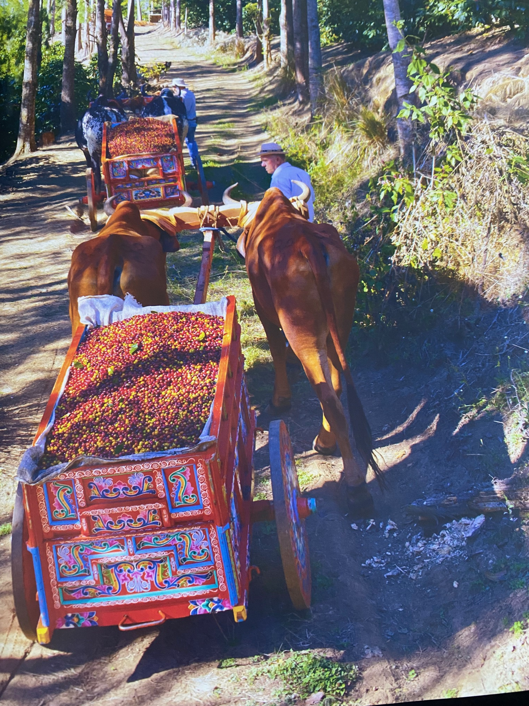
History of coffee production in Costa Rica
1821 first coffee plantations.
1843 first coffee exports to Great Britain and Germany.

Slide 4
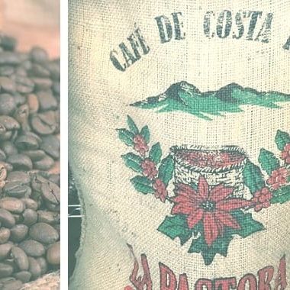
The first years
Increasing development of Costa Rican coffee production.
Increasing exports.
Development of farms.
But very small local market and no added value.

Slide 5
Data
Table 1
Coffee toasting companies according to year of foundation Costa Rica
AÑO | CANTIDAD
1950-1960 | 7
1960-1970 | 10
1970-1980 | 7
1980-1990 | 8
1990-2000 | 14
2000-2010 | 29
2010-2020 | 29
Adapted from Table 2, La industria de café tostado de Costa Rica en el contexto de la industrialización y el desarrollo, Cuadernos de Política Económica por Centro Internacional de Política Económica para el Desarrollo Sostenible, 2021.

Slide 6
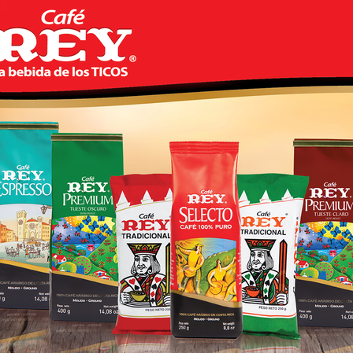
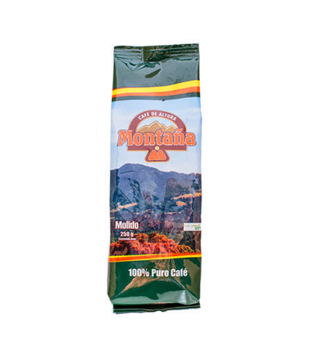
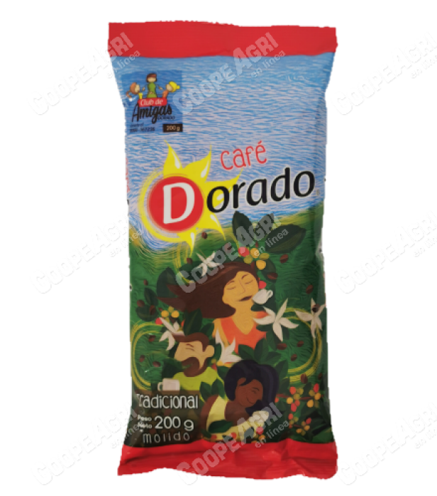

Slide 7
From 1985 to date…the transformation
Perception that Costa Rica can add value to the coffee production.
First attempts.
Fine coffees.
Excellent quality.
Expansion of the local market.
Increasing of local companies and trademarks.

Slide 8
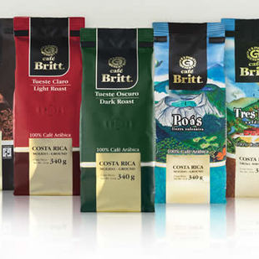
Branding
Café Britt the Pioneer
Introduction of the degassing valve in the package.

Slide 9
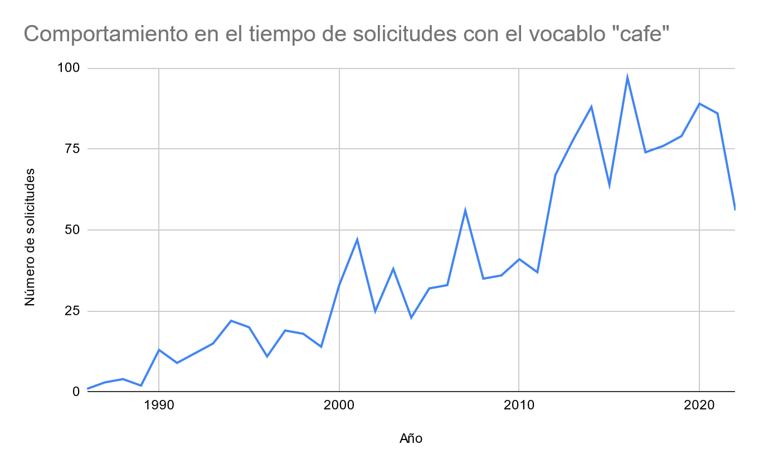
Data
Table 2
Elaboración propia con datos del Registro de Marcas, Costa Rica

Slide 10
Data

Slide 11
Key elements in coffee branding. The new consumer… The new market…
Quality
Taste
Sustainability
Good agricultural practices.
Environmental sustainability.
Organic coffee.
Good social practices.
Importance of the origin.
Different tastes and perceptions for different consumers and markets.

Slide 12
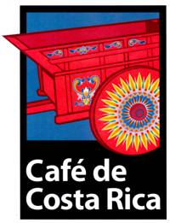
Geographical indications

Slide 13
Apellation of origin

Slide 14
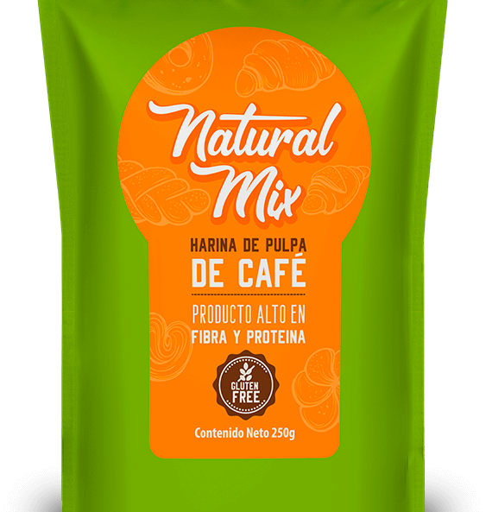
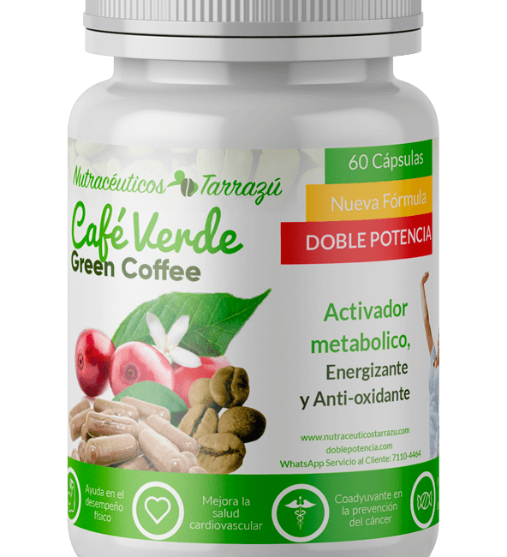
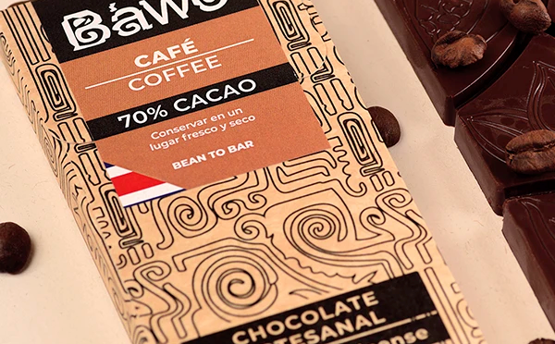
Development of new products

Slide 15
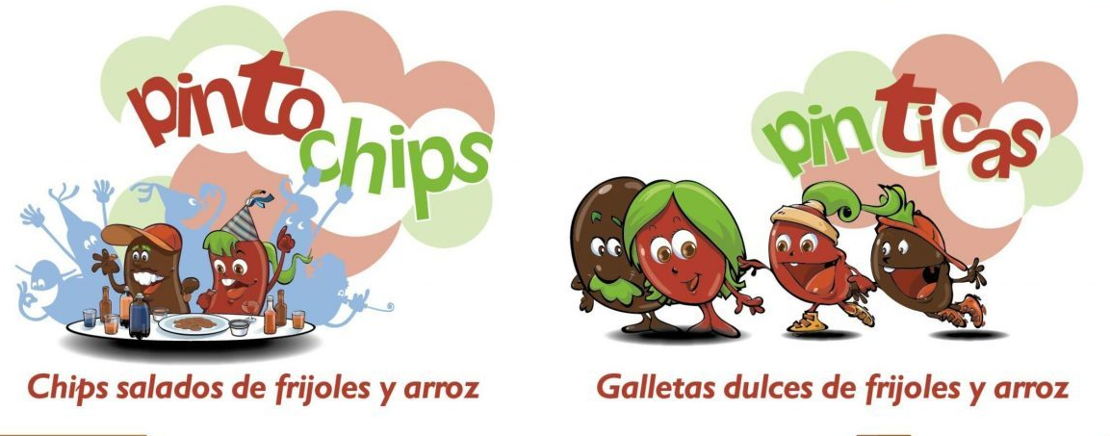
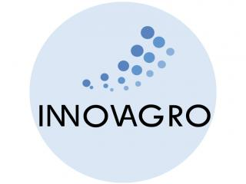
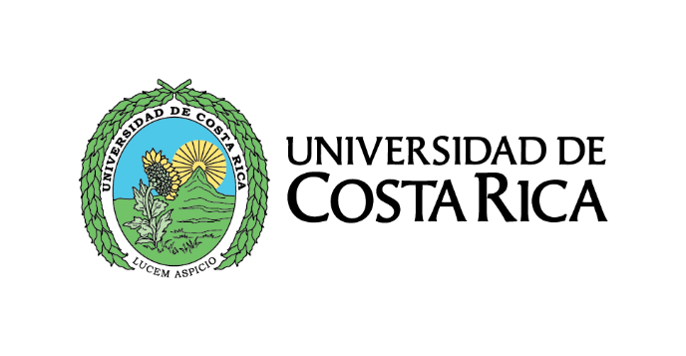
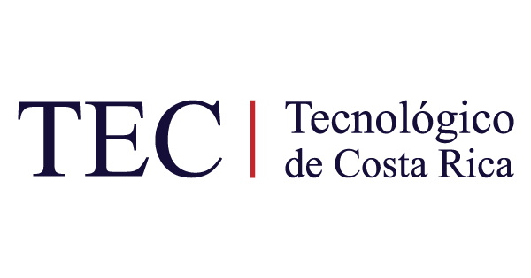
GALLETAS Y CHIPS a base de frijoles y arroz
Equipo de investigadores liderado por Ana Ruth Bonilla del CITA, generaron un paquete tecnológico que permitía promover el consumo del frijol y así aprovechar su gran valor nutricional.
Se licenció de manera gratuita a la Red de Mujeres Rurales: encargadas de producirlos y comercializarlos.
PRONTO
Venta en el Aeropuerto Juan Santamaría
Mercadito Heredia
Mercadito Cartago
Reconocimiento Innovación Social 2015
Con apoyo de:

Slide 16
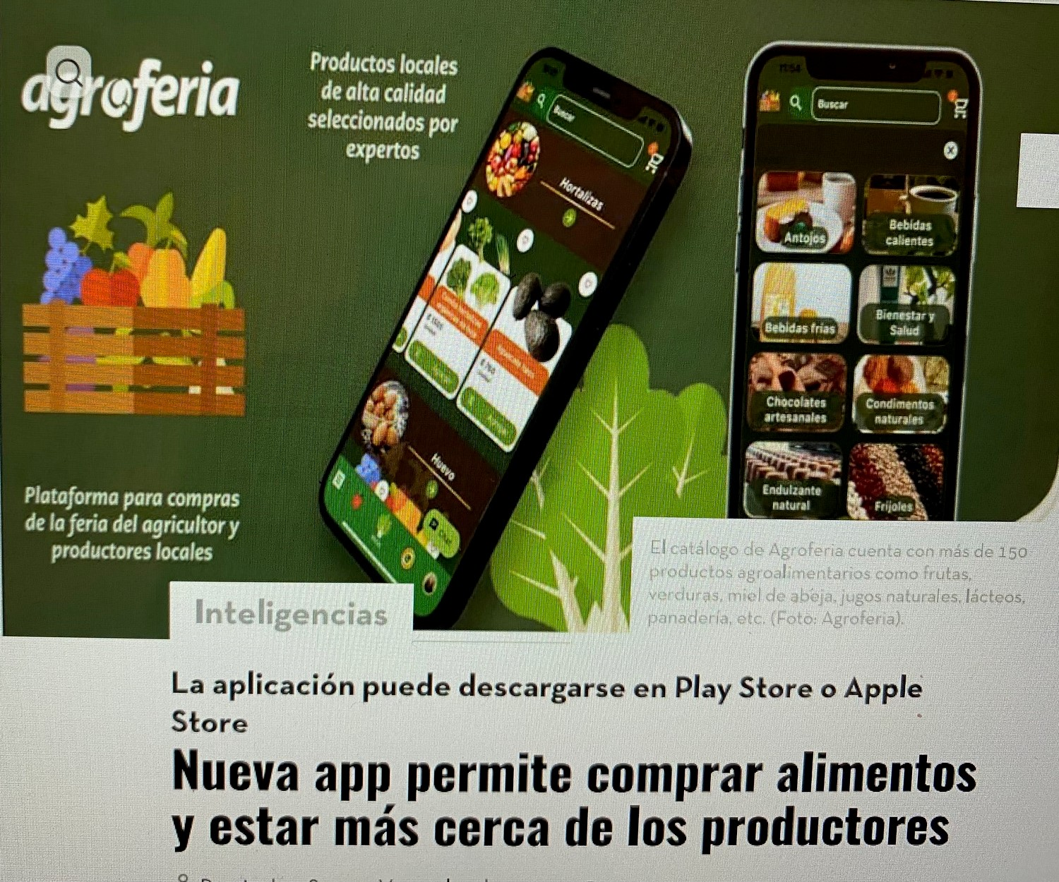

Slide 17
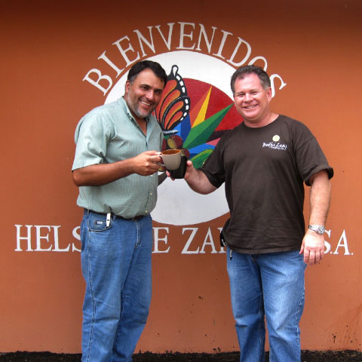
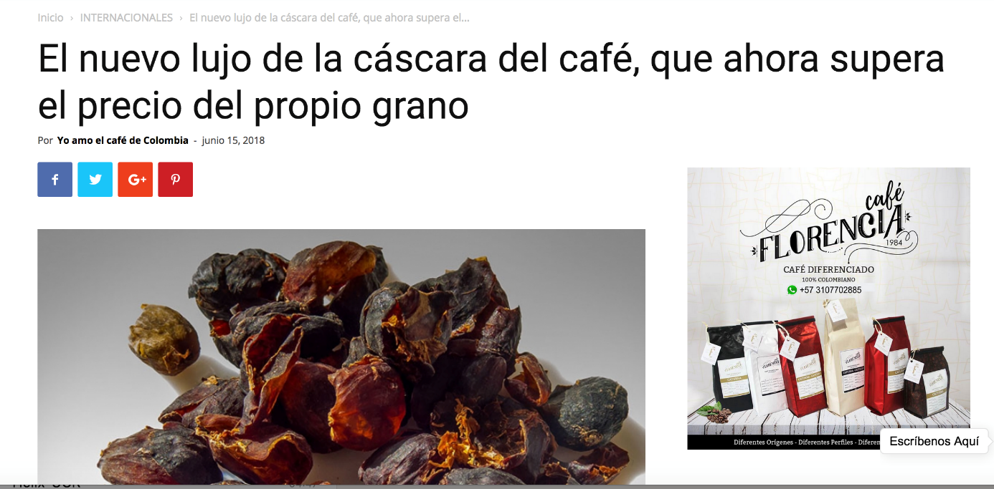
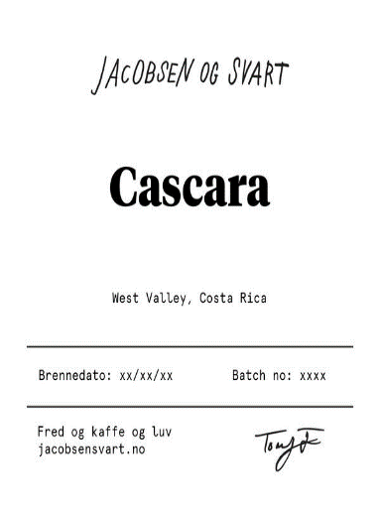
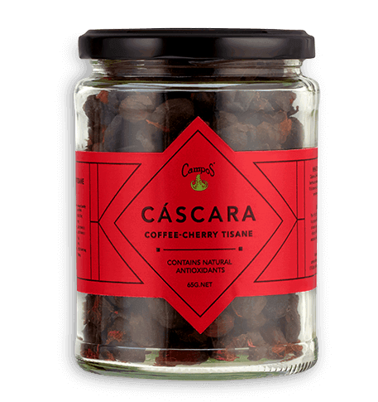
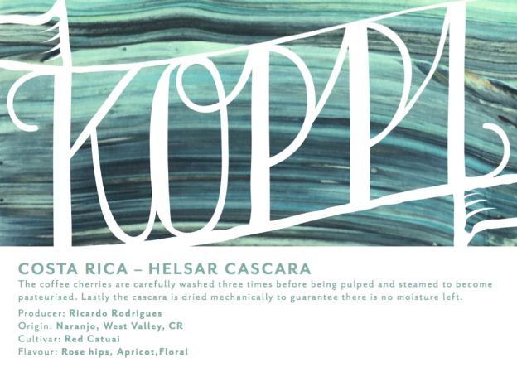
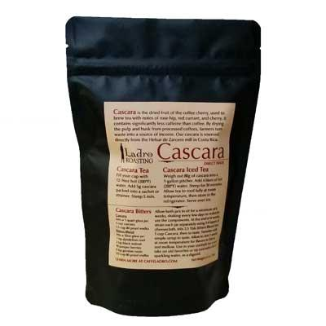
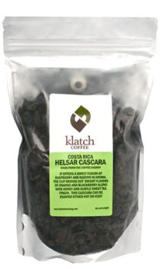
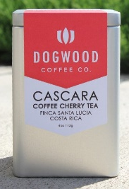
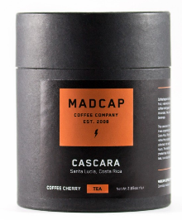
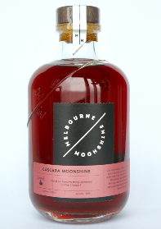
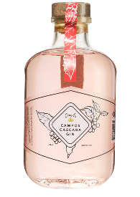
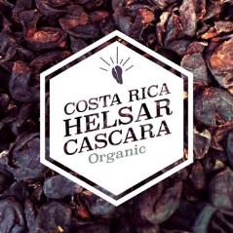
“Cascara”: bebida funcional
Elba Cubero, Pedro Vargas y Ana Ruth Bonilla desarrollaron una metodología para dar valor agregado a la pulpa de café.
A partir de este proyecto se licenció a una PYME productora de café ubicada en Zarcero.
La pulpa de café deshidratada es vendida en Estados Unidos, Canadá, Australia, Suecia, Noruega, Alemania y Japón.
http://www.yoamoelcafedecolombia.com/2018/06/15/el-nuevo-lujo-de-la-cascara-del-cafe-que-ahora-supera-el-precio-del-propio-grano/

Slide 18
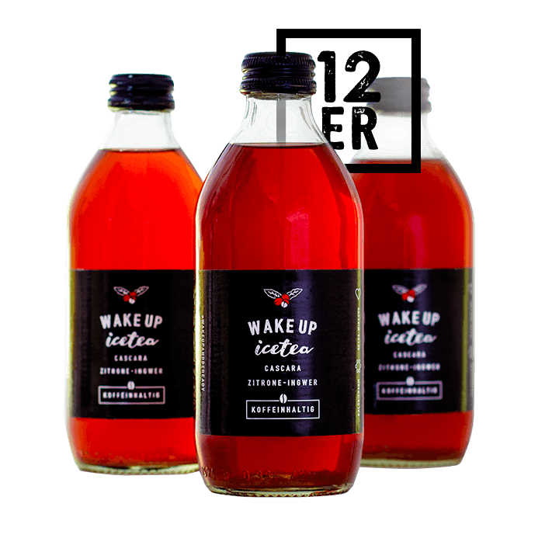
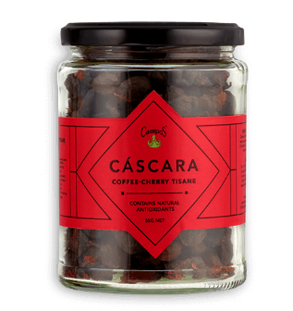
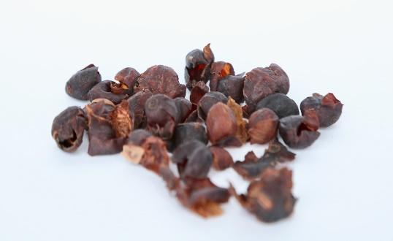
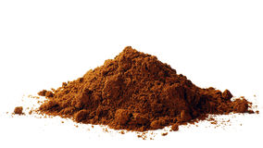
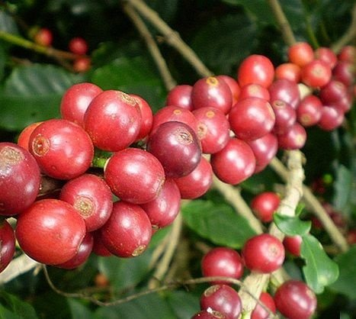
“Cascara” Gin
$112.75 / 700 mL
Coffee pulp valorization
Cascara Moonshine Liquor
$52.62 / 700 mL
$ 2,93 / 330 mL
$8,95 / 0.113 Kg
$14 / Kg
$2,17 - $3.26 / Kg
$12 / 1 kilo
https://sprudge.com/magic-in-the-moonshine-cascara-booze-is-here-115811.html
$2 / 1 cup
Notes:
Licor
https://www.mybottleshop.com.au/melbourne-moonshine-campos-cascara-gin-700ml
Gin
Melbourne Moonshine Campos Coffee Cascara Gin - Following on from the very popular Cascara Moonshine, in 2017 Melbourne Moonshine collaborated with Campos Coffee from Newtown in Sydney's Inner West (and just down the road from MyBottleShop). This time around MM have made a Cascara Gin. Crafted using a blend of five botanicals including Cascara, Juniper and Orange. The Gin is subtle with hints of cherry and citrus. Cascara (which means “husk,” “peel” or “skin” in Spanish) or coffee cherry is the dried skins of coffee cherries. These pulped skins are collected after the seeds (aka coffee beans) have been removed from the cherries.
Cascara is often described as having a sweet, fruity taste with notes of rose hip, hibiscus, cherry, red current, mango or even tobacco

Slide 19
Conclusion
Branding and other IP tools have supported the evolution of Costa Rican coffee industry from coffee grain production to the commercialization of value added products for the benefit of Costa Rican coffee producers and consumers.

