Slide 1
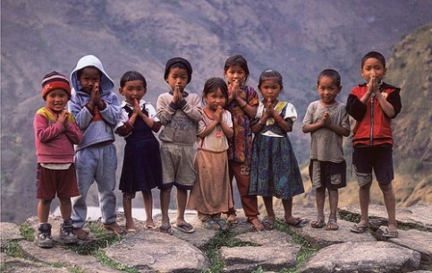
IP and Development International Conference April 2016

Slide 2
Global Cooperation on IP and Development The Role of WIPO and Other Key Actors
Developed Country View
Who are the Other Key Actors?
How can they help?

Slide 3
Other Key Actors
Developed Country/Regional Governments

Slide 4
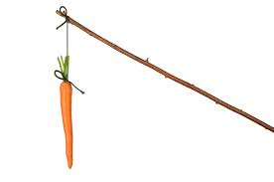
TRIPS Article 66.2
Developed country members shall provide incentives to enterprises and institutions in their territories for the purpose of promoting and encouraging transfer of technology to least developed country members in order to enable them to create a sound and viable technology base
Not compulsory
Only addresses LDCs

Slide 5
How can you find Article 66.2 Reports?
https://www.wto.org/english/tratop_e/trips_e/techtransfer_e.htm
At the bottom of this page, find the yellow box, use the second link
Recommendation to WTO:
Design new portal for 66.2 Reports!
Obtain from Developed Countries with no Submissions

Slide 6
Reporting on Implementation of Article 66.2 United States September 28, 2015
US committed to continually enhancing 66.2 assistance
Reports annually
US has $40 Billion budget for R&D, includes research that can assist LDCs
Asks for “Self-identified Tech Transfer Interests”
TRIPS Council Secretariat to organize requests
Tech Transfer is most effective when technology is requested by the group that will be using it
President Obama (Oct 2011) issued memo to all federal R&D labs to improve TT programs
Each Agency implements plans 2013-2017
Connects to 300 federal labs

Slide 7
Reporting on Implementation of Article 66.2 United States September 28, 2015
Partnership for Enhanced Engagement in Research (“PEER”)
Joint project of USAID, NSF and NIH
UN Framework Convention on Climate Change
U.S. Science and Technology Agreements
Programs to Advance Entrepreneurship (Spark Initiative)
Global Entrepreneurship Summit
National Science Foundation
USAID’ Feed the Future
Power Africa ($7B over 5 years, Presidential initiative)
Overseas Private Investment Corporation ($225 Billion/100 DCs)
Contributor to Medicines Patent Pool
WIPO Re:search

Slide 8
Suggestions for Developed Country Initiatives
Tax incentives to donate used equipment
Grants to assist shipping expenses
Tax incentives to send unwanted chemical reagents, lab supplies
Global fund to support patent filing expenses for inventors in developing countries

Slide 9
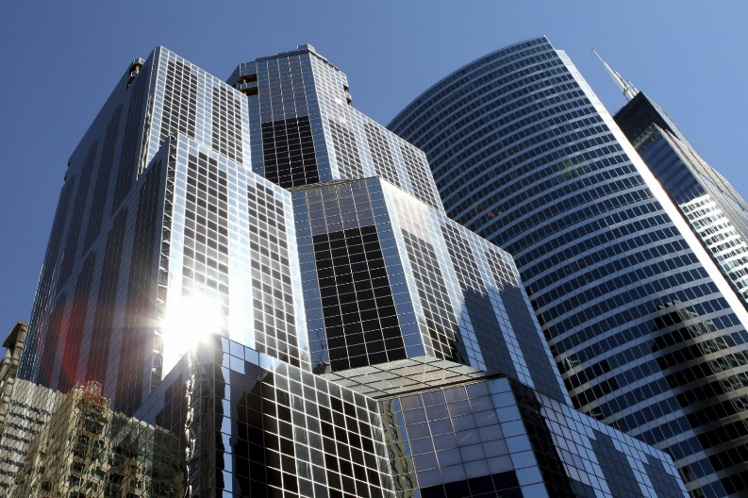
Other Key Actors
Large Corporations

Slide 10
How can you find information on U.S. Corporation Programs?
www.sec.gov
www.sec.gov/edgar/searchedgar
Corporate Social Responsibility Reports

Slide 11
Other Key Actors: Corporations
Voluntary Licensing
Education and Training
IT Supplies
Collaborations
Manufacturing

Slide 12
Practical Tips: Motivating Corporate Assistance
Be Specific!
“We need a formulation that is stable without refrigeration for a year for the active drug X”
Group entity who would use it should ask
Carrot (part of a worthy effort) v. Stick (threats, bad PR)
Approach in the right way through the right channels
Ask for something that they likely have

Slide 13
Other Key Players
Developed Country View:
Universities
Non-Profit Organizations

Slide 14
Celebrating the 500th story on University research
For collaborations to improve lives globally
www.betterworldproject.org

Slide 15
University Innovation Global Outreach
Over 100 Members

Slide 16
Mentoring Networks for Licensing
“Advancing the Business of IP Globally”
13,000 Members in 97 Countries

Slide 17
International Conferences

Slide 18
What can WIPO do to help?
Create Technology Clearing House Board
Technology needed by area
Supervised so content is clear, answerable
Invite Large Corporations to monitor
Connect Developed Country Gov’t and Corporations with requestors
Help that contact comes from WIPO
Able to find the right people

Slide 19
What can WIPO do to help?
Host Web-based Tutorial Programs
Inspirational Talks
Ground-breaking scientists
Entrepreneurship
Scientific Know-How
Portal for DC and LDC researchers to submit requests for expert presentations on specific questions
WIPO Identifies experts
Legal Best Practices
Technology transfer
Patent prosecution strategy

Slide 20
What can Developing Countries Do?

Slide 21
Framework for Receptive Ecosystem
Shadow of the Leader:
What is your government’s message?
Enact transformational patent laws
If you aim for the bottom, you will get there
Identify and support key talent
Rule-breakers
Minimum ecosystem and infrastructure
Results-based incentives
Achievable goals for level of innovation
Aspirational goals for amount of innovation
Mentoring networks (“Each one teach one”)

Slide 22
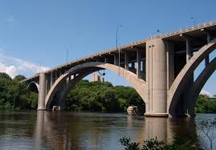
What can we do personally to support IP and Development?
Host students from developing countries
Create and maintain strong personal relationships that bridge developed/developing countries
Look for bridge-building opportunities
Be ready to volunteer
Keep the dialogue fresh

Slide 23
IP Collaboration for Global Development

Slide 24
Contact
Sherry M. Knowles, Esq.
Principal
Knowles Intellectual Property Strategies, LLC.
400 Perimeter Center Terrace
Suite 200
Atlanta, Georgia 30346
sknowles@kipsllc.com
www.kipsllc.com

