Slide 1
Global Cooperation for IP and Development
Esteban Burrone
Head of Policy
Medicines Patent Pool

Slide 2
Collaboration to promote innovation and aCCESS TO MEDICINES
Innovation and Access are two sides of the same coin and central to ensuring improvements in public health outcomes worldwide
How to maintain the incentives for innovation in pharmaceuticals while promoting widespread access to new medicines at affordable prices?
Can socially responsible licensing be used as a collaborative mechanism to address major public health challenges such as HIV, HCV and other diseases, particularly in developing countries?

Slide 3
Case of hiv
Innovation on an unprecedented scale
Since discovery of the Human Immunodeficiency Virus (HIV) in 1980s, 29 new antiretroviral medicines have reached the market – even more if we include combinations
Need to ensure Access to all
While 15 million people have access to HIV treatment (!) worldwide, there are 37 million people living with HIV
How to ensure everybody needing treatment has access at affordable prices?
How to ensure that new, improved treatments become available faster in developing countries?

Slide 4
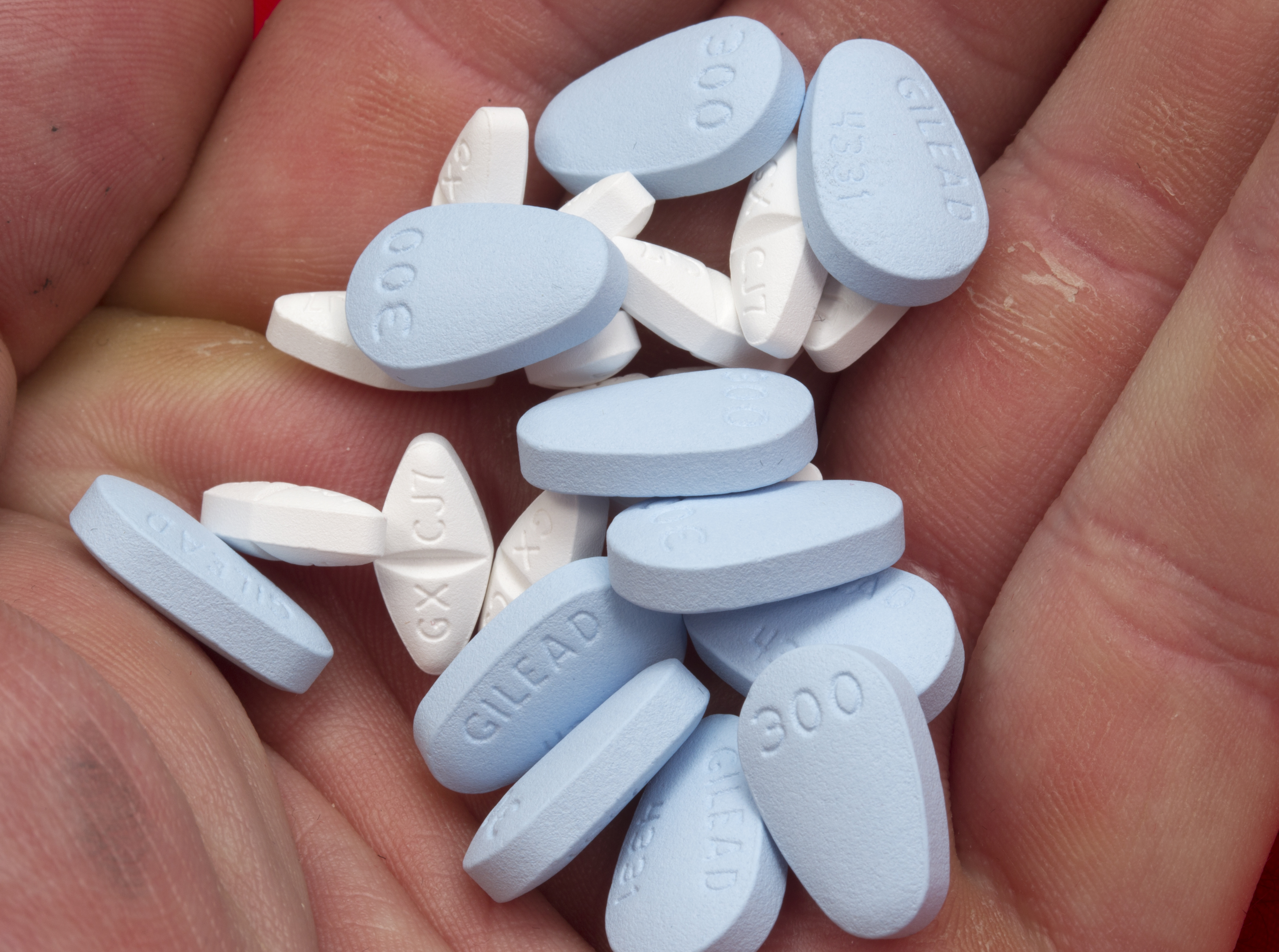
The Medicines Patent Pool (MPP)
Our Goal
Improving access to affordable,
appropriate HIV,
viral hepatitis C and
tuberculosis treatments
in low- and middle-income countries

Slide 5




THE MEDICINES PATENT POOL:
A PUBLIC HEALTH VOLUNTARY LICENSING MECHANISM
PEOPLE LIVING WITH HIV, HEPATITIS C OR TUBERCULOSIS
PATENT HOLDERS
GENERIC MANUFACTURERS
Sub-
Licences
Licences
Medicines
ROYALTIES
The MPP was founded and remains fully funded by UNITAID

Slide 6
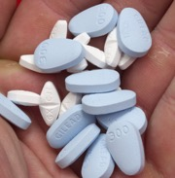
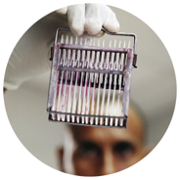


The Medicines Patent Pool:
Driving innovation and access
Share Patents
  “Pool” patents & technology through a collaborative voluntary licensing system
Spur New Innovation
  Enable development of new fixed-dose combinations and formulations for children
Ensure Access
  Accelerate availability of more affordable versions of needed medicines to developing countries
Reward Innovation
  Ensure continued incentives for innovation

Slide 7
voluntary licensing and patent pooling
Ensures multiple quality assured suppliers
Accelerates market availability of generics
Complements
alternative access strategies
Can benefit many countries reaching large number of people
Non-exclusive. Ensures competition
Enables simple access to multiple IP rights needed for a given medicine
Can include technology transfer

Slide 8
Key features of MPP Licences
Non-exclusive, non-restrictive to encourage competition
Transparent – all licences are public
Wide geographical scope
55% to 80% of middle income countries covered
Waivers for regulatory data exclusivity
Public-Private Market Segmentation to increase geographical scope
Tiered royalties where possible to enhance coverage

Slide 9
Key features of MPP Licences
Compatibility with TRIPS flexibilities
Address diversion and pharmacovigilance
Company patent information disclosed
Flexibility to create fixed-dose combinations
Freedom to challenge patents
Sales allowed outside agreed territory if no patent infringement
Out-licensing management

Slide 10

Our work in bridging innovation and access

Slide 11

OUR WORK IN THE HIV FIELD
37 million people eligible to receive HIV treatment according to WHO
15 million only have currently access
3.3 million children living with HIV today but
32% only receive antiretroviral therapy
12 antiretrovirals licensed to the MPP
87%-93% of people living with HIV in developing countries covered by MPP adults licences
7 million patient-years of WHO-recommended ARVs supplied by MPP’s generic partners

Slide 12

OUR WORK IN THE HEPATITIS C FIELD
132- 150 million people globally estimated to have the chronic hepatitis C infection
Approximately 500’000 people die each year of hepatitis C-related diseases
At least 95% of people infected with HCV worldwide are not receiving treatment
1 direct-acting antiviral (DAA) licensed to the MPP
112 low- and middle-income countries covered by the MPP licence
4 MPP’s generic partners to produce and sell daclatasvir

Slide 13
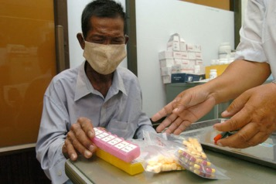
OUR WORK IN THE TUBERCULOSIS FIELD
9.6 million people worldwide are affected by tuberculosis
480’000 estimated new cases of MDR-TB in 2014
1.5 million people died from the disease in 2014
95% of TB victims are in low- and middle-income countries
Following the expansion of its mandate in November 2015, the MPP will work to ensure access to new treatments for multi-drug resistant and drug susceptible-TB.

Slide 14









In-Licensing: Concluded Agreements
Lopinavir
Ritonavir
(separate paediatrics and adults licences)
Atazanavir
Daclatasvir (HCV)
Cobicistat
Elvitegravir
Emtricitabine
Tenofovir Alafenamide
Tenofovir Disoproxil
Raltegravir (paed)
Darunavir related
Darunavir (paed) (non-assert)
Solid dispersion nano technology for HIV
Abacavir (paed)
Dolutegravir (paed)
Dolutegravir (adults)
Valganciclovir (pricing agreement)

Slide 15












gENERIC INDUSTRY PARTNERS
MPP is currently running more than 50 development projects
with 12 development partners

Slide 16
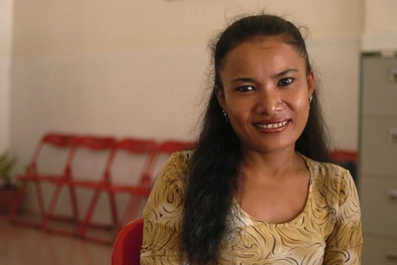
The mEDICINES PATENT POOL
“The Pool, with its public health-driven business model, has pioneered ways to improve access by partnering with generic and originator companies alike. This is a new system of IP management that engages industry and shows great promise for the future.
Dr. Margaret Chan, Director General, World Health Organization
The final Addis Ababa Declaration on Financing Sustainable Development supports “relevant initiatives…which incentivise[s] innovation while expanding access in developing countries,” and acknowledges “voluntary patent pooling and other business models, which can enhance access to technology and foster innovation.”
Third International Conference – Financing for Development, 2015
The MPP was founded at the request of the international community
and remains fully funded by UNITAID

Slide 17
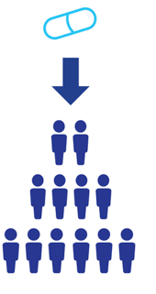
Further Challenges in access to medicines
Regulatory issues
Social stigma
R&D
Sub-standard medicines
Price
Treatment funding
Local manufacturing
Health systems
Distribution

Slide 18
Medicines patent pool
WWW.MEDICINESPATENTPOOL.ORG
@MEDSPATENTPOOL

