Slide 1
Copyright and the public domain: contradictory or complementary notions?
Irini Stamatoudi, LL.M., Ph.D., General Director,
Hellenic Copyright Organisation

Slide 2
Development Agenda
Recommendation 16
“Consider the preservation of the public domain within WIPO’s normative processes and deepen the analysis of the implications and benefits of a rich and accessible public domain”.
Recommendation 20
“To promote norm-setting activities related to IP that support a robust public domain in WIPO’s Member States, including the possibility of preparing guidelines which could assist interested Member States in identifying subject matters that have fallen into the public domain within their respective jurisdictions”.

Slide 3
COPYRIGHT: A basic tool for promoting and sustaining creativity and investment in the creative industries
Through…
the reward of creators and related rights holders
moral rights protection
Balancing the interests of creators and related rights holders with those of users and the public at large

Slide 4
COPYRIGHT: a balancing exercise
Found in…
Protected/excluded subject matter
Term of protection
Exceptions and limitations rooted in copyright or other laws (e.g. human rights and civil law)
Open source and open access licensing
Special legal regimes and voluntary agreements (e.g. Oprhan works and out of commerce works, PSI)
Public domain
and so on…

Slide 5
PUBLIC DOMAIN
Subject matter not protected by copyright
Works whose term of protection has expired
Works in which the author has waived his rights (e.g. CC0 1.0 Universal*)
* A CC0 1.0 license indicates that one dedicates his/her work to the public domain by waiving all of his or her rights to the work worldwide under copyright law, including all related and neighboring rights, to the extent allowed by law.

Slide 6
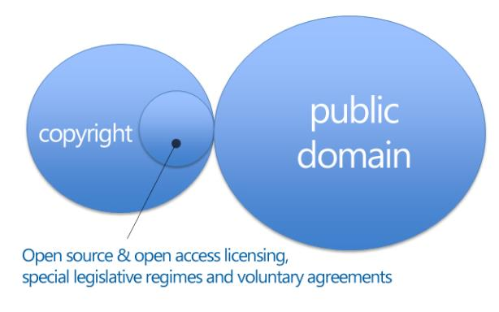
In schemas…

Slide 7
Some observations…
The scope of copyright protection varies between the different jurisdictions (e.g. eligible subject matter, originality, term of protection, etc.)
That has also effect on the scope of the public domain

Slide 8
Free/Open Source Software and the 4 essential freedoms
Freedom to Run
  Anyone for any purpose
Freedom to Study
  Access to see and modify source code
Freedom to Redistribute
  Share binaries and source code
Freedom to Improve
  Make it better for the whole community

Slide 9
Differences with proprietary software
Proprietary software:
  all rights reserved
  author/rightholder identified
  source code not distributed
Open source software:
  limited rights reserved
  authorship fluid/collaborative
  source code distributed

Slide 10
Creative commons
Copyright licenses released under this label aim at providing a simple, standardized way to give the public permission to share and use the creative work made available under them.
CC licenses are rooted in copyright. They are not an alternative to it. They work alongside to it. If a user does not respect their terms and conditions, the user is liable under copyright law and is considered to be an infringer. CC licenses aim at simplifying (by classifying and standardizing) terms of use and at allowing to share and use copyright material such as images, films, video, music, writings or any other copyright work on the basis of the license’s conditions.
So, instead of “all rights reserved” CC licenses provide for “some rights reserved”.
Source: <https://creativecommons.org/about/>

Slide 11
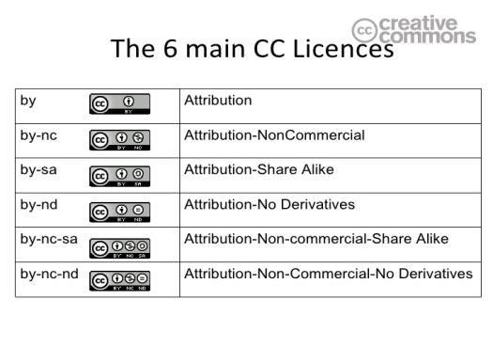

Slide 12
Open access to scientific publications
See the Berlin Declaration on Open Access to Knowledge in the Sciences and Humanities 22.10.2013
It requires authors associated with the signatories to grant to all users free worldwide access (including unrestricted distribution, interoperability and long term archiving) to their works by depositing them in at least one open access repository and publish them in open access journals when available.
Source: <http://openaccess.mpg.de/Berlin-Declaration>

Slide 13
Orphan works
The EU Directive 2012/28 has introduced common rules on the digitisation and online display of ‘orphan works’. Orphan works are works like books, newspaper and magazine articles and films that are still protected by copyright but whose authors or other rightholders are not known or cannot be located or contacted to obtain copyright permissions.
Source: <http://ec.europa.eu/internal_market/copyright/orphan_works/index_en.htm>

Slide 14
Out-of-Commerce Works
E.g. EU MoU on Key Principles on the Digitisation and Making Available of Out-of-Commerce Worksbetween between representatives of the rightholders’ community (publishers and authors), libraries and collecting societies
Aim:
facilitate the digitisation and making available by European libraries and similar institutions of books and learned journals in their collections which are out-of-commerce.
serve as a blueprint for collective licensing agreements negotiated amongst rightholders, libraries and collecting societies.
Source: <http://ec.europa.eu/internal_market/copyright/out-of-commerce/index_en.htm>

Slide 15
Public Sector Information
E.g. The EU Directive on the re-use of public sector information (Directive 2003/98/EC revised by Directive 2013/37/EU) concerns content that can be accessed under national access to documents laws and provides that it is in principle re-usable beyond its initial purpose of collection for commercial and non-commercial purposes. It encourages EU Member States to make as much information available for re-use as possible. It addresses material held by public sector bodies in the Member States, at national, regional and local levels, such as ministries, state agencies, municipalities, as well as organisations funded for the most part by or under the control of public authorities (e.g. meteorological institutes). Since 2013 content held by museums, libraries and archives falls within the scope of application as well.
The Directive covers written texts, databases, audio files and film fragments; it does not apply to the educational, scientific, and broadcasting sectors.
Source: <https://ec.europa.eu/digital-single-market/en/european-legislation-reuse-public-sector-information>

Slide 16
Conclusions
International, regional and national laws on copyright provide for flexibilities
Open source/open access licensing as well as special legal regimes and voluntary agreements are means of adapting copyright norms to the needs of the new era at a supranational level
The public domain as a counterbalance to copyright

Slide 17
Public domain
“The importance of the public domain in terms of the public interest is thus manifold, from educational, democratic, economic and free competition perspectives. It has an equal role to copyright in a democratic society where cultural diversity and freedoms to create, to innovate and to take part to the cultural and scientific environment are fundamental objectives. A strong and vivid public domain in culture and science is a pivotal element of the common heritage of mankind and as such, it should be made available to all. It is a key driver for social and economic development. It should also be preserved from undue privatisation and encroachment, and should serve as a balanced counterpart to intellectual property exclusivity.”
Severine Dusollier, Scoping study on copyright and related rights and the public domain, p. 14.

