Slide 1
IP for University Research Commercialization
An Entrepreneurial Journey in Pakistan

Slide 2
Pakistan Education Landscape
Total Population: 200 Million
Cell Phone Users: 140 Million
Total Students population: 37.5 million
Higher Education: 1.3 Million
Middle Class household spends 30% of monthly income on children education
Universities: 180

Slide 3
Pakistan Education Landscape
New wave of Tech Startups is emerging
Over 15 Tech Incubators surfaced in last 3 years
Pakistan is ranked 3rd in the world for Freelance Software Development Services.

Slide 4
Pakistan Innovation Potential
Video Clip

Slide 5
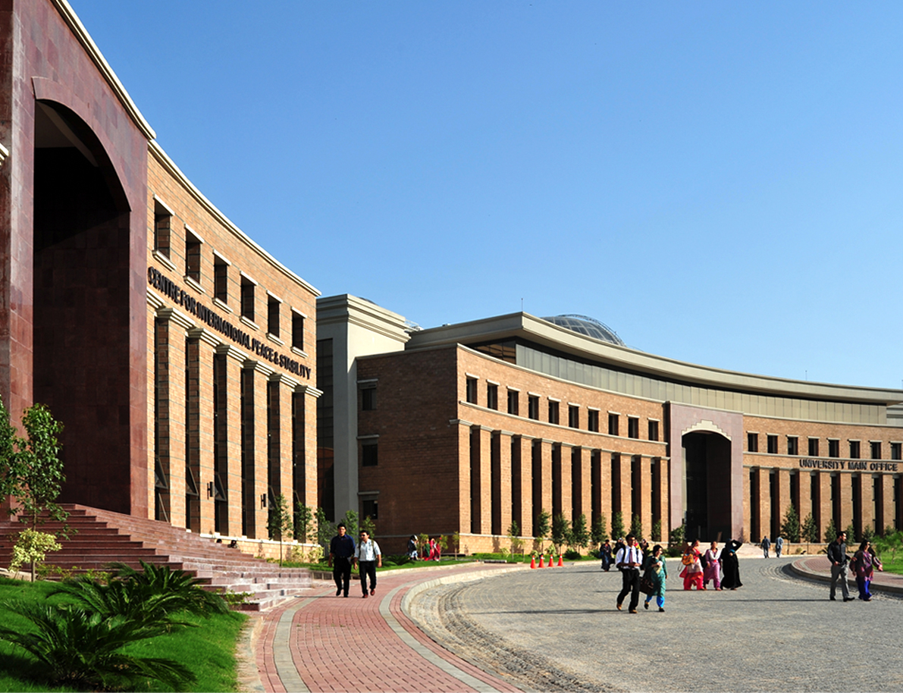
National University of Sciences & Technology
(Established in 1991)
The IP Journey

Slide 6
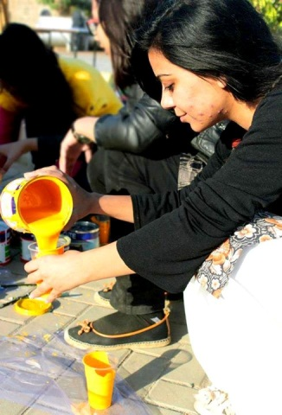
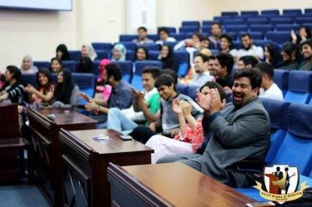
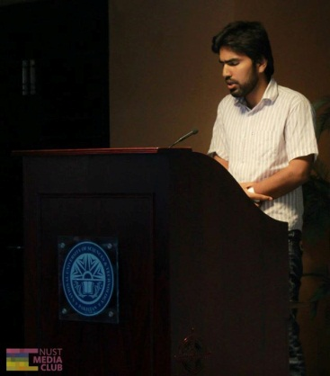
NUST Rankings
WORLD RANKING
Among Top 500 Universities
ASIAN RANKING
Top 200 Universities (120th)
Pakistan HEC RANKING
Top General (Large) University

Slide 7
NUST – 2000
NUST established in 1991 was more teaching focused University having no linkages with industry.
In 2000 it established NUST Institute of IT (NIIT)
NIIT established Corporate Advisory Council (CAC) in 2003, but local industry had no interest in university beyond hiring the top talent.
International industry is largely unaware of the potential and opportunity of working with universities or IT industry in Pakistan.
Notes:
Hidden slide

Slide 8
NUST – 2001 to 2003
Professors working in academic silos, producing decent quality research but not thinking about Tech commercialization aspects.
NIIT initiated research collaboration with CERN which opened opportunities of research partnership with Stanford USA, Caltech USA and UWE UK
In 2003, one IT training company from another country sued NIIT for similarity in name and trademark
Principal NIIT started learning about legal aspects of addressing IP infringement issues
IPO Pakistan helped in bootstrapping learning process
Notes:
Hidden slide

Slide 9
NUST – 2004
NIIT exposure to Stanford helped in interaction with Silicon Valley based Pakistani entrepreneurs
NIIT undertook the mission of bridging the gap between industry and academia to foster a culture of innovation and entrepreneurship.
The Silicon valley companies demanded confidentiality agreements and IP rights protection
IPO Pakistan helped in arranging trainings on various aspects of IP protection including prior-art search, copy right/trade mark, patent drafting, IP licensing, etc.
Notes:
Hidden slide

Slide 10
NUST – 2005
Pakistan ICT R&D Fund was established by the Ministry of IT Pakistan with a similar mandate.
NIIT had a large presence of top tier PhD faculty members who won a number of commercializable research projects from ICT R&D Fund.
ICT R&D fund proposals required IP to be shared between NUST and Fund
At this stage not much understanding existed on either side about IP management.
Notes:
Hidden slide

Slide 11
NUST – 2006 to 2007
To avoid legal hitches and as part of NUST reorganization program, NIIT was changed to SEECS (School of EE&CS)
IPO Pakistan helped select faculty members in obtaining IP training at IP Singapore.
The faculty members in turn trained many other faculty members in patent drafting and patent regulations.
Notes:
Hidden slide

Slide 12
NUST – 2008
Multiple patent applications were filed locally in Pakistan and with USPTO from NUST SEECS.
WIPO facilitated in IP filing by connecting SEECS faculty members with IP lawyers who vetted the patent drafts and help iron out regulatory issues
SEECS also established direct and meaningful relationships with the Pakistani/international patent lawyers
The projects funded by ICTRDF bear fruits and a number of top quality research publications and patent applications produced.
Notes:
Hidden slide

Slide 13
NUST – 2009 to 2010
NUST reached out to entrepreneurs in silicon valley, Many successful SV entrepreneurs ended up funding multiple industry-relevant research projects.
Professors delivered many successful research projects to companies in silicon valley.
Three companies need special mention Cavium Networks, Marvell Technologies, WiChorus (acquired by Tellabs for $180 million), Vertical Systems, Inc and Techionics, Inc.
Notes:
Hidden slide

Slide 14
NUST – 2011 to 2012
Dr. Ali Khayam's research in the cutting edge software defined networking (SDN) domain gets international attention and he co-founds a technology company, xFlow Research, Inc., with another Silicon Valley entrepreneur.
This company gets business from some of the largest technology companies in Silicon Valley, including Dell, Broadcom, Marvell Technologies and Cavium Networks.
Notes:
Hidden slide

Slide 15
NUST – 2013
UC Berkely supported SDN research/training in SEECS by donating network adaptors
One top student from SEECS selected for research in SDN security, at Berkely.
Mid 2013, xFlow's team is acquired by one of the hottest networking startups in Silicon Valley.
The new startup setup operations in Pakistan.
Notes:
Hidden slide

Slide 16
NUST – 2015
Currently Pakistan is considered a hub of SDN talent.
More than $2 million investment comes into Pakistan every year for SDN software.
More than 175 people are hired in different companies in Pakistan for SDN software development.
Notes:
Hidden slide

Slide 17
NUST Transformation to IP Mindset
The success generated university management interest towards protecting IP and its commercialization
NUST establishes RIC (Research, Innovation and Commercialization) Division
Higher Education Commission started providing funding for 40 ORICs in various Universities

Slide 18
NUST Corporate Advisory Council
Combines thought-leadership from 13 key sectors across the national economy.
Aims to bridge gap between academic research and business requirements
Creates effective linkages between NUST apparatus and Industry initiatives

Slide 19
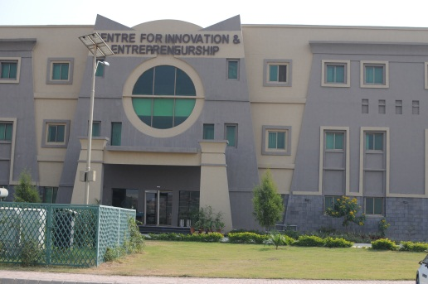
The RIC Ecosystem
Directorate of Research
Intellectual Property Office
Centre for Innovation & Entrepreneurship
Directorate of Innovation and Commercialization
Technology Transfer Office
Technology Incubation Centre
Industrial Liaison Office
Professional Development Centre

Slide 20
NUST IP Unit
NUST has established an Intellectual Property Office at its Centre of Innovation & Entrepreneurship for IP Management. It evaluates inventions for commercial potential and facilitates filing for national and international patents.
NUST IP Policy, has been prepared in consultation with WIPO and other relevant experts & stakeholders.
Patents Filed in last 8 years: 97, Granted: 27 (US-5, Korea 03, PCT-01)

Slide 21
Directorate of Innovation and Commercialization
Technology Transfer Office
Responsible for moving research results from the laboratory to the market place
TTO evaluates and manages invention portfolios, gets assistance from IPO in patent prosecution, negotiates licensing agreements and periodically reviews cooperative research agreements already in place
Notes:
Hidden slide

Slide 22
Directorate of Innovation and Commercialization
Industrial Liaison Office
Develops and maintains linkages with Industry for facilitating internships and placements of NUST students and graduates
Notes:
Hidden slide

Slide 23
Technology Incubation Centre
First incubation center in Pakistani academia, established in 2005
Coveted memberships like NBIA, AABI, APIN, World b Bank infoDev
11 TIC graduate companies in the industry
23 Incubatees including in-house, virtual and pre-incubation
Annual revenue of current Incubatees over US $ 2.5 m
Employment generated so far for over 400 knowledge workers
New induction through DISCOVER – NUST Business Plan Competition
Establishment of incubation at universities and organizations of MoST and participation in local and international training
Notes:
TIC performing national role by facilitating establishment of Incubators, sharing experience at Agriculture University, UET Peshawar, Bahria University, Organizations of MoST; Participation in local & foreign trainings etc.
InfoDev (Information for Development program) is a special program of the World Bank and many other international development agencies focusing on how the use of information and communication technologies (ICTs) can help to combat poverty and promote opportunity, empowerment and economic growth in developing countries, a field of activity often referred to as 'ICT for Development', or ICT4D for short.
National Business Incubation Association www.nbia.org/‎
Aviation Accreditation Board International www.aabi.aero/
Asia Pacific Incubation Network http://www.incubationasia.com/

Slide 24
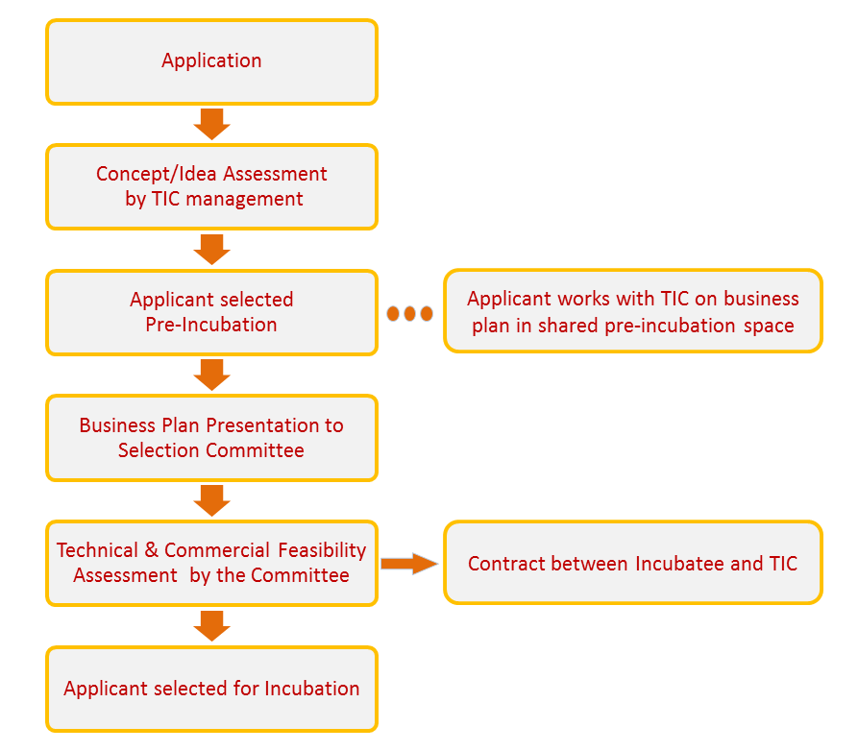
TIC Selection Process

Slide 25
Professional Development Centre
Enables working professionals to remain updated with the latest developments in their related disciplines thus enhancing their knowledge, employability, and managerial skills.
It also greatly helps towards building academia-industry linkage.

Slide 26
NUST Science & Technology Park
Plan for establishing a state-of-the-art Science and Technology Park. The park would consist of:
R&D Centre
Manufacturing & Resource Centre (MRC)
Rental Services Unit
Tertiary & Vocational Education Institute
Business Development Unit
Science Centre
Corporate Finance & Management Services Unit
Support and Recreational Facilities
Notes:
Copyright (C) 2008 NUST

Slide 27
Pakistan Innovation Network

Slide 28
Industry-driven research approach
1. Industry describes problems
2. Available resource identification
3. Initial cost-benefit analysis
4. R&D grant and IP rights
5. Solution and technology development
6. Tech transfer to industry
Notes:
6-step process for involving industry in to academic research cycle

Slide 29
What PiNET provides?
Companies
Universities
PiNET
OBJECTIVES
To be a central point of contact for Pakistani universities & companies
Provide access to available research & expressed needs of companies
To make it easier to communicate, engage and collaborate with each other
To help build a foundation of shared objectives, opportunities & relationships
Once the matchmaking takes place, the subsequent stages leading to the actual technology transfer are beyond the current scope of this forum

Slide 30
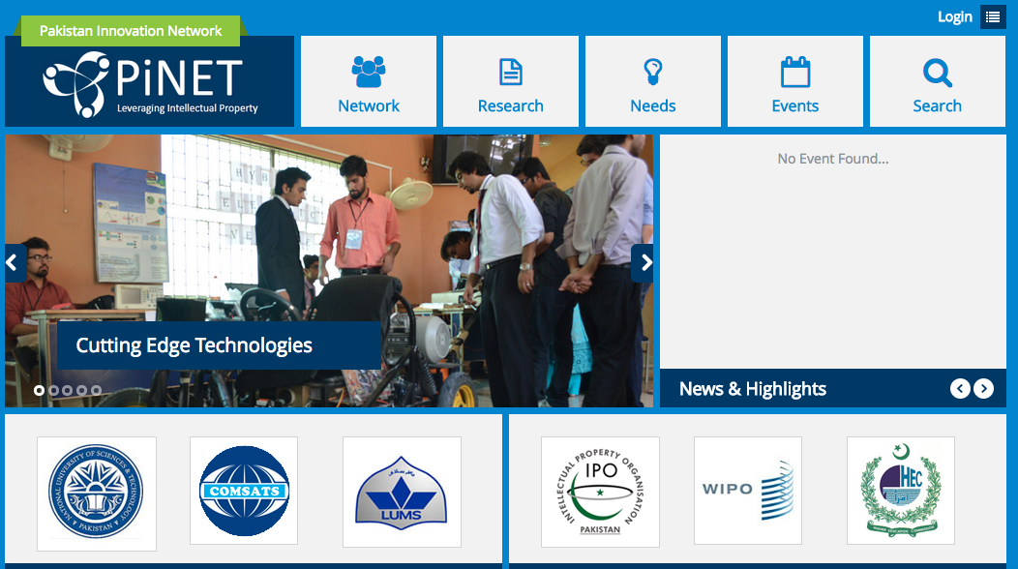
PiNET.PK

Slide 31
Incubatee Success Stories
E4 Technologies
Internet of Things and Hardware devices
Developed smart hockey , Cowlar (smart collar for cows 1000+ units on order), irrigation sensor
Monthly revenue has crossed USD 100,000/-
Selected for Google’s Blackbox Connect 2016 program in the Silicon Valley
Won the national Future Agro Challenge
Won Pakistan’s first and only Google HackFair
National winner of the 1776 Challenge Cup
Among top 30 startups at SLUSH Impact Accelerator Finland
Notes:
Copyright (C) 2008 NUST

Slide 32
Incubatee Success Stories
Swaggable
Works on social sampling for brands, to determine brand consumer profile & location
Raised raise Series A funding and valued at 20 Mil USD
Featured on Forbes, TechCrunch and multiple blogs
Partnership with Whole Foods Inc. and other retailers
eMumba
Ranked among top 7 entrepreneurs in Pakistan
Flagship product: Cricout, an online hangout for cricket
Raised $ 85,000 from Silicon Valley
Founder is President OPEN Islamabad chapter
Featured extensively in local print media
Notes:
Copyright (C) 2008 NUST

Slide 33
Take Away Lessons
Key challenges pertained to awareness, policies, people, finances and outreach
Build IP awareness amongst faculty/students
Establish an IP policy – and review periodically
Establish an institutional framework for IP management
(through individual TTOs and sharing experiences through TTO hubs)
Having dedicated Technology manager is extremely important; establish networks of tech/IP managers

Slide 34
Take Away Lessons
Assert university’s IP rights gradually (need to build credibility first)
Aggressively build linkages with industry (PiNet)
Access to finance comes with entrepreneurial Echo System. New venture funding is now becoming available to young entrepreneurs. Examples include Abraj Capital Venture fund, TiE ventures, individual investers.
Govt of Pakistan after seeing the opportunities also plan to establish venture fund through HEC and university ORICs

Slide 35
Thank you
Notes:
Copyright (C) 2008 NUST

